Slide 1
Semantic Metadata Annotation for Network Anomaly Detection draft-netana-nmop-network-anomaly-semantics-01
Experiment: Network Anomaly Lifecycle draft-netana-nmop-network-anomaly-lifecycle-01
Helps to annotate operational data, refine outlier detection, supports supervised and semi-supervised machine learning development,
enables data exchange among network operators, vendors and academia, and make anomalies for humans apprehensible
thomas.graf@swisscom.com wanting.du@swisscom.com
alex.huang-feng@insa-lyon.fr
vincenzo.riccobene@huawei-partners.com
antonio.roberto@huawei.com
15. March 2024

Slide 2
What to monitor Which operational metrics are collected
« Network operators connect customers in routing tables called VPN's »
« Network Telemetry (RFC 9232) describes how to collect data from all 3 network planes efficiently »

Slide 3




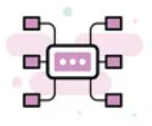

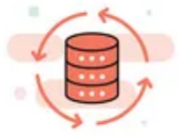

How to organize and collaborate with data The Data Mesh Architecture enables Network Analytics use
Alert
Postmortem
RFC 8632
draft-netana-nmop-network-anomaly-semantics draft-netana-nmop-network-anomaly-lifecycle
Analytical Data
Network Device Trend Detection
Verify, Troubleshoot and Notify
Network Anomaly Detection
Network Visualization
Network SLI and SLO
Closed Loop Operation
Operational Data
Network Data Collection
RFC 9232

Slide 4



What does Network Anomaly Detection mean Monitor changes
Answers
What changed and when, on which connectivity service, and how does it impact the customers?
Focuses
Provides meaningful connectivity service impact information before customer is aware of and support in root-cause analysis.
Data Mesh
Consumes operational real-time Forwarding Plane, Control Plane and Management Plane metrics and produces analytical alerts.
Direction
From connectivity service to network platform.
Network Anomaly Detection
For VPNs, Network Anomaly Detection constantly monitors and detects any network or device topology changes, along with their associated forwarding consequences for customers as outliers. Notifications are sent to the Network Operation Center before the customer is aware of service disruptions. It offers operational metrics for in-depth analysis, allowing to understand on which platform the problem originates and facilitates problem resolution.

Slide 5
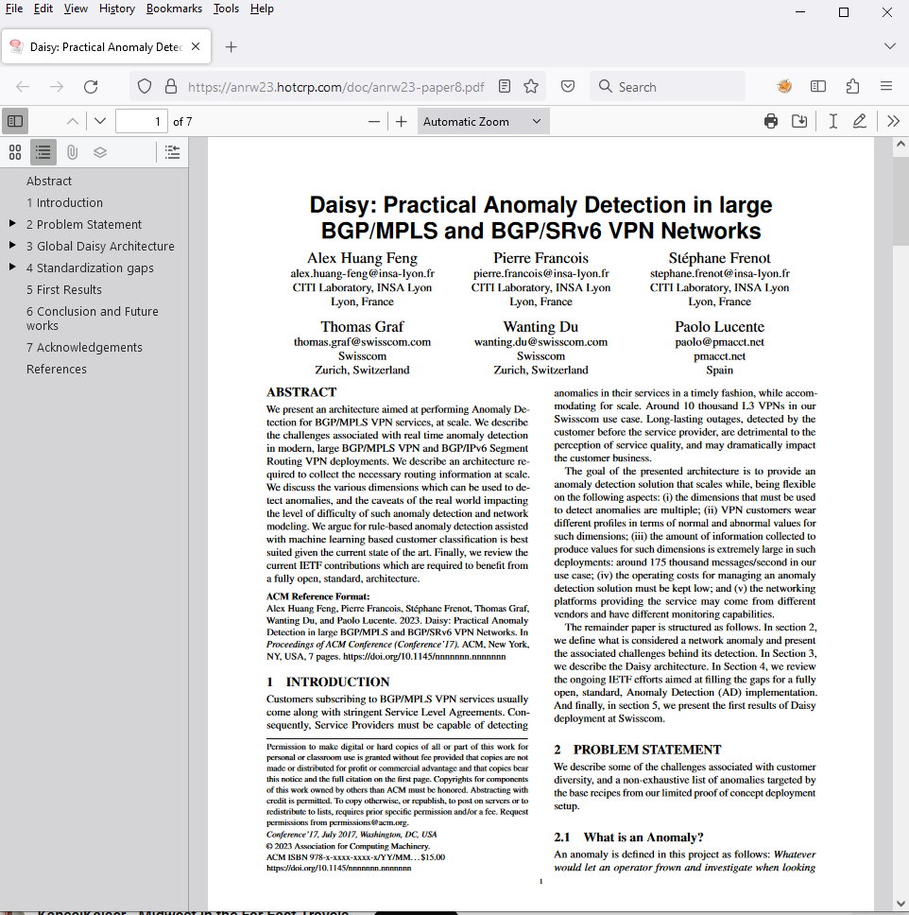
Presented in ANRW 2023 At IETF 117 San Francisco
« A more detailing paper will be submitted soon to IEEE Transactions on Network and Service Management»

Slide 6
What our motivation is Automate learn and improve
From network incidents postmortems we network operators learn and improve so does network anomaly detection and supervised and semi-supervised machine learning.
The more network incidents are observed, the more we can improve. With more incidents the postmortem process needs be automated, let's get organized first by defining human and machine-readable metadata semantics and annotate operational and analytical data.
Let's get further organized by exchanging standardized labeled network incident data among network operators, vendors and academia to collaborate on academic research.
« The community working on Network Anomaly Detection is probably the only group wishing for more network incidents »

Slide 7

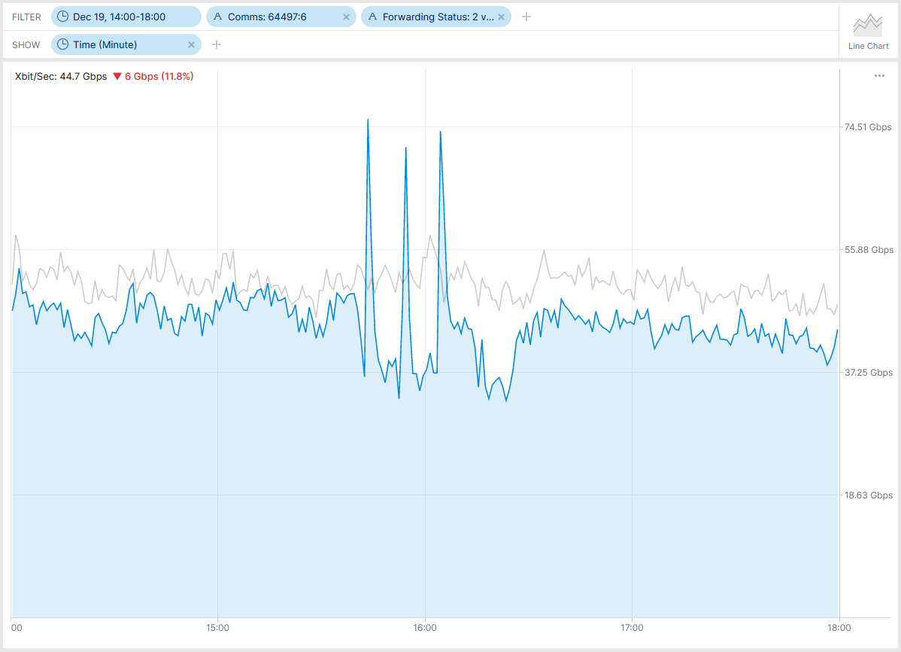
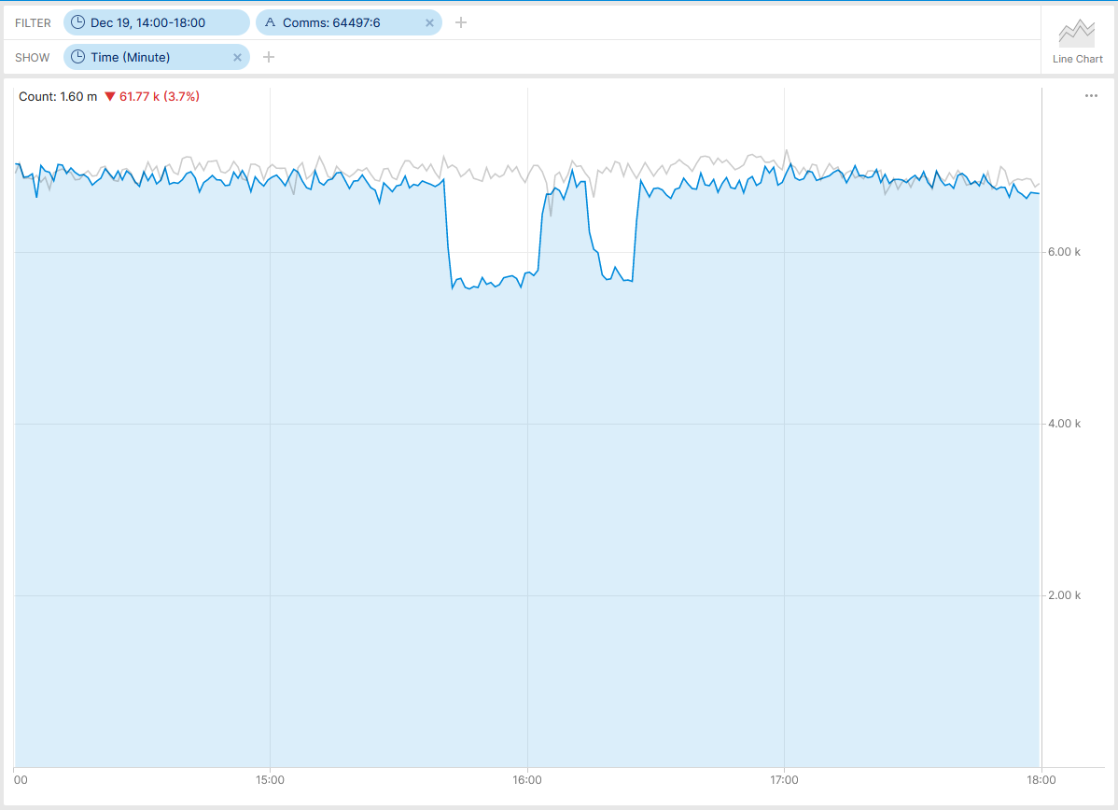

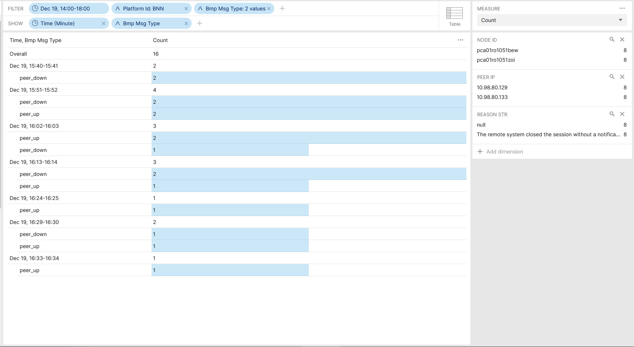
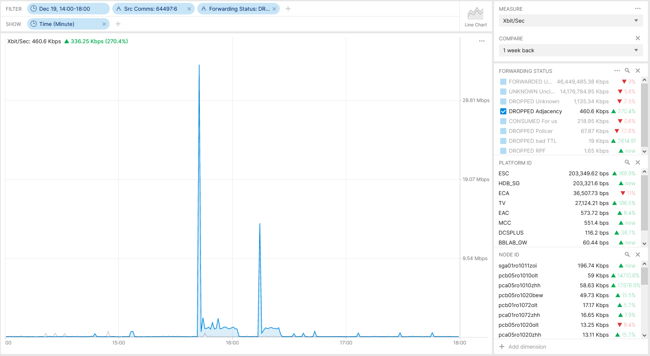

Postmortem, Maximum Prefix BGP Peer State Change SBInfo-028166, PBI000000193943, INC000012284550
IPFIX configured on PE and Inter-AS Option A ASBR nodes.
Traffic Drop with Reason Code Adjacency at TV was unrelated.
BMP ADJ-RIB In pre-policy on BGP VPNv4 /6 and IPv4/6 VRF unicast peers configured on MPLS PE's. BMP ADJ-RIB In pre-policy on BGP VPNv4 /6 on Route Reflectors.
BMP peer_down reports that it is type 4 (Remote system closed, no data) instead of type 1 (Local system closed, NOTIFICATION PDU follows) due to CSCwi61922.
Missing Traffic 64497:6
Flow Count Drop 64497:6
BMP Peer State Change 64497:6
Traffic Drop 64497:6

Slide 8

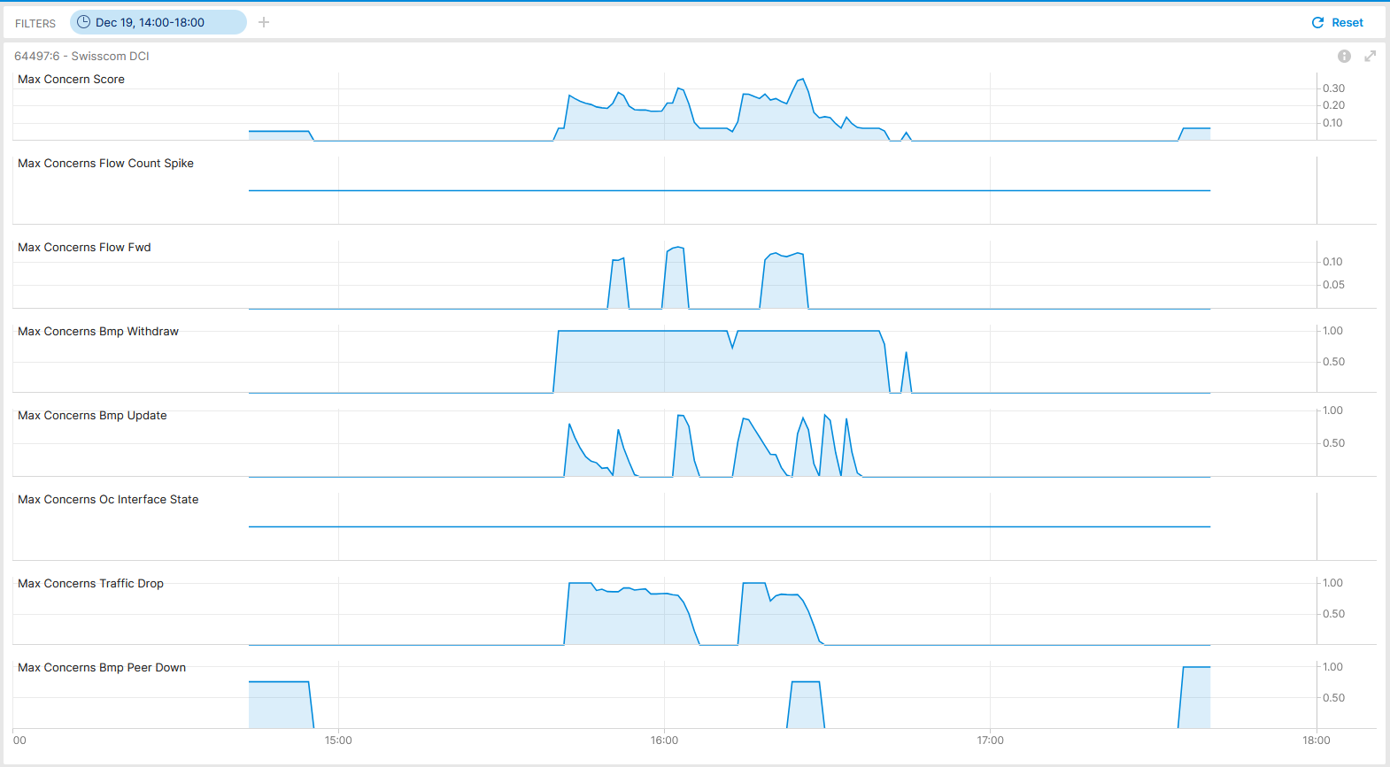

Postmortem, Maximum Prefix BGP Peer State Change SBInfo-028166, INC000012284550, Bright Lights Live
Max Concern Score: 0.36
Traffic Drop: 1.0 Missing Traffic: 0.13
BMP Update/Withdraw: 1.0
BMP Peer Down: 0.76
BMP route-monitoring Update/Withdraw recognized topology change.
BMP peer Down recognized peering state change delayed due to potential data processing lag.
Interface Down/Up check did not apply.
Traffic Drop check recognized forwarding drop.
Missing Traffic recognized that connectivity is impaired.
Flow Count Spike did not apply.
Overall: 4 out of 6 checks have detected a customer impact inside of monitoring domain. Works as designed.
Cosmos Bright Lights Anomaly Detection – 64497:6 SC-DCI

Slide 9
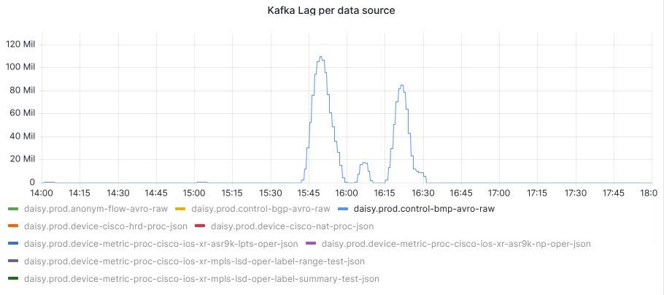
What went well?
Anomaly Detection rules detected outage based on BMP update/withdrawal and peer_down, IPFIX flow count drop, traffic drop and missing traffic. Works as designed.
Postmortem
What to do next?
Record incident in Cosmos Bright Lights lab. -> Done!
Analyze why (TSDB ingestion delay?) not all BMP peer_down where being recognized by BMP peer_down check.
What could be improved?
Consider to implement capacity management and trend detection analytical use case for BGP max prefix configured peers, BGP Local RIB path count and BGP process memory.
draft-ietf-grow-bmp-rel authors considering to support two reason code TLV's for prefixes crossing the warning and the maximum threshold.
draft-msri-grow-bmp-bgp-rib-stats authors contacted at GROW to consider another BMP statistics definition describing how many percent of the configured maximum prefix count has been reached.
Similar as we are draft-ietf-grow-bmp-path-marking-tlv how the BGP path will be installed into the RIB, we could add as a TLV also the local allocated MPLS label from the Label FIB.
BMP peer_down reason code is 4 instead of 1 on Cisco IOS XR. Addressed and confirmed in SR 696692110. CSCwi61922 bugfix verified.
BGP notification sub-code support in NetGauze verified.

Slide 10
What is a symptom and how to categorize them From action to reason to cause
Action: Which action the network node performed for a packet in the forwarding plane, a path or adjacency in the control plane or state or statistical changes in the management plane.
Reason: For each reason one or more actions describing why this action was used. From drop unreachable, administered, and corrupt in forwarding plane, to reachability withdraw and adjacency teared down in control plane, to Interface down, errors or discard in management plane.
Cause: For each reason one or more causes describes why the action was chosen. From missing next-hop and link-layer information in forwarding plane, to reachability withdrawn due to peer down or path no longer redistributed.
« Symptoms are categorized in which plane they have been observed, their action, reason and cause »

Slide 11
Outliers in Anomaly Detection From global to contextual to collective
Global outliers: An outlier is considered "global" if its behavior is outside the entirety of the considered data set.
Contextual outliers: An outlier is considered "contextual" if its behavior is within a normal (expected) range, but it would not be expected based on some context. Context can be defined as a function of multiple parameters, such as time, location, etc.
Collective outliers: An outlier is considered "collective" if the behavior of each single data point that are part of the anomaly are within expected ranges (so they are not anomalous, it’s either a contextual or a global sense), but the group taking all the data points together, is.
« Collective outliers are important because networks are connected. Through different planes interconnected symptoms from various angles can be observed »

Slide 12
Annotate Operational Data YANG Module
module: ietf-symptom-semantic-metadata
+--rw symptom
+--rw id yang:uuid
+--rw event-id yang:uuid
+--rw description string
+--rw start-timeyang:date-and-time
+--rw end-time yang:date-and-time
+--rw confidence-score float
+--rw concern-score? float
+--rw tags* [key]
| +--rw key string
| +--rw value string
+--rw (pattern)?
| +--:(drop)
| | +--rw dropempty
| +--:(spike)
| | +--rw spike empty
| +--:(mean-shift)
| | +--rw mean-shift empty
| +--:(seasonality-shift)
| | +--rw seasonality-shift empty
| +--:(trend)
| | +--rw trend empty
| +--:(other)
| +--rw other string
+--rw source
+--rw (source-type)
| +--:(human)
| | +--rw human empty
| +--:(algorithm)
| +--rw algorithm empty
+--rw name? string
Symptoms describe what changed in the network for what reason and cause with which concern score from when to when.
Tags describes in which network plane, which action, reason and cause was observed.
Pattern describes the measurement pattern over time of the time series data.
Source describes which system observed the outlier. A human or a network anomaly detection system.

Slide 13
Experiment: Network Anomaly Lifecycle What is the Motivation?
Network anomaly detection is about identifying behaviours that provide evidence of service consumers experiencing a degradation.
Network Operators often implement a continuous review process, in order to iteratively collect and incorporate more and more network and service knowledge into the methodology, to improve (reducing False Positives and False Negatives) and validate the detection, e.g. by performing post-mortem analysis.
We see the need to provide a well-defined lifecycle for the refinement of network anomaly detection, as this can open up to a more structured cooperation between different actors involved in different stages of the lifecycle, including customer service operators, network engineers, Data Scientists, AI algorithms, etc.
This proposed draft describe an experiment: verifying whether the approach is usable in real use case scenarios to support proper refinement and adjustments of network anomaly detection algorithms.
Notes:
Network anomaly detection is about identifying behaviours that provide evidence of service consumers experiencing a degradation.
During our work to implement network anomaly detection, we realized that this requires a continuous review process, in order to iteratively collect and incorporate more and more network and service knowledge into the methodology.
Network operators often implement review processes of their detection mechanisms to improve over time (reducing both False Positives and False Negatives), validating the detected network anomalies and performing post-mortem analysis, etc.
We see the need to provide a well-defined lifecycle for the refinement of network anomaly detection, as this can open up to a more structured cooperation between different actors involved in different stages of the lifecycle, including customer service operators, network engineers, Data Scientists, AI algorithms, etc.
This proposed draft describe an experiment: verifying whether the approach is usable in real use case scenarios to support proper refinement and adjustments of network anomaly detection algorithms.

Slide 14
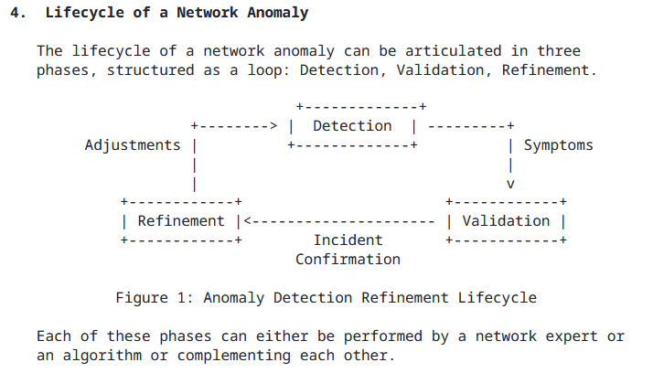
Network Anomaly Lifecycle draft-netana-nmop-network-anomaly-lifecycle
Detection: The Network Anomaly Detection stage is about the continuous monitoring of the network through Network Telemetry [RFC9232] and the identification of symptoms.
Validation: Decides if the detected symptoms are signaling a real incident or if they are to be treated as false positives.
Refinement: Network operator performs detailed postmortem analysis of the network incident, collected Network Telemetry data and detected anomaly with the objective to identify useful adjustments in the Network Telemetry data collection and Anomaly Detection system.

Slide 15
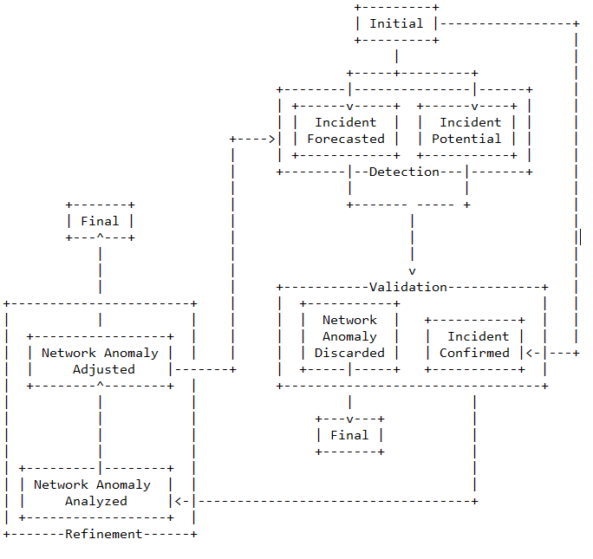
Network Anomaly State Machine Incident Relationships
Incident Forecasted: A potential network incident is predicted in the future by the Network Anomaly Detection system.
Incident Potential: A potential network incident has been detected by the Network Anomaly Detection system.
Incident Confirmed: A potential network incident has been confirmed in the postmortem validation.

Slide 16
Network Anomaly Metadata YANG Module
module: ietf-network-anomaly-metadata
+--rw network-anomalies
+--rw network-anomaly* [id author-name version state]
+--rw id yang:uuid
+--rw description? string
+--rw author
| +--rw author-name string
| +--rw author-type? identityref
| +--rw algo-version? uint8
+--rw version uint8
+--rw state identityref
+--rw symptoms* [symptom_id]
+--rw symptom_id yang:uuid
ID and Description uniquely identifies the detected anomaly.
Author Name, Type, Version and Algo-Version describes wherever the anomaly was detected by a human or algorithm and uniquely identifies the system and version who/which detected.
State describes the state of the anomaly (selected among the states defined in the state machine).
Symptoms describes the identified symptoms defined in ietf-symptom-semantic-metadata.

Slide 17


IETF 119 Hackathon - Antagonist Design and workflow
Antagonist has been extended to become agnostic of the technologies used for the persistence and annotation of telemetry data
Antagonist Frontend
Symptoms & Network Anomalies (+ metadata)
Symptoms & Network Anomalies (+ metadata)
Symptom Annotation Tool
Example:
REST API
Antagonist exposes a REST API to support ingestion and exposure of symptoms and network anomaly data and semantic metadata.
The exposed data can be used as ground-truth.
Time Series Metrics
Antagonist (Anomaly tagging on historical data)
Time Series Database
Telemetry Data
Example:
Source Code: https://github.com/vriccobene/antagonist

Slide 18
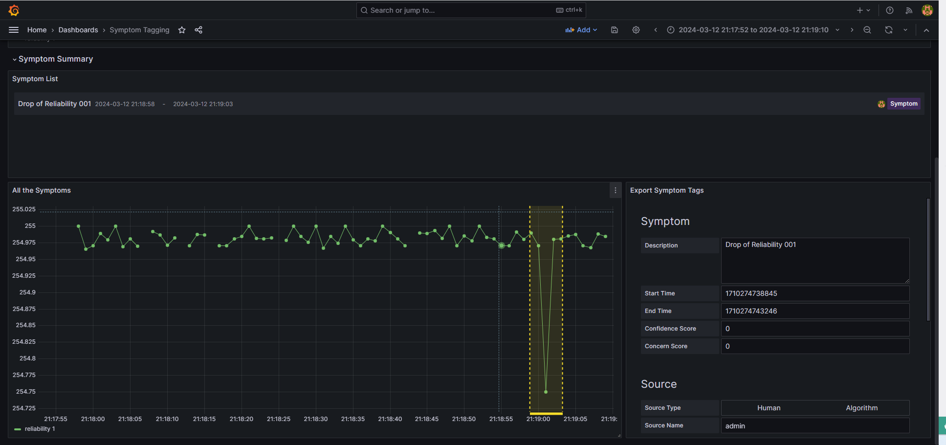
IETF 119 Hackathon – Antagonist Labelling a Symptom on Time Series
When symptoms are tagged, they get submitted to Antagonist

Slide 19
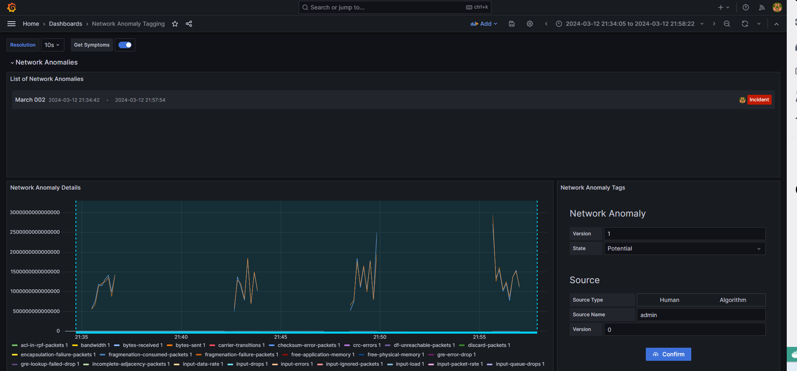
IETF 119 Hackathon – Antagonist Labelling a Network Anomalies on Time Series
When Network Anomalies are tagged, they get submitted to Antagonist

Slide 20
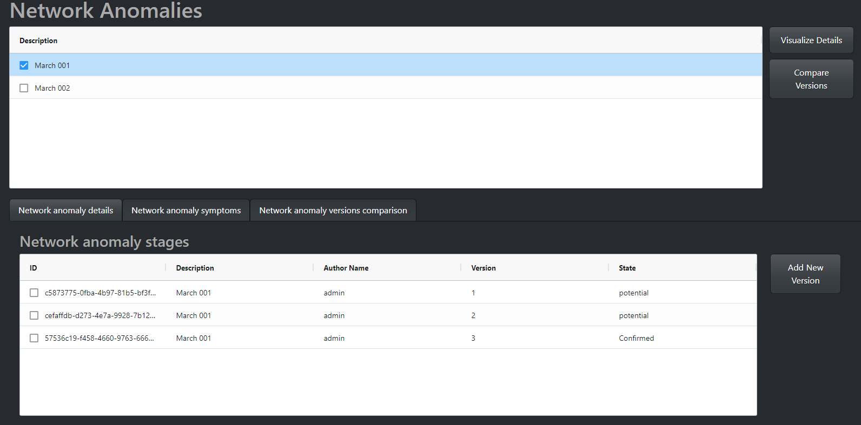
IETF 119 Hackathon – Antagonist Labelling a Network Anomalies on Time Series
Antagonist can be used to review and analyse network anomalies
A list of the identified network anomalies is provided
All the reviews for a selected network anomaly can be analyzed

Slide 21
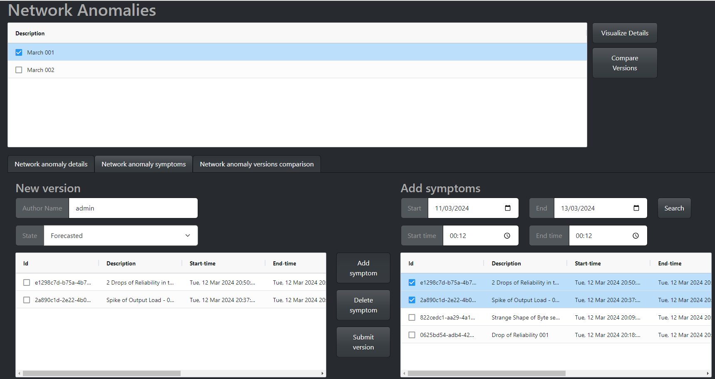
IETF 119 Hackathon – Antagonist Labelling a Network Anomalies on Time Series
Antagonist allows to move the network anomaly forward in its lifecycle, by adding new revisions
A list of the identified network anomalies is provided
Symptoms can be retrieved by time window and included in the network anomaly list, if they were missed before (e.g. False Negatives)
Existing symptoms in the current version can be removed, if they are deemed irrelevant for the network anomaly (e.g. False Positives)
All the reviews for a selected network anomaly can be analyzed
New Revision
The information collected by Antagonist can be used by network engineers to review the network anomaly history or can be provided to AI algorithms as additional knowledge for training.

