Slide 1
Extensible YANG Model for Network Telemetry Notifications
draft-netana-nmop-message-broker-telemetry-message
ahmed.elhassany@swisscom.com
thomas.graf@swisscom.com
13. March 2025

Slide 2
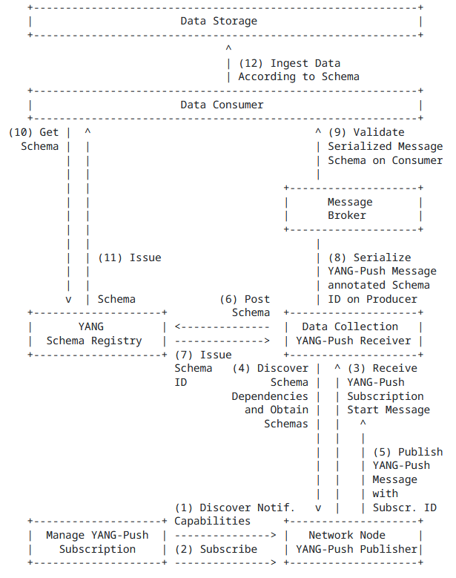
YANG-Push to Message Broker Architecture draft-ietf-nmop-yang-message-broker-integration
The integration architecture is defined in draft-ietf-nmop-yang-message-broker-integration
The message produced by the Data Collection YANG-Push receiver towards the Message Broker is assumed to be the same as the one received from the router.
In production networks, operators often enrich collected data with additional information such as collection time and the YANG-Push subscription path.

Slide 3
What metadata is needed?
The network operating system collected the data
The network platform the network node belongs to
The subscribed xpath, sub-tree filter and its schema reference
Time when the data collection received the data
Additional provider-specific metadata necessary for a consumer to make sense of the data

Slide 4
module: ietf-telemetry-message
+--ro message
+--ro timestamp yang:date-and-time
+--ro session-protocol telemetry-session-protocol-type
+--ro node
| +--ro address inet:host
| +--ro port inet:port-number
| +--ro platform-name? string
| +--ro vendor? string
| +--ro vendor-pen? uint32
| +--ro software-version? string
| +--ro software-flavor? string
| +--ro os-version? string
| +--ro os-type? string
+--ro collector
| +--ro address inet:host
| +--ro port inet:port-number
| +--ro platform-name? string
| +--ro vendor? string
| +--ro vendor-pen? uint32
| +--ro software-version? string
| +--ro software-flavor? string
| +--ro os-version? string
| +--ro os-type? string
+--ro session-metadata
| +--ro event-time yang:date-and-time
+--ro metadata
| +--ro labels* [name]
| +--ro name string
| +--ro (value)
| +--:(string-value)
| | +--ro (string-value)?
| | +--:(string-value)
| | +--ro string-value? string
| +--:(anydata-value)
| +--ro (anydata-value)?
| +--:(anydata-value)
| +--ro anydata-value? anydata
+--ro payload? anydata
1
ietf-telemetry-message YANG Schema Tree draft-netana-nmop-message-broker-telemetry-message
2
When and how the message is collected
Information about the publisher node.
Information about the YANG-Push receiver
Session specific metadata, extended with augmentations.
Provider specific metadata
YANG-Push message received from the router
3
4
5
6

Slide 5
ietf-telemetry-message YANG Schema Tree draft-netana-nmop-message-broker-telemetry-message
module: ietf-yang-push-telemetry-message
augment /tm:message/tm:session-metadata:
+--ro yang-push-subscription
+--ro id sn:subscription-id
+--ro filters
| +--ro stream-filter* [name]
| +--ro name string
| +---u sn:stream-filter-elements
+---u ypr:yang-push-module-version-list
Extends ietf-telemetry-message ietf-telemetry-message with YANG-Push subscription.
The subscription id and filters are obtained from the YANG-Push subscription-started notification.

Slide 6
