Slide 1
An Architecture for YANG-Push to Message Broker Integration draft-ietf-nmop-yang-message-broker-integration-06
Motivation and architecture of a native
YANG-Push notifications and YANG Schema integration
into Message Broker and YANG Schema Registry
thomas.graf@swisscom.com ahmed.elhassany@swisscom.com
alex.huang-feng@insa-lyon.fr
10. February 2025

Slide 2
Agenda Items
Architecture Overview and Document Relationships
Document Changes in -06 and next steps
Changes in draft-ietf-netconf-yang-notifications-versioning-07
IETF 122 hackathon activities
Related YANG-Push integration and specification gaps status

Slide 3
Goals of today’s Interim meeting
Establish a common understanding on relationships to YANG-Push notification and capabilities documents.
Document and implementation status is clarified.
Current blocking points are well understood.

Slide 4
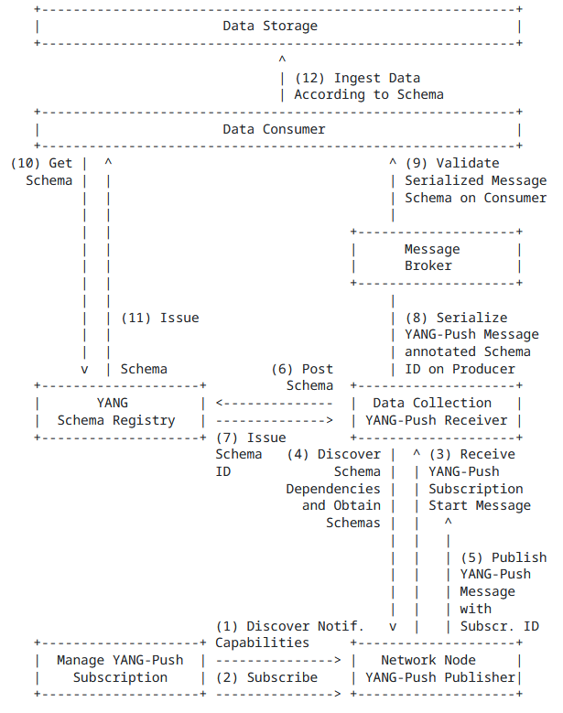
Elements of the Architecture Document Relationships
4.1. YANG-Push Subscription Thanks to RFC 9196 based YANG modules describing capabilities for systems and notifications, transport (draft-netana-netconf-yp-transport-capabilities), notification extensions (draft-netana-netconf-notif-envelope) and supported xpaths can be discovered.
4.2. YANG-Push Publisher For configured subscriptions, udp-notif, distributed-notif and https-notif are the RFC 8639, RFC 8641 based YANG-Push transport protocols. draft-netana-netconf-notif-envelope provides the notification header with hostname, sequence and observation timestamp extensions.
4.3. YANG-Push Receiver Discovers subscription state changes by detecting changes in xpath/sub-tree, module name, revision, revision-label and YANG library content-id defined in draft-ietf-netconf-yang-notifications-versioning and discovers YANG schema tree through YANG library with ietf-netconf-yang-library-augmentedby extension.
4.6. YANG Message Broker Consumer Validates YANG notifications against schema. Anydata described in Section 7.10 of RFC 7950, validation described in draft-aelhassany-anydata-validation.
4.7. YANG Data Consumer Thanks to hostname, sequence-number and event-time from draft-netana-netconf-notif-envelope, loss and serialization delay can be measured.
4.8. YANG Data Storage Metrics can be indexed in timeseries database thanks to observation timestamp defined in draft-netana-netconf-notif-envelope.

Slide 5
An Architecture for YANG-Push to Message Broker Integration Status, Summary and Next steps
Changes in -06
draft-netana-netconf-notif-envelope-02, draft-netana-netconf-yp-transport-capabilities-01 and draft-ietf-netconf-yang-notifications-versioning-07 (details on slide 5) changes are incorporated.
Terminology section has been updated with data product terms from Data Mesh.
YANG-Push Receiver section describes now how YANG-Push schema changes are being detected by incorporating xpath, sub-tree filter module name, revision, revision-label or YANG Library content-id.
A change in xpath or sub-tree filter or module name in the subscription state change notifications indicates that the subscribed path has changed. A change in revision indicates that the version of the YANG module of the subscribed path has changed, where revision-label indicates wherever the revision was backward compatible or not. YANG Libary content-id changes indicates that there were potential semantic changes in the augmented or imported yang modules of the subscribed xpath or sub-tree. If no change to previous subscription state is observed, step 4 can be omitted.
YANG Data Consumer section describes how notification message loss and reordering is being detected and how it contributes to Data Mesh data product excellence.
By tracking the YANG-Push notification sequence-number for a given hostname as defined in Section 3.4 of [I-D.netana-netconf-notif-envelope] loss can be recognized across the YANG data processing chain. By taking the event-time in the YANG-Push notification header and the time the YANG-Push notification messages was consumed into account, the serialization delay between YANG-Push publisher and YANG Data Consumer can be measured. The loss rate and delay for a given hostname can be used as a Service Level Indicator for the YANG data product in the Data Mesh [Deh22].
Next Steps
Looking forward for review and comments.
Message Broker message schema document will be published before IETF 122.

Slide 6
Support of Versioning in YANG Notifications Subscription For subscription state change notification messages
module: ietf-yang-push-revision
augment /sn:establish-subscription/sn:input:
+---w module-version-config* [module-name]
+---w module-name yang:yang-identifier
+---w revision? rev:revision-date-or-label
+---w revision-label? ysver:version
augment /sn:subscription-started:
+--ro module-version* [module-name]
| {yang-push-revision-supported}?
| +--ro module-name yang:yang-identifier
| +--ro revision rev:revision-date
| +--ro revision-label? ysver:version
+--ro yang-library-content-id? -> /yanglib:yang-library/content-id
{yang-push-revision-supported}?
Network operators need to control semantics in its data processing pipeline. That includes YANG-Push.
This is today only possible during YANG-Push subscription but not when nodes are being upgraded or when messages are being published for configured subscription.
draft-ietf-netconf-yang-notifications-versioning extends the YANG push subscription and publishing mechanism defined in RFC 8641:
By adding the ability to subscribe to a specific revision or latest-compatible-semversion of one or more yang modules.
By extending the YANG push Subscription State Change Notifications Message so that the YANG push receiver learns beside the xpath and the sub-tree filter also the yang module name, revision, revision-label and the yang-library-content-id. With YANG Library content-id a YANG-Push receiver is now able to detect changes in the YANG library. This includes also the imported YANG modules of the subscribed xpath.
Extends RFC 9196 defined subscription-capabilities with a yang-push-module-revision-supported leaf.
{
"ietf-notification:notification": {
"eventTime": "2023-03-25T08:30:11.22Z",
"ietf-notification-sequencing:sysName": "example-router",
"ietf-notification-sequencing:sequenceNumber": 1,
"ietf-subscribed-notification:subscription-started": {
"id": 6666,
"ietf-yang-push:datastore": "ietf-datastores:operational",
"ietf-yang-push:datastore-xpath-filter": "/if:interfaces",
"ietf-yang-push-revision:revision": "2014-05-08",
"ietf-yang-push-revision:module-name": "ietf-interfaces",
"ietf-yang-push-revision:revision-label": "",,
"ietf-yang-push-revision:yang-library-content-id": "1",
"ietf-distributed-notif:message-observation-domain-id": [1,2],
"transport": "ietf-udp-notif-transport:udp-notif",
"encoding": "encode-json",
"ietf-yang-push:periodic": {
"ietf-yang-push:period": 100
}
}
}
}

Slide 7
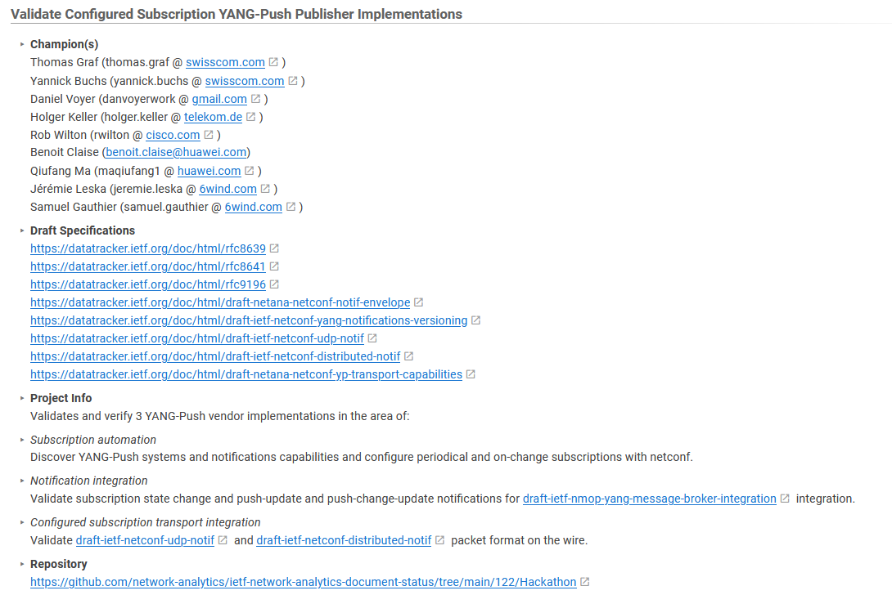
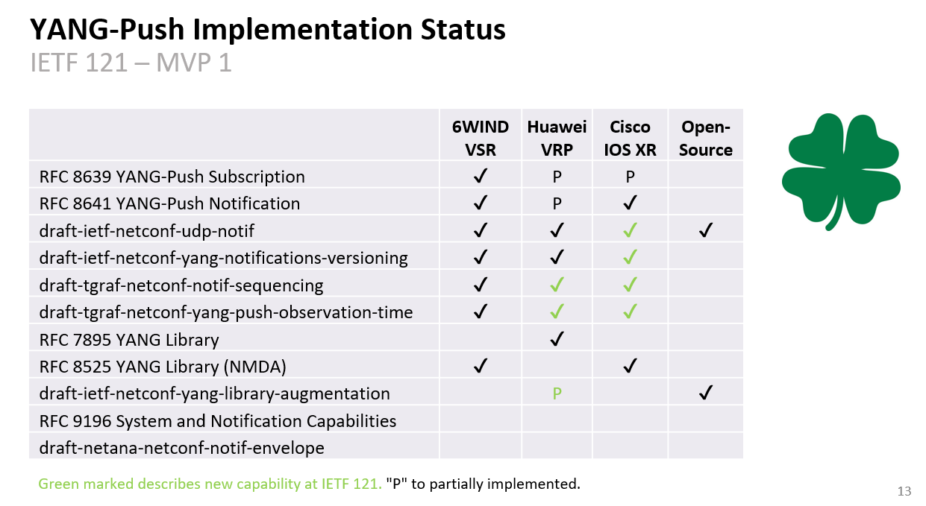
An Architecture for YANG-Push to Message Broker Integration IETF 122 Hackathon

Slide 8
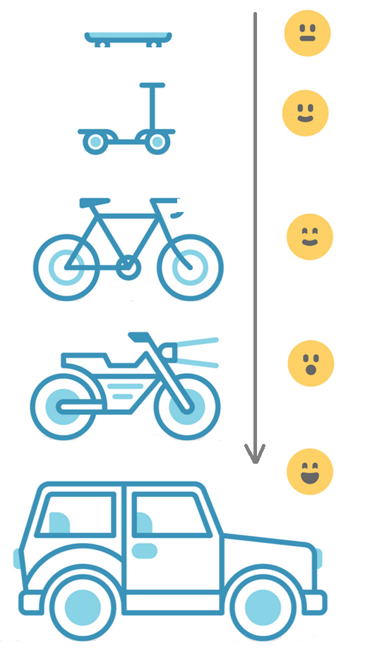
Address YANG Specification and Integration Gaps Aiming for an automated data processing pipeline
YANG Specifications Gaps:
Extensible YANG model for YANG-Push Notifications draft-netana-netconf-notif-envelope
YANG Notification Transport Capabilities draft-netana-netconf-yp-transport-capabilities
Validating anydata in YANG Library context draft-aelhassany-anydata-validation
YANG Integration Gaps:
Support of Network Observation Timestamping in YANG Notifications draft-tgraf-netconf-yang-push-observation-time
Support of Versioning in YANG Notifications Subscription draft-ietf-netconf-yang-notifications-versioning
Augmented-by Addition into the IETF-YANG-Library draft-ietf-netconf-yang-library-augmentation
YANG Simplification:
YANG-Push Operational Data Observability Enhancements draft-wilton-netconf-yp-observability

Slide 9
Current Blocking Points
draft-netana-netconf-notif-envelope and draft-netana-netconf-yp-transport-capabilities implementations are underway but working group adoption is still pending. For reaching MVP 1 timeline (Q4 2025), implementors are concerned about current working group progress. Without working group adoption call before IETF 122, authors are concerned that there isn't enough time to discuss normative changes before software commit windows are closing. MVP 2 and 3 are scheduled for in Q2 resp. Q4 2026.

Slide 10
BACKUP

Slide 11
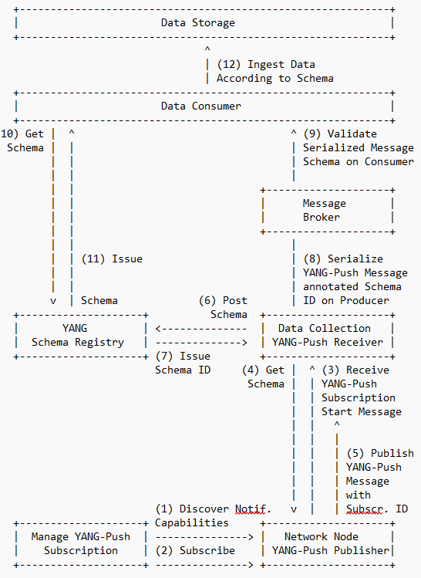
An Architecture for YANG-Push to Message Broker Integration Status, Summary and Next steps
Changes in -05
Section 4.1 covers now
draft-netana-netconf-yp-transport-capabilities which helps the NETCONF, RESTCONF client performing YANG-Push subscription to discover the YANG-Push transport, encoding and security capabilities of the YANG-Push publisher.
draft-netana-netconf-notif-envelope defines a new extensible notification structure, defined in YANG, for use in YANG-Push Notification messages enabling any YANG compatible encodings such as XML, JSON or CBOR. Replaces and consolidates draft-ahuang-netconf-notif-yang and draft-tgraf-netconf-notif-sequencing based on the outcome of the last NETCONF interim.
Milestones for IETF 121 and 122 have been added.
Open Points and YANG-Push notification examples have been updated reflecting the changes from draft-netana-netconf-yp-transport-capabilities and draft-netana-netconf-notif-envelope.
Next Steps
Looking forward for review and comments.

Slide 12
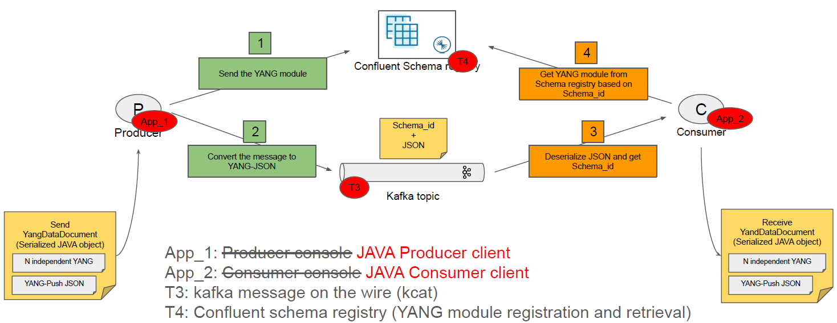
An Architecture for YANG-Push to Message Broker Integration Implementation Status

