Slide 1
An Architecture for YANG-Push to Message Broker Integration draft-ietf-nmop-yang-message-broker-integration-11
Motivation and architecture of a native
YANG-Push notifications and YANG Schema integration
into Message Broker and YANG Schema Registry
thomas.graf@swisscom.com ahmed.elhassany@swisscom.com
19. March 2026

Slide 2
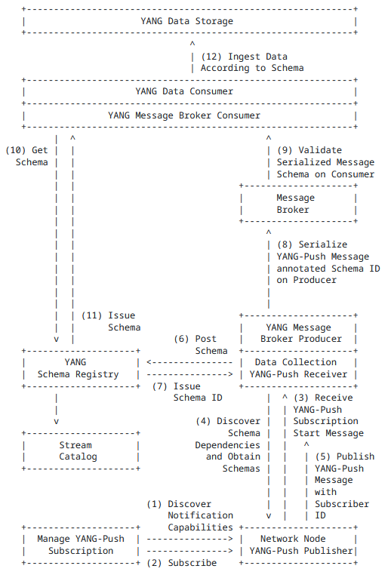
An Architecture for YANG-Push to Message Broker Integration Status from -10 and -11 and Next Steps
Status
Expanded system architecture picture with YANG Message Broker Producer and Consumer
Expanded terminology section with terms defined by the document.
Detailed YANG-Push Receiver and YANG Schema Registry sections to describe and example how YANG features are being covered in schema registration.
Added IETF 125 in the milestone appendix to describe the current implementation states and the planned hackathon items.
Minor editorial edits.
Next Steps
Add security and operations considerations section.

Slide 3

Validate YANG-Push to Message Broker End-To-End Data Processing Chain IETF 125 Hackathon, March 14-15th 2026
NMOP & NETCONF WG

Slide 4
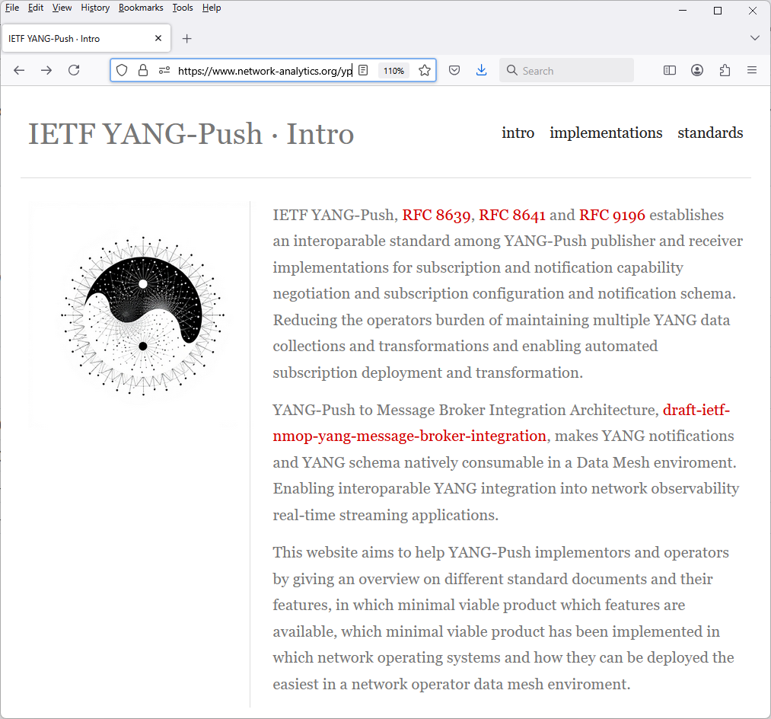
Hackathon Plan, Software and Website
Test Plan
Validate and verify
5 YANG-Push Publishers
2 YANG-Push Receivers
2 YANG-Push Network Telemetry Message
1 YANG Message Broker Producer and Schema Registry
3 YANG Message Broker Consumers
implementation in YANG data integration automation. Subscribe to YANG data on YANG-Publisher, obtain and register all YANG modules necessary to build YANG schema tree, register YANG schemas to Schema Registry and verify YANG notifications against scheme trees and produce and consume from Message Broker.
Software
YANG-Push Publisher - Cisco IOS XR, 6WIND VSR, Huawei NE (Router) and MA (OLT) and Arrcus Arcos
YANG-Push Receiver – NetGauze and Pmacct
YANG Message Broker Producer – NetGauze
YANG Message Broker Consumer – NetGauze, Ciena Blueplanet UAA Workflow Engine, Cisco Crosswork Ingestion Service
YANG Schema Registry – Apache Kafka YANG Plugin
Libyang - https://github.com/CESNET/libyang/compare/master...devel
Yangkit - https://github.com/yang-central/yangkit/pull/41
Wireshark - udp-notif dissector
NMOP & NETCONF WG
https://www.network-analytics.org/yp/how-to-deploy.html

Slide 5
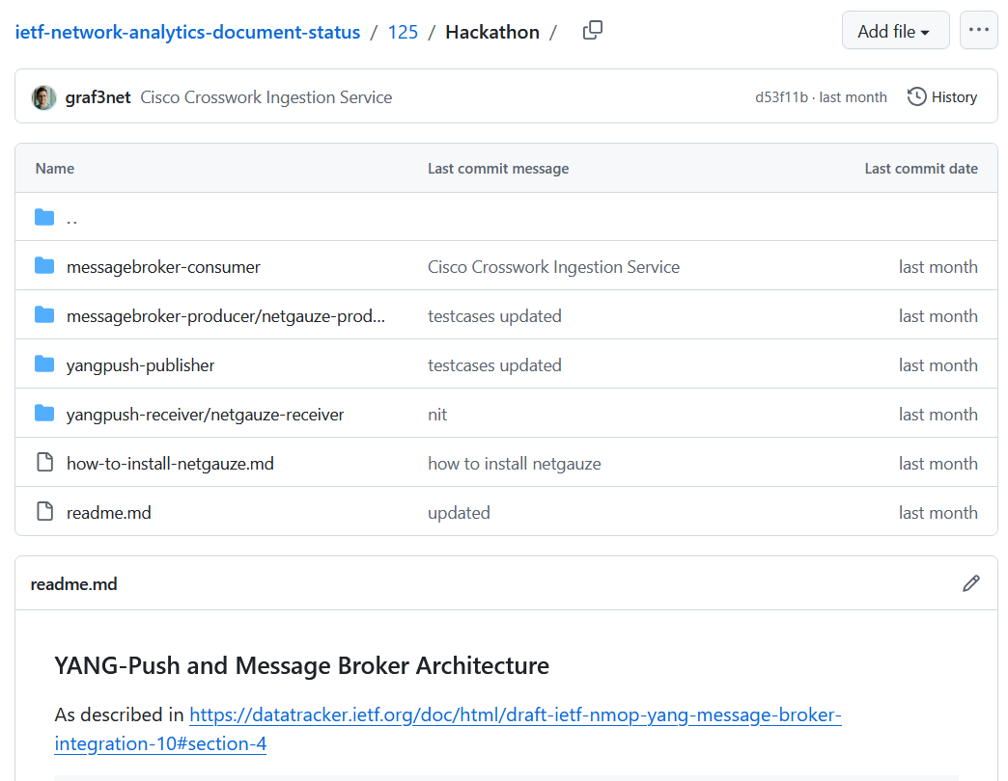
Hackathon – Repositories
The results of the end-to-end tests
Netconf RPCs and YANG-Push JSON encoded notifications with wire captures from receiver
YANG-Push Receiver cache content generation with YANG library context, YANG modules, metadata and notification schema validation logs
YANG Message Broker Producer serialization logs
YANG Schema Registry schema examples
YANG Message Broker Consumer, serialization logs, YANG library context, YANG modules and message schema validation
NMOP & NETCONF WG
https://github.com/network-analytics/ietf-network-analytics-document-status/tree/main/125/Hackathon/

Slide 6
An Architecture for YANG-Push to Message Broker Integration draft-ietf-nmop-yang-message-broker-integration draft-ietf-nmop-message-broker-telemetry-message draft-ietf-nmop-yang-message-broker-message-key draft-netana-nmop-message-broker-bmp-telemetry-message
+------------------------------------------------------------+
| Data Storage |
+------------------------------------------------------------+
^
| (12) Ingest Data
| According to Schema
+------------------------------------------------------------+
| Data Consumer |
+------------------------------------------------------------+
| ^ ^
(10) Get | | | (9) Validate
Schema | | | Serialized Message
| | | Schema on Consumer
| | +--------------------+
| | | Message |
| | | Broker |
| | +--------------------+
| | ^
| | | (8) Serialize
| | (11) Issue | YANG-Push Message
| | Schema | annotated Schema
v | (6) Post | ID on Producer
+--------------------+ Schema +--------------------+
| YANG | <--------------- | Data Collection |
| Schema Registry | ---------------> | YANG-Push Receiver |
+--------------------+ (7) Issue +--------------------+
| Schema ID | ^ (3) Receive
| | | YANG-Push
v (4) Discover | | Subscription
+--------------------+ Schema | | Start Message
| Stream | Dependencies | | ^
| Catalog | and Obtain | | | (5) Publish
+--------------------+ Schemas | | | YANG-Push
| | | Message
| | | with
(1) Discover | | | Subscriber
Notification v | | ID
+--------------------+ Capabilities +--------------------+
| Manage YANG-Push | ---------------> | Network Node |
| Subscription | ---------------> | YANG-Push Publisher|
+--------------------+ (2) Subscribe +--------------------+
Subscription to YANG Notifications RFC 8639
Subscription to YANG Notifications for Datastore Updates RFC 8641
UDP-based Transport for Configured Subscriptions draft-ietf-netconf-udp-notif
Subscription to Distributed Notifications draft-ietf-netconf-distributed-notif
Extensible YANG Model for YANG-Push Notifications draft-ietf-netconf-notif-envelope
Support of Versioning in YANG Notifications Subscription draft-ietf-netconf-yang-notifications-versioning
YANG Modules Describing Capabilities for Systems and Datastore Update Notifications RFC 9196
YANG Notification Transport Capabilities draft-ietf-netconf-yp-transport-capabilities
YANG Library RFC 8525
Augmented-by Addition into the IETF-YANG-Library draft-ietf-netconf-yang-library-augmentation
Validating anydata in YANG Library context draft-ietf-netmod-yang-anydata-validation
Encoding of Data Modeled with YANG in the CBOR RFC 9254
NMOP & NETCONF WG

Slide 7
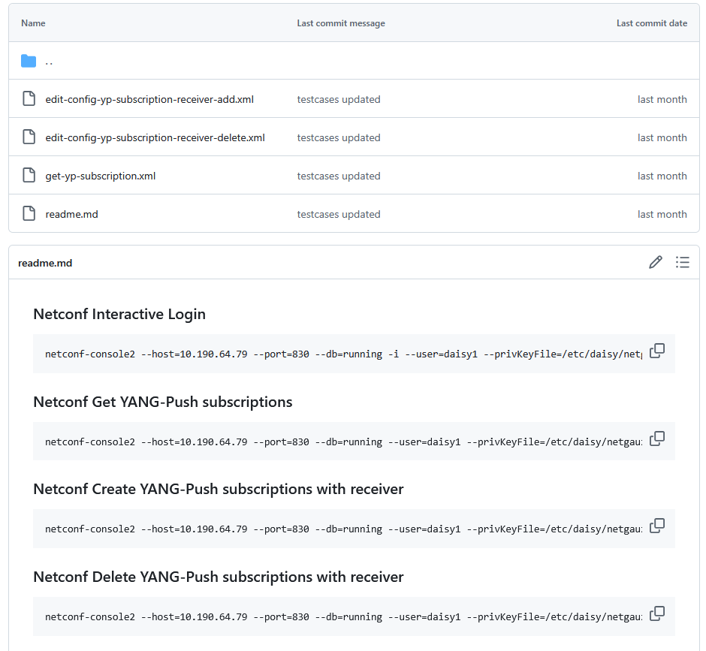
YANG-Push Publisher - Subscription
Netconf RPC calls to create, delete and obtain YANG-Push subscriptions and receiver configurations.
NMOP & NETCONF WG

Slide 8
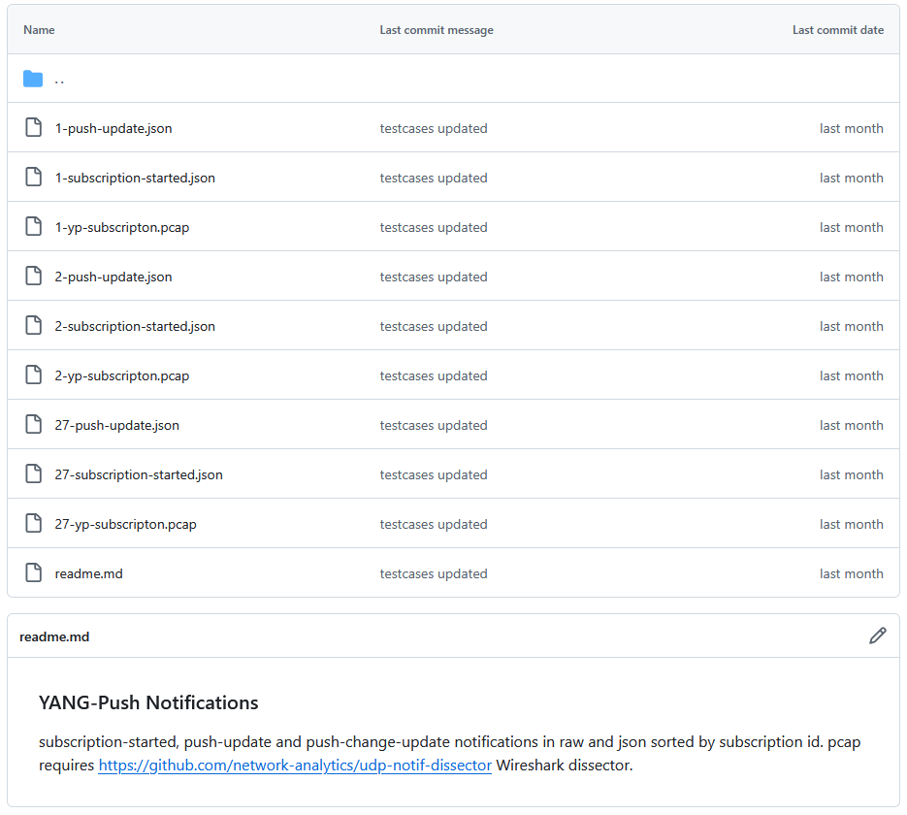
YANG-Push Publisher - Notifications
Subscription state change notifications as JSON and PCAP.
Push update and change-update notifications as JSON and PCAP.
NMOP & NETCONF WG

Slide 9

YANG-Push IETF 125 Publisher Implementation Status
 | 6WIND VSR | Huawei NE | Huawei MA | Cisco IOS XR | Arrcus Arcos | Open-Source
RFC 8639 YANG-Push Subscription | ✔ | ✔ | ✔ | ✔ | ✔
RFC 8641 YANG-Push Notification | ✔ | ✔ | ✔ | ✔ | ✔
draft-ietf-netconf-udp-notif | ✔ | ✔ | ✔ | ✔ | ✔ | ✔
draft-ietf-netconf-distributed-notif | ✔ | ✔ | ✔ |  | na
draft-ietf-netconf-notif-envelope | ✔ | ✔ | ✔ | ✔ | ✔
draft-ietf-netconf-yang-notifications-versioning | ✔ | ✔ | ✔ | ✔ | ✔
RFC 8525 YANG Library | ✔ | ✔ | ✔ | ✔ | ✔
draft-ietf-netconf-yang-library-augmentation | ✔ | ✔ | ✔ | ✔ |  | ✔
RFC 9196 System and Notification Capabilities |  |  | ✔ | P | ✔
draft-netana-netconf-yp-transport-capabilities |  |  | ✔ | ✔ | ✔
RFC 9254 CBOR Named Identifiers | ✔
NMOP & NETCONF WG
NetGauze
Pmacct
udp-notif-c-collector
yang-library-augmentedby
Green marked describes new capability at IETF 125. "P" to partially implemented.

Slide 10
Operational IETF/IEEE YANG IETF 125 Module Implementation Status
 | 6WIND VSR | Huawei NE | Huawei MA | Cisco IOS XR | Arrcus Arcos
ietf-interfaces.yang (inventory, state and statistic) | ✔ | P | ✔
ietf-hardware.yang (inventory, state and statistic) | (✔) |  | ✔
ietf-alarms.yang (state) | ✔ |  | ✔
ieee802-dot1ab-lldp.yang (inventory and state) | (✔)
ieee802-dot1ax.yang (inventory, state and statistic)
ietf-bfd-ip-sh.yang (state)
ietf-bfd-ip-mh.yang (state)
ietf-bfd-lag.yang (state)
ietf-isis.yang (state)
NMOP & NETCONF WG
Green marked describes new capability at IETF 125. "P" to partially implemented.

Slide 11
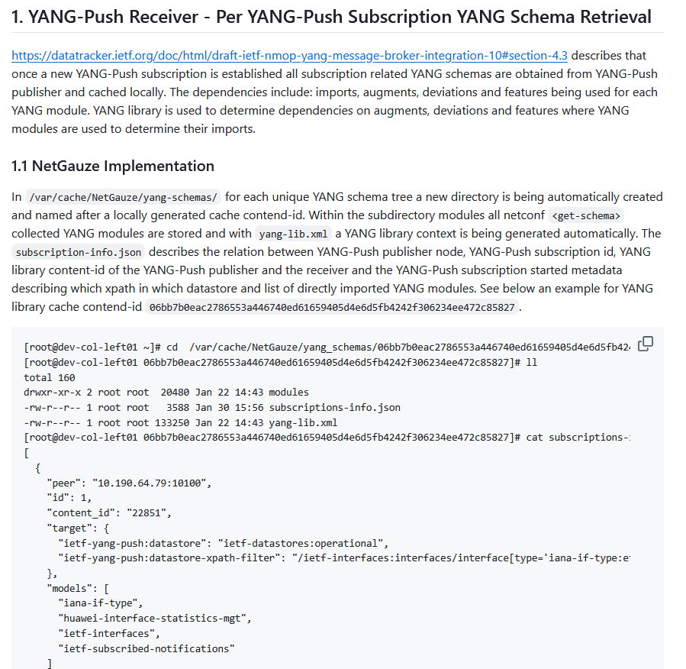
YANG-Push Receiver - NetGauze
Describes how NetGauze organizes and caches YANG modules for a set of YANG-Push Subscriptions with the same YANG schema tree.
Includes generated YANG library and YANG-Push Subscription metadata.
Generates unique cache contend-id. Same principle as with YANG library contend-id on YANG-Push Publisher.
Repository examples with two sets of YANG-Push Subscriptions in two tar.gz files.
NMOP & NETCONF WG

Slide 12
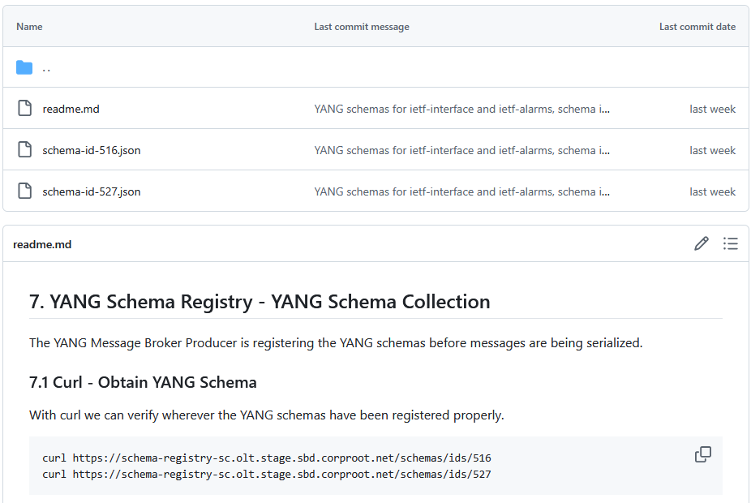
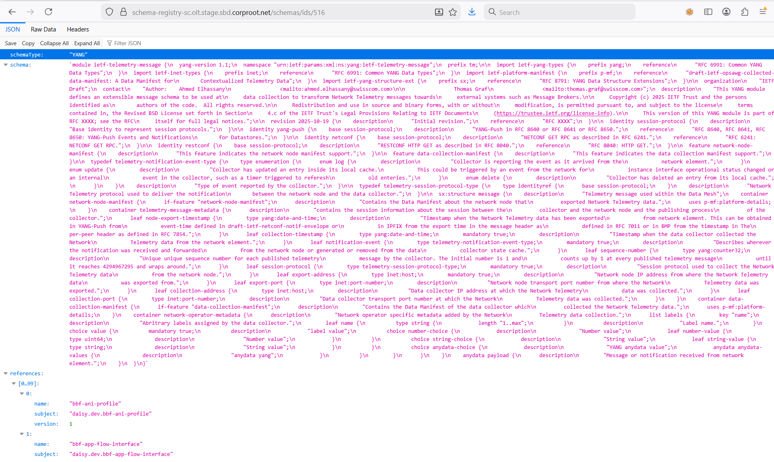
YANG Schema Registry
Examples two YANG schema trees registgered as schema id 516 and 527.
Shows ietf-telemetry-message as the top YANG module and its references.
NMOP & NETCONF WG

Slide 13
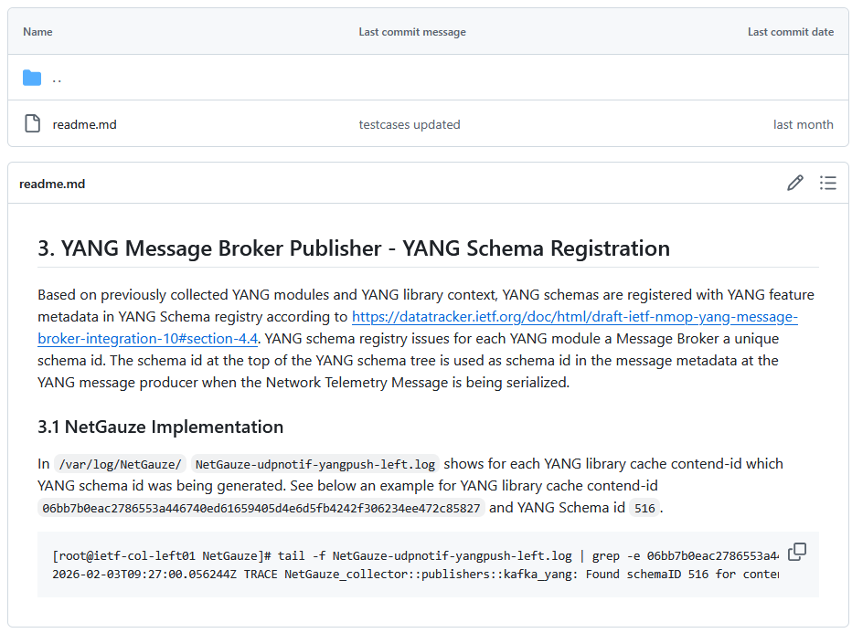
Message Broker Producer - NetGauze
Shows in tracelogs how NetGauze maps YANG cache contend-id to YANG schema-id.
Troubleshooting can be performed with notificication sequence number per Message Broker telemetry message.
NMOP & NETCONF WG

Slide 14
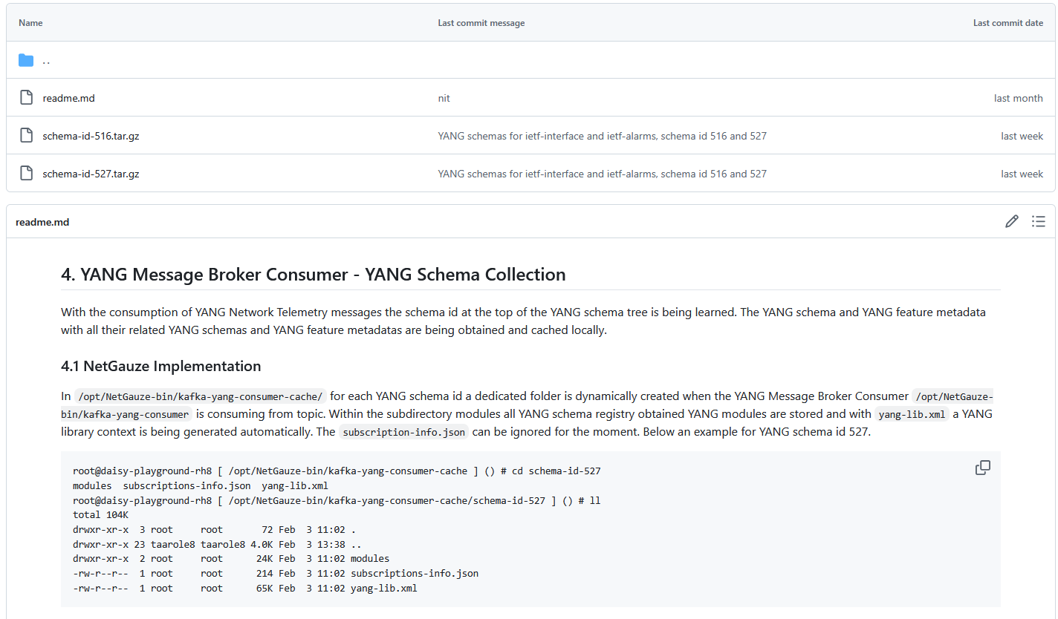
Message Broker Consumer – NetGauze (1)
Describes how NetGauze organizes and caches YANG modules for a set of YANG-Push Subscriptions with the same YANG schema tree with schema-id.
Includes generated YANG library.
Repository examples with two sets of YANG-Push Subscriptions in two tar.gz files.
NMOP & NETCONF WG

Slide 15
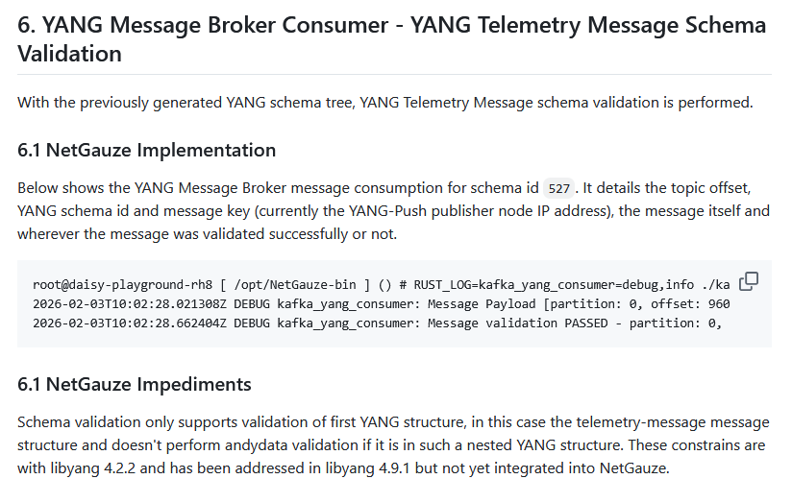
Message Broker Consumer – NetGauze (2)
Shows in tracelogs which Message Broker telemetry message, kafka offset, and notificication sequence number passed YANG schema validation or not.
NMOP & NETCONF WG

Slide 16
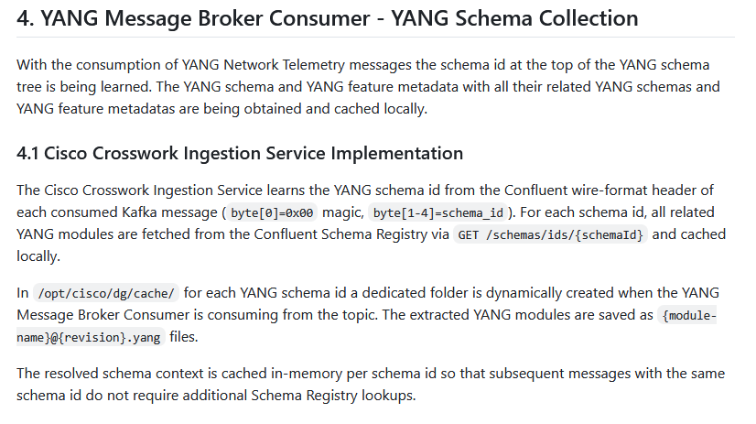
Message Broker Consumer – Cisco Crosswork (1)
Describes how Cisco Crosswork Ingestion Service organizes and caches YANG modules for a set of YANG-Push Subscriptions with the same YANG schema tree with schema-id.
NMOP & NETCONF WG

Slide 17
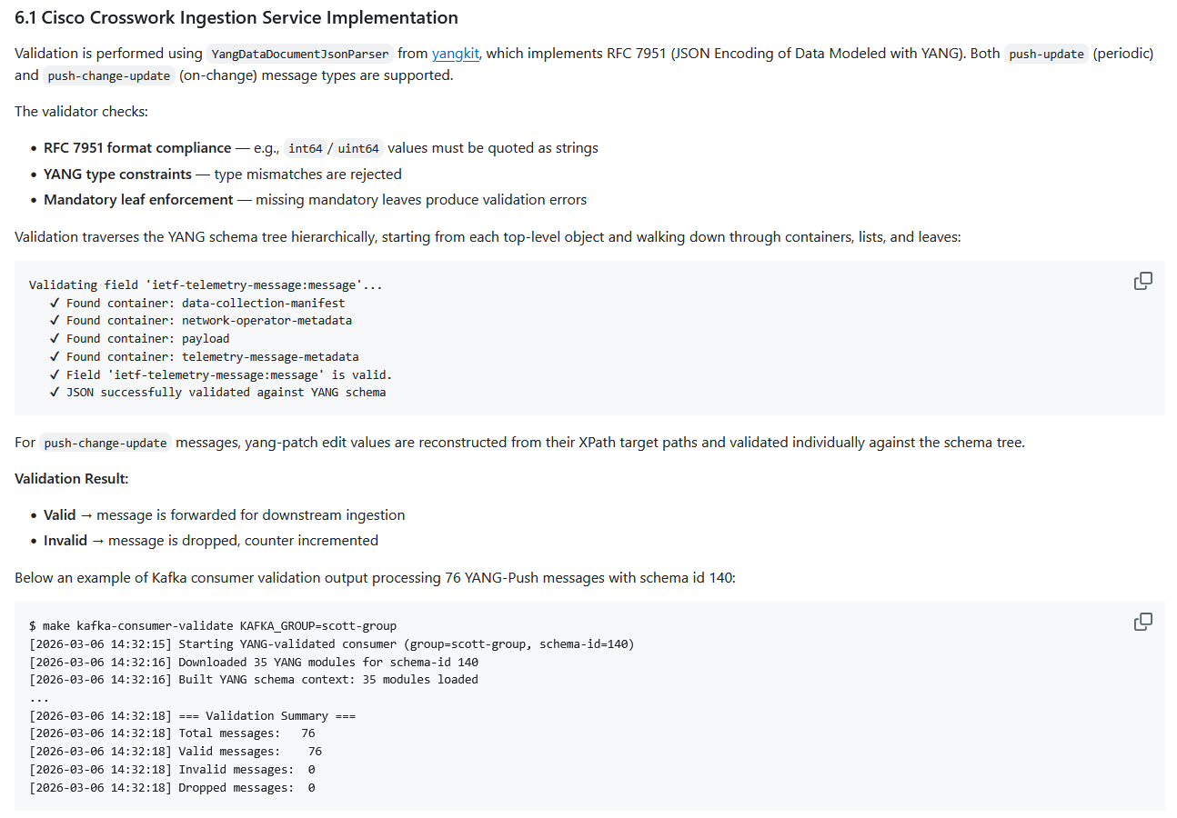
Message Broker Consumer – Cisco Crosswork (2)
Describes how Cisco Crosswork Ingestion Service validates Message Broker telemetry messages against YANG schema tree.
NMOP & NETCONF WG

Slide 18
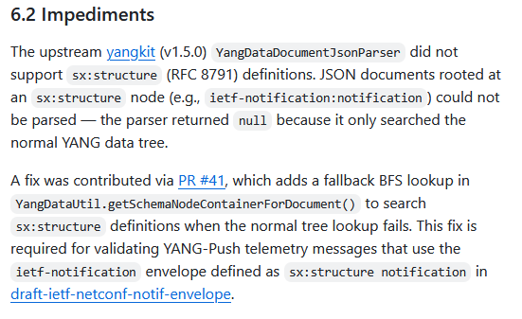
Message Broker Consumer – Cisco Crosswork (3)
YANG structure (RFC 8791) support has been merged with PR 41 to yangkit.
YANG anydata validation (draft-ietf-netmod-yang-anydata-validation) is noted as impediment for next IETF 126 hackathon.
Describes how Cisco Crosswork Ingestion Service validates Message Broker telemetry messages against YANG schema tree.
NMOP & NETCONF WG

Slide 19
YANG Message Broker IETF 125 Implementation Status
 | NetGauze | Pmacct | Apache Kafka | Ciena Blueplanet | Cisco Crosswork
draft-ietf-nmop-message-broker-telemetry-message | ✔ | ✔
YANG-Push Receiver | ✔ | ✔
YANG Schema Retrieval | ✔
YANG Message Broker Producer | ✔
YANG Schema Registry | na | na | ✔ | na | na
YANG Message Broker Consumer | ✔ |  |  | (✔) | ✔
Validate Telemetry Message against YANG Schema | ✔ |  |  | (✔) | ✔
draft-ietf-netmod-yang-anydata-validation | ✔
YANG Schema Comparison | na | na | ✔ | na | na
NMOP & NETCONF WG
NetGauze
Pmacct
Green marked describes new capability at IETF 125. "P" to partially implemented.

Slide 20

Next Steps from IETF 124 Hackathon…
Yanglint, misses anydata validation support within YANG structures
Pmacct corrects collection-timestamp to be typedef date-and-time compliant.
Pmacct corrects encoding value to include ietf-subscribed-notifications namespace in JSON encoding.
Pmacct corrects network-operator-metadata/labels/anydata-values anydata statement to be valid I-JSON.
YANG schema registry supporting YANG features
NetGauze supporting
netconf <get> to obtain YANG library content,
YANG validation for YANG-Push notifications,
YANG schema registration.
NMOP & NETCONF WG

Slide 21

Next Steps for IETF 126 and 127 Hackathon…
Re-do YANG Message Broker Consumer tests on updated testbed with Ciena Blue Planet UAA Workflow Engine
Complete IETF YANG module subscription tests with 6Wind VSR
Compare YANG feature coverage between libyang, yangkit and yangtools
Support draft-ietf-netmod-yang-anydata-validation in yangkit
Revert import only modules for augmented-by workaround
Preserve cached YANG-Push subscription state across receiver reload
Obtain YANG-Push subscription state from publisher if missing
Support Netconf session queuing for schema retrieval
Support YANG-Push Message Broker Topic Naming with dynamic Apache Kafka topic creation API
NMOP & NETCONF WG

Slide 22
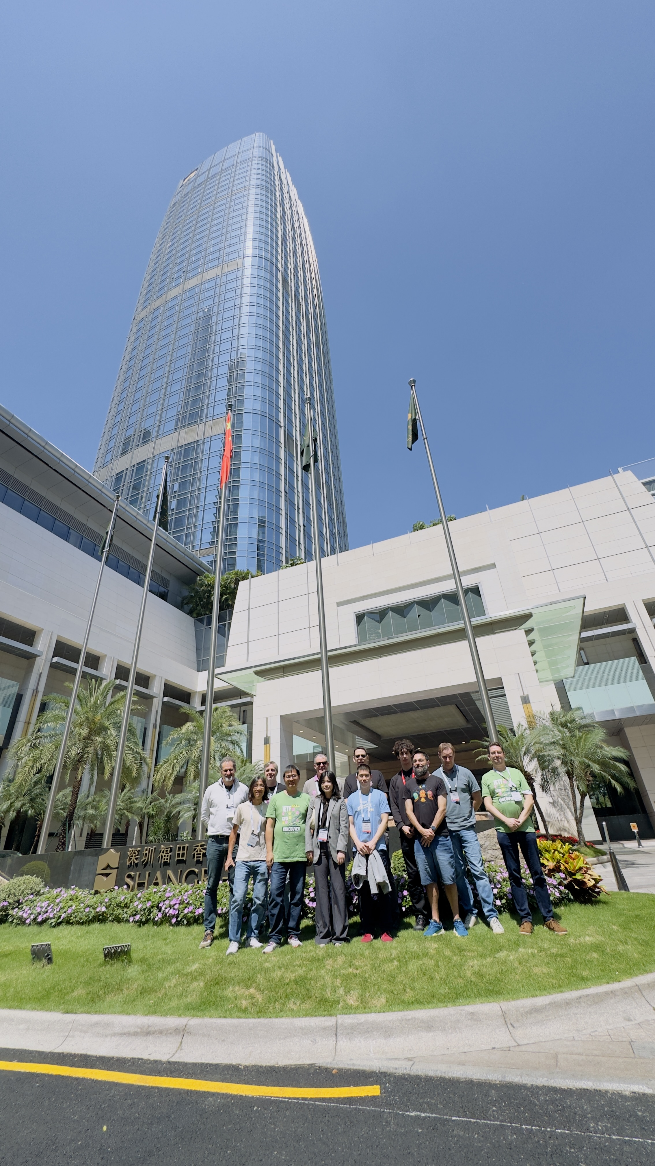
Thanks to…
Paolo Lucente – Pmacct
Qin Wu – Huawei
Michael Mackey – Huawei
Scott Huang - Cisco
Rob Wilton – Cisco
Dan Voyer – Cisco
Sivakumar Sundaravadivel – Ciena
IJsbrand Wijnands – Arrcus
Irfan Mohammad – Arrcus
Benoit Claise - Everything OPS
Wanting Du – Swisscom
Rafael Julio – Swisscom
Leonardo Rodoni - Swisscom
Ahmed Elhassany – Swisscom
Thomas Graf – Swisscom
NMOP & NETCONF WG
Want to know more then join us at…
NMOP on Friday 09:00 – 11:00 at the Grand Ballroom 1 for Message Broker, Telemetry Message and Message Key document updates and hackathon related details.

Slide 23
Backup

Slide 24
An Architecture for YANG-Push to Message Broker Integration Normative References, State and Reviewers
Working Group | Document Name | Document State | Reviews
NETCONF | draft-ietf-netconf-notif-envelope-04 | WG Document (passed working group last call) and is looking for a shepherd | OPSDIR Early review by Joe Clarke YANGDOCTORS Early review (of -02) by Jürgen Schönwälder
NETCONF | draft-ietf-netconf-yang-library-augmentedby-17 | RFC editor queue | OPSDIR Early review (of -08 and -14) by Sheng Jiang, Xiao Min YANGDOCTORS Early review (of -07 and -13) by Andy Bierman SECDIR review (of -14 and -15) by Rich Salz
NETCONF | draft-ietf-netconf-yang-notifications-versioning-11 | Working group last call past- Pending shepherd review. | YANGDOCTORS Early Review due 2025-10-29 OPSDIR review (of -10) by Gabriele Galimberti
NETCONF | draft-ietf-netconf-yp-transport-capabilities-05 | Submitted to IESG for Publication | OPSDIR IETF Last Call review by Xiao Min TSVART IETF Last Call review by Tommy Pauly YANGDOCTORS IETF Last Call review by Jan Lindblad OPSDIR Early review (of -03) by Xiao Min YANGDOCTORS Early review (of -01) by Jan Lindblad SECDIR IETF Last Call Review due 2025-10-18
NMOP | draft-ietf-nmop-yang-message-broker-integration-11 | WG Document (request for working group last call at IETF 124)
NMOP | draft-ietf-nmop-message-broker-telemetry-message-04 | WG Document (request for working group last call at IETF 125) | YANGDOCTORS Early review (of -02) by Martin Björklund

Slide 25
An Architecture for YANG-Push to Message Broker Integration Informative References, State and Reviewers
Working Group | Document Name | Document State | Reviews
NETCONF | draft-ietf-netconf-udp-notif-25 | AD review received. Pending confirmation. | OPSDIR Early review (of -21) by Tina Tsou YANGDOCTORS Early review (of -20) by Jürgen Schönwälder TSVART Early review (of -11) by Michael Tüxen TSVART Early Review due 2025-10-23
NETCONF | draft-ietf-netconf-udp-client-server-10 | Publication Requested | OPSDIR Early review (of -07) by Ran Chen TSVART Early review (of -06) by Joerg Ott YANGDOCTORS Early review (of -06) by Jürgen Schönwälder GENART review (of -09) by Elwin Davies DNSDIR review (of -09) by Peter Van Dijk
NETCONF | draft-ietf-netconf-distributed-notif-18 | AD review received. Pending confirmation. | OPSDIR Early review (of -14) by Jürgen Schönwälder YANGDOCTORS Early review (of -13 and -17) by Martin Björklund
NETMOD | draft-ietf-nmop-yang-anydata-validation-00 | Working group adopted at IETF 124.

