Slide 1

Validate YANG-Push to Message Broker End-To-End Data Processing Chain
IETF 127 Hackathon, November 14/15th 2026
NMOP & NETCONF WG

Slide 2
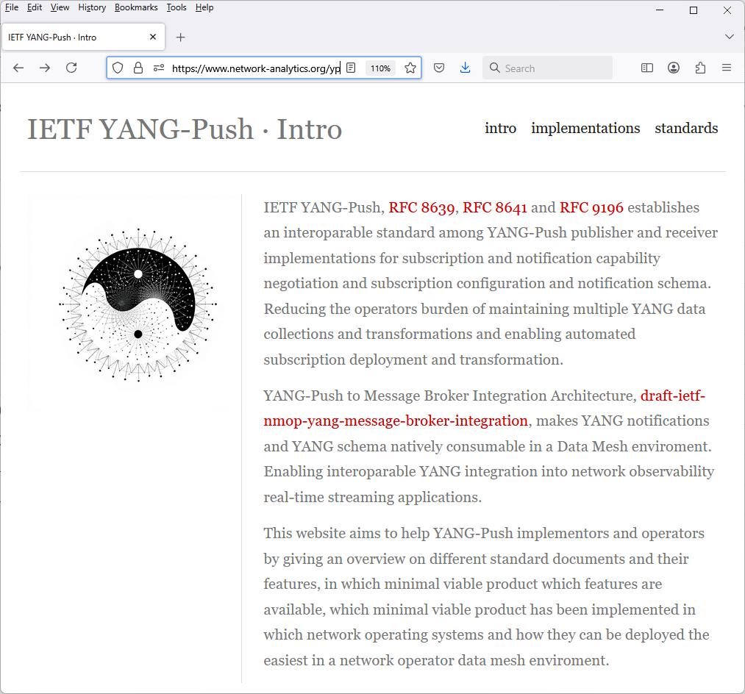
Hackathon Plan, Software and Website
Test Plan
Validate and verify
6 YANG-Push Publishers
3 YANG-Push Receivers
3 YANG-Push Network Telemetry Message
2 YANG Message Broker Producer
1 YANG Schema Registry
3 YANG Message Broker Consumers
implementation in YANG data integration automation. Subscribe to YANG
data on YANG-Publisher, obtain and register all YANG modules necessary
to build YANG schema tree, register YANG schemas to Schema Registry
and verify YANG notifications against scheme trees and produce and
consume from Message Broker.
Software
YANG-Push Publisher - Cisco IOS XR, 6WIND VSR, Huawei NE (Router),MA (OLT), Arrcus Arcos and Ductus DMAP
YANG-Push Receiver – NetCalyx, NetGauze® and Pmacct
YANG Message Broker Producer – NetCalyx, NetGauze®
YANG Message Broker Consumer – NetCalyx, NetGauze®, Ciena Blue Planet UAA, Cisco Crosswork
YANG Schema Registry – Apache Kafka YANG Plugin
Libyang - https://github.com/CESNET/libyang/releases/tag/v5.4.9
Yangkit - https://github.com/yang-central/yangkit/
Wireshark - udp-notif dissector
NMOP & NETCONF WG
https://www.network-analytics.org/yp/how-to-deploy.html

Slide 3
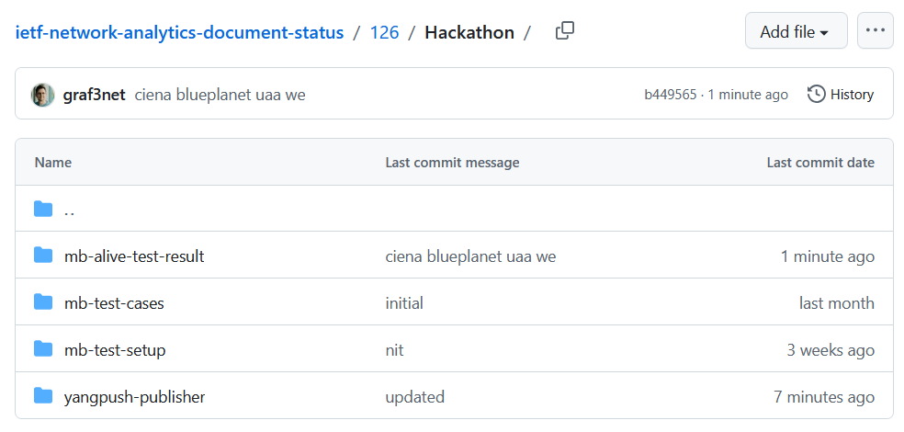
Hackathon – Repositories
The results of the end-to-end tests
Netconf RPCs and YANG-Push JSON and CBOR encoded notifications with wire captures from receiver
YANG-Push Receiver cache content generation with YANG library context, YANG modules, metadata and notification schema validation logs
YANG Message Broker Producer serialization logs
YANG Schema Registry schema examples
YANG Message Broker Consumer, serialization logs, YANG library context, YANG modules and message schema validation
NMOP & NETCONF WG
https://github.com/network-analytics/ietf-network-analytics-document-status/tree/main/127/Hackathon/

Slide 4
An Architecture for YANG-Push to Message Broker Integration draft-ietf-nmop-yang-message-broker-integration draft-ietf-nmop-message-broker-telemetry-message draft-ietf-nmop-yang-message-broker-message-key draft-netana-nmop-message-broker-bmp-telemetry-message
+------------------------------------------------------------+
| Data Storage |
+------------------------------------------------------------+
^
| (12) Ingest Data
| According to Schema
+------------------------------------------------------------+
| Data Consumer |
+------------------------------------------------------------+
| ^ ^
(10) Get | | | (9) Validate
Schema | | | Serialized Message
| | | Schema on Consumer
| | +--------------------+
| | | Message |
| | | Broker |
| | +--------------------+
| | ^
| | | (8) Serialize
| | (11) Issue | YANG-Push Message
| | Schema | annotated Schema
v | (6) Post | ID on Producer
+--------------------+ Schema +--------------------+
| YANG | <--------------- | Data Collection |
| Schema Registry | ---------------> | YANG-Push Receiver |
+--------------------+ (7) Issue +--------------------+
| Schema ID | ^ (3) Receive
| | | YANG-Push
v (4) Discover | | Subscription
+--------------------+ Schema | | Start Message
| Stream | Dependencies | | ^
| Catalog | and Obtain | | | (5) Publish
+--------------------+ Schemas | | | YANG-Push
| | | Message
| | | with
(1) Discover | | | Subscriber
Notification v | | ID
+--------------------+ Capabilities +--------------------+
| Manage YANG-Push | ---------------> | Network Node |
| Subscription | ---------------> | YANG-Push Publisher|
+--------------------+ (2) Subscribe +--------------------+
Subscription to YANG Notifications
RFC 8639
Subscription to YANG Notifications for Datastore Updates
RFC 8641
UDP-based Transport for Configured Subscriptions
draft-ietf-netconf-udp-notif
Subscription to Distributed Notifications
draft-ietf-netconf-distributed-notif
Extensible YANG Model for YANG-Push Notifications
draft-ietf-netconf-notif-envelope
Support of Versioning in YANG Notifications Subscription
draft-ietf-netconf-yang-notifications-versioning
YANG Modules Describing Capabilities for Systems and
Datastore Update Notifications
RFC 9196
YANG Notification Transport Capabilities
draft-ietf-netconf-yp-transport-capabilities
YANG Library
RFC 8525
Augmented-by Addition into the IETF-YANG-Library
RFC 10035
Validating anydata in YANG Library context
draft-netana-netmod-yang-anydata-validation
Encoding of Data Modeled with YANG in the CBOR
RFC 9254
NMOP & NETCONF WG

Slide 5
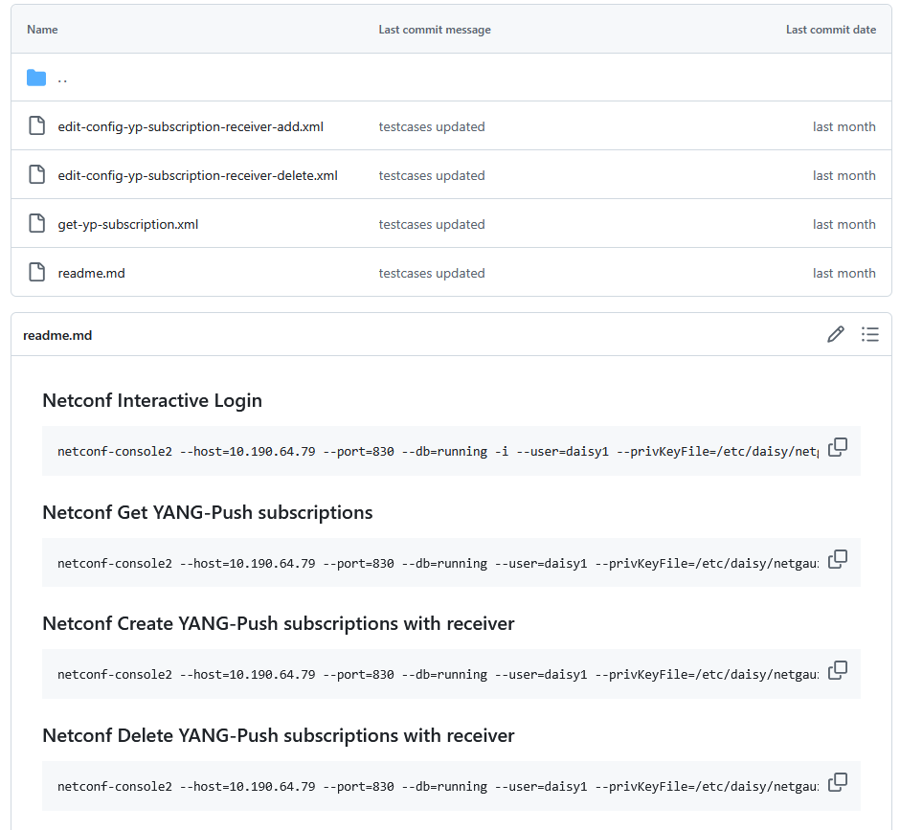
YANG-Push Publisher - Subscription
Netconf RPC calls to create, delete and obtain YANG-Push subscriptions and receiver configurations.
NMOP & NETCONF WG

Slide 6
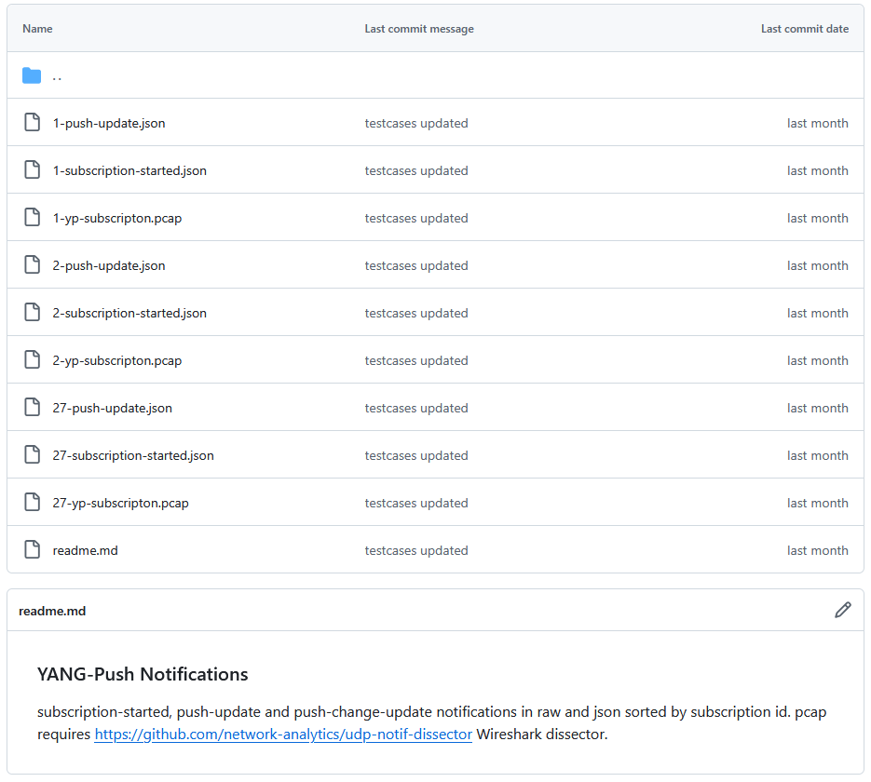
YANG-Push Publisher - Notifications
Subscription state change notifications as JSON and PCAP.
Push update and change-update notifications as JSON and PCAP.
NMOP & NETCONF WG

Slide 7
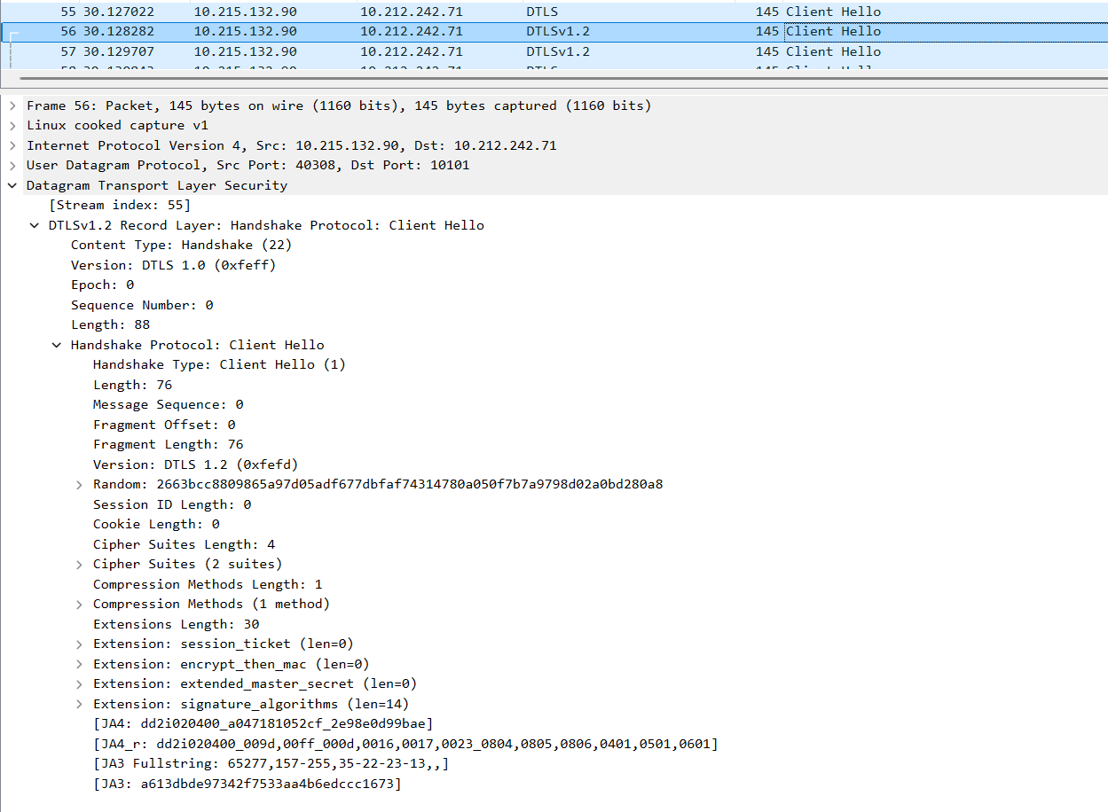
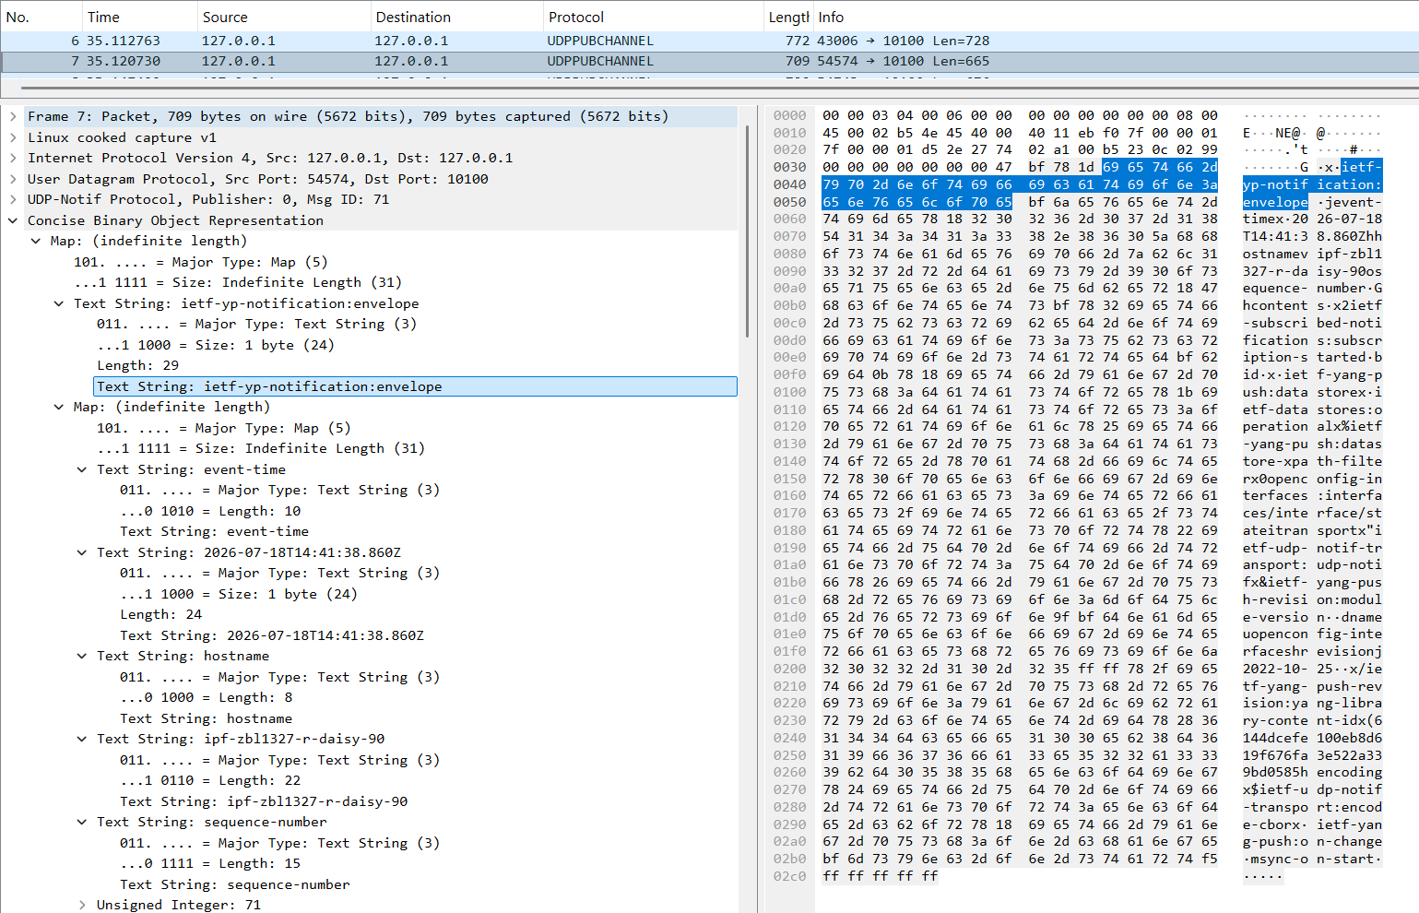
YANG-Push UDP-Notif – DTLS and CBOR
With Cisco IOS XR, 6Wind VSR and Arrcus Arcos we have now three implementations support CBOR Name Identifiers
With Cisco IOS XR we have the first implementation support DTLS 1.2 in UDP-Notif.
NMOP & NETCONF WG

Slide 8
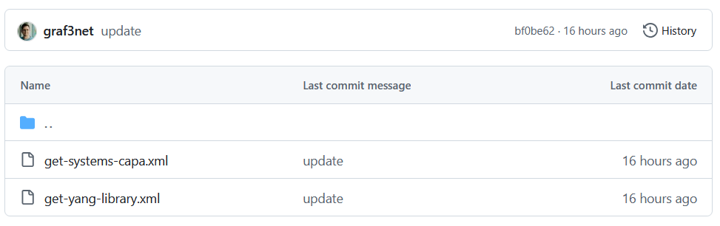
YANG-Push Capabilities & YANG Library - RPC
Netconf XML encoded reply for RFC 9196 YANG-Push capabilities.
Netconf XML encoded reply for RFC 8525 with RFC 10035.
NMOP & NETCONF WG

Slide 9

YANG-Push
IETF 127 Publisher Implementation Status
 | 6WIND VSR | Huawei NE | Huawei MA | Cisco IOS XR | Arrcus Arcos | Open-Source | Ductus DMAP
RFC 8639 YANG-Push Subscription | ✔ | ✔ | ✔ | ✔ | ✔ |  | ✔
RFC 8641 YANG-Push Notification | ✔ | ✔ | ✔ | ✔ | ✔ |  | ✔
draft-ietf-netconf-udp-notif | ✔ | ✔ | ✔ | ✔ | ✔ | ✔
draft-ietf-netconf-udp-notif with DTLS |  |  |  | ✔
draft-ietf-netconf-distributed-notif | ✔ | ✔ | ✔ |  | na
draft-ietf-netconf-notif-envelope | ✔ | ✔ | ✔ | ✔ | ✔ |  | P
draft-ietf-netconf-yang-notifications-versioning | ✔ | ✔ | ✔ | ✔ | ✔
RFC 8525 YANG Library | ✔ | ✔ | ✔ | ✔ | ✔ |  | ✔
draft-ietf-netconf-yang-library-augmentation | ✔ | ✔ | ✔ | ✔ |  | ✔ | ✔
RFC 9196 System and Notification Capabilities |  |  | ✔ | P | ✔ |  | ✔
draft-netana-netconf-yp-transport-capabilities |  |  | ✔ | ✔ | ✔
RFC 9254 CBOR Named Identifiers | ✔ |  |  | ✔ | ✔
NMOP & NETCONF WG
Green marked describes new capability at IETF 127. "P" to partially implemented.

Slide 10
Operational IETF/IEEE YANG
IETF 127 Module Implementation Status
 | 6WIND VSR | Huawei NE | Huawei MA | Cisco IOS XR | Arrcus Arcos
ietf-interfaces.yang (inventory, state and statistic) | ✔ | ✔ | ✔
ietf-hardware.yang (inventory, state and statistic) | P | ✔ | ✔
ietf-alarms.yang (state) | ✔ | ✔ | ✔
ieee802-dot1ab-lldp.yang (inventory and state) | P | ✔
ieee802-dot1ax.yang (inventory, state and statistic) |  | ✔
ietf-bfd-ip-sh.yang (state) |  | P
ietf-bfd-ip-mh.yang (state) |  | P
ietf-bfd-lag.yang (state) |  | P
ietf-isis.yang (state) |  | P
NMOP & NETCONF WG
Green marked describes new capability at IETF 127. "P" to partially implemented.

Slide 11
YANG Message Broker
IETF 127 Implementation Status
 | NetCalyx | NetGauze® | Pmacct | Apache Kafka | Ciena Blueplanet | Cisco Crosswork
draft-ietf-nmop-message-broker-telemetry-message | ✔ | ✔ | ✔
YANG-Push Receiver | ✔ | ✔ | ✔
YANG Schema Retrieval | ✔ | ✔
YANG Message Broker Producer | ✔ | ✔
YANG Schema Registry | na | na | na | ✔ | na | na
YANG Message Broker Consumer | ✔ | ✔ |  |  | ✔ | ✔
Validate Telemetry Message against YANG Schema | ✔ | ✔ |  |  | ✔ | P
draft-netana-netmod-yang-anydata-validation | P | P |  |  | P
YANG Schema Comparison | na | na | na | ✔ | na | na
NMOP & NETCONF WG
Green marked describes new capability at IETF 127. "P" to partially implemented.

Slide 12

Next Steps from IETF 126 Hackathon…
Support building RFC 8525 YANG Library in Java Message Broker Consumer
Support draft-netana-netmod-yang-anydata-validation and RFC 8525 YANG library in yangkit
draft-netana-netmod-yang-anydata-validation schema anchor proof of concept in libyang
NMOP & NETCONF WG

Slide 13
Next Steps for IETF 128 Hackathon…
draft-netana-netmod-yang-anydata-validation schema anchor support in NetCalyx
draft-netana-netmod-yang-anydata-validation support in yang-tools
YANG identityref schema dependency resolution
Support YANG-Push Message Broker Topic Naming with dynamic Apache Kafka topic creation API
NMOP & NETCONF WG

Slide 14
Thanks to…
Jiaxin PAN – Huawei
Zhengliang Li – Huawei
Xiao Chen – Huawei
Qin Wu - Huawei
Rob Wilton – Cisco
Dan Voyer – Cisco
Scott Huang - Cisco
Muthumayan Madhayyan - Cisco
Jérémie Leska – 6Wind
Per Anderson - Ductus
Deepya Mandadi – Ciena
IJsbrand Wijnands – Arrcus
Irfan Mohammad – Arrcus
Benoit Claise - Everything OPS
Paolo Lucente – Pmacct
Vivekananda Boudia – INSA Lyon
Alex Huang Feng – T-Systems
Mohamed Kheir - SingleStore
Helmar Becker - ClickHouse
Maxence Younsi – Swisscom
Leonardo Rodoni - Swisscom
Ahmed Elhassany – Swisscom
Thomas Graf – Swisscom
NMOP & NETCONF WG
Want to know more then join us at…
Side meeting on Monday 11:00 – 12:00 at Plaza A for end-to-end demo on YANG-Push to Message Broker and time series database integration.
NMOP on Thursday 16:30 – 18:30 at Golden Gate 3 for Message Broker, BMP Telemetry Message, YANG anydata validation document updates and hackathon.
NETMOD on Monday 16:30 – 18:30 at Golden Gate 4-5 for YANG anydata validation.

