Slide 1
Extensible YANG Model for YANG-Push Notifications I-D: draft-netana-netconf-notif-envelope-02
A. Huang Feng, INSA-Lyon
P. Francois, INSA-Lyon
T. Graf, Swisscom
B. Claise, Huawei
February 10th 2024
Interim NMOP - NETCONF WG

Slide 2
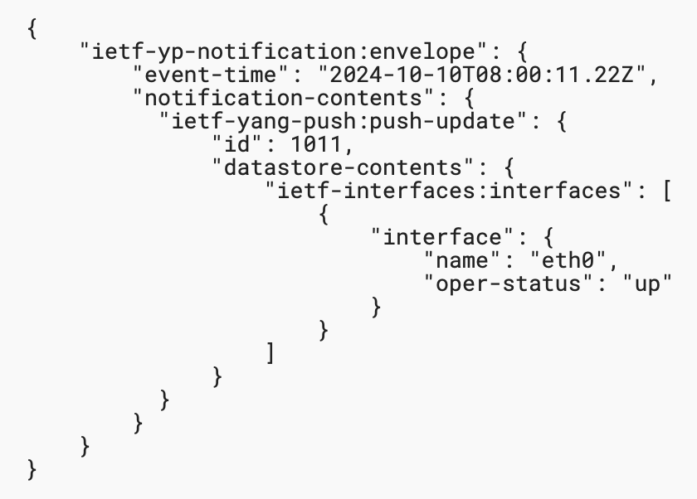
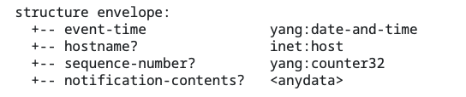


Extensible YANG model for YANG-Push Notifications Proposal of this I-D
Structure defined as a notification containing
event-time
metadata(s)
notification-contents
JSON example without metadata
Configured Subscriptions
Dynamic Subscriptions
enable-notif-envelope=True
enable-notif-envelope=True
Notification-envelope
Collector
Notification-envelope

Slide 3
Extensible YANG model for YANG-Push Notifications Proposal of this I-D
YANG Notification structure for YANG-Push Notifications [RFC 8639/8641]
(1) Option to “opt-in” to this notification envelope
(2) Able to discover the capability of this new header through “ietf-notification-capabilities”
(3) Extensible header defined in YANG 1.1
(4) Definition of each encoding (XML, JSON, CBOR)
(5) Defines the first base extensions (I-D.tgraf-netconf-notif-sequencing; I-D.tgraf-netconf-yang-push-observation-time)

Slide 4
Extensible YANG model for YANG-Push Notifications Feedback IETF 121 Dublin
Envelope header is configurable per subscription
Too complex, suggested to enable it globally [Reshad, Rob]
Let’s simplify, don’t allow configuring “which headers” we want
Suggested to let the client discover what is supported [Joe]
The envelope need to be a sx:structure [Rob]
Plenty of support of this I-D
Multiple contributors agreed to implement this I-D

Slide 5
Extensible YANG model for YANG-Push Notifications Changes since -00
(1) Envelope is enabled and disabled globally via an RPC
(2) Added Observation Timestamp extension [draft-tgraf-netconf-yang-push-observation-time]
(3) Other changes
The XML namespace has been changed to “urn:ietf:params:xml:ns:yang:ietf-yp-notification”
Editorial changes
“The 'notification-contents' element SHOULD be located at the end of the notification envelope structure.”

Slide 6
Extensible YANG model for YANG-Push Notifications Goals of today’s Interim meeting
Confirm current draft direction
(1) Envelope is enabled and disabled globally via an RPC
Whether this approach is the best?
If not, which approach should we follow?
(2) Added Observation Timestamp extension [draft-tgraf-netconf-yang-push-observation-time]
Confirm interest on Observation Timestamp
Confirm current approach

Slide 7
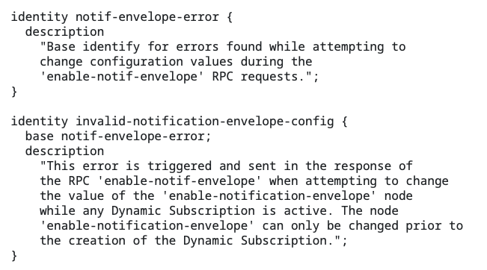
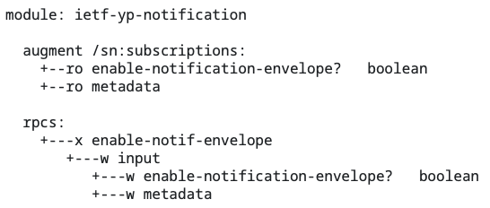
Extensible YANG model for YANG-Push Notifications (1) Enabling the envelope globally
Global RPC “enable-notif-envelope”
This RPC is the only way to enabling/disabling the envelope
The node “/sn:subscriptions/enable-notification-envelope” becomes read-only
The enabling of the envelope MUST be configured before the creation of any dynamic subscriptions
If any subscriptions exist → “invalid-notification-envelope-config” error

Slide 8

Extensible YANG model for YANG-Push Notifications (1) Enabling the envelope globally
Configured Subscriptions
Dynamic Subscriptions
enable-notif-envelope=False
RFC5277 Header
Collector
enable-notif-envelope=False
RFC5277 Header
Collector
RFC5277 Header
RFC5277 Header
Collector
RFC5277 Header
RFC5277 Header
Collector
enable-notif-envelope=True
notif-envelope
invalid-notification-envelope-config
enable-notif-envelope=True
notif-envelope
Collector
RFC5277 Header

Slide 9
Extensible YANG model for YANG-Push Notifications Discussion on change (1) Enabling the envelope globally
Is this current approach appropriate?
Request to raise a poll on February 10th interim and confirm wherever proposed changes reflect the will of the WG
(1) Envelope is enabled and disabled globally with RPC call
(2) The node “/sn:subscriptions/enable-notification-envelope” becomes writable & remove RPC
(3) Notification-envelope configurable per subscription
Operational concerns:
This RPC complexifies operations where network operators onboarding new nodes would need to explicitly enable the the envelope via the RPC, rather than use <edit-config> requests
Defaulting enable-notif-envelope=True eases this case
Request to raise a second poll on February 10th interim to enable the envelope by default
(2) Defaulting enable-notif-envelope=True (notification-envelope enabled by default)

Slide 10
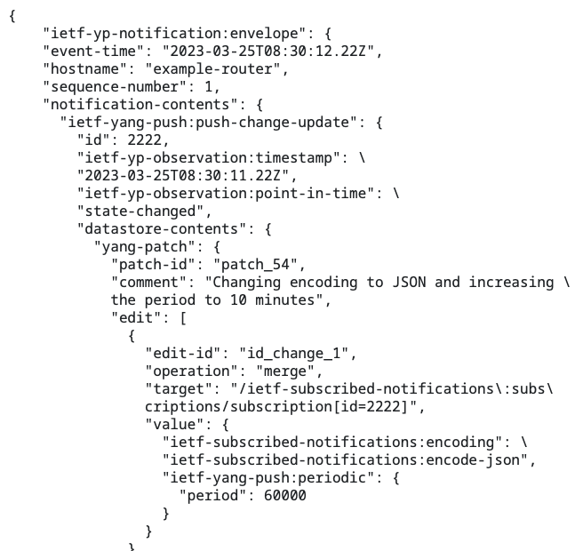
Extensible YANG model for YANG-Push Notifications (2) Added Observation Timestamp extension
Timestamp representing
The time the metrics were polled
The time the exported event occurred
Extensions to YANG-Push
Impact the following YANG-Push Notification only:
push-update
push-change-update
Use same mechanism to get the support of this extension via “/sysc:system-capabilities/notc:subscription-capabilities”
Based on: draft-tgraf-netconf-yang-push-observation-time

Slide 11
Extensible YANG model for YANG-Push Notifications Discussion on change (2) Adding Observation Timestamp extension
Is this current approach appropriate?
Request to raise a poll on February 10th interim and confirm wherever proposed changes reflect the will of the WG
(3) Observation timestamps added in the YANG-Push header

Slide 12
Extensible YANG model for YANG-Push Notifications (3) Other minor changes
The XML namespace has been changed to “urn:ietf:params:xml:ns:yang:ietf-yp-notification”
Editorial changes, improve reading
“The 'notification-contents' element SHOULD be located at the end of the notification envelope structure.”
Idea: have the header located at the beginning of the message

Slide 13
Extensible YANG model for YANG-Push Notifications Discussion and open issues
All the YANG notifications or only YANG-Push Notifications? So, far, current scope if fine (YANG-Push)
Should this notification be defined as a “notification” or as a “sx:structure”? sx:structure
XML namespace: which one to use?
urn:ietf:params:xml:ns:netconf:notification:2.0 → following RFC5277
urn:ietf:params:xml:ns:yang:ietf-yp-notification → following YANG guidelines
Which notification and subscription extensions should be added?
Metadata sent by default when the envelope is enabled? Yes, feedback IETF 121
Hostname and Sequencing [draft-tgraf-netconf-notif-sequencing]; Added
Observation time? [draft-tgraf-netconf-yang-push-observation-time]; Added
Some of the extensions only impact a subset of YANG-Push notifications
How to deal with this? → Current approach, extend YANG-Push header

Slide 14
Extensible YANG model for YANG-Push Notifications Discussion and open issues
Thanks Qiufang, Andy, Pierre Francois, and Reshad for the feedback.
We will integrate todays feedback on the next iteration
Kent and Mahesh suggested at IETF 122 to initiate working group adoption call.
Considering that this is the 7th document (including the preceding document) iteration, that 4 major implementations are under way and draft-wilton-netconf-yp-observability build on top of it, the authors request to initiate the working group adoption before IETF 122.

Slide 15
BACKUP

Slide 16
YANG model for NETCONF Event Notifications Interim 2024-09-19 – draft-ahuang-netconf-notif-yang
https://datatracker.ietf.org/doc/minutes-interim-2024-netconf-02-202409191300/
Thorough review of draft-ahuang-netconf-notif-yang/YANG-Push/NETCONF Event Notifications
Conclusion
draft-ahuang-netconf-notif-yang fixes a gap for YANG-Push but might be worth putting the effort on a brand new header
We need:
Bypass RFC5277, thus use YANG-Push only
Extensible header
be able to add new metadata (sequencing, versioning, others…)
A client should be able to “opt-in”
Clients that don’t support this new header should continue working seamlessly
The notification should be a YANG-based solution
Fix JSON and CBOR underspecification
including CBOR-SID allocation

Slide 17
YANG model for NETCONF Event Notifications Problem statement - (draft-ahuang-netconf-notif-yang)
<notification xmlns="urn:ietf:params:xml:ns:netconf:notification:1.0">
<eventTime>2022-09-02T10:59:55.32Z</eventTime>
<push-update xmlns="urn:ietf:params:xml:ns:yang:ietf-yang-push">
<id>101</id>
<datastore-contents>
<interfaces xmlns="urn:ietf:params:xml:ns:yang:ietf-interfaces">
<interface>
<name>eth0</name>
<oper-status>up</oper-status>
</interface>
</interfaces>
</datastore-contents>
</push-update>
</notification>
{
"ietf-notification:notification": {
"eventTime": "2017-10-25T08:00:11.22Z",
"ietf-yang-push:push-update": {
"id": 1011,
"datastore-contents": {
"ietf-interfaces:interfaces": [
"interface": {
"name": "eth0",
"oper-status": "up"
}
]
}
}
}
}
Implementation Issues:
(1) YANG module not defined
(2) Non-existing Normative text defining this header
RFC 5277 - Netconf Event Notifications
RFC 8641 - YANG Push
YANG encodings:
RFC 7950 - YANG XML
RFC 7951 - YANG JSON
RFC 9254 - YANG CBOR
Thanks Andy for confirming the approach was not correct.

Slide 18
Extensible YANG model for YANG-Push Notifications Proposal (comments)
As requested
Scoped to YANG-Push (both dynamic and configured subscriptions)
Can be implemented with NETCONF and RESTCONF
Use a “notification” statement rather than a “sx:structure”
Given that it’s intended for YANG-Push, the following notifications are impacted:
push-update; push-change-update
subscription-started; subscription-modified; subscription-terminated
subscription-suspended; subscription-resumed; subscription-completed
replay-completed

Slide 19
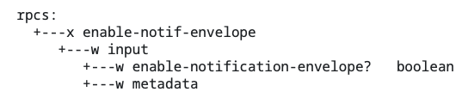
Extensible YANG model for YANG-Push Notifications (1) Option to “opt-in” through a YANG-Push Subscription
Configuration on Globally on the server via the RPC “enable-notif-envelope”
Currently
Default=False
enable-notification-envelope=false
Old Header as RFC5277
Collector
enable-notification-envelope=true
New envelope Header
Collector

Slide 20
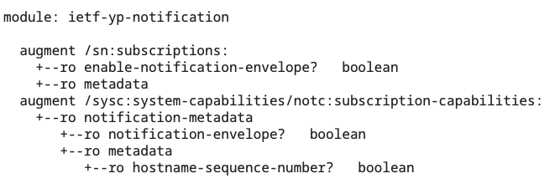
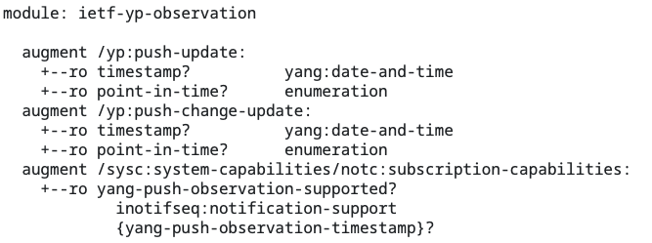
Extensible YANG model for YANG-Push Notifications (2) Able to discover the capability of this new header
Augmentation on notification capabilities (RFC9196)
Get Capabilities
notification-envelope=True

Slide 21
Extensible YANG model for YANG-Push Notifications (3) Extensible header defined in YANG
Structure defined as a notification containing
event-time
metadata(s)
notification-contents
JSON example without metadata
Configured Subscriptions
Dynamic Subscriptions
enable-notif-envelope=True
enable-notif-envelope=True
Notification-envelope
Collector
Notification-envelope

Slide 22
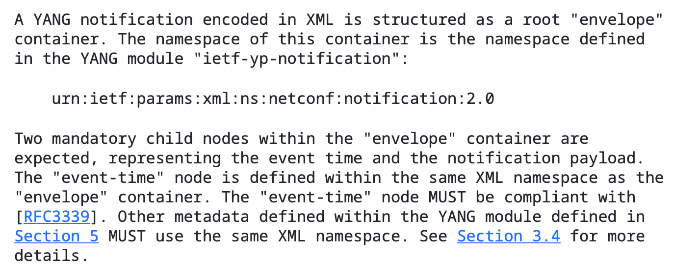
Extensible YANG model for YANG-Push Notifications (4) Definition of each encoding (XML, JSON, CBOR)
Explicit definition of the content of the “envelope” (solving gap for JSON and CBOR)
Definition of the namespace (urn:ietf:params:xml:ns:netconf:notification:2.0)
Mandatory event-time node
Mandatory notification-contents node
Metadata present when configured

Slide 23
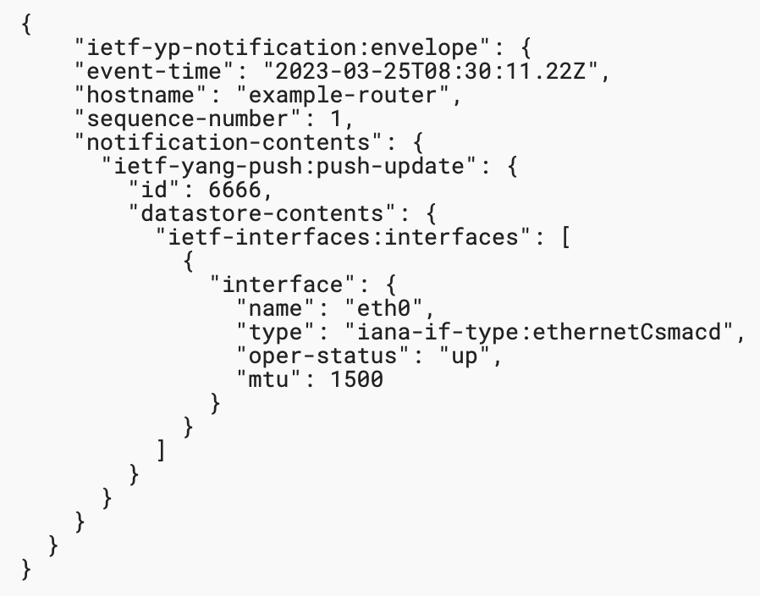
Extensible YANG model for YANG-Push Notifications (5) Extensions for hostname and sequence-number
Definition of hostname and sequence-number extensions (draft-tgraf-netconf-notif-sequencing)
Present by default when the envelope is enabled
Discovery of support of this header through RFC9196

