Slide 1
YANG Notification Transport Capabilities draft-netana-netconf-yp-transport-capabilities-00
Augments "ietf-system-capabilities" to enable
a client to discover the transport protocol, encoding and security capabilities of a YANG-Push publisher
thomas.graf@swisscom.com
alex.huang-feng@insa-lyon.fr bill.wu@huawei.com
maqiufang1@huawei.com
29. October 2024

Slide 2
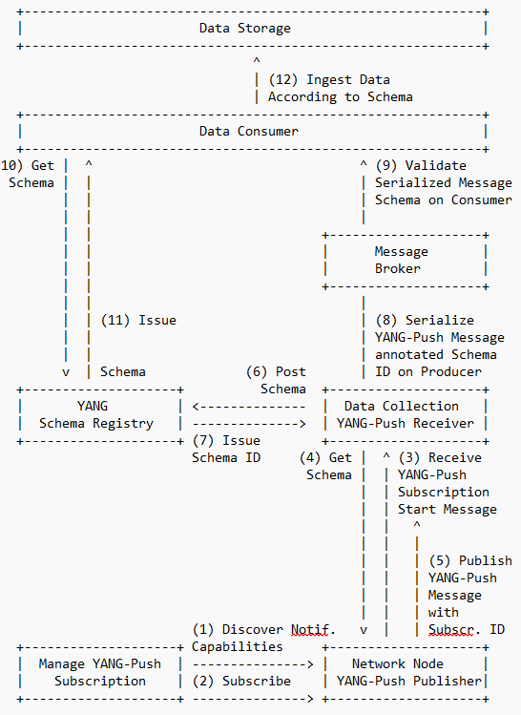
YANG Notification Transport Capabilities Integrates in the YANG-Push to Message Broker Integration Architecture
draft-ietf-nmop-yang-message-broker-integration describes an Architecture for YANG-Push to Message Broker Integration.
Section 4.1 of draft-ietf-nmop-yang-message-broker-integration describes the YANG-Push subscription workflow where before the subscription configuration the transport, notification and subscription capabilities are being discovered first.
draft-netana-netconf-yp-transport-capabilities extends "ietf-system-capabilities" for discovering transport, Section 3.2 of draft-netana-netconf-notif-envelope for notification metadata and Section 4 of draft-tgraf-netconf-yang-push-observation-time for observation timestamping.
This allows a client to discover all YANG-Push server capabilities to enable the automation of the YANG-Push subscription configuration workflow depending on the YANG-Push server capabilities .

Slide 3
YANG Notification Transport Capabilities Capabilities for Systems and Datastore Update Notifications
Section 7 of RFC 8639 and errata 6211 describes that that supported YANG-Push transport encodings needs to be discoverable.
Section 2.5 of RFC 8639 describes configured YANG-Push subscriptions. draft-ietf-netconf-udp-notif and draft-ietf-netconf-https-notif are two transport protocols for configured YANG-Push subscriptions.
RFC 9196 defines two YANG modules, "ietf-system-capabilities" and "ietf-notification-capabilities".
The module "ietf-system-capabilities" provides a placeholder structure that can be used to discover YANG-related system capabilities for servers.
The module "ietf-notification-capabilities" augments "ietf-system-capabilities" to specify notification capabilities related to RFC 8641.
Section 3 of RFC 9196 defines the following transport agnostic notification capabilities
supported (reporting) periods for "periodic" subscriptions.
the maximum number of objects that can be sent in an update.
the set of datastores or data nodes for which "periodic" notification is supported.
supported dampening periods for "on-change" subscriptions.
the set of datastores or data nodes for which "on-change" notification is supported.

Slide 4
YANG Notification Transport Capabilities Extending System Capabilities for YANG-Push Configured Subscription Transport
module: ietf-notification-transport-capabilities
augment /sysc:system-capabilities/notc:subscription-capabilities:
+--ro transport-capabilities
+--ro transport-capability* [transport-protocol]
+--ro transport-protocol identityref
+--ro security-protocol? identityref
+--ro encoding-format* identityref
augment "/sysc:system-capabilities/notc:subscription-capabilities" {
description "Add system level capability.";
container transport-capabilities {
description "Capabilities related to YANG-Push transports.";
list transport-capability {
key "transport-protocol";
description "Capability list related to notification transport capabilities.";
leaf transport-protocol {
type identityref {
base sn:transport;
}
description "Supported transport protocol for YANG-Push.";
}
leaf security-protocol {
type identityref {
base security-protocol;
}
description "Type of secure transport.";
}
leaf-list encoding-format {
type identityref {
base sn:encoding;
}
description "Supported encoding formats.";
}
}
}
draft-netana-netconf-yp-transport-capabilities augments System Capabilities model and provides additional transport related attributes associated with system capabilities:
Specification of transport protocols the client can request to establish a draft-ietf-netconf-udp-notif or draft-ietf-netconf-https-notif configured transport connection;
Specification of transport encoding, such as JSON or XML as defined in RFC 8040 or CBOR as defined in RFC 9254 the client can request to encode YANG notifications;
Specification of secure transport mechanisms that are needed by the client to communicate with the server such as DTLS as defined in RFC 9147 TLS as defined in RFC 8446 or SSH as defined in RFC 4254;

Slide 5
YANG Notification Transport Capabilities draft-netana-netconf-yp-transport-capabilities-00 - Status and Next Steps
Current Status
Replaces draft-tao-netconf-data-export-capabilities.
Addresses Kent's comment on encoding and complements with transport end security discoverability.
Next Steps
Request a working group poll wherever it addresses the discoverability requirements defined in Section 7 of RFC 8639 and errata 6211 for draft-ietf-netconf-udp-notif and draft-ietf-netconf-https-notif.
Request working group adoption.
thomas.graf@swisscom.com
alex.huang-feng@insa-lyon.fr bill.wu@huawei.com
maqiufang1@huawei.com
29. October 2024

