Slide 1
An Architecture for YANG-Push to Message Broker Integration
draft-ietf-nmop-yang-message-broker-integration
Motivation and architecture of a native
YANG-Push notifications and YANG Schema integration
into Message Broker and YANG Schema Registry
yannick.buchs@swisscom.com
thomas.graf@swisscom.com
29. October 2026

Slide 2
IETF YANG-Push
A 22 years journey
IAB Workshop
Defines operators' requirements in RFC 3535 to lifecycle CLI and SNMP. YANG, Netconf and Restconf development started.
YANG 1.0
Specified in RFC 6020. 1.1 in RFC 7950.
gNMI
gNMI was presented to IETF NETCONF and implementations started at major network vendors.
Data Mesh Integration
Vendor-specific implementations and IETF YANG-Push are hard to manage. New requirements emerged for integrating with the message broker and an automated data processing chain. New specifications are proposed to resolve these challenges.
2002
2010
2017
2022
2015
2019
2024
IETF YANG-Push Specification Started
Development of RFC 8639 and RFC 8641 started at IETF NETCONF.
IETF YANG-Push
Specification Finished
Development of RFC 8639 and RFC 8641 concluded at IETF NETCONF without any major network vendor implementations.
IETF YANG-Push Major
Implementations Started
Questions arise. Proposing a simplified IETF YANG-Push and an Agile Incremental Driven Development.

Slide 3
Handling Operational YANG Modelled Data
State of the Union
Nowadays network operators are using machine and human readable YANG RFC 7950 to model their configurations and obtain YANG modelled data from their networks.
Network operators organize their data in a Data Mesh where a message broker such as Apache Kafka facilitates the exchange of messages among data processing components.
Today, subscribing to a YANG datastore, publishing a YANG modeled notifications message from the network and viewing the data in a time series database, manual labor is needed to perform data transformation to make a message broker and its data processing components with YANG notifications interoperable.
« Even though YANG is intented to ease data management, this promise has not yet been fulfilled for Network Telemetry RFC 9232 »

Slide 4
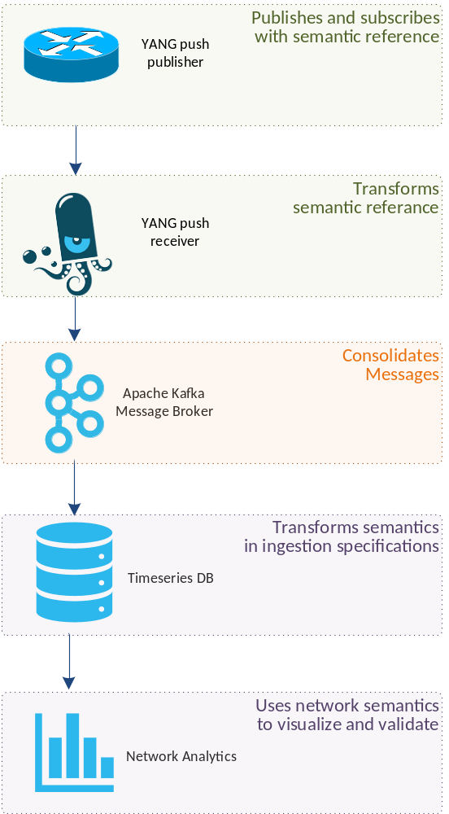
From YANG-Push to Network Analytics
Aiming for an automated data processing pipeline
A network operator aims for:
  An automated data processing pipeline which starts with YANG-Push, consolidates at Data Mesh and ends at Network Analytics.
  Operational metrics where IETF defines the semantics.
  Analytical metrics where network operators gain actionable insights.
We achieve this by integrating YANG-Push into Data Mesh to:
  Produce metrics from networks with timestamps when network events were observed.
  Hostname, publisher ID and sequence numbers help us to understand from where metrics were exported and measure its delay and loss.
  Forward metrics unchanged from networks
  Learn semantics from networks and validate messages.
  Control semantic changes end to end.

Slide 5
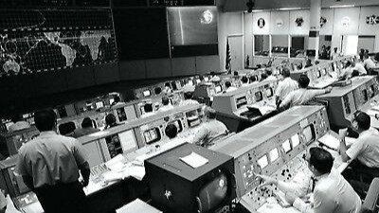
We have a dream
Digital Twin at your fingertips
« Imagine that your entire life as network engineer you have logged into routers to perform show commands to get a glimpse into the current state of your networks. »
« Suddenly you see your colleague on the right querying the current network state in seconds directly from a real-time data stream. No access to routers needed. No databases needed. »
"NASA Mission Control Digital Twin in the 60s,
Digital Twin is not Rocket Science"

Slide 6
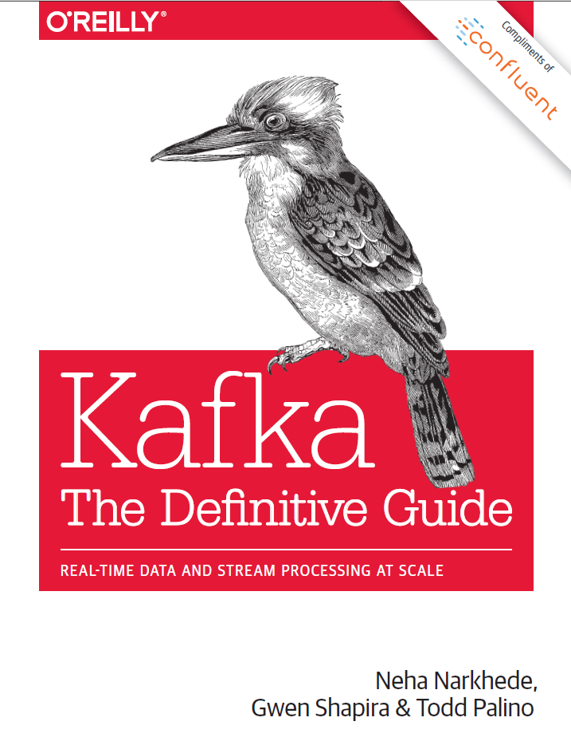
Terminology (1)
Message Broker
Subject: A named communication channel where a schema registry assigned schema id is associated.
Topic: A communication channel for publishing and subscribing messages between producer and consumer with one or more subjects.
Topic Compaction: The act of compressing messages in a topic to the latest state.
Partition: Messages in a topic are spread over hash buckets where a hash bucket refers to a partition.
Message: A piece of structured data sent between data processing components to facilitate communication in a distributed system
Message Key: Metadata associated with a message to facilitate deterministic hash bucketing.
Segment: A physical file containing multiple messages.
https://www.confluent.io/thank-you/resources/ebook/kafka-the-definitive-guide/

Slide 7
Terminology (2)
YANG Data Taxonomy and Index
module: ietf-interfaces
+--rw interfaces
+--rw interface* [name]
+--rw name string
+--rw description? string
+--rw type identityref
+--rw enabled? boolean
+--rw link-up-down-trap-enable? enumeration {if-mib}?
+--ro admin-status enumeration {if-mib}?
+--ro oper-status enumeration
+--ro last-change? yang:date-and-time
+--ro if-index int32 {if-mib}?
+--ro phys-address? yang:phys-address
+--ro higher-layer-if* interface-ref
+--ro lower-layer-if* interface-ref
+--ro speed? yang:gauge64
+--ro statistics
+--ro discontinuity-time yang:date-and-time
+--ro in-octets? yang:counter64
+--ro in-unicast-pkts? yang:counter64
+--ro in-broadcast-pkts? yang:counter64
+--ro in-multicast-pkts? yang:counter64
+--ro in-discards? yang:counter32
+--ro in-errors? yang:counter32
+--ro in-unknown-protos? yang:counter32
+--ro out-octets? yang:counter64
+--ro out-unicast-pkts? yang:counter64
+--ro out-broadcast-pkts? yang:counter64
+--ro out-multicast-pkts? yang:counter64
+--ro out-discards? yang:counter32
+--ro out-errors? yang:counter32
Dimensional Data: Structured information in a data store [Ralph Kimball]. Example: YANG with data taxonomy.
Data Taxonomy: Is a hierarchical system for classifying and organizing data into categories and subcategories
YANG Schema Tree: The definition hierarchy specified within a module.
YANG Schema Node: A node in the schema tree.
YANG Item Identifiers: Section 3.3 in RFC 9254 defines unique text-based identifiers for each YANG element including YANG schema nodes.
YANG index: Is a subset of YANG item identifiers containing only YANG schema node identifiers.

Slide 8
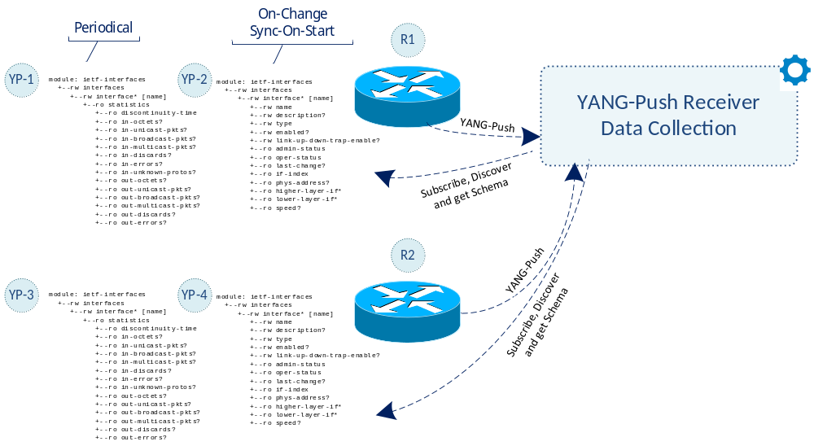
YANG-Push
Discover and Subscribe to YANG metrics
From discovering YANG-Push subscription capabilities defined in RFC 9196, subscribing interesting metrics periodical (statistics), on-change (state changes) or on-change with sync-on-start (states) defined in RFC 8641.
Each subscription refers to network node, datastore (RFC 8342) and a schema tree.
In this RFC 8343 example ietf-interface statistics are subscribed periodically and ietf-interface states on-change sync-on-start. YANG-Push subscription ID's are per network node significant.
Data Collection obtains for each subscription the YANG schema tree by leveraging <get-schema> (RFC 6022), YANG Library (RFC 8525) and draft-ietf-netconf-yang-library-augmentedby.

Slide 9
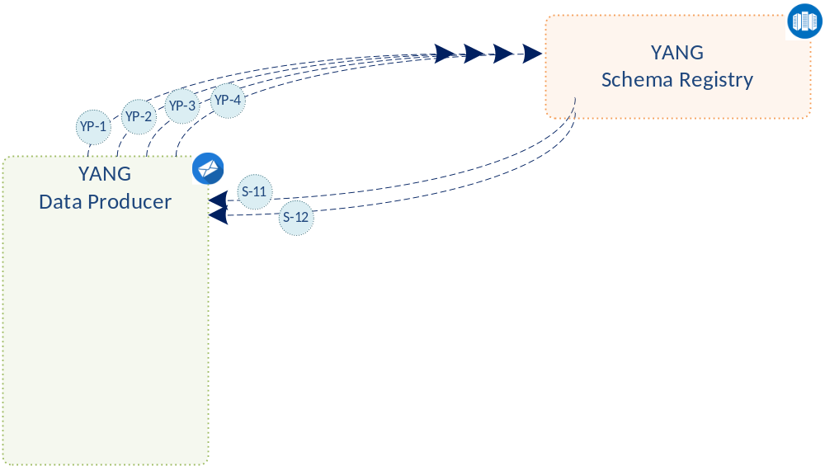
YANG Schema Registry
From 4 subscription ID's to 2 schema ID's
For all 4 YANG-Push subscriptions, YANG schema registration and comparison is performed.
Since the two YANG schema trees for both YANG-Push subscriptions are identical on both network nodes, two YANG globally unique schema ID's are being issued from the YANG schema registry to the YANG data producer.

Slide 10
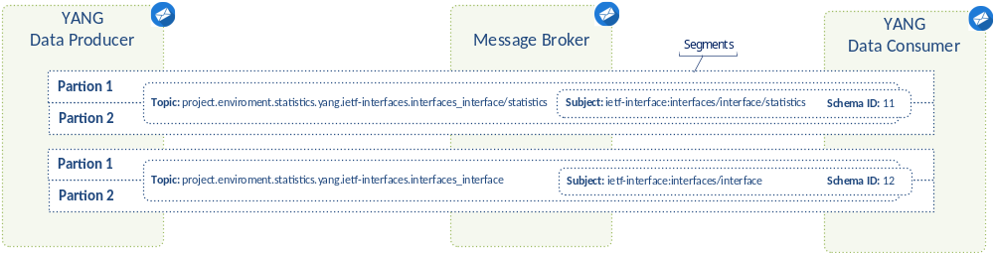
Message Broker
Topics, Subjects, Partitions, Segments and Message Keys
The YANG data producer creates for each YANG schema a new message broker topic, a message key and defines the number of partitions being used for the topic.
It serializes the message with the previously generated message key and message content according to
draft-ietf-nmop-message-broker-telemetry-message.
Each message is prefixed with the previously obtained schema ID representing a unique message subject. The messages are distributed according to the hashed message key across the partitions into continuous segments.

Slide 11
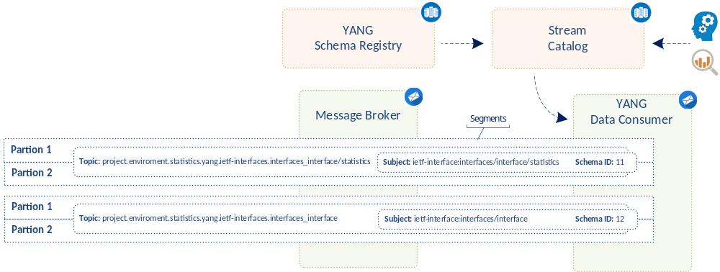
YANG Data Consumption
Discover and Subscribe to YANG metrics
A user or AI application/agent subscribes discovers through the stream catalog interesting metrics and subscribes to message broker topic.
More than one topic can be consumed at once by using a wildcard such as: project.enviroment.states.yang.* to consume all YANG state metrics.
The consumer hashes the message key and applies modulo with the number of partitions to determine the partition it needs to consume from to obtain messages with desired message key.

Slide 12
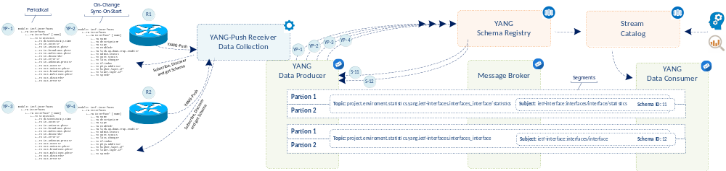
Fully YANG aware Data Pipeline
From network nodes to message broker nodes
At the YANG data producer, thanks to the YANG awareness to the YANG data producer and the YANG schema registry, for each unique YANG schema tree a message broker topic and subject is being created, and messages are being indexed and hashed according to the message key.
At the message broker, thanks to the dedicated topic per YANG schema and its message key, YANG state metrics can be compacted to the latest state; reducing the number of stored messages.
At the YANG data consumer, thanks to the YANG awareness of the stream catalog and consumer, a specific topic, partition and subject can be consumed for the interested YANG metrics; reducing the number of messages to be consumed.

Slide 13

Addressing YANG Specification and Integration Gaps
12 documents at NMOP, NETCONF and NETMOD
YANG-Push Transport Gaps:
UDP-based Transport for Configured Subscriptions
draft-ietf-netconf-udp-notif
Subscription to Distributed Notifications
draft-ietf-netconf-distributed-notif
YANG-Push Specifications Gaps:
YANG Notification Transport Capabilities
draft-ietf-netconf-yp-transport-capabilities
Extensible YANG model for YANG-Push Notifications
draft-ietf-netconf-notif-envelope
Validating anydata in YANG Library context
draft-ietf-netmod-yang-anydata-validation
YANG-Push Integration Gaps and Arch:
Support of Versioning in YANG Notifications Subscription
draft-ietf-netconf-yang-notifications-versioning
Augmented-by Addition into the IETF-YANG-Library
draft-ietf-netconf-yang-library-augmentation
YANG-Push Simplification:
YANG-Push Operational Data Observability Enhancements
draft-ietf-netconf-yp-observability
YANG-Push Message Broker:
An Architecture for YANG-Push to Message Broker Integration
draft-ietf-nmop-yang-message-broker-integration
Extensible YANG Model for Network Telemetry Notifications
draft-ietf-nmop-message-broker-telemetry-message
YANG Message Keys for Message Broker Integration
draft-ietf-nmop-yang-message-broker-message-key
BMP YANG Model for Network Telemetry Messages
draft-netana-nmop-message-broker-bmp-telemetry-msg
IESG
IESG
IESG
IESG
IESG
IESG
2025
2026
2027
2028

Slide 14
IETF YANG-Push Implementations
Incremental development…
MVP 1 - Works
draft-ietf-netconf-udp-notif transport (with segmentation option) and notifications encoded in RFC 7951 IETF-JSON.
RFC 8641 periodic subscription with anchor-time configurable in ietf-subscribed-notifications.
YANG notifications as defined in draft-netana-netconf-notif-envelope, YANG module name, version and yang-library-content-id as in draft-ietf-netconf-yang-notifications-versioning and notification capabilities (RFC 9196) discoverable as defined in their documents.
YANG-Library as defined in RFC 8525 and draft-ietf-netconf-yang-library-augmentedby.
MVP 2 – Scales and Secures
Distributed notifications as defined in draft-ietf-netconf-distributed-notif.
YANG notifications encoded in CBOR (named identifiers) as defined in RFC 9254.
YANG notifications DTLS (1.2 MUST RFC 6347, 1.3 SHOULD RFC 9147) encrypted as defined in draft-ietf-netconf-udp-notif.
MVP 3 - Optimizes
RFC 8641 on-change subscription configurable in ietf-subscribed-notifications.
RFC 8641 on-change and periodical subscription in RFC 9196 defined capabilities discoverable.
draft-ietf-netconf-udp-notif transport, encoding and encryption capabilities (RFC 9196) discoverable with draft-ietf-netconf-yp-transport-capabilities.
4 major vendor implementations finalized.
2 major vendor implementations started.

Slide 15
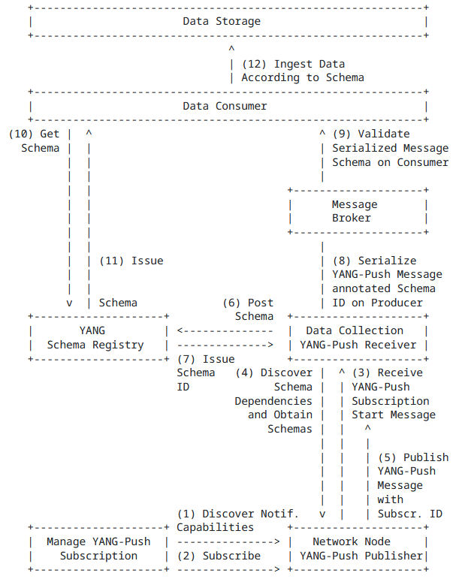
Part 2
Our collaboration goes into
the next step in 2026
This allows Swisscom
to transition from
SNMP to YANG
2025
2026
2027
2028

Slide 16

IETF YANG Model Implementations
Incremental development…
"Starting 2026, Swisscom onboards new network platforms with YANG-Push only. Initiating the SNMP to YANG lifecycle and the standardization of YANG models."
MVP 2 – Physical & Essential
ietf-interfaces.yang (inventory, state and statistic)
ietf-hardware.yang (inventory, state and statistic)
ietf-alarms.yang (state)
ieee802-dot1ab-lldp.yang (inventory and state)
MVP 3 – Logical Relationships
ieee802-dot1ax.yang (inventory, state and statistic)
ietf-bfd-ip-sh.yang (state)
ietf-bfd-ip-mh.yang (state)
ietf-bfd-lag.yang (state)
ietf-isis.yang (state)
Already supported by OLT MA5800.

Slide 17
RFC 8343 – ietf-interfaces.yang
YANG Data Model for Interface Management
module: ietf-interfaces
+--rw interfaces
+--rw interface* [name]
+--rw name string
+--rw description? string
+--rw type identityref
+--rw enabled? boolean
+--rw link-up-down-trap-enable? enumeration {if-mib}?
+--ro admin-status enumeration {if-mib}?
+--ro oper-status enumeration
+--ro last-change? yang:date-and-time
+--ro if-index int32 {if-mib}?
+--ro phys-address? yang:phys-address
+--ro higher-layer-if* interface-ref
+--ro lower-layer-if* interface-ref
+--ro speed? yang:gauge64
+--ro statistics
+--ro discontinuity-time yang:date-and-time
+--ro in-octets? yang:counter64
+--ro in-unicast-pkts? yang:counter64
+--ro in-broadcast-pkts? yang:counter64
+--ro in-multicast-pkts? yang:counter64
+--ro in-discards? yang:counter32
+--ro in-errors? yang:counter32
+--ro in-unknown-protos? yang:counter32
+--ro out-octets? yang:counter64
+--ro out-unicast-pkts? yang:counter64
+--ro out-broadcast-pkts? yang:counter64
+--ro out-multicast-pkts? yang:counter64
+--ro out-discards? yang:counter32
+--ro out-errors? yang:counter32
With IETF YANG-Push we like to subscribe
with on-change sync-on-start
  For inventory and alert use cases the state of the interface.
and periodically
  For performance measurement use cases the interface statistics.

Slide 18
RFC 8348 – ietf-hardware.yang
YANG Data Model for Hardware Management
module: ietf-hardware
+--rw hardware
+--ro last-change? yang:date-and-time
+--rw component* [name]
+--rw name string
+--rw class identityref
+--ro physical-index? int32 {entity-mib}?
+--ro description? string
+--rw parent? -> ../../component/name
+--rw parent-rel-pos? int32
+--ro contains-child* -> ../../component/name
+--ro hardware-rev? string
+--ro firmware-rev? string
+--ro software-rev? string
+--ro serial-num? string
+--ro mfg-name? string
+--ro model-name? string
+--rw alias? string
+--rw asset-id? string
+--ro is-fru? boolean
+--ro mfg-date? yang:date-and-time
+--rw uri* inet:uri
+--ro uuid? yang:uuid
+--rw state {hardware-state}?
| +--ro state-last-changed? yang:date-and-time
| +--rw admin-state? admin-state
| +--ro oper-state? oper-state
| +--ro usage-state? usage-state
| +--ro alarm-state? alarm-state
| +--ro standby-state? standby-state
+--ro sensor-data {hardware-sensor}?
+--ro value? sensor-value
+--ro value-type? sensor-value-type
+--ro value-scale? sensor-value-scale
+--ro value-precision? sensor-value-precision
+--ro oper-status? sensor-status
+--ro units-display? string
+--ro value-timestamp? yang:date-and-time
+--ro value-update-rate? uint32
With IETF YANG-Push we like to subscribe
with on-change sync-on-start
  For inventory use cases the state of the hardware.
  For alert use cases the hardware state change notifications.
and periodically
For performance measurement use cases the hardware sensor-data.
notifications:
+---n hardware-state-change
+---n hardware-state-oper-enabled {hardware-state}?
| +--ro name? -> /hardware/component/name
| +--ro admin-state? -> /hardware/component/state/admin-state
| +--ro alarm-state? -> /hardware/component/state/alarm-state
+---n hardware-state-oper-disabled {hardware-state}?
+--ro name? -> /hardware/component/name
+--ro admin-state? -> /hardware/component/state/admin-state
+--ro alarm-state? -> /hardware/component/state/alarm-state

Slide 19
RFC 8632 – ietf-alarms.yang
YANG Data Model for Alarm Management
notifications:
+---n alarm-notification
| +--ro resource resource
| +--ro alarm-type-id alarm-type-id
| +--ro alarm-type-qualifier? alarm-type-qualifier
| +--ro alt-resource* resource
| +--ro related-alarm* [resource alarm-type-id alarm-type-qualifier] {alarm-correlation}?
| | +--ro resource -> /alarms/alarm-list/alarm/resource
| | +--ro alarm-type-id -> /alarms/alarm-list/alarm[resource=current()/../resource]/alarm-type-id
| | +--ro alarm-type-qualifier -> /alarms/alarm-list/alarm[resource=current()/../resource][alarm-type-id=current()/../alarm-type-id]/alarm-type-qualifier
| +--ro impacted-resource* resource {service-impact-analysis}?
| +--ro root-cause-resource* resource {root-cause-analysis}?
| +--ro time yang:date-and-time
| +--ro perceived-severity severity-with-clear
| +--ro alarm-text alarm-text
+---n alarm-inventory-changed
With IETF YANG-Push we like to subscribe
with on-change
  For alert use cases the alarm notifications.

Slide 20
IEEE LLDP – ieee802-dot1ab-lldp.yang
YANG Data Model for LLDP Neighbor Discovery
module: ieee802-dot1ab-lldp
+--rw lldp
+--ro local-system-data
| +--ro chassis-id-subtype? ieee:chassis-id-subtype-type
| +--ro chassis-id? ieee:chassis-id-type
| +--ro system-name? string
| +--ro system-description? string
| +--ro system-capabilities-supported? lldp-types:system-capabilities-map
| +--ro system-capabilities-enabled? lldp-types:system-capabilities-map
+--rw port* [name dest-mac-address]
+--rw name if:interface-ref
+--rw dest-mac-address ieee:mac-address
+--ro port-id? ieee:port-id-type
+--ro remote-systems-data* [time-mark remote-index]
+--ro time-mark yang:timeticks
+--ro remote-index uint32
+--ro remote-too-many-neighbors? boolean
+--ro remote-changes? boolean
+--ro chassis-id-subtype? ieee:chassis-id-subtype-type
+--ro chassis-id? ieee:chassis-id-type
+--ro port-id-subtype? ieee:port-id-subtype-type
+--ro port-id? ieee:port-id-type
+--ro port-desc? string
+--ro system-name? string
+--ro system-description? string
+--ro system-capabilities-supported? lldp-types:system-capabilities-map
+--ro system-capabilities-enabled? lldp-types:system-capabilities-map
With IETF YANG-Push we like to subscribe
with on-change sync-on-start
  For inventory use cases the local and remote-systems-data.

Slide 21
IEEE dot1ax – ieee802-dot1ax.yang
YANG Data Model for LAG Interface Management
module: ieee802-dot1ax
+--rw lag-system
+--rw aggregating-system* [agg-system]
+--rw agg-system string
+--rw system-id? ieee:mac-address
+--rw system-priority? uint32
augment /if:interfaces/if:interface:
+--rw aggregator
+--rw name? string
+--rw agg-system-name? string
+--rw admin-state? enumeration
+--rw link-up-down-notification? enumeration
+--rw collector-max-delay? int16
+--rw aggregator-lacp
+--rw actor-admin-key? int16
augment /if:interfaces/if:interface:
+--rw aggregation-port
+--rw aggregation-port-lacp
+--rw actor-system-priority? int16
+--rw actor-admin-key? int16
+--rw partner-admin-system-priority? int16
+--rw partner-admin-system-id? ieee:mac-address
+--rw partner-admin-key? int16
+--rw actor-port-priority? int16
+--rw partner-admin-port? int16
+--rw partner-admin-port-priority? int16
+--rw actor-admin-state? bits
+--rw partner-admin-state? bits
With IETF YANG-Push we like to subscribe
with on-change sync-on-start
  For inventory use cases the state of the hardware.

Slide 22
RFC 9127 – ietf-bfd.yang
YANG Data Model for Bidirectional Forwarding Detection
BFD IP Single-Hop Hierarchy
https://datatracker.ietf.org/doc/html/rfc9127#section-2.6
notifications:
+---n singlehop-notification
+--ro local-discr? discriminator
+--ro remote-discr? discriminator
+--ro new-state? state
+--ro state-change-reason? iana-bfd-types:diagnostic
+--ro time-of-last-state-change? yang:date-and-time
+--ro dest-addr? inet:ip-address
+--ro source-addr? inet:ip-address
+--ro session-index? uint32
+--ro path-type? identityref
+--ro interface? if:interface-ref
+--ro echo-enabled? boolean
BFD-over-LAG Hierarchy
https://datatracker.ietf.org/doc/html/rfc9127#section-2
notifications:
+---n lag-notification
+--ro local-discr? discriminator
+--ro remote-discr? discriminator
+--ro new-state? state
+--ro state-change-reason? iana-bfd-types:diagnostic
+--ro time-of-last-state-change? yang:date-and-time
+--ro dest-addr? inet:ip-address
+--ro source-addr? inet:ip-address
+--ro session-index? uint32
+--ro path-type? identityref
+--ro lag-name? if:interface-ref
+--ro member-link? if:interface-ref
With IETF YANG-Push we like to subscribe
with on-change sync-on-start
  For alert use cases the hardware state notifications.
BFD IP Multihop Hierarchy
https://datatracker.ietf.org/doc/html/rfc9127#section-2.7
notifications:
+---n multihop-notification
+--ro local-discr? discriminator
+--ro remote-discr? discriminator
+--ro new-state? state
+--ro state-change-reason? iana-bfd-types:diagnostic
+--ro time-of-last-state-change? yang:date-and-time
+--ro dest-addr? inet:ip-address
+--ro source-addr? inet:ip-address
+--ro session-index? uint32
+--ro path-type? identityref

Slide 23
RFC 9130 – ietf-isis.yang
YANG Data Model for the IS-IS Protocol
notifications:
+---n database-overload
| +--ro routing-protocol-name? -> /rt:routing/
| | control-plane-protocols/
| | control-plane-protocol/name
| +--ro isis-level? level
| +--ro overload? enumeration
+---n if-state-change
| +--ro routing-protocol-name? -> /rt:routing/
| | control-plane-protocols/
| | control-plane-protocol/name
| +--ro isis-level? level
| +--ro interface-name? if:interface-ref
| +--ro interface-level? level
| +--ro extended-circuit-id? extended-circuit-id
| +--ro state? if-state-type
+---n adjacency-state-change
| +--ro routing-protocol-name? -> /rt:routing/
| | control-plane-protocols/
| | control-plane-protocol/name
| +--ro isis-level? level
| +--ro interface-name? if:interface-ref
| +--ro interface-level? level
| +--ro extended-circuit-id? extended-circuit-id
| +--ro neighbor? string
| +--ro neighbor-system-id? system-id
| +--ro state? adj-state-type
| +--ro reason? string
With IETF YANG-Push we like to subscribe
with on-change sync-on-start
  For alert use cases the hardware state notifications.

Slide 24
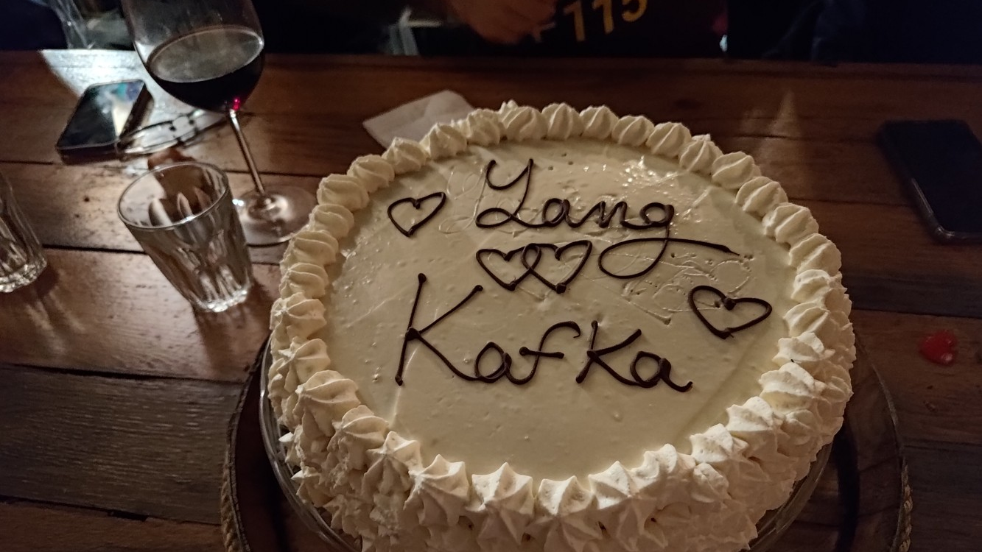

Slide 25
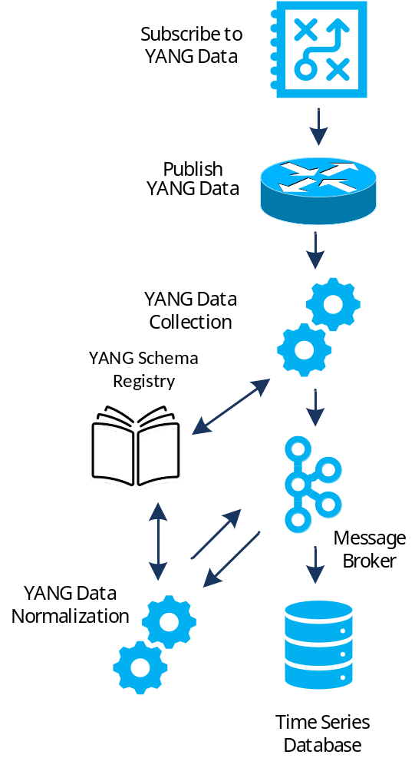

Validate YANG-Push to Message Broker End-To-End Data Processing Chain
IETF 126 Hackathon, July 18/19th 2026
NMOP & NETCONF WG

Slide 26
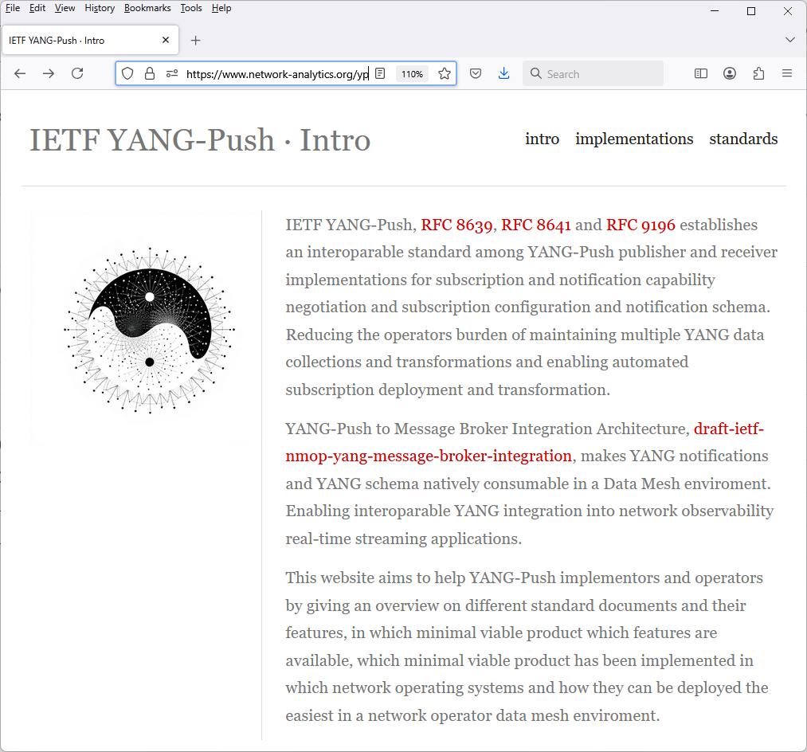
Hackathon Plan, Software and Website
Test Plan
Validate and verify
5 YANG-Push Publishers
2 YANG-Push Receivers
2 YANG-Push Network Telemetry Message
1 YANG Message Broker Producer and Schema Registry
3 YANG Message Broker Consumers
implementation in YANG data integration automation. Subscribe to YANG
data on YANG-Publisher, obtain and register all YANG modules necessary
to build YANG schema tree, register YANG schemas to Schema Registry
and verify YANG notifications against scheme trees and produce and
consume from Message Broker.
Software
YANG-Push Publisher - Cisco IOS XR, 6WIND VSR, Huawei NE (Router),MA (OLT), Arrcus Arcos and Ductus DMAP
YANG-Push Receiver – NetGauze™ and Pmacct
YANG Message Broker Producer – NetGauze™
YANG Message Broker Consumer – NetGauze™, Ciena Blue Planet UAA Workflow Engine, Cisco Crosswork Ingestion Service
YANG Schema Registry – Apache Kafka YANG Plugin
Libyang - https://github.com/CESNET/libyang/releases/tag/v5.4.9
Yangkit - https://github.com/yang-central/yangkit/
Wireshark - udp-notif dissector
NMOP & NETCONF WG
https://www.network-analytics.org/yp/how-to-deploy.html

Slide 27
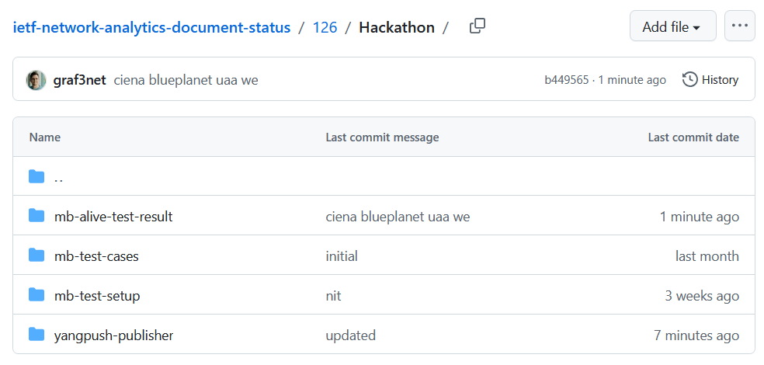
Hackathon – Repositories
The results of the end-to-end tests
Netconf RPCs and YANG-Push JSON and CBOR encoded notifications with wire captures from receiver
YANG-Push Receiver cache content generation with YANG library context, YANG modules, metadata and notification schema validation logs
YANG Message Broker Producer serialization logs
YANG Schema Registry schema examples
YANG Message Broker Consumer, serialization logs, YANG library context, YANG modules and message schema validation
NMOP & NETCONF WG
https://github.com/network-analytics/ietf-network-analytics-document-status/tree/main/126/Hackathon/

Slide 28
An Architecture for YANG-Push to Message Broker Integration draft-ietf-nmop-yang-message-broker-integration draft-ietf-nmop-message-broker-telemetry-message draft-ietf-nmop-yang-message-broker-message-key draft-netana-nmop-message-broker-bmp-telemetry-message
+------------------------------------------------------------+
| Data Storage |
+------------------------------------------------------------+
^
| (12) Ingest Data
| According to Schema
+------------------------------------------------------------+
| Data Consumer |
+------------------------------------------------------------+
| ^ ^
(10) Get | | | (9) Validate
Schema | | | Serialized Message
| | | Schema on Consumer
| | +--------------------+
| | | Message |
| | | Broker |
| | +--------------------+
| | ^
| | | (8) Serialize
| | (11) Issue | YANG-Push Message
| | Schema | annotated Schema
v | (6) Post | ID on Producer
+--------------------+ Schema +--------------------+
| YANG | <--------------- | Data Collection |
| Schema Registry | ---------------> | YANG-Push Receiver |
+--------------------+ (7) Issue +--------------------+
| Schema ID | ^ (3) Receive
| | | YANG-Push
v (4) Discover | | Subscription
+--------------------+ Schema | | Start Message
| Stream | Dependencies | | ^
| Catalog | and Obtain | | | (5) Publish
+--------------------+ Schemas | | | YANG-Push
| | | Message
| | | with
(1) Discover | | | Subscriber
Notification v | | ID
+--------------------+ Capabilities +--------------------+
| Manage YANG-Push | ---------------> | Network Node |
| Subscription | ---------------> | YANG-Push Publisher|
+--------------------+ (2) Subscribe +--------------------+
Subscription to YANG Notifications
RFC 8639
Subscription to YANG Notifications for Datastore Updates
RFC 8641
UDP-based Transport for Configured Subscriptions
draft-ietf-netconf-udp-notif
Subscription to Distributed Notifications
draft-ietf-netconf-distributed-notif
Extensible YANG Model for YANG-Push Notifications
draft-ietf-netconf-notif-envelope
Support of Versioning in YANG Notifications Subscription
draft-ietf-netconf-yang-notifications-versioning
YANG Modules Describing Capabilities for Systems and
Datastore Update Notifications
RFC 9196
YANG Notification Transport Capabilities
draft-ietf-netconf-yp-transport-capabilities
YANG Library
RFC 8525
Augmented-by Addition into the IETF-YANG-Library
draft-ietf-netconf-yang-library-augmentation
Validating anydata in YANG Library context
draft-netana-nmop-yang-anydata-validation
Encoding of Data Modeled with YANG in the CBOR
RFC 9254
NMOP & NETCONF WG

Slide 29
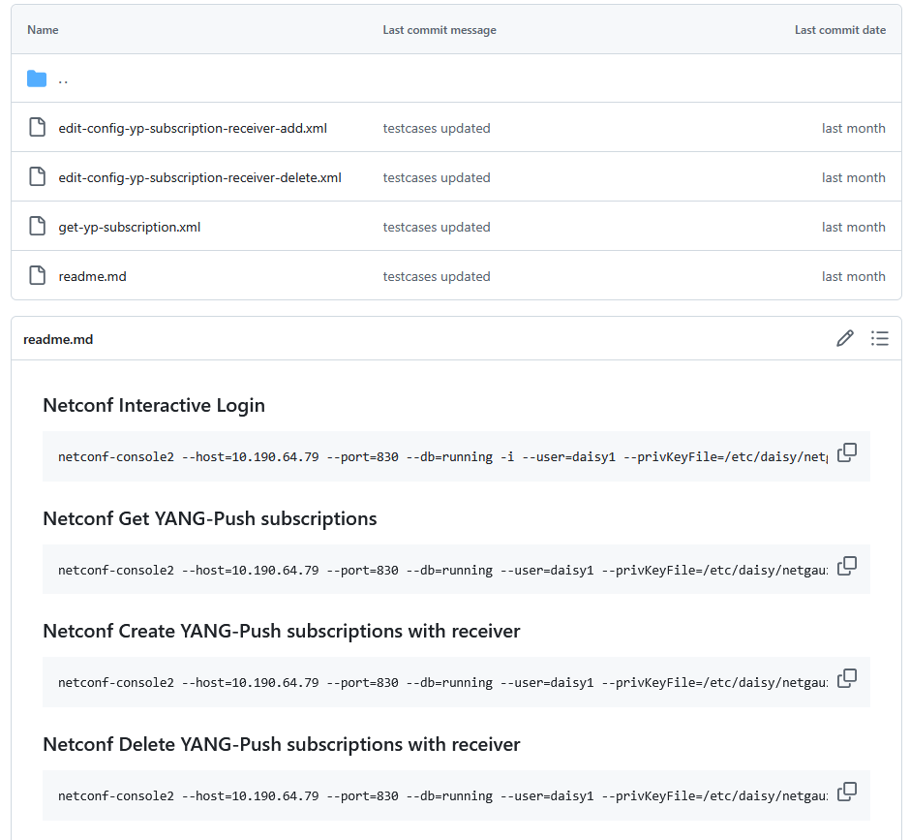
YANG-Push Publisher - Subscription
Netconf RPC calls to create, delete and obtain YANG-Push subscriptions and receiver configurations.
NMOP & NETCONF WG

Slide 30
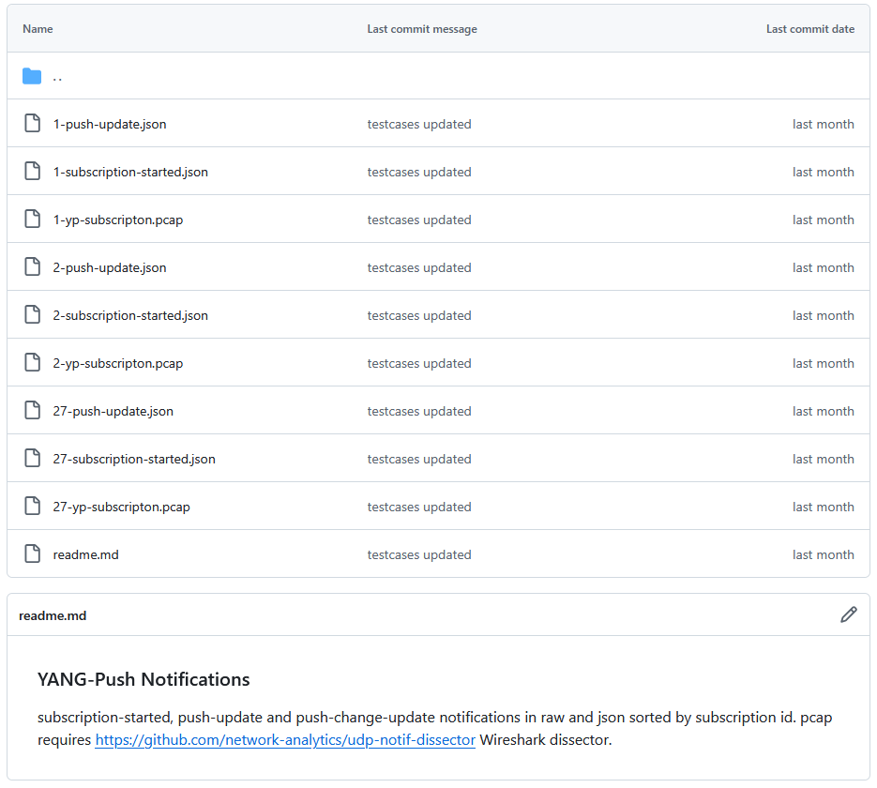
YANG-Push Publisher - Notifications
Subscription state change notifications as JSON and PCAP.
Push update and change-update notifications as JSON and PCAP.
NMOP & NETCONF WG

Slide 31
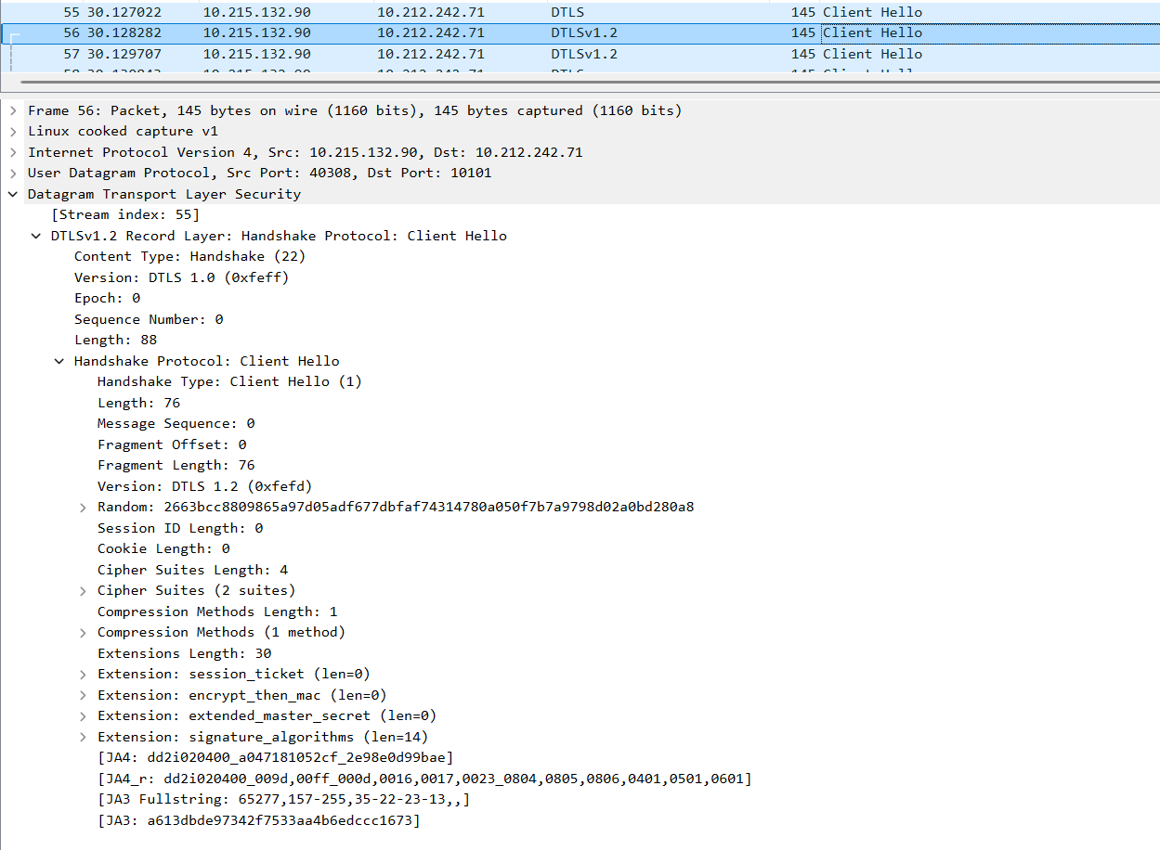
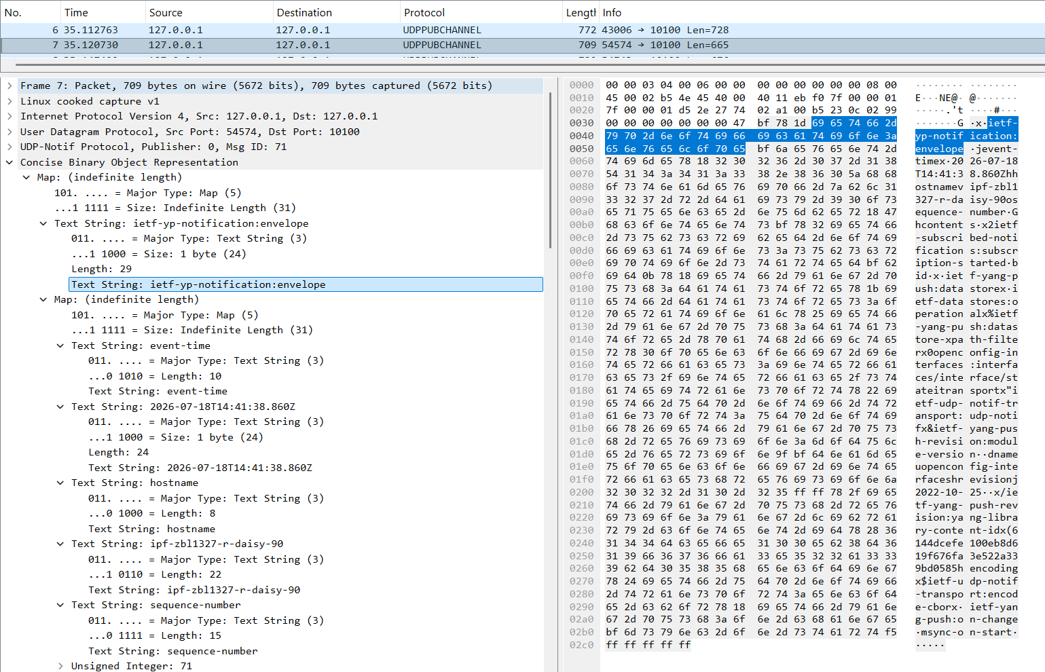
YANG-Push UDP-Notif – DTLS and CBOR
With Cisco IOS XR, 6Wind VSR and Arrcus Arcos we have now three implementations supporting CBOR Name Identifiers
With Cisco IOS XR we have the first implementation supporting DTLS 1.2 in UDP-Notif.
NMOP & NETCONF WG

Slide 32
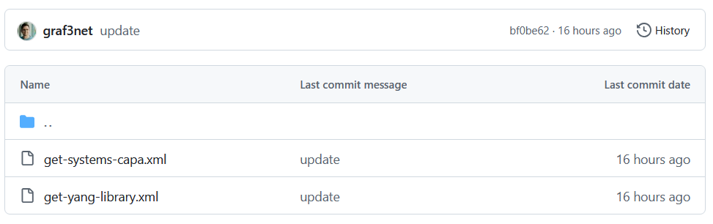
YANG-Push Capabilities & YANG Library - RPC
Netconf XML encoded reply for RFC 9196 YANG-Push capabilities.
Netconf XML encoded reply for RFC 8525 with draft-ietf-netconf-yang-library-augmentedby.
NMOP & NETCONF WG

Slide 33

YANG-Push
IETF 126 Publisher Implementation Status
 | 6WIND VSR | Huawei NE | Huawei MA | Cisco IOS XR | Arrcus Arcos | Open-Source | Ductus DMAP
RFC 8639 YANG-Push Subscription | ✔ | ✔ | ✔ | ✔ | ✔ |  | ✔
RFC 8641 YANG-Push Notification | ✔ | ✔ | ✔ | ✔ | ✔ |  | ✔
draft-ietf-netconf-udp-notif | ✔ | ✔ | ✔ | ✔ | ✔ | ✔
draft-ietf-netconf-udp-notif with DTLS |  |  |  | ✔
draft-ietf-netconf-distributed-notif | ✔ | ✔ | ✔ |  | na
draft-ietf-netconf-notif-envelope | ✔ | ✔ | ✔ | ✔ | ✔ |  | P
draft-ietf-netconf-yang-notifications-versioning | ✔ | ✔ | ✔ | ✔ | ✔
RFC 8525 YANG Library | ✔ | ✔ | ✔ | ✔ | ✔ |  | ✔
draft-ietf-netconf-yang-library-augmentation | ✔ | ✔ | ✔ | ✔ |  | ✔ | ✔
RFC 9196 System and Notification Capabilities |  |  | ✔ | P | ✔ |  | ✔
draft-netana-netconf-yp-transport-capabilities |  |  | ✔ | ✔ | ✔
RFC 9254 CBOR Named Identifiers | ✔ |  |  | ✔ | ✔
NMOP & NETCONF WG
Green marked describes new capability at IETF 126. "P" to partially implemented.

Slide 34
Operational IETF/IEEE YANG
IETF 126 Module Implementation Status
 | 6WIND VSR | Huawei NE | Huawei MA | Cisco IOS XR | Arrcus Arcos
ietf-interfaces.yang (inventory, state and statistic) | ✔ | ✔ | ✔
ietf-hardware.yang (inventory, state and statistic) | ✔ | ✔ | ✔
ietf-alarms.yang (state) | ✔ | ✔ | ✔
ieee802-dot1ab-lldp.yang (inventory and state) | ✔ | ✔
ieee802-dot1ax.yang (inventory, state and statistic)
ietf-bfd-ip-sh.yang (state)
ietf-bfd-ip-mh.yang (state)
ietf-bfd-lag.yang (state)
ietf-isis.yang (state)
NMOP & NETCONF WG
Green marked describes new capability at IETF 126. "P" to partially implemented.

Slide 35

YANG Message Broker
IETF 126 Implementation Status
 | NetGauze™ | Pmacct | Apache Kafka | Ciena Blueplanet | Cisco Crosswork
draft-ietf-nmop-message-broker-telemetry-message | ✔ | ✔
YANG-Push Receiver | ✔ | ✔
YANG Schema Retrieval | ✔
YANG Message Broker Producer | ✔
YANG Schema Registry | na | na | ✔ | na | na
YANG Message Broker Consumer | ✔ |  |  | ✔ | ✔
Validate Telemetry Message against YANG Schema | ✔ |  |  | P | P
draft-ietf-netmod-yang-anydata-validation | ✔
YANG Schema Comparison | na | na | ✔ | na | na
NMOP & NETCONF WG
Green marked describes new capability at IETF 126. "P" to partially implemented.

Slide 36
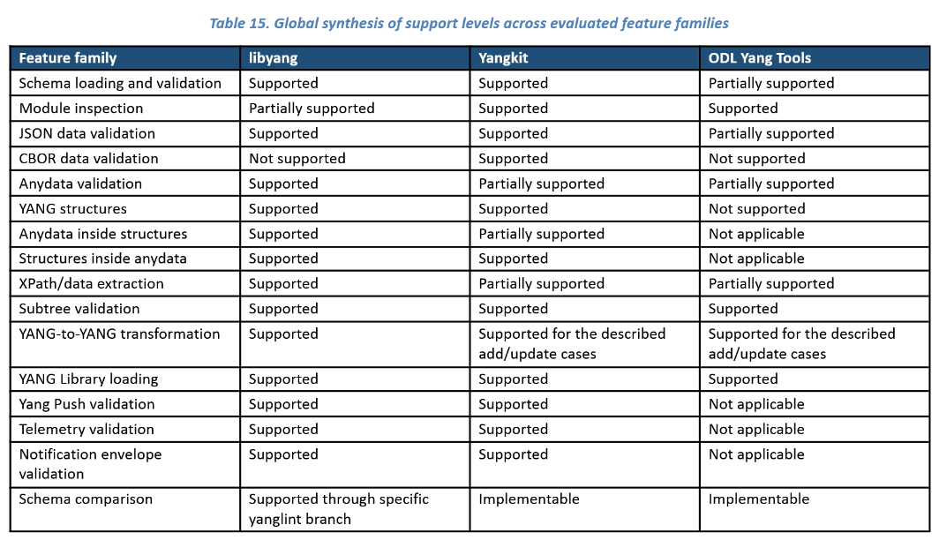
YANG Library Feature Comparison
An extensive YANG feature comparison between the different YANG library open-source implementations.
Focuses on YANG features needed to validate YANG instance data against YANG schema and performing YANG to YANG transformations.
NMOP & NETCONF WG
https://github.com/network-analytics/yang_tests/blob/master/report_v2.pdf

Slide 37

Next Steps from IETF 125 Hackathon…
Re-do YANG Message Broker Consumer tests on updated testbed with Ciena Blue Planet UAA Workflow Engine
Complete IETF YANG module subscription tests with 6Wind VSR
Compare YANG feature coverage between libyang, yangkit and yangtools
Revert import only modules for augmented-by workaround
Preserve cached YANG-Push subscription state across receiver reload
Obtain YANG-Push subscription state from publisher if missing
Support Netconf session queuing for schema retrieval
Support libyang 5.4.9 in YANG-Push Receiver and Message Broker Consumer
Message Key and Topic Name proof of concept
NMOP & NETCONF WG

Slide 38
Next Steps for IETF 127 Hackathon…
Support building RFC 8525 YANG Library in Java Message Broker Consumer
Support draft-netana-nmop-yang-anydata-validation and RFC 8525 YANG library in yangkit
Support YANG-Push Message Broker Topic Naming with dynamic Apache Kafka topic creation API
NMOP & NETCONF WG

Slide 39
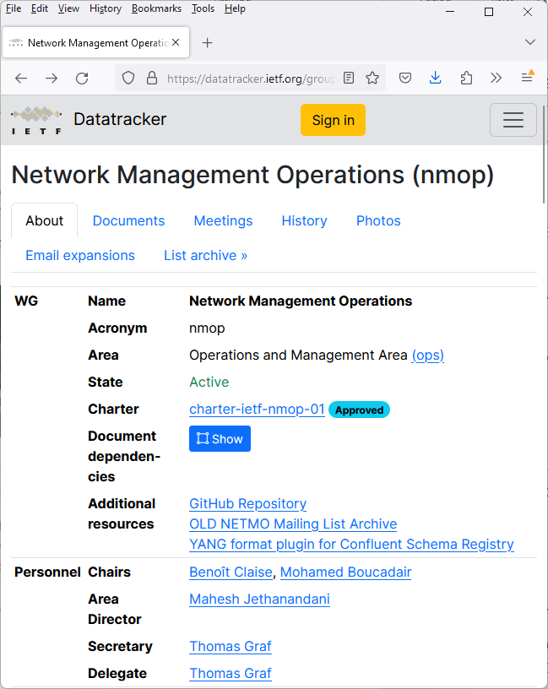
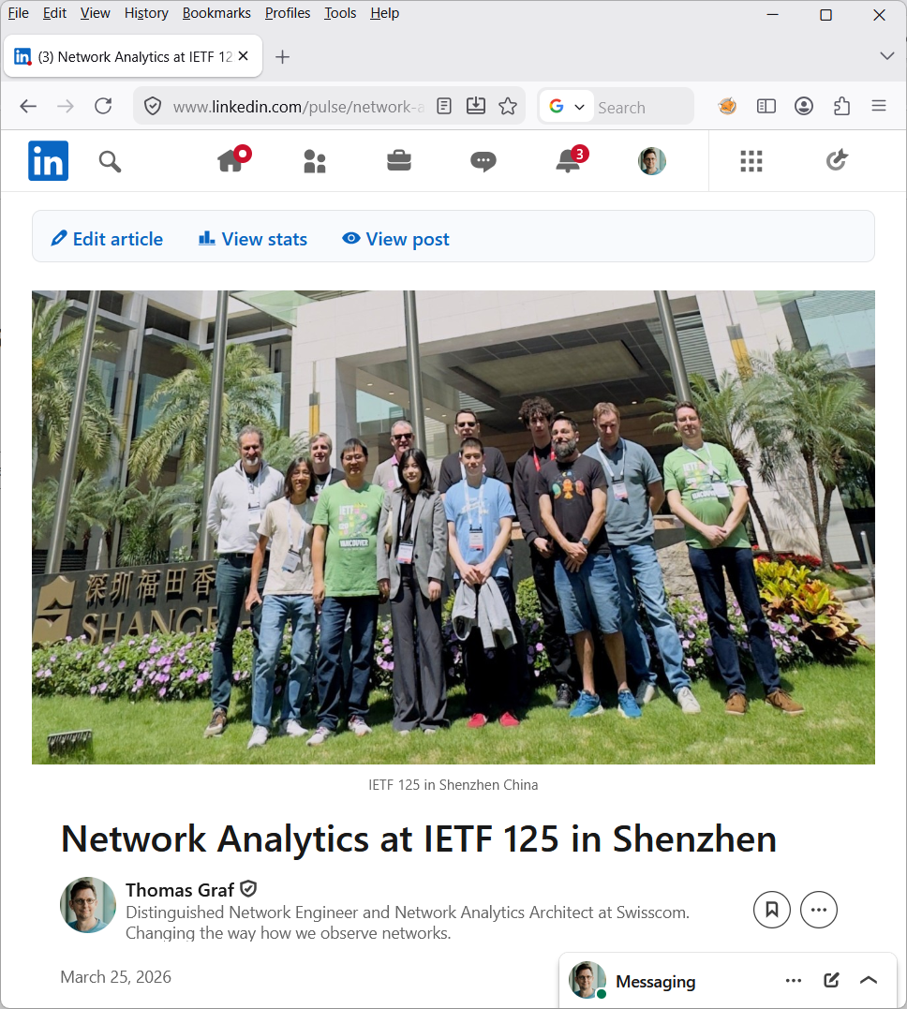
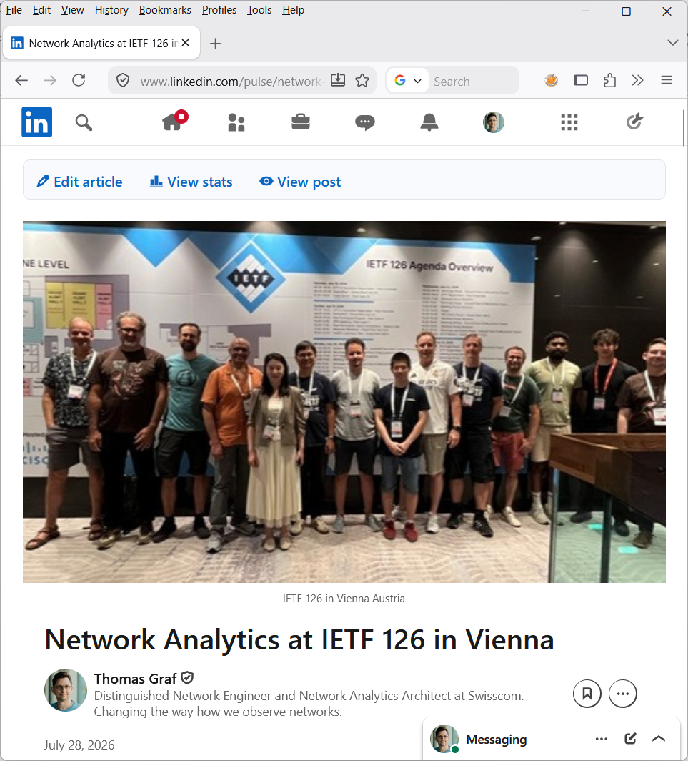
IETF NMOP 125/126 – Network Observability Development
Network Anomaly Detection and YANG-Push/Message Broker Integration
https://datatracker.ietf.org/group/nmop/about/
https://www.linkedin.com/pulse/network-analytics-ietf-125-shenzhen-thomas-graf-svmee/.
https://www.linkedin.com/pulse/network-analytics-ietf-126-vienna-thomas-graf-vng8f/

Slide 40
RFC 8343 – ietf-interfaces.yang vs. openconfig-interfaces.yang
YANG Data Model for Interface Management
module: ietf-interfaces
+--rw interfaces
+--rw interface* [name]
+--rw name string
+--rw description? string
+--rw type identityref
+--rw enabled? boolean
+--rw link-up-down-trap-enable? enumeration {if-mib}?
+--ro admin-status enumeration {if-mib}?
+--ro oper-status enumeration
+--ro last-change? yang:date-and-time
+--ro if-index int32 {if-mib}?
+--ro phys-address? yang:phys-address
+--ro higher-layer-if* interface-ref
+--ro lower-layer-if* interface-ref
+--ro speed? yang:gauge64
+--ro statistics
+--ro discontinuity-time yang:date-and-time
+--ro in-octets? yang:counter64
+--ro in-unicast-pkts? yang:counter64
+--ro in-broadcast-pkts? yang:counter64
+--ro in-multicast-pkts? yang:counter64
+--ro in-discards? yang:counter32
+--ro in-errors? yang:counter32
+--ro in-unknown-protos? yang:counter32
+--ro out-octets? yang:counter64
+--ro out-unicast-pkts? yang:counter64
+--ro out-broadcast-pkts? yang:counter64
+--ro out-multicast-pkts? yang:counter64
+--ro out-discards? yang:counter32
+--ro out-errors? yang:counter32
module: openconfig-interfaces
+--rw interfaces
+--rw interface* [name]
+--rw subinterfaces
+--rw subinterface* [index]
+--rw index -> ../config/index
+--rw config
| +--rw index? uint32
| +--rw description? string
| +--rw enabled? boolean
+--ro state
+--ro index? uint32
+--ro description? string
+--ro enabled? boolean
+--ro name? string
+--ro ifindex? uint32
+--ro admin-status enumeration
+--ro oper-status enumeration
+--ro last-change? oc-types:timeticks64
+--ro logical? boolean
+--ro management? boolean
+--ro cpu? boolean
+--ro counters
+--ro in-octets? oc-yang:counter64
+--ro in-pkts? oc-yang:counter64
+--ro in-unicast-pkts? oc-yang:counter64
+--ro in-broadcast-pkts? oc-yang:counter64
+--ro in-multicast-pkts? oc-yang:counter64
+--ro in-discards? oc-yang:counter64
+--ro in-errors? oc-yang:counter64
+--ro in-unknown-protos? oc-yang:counter64
+--ro in-fcs-errors? oc-yang:counter64
+--ro out-octets? oc-yang:counter64
+--ro out-pkts? oc-yang:counter64
+--ro out-unicast-pkts? oc-yang:counter64
+--ro out-broadcast-pkts? oc-yang:counter64
+--ro out-multicast-pkts? oc-yang:counter64
+--ro out-discards? oc-yang:counter64
+--ro out-errors? oc-yang:counter64
module: openconfig-interfaces
+--rw interfaces
+--rw interface* [name]
+--rw name -> ../config/name
+--rw config
| +--rw name? string
| +--rw type identityref
| +--rw mtu? uint16
| +--rw loopback-mode? oc-opt-types:loopback-mode-type
| +--rw description? string
| +--rw enabled? boolean
+--ro state
| +--ro name? string
| +--ro type identityref
| +--ro mtu? uint16
| +--ro loopback-mode? oc-opt-types:loopback-mode-type
| +--ro description? string
| +--ro enabled? boolean
| +--ro ifindex? uint32
| +--ro admin-status enumeration
| +--ro oper-status enumeration
| +--ro last-change? oc-types:timeticks64
| +--ro logical? boolean
| +--ro management? boolean
| +--ro cpu? boolean
| +--ro counters
| +--ro in-octets? oc-yang:counter64
| +--ro in-pkts? oc-yang:counter64
| +--ro in-unicast-pkts? oc-yang:counter64
| +--ro in-broadcast-pkts? oc-yang:counter64
| +--ro in-multicast-pkts? oc-yang:counter64
| +--ro in-discards? oc-yang:counter64
| +--ro in-errors? oc-yang:counter64
| +--ro in-unknown-protos? oc-yang:counter64
| +--ro in-fcs-errors? oc-yang:counter64
| +--ro out-octets? oc-yang:counter64
| +--ro out-pkts? oc-yang:counter64
| +--ro out-unicast-pkts? oc-yang:counter64
| +--ro out-broadcast-pkts? oc-yang:counter64
| +--ro out-multicast-pkts? oc-yang:counter64
| +--ro out-discards? oc-yang:counter64
| +--ro out-errors? oc-yang:counter64

Slide 41
RFC 8348 – ietf-hardware.yang vs. openconfig-platform.yang
YANG Data Model for Hardware Management
module: openconfig-platform
+--rw components
+--rw component* [name]
+--rw name -> ../config/name
+--rw config
| +--rw name? string
+--ro state
| +--ro name? string
| +--ro type? union
| x--ro id? string
| x--ro location? string
| +--ro install-position? string
| +--ro install-component? -> ../name
| +--ro description? string
| +--ro mfg-name? string
| +--ro mfg-date? oc-yang:date
| +--ro hardware-version? string
| +--ro firmware-version? string
| +--ro software-version? string
| +--ro serial-no? string
| +--ro part-no? string
| +--ro model-name string
| +--ro clei-code? string
| +--ro removable? boolean
| +--ro oper-status? identityref
| +--ro empty? boolean
| +--ro parent? -> ../../../component/config/name
| +--ro redundant-role? oc-platform-types:component-redundant-role
| +--ro last-poweroff-reason
| | +--ro trigger? component-last-poweroff-reason-trigger
| | +--ro details? string
| +--ro last-poweroff-time? oc-types:timeticks64
| +--ro last-switchover-reason
| | +--ro trigger? component-redundant-role-switchover-reason-trigger
| | +--ro details? string
| +--ro last-switchover-time? oc-types:timeticks64
| +--ro last-reboot-reason? identityref
| x--ro last-reboot-time? oc-types:timeticks64
| +--ro boot-time? oc-types:timeticks64
| +--ro switchover-ready? boolean
| +--ro base-mac-address? oc-yang:mac-address
| +--ro temperature
| | +--ro instant? decimal64
| | +--ro avg? decimal64
| | +--ro min? decimal64
| | +--ro max? decimal64
| | +--ro alarm-status? boolean
| | +--ro alarm-threshold? uint32
| | +--ro alarm-severity? identityref
| +--ro memory
| | +--ro available? uint64
| | +--ro utilized? uint64
| +--ro allocated-power? uint32
| +--ro used-power? Uint32
+--rw chassis
| +--rw config
| +--ro state
| +--rw utilization
| +--rw resources
| +--rw resource* [name]
| +--rw name -> ../config/name
| +--rw config
| | +--rw name? string
| | +--rw used-threshold-upper? oc-types:percentage
| | +--rw used-threshold-upper-clear? oc-types:percentage
| +--ro state
| +--ro name? string
| +--ro used-threshold-upper? oc-types:percentage
| +--ro used-threshold-upper-clear? oc-types:percentage
| +--ro used? uint64
| +--ro committed? uint64
| +--ro free? uint64
| +--ro max-limit? uint64
| +--ro high-watermark? uint64
| +--ro last-high-watermark? oc-types:timeticks64
| +--ro used-threshold-upper-exceeded? boolean
+--rw power-supply
| +--rw config
| +--ro state
+--rw fan
| +--rw config
| +--ro state
| +--ro oc-fan:speed? uint32
+--rw fabric
| +--rw config
| +--ro state
+--rw storage
| +--rw config
| +--ro state
+--rw cpu
| +--rw config
| +--ro state
| +--rw oc-cpu:utilization
| +--ro oc-cpu:state
+--rw integrated-circuit
| +--rw config
| +--ro state
| +--rw utilization
| +--rw resources
| +--rw resource* [name]
| +--rw name -> ../config/name
| +--rw config
| | +--rw name? string
| | +--rw used-threshold-upper? oc-types:percentage
| | +--rw used-threshold-upper-clear? oc-types:percentage
| +--ro state
| +--ro name? string
| +--ro used-threshold-upper? oc-types:percentage
| +--ro used-threshold-upper-clear? oc-types:percentage
| +--ro used? uint64
| +--ro committed? uint64
| +--ro free? uint64
| +--ro max-limit? uint64
| +--ro high-watermark? uint64
| +--ro last-high-watermark? oc-types:timeticks64
| +--ro used-threshold-upper-exceeded? boolean
+--rw oc-transceiver:transceiver
| +--rw oc-transceiver:config
| | +--rw oc-transceiver:enabled? boolean
| | +--rw oc-transceiver:form-factor-preconf? identityref
| | +--rw oc-transceiver:ethernet-pmd-preconf? identityref
| | +--rw oc-transceiver:fec-mode? identityref
| | +--rw oc-transceiver:module-functional-type? identityref
| +--ro oc-transceiver:state
| | +--ro oc-transceiver:enabled? boolean
| | +--ro oc-transceiver:form-factor-preconf? identityref
| | +--ro oc-transceiver:ethernet-pmd-preconf? identityref
| | +--ro oc-transceiver:fec-mode? identityref
| | +--ro oc-transceiver:module-functional-type? identityref
| | +--ro oc-transceiver:present? enumeration
| | +--ro oc-transceiver:form-factor? identityref
| | +--ro oc-transceiver:connector-type? identityref
| | +--ro oc-transceiver:vendor? string
| | +--ro oc-transceiver:vendor-part? string
| | +--ro oc-transceiver:vendor-rev? string
| | +--ro oc-transceiver:ethernet-pmd? identityref
| | +--ro oc-transceiver:sonet-sdh-compliance-code? identityref
| | +--ro oc-transceiver:otn-compliance-code? identityref
| | +--ro oc-transceiver:serial-no? string
| | +--ro oc-transceiver:date-code? oc-yang:date-and-time
| | +--ro oc-transceiver:fault-condition? boolean
| | +--ro oc-transceiver:fec-status? identityref
| | +--ro oc-transceiver:fec-uncorrectable-blocks? yang:counter64
| | +--ro oc-transceiver:fec-uncorrectable-words? yang:counter64
| | +--ro oc-transceiver:fec-corrected-bytes? yang:counter64
| | +--ro oc-transceiver:fec-corrected-bits? yang:counter64
module: ietf-hardware
+--rw hardware
+--ro last-change? yang:date-and-time
+--rw component* [name]
+--rw name string
+--rw class identityref
+--ro physical-index? int32 {entity-mib}?
+--ro description? string
+--rw parent? -> ../../component/name
+--rw parent-rel-pos? int32
+--ro contains-child* -> ../../component/name
+--ro hardware-rev? string
+--ro firmware-rev? string
+--ro software-rev? string
+--ro serial-num? string
+--ro mfg-name? string
+--ro model-name? string
+--rw alias? string
+--rw asset-id? string
+--ro is-fru? boolean
+--ro mfg-date? yang:date-and-time
+--rw uri* inet:uri
+--ro uuid? yang:uuid
+--rw state {hardware-state}?
| +--ro state-last-changed? yang:date-and-time
| +--rw admin-state? admin-state
| +--ro oper-state? oper-state
| +--ro usage-state? usage-state
| +--ro alarm-state? alarm-state
| +--ro standby-state? standby-state
+--ro sensor-data {hardware-sensor}?
+--ro value? sensor-value
+--ro value-type? sensor-value-type
+--ro value-scale? sensor-value-scale
+--ro value-precision? sensor-value-precision
+--ro oper-status? sensor-status
+--ro units-display? string
+--ro value-timestamp? yang:date-and-time
+--ro value-update-rate? uint32

Slide 42
RFC 8632/8348 – ietf-alarms/ietf-hardware.yang vs openconfig-alarms.yang
YANG Data Model for Alarm Management
notifications:
+---n hardware-state-change
+---n hardware-state-oper-enabled {hardware-state}?
| +--ro name? -> /hardware/component/name
| +--ro admin-state? -> /hardware/component/state/admin-state
| +--ro alarm-state? -> /hardware/component/state/alarm-state
+---n hardware-state-oper-disabled {hardware-state}?
+--ro name? -> /hardware/component/name
+--ro admin-state? -> /hardware/component/state/admin-state
+--ro alarm-state? -> /hardware/component/state/alarm-state
module: openconfig-platform
+--rw components
+--rw component* [name]
+--rw name -> ../config/name
+--rw config
| +--rw name? string
+--ro state
| +--ro oc-alarms:equipment-failure? boolean
| +--ro oc-alarms:equipment-mismatch? boolean
notifications:
+---n alarm-notification
| +--ro resource resource
| +--ro alarm-type-id alarm-type-id
| +--ro alarm-type-qualifier? alarm-type-qualifier
| +--ro alt-resource* resource
| +--ro related-alarm* [resource alarm-type-id alarm-type-qualifier] {alarm-correlation}?
| | +--ro resource -> /alarms/alarm-list/alarm/resource
| | +--ro alarm-type-id -> /alarms/alarm-list/alarm[resource=current()/../resource]/alarm-type-id
| | +--ro alarm-type-qualifier -> /alarms/alarm-list/alarm[resource=current()/../resource][alarm-type-id=current()/../alarm-type-id]/alarm-type-qualifier
| +--ro impacted-resource* resource {service-impact-analysis}?
| +--ro root-cause-resource* resource {root-cause-analysis}?
| +--ro time yang:date-and-time
| +--ro perceived-severity severity-with-clear
| +--ro alarm-text alarm-text
+---n alarm-inventory-changed

Slide 43
IEEE LLDP – ieee802-dot1ab-lldp.yang vs. openconfig-lldp.yang
YANG Data Model for LLDP Neighbor Discovery
module: ieee802-dot1ab-lldp
+--rw lldp
+--ro local-system-data
| +--ro chassis-id-subtype? ieee:chassis-id-subtype-type
| +--ro chassis-id? ieee:chassis-id-type
| +--ro system-name? string
| +--ro system-description? string
| +--ro system-capabilities-supported? lldp-types:system-capabilities-map
| +--ro system-capabilities-enabled? lldp-types:system-capabilities-map
+--rw port* [name dest-mac-address]
+--rw name if:interface-ref
+--rw dest-mac-address ieee:mac-address
+--ro port-id? ieee:port-id-type
+--ro remote-systems-data* [time-mark remote-index]
+--ro time-mark yang:timeticks
+--ro remote-index uint32
+--ro remote-too-many-neighbors? boolean
+--ro remote-changes? boolean
+--ro chassis-id-subtype? ieee:chassis-id-subtype-type
+--ro chassis-id? ieee:chassis-id-type
+--ro port-id-subtype? ieee:port-id-subtype-type
+--ro port-id? ieee:port-id-type
+--ro port-desc? string
+--ro system-name? string
+--ro system-description? string
+--ro system-capabilities-supported? lldp-types:system-capabilities-map
+--ro system-capabilities-enabled? lldp-types:system-capabilities-map
module: openconfig-lldp
+--rw lldp
+--ro state
| +--ro enabled? boolean
| +--ro hello-timer? uint64
| +--ro suppress-tlv-advertisement* identityref
| +--ro system-name? string
| +--ro system-description? string
| +--ro chassis-id? string
| +--ro chassis-id-type? oc-lldp-types:chassis-id-type
+--rw interfaces
+--rw interface* [name]
+--rw name -> ../config/name
+--ro state
| +--ro name? oc-if:base-interface-ref
| +--ro enabled? boolean
+--ro neighbors
+--ro neighbor* [id]
+--ro id -> ../state/id
+--ro state
| +--ro system-name? string
| +--ro system-description? string
| +--ro chassis-id? string
| +--ro chassis-id-type? oc-lldp-types:chassis-id-type
| +--ro id? string
| +--ro age? uint64
| +--ro last-update? int64
| +--ro ttl? uint16
| +--ro port-id? string
| +--ro port-id-type? oc-lldp-types:port-id-type
| +--ro port-description? string
| +--ro management-address? string
| +--ro management-address-type? string

Slide 44
IEEE dot1ax – ieee802-dot1ax.yang vs. openconfig-lacp.yang
YANG Data Model for LAG Interface Management
module: ieee802-dot1ax
+--rw lag-system
+--rw aggregating-system* [agg-system]
+--rw agg-system string
+--rw system-id? ieee:mac-address
+--rw system-priority? uint32
augment /if:interfaces/if:interface:
+--rw aggregator
+--rw name? string
+--rw agg-system-name? string
+--rw admin-state? enumeration
+--rw link-up-down-notification? enumeration
+--rw collector-max-delay? int16
+--rw aggregator-lacp
+--rw actor-admin-key? int16
augment /if:interfaces/if:interface:
+--rw aggregation-port
+--rw aggregation-port-lacp
+--rw actor-system-priority? int16
+--rw actor-admin-key? int16
+--rw partner-admin-system-priority? int16
+--rw partner-admin-system-id? ieee:mac-address
+--rw partner-admin-key? int16
+--rw actor-port-priority? int16
+--rw partner-admin-port? int16
+--rw partner-admin-port-priority? int16
+--rw actor-admin-state? bits
+--rw partner-admin-state? bits
module: openconfig-lacp
+--rw lacp
+--ro state
| +--ro system-priority? uint16
+--rw interfaces
+--rw interface* [name]
+--rw name -> ../config/name
+--ro state
| +--ro name? oc-if:base-interface-ref
| +--ro interval? lacp-period-type
| +--ro lacp-mode? lacp-activity-type
| +--ro system-id-mac? oc-yang:mac-address
| +--ro system-priority? uint16
+--ro members
+--ro member* [interface]
+--ro interface -> ../state/interface
+--ro state
+--ro interface? oc-if:base-interface-ref
+--ro activity? lacp-activity-type
+--ro timeout? lacp-timeout-type
+--ro synchronization? lacp-synchronization-type
+--ro aggregatable? boolean
+--ro collecting? boolean
+--ro distributing? boolean
+--ro system-id? oc-yang:mac-address
+--ro oper-key? uint16
+--ro partner-id? oc-yang:mac-address
+--ro partner-key? uint16
+--ro port-num? uint16
+--ro partner-port-num? uint16
+--ro last-change? oc-types:timeticks64

Slide 45
RFC 9127 – ietf-bfd.yang vs. openconfig-bfd.yang
YANG Data Model for Bidirectional Forwarding Detection
BFD IP Single-Hop Hierarchy
https://datatracker.ietf.org/doc/html/rfc9127#section-2.6
notifications:
+---n singlehop-notification
+--ro local-discr? discriminator
+--ro remote-discr? discriminator
+--ro new-state? state
+--ro state-change-reason? iana-bfd-types:diagnostic
+--ro time-of-last-state-change? yang:date-and-time
+--ro dest-addr? inet:ip-address
+--ro source-addr? inet:ip-address
+--ro session-index? uint32
+--ro path-type? identityref
+--ro interface? if:interface-ref
+--ro echo-enabled? boolean
BFD-over-LAG Hierarchy
https://datatracker.ietf.org/doc/html/rfc9127#section-2
notifications:
+---n lag-notification
+--ro local-discr? discriminator
+--ro remote-discr? discriminator
+--ro new-state? state
+--ro state-change-reason? iana-bfd-types:diagnostic
+--ro time-of-last-state-change? yang:date-and-time
+--ro dest-addr? inet:ip-address
+--ro source-addr? inet:ip-address
+--ro session-index? uint32
+--ro path-type? identityref
+--ro lag-name? if:interface-ref
+--ro member-link? if:interface-ref
module: openconfig-bfd
+--rw bfd
+--rw interfaces
+--rw interface* [id]
+--rw id -> ../config/id
+--ro state
| +--ro id? string
| +--ro enabled? boolean
| +--ro local-address? oc-inet:ip-address
| +--ro desired-minimum-tx-interval? uint32
| +--ro required-minimum-receive? uint32
| +--ro detection-multiplier? uint8
| +--ro enable-per-member-link? boolean
+--rw interface-ref
| +--ro state
| +--ro interface? -> /oc-if:interfaces/interface/name
| +--ro subinterface? -> /oc-if:interfaces/interface[oc-if:name=current()/../interface]/subinterfaces/subinterface/index
+--rw peers
+--ro peer* [local-discriminator]
+--ro local-discriminator -> ../state/local-discriminator
+--ro state
+--ro local-address? oc-inet:ip-address
+--ro remote-address? oc-inet:ip-address
+--ro subscribed-protocols* identityref
+--ro session-state? bfd-session-state
+--ro remote-session-state? bfd-session-state
+--ro last-failure-time? oc-types:timeticks64
+--ro failure-transitions? uint64
+--ro local-discriminator? string
+--ro remote-discriminator? string
+--ro local-diagnostic-code? bfd-diagnostic-code
+--ro remote-diagnostic-code? bfd-diagnostic-code
+--ro remote-minimum-receive-interval? uint32
+--ro demand-mode-requested? boolean
+--ro remote-authentication-enabled? boolean
+--ro remote-control-plane-independent? boolean

Slide 46
RFC 9130 – ietf-isis.yang vs. openconfig-isis.yang
YANG Data Model for the IS-IS Protocol
notifications:
+---n database-overload
| +--ro routing-protocol-name? -> /rt:routing/
| | control-plane-protocols/
| | control-plane-protocol/name
| +--ro isis-level? level
| +--ro overload? enumeration
+---n if-state-change
| +--ro routing-protocol-name? -> /rt:routing/
| | control-plane-protocols/
| | control-plane-protocol/name
| +--ro isis-level? level
| +--ro interface-name? if:interface-ref
| +--ro interface-level? level
| +--ro extended-circuit-id? extended-circuit-id
| +--ro state? if-state-type
+---n adjacency-state-change
| +--ro routing-protocol-name? -> /rt:routing/
| | control-plane-protocols/
| | control-plane-protocol/name
| +--ro isis-level? level
| +--ro interface-name? if:interface-ref
| +--ro interface-level? level
| +--ro extended-circuit-id? extended-circuit-id
| +--ro neighbor? string
| +--ro neighbor-system-id? system-id
| +--ro state? adj-state-type
| +--ro reason? string
module: openconfig-network-instance
+--rw network-instances
+--rw network-instance* [name]
+--rw name -> ../config/name
+--rw protocols
+--rw protocol* [identifier name]
+--rw isis
| +--rw global
| +--rw interfaces
| +--rw interface* [interface-id]
| +--rw interface-id -> ../config/interface-id
| +--rw levels
| | +--rw level* [level-number]
| | +--rw level-number -> ../config/level-number
| | +--ro adjacencies
| | | +--ro adjacency* [system-id]
| | | +--ro system-id -> ../state/system-id
| | | +--ro state
| | | +--ro system-id? oc-isis-types:system-id
| | | +--ro neighbor-ipv4-address? oc-inet:ipv4-address
| | | +--ro neighbor-ipv6-address? oc-inet:ipv6-address
| | | +--ro neighbor-snpa? oc-isis-types:snpa
| | | +--ro local-extended-circuit-id? oc-isis-types:extended-circuit-id
| | | +--ro neighbor-extended-circuit-id? oc-isis-types:extended-circuit-id
| | | +--ro priority? uint8
| | | +--ro dis-system-id? oc-isis-types:system-id
| | | +--ro neighbor-circuit-type? oc-isis-types:level-type
| | | +--ro adjacency-type? oc-isis-types:level-type
| | | +--ro adjacency-state? oc-isis-types:isis-interface-adj-state
| | | +--ro up-timestamp? oc-types:timeticks64
| | | +--ro multi-topology? boolean
| | | +--ro topology* identityref
| | | +--ro restart-support? boolean
| | | +--ro restart-suppress? boolean
| | | +--ro restart-status? boolean
| | | +--ro area-address* oc-isis-types:area-address
| | | +--ro nlpid* enumeration

