Slide 1
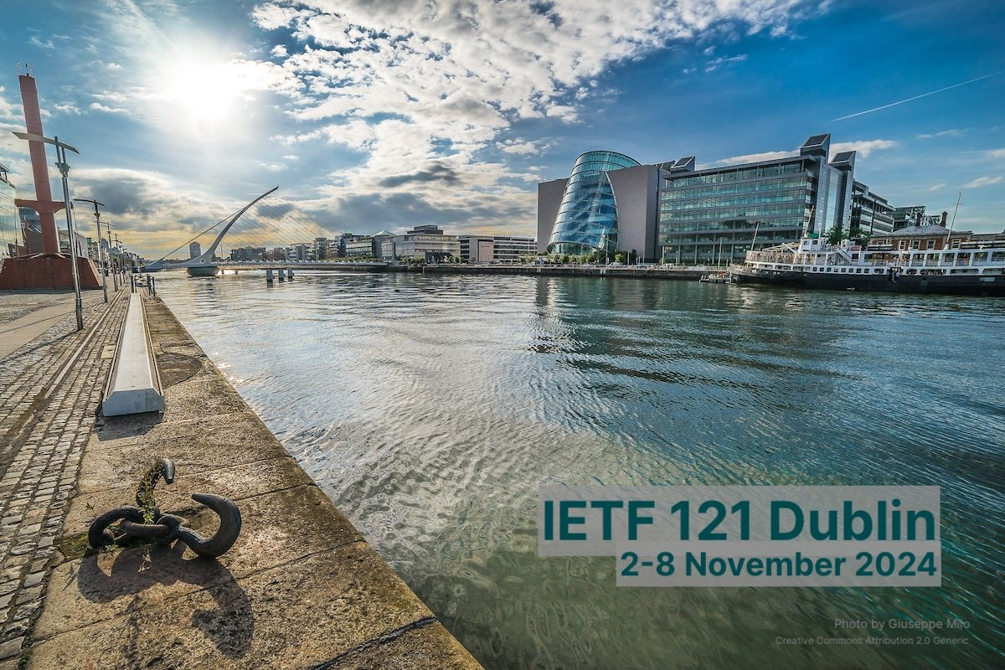
Validate BMP Extension for Path Status TLV GROW WG
BMP Monitoring Station
Frrouting https://github.com/mxyns/frr/commits/bmp-draft-path-marking/
BMP Data Collection
Pmacct https://github.com/pmacct/pmacct
Tools
Wireshark dissector https://www.wireshark.org/download//automated/ https://github.com/network-analytics/wireshark/tree/draft-cppy-grow-bmp-path-marking-tlv
Many thanks to…
Paolo Lucente – Pmacct
Maxence Younsi – INSA Lyon
Yannick Buchs – Swisscom
Thomas Graf – Swisscom

Slide 2

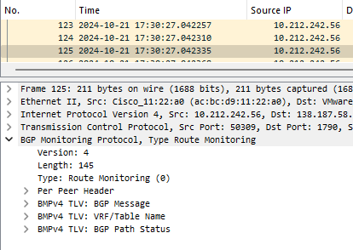
BMP Data Processing Pipeline
Apache Kafka
{
"afi": 1,
"as_path": "4226809912 64496",
"bgp_nexthop": "0.0.0.0",
"bmp_msg_type": "route_monitor",
"bmp_rib_type": "Adj-Rib-In Post-Policy",
"bmp_rm_info_vrf": "67-6C-6F-62-61-6C",
"bmp_router": "10.212.242.56",
"bmp_router_port": 54145,
"event_type": "log",
"ip_prefix": "0.0.0.0/0",
"is_filtered": 0,
"is_in": 1,
"is_post": 1,
"label": {
"nkey": "unknown",
"pkey": "unknown"
},
"log_type": "update",
"origin": "u",
"path_status": [
"Best",
"Primary"
],
"peer_asn": 64496,
"peer_ip": "198.51.100.88",
"peer_tcp_port": 0,
"safi": 1,
"seq": 9,
"timestamp": "1730203302.115060",
"timestamp_arrival": "1730804763.236933",
"writer_id": "taarole8-rocky8 nfacctd_bmp 20241103-1 (3728c746)"
}
BMP Monitoring Station
BMP Data Collection
BMP Packet Capture
Apache Kafka
JSON Message

Slide 3
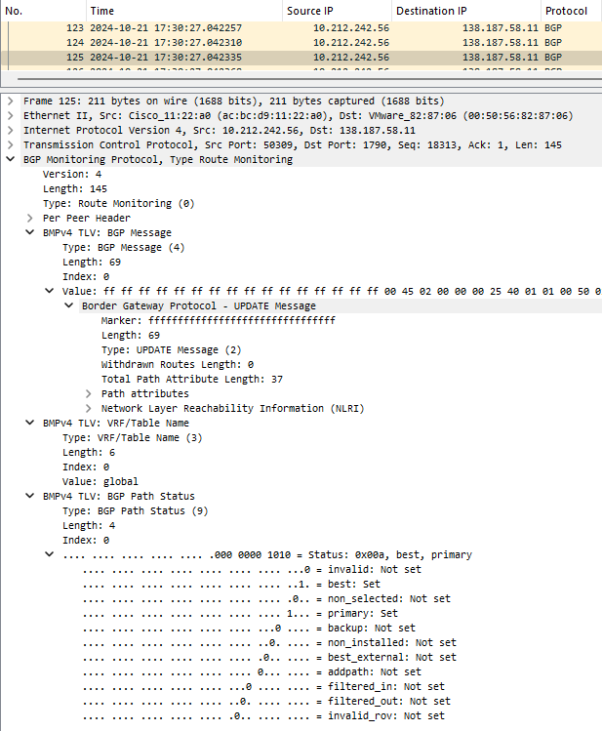
BMPv4 route-monitoring Path Status TLV
BMPv4 Path Status TLV for route-monitoring
{
"afi": 1,
"as_path": "4226809912 64496",
"bgp_nexthop": "0.0.0.0",
"bmp_msg_type": "route_monitor",
"bmp_rib_type": "Adj-Rib-In Post-Policy",
"bmp_rm_info_vrf": "67-6C-6F-62-61-6C",
"bmp_router": "10.212.242.56",
"bmp_router_port": 54145,
"event_type": "log",
"ip_prefix": "0.0.0.0/0",
"is_filtered": 0,
"is_in": 1,
"is_post": 1,
"label": {
"nkey": "unknown",
"pkey": "unknown"
},
"log_type": "update",
"origin": "u",
"path_status": [
"Best",
"Primary"
],
"peer_asn": 64496,
"peer_ip": "198.51.100.88",
"peer_tcp_port": 0,
"safi": 1,
"seq": 9,
"timestamp": "1730203302.115060",
"timestamp_arrival": "1730804763.236933",
"writer_id": "taarole8-rocky8 nfacctd_bmp 20241103-1 (3728c746)"
}

