Slide 1
Export of Gigabit Passive Optical Network Encapsulation Mode in IPFIX draft-netana-opsawg-ipfix-gpon-gem
Enabling data plane visibility in passive optical transport
of the optical distribution network in broadband access
thomas.graf@swisscom.com
zhenghaomian@huawei.com
4. July 2025

Slide 2
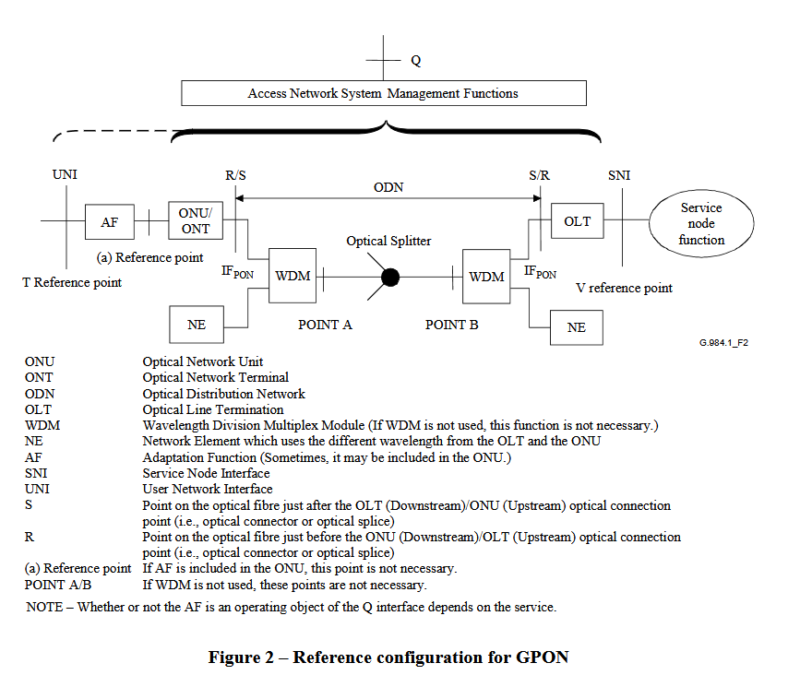
Export of GPON Encapsulation Mode in IPFIX ITU-T G.984.1 defines the General characteristics
ITU-T G.984.1 defines the General characteristics of GPON.
Figure 2 in Section 5.2 shows the Reference Configuration.
Red marked highlights the Optical Distribution Network (ODN) where GPON Encapsulation Mode (GEM) is used between ONU/ONT and OLT.

Slide 3
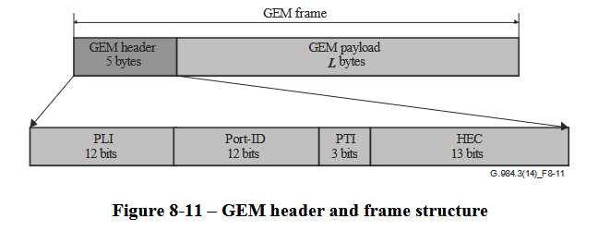
Export of GPON Encapsulation Mode in IPFIX ITU-T G.984.3 defines the transmission convergence layer
ITU-T G.984.3 defines the transmission convergence layer.
Figure 8-11 in Section 8.3.1 shows the GEM header.
The GEM header contains the payload length indicator (PLI), Port-ID, payload type indicator (PTI) and a 13-bit header error control (HEC) field.
Red marked highlights the GEM Port-ID and PTI which is of interest to account frames and bytes in IPFIX [RFC 7011], [RFC 7012] and [RFC 7015].
Payload length indicator (PLI) and header error control (HEC) are for tracing and debugging purposes interesting but not relevant for accounting. Therefore, excluded from IPFIX.

Slide 4
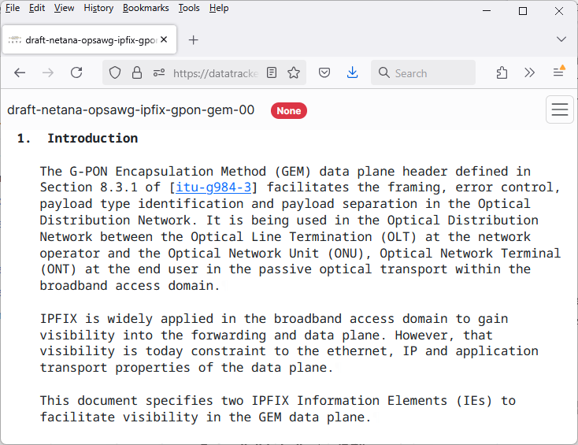
Export of GPON Encapsulation Mode in IPFIX draft-netana-opsawg-ipfix-gpon-gem defines IPFIX entities
5.1.1. gponGemPti
Name: gponGemPti
ElementID: TBD1
Description: Values for this Information Element are listed in the Section 8.3.1 of [itu-g984-3]. "G-PON Encapsulation Method PTI" subregistry, see [IANA-IPFIX].
Abstract Data Type: unsigned8
Data Type Semantics: flags
Range: The valid range is 0-7.
Additional Information: See the assigned types in [IPFIX G-PON content type list. Encapsulation Method PTI Subregistry]. The values encoded in the 3 least significant bits of the IE.
Reference: [RFC-to-be]
5.1.2. gponGemPortId
Name: gponGemPortId
ElementID: TBD2
Description: The 12-bit GEM Port-ID field defined in Section 8.3.1 of [itu-g984-3].
Abstract Data Type: unsigned16
Data Type Semantics: identifier
Additional Information: See Section 8.3.1 of [itu-g984-3] for the content type list.
Reference: [RFC-to-be]

Slide 5
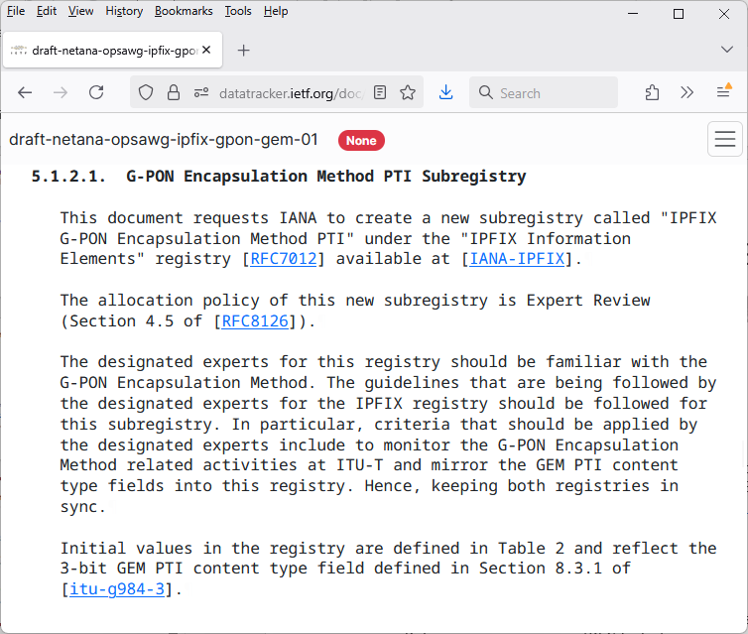
Export of GPON Encapsulation Mode in IPFIX IPFIX G-PON Encapsulation Method PTI Subregistry
Based clarifications with Paul Aitken (IE doctor) and Amanda Baber (IANA), the best approach is to mirror the PTI registry from ITU-T G.984.3 as a IPFIX Subregistry.
+-------+----------------------------------------------------------+
| Value | GEM PTI Content Type Meaning | Additional |
| | | Information |
+-------+----------------------------------------------------------+
| 000 | User data fragment, not the end of a frame | [RFC-to-be] |
+-------+----------------------------------------------------------+
| 001 | User data fragment, end of a frame | [RFC-to-be] |
+-------+----------------------------------------------------------+
| 010 | Reserved | [RFC-to-be] |
+-------+----------------------------------------------------------+
| 011 | Reserved | [RFC-to-be] |
+-------+----------------------------------------------------------+
| 100 | GEM OAM, not the end of a frame | [RFC-to-be] |
+-------+----------------------------------------------------------+
| 101 | GEM OAM, end of a frame | [RFC-to-be] |
+-------+----------------------------------------------------------+
| 110 | Reserved | [RFC-to-be] |
+-------+----------------------------------------------------------+
| 111 | Reserved | [RFC-to-be] |
+-------+----------------------------------------------------------+
Table 2: "IPFIX G-PON Encapsulation Method PTI" Subregistry

Slide 6
Export of GPON Encapsulation Mode in IPFIX Sample Use Case
GEM Port-ID is usually mapped to IEEE 802.1Q into VLAN identifier (VID) and Priority code point (PCP, IEEE 802.1p class of service) which is used for Network Slicing related use cases. Differentiate between different application and their Quality-of-Service properties.
The IPFIX IEs gponGemPti (TBD1) or gponGemPortId (TBD2), sourceMacAddress (56), destinationMacAddress (80), ingressInterface (10), egressInterface (14) and forwardingStatus (89)[RFC5102] [RFC7270] [IANA-IPFIX], and some existing counter information's [IANA-IPFIX] providing answers to the following questions (amongst others):
How many user or OAM frames are forwarded or dropped to which ONU on which egress interface and GEM Port-ID?
If dropped, for which reasons?
The received ONU frames on an OLT are mapped and forwarded depending on GEM Port-ID to a dot1qVlanId (243) and dot1qPriority (244) upstream to the provider network.
ONU ONT
GEM-Port ID 1001
GEM-Port ID 1011
GEM-Port ID 2005
ONU ONT
GEM-Port ID 1001
Optical Splitter
OLT
VLAN 100, CS 1
GEM-Port ID 1011
VLAN 101, CS 1
GEM-Port ID 2005
VLAN 200, CS 5
ONU ONT
GEM-Port ID 1001
GEM-Port ID 1011
GEM-Port ID 2005

Slide 7
Export of GPON Encapsulation Mode in IPFIX Document Status and Next Steps
First document revision published on April 7th 2025 and presented at CCAMP.
Second revision includes review from Paul Aitken and IANA.
Implementation planned on Huawei MA5800T-X17 with IETF hackathon verification.
Request feedback, review and working group adoption from OPSAWG.
Is a ITU-T liaison needed?
thomas.graf@swisscom.com
zhenghaomian@huawei.com
4. July 2025

