Slide 1
Swisscom: Network Incident Network Analytics Postmortem
Describes an incident in terms of what happened, which operational metrics where available, which analytical metrics described the symptoms and what improvements in the network anomaly detection system and network telemetry protocols are proposed.
thomas.graf@swisscom.com
01. March 2025

Slide 2






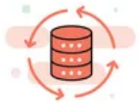

Data Mesh organizes Data in Organizations Enables Network Analytics use cases
Alert
Postmortem
RFC 8632
draft-netana-nmop-network-anomaly-semantics draft-netana-nmop-network-anomaly-lifecycle
Analytical Data draft-netana-nmop-yang-message-broker-integration
Network Device Trend Detection
Verify, Troubleshoot and Notify
Network Anomaly Detection
Network Visualization
Network SLI and SLO
Closed Loop Operation
draft-netana-nmop-network-anomaly-architecture
Operational Data draft-netana-nmop-yang-message-broker-integration
Network Data Collection
Network Telemetry (RFC 9232) IPFIX (RFC 7011, RFC 9487, RFC 9160, draft-ietf-opsawg-ipfix-on-path-telemetry)
BMP (RFC 7854, RFC 8671, RFC 9069, draft-ietf-grow-bmp-tlv, draft-ietf-grow-bmp-path-marking-tlv, draft-lucente-grow-bmp-rel)
YANG-Push (RFC 8639, RFC 8641, draft-ietf-netconf-udp-notif, draft-ietf-netconf-distributed-notif, draft-ahuang-netconf-notif-yang, draft-ietf-netconf-yang-notifications-versioning, draft-tgraf-netconf-notif-sequencing, draft-tgraf-netconf-yang-push-observation-time)

Slide 3
Monitoring L3 VPN's with IPFIX, BMP and YANG Push From Connectivity Service to Realtime Network Analytics
Connectivity Service perspective, Connection Points are connected through Logical Connections.
From a BGP control-plane perspective, IPv4/6 unicast prefixes in VRF's are tagged with BGP standard communities.
One BGP standard community to identify the Logical Connection. One BGP standard community to identify each Connection Point.
When IPv4/6 prefixes are exported from VRF's, a BGP route-distinguisher, BGP extended community route-targets and a SRv6 VPN SID for the IPv6 next-hop are allocated.
From a forwarding plane perspective, when IPv4/6 unicast traffic is received from the edge at the SRv6 PE, a lookup is performed, the SRv6 VPN SID is obtained and IPv6 next-hop is added when forwarded to the core.
Swisscom collects MPLS and SRv6 provider data plane, IPv4/6 unicast customer data-plane in IPFIX and at provider edge BGP VPNv4/6 unicast in production to perform real-time data correlation.

Slide 4

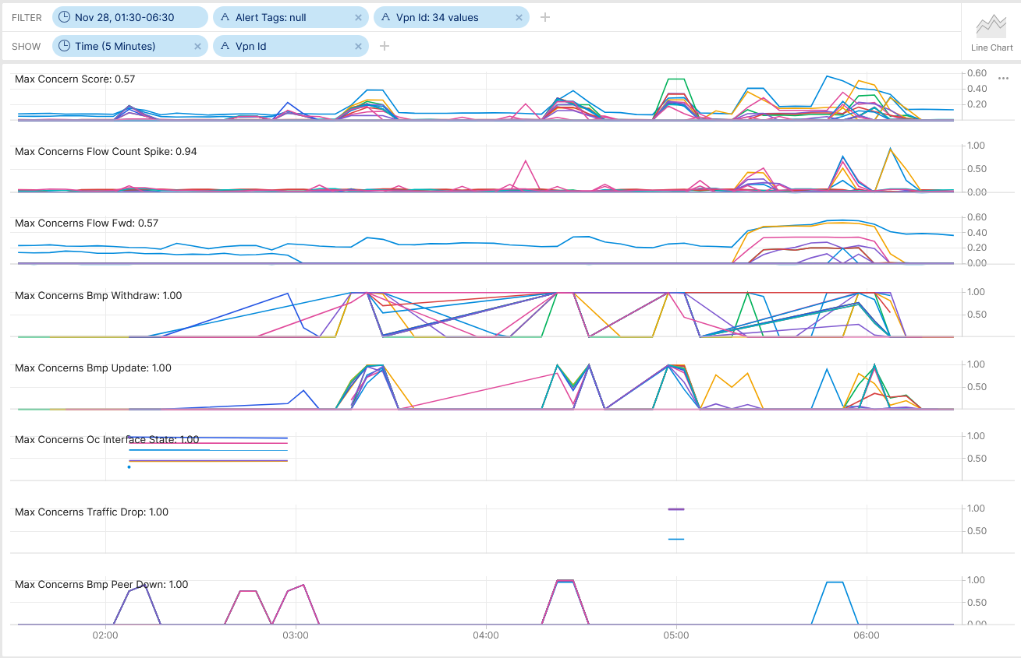
SRv6 Resilience Analysis & Tests in Production SRv6 Blackholing
Between 02:05-08 AM, use case 1, physical links on ipt-zhb790-a-des-01 Bundle-Ether10011 (CE facing interface to TC-GW Inter-AS Option A) had been disconnected. Interface and BGP peering state changes, BGP topology changes and interface traffic shift were observed and not alerted.
Between 02:56-59 AM, use case 2, physical links on ipt-zhb790-a-des-01 Bundle-Ether10031 (CE facing interface to MV-GW Inter-AS Option A) had been disconnected. Interface and BGP peering state changes, BGP topology changes and interface traffic shift were observed and not alerted.
Between 03.17-24 AM, use case 3, physical links on ipt-zhb790-a-des-02 Bundle-Ether2000 and Bundle-Ether2100 (P ABR facing) had been disconnected. Interface state changes, BGP topology changes and interface traffic shift were observed and alerted.
Between 04:22-30 AM, use case 4, BGP process was terminated and restarted at ipt-zhb790-a-des-02 (PE node Inter-AS Option A to SMEN) had been disconnected. BGP peering state changes, BGP topology changes and interface traffic shift were observed and alerted.
Between 04:53-57 AM, use case 5, IS-IS process was terminated and restarted at ipt-zhb790-a-des-02 (PE node Inter-AS Option A to SMEN) had been disconnected. BGP topology changes, traffic drop and interface traffic shift were observed and alerted.
Cosmos Bright Lights monitoring 34 L3 VPN's in real-time during maintenance window – Pivot Link

Slide 5


SRv6 Resilience Analysis & Tests in Production SRv6 Blackholing
At 05:17 AM, use case 6, RSP failover at ipt-zhb790-a-des-02 (PE node Inter-AS Option A to SMEN) was been performed. Missing traffic and NPU "IPv6 next-hop index invalid transmit adjacency" drops were observed and alerted.
At 05:43 and 05:47 AM, BGP peerings at pt-zhb790-a-des-02 (PE node Inter-AS Option A to SMEN) were being reset to update BGP routing tables. Along BGP peering state and topology changes, Missing traffic and NPU "IPv6 next-hop index invalid transmit adjacency" drops were still unchanged observed and alerted.
At 06:00 AM, ipt-zhb790-a-des-02 Bundle-Ether2000 and Bundle-Ether2100 (P ABR facing) were being shutdown. Missing traffic and NPU "IPv6 next-hop index invalid transmit adjacency" drops were no longer observed and traffic shifted to redundant ipt-zhh790-b-des-02.
At 06:54 AM, Cisco TAC SR 698355511 case has been opened to investigate traffic blackholing after RSP fail back.
Cosmos Bright Lights monitoring 34x L3 VPN's in real-time during maintenance window – Pivot Link

Slide 6
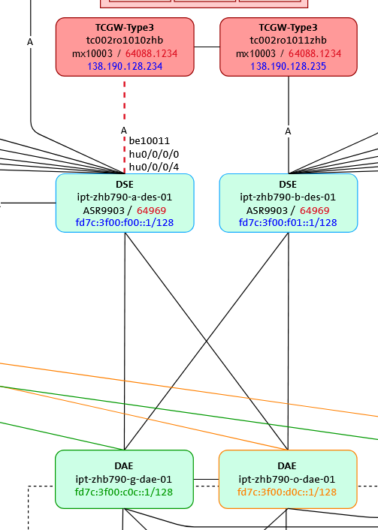
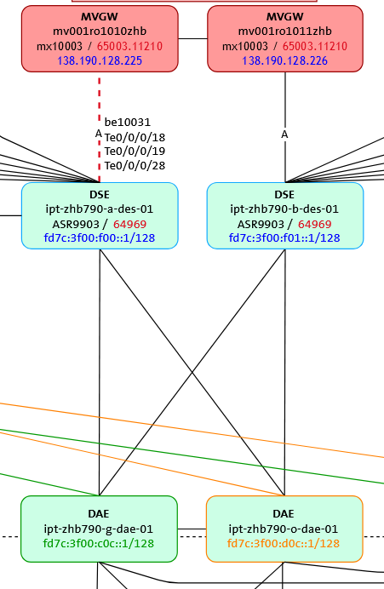
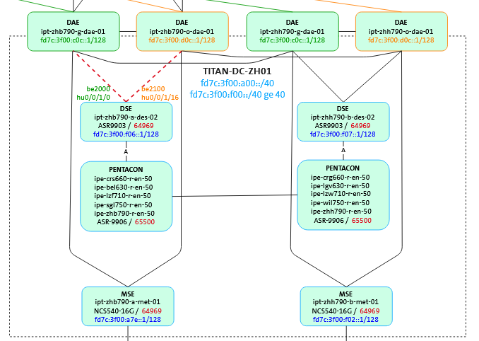
SRv6 Resilience Analysis & Tests in Production L1-3 Topology
1
2
3
4
6
5
Use Case 1, Edge Facing Link State Change
Use Case 2, Edge Facing Link State Change
Use Case 3, Core Facing Link State Change Use Case 4, BGP Process Restart Use Case 5, IS-IS Process Restart Use Case 6, RSP Failover

Slide 7
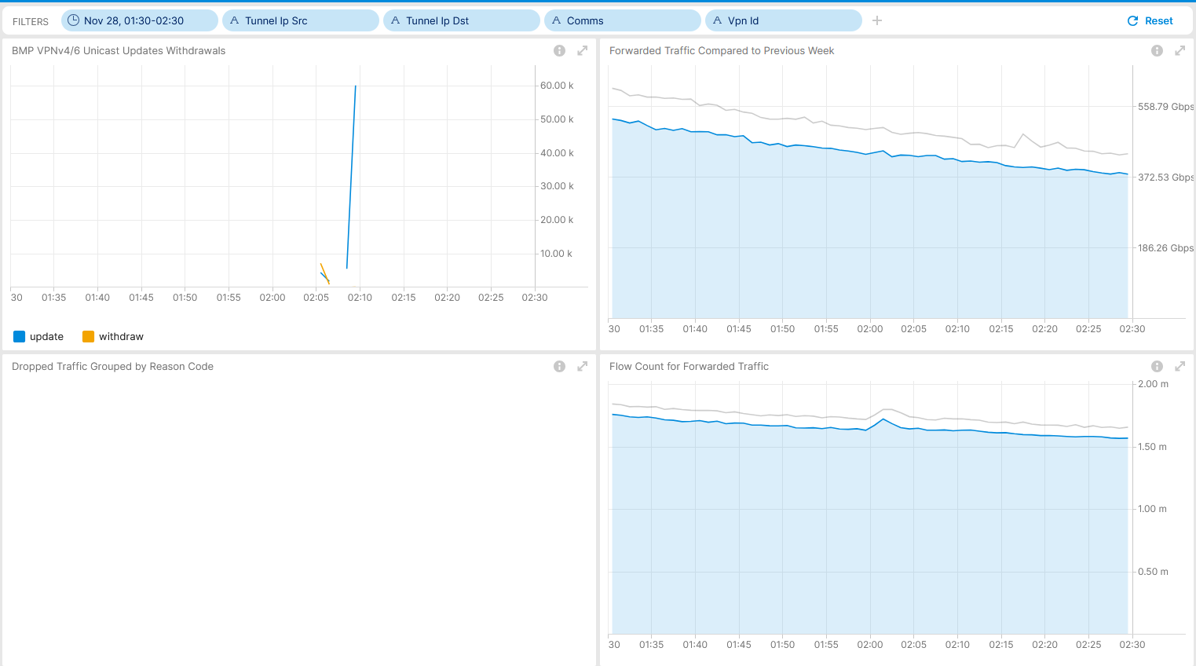
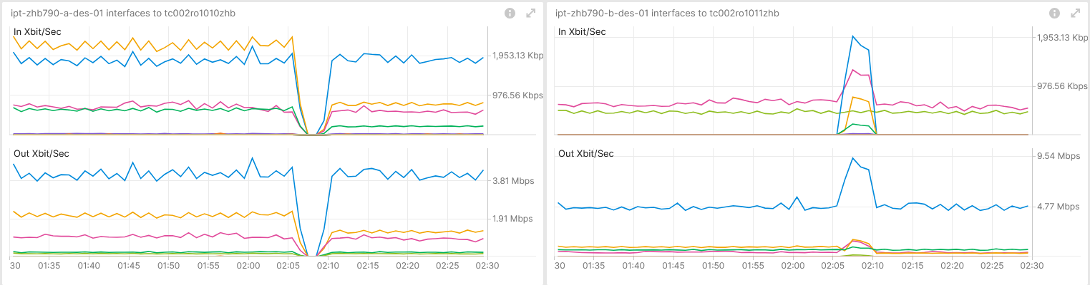
November 28th, SRv6 Resilience Analysis & Tests in Production Use Case 1 – Inter-AS Option A Interface State Change – Real-Time Maintenance Window Analysis
Shows BGP topology change and no traffic volume change. Measured with IPFIX and Correlated with BMP Local RIB.
Shows flow count spike due to BGP topology change. Measured with IPFIX and Correlated with BMP Local RIB.
Shows traffic shift among Inter-AS Option A ASBR's. Measured with YANG-Push openconfig-interface.yang.
Operational Network Telemetry forwarding plane, YANG-Push, IPFIX, BMP and BGP measured control plane metrics

Slide 8
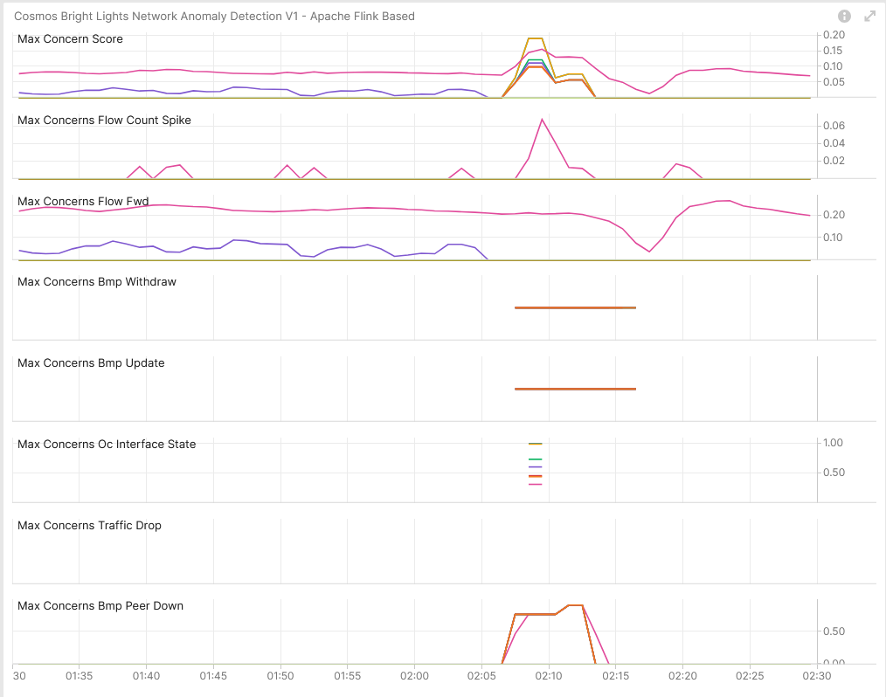

November 28th, SRv6 Resilience Analysis & Tests in Production Use Case 1 – Network Anomaly Detection – Live
Concern Score: 0.19
Flow Count Spike: 0.07
Missing Traffic: 0.26
Traffic Drop: 0.00
BMP Peer/Interface Down: 0.91/0.99 BMP Update/Withdrawal: 0.00/0.00
BMP route-monitoring Update/Withdraw check did not recognize topology change.
BMP peer Down/Up check recognized BGP peering state change.
Interface Down/Up check recognized Interface state change.
Traffic Drop spike recognized did not apply.
Missing Traffic check recognized long term traffic loss on 64498:2949.
Increased or decreased Flow Count check did recognize flow spike decrease.
Overall: 4 out of 6 checks have detected the Interface and BGP topology change and flow count spike. Why BGP topology changes were not identified needs to be investigated.
Cosmos Bright Lights Anomaly Detection – 8x L3 VPN's

Slide 9
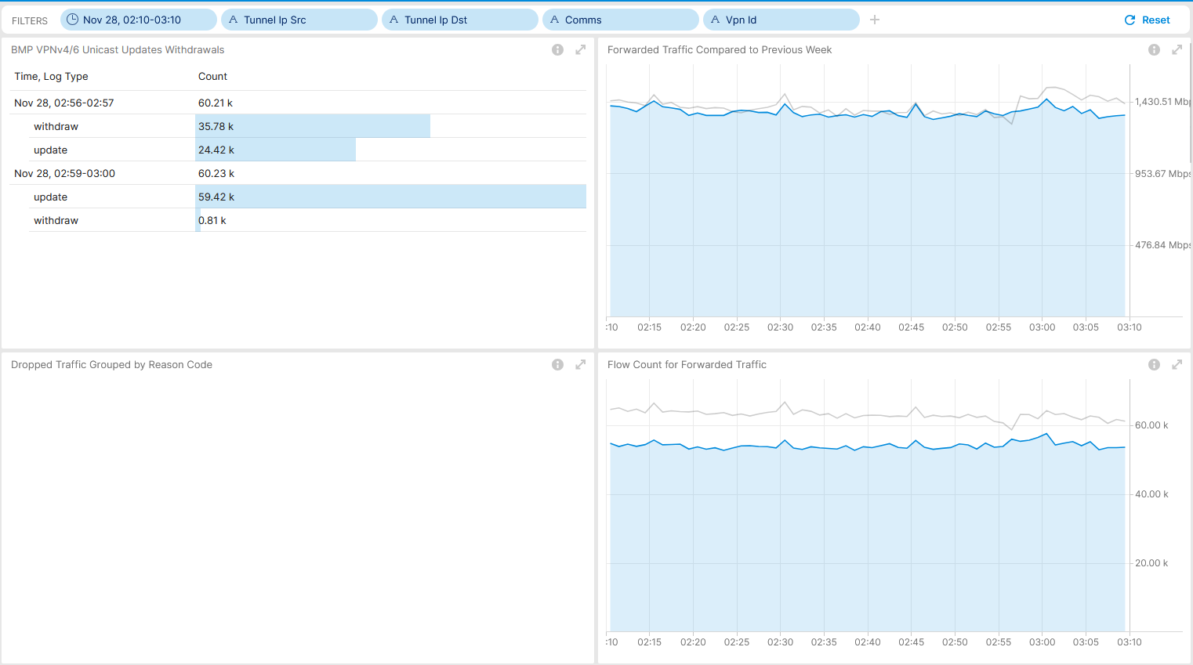
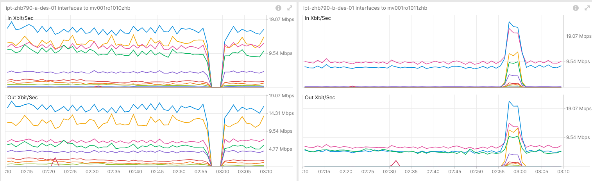
November 28th, SRv6 Resilience Analysis & Tests in Production Use Case 2 – Inter-AS Option A Interface State Change – Real-Time Maintenance Window Analysis
Shows BGP topology change and no traffic volume change. Measured with IPFIX and Correlated with BMP Local RIB.
Shows no flow count change. Measured with IPFIX and Correlated with BMP Local RIB.
Shows traffic shift among Inter-AS Option A ASBR's. Measured with YANG-Push openconfig-interface.yang.
Operational Network Telemetry forwarding plane, YANG-Push, IPFIX, BMP and BGP measured control plane metrics.

Slide 10
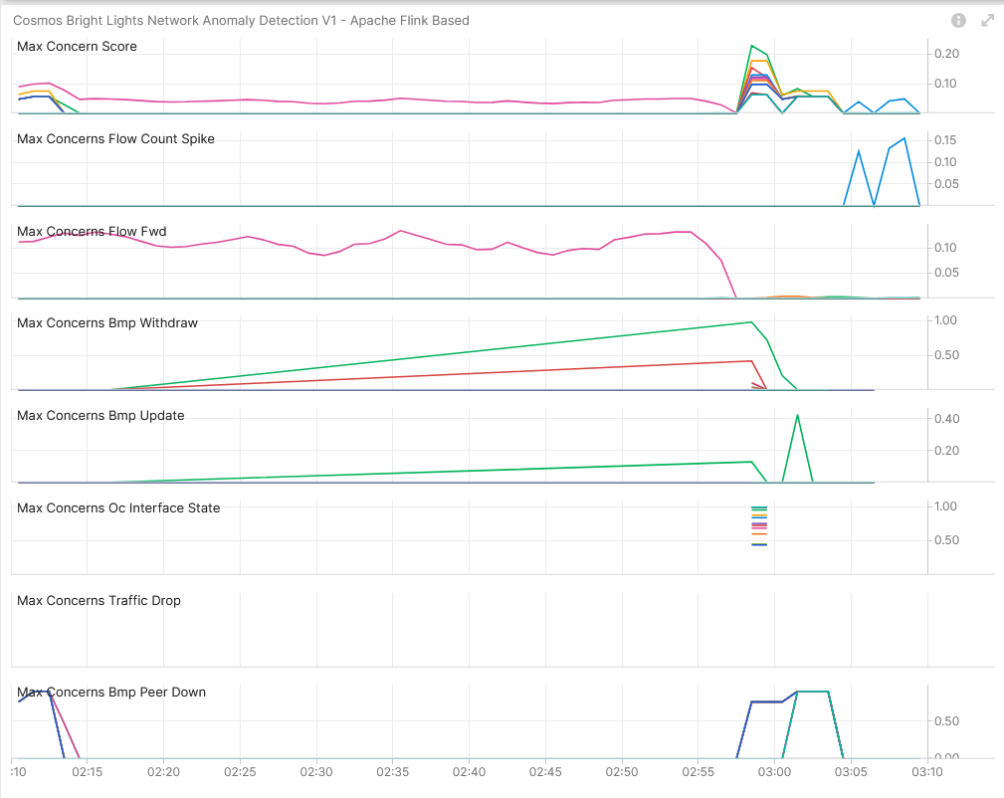
November 28th, SRv6 Resilience Analysis & Tests in Production Use Case 2 – Network Anomaly Detection – Live
Concern Score: 0.23
Flow Count Spike: 0.16
Missing Traffic: 0.00
Traffic Drop: 0.00
BMP Peer/Interface Down: 0.91/1.00 BMP Update/Withdrawal: 0.43/0.98
BMP route-monitoring Update/Withdraw check recognized topology change.
BMP peer Down/Up check recognized BGP peering state change.
Interface Down/Up check recognized Interface state change.
Traffic Drop spike recognized did not apply.
Missing Traffic check did not apply.
Increased or decreased Flow Count check did recognize flow spike increase.
Overall: 5 out of 6 checks have detected the interface and BGP topology change and flow count spike. Meets perfectly our expectations.
Cosmos Bright Lights Anomaly Detection – 12x L3 VPN's

Slide 11
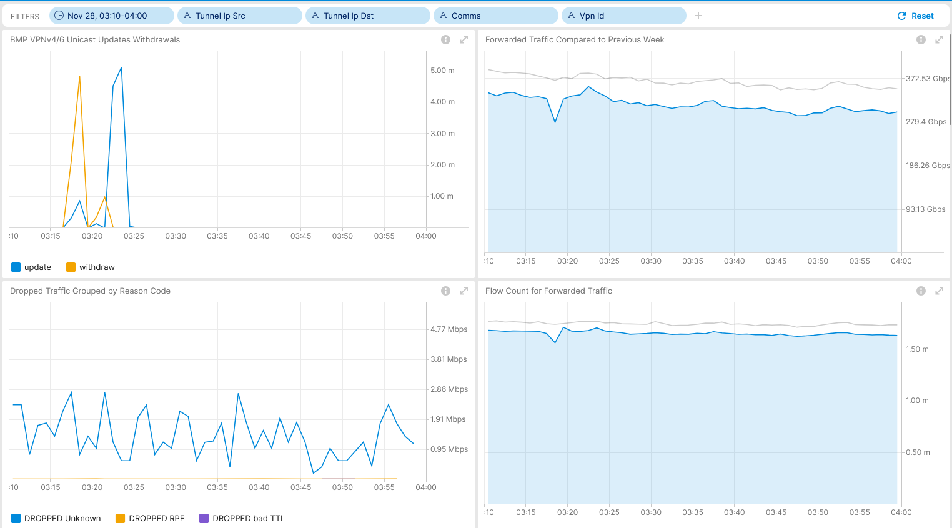
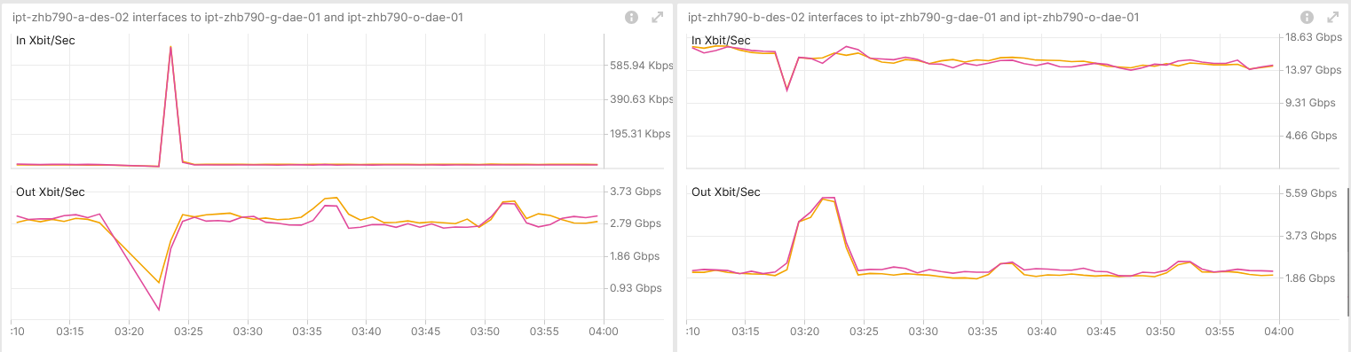
November 28th, SRv6 Resilience Analysis & Tests in Production Use Case 3 – SRv6 Provider Interface State Change – Real-Time Maintenance Window Analysis
Shows BGP topology change and brief missing traffic volume. Measured with IPFIX and Correlated with BMP Local RIB.
Shows brief flow count change. Measured with IPFIX and Correlated with BMP Local RIB.
Shows traffic shift among Inter-AS Option A ASBR's. Measured with YANG-Push openconfig-interface.yang.
Operational Network Telemetry forwarding plane, YANG-Push, IPFIX, BMP and BGP measured control plane metrics

Slide 12
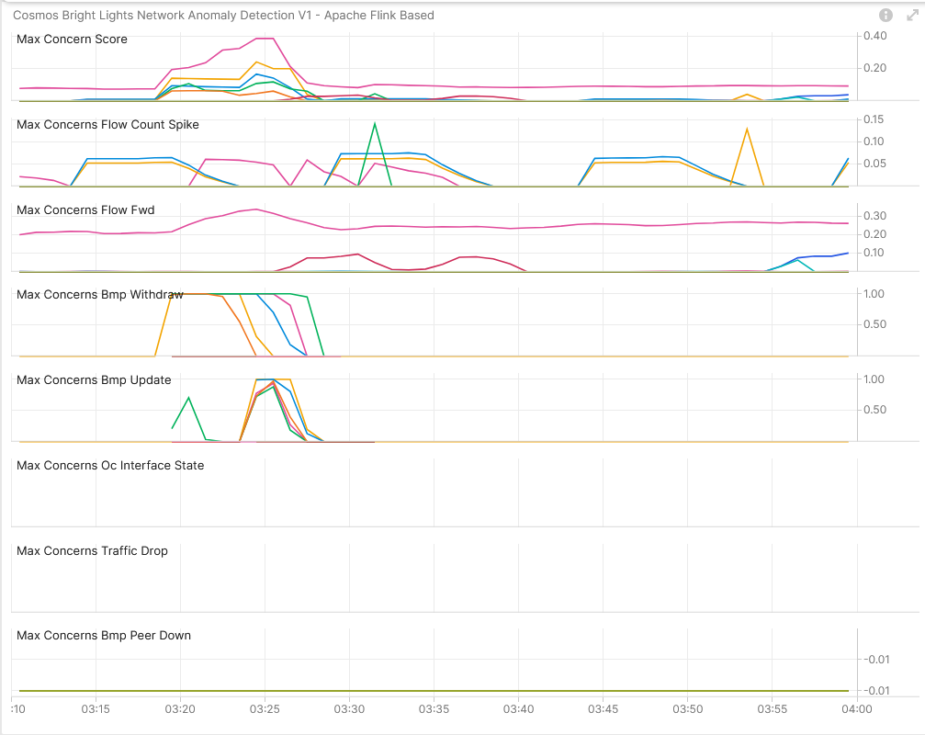
November 28th, SRv6 Resilience Analysis & Tests in Production Use Case 3 – Network Anomaly Detection – Live
Concern Score: 0.39
Flow Count Spike: 0.14
Missing Traffic: 0.34
Traffic Drop: 0.00
BMP Peer/Interface Down: 0.00/0.00 BMP Update/Withdrawal: 1.00/1.00
BMP route-monitoring Update/Withdraw check recognized topology change.
BMP peer Down/Up check did not apply.
Interface Down/Up did not apply.
Traffic Drop spike recognized did not apply.
Missing Traffic check did not recognize brief traffic loss.
Increased or decreased Flow Count check did not recognize decreased and increased flow count spike.
Overall: 1 out of 6 checks have detected the BGP topology change. Missing traffic and Flow Count changes are hard to recognize when many changes occur in short period of time. Nevertheless, lets investigate wherever we have a chance to improve.
Cosmos Bright Lights Anomaly Detection – 16x L3 VPN's

Slide 13
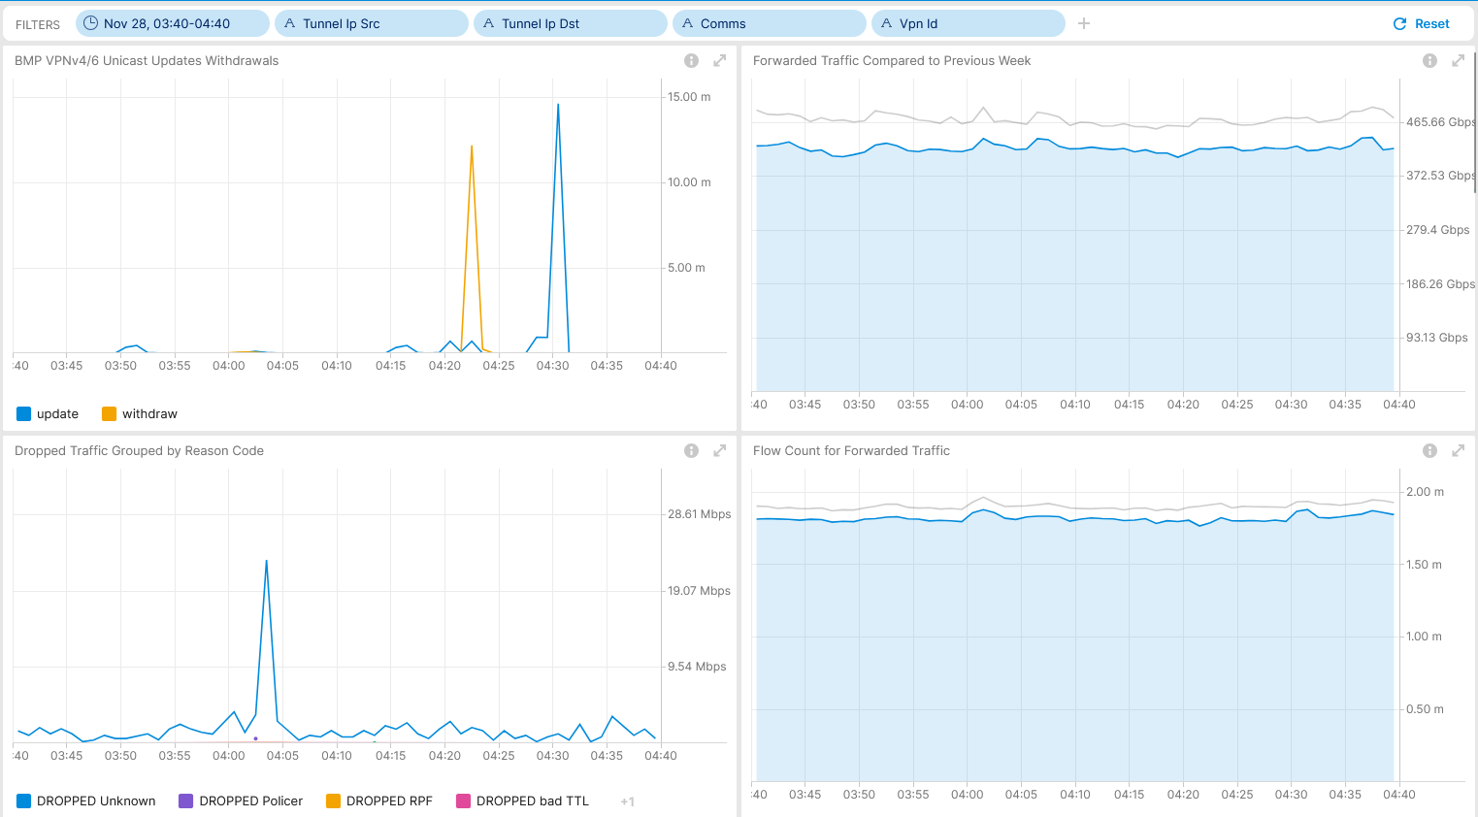
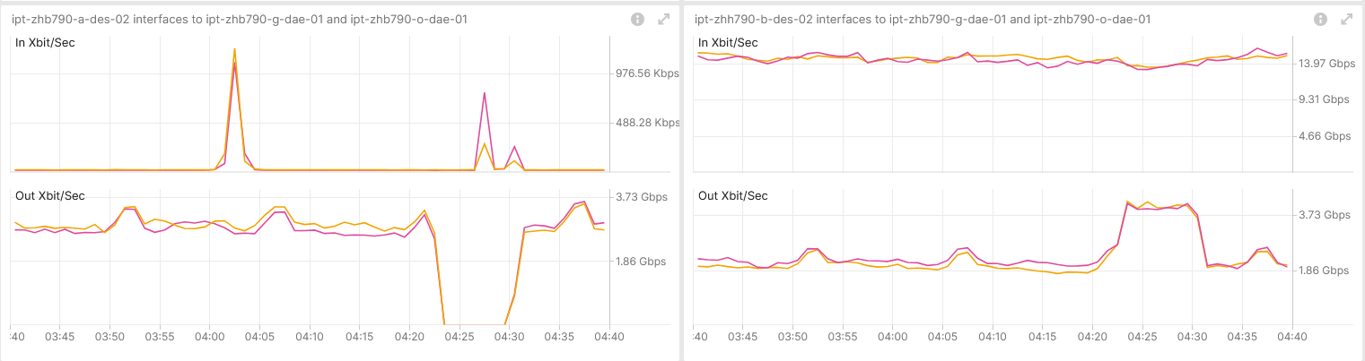
November 28th, SRv6 Resilience Analysis & Tests in Production Use Case 4 – BGP Process Restart – Real-Time Maintenance Window Analysis
Shows BGP topology change. Measured with IPFIX and Correlated with BMP Local RIB.
Shows no change in drops or flow count. Measured with IPFIX and Correlated with BMP Local RIB.
Shows traffic shift among Inter-AS Option A ASBR's. Measured with YANG-Push openconfig-interface.yang.
Operational Network Telemetry forwarding plane, YANG-Push, IPFIX, BMP and BGP measured control plane metrics

Slide 14
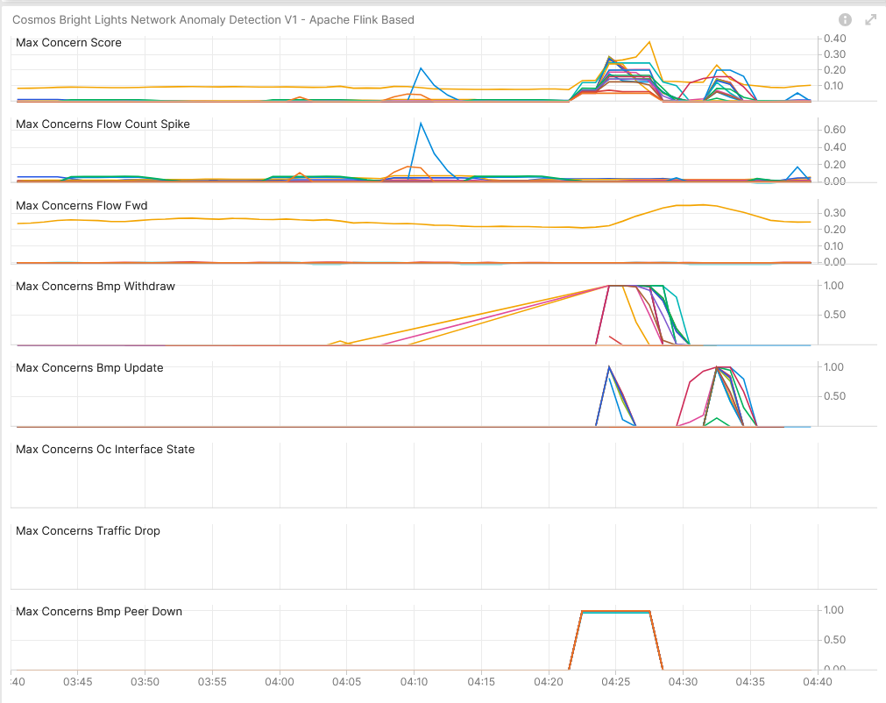
November 28th, SRv6 Resilience Analysis & Tests in Production Use Case 4 – Network Anomaly Detection – Live
Concern Score: 0.38
Flow Count Spike: 0.04
Missing Traffic: 0.35
Traffic Drop: 0.00
BMP Peer/Interface Down: 1.00/0.00 BMP Update/Withdrawal: 1.00/1.00
BMP route-monitoring Update/Withdraw check recognized topology change.
BMP peer Down/Up check recognize peering state changes.
Interface Down/Up did not apply.
Traffic Drop spike recognized did not apply.
Missing Traffic check recognized long term traffic loss on 64498:2949.
Increased or decreased Flow Count check did not apply.
Overall: 2 out of 6 checks have detected the BGP topology and peering state change. Meets perfectly our expectations.
Cosmos Bright Lights Anomaly Detection – 19x L3 VPN's

Slide 15
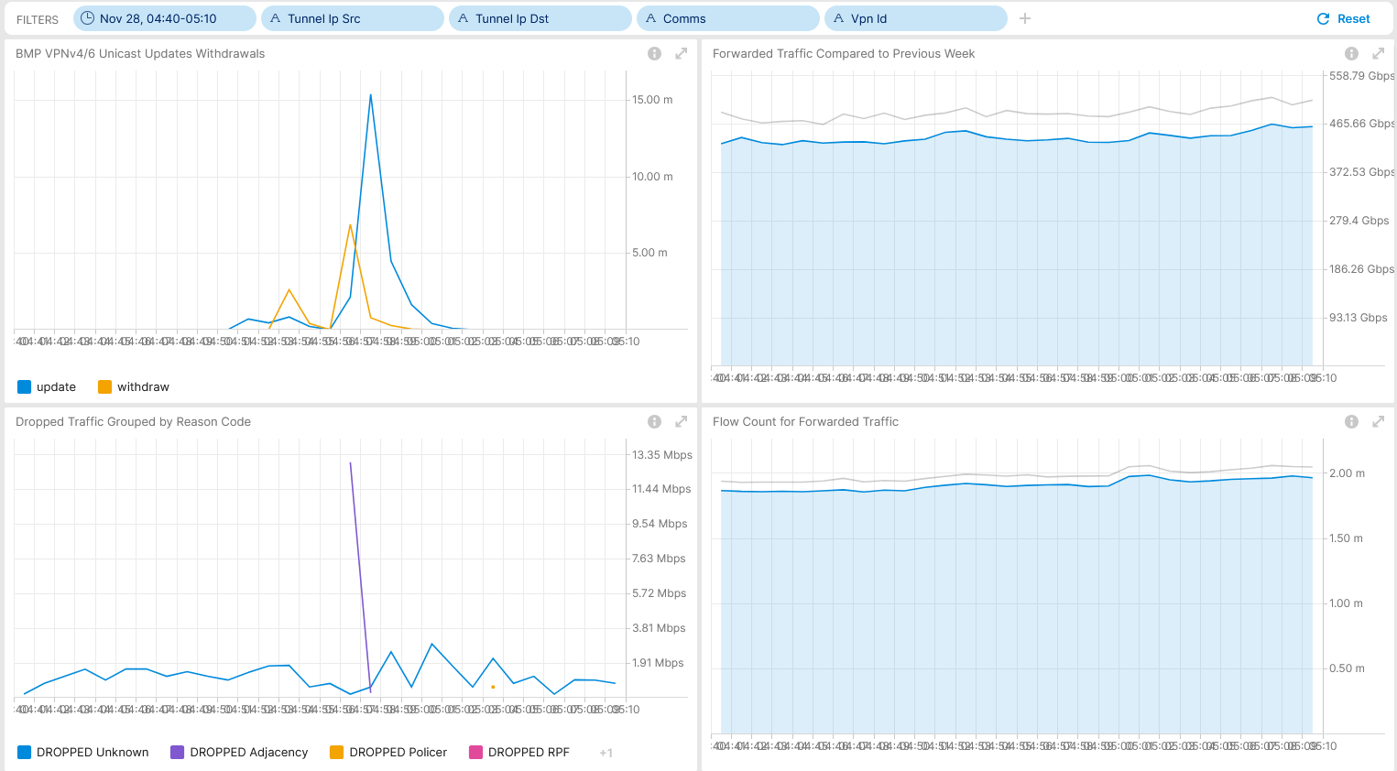
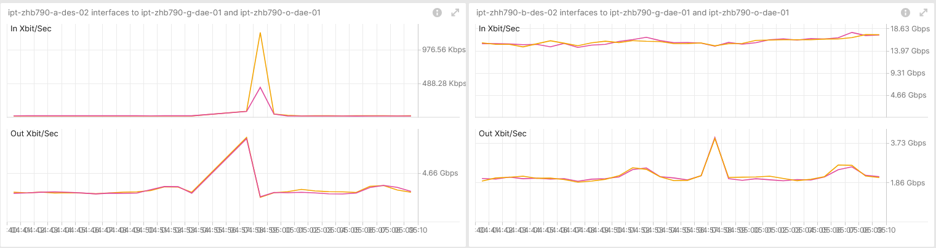
November 28th, SRv6 Resilience Analysis & Tests in Production Use Case 5– IS-IS Process Restart – Real-Time Maintenance Window Analysis
Shows BGP topology change. Measured with IPFIX and Correlated with BMP Local RIB.
Shows drop adjacency. Measured with IPFIX and Correlated with BMP Local RIB.
Shows brief traffic shift among Inter-AS Option A ASBR's. Measured with YANG-Push openconfig-interface.yang.
Operational Network Telemetry forwarding plane, YANG-Push, IPFIX, BMP and BGP measured control plane metrics

Slide 16
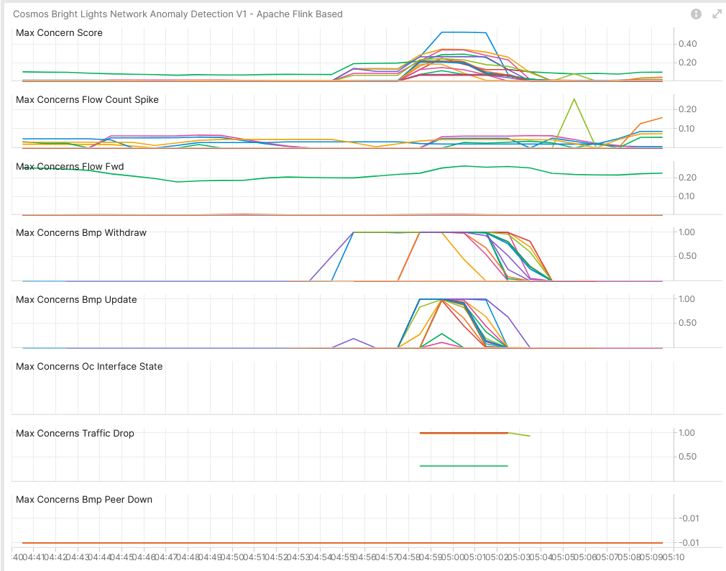
November 28th, SRv6 Resilience Analysis & Tests in Production Use Case 5 – Network Anomaly Detection – Live
Concern Score: 0.53
Flow Count Spike: 0.25
Missing Traffic: 0.27
Traffic Drop: 1.00
BMP Peer/Interface Down: 0.00/0.00 BMP Update/Withdrawal: 1.00/1.00
BMP route-monitoring Update/Withdraw check recognized topology change.
BMP peer Down/Up check did not apply.
Interface Down/Up did not apply.
Traffic Drop spike recognized topology change.
Missing Traffic check recognized long term traffic loss on 64498:2949.
Increased or decreased Flow Count check did not apply.
Overall: 2 out of 6 checks have detected the BGP topology change, and traffic drop spike. Meets perfectly our expectations.
Cosmos Bright Lights Anomaly Detection – 19x L3 VPN's

Slide 17
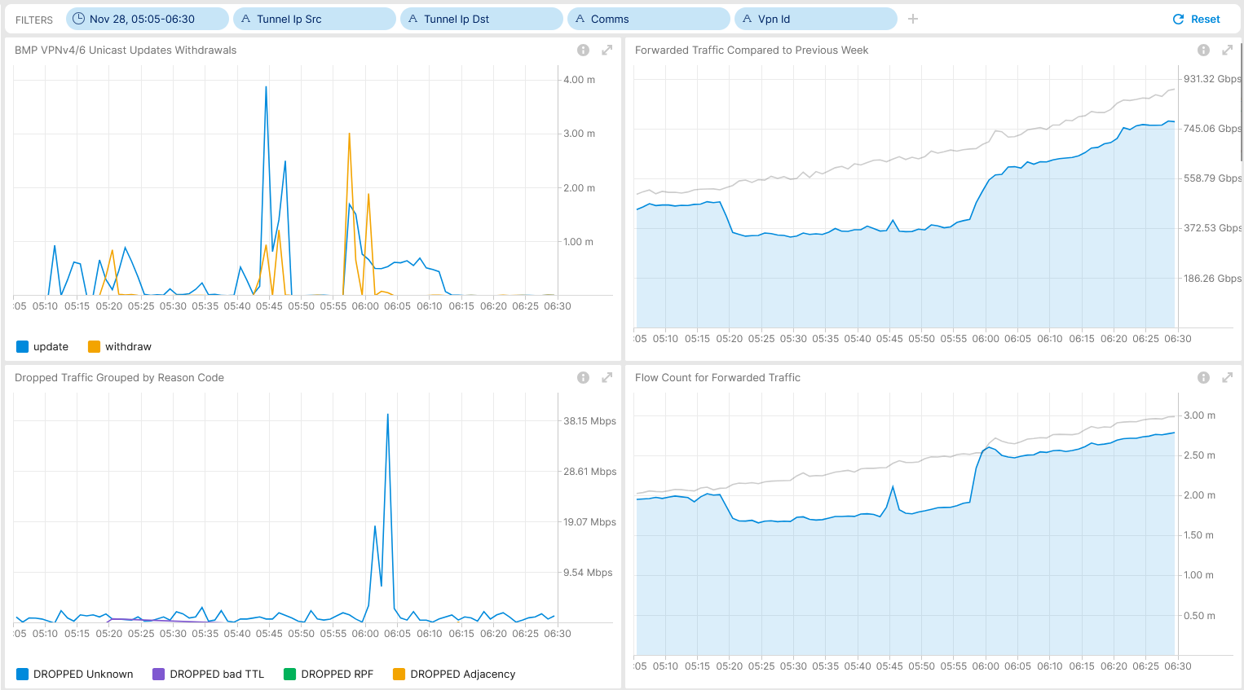
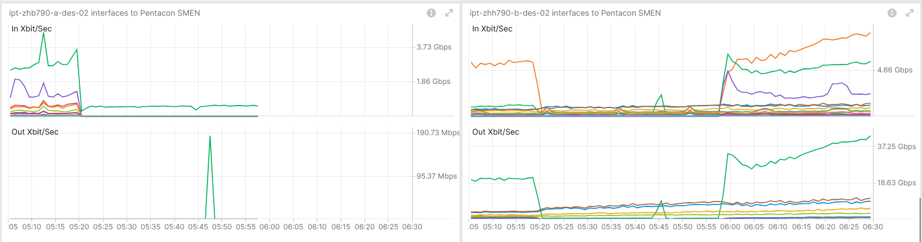
November 28th, SRv6 Resilience Analysis & Tests in Production Use Case 6– RSP Failover – Real-Time Maintenance Window Analysis
Shows BGP topology change and missing traffic during blackholing. Measured with IPFIX and Correlated with BMP Local RIB.
Shows drop unknown at recovery and reduced flow count during blackholing. Measured with IPFIX and Correlated with BMP Local RIB.
Shows traffic shift among Inter-AS Option A ASBR's. Measured with YANG-Push openconfig-interface.yang.
Operational Network Telemetry forwarding plane, YANG-Push, IPFIX, BMP and BGP measured control plane metrics

Slide 18
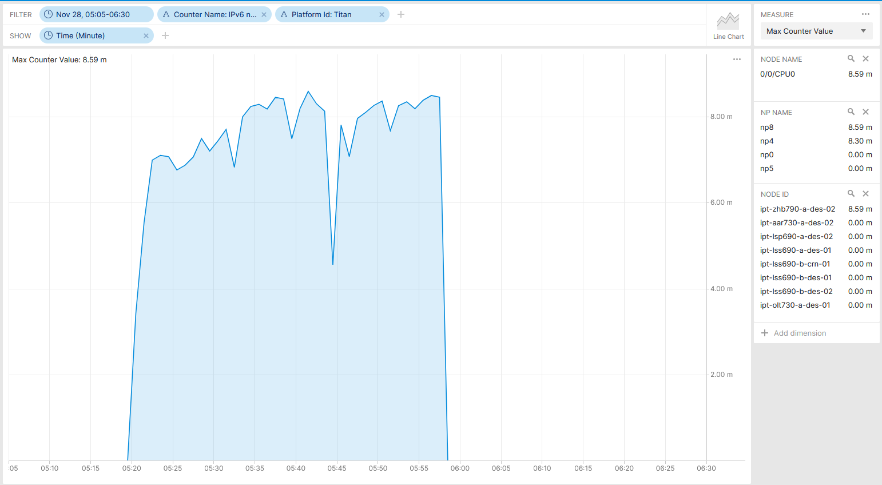
November 28th, SRv6 Resilience Analysis & Tests in Production IPv6 next-hop index invalid transmit adjacency drops - Real-Time Maintenance Window Analysis
Shows egress NPU drops on NPU 4 and 8 on line card 0/0/CPU0 at ipt-zhb790-a-des-02. Measured with YANG-Push.
Operational Network Telemetry YANG-Push collected NPU drop counter (IPv6 next-hop index invalid transmit adjacency) metrics.

Slide 19
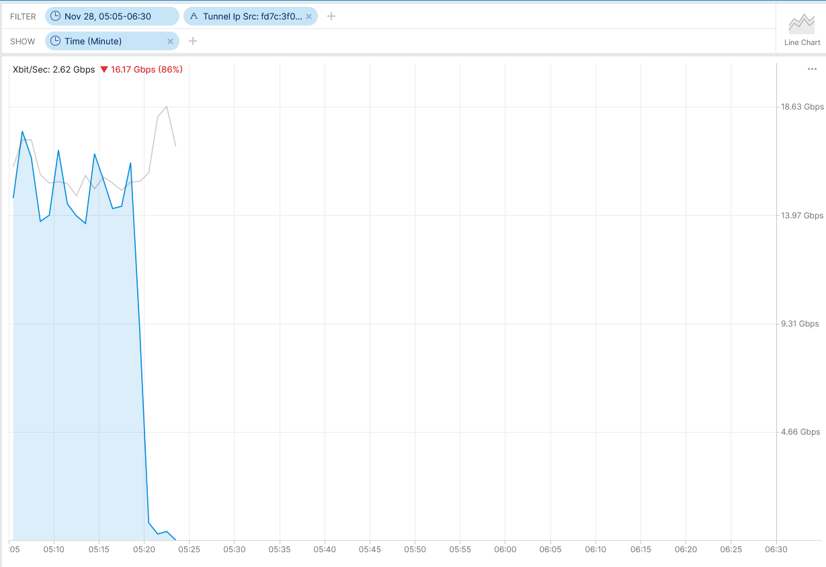
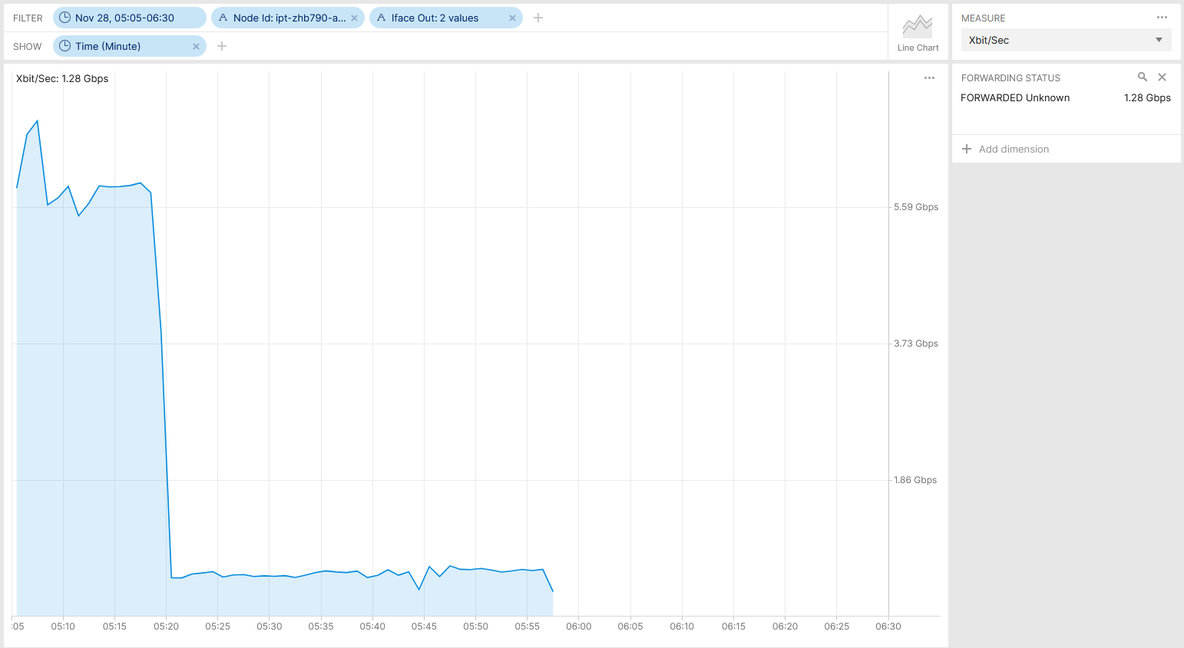
November 28th, SRv6 Resilience Analysis & Tests in Production IPFIX does not recognize at ingress the egress drop - Real-Time Maintenance Window Analysis
Shows that ingress captured traffic is measured forwarded mistakenly, however then dropped at egress on ipt-zhb790-a-des-02. Measured with IPFIX in different parts of the SRv6 domain.
Operational Network Telemetry IPFIX collected metrics showing traffic originated by IPv6 Tunnel source fd7c:3f00:f06::1 (ipt-zhb790-a-des-02).
Operational Network Telemetry IPFIX collected metrics showing traffic on Bundle-Ether2000 and Bundle-Ether2100 egress (SRv6 P) at ipt-zhb790-a-des-02 captured ingress.

Slide 20
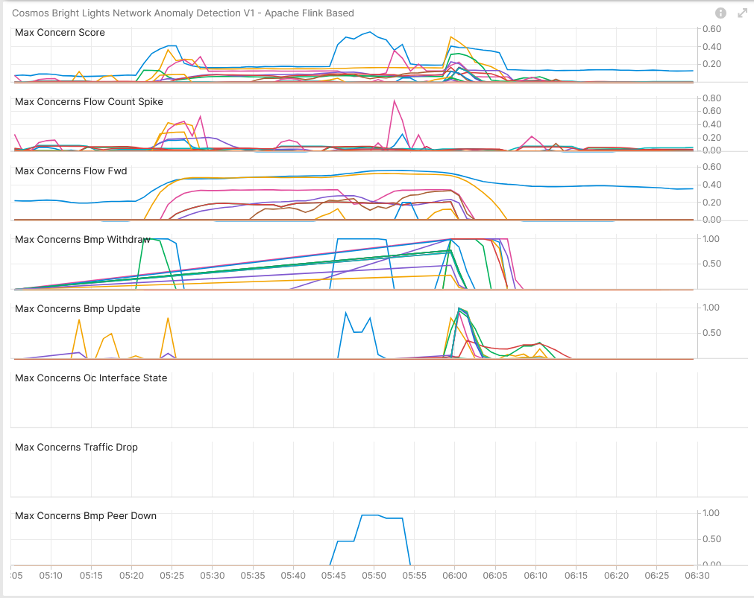
November 28th, SRv6 Resilience Analysis & Tests in Production Use Case 6 – Network Anomaly Detection – Live
Concern Score: 0.57
Flow Count Spike: 0.76
Missing Traffic: 0.57
Traffic Drop: 0.00
BMP Peer/Interface Down: 0.00/0.96 BMP Update/Withdrawal: 1.00/1.00
BMP route-monitoring Update/Withdraw check recognized topology change.
BMP peer Down/Up check recognized peering state changes.
Interface Down/Up did not apply.
Traffic Drop spike did not apply since IPFIX did not recognize egress drop.
Missing Traffic check recognized blackholing.
Increased or decreased Flow Count check recognize drop spike due to topology change.
Overall: 4 out of 6 checks have detected the BGP topology change, missing traffic and traffic drop spike. Meets perfectly our expectations.
Cosmos Bright Lights Anomaly Detection – 19x L3 VPN'

Slide 21
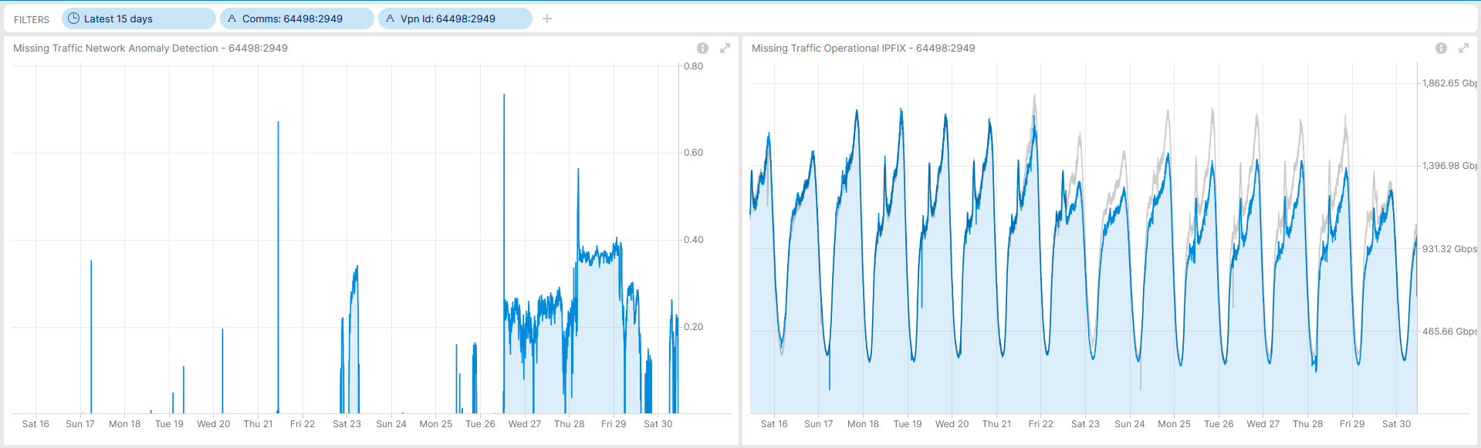
November 28th, SRv6 Resilience Analysis & Tests in Production Missing Traffic doesn't have to be always a Network Incident
Shows Missing Traffic Anomaly Detected based on IPFIX Operational Metrics for 64498:2949.

Slide 22
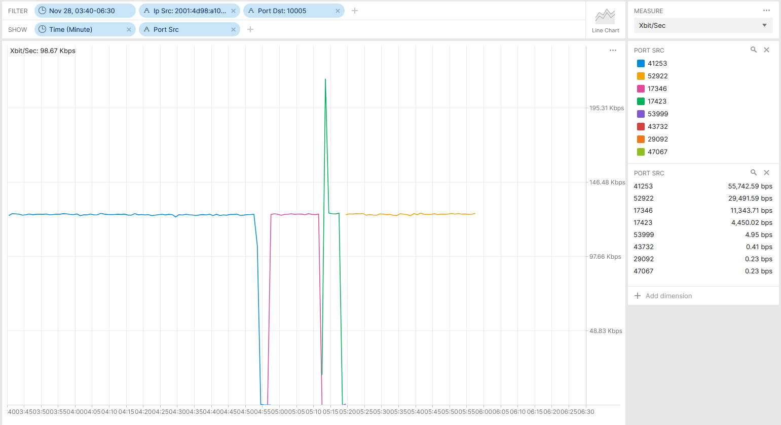
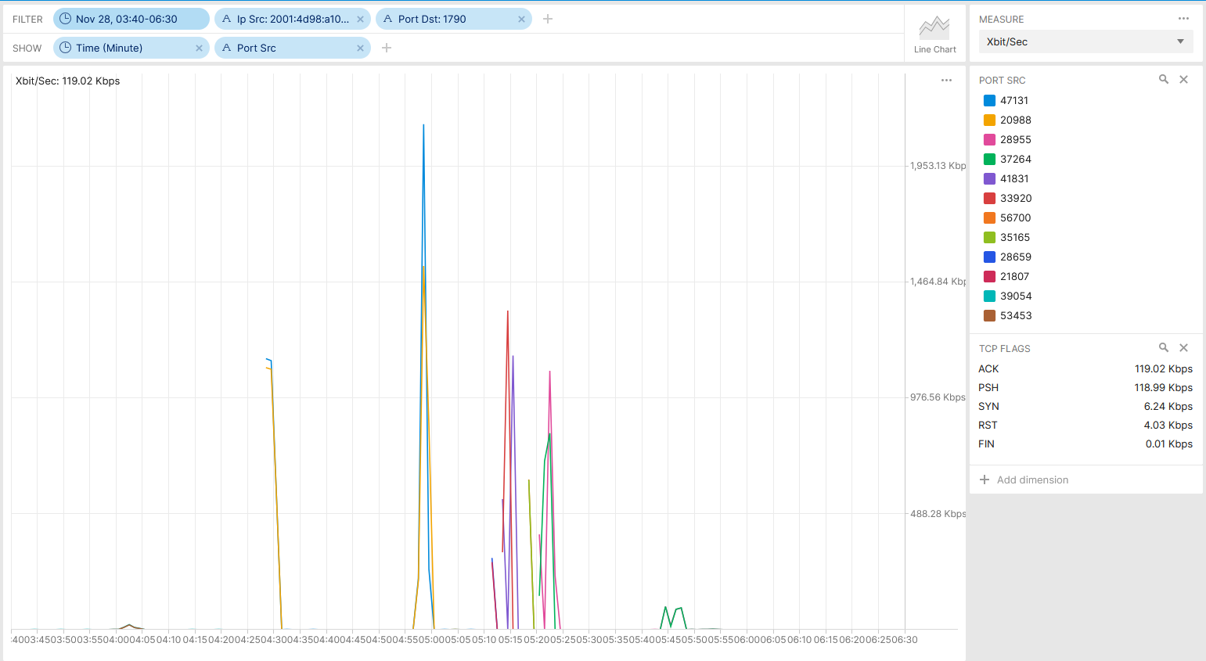
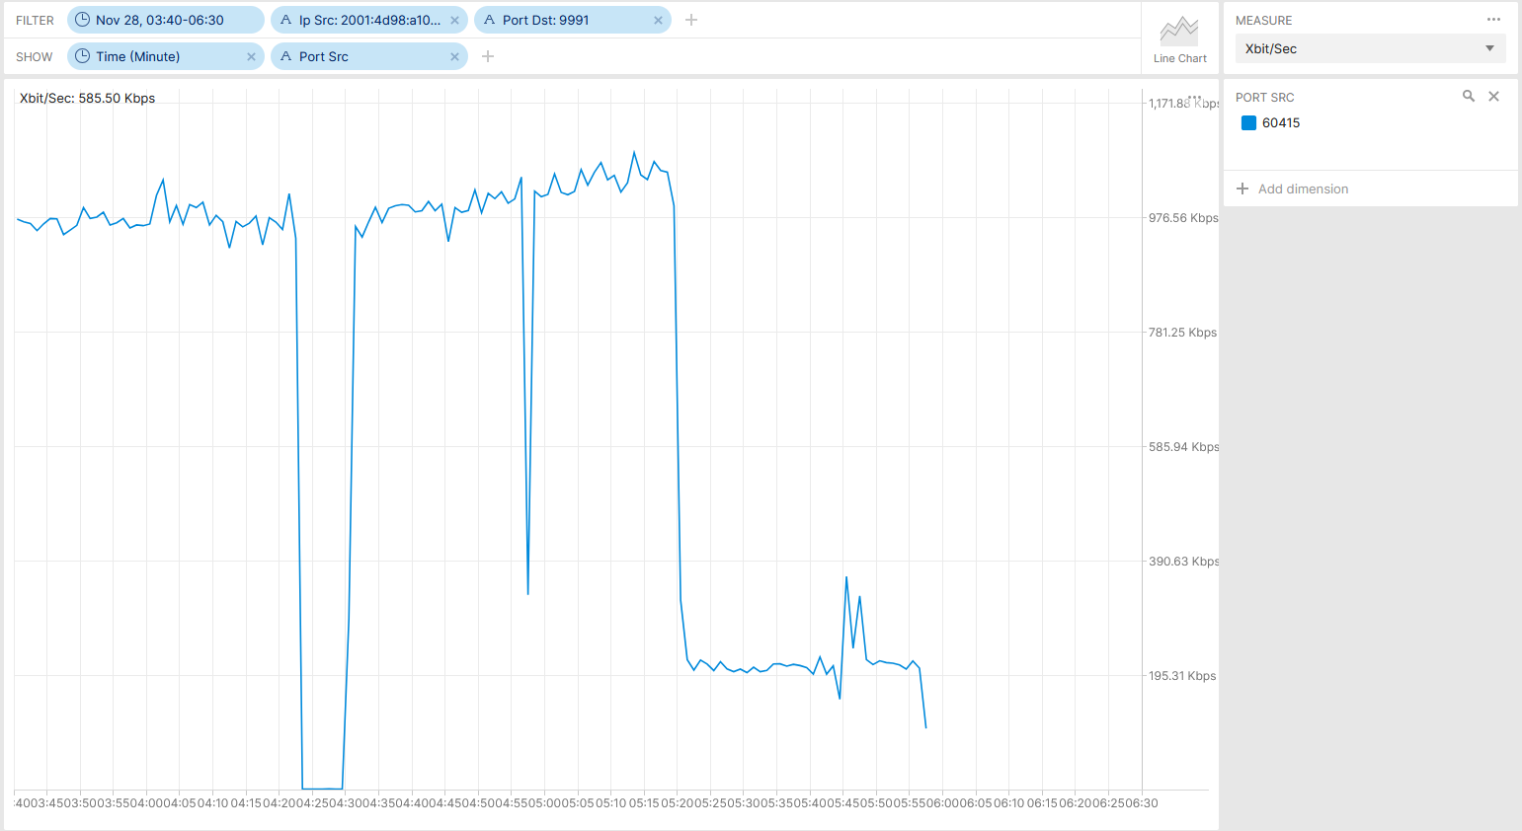
November 28th, SRv6 Resilience Analysis & Tests in Production Network Telemetry Packet Analysis at Data Collection
Shows that YANG-Push Cisco TCP transport session has been re-established in use case 4 (IS-IS process restart) and use case 6 (RSP failover).
Shows that BMP TCP transport session has been re-established in use case 5 (BGP process restart) and use case 6 (RSP failover).
Shows that IPFIX UDP transport session has been terminated when SRv6 P interfaces where shutdown.

Slide 23
What went well?
IPFIX, BMP and YANG-Push delivered the almost perfect operational view on the impacted network.
Cosmos Bright Lights Network Anomaly Detection was battelled in a series of tests and showed that is more then just ready for production. It excels in most of the areas.
We are real-time. BGP topology changes within 3 seconds. Interface traffic within 60 seconds. IPFIX flow aggregation within 90 seconds. Network Anomaly Detection within 180 seconds.
What to do next?
Evaluate why in use case 1 BGP topology changes were not recognized. -> Ongoing.
Evaluate if in use case 3 Missing traffic and flow count changes could be detected. -> Ongoing.
Clarify wherever egress IPFIX could have identified drops. -> Done.
Persist operational data in TSDB for training purposes. -> Done.
What could be improved?
Detect egress drops on data plane serialization in IPFIX.
Include NPU drop verification in resilience analysis and add semantics in Cisco-IOS-XR-asr9k-np-oper.yang describing drop counter meaning.
Add "Cisco-IOS-XR-wdsysmon-fd-oper:system-monitoring/cpu-utilization" xpath in YANG-Push configuration.
Restart of IS-IS process would have no impact if Network Telemetry transport sessions would have been established outband.
Cisco TAC having access to operative Network Telemetry and network node software process, management plane, tracing data.

Slide 24
Cosmos Bright Lights Full Scale Summary With >13'000 L3 VPN's after 16 days and 31 Notifications
Key Facts in 2025
99.92% of the time the analytical conclusions are correct. Not considering false negatives yet.
Even with >13'000 L3 VPN's monitored, only 0-5 alerts a day, far lower then expected.
The addition and removal of VPN's impacts false positives.
Often, network operation is not aware of the connectivity service topology change or the forwarding impact.
3
Inventory was
added/removed
51 Alert Notifications since January 9th 2025
19
Works perfectly
14
Should not have
alerted
15
Could
be improved

Slide 25
Cosmos Bright Lights Full Scale Detail Where to improve
Improvements in PI 25-1
Adjust sensitivity in missing traffic default strategy (already deployed)
Suppress alerts when L3 VPN was removed in inventory.
Add URL's in concern objects.
Improvements in 2025
Improve profiling for BMP route-monitoring updates.
Implement draft-ietf-nmop-network-anomaly-semantics information model.
Implement draft-ietf-nmop-network-anomaly-lifecycle information model.
Establish postmortem system to scale.
Measure false negatives.
6
BMP route-monitoring updates, topology change not detected
29 Alert Notifications to Improve since January 9th 2025
15
Other
8
Missing traffic default strategy to sensitive

Slide 26
Network Analytics Postmortem 2022-2024 Summary Steadily Improving in the last 36 months
Key Facts
66% of the suggestions have already been addressed at the IETF.
30% of the suggestions for Network Anomaly Detection has already been implemented.
33% of the Network and Daisy team backlogs has already been implemented.
0% of the Swisscom transformation items have been addressed.
BMP Local RIB All Path with Path Marking support has been missed 6 times and will be implemented by Huawei, Cisco and possibly 6Wind.
IPFIX ForwardingStatus not been implemented in Juniper JunOS has been missed 3 times. No plans for implementation.
Netconf transaction ID support has been missed 3 times.
58 Postmortem Improvement
Suggestions
10
Swisscom Transformation
11
Network Anomaly Detection Enhancements
9
Network Telemetry Enhancements at IETF
16
Network Telemetry Enhancements at Vendor
3
Daisy Team backlog
3
Network Team backlog

