Slide 1

Way Forward to 5G/6G: What is missing in network protocols and technologies
Nirmala Shenoy
Rochester Institute of technology

Slide 2
My Focus – Way Forward: Internet
AGENDA
Peek into revolutionary growth of the Internet - pillars fostering Internet growth
Architectures, topologies, silicon revolution, transmission technologies fiber optics, countless and continuing to grow - applications
The foundation for networks – the Network Protocols
Governing many protocols – algorithms
Looming ahead – growing energy consumption and carbon footprint
The challenges – the severe imbalance
What is driving? Is the situation healthy? - What is missing!

Slide 3
Architectures
Days of native LANs, advent of Internet (research project)
Commercialized – Internet Service providers – tier based architectures – to define their business relationships
Cellular, wireless, satellite networks – were growing independently
Data center networks – from the main frame days
Content delivery networks – with advent of multimedia , opting for private networks
Internet of Things --
Numerous Local domains - their own architectures, addresses etc.
What is the Internet architecture today ?
A Truly Revolutionary Growth
Evolving Independently

Slide 4
Network Topologies
Bus, ring, star, partial meshed, fully meshed, multi tiered – core aggregate, access
High availability and redundancy – Telecom Clos evolves to folded clos , D-Cell, Bcube ----
Underlay, overlay, underlay over overlay ---
Topologies in Wireless and satellite networks, sensor networks - some still arbitrary
One thing is clear – we do not have arbitrary topologies in wired networks – common from yesteryears
There is structure in wired networks !
Structured and arbitrary topologies co-exist
Revolutionary Growth ?

Slide 5
Technologies
Silicon technology
Transmission technologies
2’ by 1’ chips -
CPUs, APUs, GPUs
Processing speeds
Memory
Processing chips in cards
Coaxial
Twisted pair
Fiber
Wireless
Encoding, modulation ……
A Truly Revolutionary Growth
Very Impressive – increased capability, at reduced cost and energy consumption

Slide 6
Growth of the Internet
Growing on these pillars - phenomenal!
Foundation of the Internet
Network protocols – algorithms

Slide 7
Network Protocols : towards Internet
Native LANs, token bus, token ring – died
CSMA/CD – became CSMA without the CD, wireless LAN - adopted CSMA/CA
Advent of TCP/IP protocol suite – 40+ years ago
Internet operations governed by IP addressing scheme–
Assigned following No logic – no structure
Routing protocols to locate networks – controlled by IP addresses
Advances we made -
MPLS – depends on IP routes, segment routing - source routing
When specific operations are required – combine protocols , tunnel L2 through L3 or L3 through L2.
DCNs – very structured topologies. Use IP addresses, BGP with manipulated AS numbers, ECMP for load balancing, LAG for link aggregation
how about the operational complexity
Spanning tree not good enough, borrow Dijsktra tree implementation from IS-IS and incorporate it at Layer 2 or 2.5
Lack of Innovations ?

Slide 8
Study of complexity in network protocols – missing ?
Cycles of operation, memory needs …..
Especially when we aggregate protocols

Slide 9
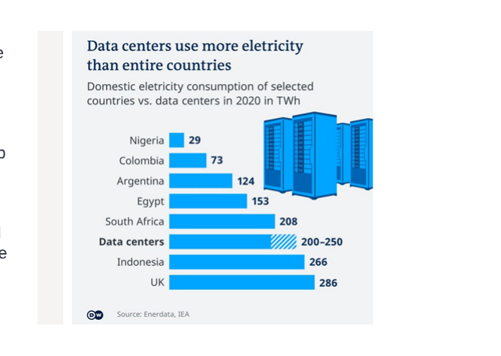
Looming Ahead – Serious energy concerns
Energy and Carbon footprints – as IT and computational complexity increases
Despite the significant energy savings in chip and transmission technologies
Growing size of networks
Operational complexity is increasing by several magnitudes – superseding the benefits
Other challenges
Management difficult , Human errors - automating
Troubleshooting difficult
Solution – use AI to selectively shutdown

Slide 10
Security and Privacy
TCP/IP suite was not invented with security in mind.
Layer 3 and Layer 4 protocols – security holes
What do we do – we patch them !
NEW PROTOCOLS CAN BE BUILT WITH SECURITY CONSIDERATION GROUND UP IN THE DESIGN

Slide 11
Challenges
WE NEED Solutions considering the big picture – not point solutions
Contributors
Researchers – universities, research labs – maximum flexibility
Revolutionary research and the “publish or perish” fear
Publications and grants
Industry – have their own agenda – who gets there first – whatever the path or process.
Standards bodies - IP from Internet or is it the other way round ?
What is missing ?
Open mind to work together, to embrace and foster revolutionary solutions

Slide 12
Are these the needs?
Backward compatibility –
Incremental deployment – test and deploy incrementally
Work in parallel with IP
Embrace different types of networks etc.
Allow for future growth
How difficult is it to achieve these ?
Freedom from routing protocols – selling point?

Slide 13
Thanks

