Slide 1

VyMobile App

Slide 2

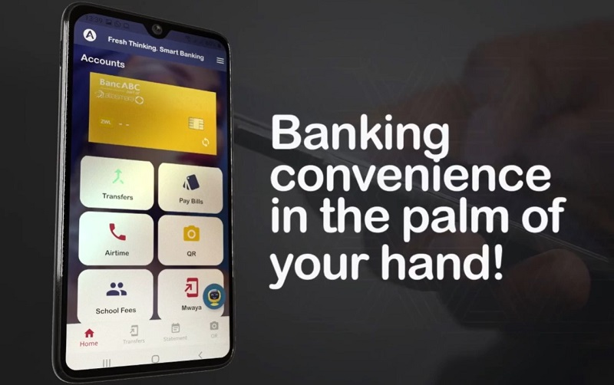
VyMobile App
Versatility and security solutions for all customers

Slide 3
