Slide 1

AAI-501 Group 3 Project
Hybrid Intrusion Detection System
Using Supervised and Unsupervised Learning Algorithm
Kalyan Brata Majumder Karthik Mekala
MS in Applied Artificial Intelligence University of San Diego
Supervisor: Prof. Anuj Kumar Sirohi
April 12, 2026

Slide 2
Background - Rising Cyber Threats
Rapid increase in global cybersecurity threats
Attack occurs every ~3 seconds
Major threats include:
Data breaches
Critical infrastructure attacks
Cyber intelligence
Real-world incidents:
815 million Indian records leaked (2023)
1.5 billion records exposed due to weak security
Economic impact:
$9.22 trillion (2024)
Projected $13.82 trillion by 2028

Slide 3
Legacy Constraints vs Modern Requirements
Why Traditional Firewalls Fail
Cannot prevent user-driven attacks (e.g., phishing clicks)
Encrypted traffic (HTTPS) hides malicious payloads
Limited to external traffic monitoring
Dependence on signature-based detection
Vulnerable to misconfiguration
Need for Advanced Cybersecurity Solutions
Traditional systems are not adaptive
Unable to detect zero-day attacks
Increasing data volume requires automation
Need for intelligent threat detection

Slide 4
Role of Machine Learning in Cybersecurity
Machine Learning transforms cybersecurity from a static barrier into an autonomous, evolving ecosystem
Behavioral Detection: Identifies unknown and evolving attack patterns.
Automated Scalability: Processes massive data volumes in real-time.
Dynamic Adaptation: Adjusts automatically to shifting threat landscapes.
Intelligent Response: Proactive identification of anomalies before breach.

Slide 5
Objective
Develop a Hybrid Intrusion Detection System (IDS)
Detect both:
Known attacks (Supervised Learning)
Unknown attacks (Unsupervised Learning)
Improve detection accuracy and generalization
Reduce false positives and false negatives
Handle class imbalance in network data
Enhance detection of rare and zero-day attacks
Optimize feature selection and model efficiency
Build a system suitable for real-world deployment

Slide 6
Dataset Summary and Description
Source: CICIDS2017 (Kaggle)
Contains millions of network traffic records
Includes multiple attack types
78 network flow features
Used for:
Training ML models
Evaluating intrusion detection performance
Modern replacement for KDD’99 dataset
Reflects real-world network traffic
Publicly available benchmark dataset
Generated by:
Canadian Institute for Cybersecurity

Slide 7
Dataset Collection
Environment:
Realistic Environmnet Setup:
Attacker and Victim network
Separated by:
Firewall and Core switch
Data sources:
Network traffic (PCAP) and Host-level logs
Strategy:
Data collected over 5 days
Day 1: Fully benign traffic
Days 2–5:
Mixed traffic (benign + attacks)
Attack types:
DoS / DDoS
Brute Force
Web attacks
Botnet
Infiltration

Slide 8
Data Cleaning/Preparation
Cleaning Negative Values
Removed invalid entries
Replaced remaining with zero to prevent data loss
Column Consistency Check
Ensured uniform column names & order
Prevented incorrect dataset merging
Handling Infinite Values
Caused by division errors (e.g., rates)
Detected and removed to avoid model failure
Duplicate Column Removal
Eliminated redundant features
Improved efficiency and data quality
Cleaned and structured dataset
Ready for:
Feature engineering
Model training
Improved data quality

Slide 9
Challenges – Network Traffic Distribution
Dataset is highly imbalanced
BENIGN traffic dominates significantly
Frequent attack types:
DoS Hulk
Port Scan
DDoS
Rare attack types:
Heartbleed
SQL Injection
Infiltration
Web Attacks (XSS, Brute Force)

Slide 10
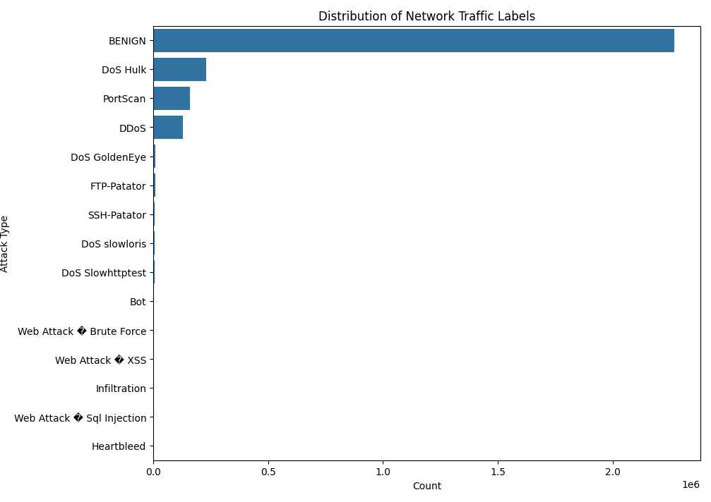
Challenges – Network Traffic Distribution

Slide 11
Feature Engineering & Selection
Correlation-based Feature Selection
Focused on numerical features only
Computed correlation matrix
Redundancy Removal
Analyzed upper triangle to avoid duplication
Threshold set to 0.95 and identified highly correlated features
Correlation Analysis:
Correlation matrix used to analyze feature relationships
Strong correlations identified (≥ 0.95 threshold)
Red blocks indicate highly correlated feature pairs
Significant feature redundancy observed

Slide 12
Correlation Analysis – Feature Redundancy
Observation:
Many features were highly correlated
Indicates redundancy in dataset
Impact of Removing Redundant Features:
Reduced dimensionality
Improved training efficiency
Lower risk of overfitting
Enhanced model interpretability
Outcome:
Efficient feature space reduction
Retained most informative features
Improved dataset quality for model training

Slide 13
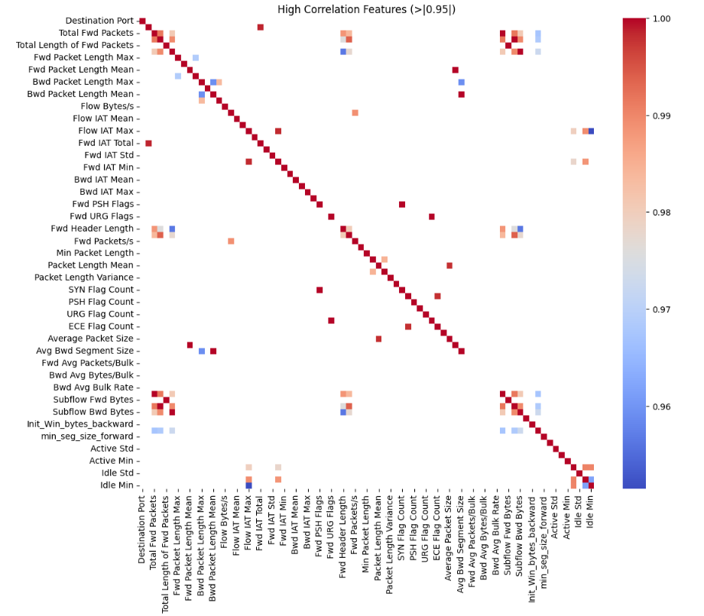
Correlation Heatmap

Slide 14
Encoding & Splitting
Binary Label Encoding
Multiple traffic classes → converted to binary classification
BENIGN → 0
ATTACK → 1
Labels standardized:
Trim spaces
Convert to uppercase
Ensures consistency & efficient model training
Train–Test Split & Imbalance Handling
Dataset is highly imbalanced
Used Stratified Sampling
Preserves class distribution
Applied Under-sampling (Training only)
Balances classes
Prevents data leakage

Slide 15
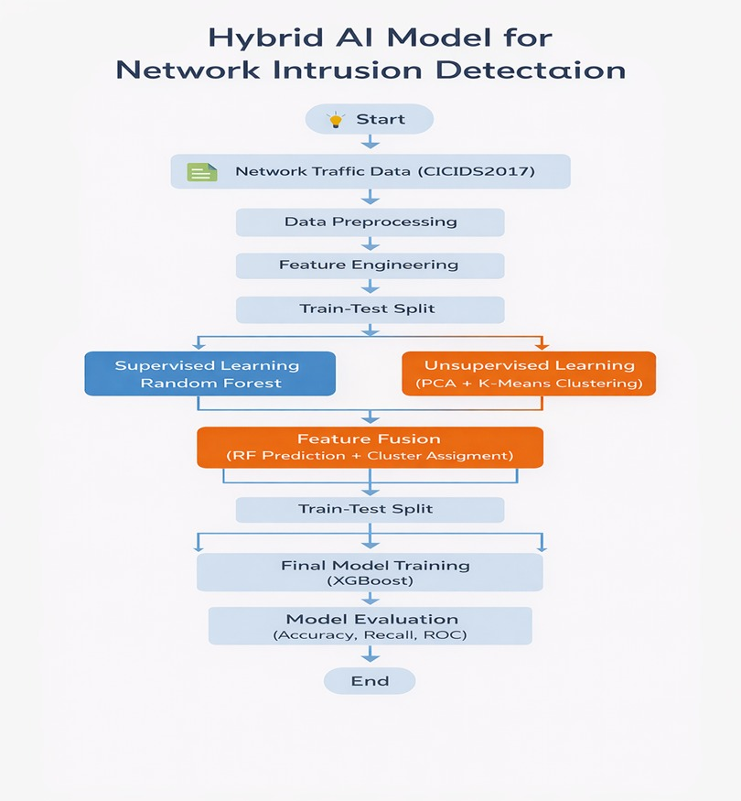
Methodology Overview

Slide 16
Methodology Overview
Dataset: CICIDS2017
Approach: Supervised Learning (Random Forest)
Objective: Detect Benign vs Attack traffic
Pipeline:
Data Preprocessing
Feature Engineering
Model Training
Evaluation

Slide 17
Data + Model + Tuning
Data Preparation:
Features (X) & Target (y: 0 = Benign, 1 = Attack)
Balanced training dataset
Model: Random Forest
Handles high-dimensional data
Robust & efficient
Parallel processing (n_jobs = -1)
Feature Selection:
Top 15 important features
Hyperparameter Tuning:
Grid Search + 5-fold CV
Best parameters:
max_depth = 20
min_samples_leaf = 2
min_samples_split = 5
n_estimators = 100

Slide 18
Model Evaluation and Results
Evaluation Metrics:
Accuracy, Precision, Recall, F1-score
Overall Performance:
Accuracy: ~99%
F1-score (macro & weighted): 0.99
Class-wise Performance:
Benign (Class 0):
Precision: 1.00
Recall: 0.99
Attack (Class 1):
Precision: 0.98
Recall: 1.00
High recall → minimal missed attacks
Low false positives
Balanced model performance

Slide 19
Confusion matrix
The Random Forest model demonstrates strong performance, as shown by the confusion matrix.
High True Negatives: 450,979
High True Positives: 110,837
Low False Positives: 2,739
Very Low False Negatives: 436
Accurate detection of benign & attack traffic
Low misclassification rates
Strong focus on detecting malicious activity
Overall, the model shows reliable performance with low misclassification rates and a strong emphasis on detecting malicious activity.

Slide 20
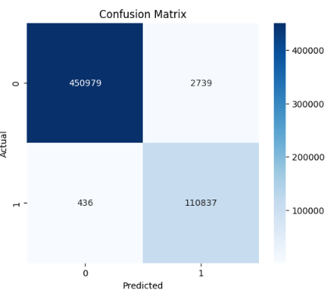
Confusion matrix

Slide 21
ROC Curve Analysis
AUC Score: 0.9996
Indicates near-perfect class separation
Curve close to top-left corner:
High True Positive Rate (TPR)
Low False Positive Rate (FPR)
Excellent discrimination between classes
Strong intrusion detection capability
Further validation needed for generalization

Slide 22
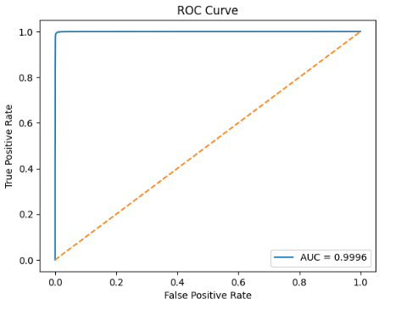
ROC Curve Analysis

Slide 23
Feature Importance Analysis
Identified using Random Forest model
Top Contributing Features:
Destination Port
Packet Length (max, mean, variance)
Forward/Backward packet features
TCP Window Size
Improves efficiency
Reduces dimensionality
Enhances interpretability

Slide 24
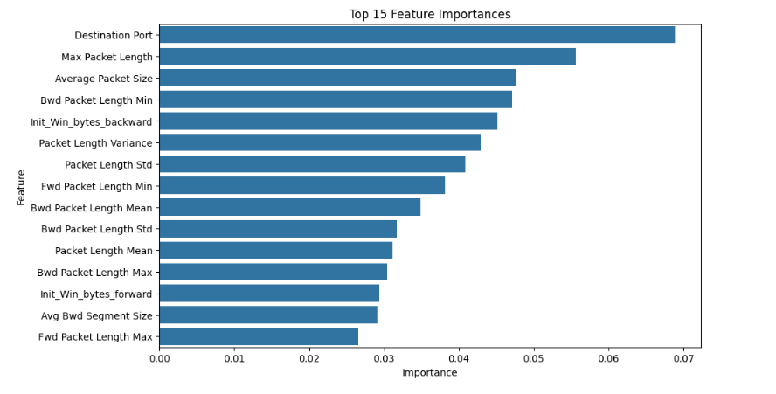
Feature Importance Analysis

Slide 25
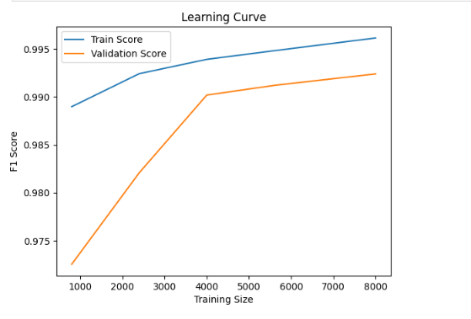
Learning Curve Analysis
Training F1-score: ~0.989 → 0.996
Validation F1-score: ~0.972 → 0.992
Small gap (~0.003–0.004)
Indicates minimal overfitting

Slide 26
Unsupervised Learning – Methodology
Approach: K-Means Clustering (MiniBatch)
Objective:
Extract hidden patterns
Generate new features
Steps:
Data balancing
Feature scaling
PCA (dimensionality reduction)
Clustering
Balanced Dataset:
50K Benign + 50K Attack samples
Feature Scaling:
StandardScaler applied
PCA:
Reduced 77 → 20 features
K-Means Configuration:
K = 2 clusters
Batch size = 5000
10 initializations

Slide 27
Cluster Interpretation & Results
Cluster Mapping:
Cluster 0 → Benign (mean = 0.40)
Cluster 1 → Attack (mean = 0.87)
Observations:
Clear separation in PCA space
Benign → dense near origin
Attack → more dispersed
Captures hidden patterns
Enhances feature representation
Improves downstream model performance

Slide 28
K-Means Clustering Visualization (PCA Space)
Clustering performed using MiniBatch K-Means (K = 2)
Visualized using PCA (PC1 vs PC2)
Observations:
Cluster 0 (Benign):
Densely packed near origin
Cluster 1 (Attack):
More dispersed across feature space
Centroids (Red X):
Represent cluster centers
Clear separation between traffic types
Captures underlying data patterns

Slide 29
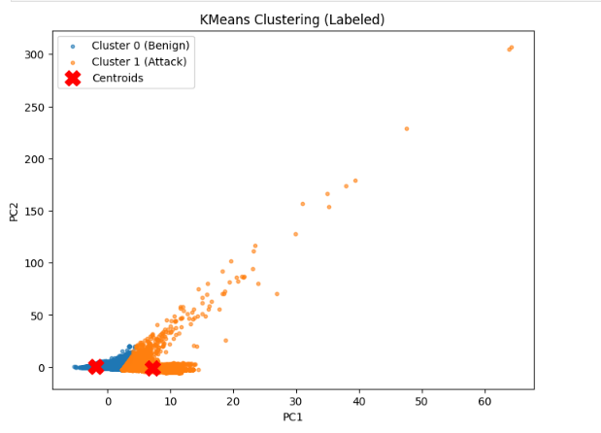
K-Means Clustering Visualization (PCA Space)

Slide 30
K-Means Model Evaluation
Overall Accuracy: 0.83
Benign Traffic (Class 0):
Recall: 0.95
F1-score: 0.90
Attack Traffic (Class 1):
Recall: 0.36
F1-score: 0.46
Strong at detecting benign patterns
Weak at detecting attack patterns

Slide 31
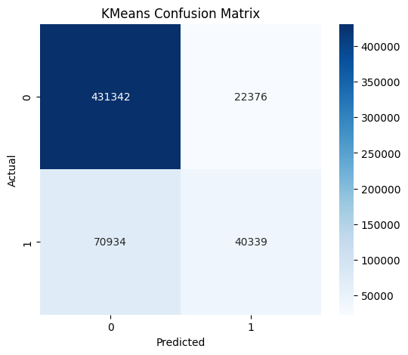
K-Means Confusion Matrix Analysis
K-Means effectively identifies benign traffic but fails to detect many attacks due to high false negatives. This shows that clustering alone is insufficient for intrusion detection and must be combined with supervised models.

Slide 32
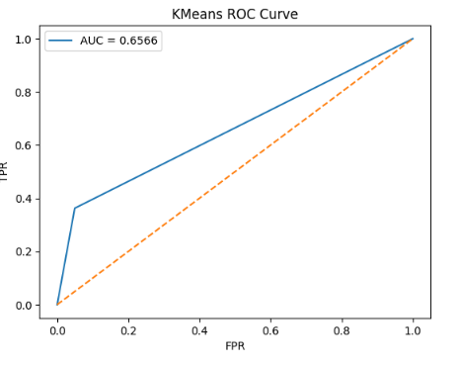
K-Means ROC Curve Analysis
The ROC curve shows that the K-Means model achieves an AUC score of 0.6566, which indicates performance slightly better than random guessing
AUC Score: 0.6566

Slide 33
Justification for Using K-Means
Limitations (Standalone Use)
Unsupervised → no use of class labels
Relies on distance-based clustering
Struggles with diverse attack patterns
Class imbalance → biased toward benign traffic
Overlap between benign & attack clusters
K-Means clustering has limitations as a standalone classifier because it does not use class labels and relies purely on distance-based grouping. This makes it less effective for classification tasks, especially in intrusion detection where attack patterns are highly diverse and often overlap with benign traffic.
K-Means plays an important role in the hybrid model as a feature engineering tool. It helps uncover hidden structures in the data and generates additional features such as cluster labels and distance-to-centroid measures.

Slide 34
Integration of features from Model 1 and Model 2
Hybrid Approach: Combines
Supervised (Random Forest)
Unsupervised (K-Means)
Random Forest Features
Prediction (rf_pred)
Probability (rf_prob)
Clustering Features:
Cluster label (cluster_pred)
Distances (cluster_dist_0, cluster_dist_1)

Slide 35
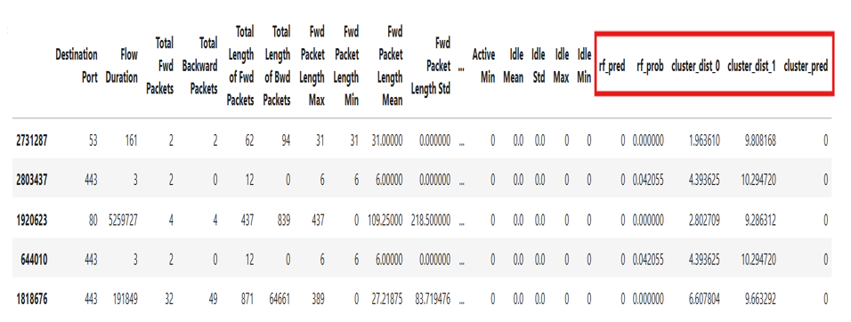
Integration of features from Model 1 and Model 2

Slide 36
Dataset Preparation & Model Optimization
Dataset Preparation
Combined:
Original + RF + K-Means features
Feature Selection:
Top 20 features (RF importance)
Added mandatory hybrid features
Data Split:
80:20 Train-Test
Stratified sampling
Hyperparameter Tuning (XGBoost)
Method: Grid Search + 3-fold CV
Total: 48 model evaluations
Best Parameters:
Learning rate = 0.1
Max depth = 6
Estimators = 200
Subsample = 0.8

Slide 37
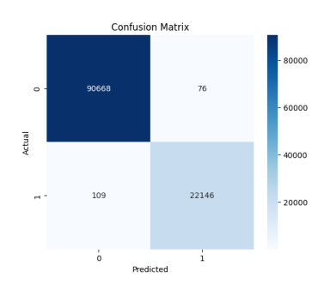
XGBoost Model Performance
Accuracy / Precision / Recall / F1-score: 1.00
Confusion Matrix:
Very low False Positives: 76
Very low False Negatives: 109

Slide 38
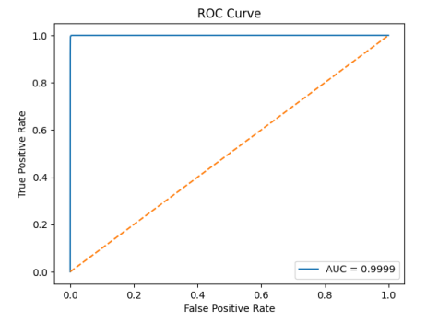
XGBoost Model Performance
ROC Curve
AUC Score: 0.9999
Near-perfect class separation

Slide 39
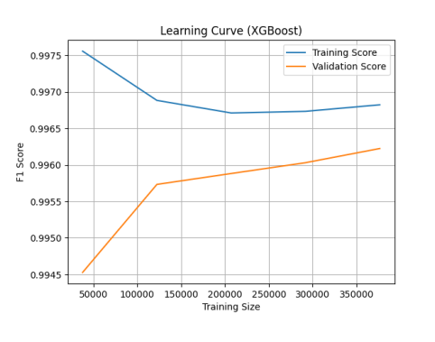
XGBoost Model Performance
Learning Curve:
Training: ~0.997
Validation: ~0.996
Minimal gap → no overfitting

Slide 40
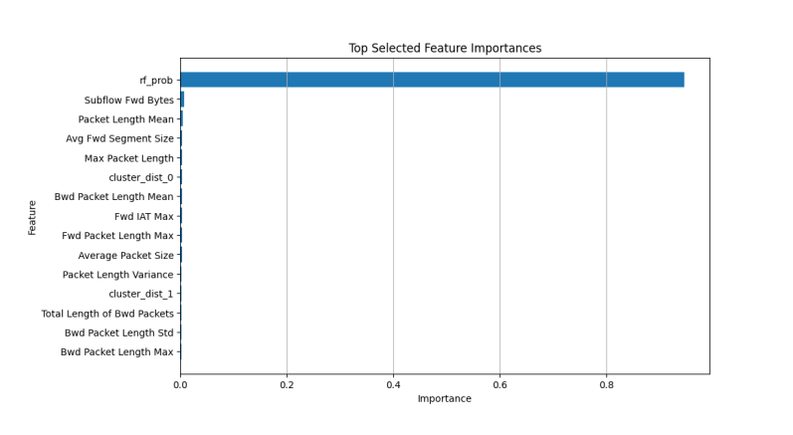
Feature Importance & Key Insights
rf_prob → Most dominant feature
Clustering features → Support complex cases
Hybrid model combines:
Supervised predictions
Clustering patterns
XGBoost optimization
Strong decision boundaries
Improved detection accuracy
Robust performance

Slide 41
Conclusion
Developed a Hybrid Intrusion Detection System (IDS)
Integrated:
Random Forest (Supervised)
K-Means (Unsupervised)
XGBoost (Final Supervised Model)
Key Achievements:
High detection accuracy (~99%)
Effective handling of class imbalance
Improved detection of attack traffic
Reduced false negatives
Hybrid approach outperforms standalone models
Combines prediction + pattern discovery
The hybrid approach significantly enhances intrusion detection by combining prediction accuracy with pattern discovery

Slide 42
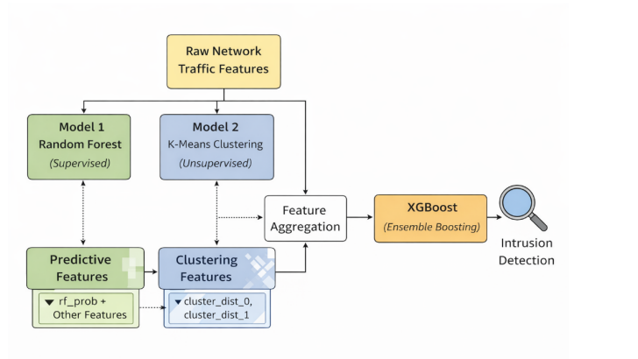
Conclusion
Solution for network intrusion detection systems

Slide 43
Limitations
Risk of data leakage (multi-model feature integration)
High dependency on derived features
Limited model interpretability
High computational cost
Performance may vary with:
Changing data distributions
Rare attack classes

Slide 44
Future Work
Develop fully integrated pipeline
Explore deep learning models (CNN, LSTM)
Enable real-time intrusion detection
Improve feature engineering & selection
Enhance model explainability
Extend to multi-class classification

Slide 45
Individual Contributions
Kalyan Brata Majumder
Data Preparation
Dataset collection (CICIDS2017)
Data cleaning & preprocessing
Handling missing, infinite & inconsistent values
Model : Supervised Learning (Random Forest)
Feature selection using random forest feature importance
Model training & hyperparameter tuning
Model : Supervised Learning (XGBoost)
Integration of RF + K-Means outputs
Feature fusion & selection
Model training & hyperparameter tuning.
Performance Evaluation of individual models using:
Classification report ,Confusion Matrix, ROC Curve, Learning Curve
Result analysis & comparison
Documentation
Technical Report
A well-structured GitHub Project repository
Code modularization.
Documentation and README preparation.

Slide 46
Individual Contributions
Karthik Mekala
Data Preparation
Data analysis, cleaning & preprocessing
Model: Unsupervised Learning (K-Means)
Data balancing & feature scaling
PCA for dimensionality reduction
Clustering & feature extraction (cluster labels, distances)
Evaluation
Confusion Matrix, ROC Curve, Learning Curve
Result analysis & comparison
Documentation
Technical Presentation
A well-structured GitHub Project repository
Code modularization.
Documentation and README preparation.

