Slide 1
AAI-510 Group 2 Project
A Hybrid Ensemble Framework for Intrusion Detection and Attack Classification Using Random Forest, Kernel PCA–K-Means, and XGBoost
Kalyan Brata Majumder • Karthik Mekala • Kunal Gurtoo
MS in Applied Artificial Intelligence University of San Diego

Slide 2
Industry Challenges : Rising Cyber Threats
Invisible Corporate Threats
Enterprise networks generate millions of data packet events every minute.
Ransomware, stealth infiltrations, and brute force attacks happen in milliseconds.
Security operations centers are drowned in millions of unclassified, cryptic system alerts.
Move from simple firewalls to autonomous behavioural triage, identifying not just "attacks" but precise threat families.
Why traditional network alerts fail
Traditional perimeter walls fail when user accidentally click malicious phishing links inside the network.
Standard secure web traffic shields malicious payloads from basic inspection tools.
Visibility remains restricted to outside entry points, leaving internal lateral threat movements completely unmonitored.
Systems only look for historically known threats, meaning they remain entirely blind to novel, evolving attack variations.
Complex configuration requirements create massive security gaps through simple human error.
Notes:
To understand why our system is so vital, we must first look at where traditional firewalls fail. Standard security tools are designed to guard the outer boundary of our business, much like a security guard at the front door of a building. However, if an attacker sends an email and an employee clicks a bad link, the perimeter is bypassed from the inside. The wall remains perfectly intact, but the threat is already within our network. Furthermore, modern network traffic is heavily encrypted, which allows malicious actors to hide dangerous data flows inside standard communication channels. Because legacy tools are blind to these internal movements, we must transition to an analytical system that continuously evaluates internal network behaviors.

Slide 3
Advantages of our Model
Detection of Unknown Attacks : Unlike firewalls that rely on predefined rules and signatures, the hybrid model can identify anomalous traffic patterns that may indicate previously unseen attacks.
Attack Categorization : The proposed system not only detects malicious traffic but also predicts the likely attack category, providing additional threat intelligence for security teams.
Behavioural Analysis : The model analyses network flow characteristics and traffic behavior rather than relying solely on packet filtering rules.
Multi-Layer Intelligence : By combining Binary Random Forest predictions, Attack-type probabilities, Kernel PCA + K-Means clustering features and XGBoost ensemble learning the system makes decisions using multiple complementary perspectives.
Reduced False Alarms : The ensemble architecture improves decision quality by combining supervised and unsupervised signals, reducing reliance on a single detection mechanism.
Adaptability : The model can be retrained with new traffic data, allowing it to adapt to evolving attack techniques and changing network environments.

Slide 4
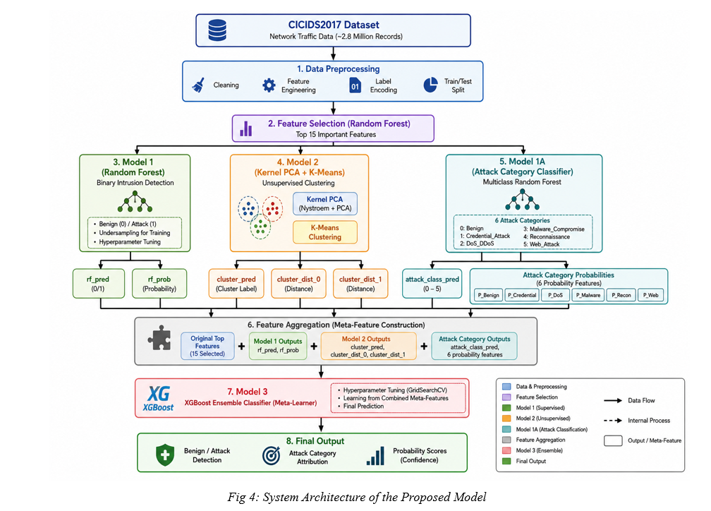
Our Strategic Objective and Unified Defence Funnel
Strategic Objective: Build an autonomous security system that instantly identifies whether a network flow is malicious and precisely attributes the specific threat family.
Layer One Supervised Detection: Model One performs rapid binary identification to separate benign and attack traffic.
Layer Two Behavioural Discovery: Model Two acts as an unsupervised behavioural tracking system to spot hidden or unlearned anomalies by grouping traffic structures.
Layer Three Deep Triage: Model One A assigns exact risk confidence profiles across our consolidated threat categories.
Notes:
Before we discuss how we streamlined our network traffic data, let us address the core mission of this project and exactly how our new architecture achieves it. Our strategic objective was to build a system that goes far beyond a simple binary warning. We set out to create an autonomous defense shield that instantly tells us if we are under attack, exactly what type of threat is hitting us, and how confident we are in that assessment.
As you can see mapped out in our master architecture diagram from image_eb92a5.jpg, we achieve this by running three distinct layers of artificial intelligence in parallel. The first layer acts as our rapid response scout, separating normal daily operations from general malicious activity. The second layer uses deep behavioral clustering to spot completely hidden or unlearned anomalies that try to slip past standard filters. The third layer acts as our specialized triage doctor, analyzing the traffic to assign precise risk profiles across our threat categories.
Finally, all three layers feed their unique notes into a master decision brain, which cross references the intelligence to deliver a verified, ultra high accuracy final action plan. This multi layered approach ensures the enterprise is never left blind to a sophisticated cyber threat

Slide 5
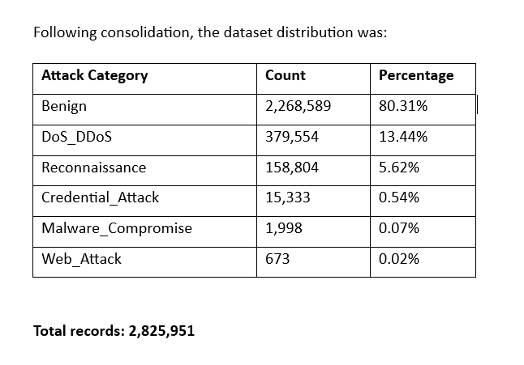
Consolidating Alert
Evaluated a massive enterprise benchmark dataset containing over 2.8 million individual network records.
Normal Day to Day Operations: Comprises 80.31 percent of the footprint with 2,268,589 safe connections.
Digital Flooding Traffic: Comprises 13.44 percent of the volume with 379,554 resource draining incidents.
The Minority Threat Challenge: Severe data imbalance exists, with critical web exploits making up less than 1 percent of raw files.
Notes:
Now that we understand our strategic mission, let us look at the actual scale of the enterprise data footprint we are protecting. As detailed in Section 3 of our Technical Report, we validated our architecture against a massive corporate communications baseline containing over 2.8 million individual network records. When we look at this data under a microscope, we discover our first major operational reality: over 80 percent of our daily network volume consists of perfectly safe, normal business operations. The remaining 19.69 percent constitutes our active threat footprint. To handle this massive volume without slowing down our business, our initial baseline model performs a rapid automated pass, acting as a high speed filter that instantly secures normal day to day operations and isolates the malicious traffic for deeper analysis.

Slide 6
Streamlining Threat Definitions
Raw network logs contain fifteen highly fragmented technical signatures that cause intense security analyst fatigue.
We streamlined our defense network by consolidating these chaotic signatures into five broad corporate attack families.
Digital Flooding (DoS and DDoS): Dominates the threat volume, accounting for 13.44 percent of total enterprise traffic.
Targeted Exploits: Reconnaissance Probing covers 5.62 percent, Credential Theft covers 0.54 percent, Malicious Takeovers cover 0.07 percent, and Web Fraud sits at a rare 0.02 percent.
The Gateway to Model 1A: This structured taxonomy reduces class fragmentation, allowing our multiclass engine to calculate explicit threat attributes.
Notes:
Isolating general threat traffic is only half the battle. In raw system logs, malicious traffic is incredibly chaotic, split across fifteen highly specific, fragmented technical signatures. Forcing a human analyst to interpret fifteen separate alarms is a recipe for operational failure. We solved this by consolidating those fifteen raw technical signatures into five highly structured, actionable corporate attack families. As you can see on the slide, Digital Flooding attacks dominate the volume, followed by Reconnaissance Probing. Specialized threats like Credential Theft, Malicious Takeovers, and Web Fraud make up a tiny fraction of the data. This strategic categorization is a massive milestone for our project. By mapping the chaos into a structured taxonomy, we have created the perfect framework for Model 1 A, our advanced multiclass classification engine, to identify and attribute exact threat types automatically.

Slide 7
Softmax Probability Triage and the Accuracy Paradox
Fluid Risk Profiling: Implemented an advanced Multiclass Random Forest framework with Softmax style probability mapping to calculate a fluid spectrum of risk across all six categories simultaneously.
Outstanding Baseline Performance: Achieved an exceptional 99.60 percent overall accuracy, validating normal traffic with 100 percent precision and mitigating massive flooding streams with a 99 percent success rate.
The Accuracy Paradox Exposed: This near perfect global score dangerously hid a total failure in rare, critical risk areas, returning a 0.00 F1 score for Web Attacks due to severe data scarcity.
Justification for a Hybrid Model: This critical defensive blind spot proves that a standalone supervised model is mathematically insufficient, providing the direct business justification for our multi layered hybrid architecture.
Notes:
Once we structured our network threat definitions, we launched our first intelligent defensive layer: a Softmax style risk triage engine. Instead of forcing a rigid black or white guess, this model operates like an automated risk officer, assigning fluid probability percentages across all threat categories at the same time.
At first glance, the performance report card looks like a complete victory, achieving an exceptional global baseline accuracy of 99.60 percent. This includes a seamless 100 percent success rate for normal daily operations and a 99 percent mitigation rate against massive digital flooding disruptions.
But as business leaders, we must look past high level summaries. This brings us to a dangerous industry illusion known as the Accuracy Paradox. Because normal operations and flooding events make up over 93 percent of our network logs, a standard algorithm can completely fail to learn rare, critical threats and still walk away with a top grade. In fact, due to extreme data scarcity, our triage model returned a devastating 0.00 F1 score for Web Attacks, missing them entirely. This hidden blind spot is our ultimate justification for building the final hybrid shield. We cannot leave our most critical web pathways vulnerable to silent, unlearned exploits simply because they happen less frequently.

Slide 8
Capturing Novel and Unlearned Threat : Advanced Behavior Upgrades
Supervised models are strictly bound by their training history and cannot identify novel or evolving attack structures.
We upgraded our unsupervised pipeline to an advanced nonlinear framework called Kernel PCA using Nystroem approximation.
This allows the system to discover novel malicious anomalies completely unlearned by the supervised models.
Key Operational Outcome: This upgrade successfully boosted our behavioural threat grouping clarity from 0.4893 to 0.5823, an exact 19.00 percent improvement.
Notes:
To eliminate the blindspots that we just described, we had to fundamentally upgrade how our system views network behaviors. Traditional analytics look at data in straight lines. However, modern hackers do not attack in straight lines; they intentionally slow down and alter their tempos to mimic normal corporate traffic and blend in. To counter this, I replaced our standard linear tracking with an advanced nonlinear behavior profiling framework called Kernel PCA using Nystroem approximation, detailed in Section 4.4 of our Technical Report. This upgrade functions like a high definition thermal camera for our network, revealing complex, curved data shapes that were previously invisible. This advanced change successfully boosted our behavioral threat grouping clarity by exactly 19.00 percent, raising our quality score from 0.4893 to 0.5823 and forcing novel, unlearned stealth attacks out of hiding

Slide 9
The Stacked Hybrid Security Shield
We constructed our final master shield by fusing supervised probability vectors with unsupervised spatial metrics.
The architecture evaluates four distinct streams of intelligence simultaneously to maximize detection confidence:
Supervised Binary Signals: Overall threat likelihood predictions and probability scores from our baseline Random Forest model.
Supervised Multiclass Intelligence: Multiclass Random Forest confidence predictions and Softmax style risk probabilities.
Unsupervised Behavioural Knowledge: Cluster assignments and centroid distance metrics mapped via our nonlinear clustering.
Raw Network Indicators: Original data flow characteristics and core connection packet metrics
Combining models allows behavioural distance metrics to fine tune prediction probabilities. This helps the final system catch inconsistencies and block hidden threats.
Notes:
We solved our security blindspot by creating a unified hybrid shield. We did not just pick one algorithm; instead, we stacked them into an interconnected defense system, which you can see visualized in our main architectural blueprint. Our final master framework, powered by an optimized XGBoost engine, evaluates four distinct intelligence layers simultaneously before making a final decision. It processes our baseline threat signals, our multiclass triage probabilities, our advanced behavioral clustering distance metrics, and the raw network features all at once. By evaluating probability vectors and spatial distance vectors simultaneously, our final model eliminates individual blindspots and achieves near perfect threat mitigation.

Slide 10
Managing Operational Complexity and Longevity
Operational Complexity Risk: Processing multiple advanced machine learning models simultaneously increases compute resource overhead.
Corporate Mitigation: We deploy optimized, lightweight mathematical approximations to ensure high speed processing.
The Threat of Data Drift: Evolving hacker strategies over time can cause standard model accuracy to decay.
Corporate Mitigation: Established a continuous update feedback loop to retrain the system automatically on fresh threat data.
Upstream Error Dependency: Final outputs rely heavily on structural features derived from earlier models in the pipeline.
Corporate Mitigation: Strict segregation rules and cross validation ensure complete protection against systemic data errors
Notes:
As executive leaders, we must balance advanced artificial intelligence with practical risk management. Deploying a multi layered hybrid framework introduces real operational questions. First, running multiple models simultaneously demands computational power. We mitigate this by utilizing highly optimized, lightweight mathematical approximations that deliver maximum speed with minimum resource drag. Second, network environments change over time, a concept known as data drift. We counter this by building an automated retraining cycle that keeps our models sharp against fresh threat intelligence. Finally, to ensure our final layer is never corrupted by an upstream mistake, we implemented strict validation guardrails across our data pipeline, as outlined in Section 6.1 of the report.

Slide 11
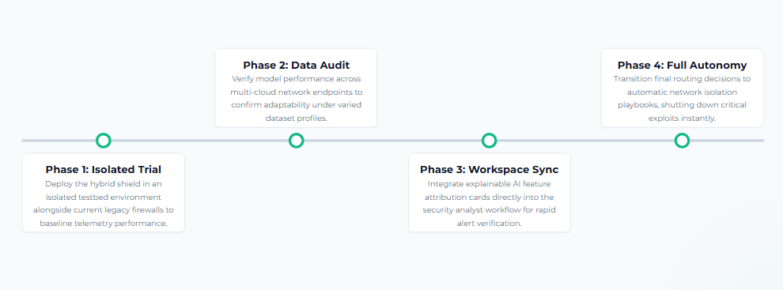
Strategic Deployment Roadmap
A clear four-phase actionable schedule designed for seamless operational transition:
Notes:
To bring this next generation protection to our enterprise, we recommend a pragmatic, three phase rollout strategy. In the first two months, we will conduct a controlled trial of our hybrid shield within an isolated sandbox network to validate stability without risking live production. In phases two and three, we will scale our validation across our diverse cloud environments and integrate Explainable AI features. This ensures our security analysts instantly see the transparent logic behind every alert, completely eliminating guesswork. By adopting this intelligent, multi layered framework, our organization will eliminate analyst fatigue, meet modern regulatory compliance, and secure our enterprise footprint for years to come. Thank you, and we are now happy to open the floor to your questions

Slide 12
AAI-510 Group 2 Project
Thank You

