Slide 1
Was ist API First
Design first Prinzip
Technische Single Source of Truth → 100% exakt (im Unterschied zu Code First).
Standardisierte REST API Spezifikation mit OpenAPI
Ökosystem mit vielen Tools
API Lifecycle Management

Slide 2
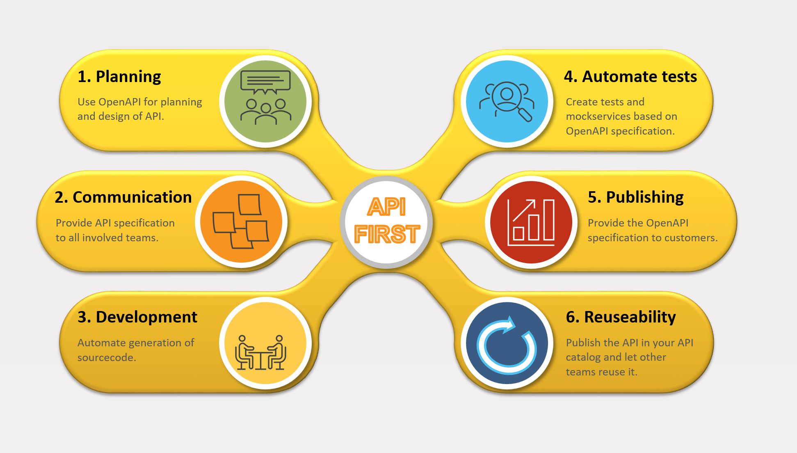
API First Vorteile in API lifecycle

Slide 3
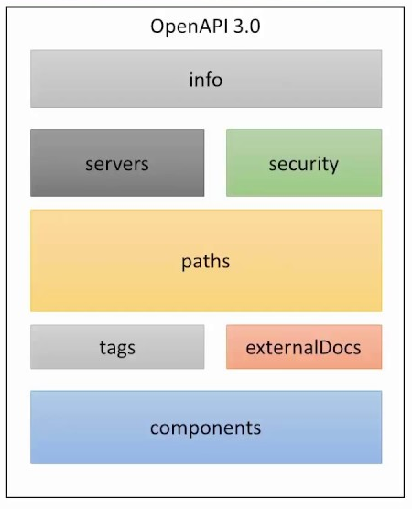
Aufbau OpenAPI 3.0 (OAS3)

Slide 4
Beispiel OpenAPI 3.0 (OAS3)
openapi: 3.0.1 info: title: Hello World API version: "1.0« description: Hello World Sample paths: /hello/: get: description: Returns a greeting to the user! parameters: - description: The name of the user to greet. in: query name: user required: true schema: type: string responses: "200": content: applicaton/json:: schema: $ref: '#/components/schemas/Person' description: Returns the greeting. "400": content: {} description: Invalid characters in "user" were provided. components: schemas: Person: type: object properties: lastname: type: string firstname: type: string age: type: integer format: int32 birthdate: type: string format: date-time

Slide 5
Tools
Allgemein: Postman
Editieren: Swagger Editor oder Apicurito
Erstellen: Joaswizard
Generator: Openapi Generator
Testframeworks: Idaithalam, Karate.
Anwendung: Springdoc
API Hub: Apicurio Studio

Slide 6
Links
https://postman.com
https://editor.swagger.io
https://inss.ch/apistudio/
https://github.com/networkinss/SampleOpenAPICollection
https://github.com/networkinss/joaswizard
https://openapi-generator.tech/
https://github.com/virtualansoftware/idaithalam
https://github.com/karatelabs/karate
https://www.apicur.io/
https://openapi.tools/

