Slide 1
What is API First & OpenAPI
API First is a method to design first the API, in second step start coding.
OpenAPI is a technical documentation.
Technical single-source of truth -> 100% precise (which Code First is not).
OpenAPI is a standardised REST API specification.
Huge community with huge variety of tools.
Benefit for the entiry API Lifecycle Management.
Together they add much value to an API project.

Slide 2
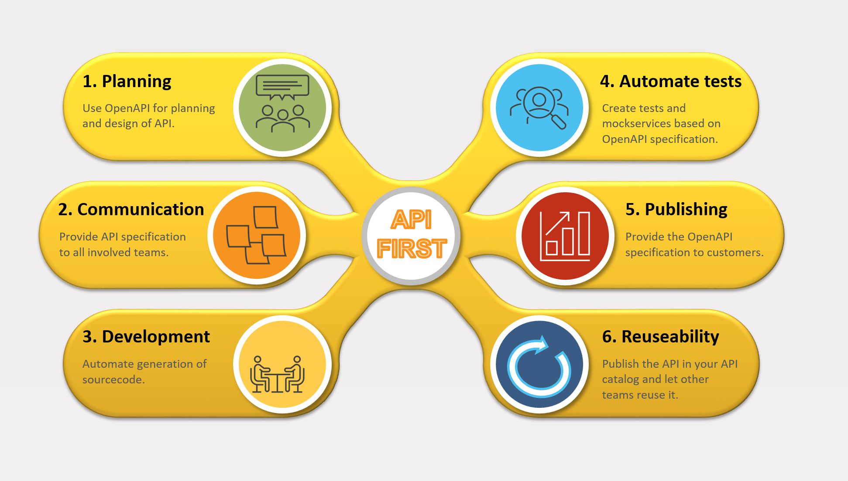
API First Vorteile in API lifecycle

Slide 3
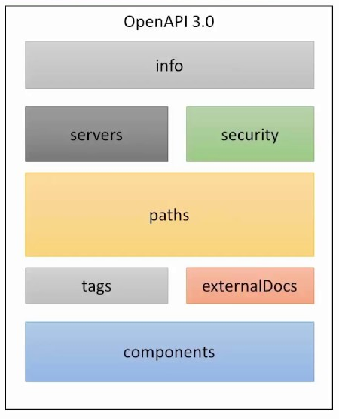
Structure OpenAPI 3.0 (OAS3)

Slide 4
Sample OpenAPI 3.0 (OAS3)
openapi: 3.0.1 info: title: Hello World API version: "1.0« description: Hello World Sample paths: /hello/: get: description: Returns a greeting to the user! parameters: - description: The name of the user to greet. in: query name: user required: true schema: type: string responses: "200": content: applicaton/json:: schema: $ref: '#/components/schemas/Person' description: Returns the greeting. "400": content: {} description: Invalid characters in "user" were provided. components: schemas: Person: type: object properties: lastname: type: string firstname: type: string age: type: integer format: int32 birthdate: type: string format: date-time

Slide 5
Demo – how to create a new webservice
Create objects with sample values as in sampledata.yaml in Yaml format. Select the file.
Call plugin OpenAPI CRUD Wizard in menu "Tools".
Edit the generated openapi.yaml in https://editor.swagger.io.
Download the OpenAPI generator jar with the script checkfiles.sh.
Generate a Spring Boot application with the file generate.sh.
Check http://localhost:8080

Slide 6
Some useful tools
General: Postman.
Editing: Swagger Editor or Apicurito.
Creation: Joaswizard or IntelliJ plugin „OpenAPI CRUD Wizard“.
Generator: Openapi Generator.
Testframeworks: Karate.
Application documentation: Springdoc
API Hub: Apicurio Studio

Slide 7
Links
https://postman.com
https://editor.swagger.io
https://inss.ch/apistudio/
https://github.com/networkinss/SampleOpenAPICollection
https://github.com/networkinss/joaswizard
https://openapi-generator.tech/
https://github.com/virtualansoftware/idaithalam
https://github.com/karatelabs/karate
https://www.apicur.io/
https://openapi.tools/

