Slide 1
API First & OpenAPI Introduction, benefits

Slide 2
Themes
API First is a method to design the API first, and start to code in the second step.
Technical single-source of truth -> 100% precise (which Code First is not).
OpenAPI is a technical documentation.
OpenAPI is a standardised REST API specification.
Huge community with huge variety of tools.
Benefit for the entiry API Lifecycle Management.
Benefits:
Support during development.
Tools and improvements during entire API life cycle.
Huge amount of tools to automate processes.

Slide 3
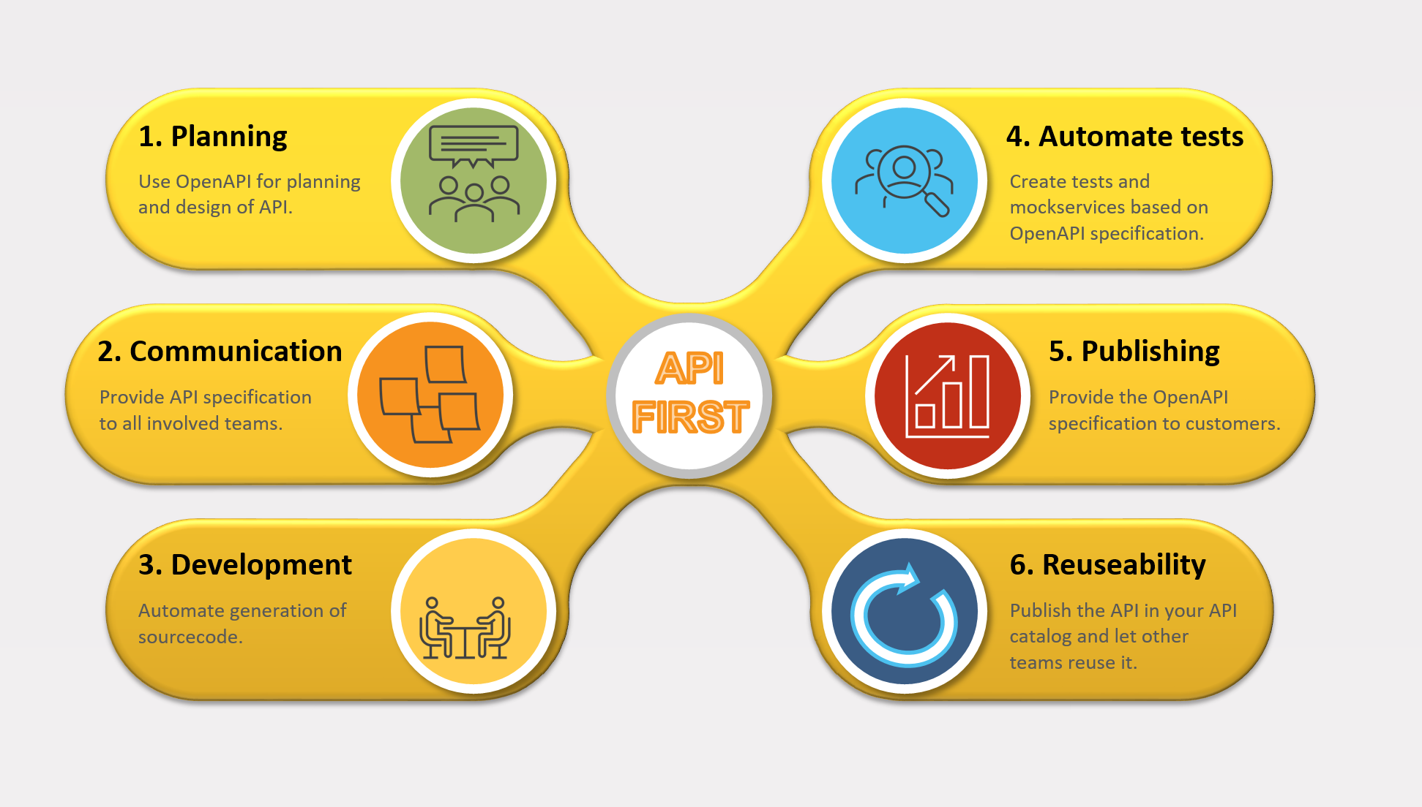
API Life cycle

Slide 4
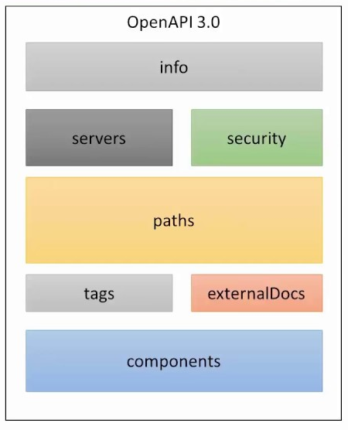
Structure OpenAPI 3.0 (OAS3)

Slide 5
Demo workshop create a new Webservice with API First
Create objects with sample values as in sampledata.yaml in Yaml format. Select the file.
Call plugin OpenAPI CRUD Wizard in menu "Tools".
Edit the generated openapi.yaml in https://editor.swagger.io.
Download the OpenAPI generator jar with the script checkfiles.sh.
Generate a Spring Boot application with the file generate.sh.
Check http://localhost:8080

Slide 6
Some useful tools
Postman
Editing: Swagger Editor or Apicurito
IntelliJ plugin „OpenAPI CRUD Wizard“
Openapi Generator
Application documentation: Springdoc
API Hub: Apicurio Studio

Slide 7
Useful links
https://postman.com
https://editor.swagger.io
https://inss.ch/apistudio/
https://github.com/networkinss/SampleOpenAPICollection
https://github.com/networkinss/joaswizard
https://openapi-generator.tech/
https://github.com/virtualansoftware/idaithalam
https://github.com/karatelabs/karate
https://www.apicur.io/
https://openapi.tools/

Slide 8
Q & A
Mail: info@inss.ch
Website: https://inss.ch

