Slide 1
Implementing CI/CD Pipelines in a NetDevOps Environment
Network to Code
Jeff Kala, Allen Hogan, Jason Edelman
Internet2 TechEx 25
December, 2025

Slide 2
Agenda
1:00
Introduction
Slides
Lab 1,2,3
2:00
BREAK
3:00
Lab 4,5,6
4:30
Notes:
230p - 3pm (Afternoon break)

Slide 3
Introduction

Slide 4



Who is standing in front of you
Jeff Kala
Automation Architect
Allen Hogan
Automation Architect
Jason Edelman
Founder/CTO

Slide 5
DevOps Principles
Notes:
As you know, CI/CD or Continuous Integration and Continuous Delivery/Deployment, follows closely the DevOps principles.
Automation: Focuses on eliminating manual effort across the entire pipeline—from code building and testing to infrastructure provisioning and deployment. This ensures speed, repeatability, and consistency.
Continuous Everything (Flow): Establishes a rapid, uninterrupted flow of work using practices like Continuous Integration (CI) and Continuous Delivery/Deployment (CD). This means smaller, more frequent releases, which are inherently less risky.
Culture and Collaboration: Emphasizes breaking down the walls between Development, Operations, and other teams (like Security). It promotes shared responsibility, transparent communication, and fast feedback loops to solve problems collectively.

Slide 6
What is DevOps?
- Developers
- QA Engineers
- Operators
- System
Administrators
- Network Administrators
Notes:
DevOps is a combination of Software Development (Dev) and IT Operations (Ops).
The core goal of DevOps is to bring these two teams closer together through shared technology, vocabulary, and collaboration to deliver faster results.
I can personally relate to the Ops side, dealing with the challenges of last-minute network provisioning like VLANs and firewalls, all while trying to maintain security compliance.

Slide 7
People + Process + Tools
People
Process
Tools
Notes:
Another way to think about DevOps is with the three inter-related categories of People, Process, and Tools.
For example, we have a group of engineers who share the same principles,
collaboratively define a set of processes conforming to these principles,
and use a set of tools that enforce the process.
In term, the tools will provide feedback to the engineers to further validate the principles and processes. We might change the process often and principles less (but they are not set in stone).
I believe one of the most overlooked area of this trifecta is the people part (environments that are successful take the time to recognize the operators):
- Recognize human nature (I am at my best at 2am in the morning, says nobody ever)
- Need to make the process and tools easy, 1 click update all the tickets and notifications, use git to consolidate changes, etc.
- Tools & process should yield to People

Slide 8
DevOps Lifecycle Overview
Shorten Development to Deployment lifecycle
Closely related to Agile and Lean software development
Design
Develop
Feedback
Deployment
Notes:
*As we have mentioned, the primary goal of DevOps is to shorten the software cycle from development to deployment.
In network engineering, we can draw parallel and adapt the DevOps principles
If we think about the network life cycle, initially, we would receive some requirements for our network, it can be a corporate campus, a data center, or retail store and we would design the network accordingly.
We would then develop the topology, necessary equipment, software license, port count, and so on.
Then we would deploy the equipment per our design. This could be the actual rack and stack, configure the equipment, and all the necessary supporting infrastructure such as IP management, DNS, DHCP, Firewall policies, etc.
Once it is deployed, we will continue to operate and monitor the network. Maybe we are adding new users, VLANs, servers, security policies, and we will continue to monitor the health of the network to make sure they are operating in an optimal state.
Inevitably, even the best designed and operated network will need to be updated with new features, new business requirement, and we will repeat the cycle again.
Since the network engineering cycle is very similar to software development, in my opinion, the existing DevOps best practices can and should be adapted into network engineering as well.

Slide 9
Continuous Integration / Deployment
Development
Check-In (Version Controlled)
Dev
Deployment
Automated Testing
Ops
Notes:
We picked GitLab as the platform of tools for illustration, but to be honest, the tools is the easiest part to swap out. The priority should be:
People
Principles
Processes
Tools

Slide 10
NetDevOps Processes / Practices
Version Control
Code, Data, Files
Continuous Integration
Automated Testing (unittest to integration testing)
Continuous Delivery or Deployment
Deployment releases code to production; delivery readies it for release
Team Ownership
Peer Review and blameless culture
Notes:
*The first DevOps practice is to have a source of truth for the software code, documentation, device configuration, or network state. This usually means a distributed version control system that all team members can refer to.
*The second DevOps practice is to have automated testing. Because we are trying to put our emphasis on small, incremental changes, we should aim to have automated testing that ensures we do not accidentally break things when these changes are made.
*We should aim to have a system of continuous integration. This means having a system for each developer and operations personnel put their changes into the source of truth as quickly as possible. This change can range from software code, device state, network configuration, and so on. It should also be pointed out the continuous integration means to have the changes make their way to the source of truth or version control system and does not equate to deployment.
*Once we have continuous integration, we can take the next step for continuous delivery or continuous deployment. What is the difference between the two? Sometimes we do not have control over deployment and just delivery, such as when we have the changes in an updated docker image, or when we have a mobile app that is only deployed when the client pulls the changes in.
*Another DevOps practice is to implement a high-trust culture for the individuals and between teams. Examples of this practice can be peer review for changes as well as a blameless culture between developers and operators.

Slide 11
Today’s Labs

Slide 12
CI/CD Labs
Part 1
The Basics
Lab 1
Basic Git
Lab 2
First Pipeline
Lab 3
Collaboration Tools
Part 2
Use-Cases
Lab 4
Source Code Checks
Lab 5
Generate Configs
Lab 6
Testing Frameworks

Slide 13
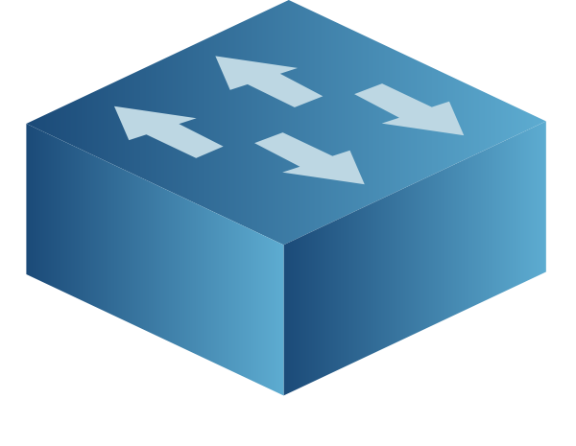
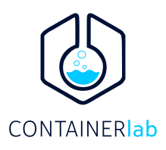
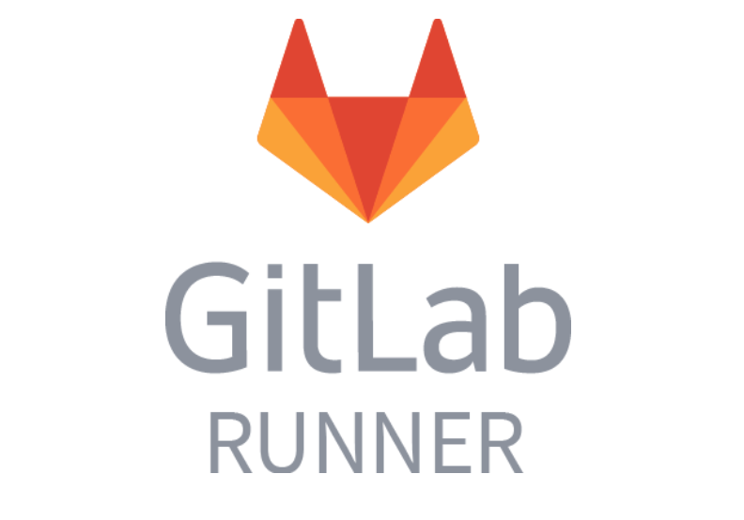

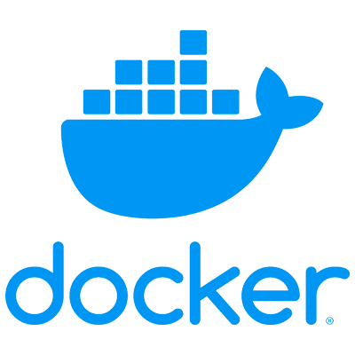
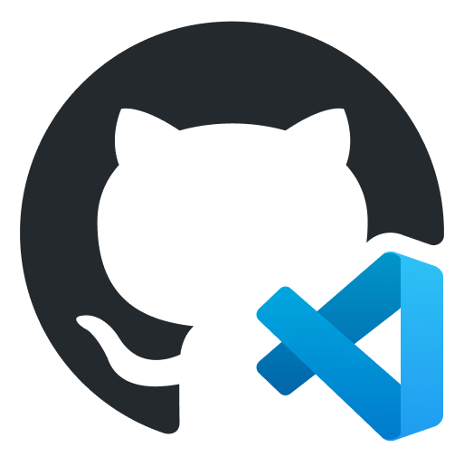
The Scenario
DEV ENVIRONMENT
VERSION CONTROL
CICD PIPELINE
TERMINAL / EDITOR
Digital Ocean Droplet
Notes:
NOTE: Anywhere in the instructions that say codespace, you can just map it in your mind to the digital ocean droplet.
Docker
Containerlab
Git

Slide 14
Labs Concepts

Slide 15
What goes into a Version Control System?
VERSION CONTROL SYSTEM
CODE / SCRIPTS
(e.g., Python, Go, Ansible playbooks)
DATA
(e.g., YAML, JSON)
TEMPLATES
(e.g., Jinja2)
CONFIG ARTIFACTS
(e.g., CLI, JSON)
TESTS
(e.g., pytest, batfish)
DOCUMENTATION
(e.g., markdown, mermaid)
PIPELINES
(e.g., gitlab CI, github actions)

Slide 16
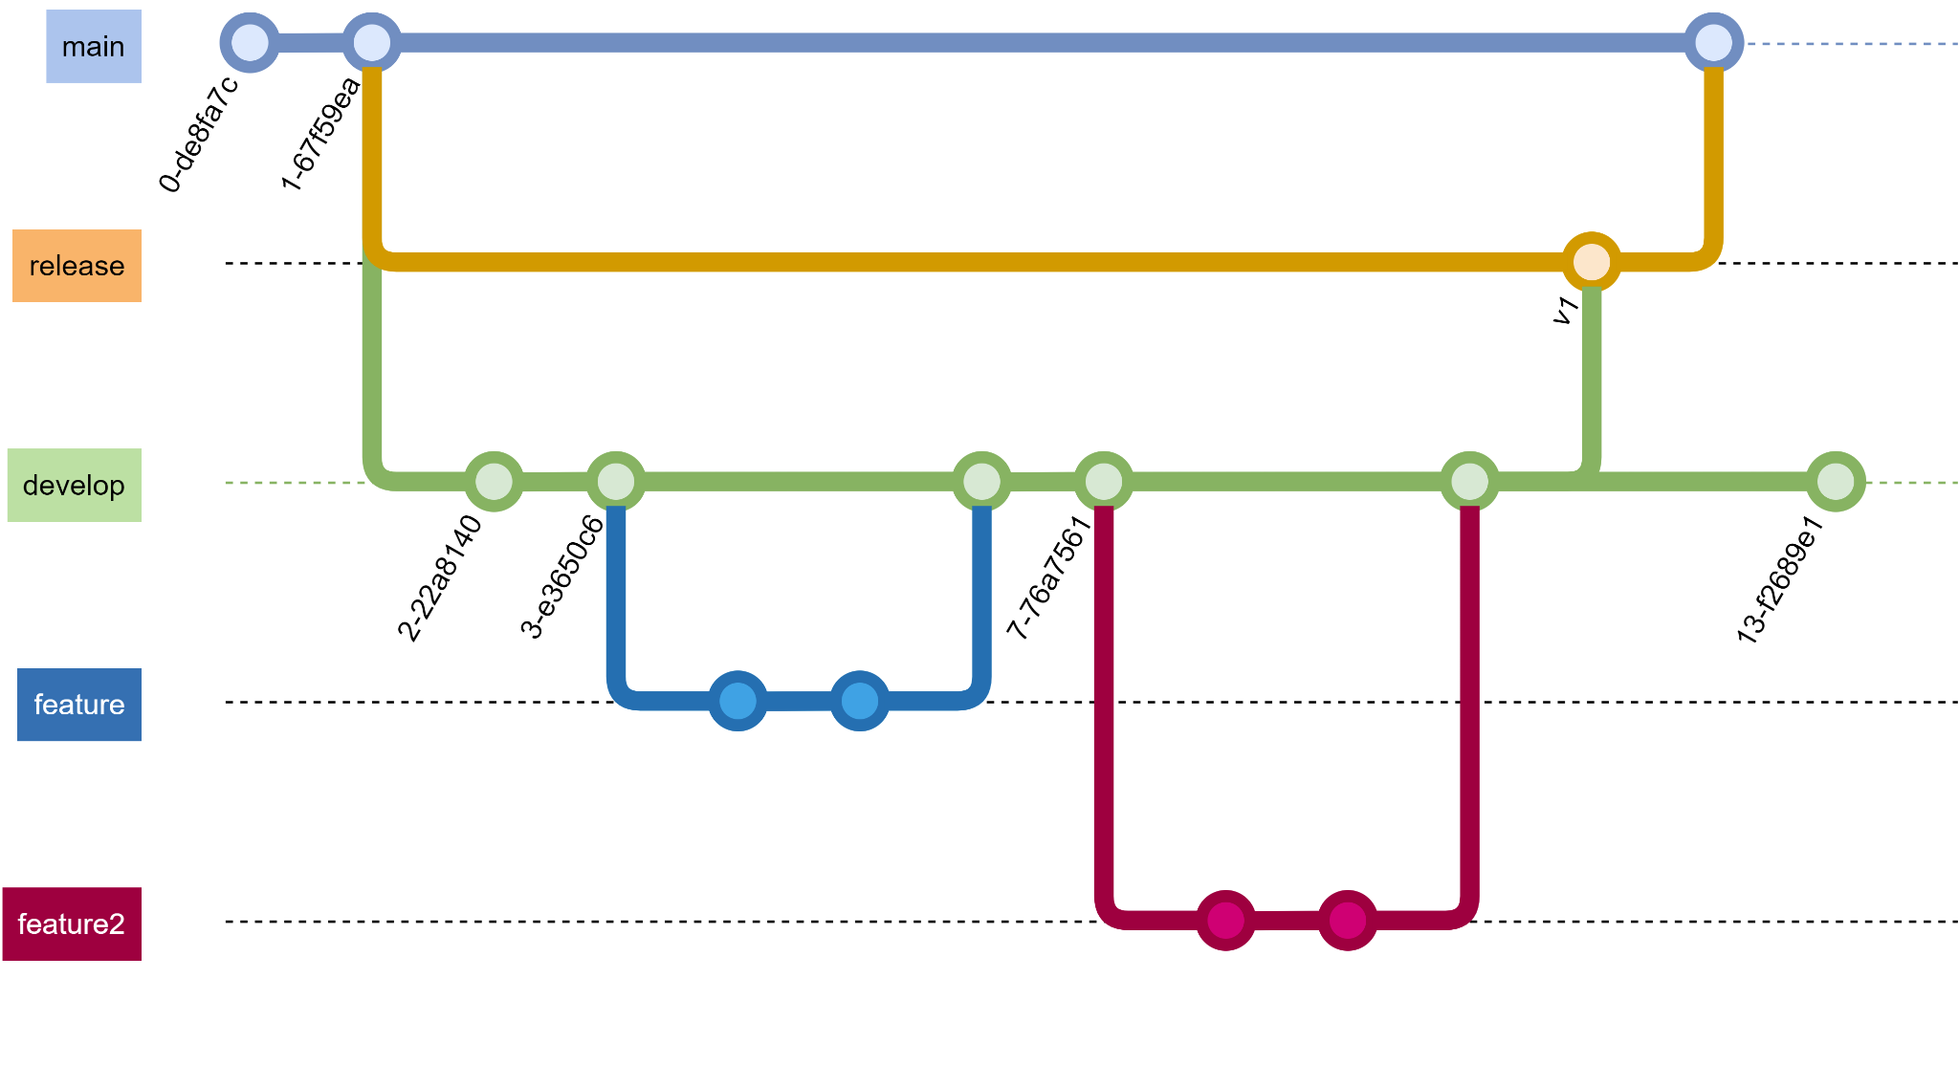
Git - Fundamentals
branch
commit
merge
tag
Notes:
SETUP:
Walk them through README portion.
Tell them to register for the image (Arista) even though the image is there.
Make sure they have a GitLab account
Walk them through gitlab-runner registration.
Let them continue with lab 1-3

Slide 17
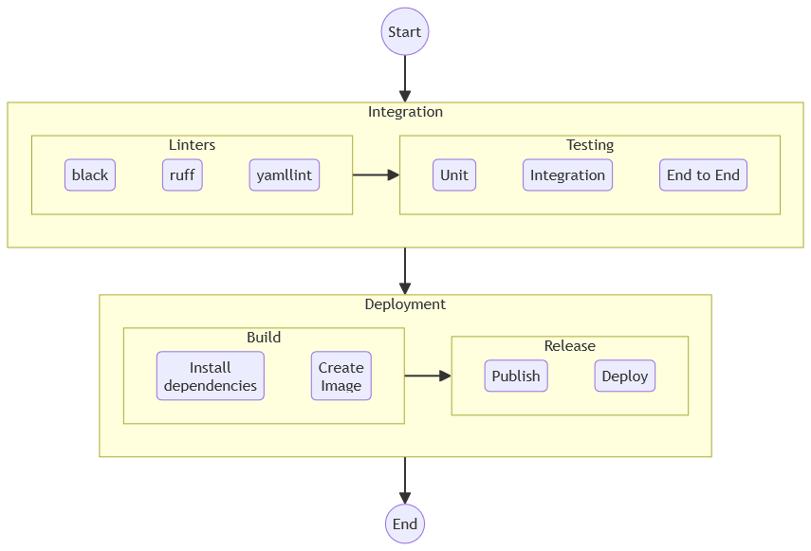
Continuous Integrations and Continuous Deployment (Lab 4)

Slide 18
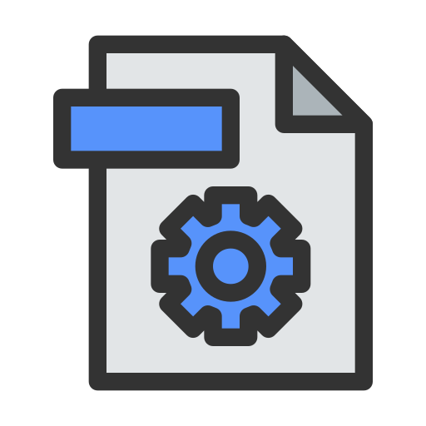
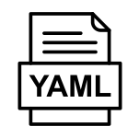
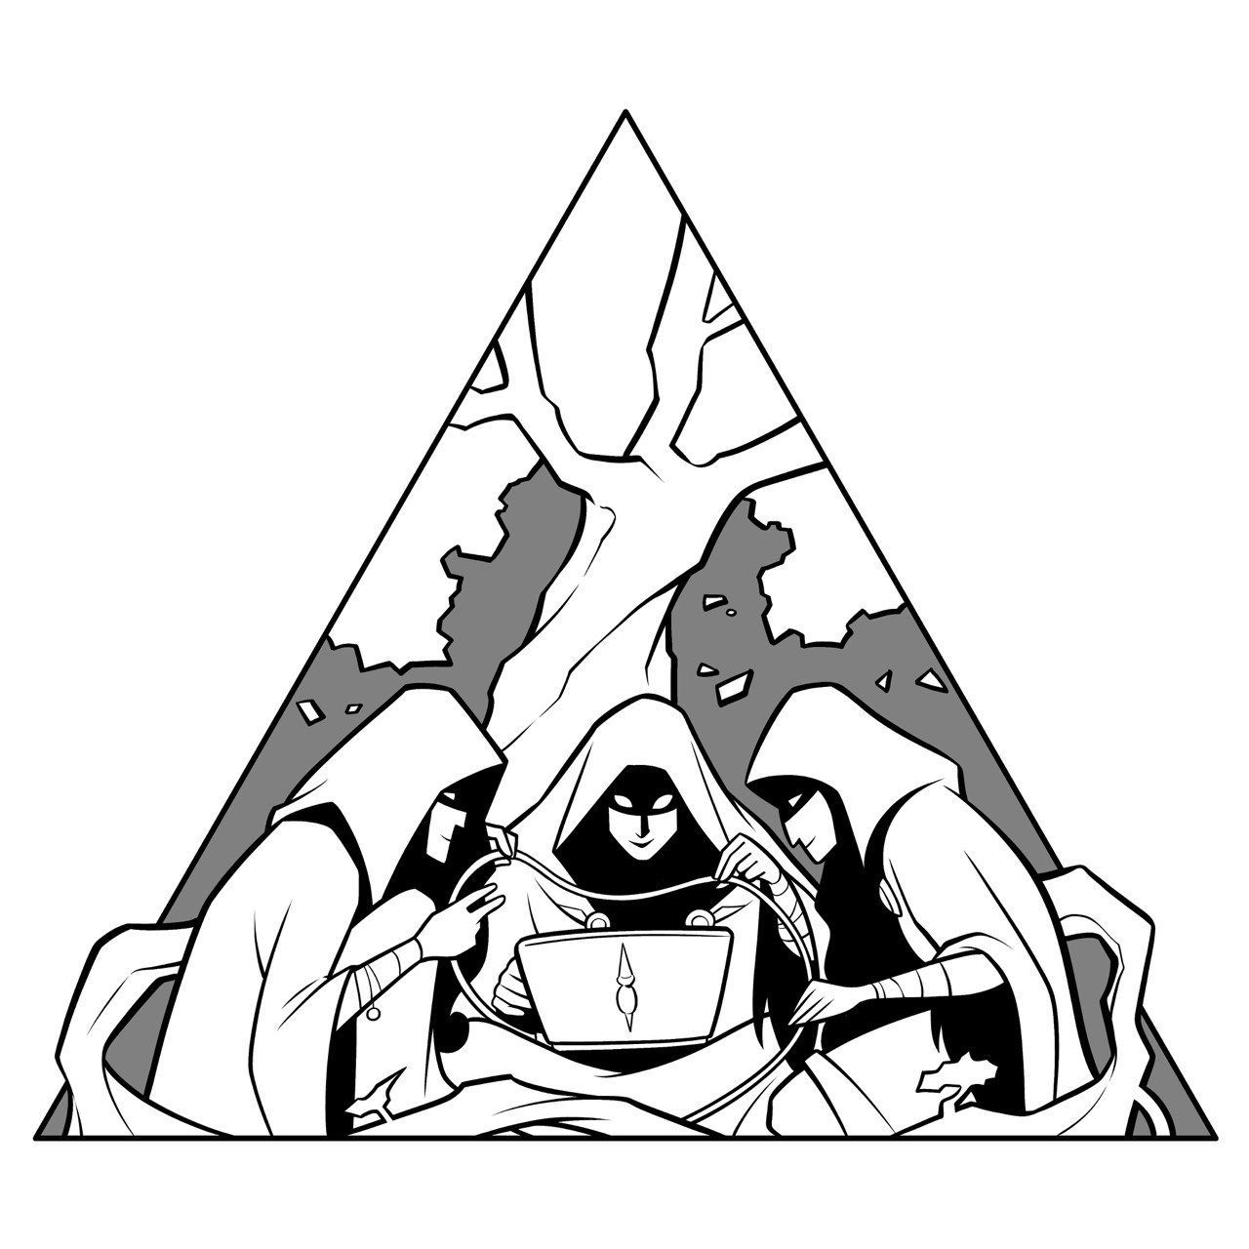

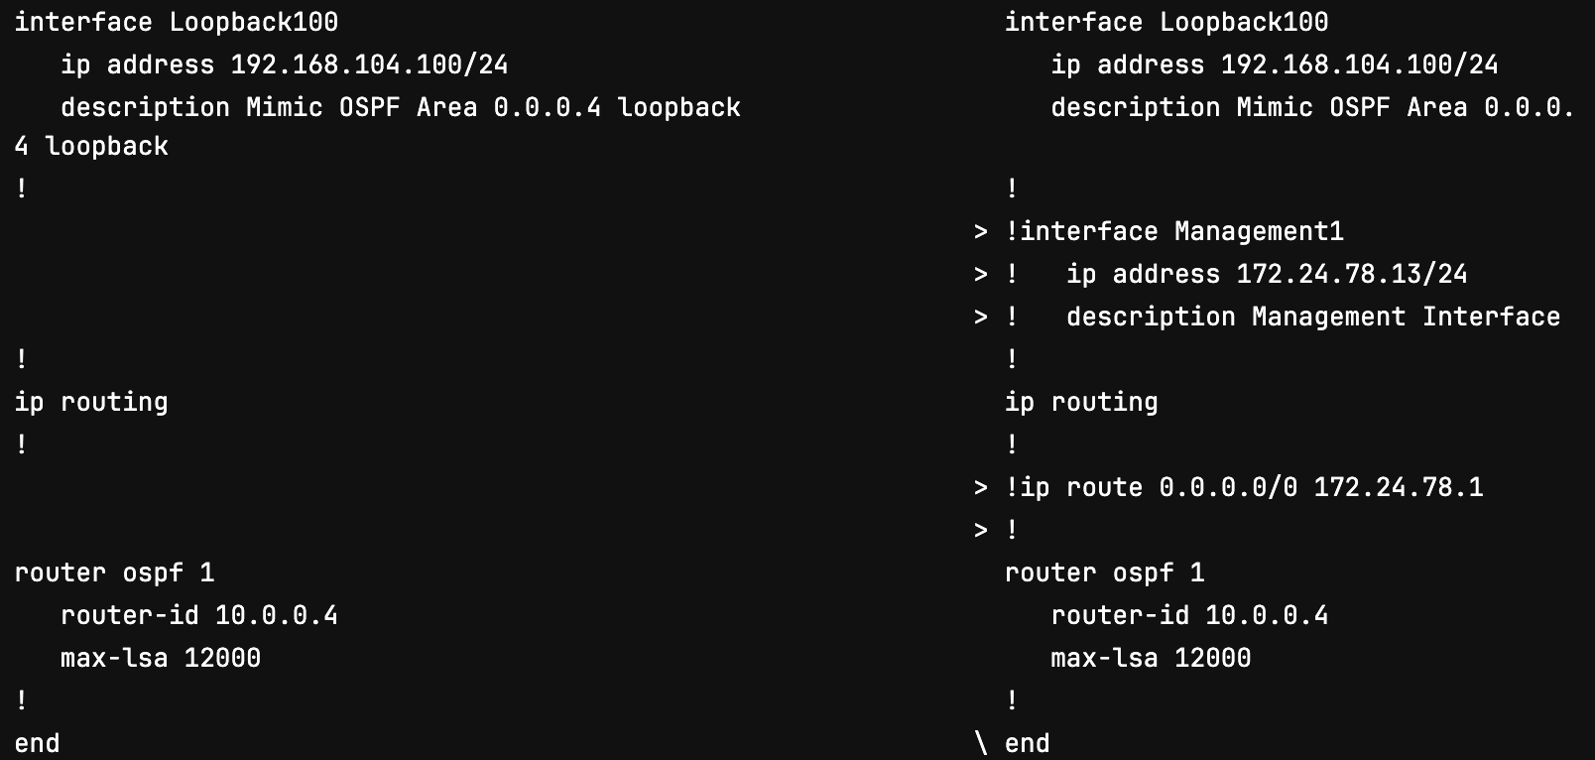
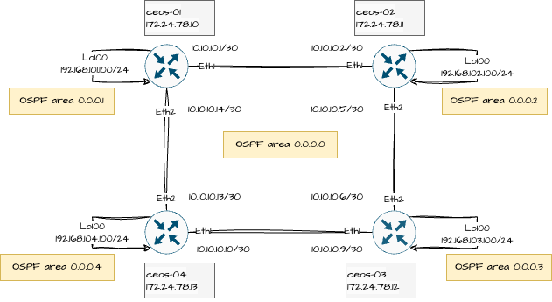
Network Configuration Scenario (Lab5)
Changes in data
Config
Reference
Nornir
Diff Config
Nornir
Generate Config
Config
Artifact

Slide 19


Pre and Post Validation (Lab 6)
Changes in data
Config
Reference
Nornir
Diff Config
Nornir
Generate Config
Config
Artifact
Nornir
Push Config
Pre-validation
Post-validation

Slide 20
Thank You

