Slide 1

NUT CI farm ❤️ Jenkins
Notes:
Thanks to https://www.jenkins.io/images/logos/hyderabad/hyderabad.png for inspiration

Slide 2
Jenkins-dynamatrix overview
Jim Klimov
Maintainer of the Network UPS Tools project
Jenkins Contributor Summit pre-FOSDEM 2026

Slide 3
Why
Our modus operandi: Any system that was power-protected with NUT, and is still alive, deserves to be protected with modern NUT versions. Their vendors may not be around… for decades now.
Ensure portability across 25+ years of distros (and toolkit versions and implementations, and language revisions, and dependencies…)
Not all tools, dependencies, features are ubiquitous, or behaved consistently over the years
Not a single-vendor ecosystem like Java, NodeJS, Perl or Python – rather a lot of loosely similar programs doing their thing in different ways, expecting and complaining variably

Slide 4
Why
Had a practical problem with existing matrix approaches (in various CI offerings), where the matrix dictates the build agents which must exist for the CI build, and changes to matrix must be part of codebase
Most free cloud CI platforms offer a few Linux/Windows(/MacOS) releases as task runners, with one or two CPU architectures
  This represents the reality of market majority, but not the world FOSS lives in
Loved Jenkins since before pipelines
Wanted to learn JSL programming when they appeared

Slide 5
More Why
Low-level projects in mind (C/C++ on different platforms), although variants of Python, JDK, etc. suffer similarly as languages evolve radically
Shadow compilations improve quality and help bug hunts by different takes on static analysis, warnings => Jenkins Warnings-NG etc.
Keep history of (main-branch) builds and their analysis and other artifacts
Community can provide runners for machines they are interested in

Slide 6
Some How
A single Jenkins Shared Library with the logical backend of the Dynamatrix itself, dissemination of tested code base to builders (DynamarixStash), work with build agents/nodes and their announced labels, supported toolkits (plain GNU autotools, ZeroMQ-inspired ci_build.sh), knowledge of supported C and C++ standards by certain GCC and CLANG version ranges, warning analysis summary, GH notification reporting of issues, Badge plugin progress reporting, etc.
A Jenkinsfile-dynamatrix in a project declares the label-based axes of interest (e.g. OS_DISTRO, COMPILER, ${COMPILER}VER…), possibly different for some “slow build” scenario groups and calls a step from the JSL to construct and run the parallel stages for work

Slide 7
Some How
“Discovery” of the build matrix as intersection of node labels and requirements of slow-build scenarios does take a while, so…
…a few quick-build scenarios may be executed during this time, e.g.:
  Spellcheck
  Stylecheck (clang-format, etc.)
  Shellcheck of shipped scripts with different interpreters
  Other smoke tests that help block bad commits quickly

Slide 8
Some How
The (optional) quick-build stages are just another scenario type, so also are chosen by presence of, and scheduled to, supported build agents (those who declare having aspell, those with label values for SHELL=xxx, etc.)
  FIXME: A way to prioritize these quick parallel stages as a QueueItem would be welcome, so that a new build can be smoked away or queued with its slow build matrix as appropriate
Problematic cases are reported to GitHub with a link to latest log file (wherever it failed – configure, build, check, distcheck?..)

Slide 9
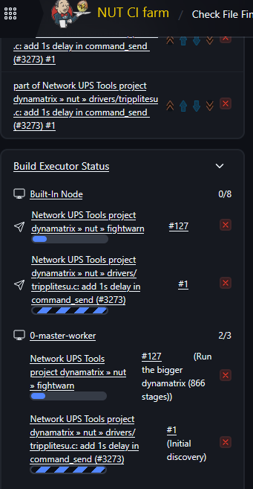
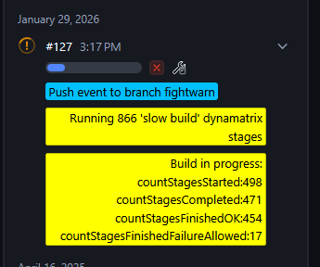
Some How
Examples from actual CI server?
  Blue Ocean view
  Agent configurations
  GitHub results view
  Badges

Slide 10
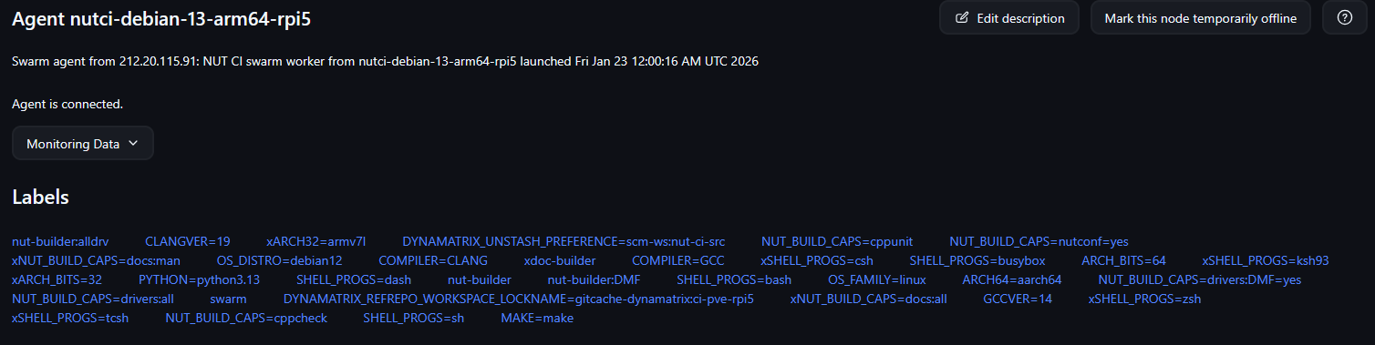

Slide 11
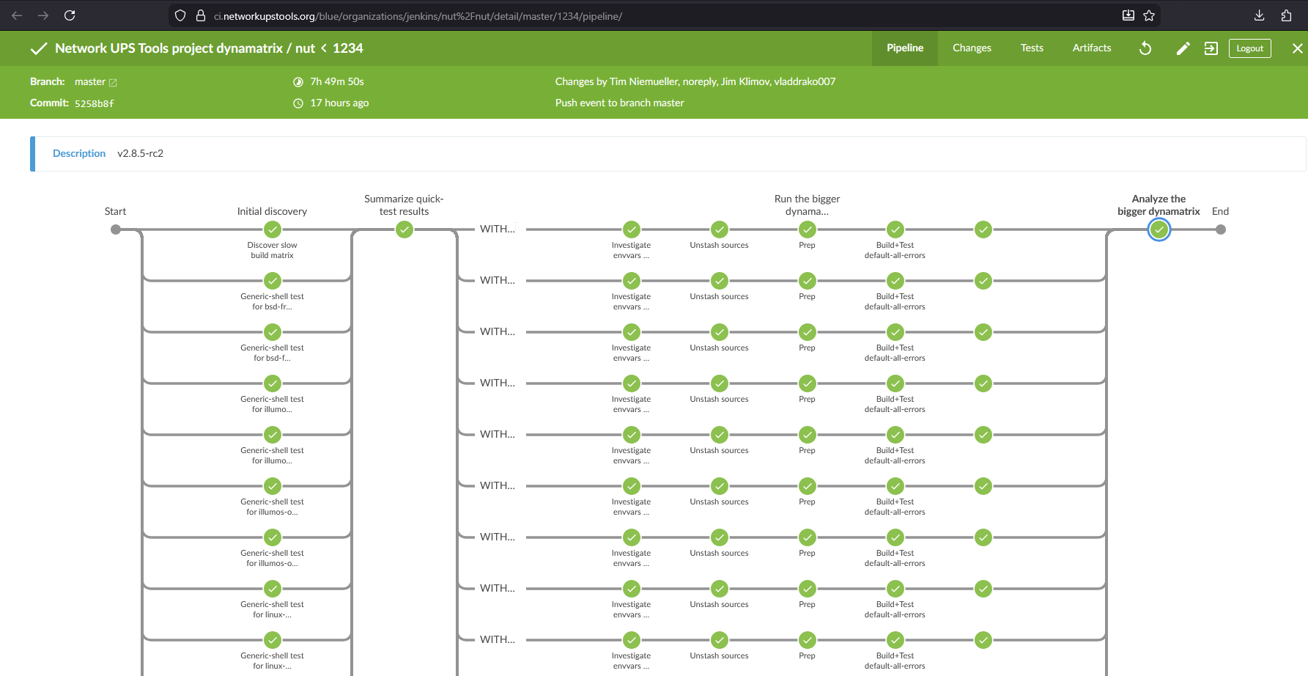

Slide 12
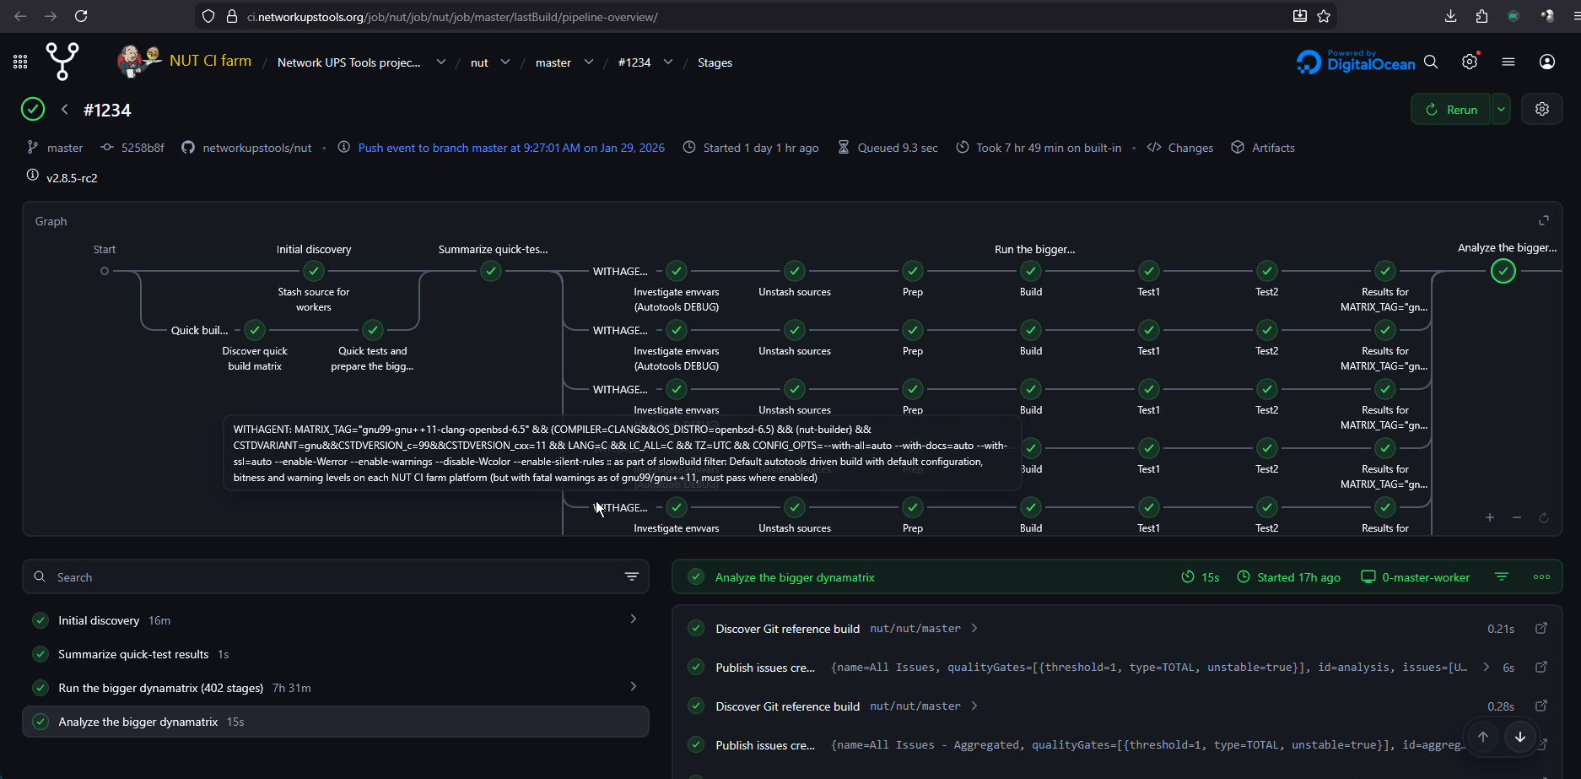

Slide 13
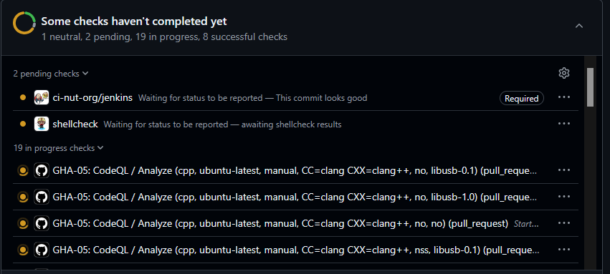
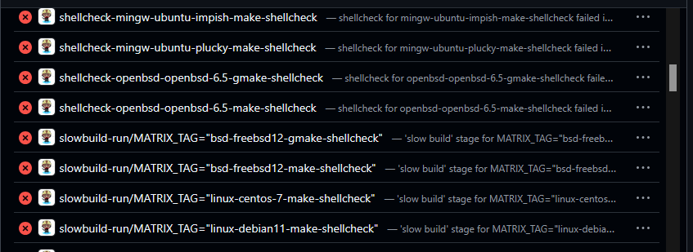

Slide 14
Stress(-test)ing Jenkins itself
~300-700 dynamatrix scenarios (queue items) per NUT code iteration
Some run more dependency-based combos internally
Burning CPUs across the globe for 7+ hours per job
Scripted transparent retries of queue items that failed due to loss of agent (networking, reboots, out of disk space…)
Updating build stats as “short text”/”badges” (box in left column)
  Cross-browser portable wrapping of long word-like tokens is a PITA
While asking on Gitter about issues I’ve hit with the NUT CI farm, they rang a bell to people running Jenkins infra. Too few projects of similar massively-parallel scale (doing this on constrained resources)?

Slide 15
Stress(-test)ing Jenkins itself
Infra-inflicted hiccups or failed builds are a pain, so some Jenkins issues were identified, reported, addressed…:
  Race conditions in serialization (several plugins) => https://issues.jenkins.io/browse/JENKINS-76294
  Agent loss/reconnection (especially swarm) => https://issues.jenkins.io/browse/JENKINS-75196 https://issues.jenkins.io/browse/JENKINS-75195
  Native OS interaction (thread name setting) => https://github.com/jenkinsci/workflow-support-plugin/pull/345
  Pipeline graph updates crashing Jenkins controller =>
  https://github.com/jenkinsci/pipeline-graph-view-plugin/issues/862
  https://github.com/jenkinsci/pipeline-graph-view-plugin/pull/887
  https://github.com/jenkinsci/pipeline-graph-view-plugin/issues/888

Slide 16
Further ecosystem cooperation
Support for @Library('libname@${BRANCH_NAME}') helps with branches like staging/stable/fightwarn whose code can be identical but respective JSL variants might differ
=> https://github.com/jenkinsci/pipeline-groovy-lib-plugin/pull/19
Builds of git-client with “Fanned-out Git refrepo” can help faster checkouts directly; some lessons learned in that PR are used in DynamatrixStash logic (e.g. .gitcache-dynamatrix directories) => https://github.com/jenkinsci/git-client-plugin/pull/644

Slide 17
Further ecosystem cooperation
Swarm Agents are very useful with community-provided build agents (as opposed to SSH Build Agents managed by NUT CI farm), but tend to be fragile when practical connections get lost (bad internet, laggy controller) - but somehow pinger et al do not trigger a reconnection:
  https://issues.jenkins.io/browse/JENKINS-70501
  https://issues.jenkins.io/browse/JENKINS-69446
  https://issues.jenkins.io/browse/JENKINS-75195
  https://issues.jenkins.io/browse/JENKINS-75196
  Maybe I’ve missed some?

Slide 18
Further ecosystem cooperation
The https://github.com/jenkinsci/conflict-aware-ondemand-strategy-plugin was made to allow co-location of numerous build containers on the same puny server (so only one at a time is used actively)
  FIXME: Currently used with SSH Build Agents; investigate if Swarm Agents can benefit from this approach?
  Scripted Cloud or similar plugins might be, or not be, useful to (also) start/shutdown containers based on demand (conserve RAM on puny servers)
  Thanks to @dbeck for initial conversion of my PR for jenkins-core into a plugin ☺

Slide 19
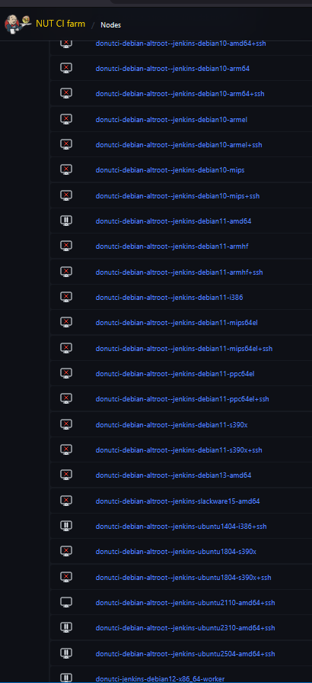
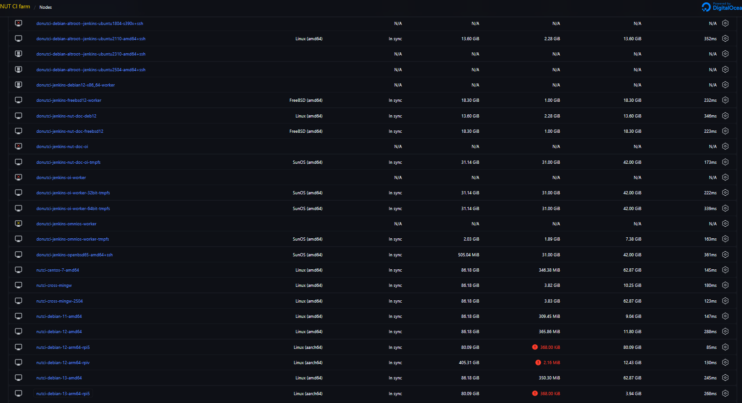

Slide 20
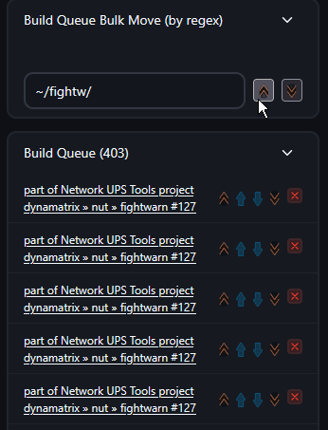
Further ecosystem cooperation
Queue management
https://github.com/jenkinsci/simple-queue-plugin/pull/17
and nearby PRs for that plugin
Need obscure views like checkFingerprints
nowadays to see and manage the queue

Slide 21
Lessons learned: Tunneled SSH agents
In some cases, the tested operating system is too old to have a modern JDK available in any manner. In other cases, qemu-static virtualization of foreign CPU architectures is not working for a JVM.
It helps to run an SSH agent to a system with modern JDK (controller localhost, hypervisor with legacy/emulated Linux containers, even a neighboring VM with shared NFS) which then uses carefully crafted prefix/suffix for command lines with further SSH hop, that in effect run them in the older operating environment.

Slide 22
Lessons learned: Tunneled SSH agents
As far as Jenkins Remoting is concerned, it works with a local file system. So same path names to same files must exist on both the “proxy” and actual builder.
SSH server on worker must allow passing envvars (AcceptEnv *)
One of the ways to set this up is documented at https://networkupstools.org/docs/user-manual.chunked/_connecting_jenkins_to_the_containers.html#_where_to_run_agent_jar => “Using Jenkins SSH Build Agents” section

Slide 23
Lessons learned: Tunneled SSH agents
Example of OpenBSD 6.5 and Solaris 8 with NFS to younger neighbors:
  Remote root directory (as seen on both actual worker and intermediate host): /export/home/abuild/jenkins-nutci-openbsd-65-amd64
  Prefix Start Agent Command: echo PING > /dev/tcp/nutci-openbsd-65-amd64/22 && test -w /var/shm/jenkins-nutci-openbsd-65-amd64/ &&
  CI_WRAP_SH=ssh -o SendEnv='*' "nutci-openbsd-65-amd64" /bin/sh -xe
Similar for Linux containers with host filesystem visibility

Slide 24
Lessons learned: TMPFS builds
Many cases automated by jenkins-swarm-nutci
Some set up manually with SSH Build agents
  Remote root directory: /tmp/jenkins-nut-32bit
  Prefix Start Agent Command: rm -rf /tmp/jenkins-nut-32bit/workspace ; mkdir -p /tmp/jenkins-nut-32bit/workspace && /usr/gnu/bin/ln -frs /export/home/abuild/.gitcache-dynamatrix{,@tmp} /tmp/jenkins-nut-32bit/workspace/ &&

Slide 25
Some links
https://stories.jenkins.io/user-story/jenkins-is-the-way-for-networkupstools/ - “Jenkins is the way to build multi-platform NUT, and jenkinsfile-dynamatrix is the way to find what can be built today”
https://github.com/networkupstools/jenkins-dynamatrix - project repository for the Jenkins Shared Library
https://github.com/networkupstools/jenkins-swarm-nutci - scripting for Jenkins Swarm agents (as a service under systemd, SMF, launchd, upstart, rc.d, init…) to dial into the project’s controller and offer themselves by labels as builders for the platform and toolkits there

Slide 26
Some links
https://github.com/networkupstools/nut/blob/master/Jenkinsfile-dynamatrix - practical example of the pipeline preparing it for a large project (NUT)
https://github.com/networkupstools/nut/blob/master/ci_build.sh - practical adaptation of feature-driven CI runs under numerous engines and developer workstations alike for the autotools based C/C++ project (NUT)
https://github.com/networkupstools/libmodbus/blob/rtu_usb_jf/Jenkinsfile-dynamatrix - a much smaller example pipeline for one autotools setup of a simpler project

