Slide 1
NetXMS
Open Source Monitoring System

Slide 2
What is NetXMS?
Open source monitoring system
Can be used for monitoring:
  Network infrastructure
  Servers
  Applications

Slide 3
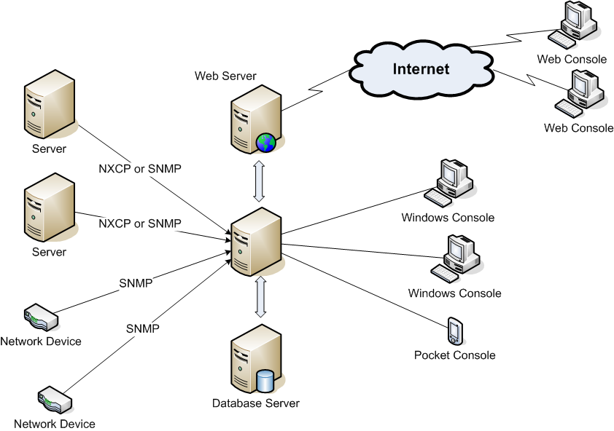
Architecture

Slide 4
Key concepts
Object
DCI (Data Collection Item)
Threshold
Event
Alarm
Action
Event Processing Policy

Slide 5
Supported Platforms
Server
  Operating System: Windows 2000, Windows XP, Windows Server 2003, Linux, FreeBSD, Solaris
  Database: Microsoft SQL, PostgreSQL, MySQL, Oracle

Slide 6
Supported Platforms (cont.)
Agent
  Windows NT4, 2000, XP, Server 2003
  Windows 95/98/Me
  Linux
  FreeBSD
  Solaris
  Novell NetWare

Slide 7
Supported Platforms (cont.)
Management Console
  Windows 2000 and higher
  Pocket Windows 2003

Slide 8
Protocols
NXCP (Proprietary TCP-based)
SNMP version 1
SNMP version 2c

Slide 9
Key Features
Easy deployment
Network devices, servers, and applications can be monitored from one application
Wide range of supported platforms
Extendable modular architecture
Very flexible event processing

Slide 10
Key Features (cont.)
Event correlation
Hierarchical service view
Layer 3 IP topology autodiscovery
Portable client library
Powerful Windows based UI
E-mail and SMS notifications
Remote actions

Slide 11
Key Features (cont.)
Centralized agent upgrade
Centralized agent configuration
Flexible access control configuration
Encrypted communications between server, agents, and clients
Open Source

Slide 12
Architecture in depth
Event processing
System components

Slide 13
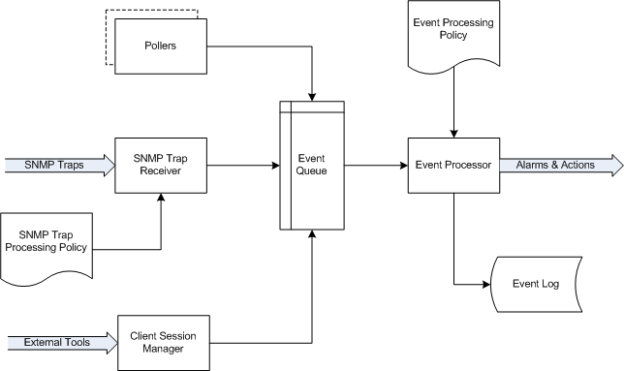
Event Processing

Slide 14
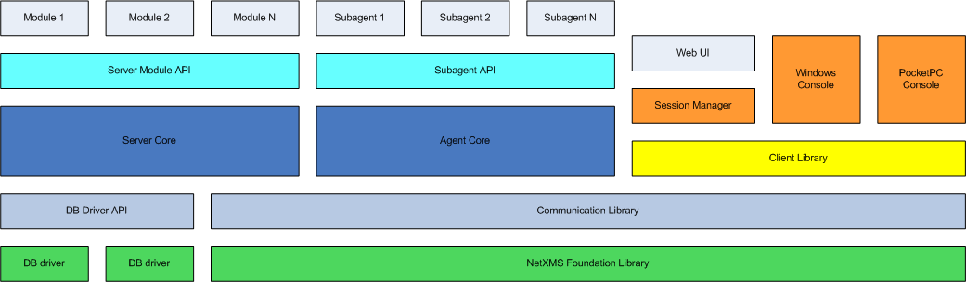
System Components

Slide 15
Development Roadmap
Version 0.3.0
  To be available in the end of the year
  Features to be added:
    Advanced event correlation
    Zoning (distributed monitoring)
    Advanced data visualization
    Support for SNMP v3
    Log monitoring
    Heartbeats
    Basic reporting
    Basic web interface

Slide 16
Development Roadmap (cont.)
Beyond version 0.3.0
  Graphical network maps
  In-depth analysis and reporting
  Powerful web interface
  Trending
  And more…

Slide 17
Need more information?
Visit NetXMS web site http://www.netxms.org
Send mails to team@netxms.org

Slide 18
Conclusion
Practical demonstration
&
Questions

