Slide 1

Development of Heuristics for Optical Transport Networks Dimensioning Eduardo Fernandes
Master’s Degree in Electronics and Telecommunications Engineering
Supervisor: Prof. Armando Humberto Moreira Nolasco Pinto
Co-Supervisor: Dr. Rui Manuel Dias Morais
Notes:
Heuristic approaches are techniques for solving a problem, faster than optimal methods and able to find an acceptable solution.
When networks are too large, the ILP models can be very slow to obtain the solution. In this chapter, algorithms are proposed based on heuristics and their implementation in a networks
design software.

Slide 2
Contents
Motivation
Network specification (reference network)
Transparent Transport Mode
Capital Expenditure (CAPEX)
Heuristics algorithm
How to use

Slide 3
Motivation
The crucial premise for network operators to choose the technology and architecture to deploy is the cost minimization, preferably in a short period of time (Heuristics).
The cost factor is therefore a major issue in the telecommunication industry and tend to have a strong influence in all engineering decisions.
Planning tools directly affect the competitiveness of system vendors and network operators.
The extreme difficulty to make a fast and scalable planning to an optical network by hand.

Slide 4
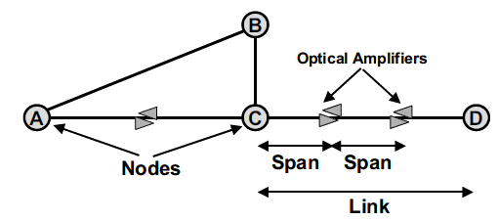
Network specification
Network components:
Nodal degree: The number of links incident on that node.
Traffic: Collection of services that must be carried (ex: ODU0 demands).
Demand: Represents an individual traffic request.
Notes:
Os links são conexões ponto-a-ponto físicas asseguradas pelos sistemas de transmissão entre dois nós adjacentes.
Cada link tem dois optical line terminal, um em cada extremidade.
Os sinais são transmitidos através de um par de fibras com comunicação bidirecional.
Contêm amplificadores ópticos a uma distância esperada (span) para aumentar a intensidade do sinal.

Slide 5
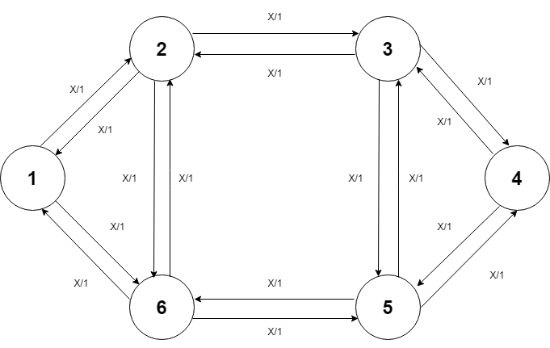
Reference network

Slide 6
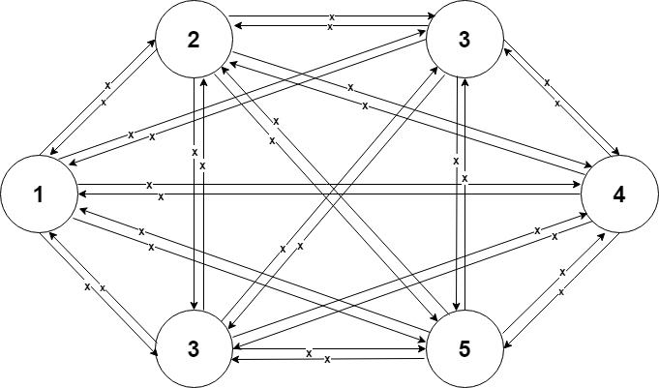
Transparent Transport Mode
Keeps the signal in the optical domain at every intermediate nodes of the path between the source and the destination;
Electrical regeneration is not present;
Only performs OEO conversion at the end nodes of the path;
Wavelength continuity must be guaranteed;
A single-hop grooming scheme is applied, where only client signals with the same source and destination can be groomed into the same wavelength.
Notes:
No modo de transporte transparente, uma rota é definida apenas entre nós de origem e destino sempre no domínio ótico.

Slide 7
Capital Expenditure
The cost of a telecommunication network can be divided into the Capital Expenditure (CAPEX) and the Operational Expenditure (OPEX).
CAPEX: The amount of money needed to setup the network.
OPEX: The amount of money needed to run the network.
Notes:
The CAPEX can be sub-divided into the cost of buying the equipments and setting up the infrastructures. The OPEX comprises the rent paid for the floor space, the payment for the energy, and the support of the operational processes.In the operational processes are included the service provisioning, fault management, maintenance, marketing and administration.

Slide 8
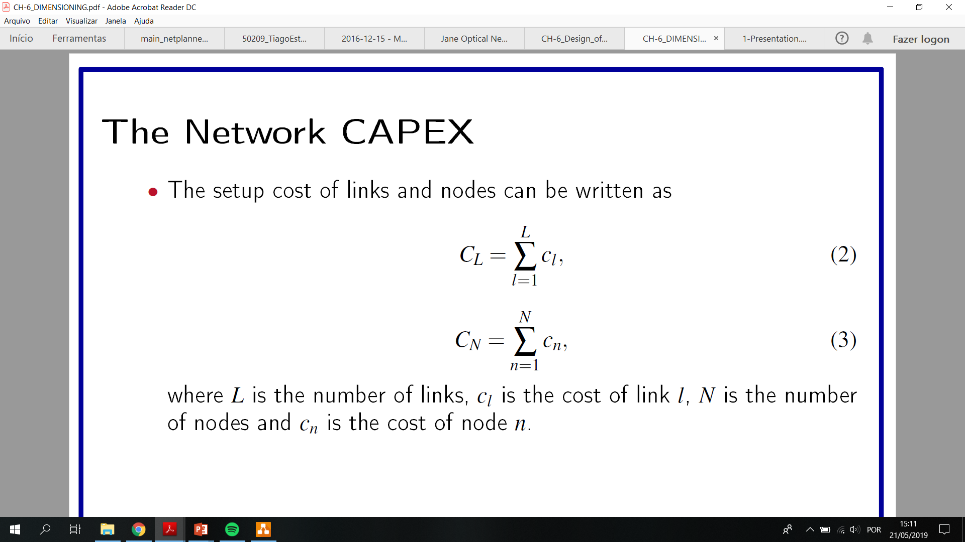
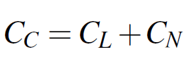
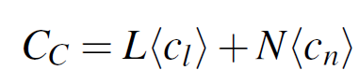
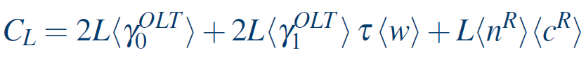
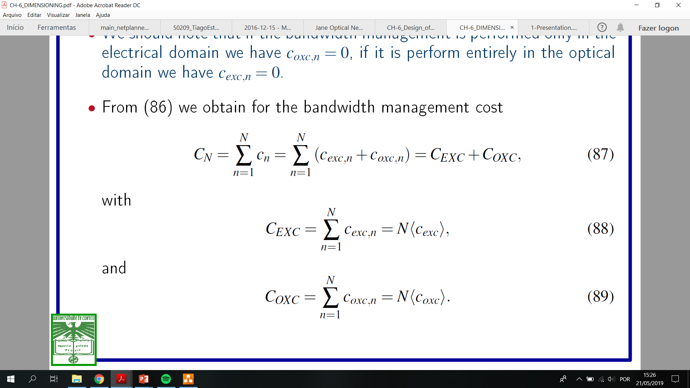
Bidirectional links

Slide 9
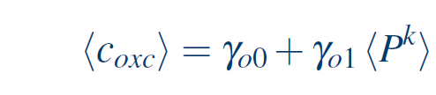
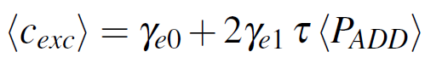

Slide 10

Heuristics algorithm

Slide 11
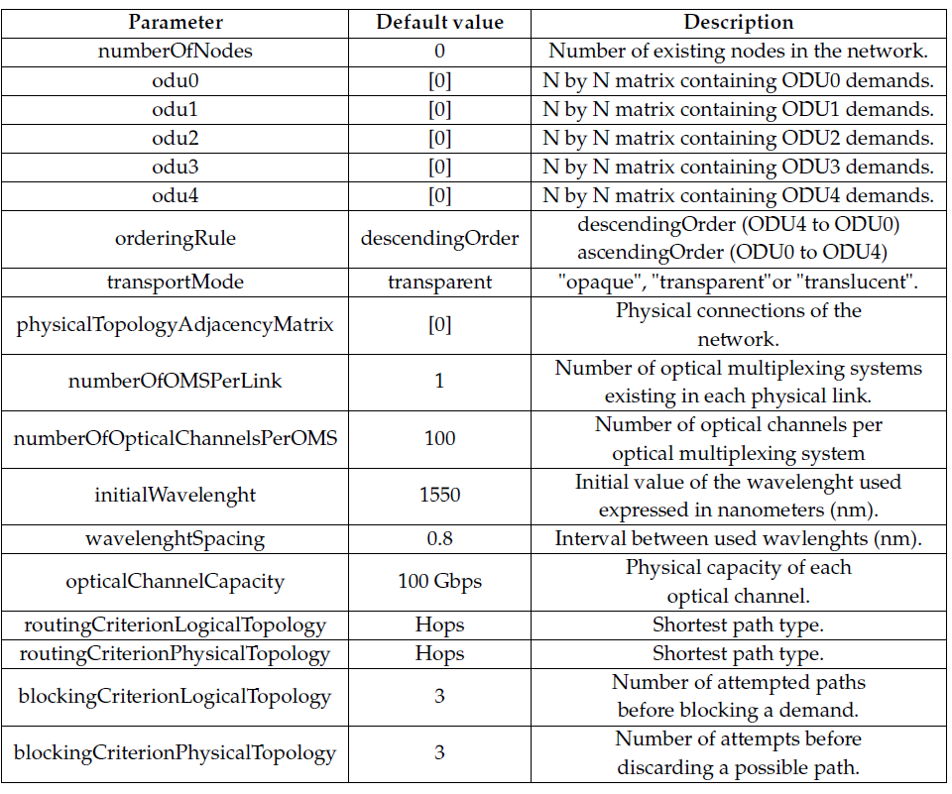
System input parameters

Slide 12
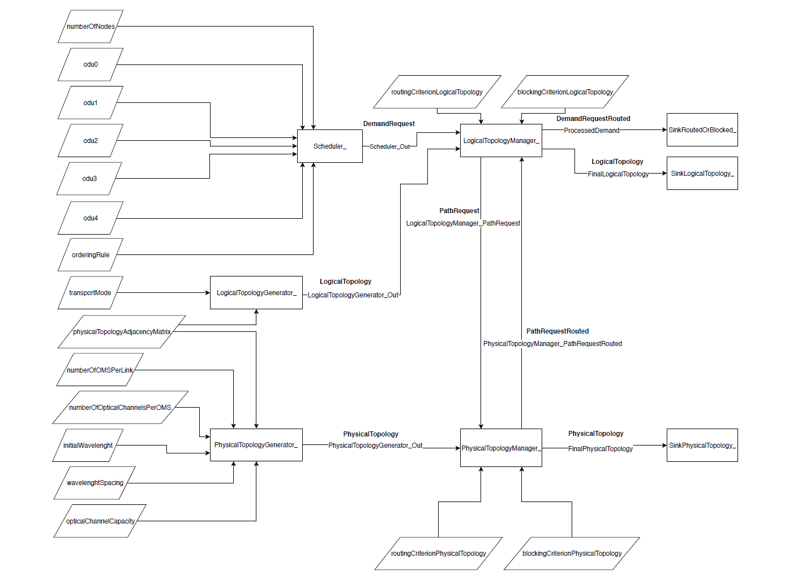
Notes:
O que são heuristicas ?

Slide 13
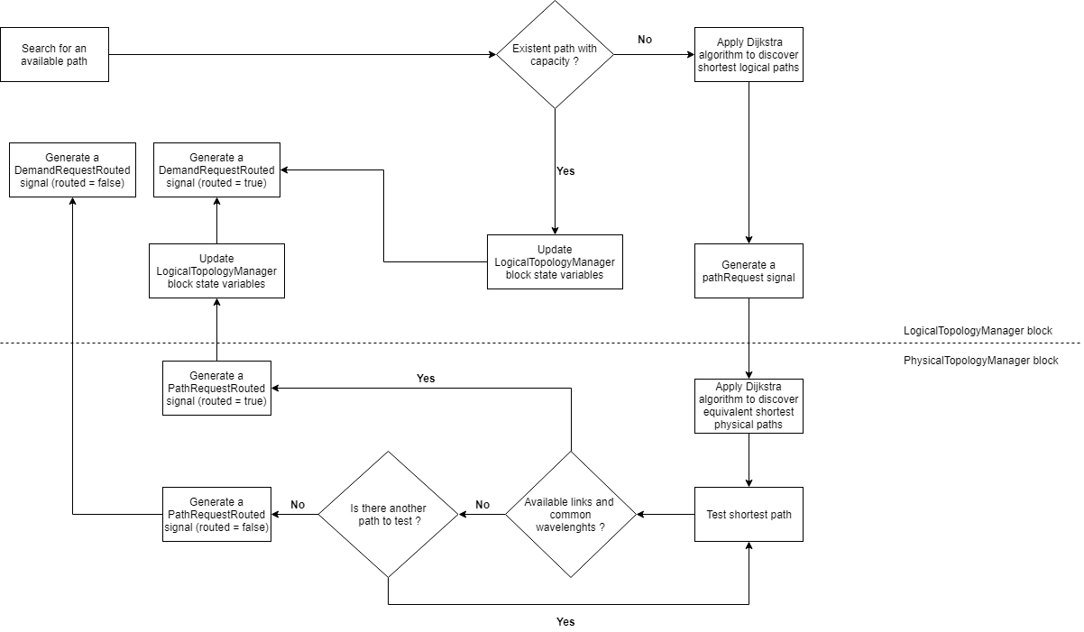
Physical and Logical Topology Manager blocks

Slide 14
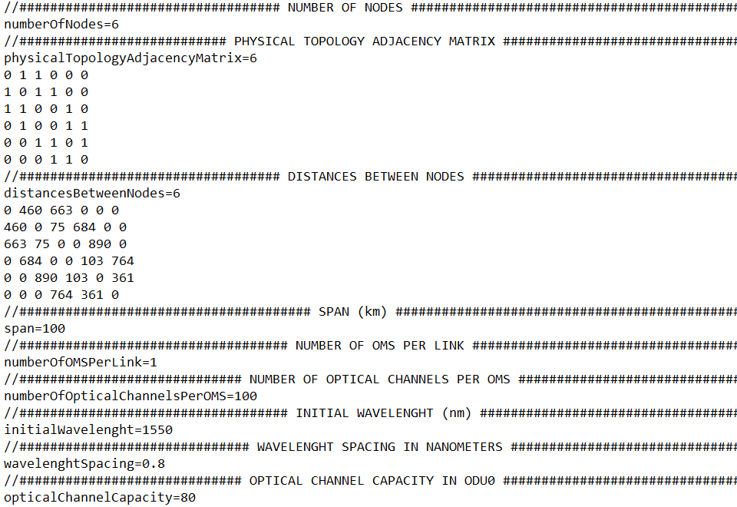
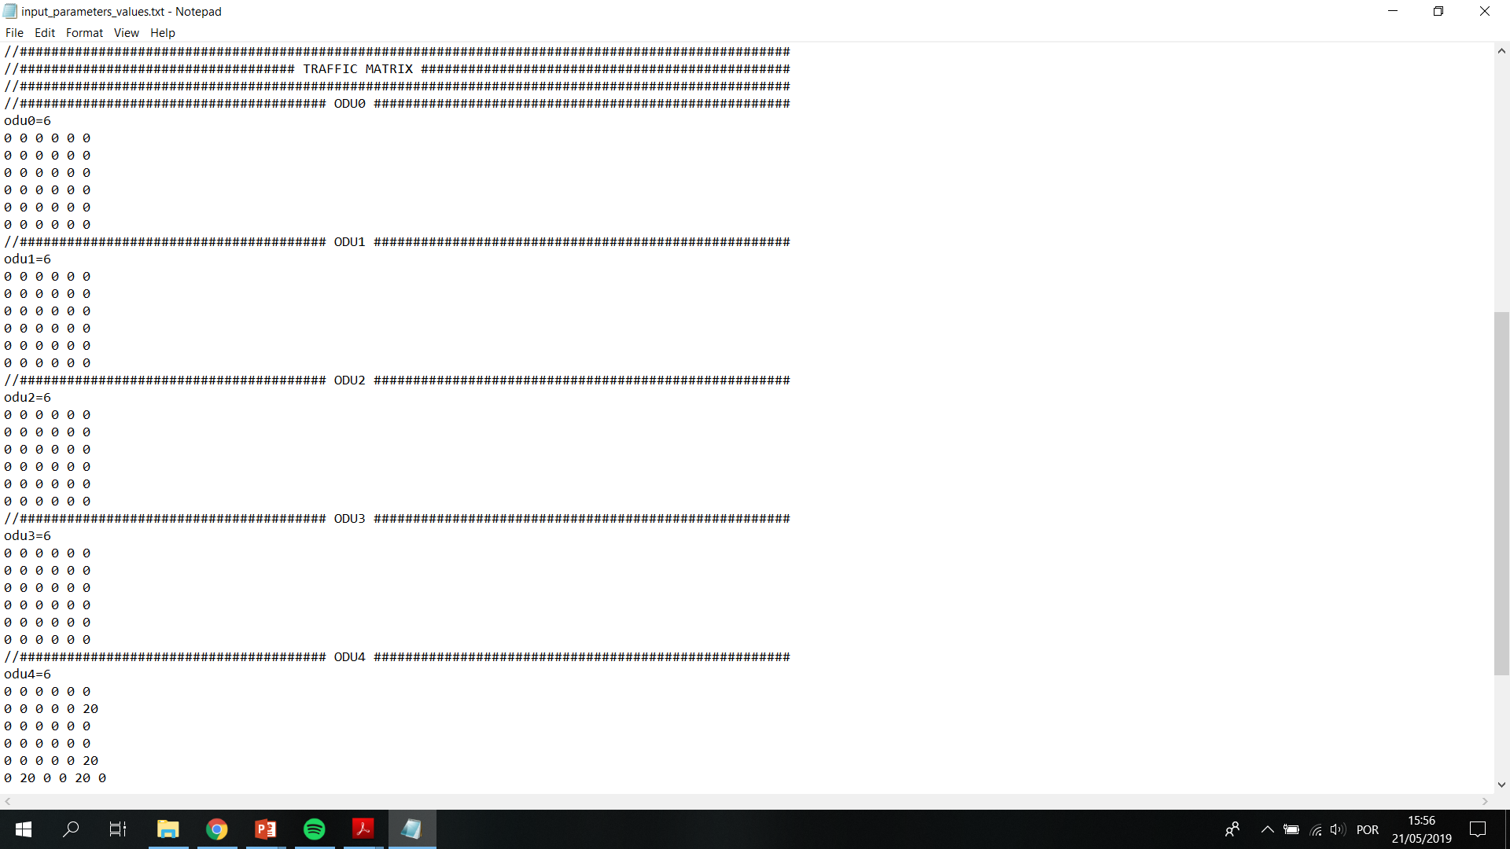
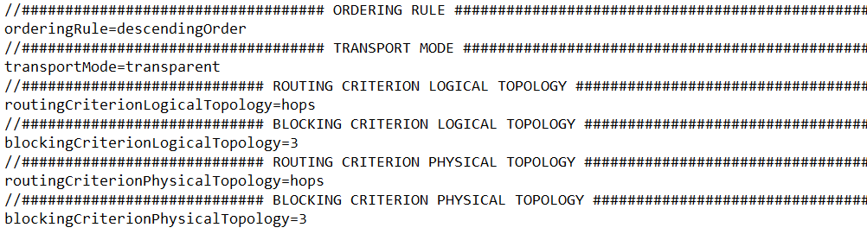
How to use
First open “input_parameters_values.txt” file and fill it in with entry variables values.

Slide 15
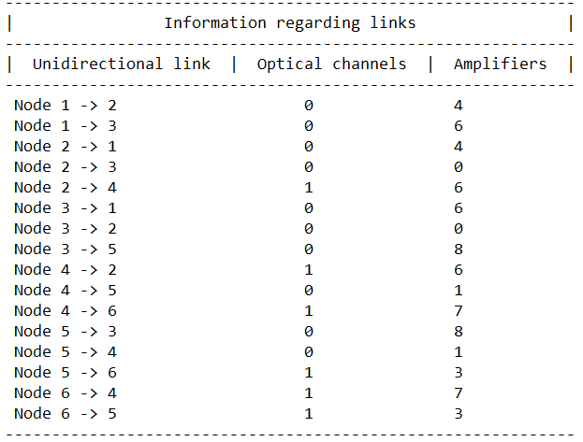
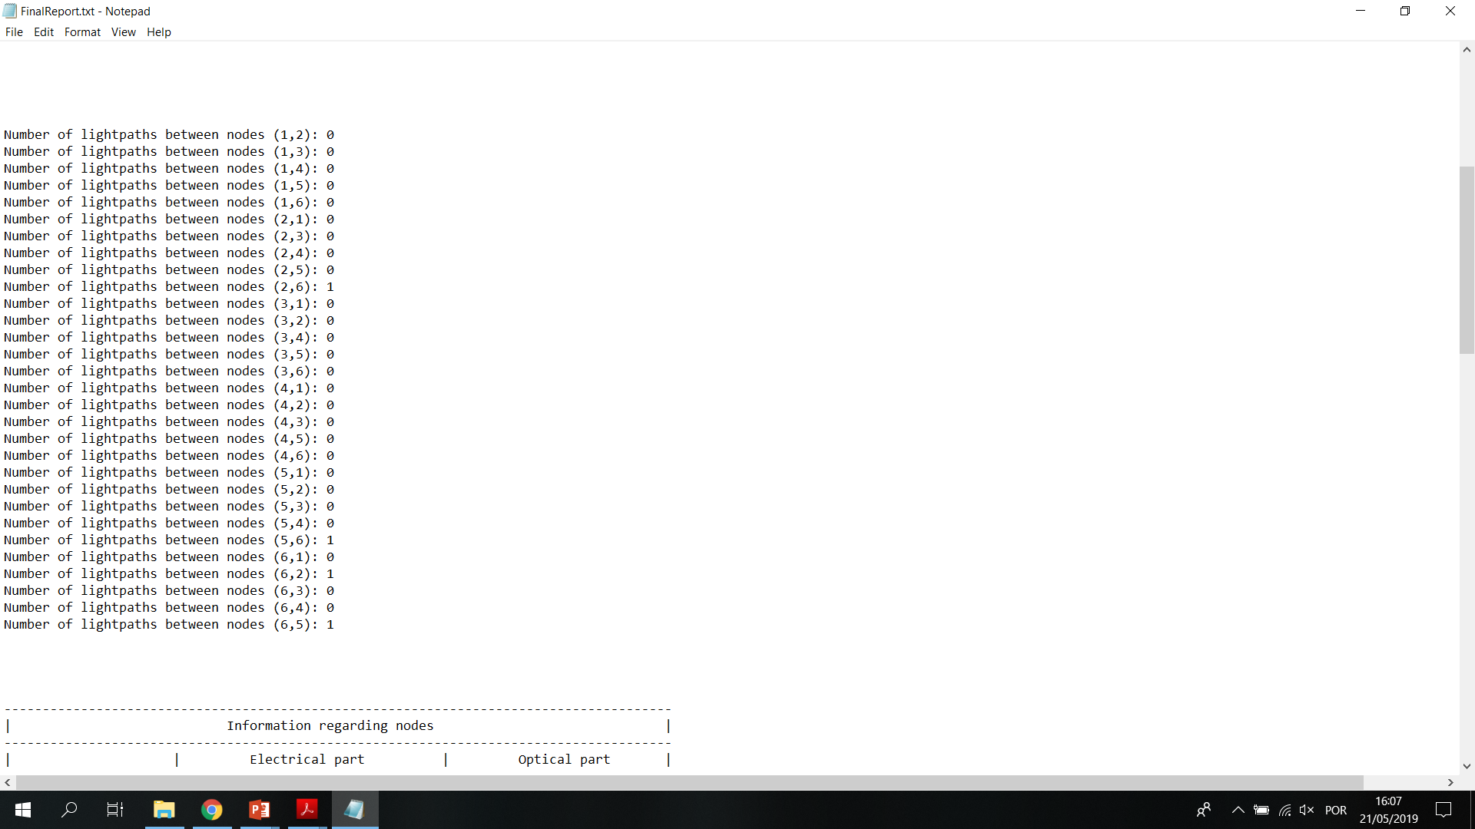
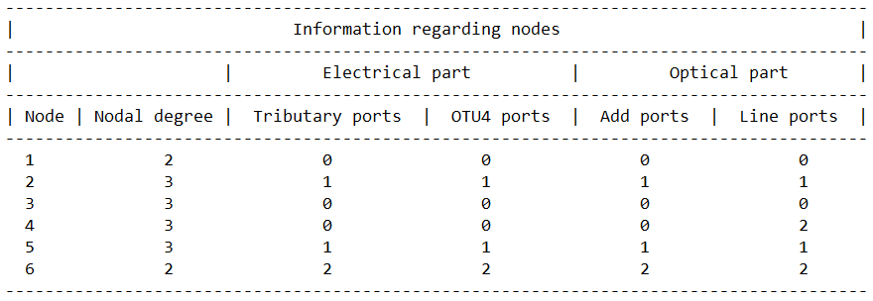
Run “transparent.exe” file;
Analyse results present in “FinalReport.txt” file.

Slide 16
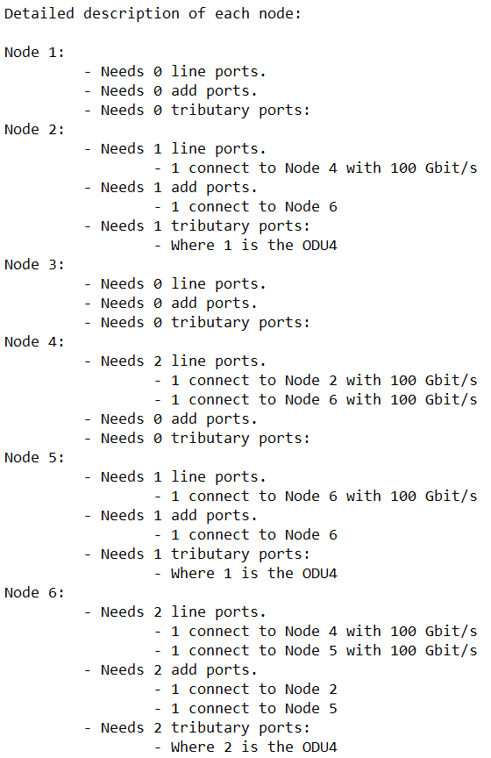
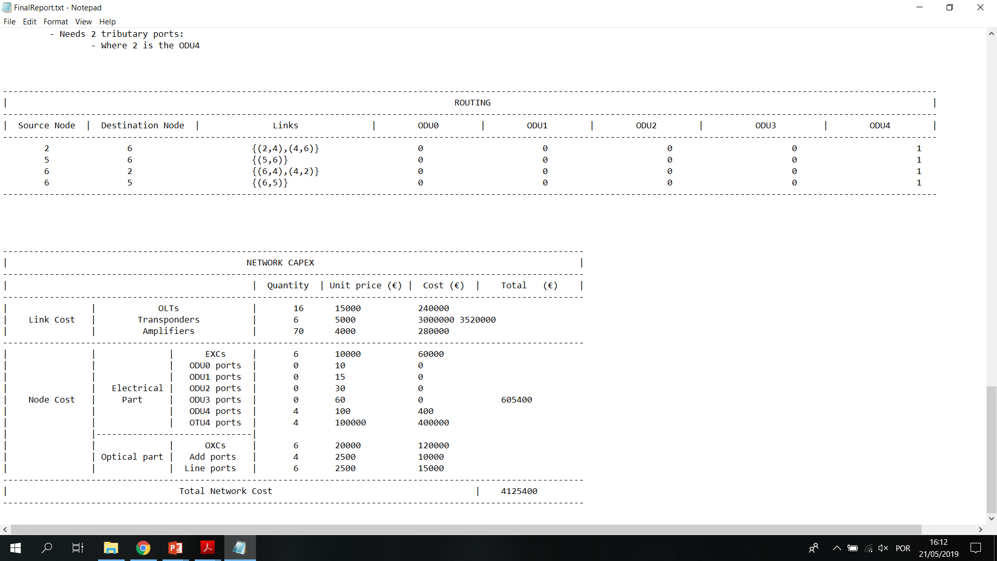
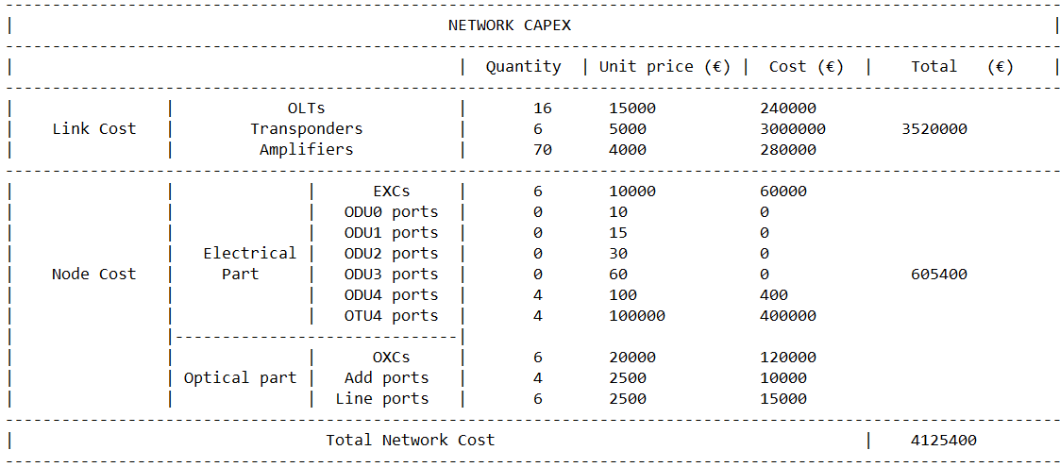

Slide 17

Thank you! Questions?

