Slide 1
Power and Sustainability
in EU AI Governance: A Social Network Analysis
of Policy Actors
Daniel Netzl, BSc.
Master’s Thesis Defense
Supervisors: Univ.-Prof. Dr. Uli Meyer & Dr. René Werner

Slide 2
CONTENTS
01
Introduction and Research Context
02
Theoretical Frameworks and Analytical Approaches
03
Empirical Analysis of EU AI Governance
04
Discussion and Implications

Slide 3
Part 01 Introduction and Research Context

Slide 4
Problem Statement and Relevance
AI's transformative potential and hidden costs
01
Planetary boundaries and structural tensions
02
The EU positions itself as multi-stakholder and inclusive
03
Notes:
KURZ HALTEN
“AI for sustainability”, “AI for ...”, “AI for ...”
Little evidence for expectations
Climate disruption, biodiversity loss, unsustainable extraction of resources —> 7/9 planetary boundaries
Expanding AI infra have environmental costs. Data centers are projected to require as much electricity as Japan.
Dominant narratives of efficiency, innovation, green growth risk framing ecological impacts as technical side-effects.
EU AI governance is commonly presented as an inclusive, multi-stakeholder process that balances innovation, ethics, and sustainability

Slide 5
Research Question
How is influence over sustainability-related AI policy distributed among organizational actors in the EU, and whose visions of ecological justice, if any, occupy central positions in the governance network?

Slide 6
Part 01 Theoretical Frameworks and Analytical Approaches
Notes:
Minute 1

Slide 7
Political Ecology: Power, Discourse, and Extractivism
Governance shaped by power
Who defines “sustainable AI”?
How does discourse shape sustainability perceptions/actions?
Often: certain narratives privileged – others marginalized
AI’s ecological cost often absent in EU discourse
Connects power structures to environmental outcomes
Notes:
Governance shaped by power, not neutral, but interest-driven, links environment and political economy
Who defines “sustainable AI”, focus on actors + narratives
Defines problems and solutions, sets what is “visible”, dominant vs. marginalized narratives
Unequal access to policy-making, central actors shape discourse, exclusion of alternative views
AI depends on raw materials, impacts externalized to Global South, largely absent in EU discourse
Sustainability = political outcome, shaped by power + discourse + material realities

Slide 8
Strategic Action Fields (SAF) Theory: Framework and Applications
Governance as a Contested Space
Incumbents and challengers compete for influence
Vital for analyzing power dynamics within EU AI governance
Helps interpret network centrality
Connects structure to outcomes
How do structural advantages affect policy outcomes?
Notes:
governance as a strategic field, actors interact under shared rules, field structured by power
incumbents → dominant, resource-rich, challengers → weaker, try to shift field
EU AI governance = contested arena, multiple actors compete for influence, not a neutral policy-making space
Explains why some actors dominate, helps interpret network centrality, connects structure to outcomes
How do structural advantages shape policy? Who stabilizes current AI trajectory? Who is able to challenge it?
“SAF helps explain why certain actors consistently shape EU AI governance, while others struggle to gain influence."
Political ecology: what kind of power relations matter, SAF: how these power relations are produced and stabilized.

Slide 9
Networks and Discourse
Social Network Analysis (SNA): tool to map relationships among actors
Reveals patterns of influence —> centrality represents incumbency
Content Analysis: examines how sustainability discourses are articulated
Links structural position and discursive framing
SNA shows distribution/structure of influence
SAF explains how actors use their position
Notes:
SNA: maps relationships between actors, shows who connects to whom, makes structure visible
central vs. peripheral actors, clusters and coalitions, pathways of influence
CA: analyzes what actors say, focuses on sustainability framing, identifies recurring narratives
how ecological concerns are framed, which issues are emphasized or ignored, differences across actor groups
SNA → who has influence, CA → how they use it, links structure and meaning
SNA shows how influence is distributed structurally, SAF explains how actors use that position to shape meaning and maintain dominance

Slide 10
Case Selection and Empirical Corpus
EU AI Act Process as Strategic Action Field
How are sustainability concerns negotiated?
Includes:
Official AI Act-related outputs
Advisory and expert bodies around the AI Act
Consultations
Studies produced in parliamentary research
Joint position papers

Slide 11
Part 02 Empirical Analysis of EU AI Governance
Notes:
Minute 5

Slide 12
Key finding 1: Power is concentrated
The network is broad, but
Participation is highly uneven
Core consists of well-connected industry actors
Brokerage positions are hardly present and still unevenly distributed
Industry actors shape discourse
Notes:
few actors dominate connections, many remain peripheral
dense central core, dominated by industry actors, high connectivity
central industry actors
have higher access, better coordination, agenda-setting capacity
shape narratives, their framing becomes dominant
governance is structurally unequal

Slide 13
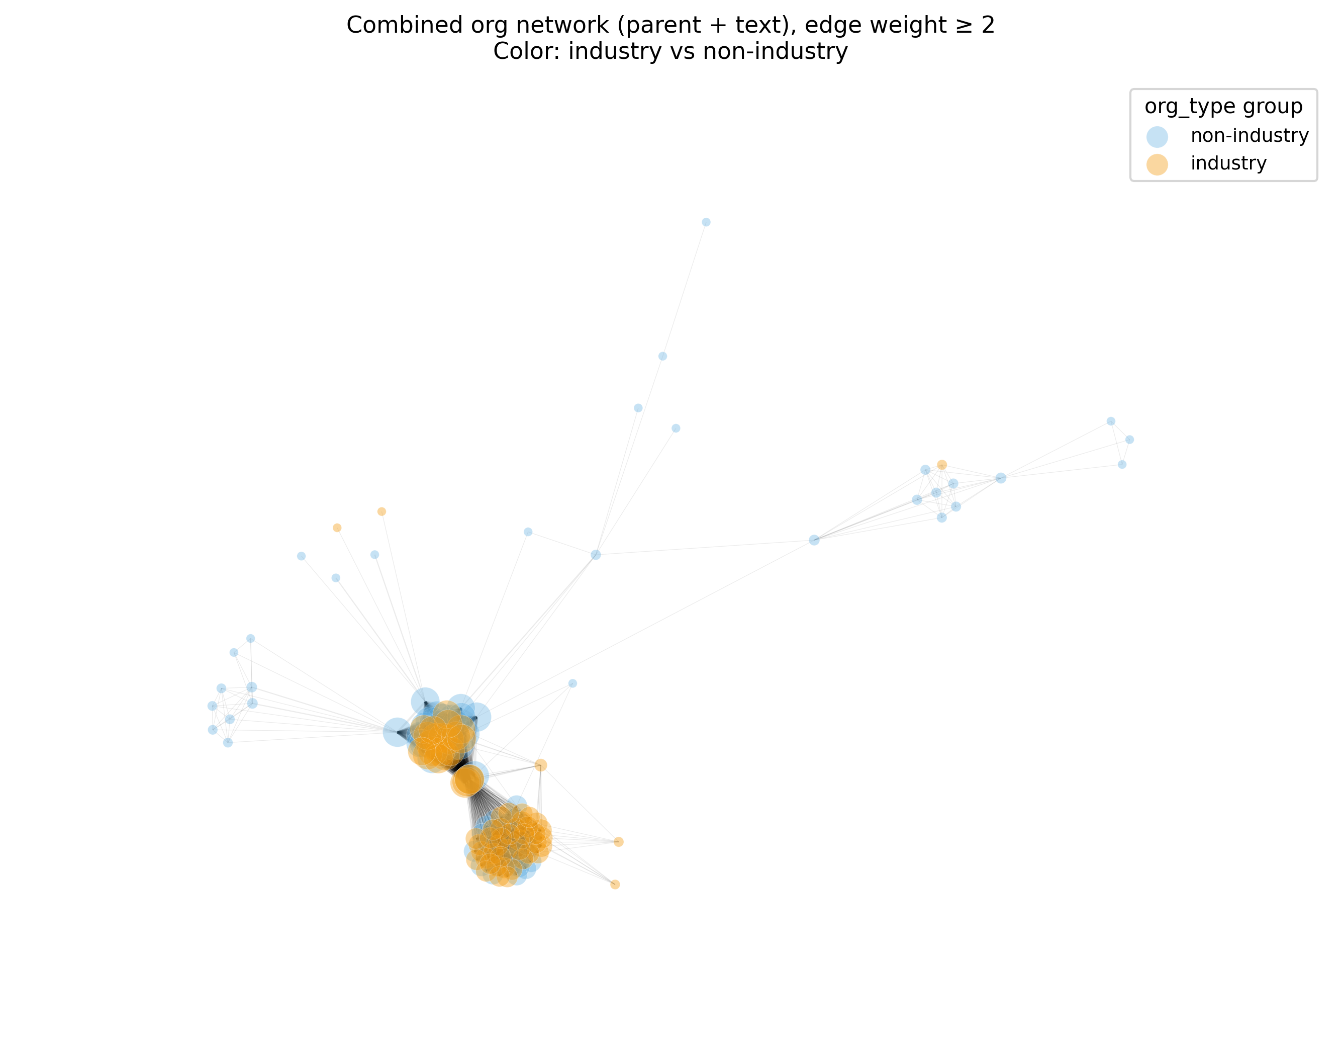
Key finding 1: Power is concentrated
Peripheral non-industry actors
Core industry actors

Slide 14
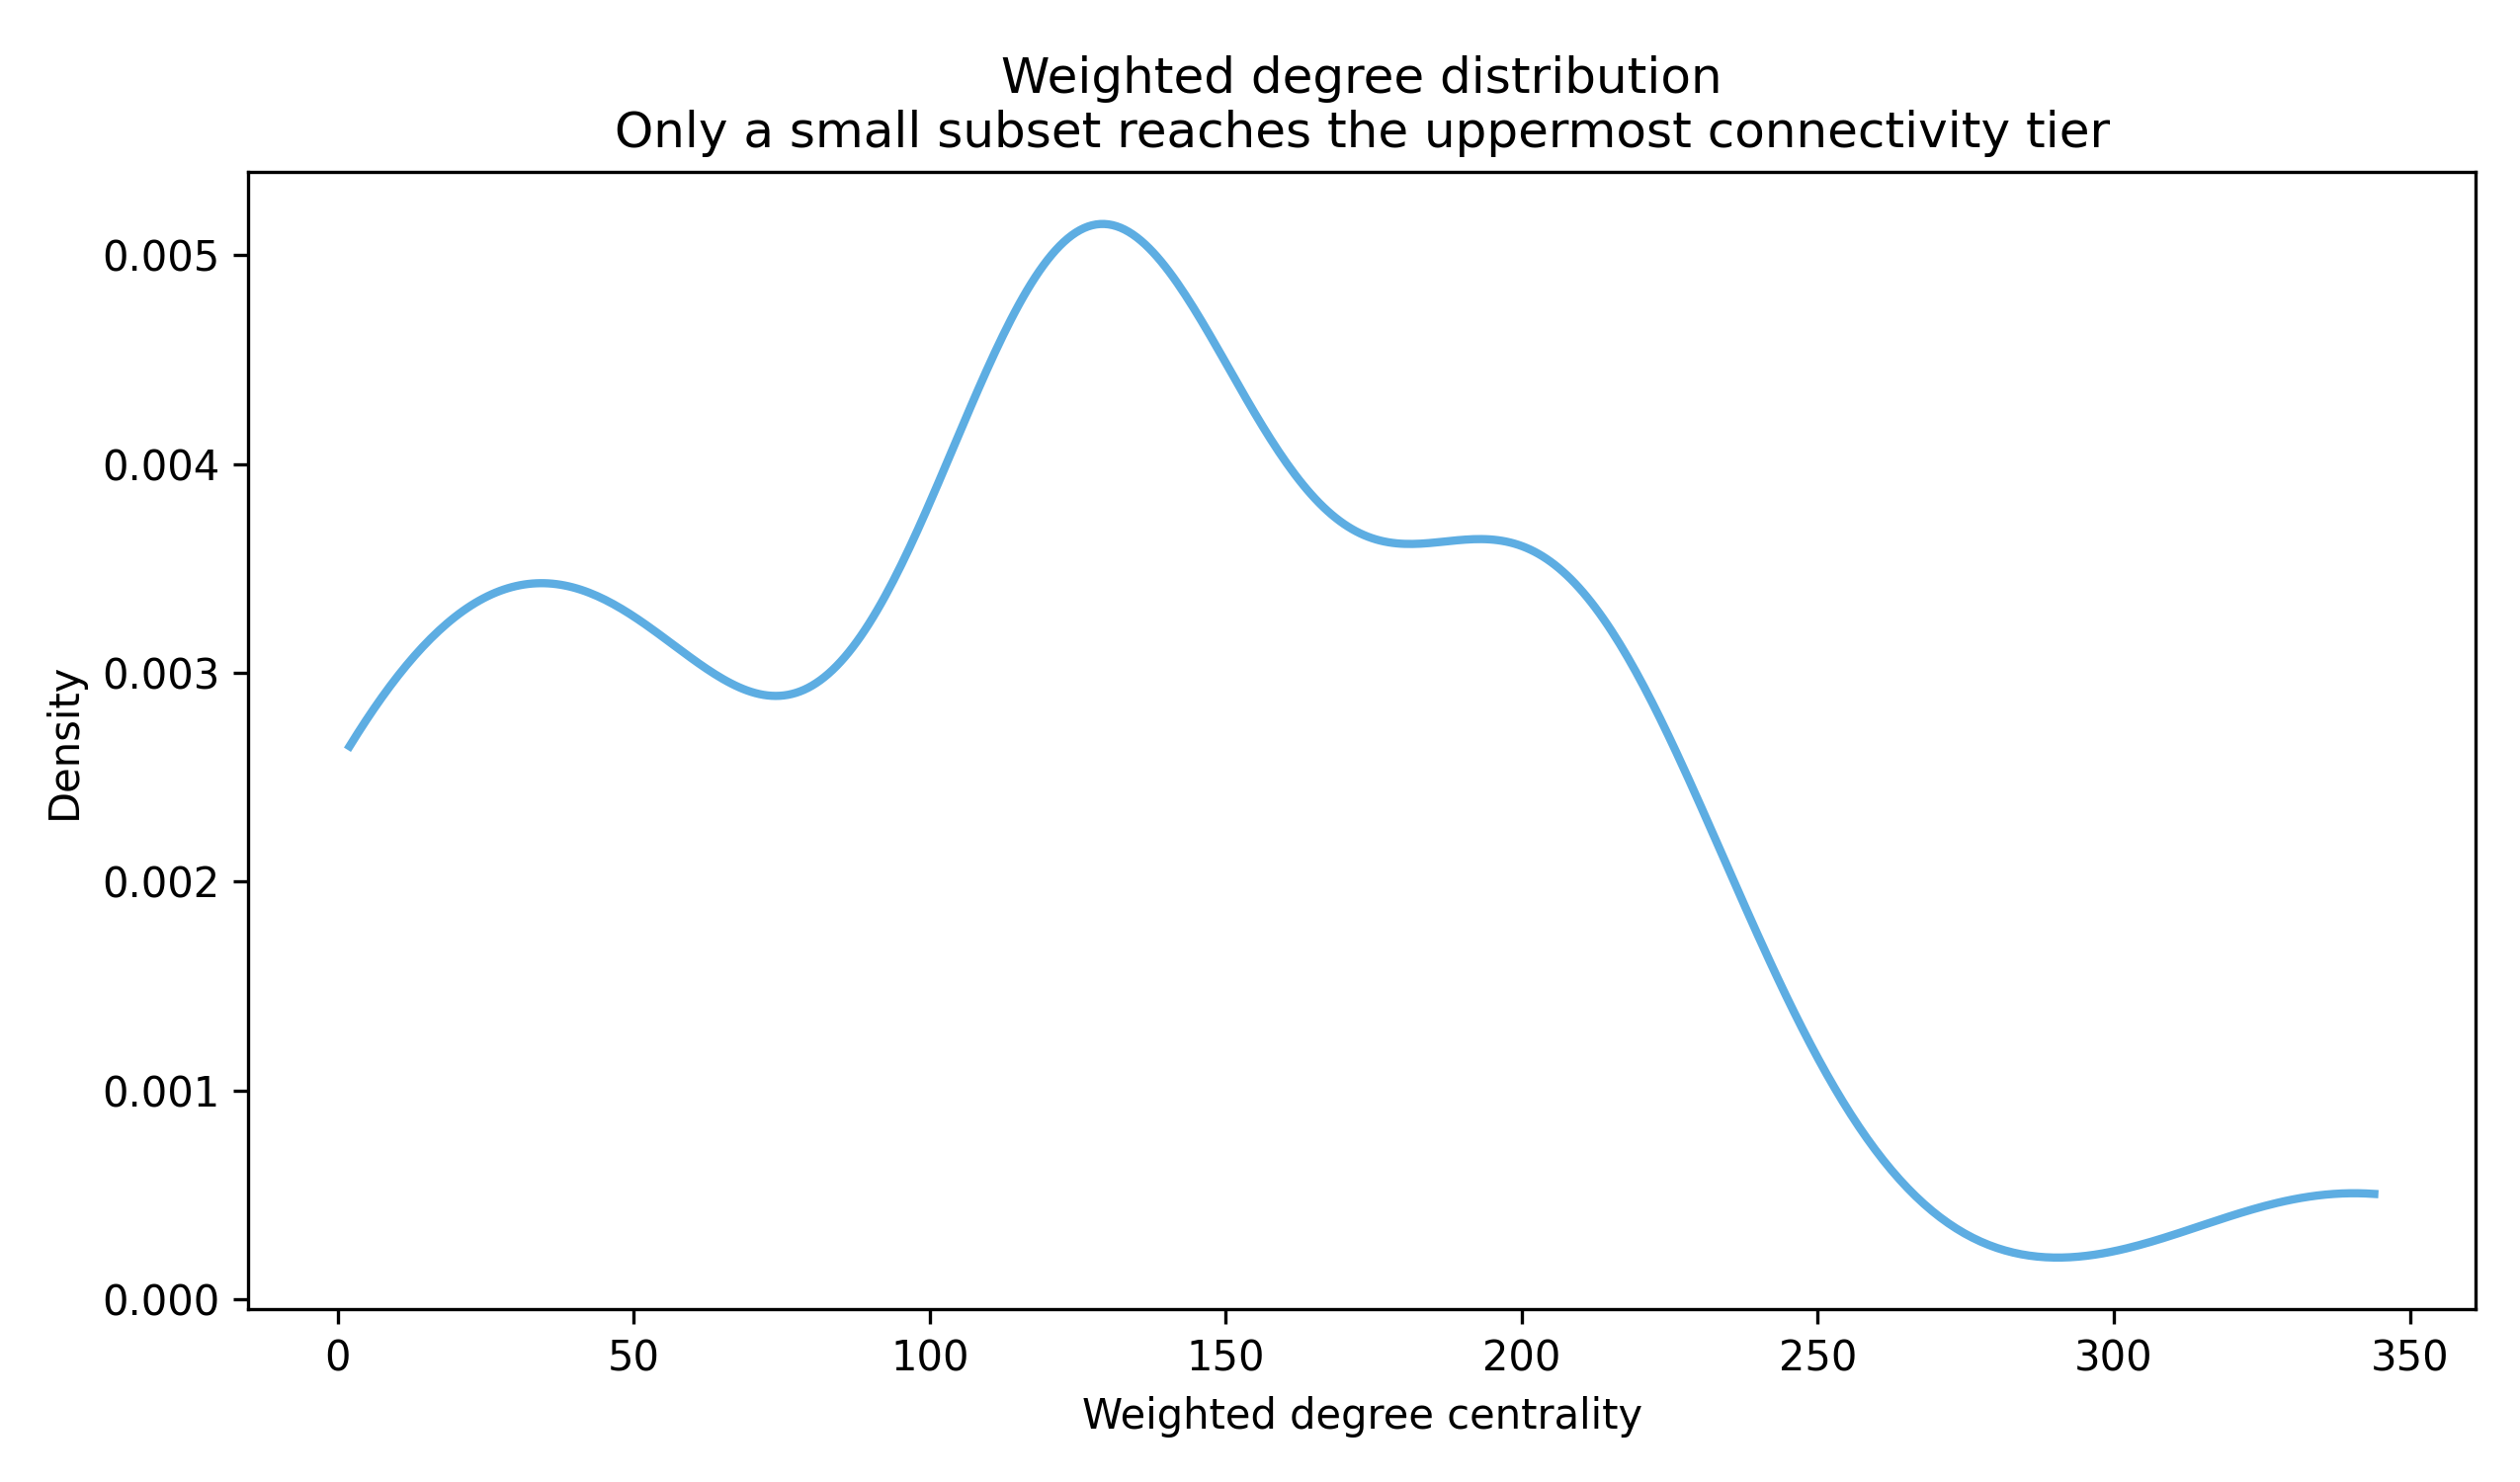
Key finding 1: Power is concentrated

Slide 15
Key finding 2: Sustainability is framed narrowly
Sustainability is predominantly framed in economic and social terms:
Competitiveness, efficiency, innovation, governance, trust, ...
Environmental considerations often absent or conditional:
Ecological limits, material footprint, energy demand, water scarcity, ...
Reflects industry priorities, reinforced by central positions
Sustainability discourse is selective
Notes:
Connection texts —> organizations
sustainability framed narrowly, focus on economic and social aspects
environmental aspects appear: secondary, conditional
ecological concerns marginalized, not integrated into core framing
sustainability discourse is selective

Slide 16
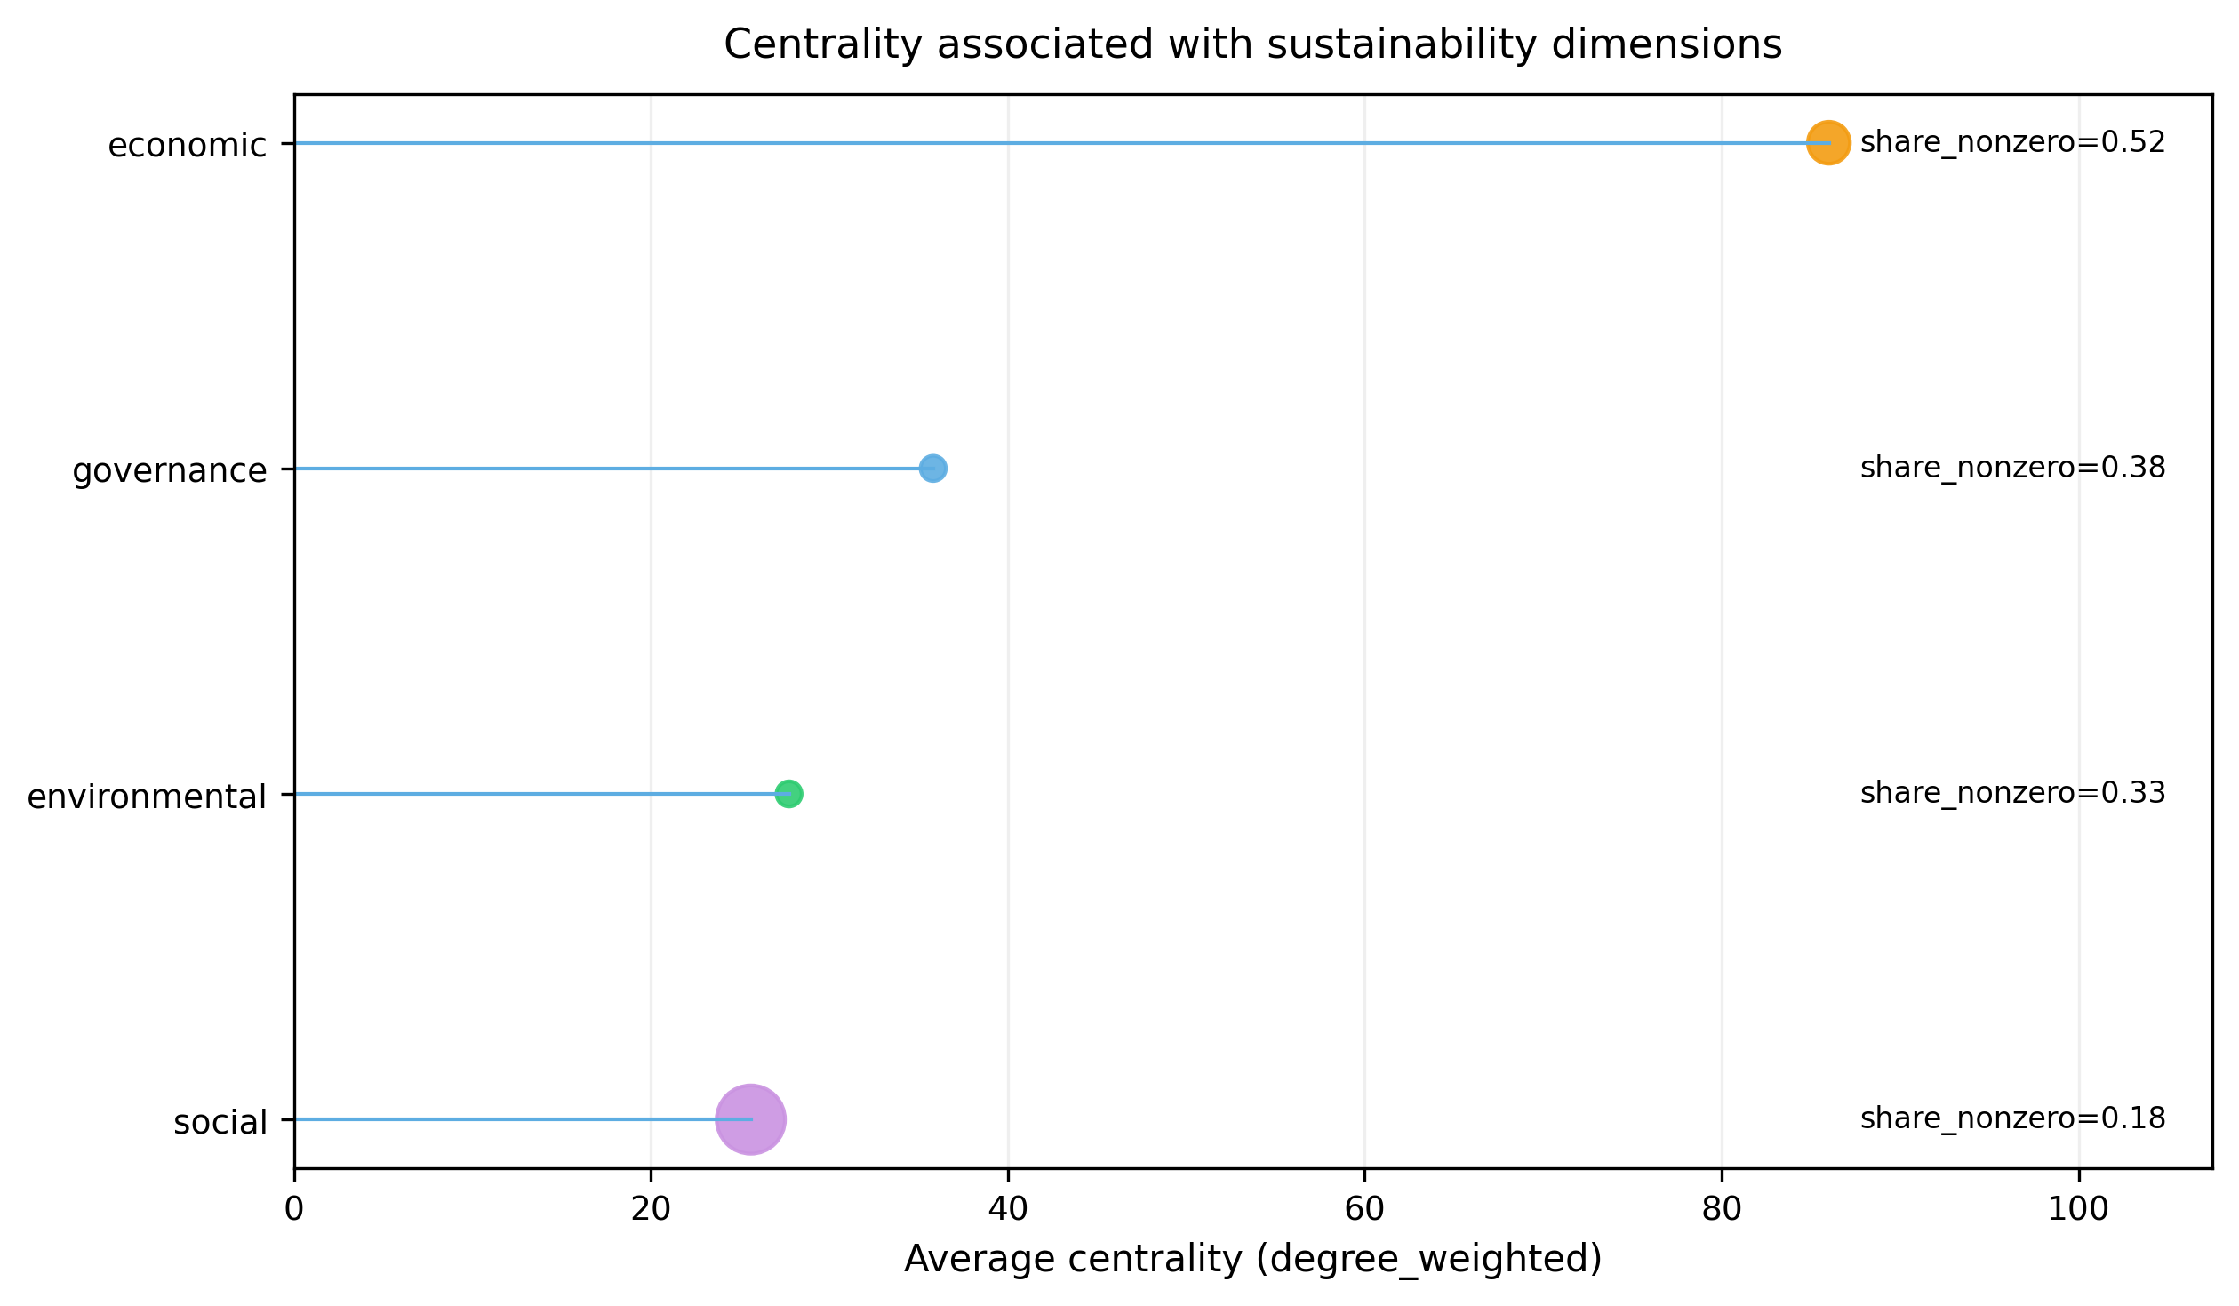
Key finding 2: Sustainability is framed narrowly

Slide 17
Key finding 3: Coalition Structures and Sustainability Challengers
Sustainability-oriented actors often unable to form cohesive coalitions
Large coalitions primarily composed of organizations with no explicit sustainability focus
Sustainability challengers struggle to find access to coalition structures
Results in weak collective voice, reduced influence over discourse
Notes:
coalitions exist, but not evenly distributed
structure favors certain actors
Challengers: fragmented and dispersed, weak coordination, no strong shared coalition
Challengers: lack entry points, limited participation in key groupings

Slide 18
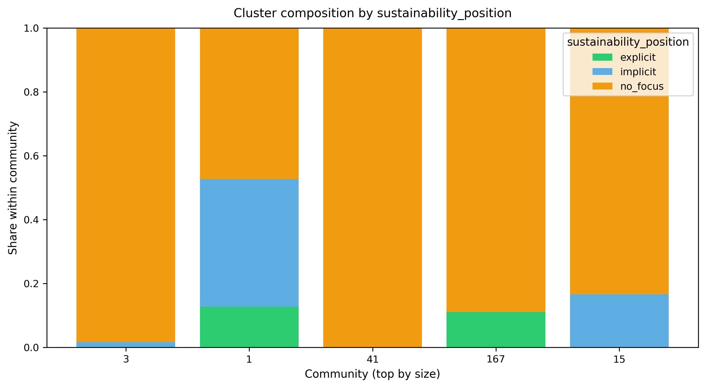
Key finding 3: Coalition Structures and Sustainability Challengers

Slide 19
Part 03 Discussion and Implications
Notes:
Minute 10

Slide 20
Reconnecting Empirical Evidence and Core Motivations
Network position shapes discourse
Incumbents dominate core, market-oriented logic
Ecological justice perspectives exist at the margins, low connectivity
Need for broader inclusion, especially environmental perspectives
Raises questions about legitimacy of the governance process
Structural bias: those who profit most decide the rules
Notes:
reconnect findings to core question
network position shapes discourse:
industry actors dominate, structural imbalance persists
limited participation of challengers, need broader inclusion, especially environmental justice perspectives
governance not evenly representative, raises legitimacy concerns, whose interests are reflected?
key actors benefit economically, same actors shape regulation, structural bias toward market logic
current setup reproduces imbalance, difficult to integrate ecological concerns
No causality, but strong alignment between structural position and sustainability framing

Slide 21
Narrative Power and Externalization of Ecological Costs
Logic of “obligatory technology”
AI framed as necessary for, e.g., competitiveness, sovereignty, innovation
Reduces space for questioning expansion itself
Governance assumes AI expansion, then optimizes within that frame
Result:
Systematic externalization of ecological costs
Environmental impacts framed as downstream issues
Notes:
narrative power shapes what is possible, sets boundaries of debate
AI framed as necessary, linked to: competitiveness, sovereignty, innovation
"AI becomes something that cannot be questioned."
limits critical discussion, expansion taken as given, no space for “do we need this?”
assumes AI growth, focuses on optimization, not on limits
ecological costs geographically and politically externalized
treated as downstream issues, secondary to innovation goals, not part of core governance

Slide 22
Rethinking the Twin Transition Narrative
EU's “twin transition” narrative requires re-evaluation
“Sustainability” framed conditionally and in economic terms
Digital expansion legitimized, masks ecological trade-offs
More as a rhetorical device than an actual framework?
More balanced approach alongside economic growth is essential
Notes:
digital + green transition, central EU narrative, promises alignment
functions as rhetorical frame, less visible in actual practice, weak integration in governance
sustainability framed economically —> mismatch between narrative and findings
growth logic remains dominant, digital expansion prioritized, green goals secondary
narrative legitimizes expansion, masks underlying trade-offs, reduces critical scrutiny
more balanced approach, integrate ecological limits, move beyond growth-centered framing

Slide 23
Conclusion
Without a a change in governance structures and power distribution, “sustainability” risks remaining disconnected from material realities.
01
This disconnect could perpetuate unsustainable practices within the AI sector.
02
Essential to address structural inequalities to foster a more inclusive and sustainable governance framework
03

Slide 24
Thank you

Slide 25
Backup Slide 1: Limitations
The network only captures formalized and documented relations
The analysis focuses on organizations, not individuals
Sustainability coding is interpretive, though theory-informed and transparent
The content analysis is deliberately limited in scope
The case is bounded to EU-level governance

Slide 26
Backup Slide 2a: Why combine SAF and Political Ecology?
Strategic Action Fields (SAF):
Maps governance arena as a structured field
Identifies incumbents, challengers, and alliances
Explains how influence is distributed and stabilized
Political Ecology
Examines how power shapes sustainability outcomes
Focuses on resource use, externalization, and inequality
Analyzes dominant narratives such as "green AI"

Slide 27
Backup Slide 2b: Why combine SAF and Political Ecology?
Combined contribution
SAF shows who holds power and how it operates
Political ecology shows what this power produces
Links governance structure to environmental consequences

Slide 28
Backup Slide 3: Case Selection and Empirical Corpus
987 organizations
57 policy texts
1200 organization-text relations
Combined weighted governance network
Notes:
large, structured dataset, covers full governance ecosystem
organizations + texts, links = participation or contribution, weighted connections
captures both: institutional actors, discursive production, allows mapping influence across arenas
comprehensive view of EU AI governance, not a single arena, but a dense network

Slide 29
Backup Slide 4: How the network was constructed
Nodes: organizations
Edges:
Co-membership in governance bodies
Co-occurrence in policy texts
Weighted edges reflect repeated interaction
Captures formalized governance relations, not all informal power

Slide 30
Backup Slide 5a: Centrality, power, and field structure
Network perspective
Degree → access and embeddedness
Betweenness → brokerage and coordination capacity
Observed pattern
Central actors:
appear repeatedly across governance arenas
connect otherwise separate groups

Slide 31
Backup Slide 5b: Centrality, power, and field structure
Link to Strategic Action Fields
Central positions correspond to incumbents
Peripheral positions correspond to challengers
Field stability is reflected in stable centrality patterns
Centrality operationalizes incumbency within the field

Slide 32
Backup Slide 6: How sustainability was analyzed
Based on public self-descriptions, mission statements, objectives
Categories:
Explicit sustainability focus
Environmental protection, ecological limits, climate impacts, ...
Implicit (indirect) focus
Efficiency, innovation, resilience, responsibility, ...
No sustainability focus
No meaningful engagement at all

Slide 33
Backup Slide 7: Linking structure and discourse
Step 1: Identify central vs peripheral actors (SNA)
Step 2: Analyze texts associated with these actors (content analysis)
Step 3: Compare sustainability framings
Discursive influence is interpreted in relation to structural position.

Slide 34
Backup Slide 8a: Coalition Structures and Sustainability Challengers
Modularity-based community detection
Network partitioned into groups
Maximize internal connectivit
Minimize connections between groups
Groups serve as coalition proxies
sensitive to parameter choices —> seen as exploratory summary

Slide 35
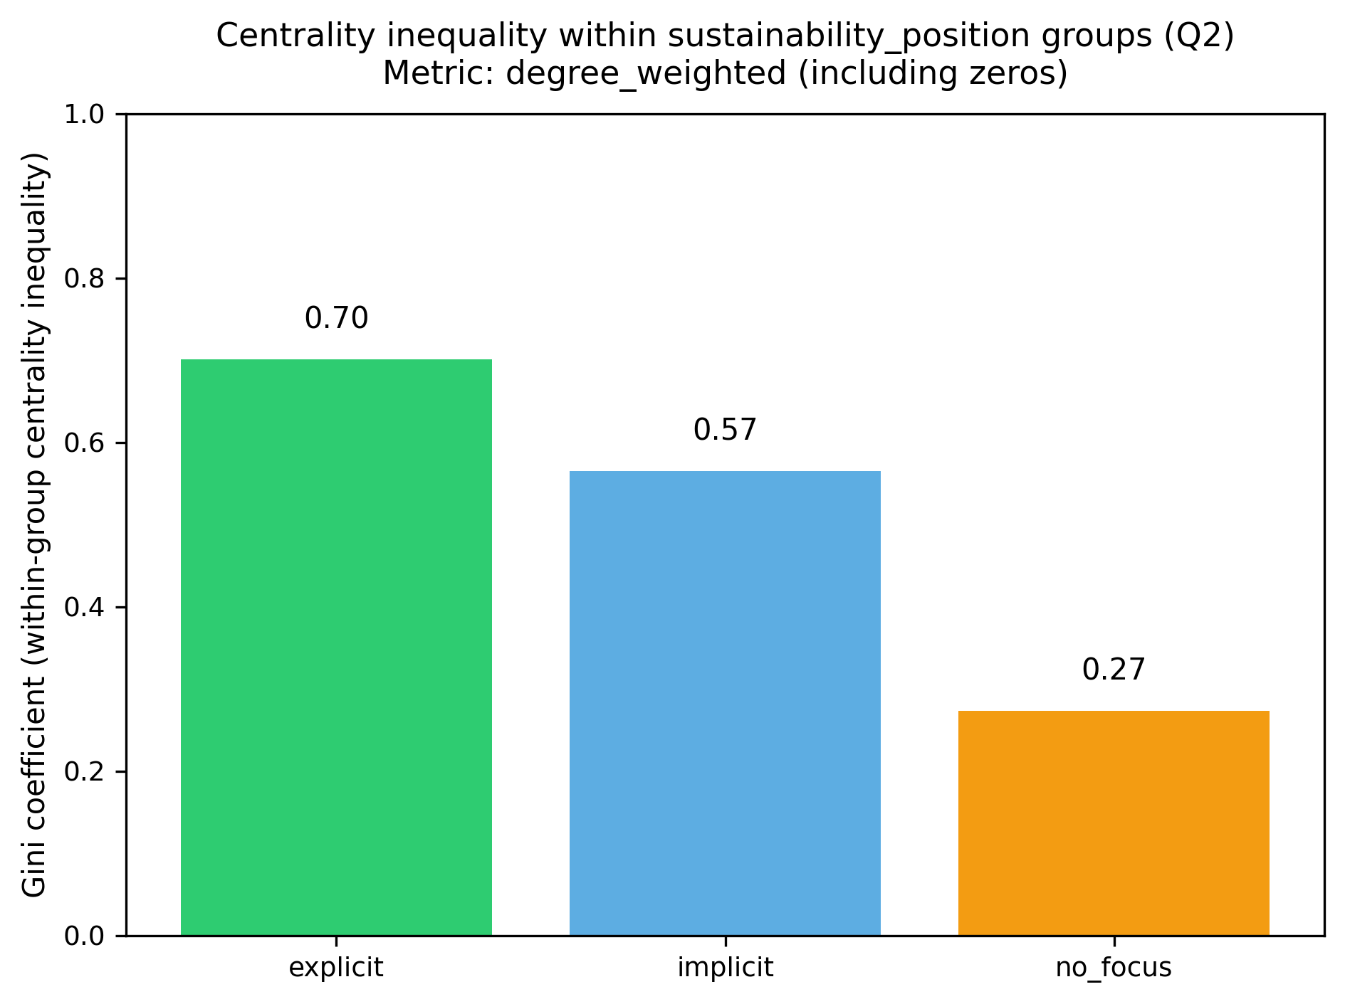
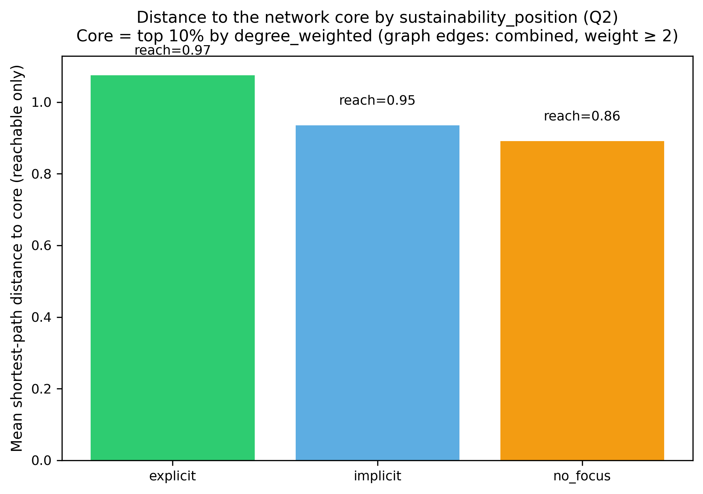
Backup Slide 8b: Coalition Structures and Sustainability Challengers

Slide 36
Backup Slide 9: What Is Influence?
Network ties capture relations such as
Co-membership in institutional settings
Shared participation in policy texts
Formal authorship, contribution, or affiliation
Centrality and brokerage indicate structural advantage
Notes:
influence through relations, embedded in network structure
"Influence often comes from being present where decisions are shaped."
high centrality → more connections, better access to information, higher visibility
brokers connect different groups, control information flows, enable coordination across clusters
influence = position + access + coordination

Slide 37
Linking Network Position to Sustainability Framing
Influence over sustainability-related AI policy is distributed unequally
Central positions are occupied mainly by market-oriented incumbents
Ecological justice perspectives exist, but do not occupy central positions
Narrative power follows structural embeddedness
Hard for ecological justice advocates within landscape dominated by corporate interests
Notes:
network position shapes discourse:
incumbents dominate core, market-oriented logic, strong structural embeddedness
ecological justice perspectives exist, located at the margins, low connectivity
follows centrality, central actors define framing, peripheral voices less visible
limited access for challengers, hard to shift dominant narratives/the action field, structural barriers persist
No causality, but strong alignment between structural position and sustainability framing

Slide 38
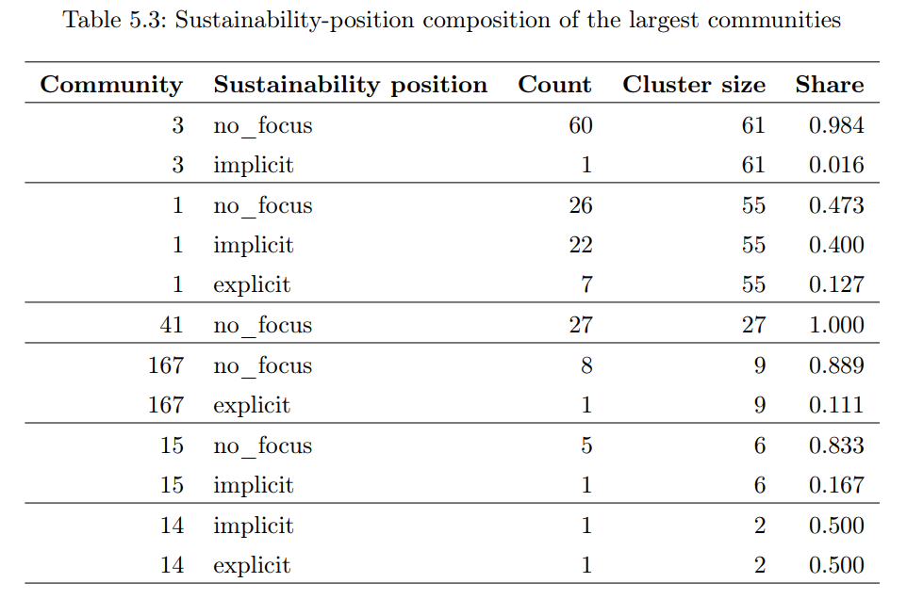

Slide 39
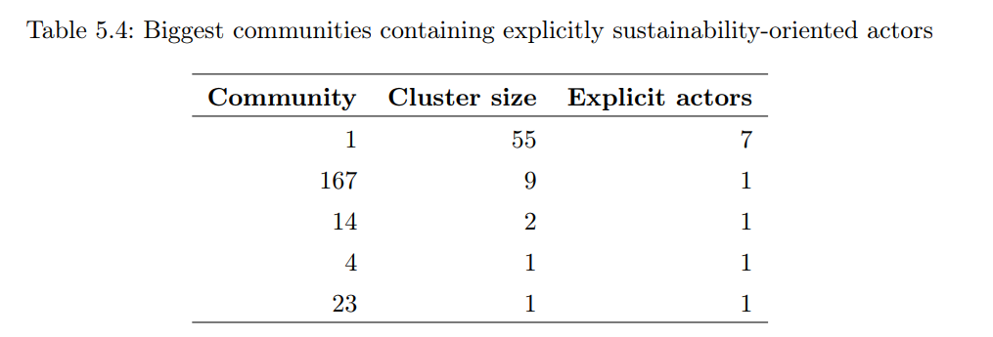

Slide 40
My 6 favorite quotes from analyzed texts
“AI [...] enables climate mitigation, efficiency, and optimization” (White Paper,p. 2)
“Environmental impact [...] is treated through a trust-and-uptake logic” (Impact Assessment, p. 81) —> Environmental Impact only as side-effect of uptake.
“Sustainability is often defined as compatible with economic strengthening” (EESC 2019, p. 5)
“Economic sustainability” is explicitly tied to being “productive, profitable and competitive” (EESC 2019, p. 9)
“Stricter rules risk innovation and create administrative burden” (DIGITALEUROPE, p. 5)
“Digitalization has not reduced energy demand or emissions so far” (EESC 2020, p. 14)

