Slide 1
Pragmatic REST API design

Slide 2
What REST is NOT!
Fancy annotations added to class for webservice creation
Not a standard
  No w3s specification
  No RFC
Thinking in term of separate components, but components + infrastructure

Slide 3
REST Wikipedia definition.
Representational state transfer (REST) is an architectural style consisting of a coordinated set of constraints applied to components, connectors, and data elements, within a distributed hypermedia system.
REST ignores the details of component implementation and protocol syntax in order to focus on the roles of components, the constraints upon their interaction with other components, and their interpretation of significant data elements

Slide 4
REST Constraints
Client-Server
Stateless server
Cache
Uniform Interface
  Identification of resources
  Manipulation of resources through representation
  Self descriptive messages
  HATEOS
Layered System
Code on demand (optional)

Slide 5
Benefits of using REST
Scalability
Generality
Independent
Latency(Caching)
Security
Encapsulation

Slide 6
REST Constraints
Client-Server
Stateless server
Cache
Uniform Interface
  Identification of resources
  Manipulation of resources through representation
  Self descriptive messages
  HATEOS
Layered System
Code on demand (optional)

Slide 7
Client-cache-stateless server web architecture

Slide 8
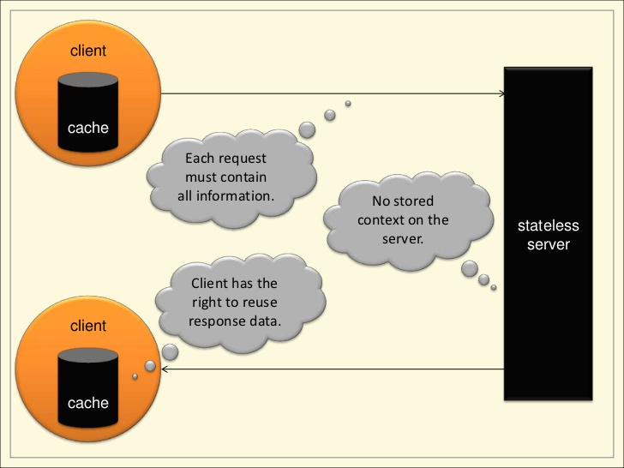

Slide 9
5) Layered System

Slide 10
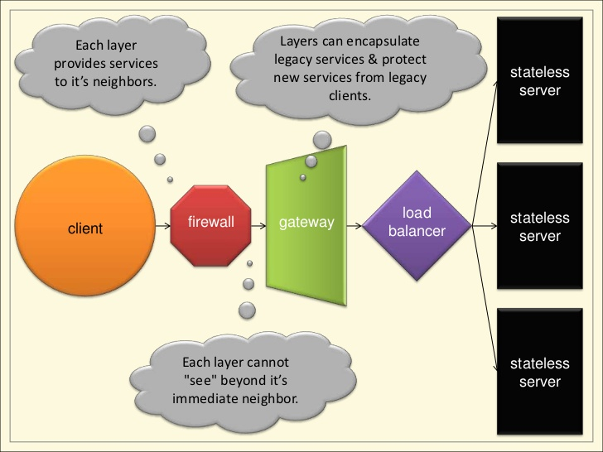

Slide 11
Uniform Interface
Identification of resources
      https://plus.google.com/105241942263733376460/posts
Manipulation of resources through representation
Self descriptive messages

Slide 12
HATEOS:Hypermedia as the engine of application state
Clients make state transitions only through actions that are dynamically identified within hypermedia by the server (e.g., by hyperlinks within hypertext). Except for simple fixed entry points to the application, a client does not assume that any particular action is available for any particular resources beyond those described in representations previously received from the server.

Slide 13
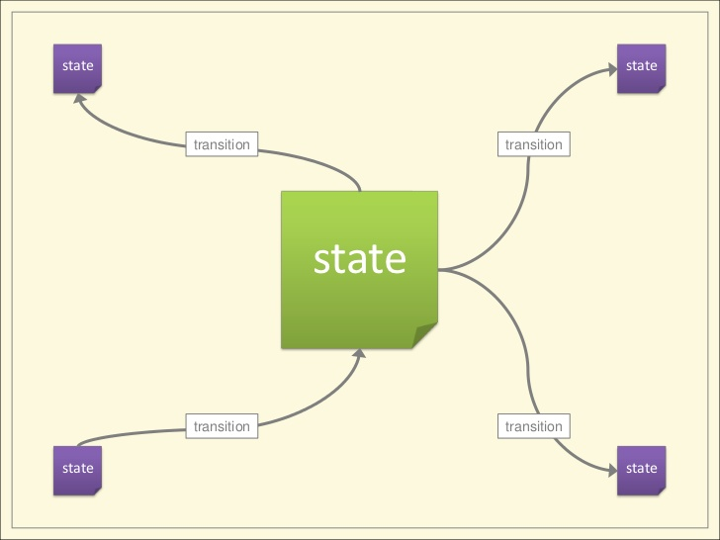

Slide 14
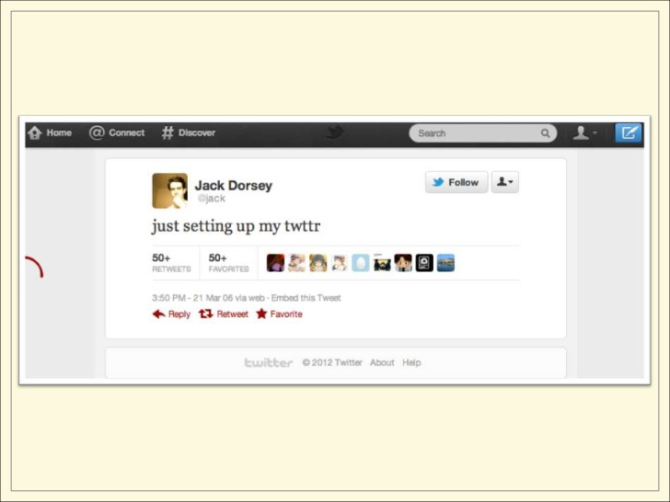

Slide 15
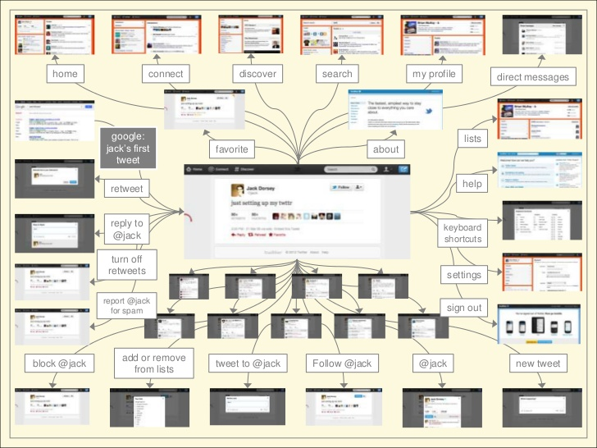

Slide 16
Designing resource identifiers

Slide 17
General thoughts
Nouns not Verbs
Focus on what makes sense for the domain
Things, not actions
Coarse grained
Think about URL's as long term support stuff, that should change as little as possible
Consider future in the design
Don't use underling technology in URL's (cgi-bin, php), or any implementation details
Should giving You potential to be used in different context

Slide 18
Typical resource identification in REST approach

Slide 19
URLs for resource collection
  /features
  /features/lines
URLs for single resource
  /features/{feature_id}
Modeling associations in URLs
  /features/datasets/{dataset_id}
  /datasets/{dataset_id}/features/{feature_id}

Slide 20
Try to delegate all your API complexity to after question mark parameters
/sessions?filter=creationTime,gt,2003-01-01
/features/lines?width=255&height=255&unit=px&bbox=23.55;55.43;21.456;56.2345

Slide 21
How to add actions to our API
Use HTTP method definition
GET
PUT
POST
DELETE
HEAD

Slide 22
Creating CRUD api with HTTP method definition

Slide 23
GET
GET /features
GET /datasets/{dataset_id}/features{feature_id}
DELETE
DELETE: /features/lines
DELETE: /datasets/{dataset_id}/features/{feature_id}

Slide 24
POST and PUT can be used for CREATION and UPDATE operations

Slide 25
PUT for CREATE
PUT http://someserver/sessions/session_id
{
name=”some_name”,
user=”some_user”,
description=”some_description”
}
Response 201

Slide 26
PUT is idempotent
It means that doesn't matter how many method will be invoked, state of the resource on the server shouldn't change.
This means that all operations with PUT need to specify the resource fully, for the each time.

Slide 27
PUT for UPDATE
PUT http://someserver/sessions/session_id
{
name=”new_name”,
user=”some_user”,
description=”some_description”
}

Slide 28
POST for CREATE
POST http://someserver/sessions
{
name=”some_name”,
user=”some_user”
}
Response 201

Slide 29
POST is the only no idempotent method in HTTP standard
It means that it can be partial, not all resource state meaningful stuff need to be specified.

Slide 30
POST for UPDATE
POST http://someserver/sessions
{
name=”dummy_name”
}

Slide 31
QUIZ
What is wrong with this URL:
http://plsrvup-src01/traffic-signs-evidence-access-service-vw-11/getFeaturesById?id=938c4898-0594-4187-b7d7-b154e8de94d9

Slide 32
Serving a response
Try to be as much verbose
Use HTTP response properly code to help client figuring out where is the problem
If this is possible point client to exact problem
Internal error code can be useful
If this is possible in case of error point user to the place where he can find more information about solving the problem

Slide 33
HTTP response codes categories
Category | Description
1xx:Informational | Communicates transfer protocol level information
2xx:Success | Indicates that client request was accepted successfully
3xx:Redirection | Indicates that client must take some additional actions to complete their request
4xx:Client Error | This category of error points the finger on the client
5xx:Server Error | The server takes responsibility for this error status codes.

Slide 34
200(OK) : It indicates that the REST API successfully carried out whatever action the client requested, and that no more specific code in the 2xx series is appropriate. Unlike the 204 status code, a 200 response should include a response body
201(CREATED): REST API responds with the 201 status code whenever a collection creates, or a store adds, a new resource at the client’s request.

Slide 35
202(Accepted): Must be used to indicate start of an asynchronous action, a 202 response should be used for action that takes long time.
204 (No Content): Should be used when the response body is intentionally empty.
301 (Moved Permanently), should be used for relocated resources, it means that REST Api resource model has been significantly redesigned, and new permanent URI has been assigned to the resource. The API should specify in the new URI in the response Location header.

Slide 36
303 (See Other): This code allows the REST api to send a reference without forcing the client to download its state, instead client may send a GET request to the value of Location header
401 (Unauthorized) A 401 error response indicates that the client tried to operate on a protected resource without providing the proper authorization. It may have provided the wrong credentials or none at all.
403 (Forbidden) should be used to forbid access regardless of authorization state

Slide 37
405 (Method Not Allowed):
The API responds with a 405 error to indicate that the client tried to use an HTTP method that the resource does not allow. For instance, a read-only resource could support only GET and HEAD,but not PUT or DELETE.
406 (Not Acceptable) must be used when the requested media type
cannot be served
409 (Conflict) should be used to indicate a violation of resource state
The 409 error response tells the client that they tried to put the REST API’s resources into an impossible or inconsistent state. For example, a REST API may return this response code when a client tries to delete a non-empty store resource.

Slide 38
500 (Internal Server Error) should be used to indicate API malfunction, undesirable state of application for the programmer

Slide 39
ERROR Handling

Slide 40
Use HTTP status codes, try map them as clearly as possible to reflect with them the current situation
To introduce better grained exceptional states, good practice is to introduce your own error codes, for self identified possible cases.
Be verbose as much as this is possible
If you decided to put some message in the response, try express the message in the context reason, hide the technical stuff.
Good practice is to point the user to some part of the documentation, where he can fin some helpful information.
500 should happen only when application have reached undesirable for state
Wrapping each failures in 200 response can be dangerous in term of caching.

Slide 41
PUT http://someserver.com/transactions
{
TrasnactionId=55,
TransactionContent=......
}
Response
406 (Confilct)
{
ErrorCode=666,
errorMessage=”Transaction with given Id (55) already exists”
}

Slide 42
Versioning

Slide 43
Don't break an existing clients!!!
API versioning cannot be tied to software versioning in any way.
http://someserver/traffic-signs-proposal-service/v2.39.11/propose....
http://someserver/traffic-signs-proposal-service/v2.39.32/propose....
If you will decide on above strategy, will lead you to maintaing huge amount of versions, and various foot print in your URL.
In such approach also caching in the middle tiers can be less effective.

Slide 44
Examples
Twilio.com -> /2010-01-04/Accounts
Salesforce.com -> /services/data/v20.0/subjects/Accounts
Facebook.com-> ?v1.0
Use versioning headers to specify the version

Slide 45
Make it mandatory, to do this make this as a part of the URL.
Put the version on most base part of the URL
Use version indicator like v1, for the most programmers it is the most common way of expressing the version
Try to use the ordinal numbers

Slide 46
Exceptions

Slide 47
Flex container interrupts all HTTP responses, other than 200 and bring to the front error message window
/public _timelines.jsonsuppress_response_codes=true
HTTP Status Code : 200
{"error": "Could not authenticate you."}

Slide 48
When the client doesn't support all http methods
Create: /dogs?method=post
Read: /dogs
Update: /dogs/1234?method=put&location=park
Delete: /dogs/1234?method=delete

Slide 49
Non resourceful stuff
Sometimes there is a need to expose, some actions, through the API, like calculate, propose, and trying to express them via nouns will lead to some artificial constructions, then just use verbs, this will more expressive to anyone

Slide 50
Thank You

