Slide 1

Clinical Data Analysis in R
Phase I - Introduction to R for Clinical Research
A five-session evening short course - Tuesdays, 8:00 PM
Trainers: Bernard Osang'ir & My Luong Vuong
Date: 8 September - 6 October 2026
Notes:
TITLE SLIDE.
Welcome participants to Phase I of Clinical Data Analysis in R.
Key teaching point: by the final session every participant will import, clean, analyse and report a real clinical dataset, with no prior coding.
Demo tip: ask the room who has opened R before - calibrate pace.
Audience question: what do you hope to analyse in your own work? Expected answer: trial/survey/audit data - reassure all fit this workflow.

Slide 2
Welcome & Course Aim
Why this course
Clinicians increasingly need to analyse their own data and read statistics critically.
R is free, reproducible and the standard tool in modern clinical research.
Our promise
Start from zero - no programming background assumed.
Learn by doing, using ONE real clinical dataset all week.
Finish able to produce publication-ready tables, figures and regression results.
TIP - Learning by analogy
Think of R as a very precise research assistant: you write the instructions once, it repeats them perfectly forever.
Neudata | #ClearDataClearImpact
Notes:
Set the tone: supportive, practical, clinically relevant.
Common misconception: 'I am not a maths/computer person so R is not for me.' Reframe: R is a skill like using a new clinical device - learnable with practice.
Clinical interpretation: reproducibility protects you in audits, revisions and re-analysis.
Audience question: how many currently use Excel/SPSS/Stata? Expected: most - bridge from there.
Demo tip: keep the first day light on jargon.

Slide 3
Who This Course Is For
Designed for busy clinical professionals - no programming experience needed.
Medical doctors and residents
Nurses and hospital research staff
Clinical and hospital pharmacists
Clinical researchers and trial coordinators
Public health professionals
Masters students and PhD candidates
Anyone who collects or interprets clinical data
Neudata | #ClearDataClearImpact
Notes:
Establish the shared starting point.
Key teaching point: the mix of backgrounds is a strength - pair confident with less confident learners.
Common misconception: that statisticians and clinicians need different tools - they do not.
Audience question: what is your single biggest data frustration today? Expected: cleaning, or 'I cannot reproduce last year's analysis'.
Demo tip: note names/roles to tailor examples.

Slide 4
Learning Objectives (1 of 2)
By the end of the week you will be able to
Navigate R and RStudio with confidence.
Understand the structure of clinical datasets.
Import data from Excel and CSV files.
Clean, validate and recode clinical data.
Perform and interpret descriptive statistics.
Generate publication-quality tables (a manuscript Table 1).
Generate publication-quality figures.
Neudata | #ClearDataClearImpact
Notes:
Walk through objectives 1-7 (the data-handling and description skills).
Key teaching point: these map one-to-one onto the five days.
Clinical interpretation: each objective is a step in a real manuscript workflow.
Audience question: which objective matters most to you? Expected: varies - reassure all are covered.
Demo tip: return to this list at each day's recap to show progress.

Slide 5
Learning Objectives (2 of 2)
You will also be able to
Choose and perform common statistical tests.
Interpret statistical output correctly.
Perform simple and multiple logistic regression.
Report odds ratios with confidence intervals.
Write reproducible analysis scripts.
Export publication-ready outputs.
Interpret findings for medical publications.
Neudata | #ClearDataClearImpact
Notes:
Objectives 8-13 (the analysis, inference and reporting skills).
Key teaching point: interpretation is weighted as heavily as computation throughout.
Common misconception: that running the test is the hard part - interpreting and reporting it well is harder.
Audience question: who has had a paper criticised for statistics? Expected: a few - this course prevents that.
Demo tip: emphasise we always ask 'what does this mean clinically?'

Slide 6
Course Structure - Five Sessions
Session | Theme | Core skill | Exercise output
1 | Introduction to R & RStudio | Import data | Dataset imported
2 | Understanding & Cleaning Clinical Data | Clean & recode | Analysis-ready data
3 | Descriptive Statistics, Tables & Figures | Tables & figures | Manuscript Table 1
4 | Common Medical Statistical Tests | t-test, Chi-square, Non-parametric | Correct test chosen
5 | Introduction to Regression & Interpreting Output | Modelling & reporting | Short Results section
Five evening sessions (Tuesdays, 90 minutes each); each session builds on the last.
Neudata | #ClearDataClearImpact
Notes:
Give the map of the whole week.
Key teaching point: skills are cumulative - Day 2's clean data feeds every later day.
Clinical interpretation: this is exactly how a real analysis project flows, start to finish.
Audience question: which day looks most daunting? Expected: Days 4-5 - reassure we build up gently.
Demo tip: keep this slide handy to re-orient anyone who feels lost.

Slide 7
How Each Session Runs (90 Minutes)
A predictable evening rhythm
Recap & set-up - about 10 minutes: reconnect to last week.
Lecture & live demo - about 55 minutes: concepts, then the trainer codes as you watch.
Guided exercise - about 20 minutes: you code, we help.
Wrap-up & questions - throughout and in the last 5 minutes.
NOTE - Bring
A laptop with R and RStudio installed (see the pre-course pack), and the course data folder.
Neudata | #ClearDataClearImpact
Notes:
Explain the format so participants know what to expect each session.
Key teaching point: watching then doing (the demo-then-exercise pattern) is how coding is learned.
Common mistake: trying to type along during the demo and falling behind - watch first, code in the exercise.
Audience question: prefer to type along or watch then do? Expected: mixed - explain why watch-first works.
Demo tip: share your screen with a large font (e.g. 16-18pt).

Slide 8
Our Case Study - One Dataset All Week
Study
Determinants of Hypertension Treatment Uptake among Adults attending Primary Healthcare Facilities.
Design
Multicentre cross-sectional study - 6 primary healthcare facilities.
1,500 adult attendees screened for hypertension.
Facilities: Bugando PHC, Kisesa HC, Nyamagana PHC, Ilemela HC, Buzuruga PHC, Igoma HC.
Primary outcome
Treatment uptake - whether a diagnosed patient is currently on antihypertensive therapy.
Neudata | #ClearDataClearImpact
Notes:
Introduce the single dataset that anchors every exercise.
Key teaching point: using one realistic dataset all week lets skills compound.
Clinical interpretation: treatment uptake is a real implementation-science question - many diagnosed patients never start therapy.
Audience question: why might a diagnosed patient not be on treatment? Expected: cost, distance, beliefs, no insurance - these are our predictors.
Demo tip: this is simulated data built to behave realistically - safe to share and reproduce.

Slide 9
The Variables We Will Use
Demographics & social
Age, sex, residence, education, occupation, marital status, health insurance.
Behavioural & clinical
Smoking, alcohol, physical activity, BMI, diabetes, family history, blood pressure.
Laboratory & outcomes
Cholesterol panel, glucose, creatinine, electrolytes; treatment uptake, adherence, BP control.
TIP - Data dictionary
A full data dictionary (36 variables) is provided - keep it open during every exercise.
Neudata | #ClearDataClearImpact
Notes:
Preview the data dictionary so variables are familiar before Day 1's import.
Key teaching point: knowing your variables and their types is half of good analysis.
Common misconception: more variables is always better - we will discuss parsimony on Day 5.
Clinical interpretation: these span the determinants framework (predisposing, enabling, need factors).
Audience question: which variable would you expect to predict uptake? Expected: insurance, diabetes, education - we will test this.
Demo tip: hand out the printed data dictionary now.

Slide 10
How the Week Builds to a Published Result
The analysis pipeline
Import (Day 1) -> Clean & validate (Day 2) -> Describe (Day 3)
Test & model (Day 4) -> Final model, interpret & report (Day 5).
Your final deliverable
A short, reproducible Results section identifying the determinants of treatment uptake -
exactly what a journal would expect.
CLINICAL INTERPRETATION - The big idea
Every day produces one piece of a real manuscript; by Friday the pieces form a whole analysis.
Neudata | #ClearDataClearImpact
Notes:
Show the throughline so participants see the destination from Day 1.
Key teaching point: analysis is a pipeline, not a single magic command.
Clinical interpretation: reproducibility means a reviewer could rerun your script and get your numbers.
Audience question: where do most analyses go wrong? Expected: cleaning and interpretation - hence two full sessions on them.
Demo tip: revisit this pipeline diagram at each session's start.

Slide 11
Sessions, Trainers & How to Register
When we meet
Five evening sessions - every Tuesday, 8:00 PM, 90 minutes each.
8 September to 6 October 2026.
Online delivery - join from anywhere with a laptop.
Your trainers
Bernard Osang'ir - Senior Biostatistician (lead trainer).
My Luong Vuong – Pharmacist, Biostatistician & Epidemiologist.
TIP - Register / enquire
My Luong Vuong - myluong1710@gmail.com - www.neu-data.com - scan the poster QR code to register.
Neudata | #ClearDataClearImpact
Notes:
Use this slide to confirm logistics and introduce the teaching team.
Key teaching point: three trainers means plenty of help during the guided exercises.
Housekeeping: share the registration link/QR and the enquiries email for colleagues who want to join a future cohort.
Demo tip: invite each trainer to say one line about themselves.
Audience question: any scheduling or access questions before we begin? Expected: confirm the Tuesday evening slot works.

Slide 12
Day 1: Introduction to R & RStudio
Today's Plan
Why R for clinical research
R vs RStudio: install and the interface
Projects, scripts, objects and vectors
Data frames and packages (tidyverse)
Importing and a first look at the study data
Hands-on exercise
Neudata | #ClearDataClearImpact
Notes:
Key point: this whole day is about getting comfortable, not memorising. By tonight every participant will have imported a real clinical dataset and looked at it.
Common misconception: that you must be a programmer. You do not; R is a tool like a calculator or a stethoscope.
Clinical interpretation: reproducible analysis means a colleague or a regulator can re-run your work and get the same numbers.
Ask the audience: who has used Excel for research? Expected answer: almost everyone. Bridge: R does what Excel does, but it records every step.
Demo tip: keep RStudio open on screen behind you so people see the real thing, not just slides.

Slide 13
Why R for Clinical Research
What R gives you
A free, open-source language for statistics and data
Used in clinical trials, epidemiology and journals
Handles import, cleaning, analysis and plots in one place
Why it matters
Every step is written down, so the analysis is repeatable
No cost and no licence: install on any computer
A huge community and packages for medical research
CLINICAL INTERPRETATION - Reproducibility
If you can re-run the script, you can defend the result.
Neudata | #ClearDataClearImpact
Notes:
Key point: the headline advantage is reproducibility plus zero cost. Click-by-click in Excel is hard to reproduce; a script is the recipe.
Common misconception: that free means low quality. R is used by FDA, EMA reviewers, and most major epidemiology groups.
Clinical interpretation: when a reviewer asks how you derived a number, you point to a line of code, not your memory.
Ask the audience: what happens if you redo last year's analysis in Excel by hand? Expected answer: you may get slightly different numbers. A script removes that risk.
Demo tip: mention that the figures in many NEJM and Lancet papers are made in R.

Slide 14
R vs RStudio: Two Different Things
R (the engine)
The actual statistical language
Does the computation
You install it first
Rarely opened on its own
RStudio (the dashboard)
A friendly workspace around R
Editor, console, plots, help
Install it second
This is what you open daily
Neudata | #ClearDataClearImpact
Notes:
Key point: R is the engine, RStudio is the dashboard. You need both, and you install R first.
Common mistake: people try to open R directly and find a bare console. Always open RStudio instead.
Clinical interpretation: think of R as the lab analyser and RStudio as the technician's interface to it.
Ask the audience: which one do you double-click each morning? Expected answer: RStudio.
Demo tip: show both icons on the desktop so the distinction is concrete.

Slide 15
The RStudio Interface: Four Panes
Top-left: Source (Script editor)
Where you write and save your code
Bottom-left: Console
Where code runs and results appear
Top-right: Environment
The objects and data you have created
Bottom-right: Files / Plots / Help
Folders, your graphs, and documentation
TIP - Orientation
Spend two minutes finding each pane before you type.
Neudata | #ClearDataClearImpact
Notes:
Key point: just four panes. Source and Console on the left, Environment and the Files/Plots/Help tabs on the right.
Common misconception: that the layout is fixed; it is configurable, but the defaults are fine for beginners.
Clinical interpretation: the Environment pane is your worktop, it shows what data is currently loaded.
Ask the audience: where will a graph appear? Expected answer: bottom-right, the Plots tab.
Demo tip: type a line in the Console and the same line in the Source, and show that only the saved Source persists.

Slide 16
RStudio Projects and the Working Directory
The working directory
The folder R looks in when you open a file
Check it with getwd()
Use a Project, not setwd()
File > New Project keeps everything in one folder
Paths become relative, like Data/file.csv
The work runs on any computer, unchanged
WARNING - Avoid setwd()
A hard-coded path breaks on every other machine.
Neudata | #ClearDataClearImpact
Notes:
Key point: an RStudio Project sets the working directory for you and makes paths portable.
Common mistake: setwd("C:/Users/me/Desktop/...") at the top of a script. It works only on that one computer.
Clinical interpretation: portability matters when you share an analysis with a statistician or a collaborator at another site.
Ask the audience: what is wrong with writing the full C: path? Expected answer: nobody else has that exact folder.
Demo tip: run getwd() once so people see what the current folder actually is, then open the course Project.

Slide 17
Script vs Console
Console
Type, press Enter, get an answer
Good for quick tries
Not saved when you close
Script (Source)
You write, then save as a .R file
Re-run any time, line by line
This is your reproducible record
Neudata | #ClearDataClearImpact
Notes:
Key point: the script is the reproducible record; the console is a scratchpad.
Common misconception: that typing in the console is enough. It vanishes on close.
Clinical interpretation: the saved script is your analysis audit trail, like a signed lab notebook.
Ask the audience: where should the real analysis live? Expected answer: in a saved script.
Demo tip: run a line with Ctrl+Enter from the script and show the result appearing in the console below.

Slide 18
First Steps: R as a Calculator
The simplest way to start - just type sums into the Console.
2 + 2
140 / 90 # a blood-pressure ratio
sqrt(16)
(120 + 130 + 145 + 150) / 4 # mean of four readings
Console output
[1] 4
[1] 1.555556
[1] 4
[1] 136.25
INTERPRETATION - Everything in R is built from small steps like these - start simple, then build up.
Neudata | #ClearDataClearImpact
Notes:
Key teaching point: R is first and foremost a calculator - functions like sqrt() and arithmetic (+, -, *, /) work exactly as you expect.
Common misconception: that you must memorise commands before you can do anything. You can explore by just typing sums.
Clinical interpretation: a blood-pressure ratio or a quick mean of a few readings is real, useful work on day one.
Audience question: what does 140 / 90 give, and what might it represent? Expected answer: about 1.56 - a crude systolic-to-diastolic ratio.
Demo tip: let participants call out sums and type them live; build confidence before introducing objects.

Slide 19
Objects and the Assignment Arrow
Store a value in an object
sbp <- 152 means store 152 in an object named sbp
Type the name sbp to print it back
The arrow <- is the assignment operator
R is case-sensitive
SBP and sbp are two different objects
COMMON MISTAKE - Common slips
Using = instead of <-; mixing up upper and lower case.
Neudata | #ClearDataClearImpact
Notes:
Key point: <- stores a value in a named object; the name then behaves like the value.
Common mistake: writing sbp = 152 (works but is discouraged) or calling it Sbp later and getting an error.
Clinical interpretation: an object is just a labelled container, like a labelled specimen tube.
Ask the audience: is Age the same as age in R? Expected answer: no, R is case-sensitive.
Demo tip: type the shortcut Alt+- (Alt and minus) to insert <- automatically, and show the case-sensitivity error live.

Slide 20
Objects and Vectors in Action
A vector holds many values of the same type.
sbp <- 152
sbp
sbp_readings <- c(152, 138, 145, 160, 129, 142)
length(sbp_readings)
mean(sbp_readings)
sd(sbp_readings)
Console output
[1] 152
[1] 6
[1] 144.3333
[1] 11.23239
INTERPRETATION - c() means combine; mean() and sd() summarise the whole vector.
Neudata | #ClearDataClearImpact
Notes:
Key point: c() combines values into a vector; functions like length(), mean() and sd() act on the whole vector at once.
Common mistake: forgetting the commas inside c(), or mixing text and numbers in one vector.
Clinical interpretation: a vector is one column of readings, six systolic measurements here.
Ask the audience: what does length() tell us? Expected answer: how many values are in the vector, here six.
Demo tip: also run summary(sbp_readings) and max(sbp_readings) so they see more functions on the same object.

Slide 21
Data Types You Will Meet
Three everyday types
numeric: numbers, like age or sbp (60, 152)
character: text in quotes, like "Female"
logical: TRUE or FALSE, like sbp >= 140
Why type matters
You can average numbers, not text
R picks the type when it reads your data
NOTE - Tip
glimpse() shows the type of every column at a glance.
Neudata | #ClearDataClearImpact
Notes:
Key point: numeric, character and logical are the three types beginners need. Each column of data is one type.
Common misconception: that a number stored as text behaves like a number; it does not, you cannot average it.
Clinical interpretation: if age was imported as text (because of a stray value like 200 or a letter), means will fail until it is fixed.
Ask the audience: what type is "Yes"/"No"? Expected answer: character text; we will recode it later.
Demo tip: create high_bp <- sbp_readings >= 140 and show the TRUE/FALSE logical vector, then sum() it to count.

Slide 22
Data Frames and Tibbles
The shape of a dataset
A data frame is a table: rows and columns
Each row is one patient (one observation)
Each column is one variable (age, sex, sbp)
Tibble
The tidyverse version of a data frame
Prints neatly and shows column types
CLINICAL INTERPRETATION - Read it as a clinic
Rows are people; columns are what you measured.
Neudata | #ClearDataClearImpact
Notes:
Key point: a data frame (or tibble) is the rectangular table that holds your study, rows = patients, columns = variables.
Common misconception: that R data looks like a spreadsheet with merged cells and colours; it is plain tidy columns.
Clinical interpretation: this rows-are-patients, columns-are-variables layout is exactly the tidy structure analyses expect.
Ask the audience: in our data, what does one row represent? Expected answer: one adult attending a PHC facility.
Demo tip: contrast a tibble print (clean, shows types) with a base data.frame print so they appreciate tibbles.

Slide 23
Packages: Install Once, Load Each Session
Two different commands
install.packages("tidyverse") downloads it once
library(tidyverse) loads it every new session
Packages we use today
tidyverse: import, wrangle, plot
readxl: read Excel .xlsx files
COMMON MISTAKE - Common mistake
Running install.packages() every time (slow, needs internet).
Neudata | #ClearDataClearImpact
Notes:
Key point: install once (downloads from the internet), library() every time you start R. Two separate jobs.
Common mistake: putting install.packages() at the top of a script that runs daily; it re-downloads needlessly and fails offline.
Clinical interpretation: a package is a toolbox of extra functions; tidyverse and readxl are the ones we need for import.
Ask the audience: do you install a package every session? Expected answer: no, you only library() it.
Demo tip: show library(tidyverse) printing its attaching message, and note that is normal, not an error.

Slide 24
Importing the Study Data
Load packages first, then read the file.
library(tidyverse)
library(readxl)
htn <- read_csv("Data/hypertension_phc_raw.csv")
htn_xl <- read_excel(
"Data/hypertension_phc_raw.xlsx", sheet = "data")
dim(htn)
Console output
Rows: 1503 Columns: 36
[1] 1503 36
INTERPRETATION - read_csv for CSV, read_excel for Excel. Note 1503, not 1500.
Neudata | #ClearDataClearImpact
Notes:
Key point: read_csv() reads the CSV, read_excel() reads the Excel; both land in a tibble. The paths are relative because we are in a Project.
Common mistake: forgetting library(readxl) before read_excel, or a wrong path/file name (case and spelling must match exactly).
Clinical interpretation: 1503 rows but the study enrolled 1,500, so three duplicate records are hiding in here.
Ask the audience: why 1503 and not 1500? Expected answer: there are 3 duplicate records, which we fix on Day 2.
Demo tip: point out the column specification message read_csv prints; it is informational, not an error.

Slide 25
First Look: Knowing Your Data
Run these the moment any dataset is imported.
dim(htn): how many rows and columns
names(htn): the variable names
glimpse(htn): every column with its type
head(htn): the first few rows
View(htn): open the spreadsheet viewer
htn$age: pull one column out with the dollar sign
summary(htn$age): min, mean, max of a variable
table(htn$sex): counts of each category
Neudata | #ClearDataClearImpact
Notes:
Key point: a fixed first-look routine, dim, names, glimpse, head, View, then $ to inspect single variables with summary and table.
Common mistake: jumping straight to analysis without looking; many data problems are visible in the first thirty seconds.
Clinical interpretation: summary() and table() are your screening tests for the data; they flag impossible values and messy categories.
Ask the audience: what does htn$age return? Expected answer: the age column as a single vector.
Demo tip: run View(htn) so people see the familiar spreadsheet grid, then close it and rely on glimpse().

Slide 26
Inspecting Single Variables
The $ extracts one column to summarise.
summary(htn$age)
table(htn$sex)
Console output
Min. 1st Qu. Median Mean 3rd Qu. Max.
0.0 38.0 52.0 53.4 66.0 200.0
f F female Female m ...
11 63 402 498 14 ...
INTERPRETATION - Max age 200 and eight spellings of sex: this data needs cleaning.
Neudata | #ClearDataClearImpact
Notes:
Key point: summary() on age and table() on sex immediately expose problems, an impossible max of 200 and many spellings of the same category.
Common misconception: that imported data is clean; raw clinical data almost never is.
Clinical interpretation: an age of 200 (and a 0) cannot be real; Female/female/F/f are all the same group recorded inconsistently.
Ask the audience: how many true sex categories should there be? Expected answer: two, but the table shows eight labels.
Demo tip: also run table(htn$facility) to reveal stray spaces, and tell them Day 2 fixes all of this.

Slide 27
Common Mistakes and Quick Debugging
When it does not work, check
Did you run library() for the package?
Did you use <- and not = for assignment?
Is the spelling and CASE exactly right?
Is the file path and name correct?
WARNING - could not find function
Usually means the package is not loaded: run library().
COMMON MISTAKE - cannot open file
Wrong path or file name; check the Files pane.
Neudata | #ClearDataClearImpact
Notes:
Key point: most beginner errors are one of four things, missing library(), wrong operator, a case/spelling slip, or a bad path.
Common mistake: panicking at red text. Read the message; it usually names the problem.
Clinical interpretation: debugging is like differential diagnosis, read the sign (the error), form a hypothesis, test the fix.
Ask the audience: you get could not find function read_csv, what is wrong? Expected answer: tidyverse is not loaded; run library(tidyverse).
Demo tip: deliberately trigger one error live (mistype the file name) and walk through reading the message calmly.

Slide 28
What the Data Is Already Telling Us
Problems visible on the first look
Age = 200 and age = 0: impossible values
Sex recorded eight different ways
1503 rows for 1,500 people: duplicates
Why this is good news
We found it in seconds, before any analysis
Cleaning is the topic of Day 2
CLINICAL INTERPRETATION - Garbage in, garbage out
No statistic is trustworthy on uncleaned data.
Neudata | #ClearDataClearImpact
Notes:
Key point: the first look has already surfaced the three big issues, impossible values, inconsistent categories, and duplicate rows.
Common misconception: that finding problems means you did something wrong; finding them early is exactly the goal.
Clinical interpretation: analysing before cleaning would bias every result, the mean age would be pulled up by the 200.
Ask the audience: should we calculate mean age right now? Expected answer: no, fix the impossible values first.
Demo tip: foreshadow Day 2 by showing how a single 200 distorts mean(htn$age); it motivates the cleaning day.

Slide 29
Day 1 Exercise: Import the Clinical Dataset
Your tasks
Open the course RStudio Project
library(tidyverse) and library(readxl)
Import the CSV with read_csv()
Import the Excel file with read_excel()
Run glimpse() on the data
summary() the age column, table() the sex column
TIP - What to notice
Spot the impossible age, the many sex spellings, 1503 rows.
Neudata | #ClearDataClearImpact
Notes:
Key point: the exercise is the whole Day 1 workflow end to end, project, packages, import both formats, then inspect.
Common mistake: forgetting a library() call, or a path typo; circulate and check these first.
Clinical interpretation: by importing and inspecting, participants experience the same data-quality red flags we just discussed.
Ask the audience: after table(sex), how many distinct labels do you see? Expected answer: eight, for two real categories.
Demo tip: give a fixed time (about 15 minutes), then debrief by asking who found the age of 200 first.

Slide 30
Recap and Bridge to Day 2
Today you learned to
Tell R from RStudio and find the four panes
Work in a Project with a saved script
Make objects (<-) and vectors (c())
Load packages and import CSV and Excel data
Inspect data with glimpse, summary and table
Tomorrow: Day 2
Cleaning the mess: fix ages, unify categories
Remove duplicates and handle missing values
NOTE - Well done
You imported real clinical data on day one.
Neudata | #ClearDataClearImpact
Notes:
Key point: consolidate the arc, from never having opened R to importing and inspecting a real dataset, then preview cleaning.
Common misconception: that we will start analysing tomorrow; first we clean, because trustworthy analysis needs clean data.
Clinical interpretation: today was data IN and a first look; Day 2 turns the raw, messy file into an analysis-ready dataset.
Ask the audience: what are the three data problems we must fix tomorrow? Expected answer: impossible values, inconsistent categories, duplicate rows.
Demo tip: end by re-opening their script and re-running it top to bottom, proving reproducibility in one keystroke.

Slide 31
Day 2: Understanding & Cleaning Clinical Data
Plan
Why cleaning matters: garbage in, garbage out
Variable types and clinical coding
Missing data, duplicates, inconsistent categories
Validation, recoding, dates and factors
Save the clean dataset: the contract for Days 3-5
Neudata | #ClearDataClearImpact
Notes:
Key point: today we turn a messy raw file into a tidy, analysis-ready dataset and save it once for the whole week.
Misconception: cleaning is not a quick step before the 'real' work; it IS most of the work.
Clinical interpretation: every later result depends on decisions made today.
Ask: who has ever found an error in their data after running the analysis? Expected: most hands go up, often after submission.
Demo tip: keep the raw file open beside the script so people see the mess we are taming.

Slide 32
Why Data Cleaning Matters
Garbage in, garbage out
A p-value cannot rescue a mistyped blood pressure.
Errors do not announce themselves; they hide in plausible numbers.
Clean data is the foundation of a credible result.
How much of a project is cleaning?
Typically 60-80% of total analysis time.
Skipping it does not save time; it moves the cost to peer review.
CLINICAL INTERPRETATION - Why clinicians should care
A wrong cut-off or unit can flip a clinical conclusion.
Neudata | #ClearDataClearImpact
Notes:
Key point: cleaning is the majority of real-world analysis time and the part reviewers scrutinise most.
Misconception: 'the data manager already cleaned it' - someone must still check it against clinical sense.
Clinical interpretation: an SBP of 7 or an age of 200 will quietly distort means and models.
Ask: what is a realistic resting SBP range for an adult? Expected: roughly 90-180; this intuition is exactly what we encode as validation rules.
Demo tip: show one impossible value and ask what it would do to a mean.

Slide 33
Variable Types in Clinical Data
Type | What it is | Example in our data
Continuous | Numbers on a scale | age, sbp_mmhg, weight_kg
Binary | Two categories | diabetes (Yes/No)
Categorical | Unordered groups | facility, occupation
Ordinal | Ordered groups | education (None to Tertiary)
Date | Calendar time | enroll_date
The type decides how R stores, summarises and models a variable.
Neudata | #ClearDataClearImpact
Notes:
Key point: choosing the right type up front controls every later summary, plot and model.
Misconception: 'a number is always continuous' - coded categories (1=Yes) are numbers but are categorical.
Clinical interpretation: ordinal education should keep its order; facility should not be treated as a ranked scale.
Ask: is a Likert pain score 0-10 continuous or ordinal? Expected: defensible either way; the point is to decide deliberately.
Demo tip: map each row to a column in the open raw file.

Slide 34
Clinical Coding: Consistent Codes
What coding means
Agreeing one written value per real-world category.
Sex stored as Female / Male, not F / f / female.
Binaries stored as Yes / No, not a mix of Y, 1, true.
Why it matters
R treats 'Yes' and 'yes' as two different groups.
Inconsistent codes split one category into several.
Consistent codes make tables and models trustworthy.
WARNING - Common trap
Eight spellings of sex become eight phantom categories.
Neudata | #ClearDataClearImpact
Notes:
Key point: a category exists only if its label is written identically every time.
Misconception: R is smart enough to know 'Y' means 'Yes' - it is not.
Clinical interpretation: a split sex variable would bias any sex-adjusted estimate.
Ask: how many distinct values of sex might a free-text field produce? Expected: surprisingly many; we will see eight.
Demo tip: run table() before cleaning to reveal the chaos.

Slide 35
Missing Data: How It Hides
It rarely looks like one thing
Blank cells, the word NA, and sentinel codes 999 or -99.
If R does not recognise them, 999 is treated as a real value.
A single 999 can wreck a mean or a regression.
Read it correctly at import
Tell read_csv which strings mean missing.
na = c("", "NA", "999", "-99")
NOTE - Types of missingness (brief)
MCAR, MAR, MNAR - the pattern affects how we handle it later.
Neudata | #ClearDataClearImpact
Notes:
Key point: define missingness at import so sentinels never enter the analysis as numbers.
Misconception: blanks are the only kind of missing - numeric sentinels are the dangerous ones.
Clinical interpretation: 999 systolic would inflate the mean and falsely raise hypertension prevalence.
Ask: what happens to mean(sbp) if one 999 is read as a real value? Expected: it jumps; the example sells the na= argument.
Demo tip: import once without na= and once with it; compare summary().

Slide 36
Duplicates: 1503 vs 1500
The story
The raw file has 1503 rows but only 1500 patients.
Three records were entered twice - exact duplicates.
Duplicates inflate the sample and distort estimates.
Detect and remove
sum(duplicated(raw)) shows how many full duplicates.
distinct(raw) keeps one copy of each unique row.
n_distinct(raw$patient_id) should then equal nrow(raw).
TIP - Always re-check
Confirm row count is 1500 after distinct().
Neudata | #ClearDataClearImpact
Notes:
Key point: duplicates are a false sample-size increase and must go before any counting.
Misconception: distinct() drops rows you wanted - it only removes exact full-row copies here.
Clinical interpretation: a duplicated patient double-counts their outcome, biasing prevalence.
Ask: why check n_distinct(patient_id) as well as nrow? Expected: to catch same-ID-different-row data-entry errors distinct() would keep.
Demo tip: print nrow before and after so the 1503 to 1500 drop is visible.

Slide 37
Inconsistent Categories: the 8 Spellings of Sex
The mess
Female, F, female, f and Male, M, male, m.
Stray spaces make even more variants.
Eight labels for two real groups.
The fix
str_trim() removes leading and trailing spaces.
str_to_lower() makes case irrelevant.
case_when() maps every variant to Female or Male.
CLINICAL INTERPRETATION - Clinical sense
Anything unexpected becomes NA, not a guess.
Neudata | #ClearDataClearImpact
Notes:
Key point: normalise case and spacing first, then map a small set of known values.
Misconception: you must list every variant by hand - lowercasing collapses half of them instantly.
Clinical interpretation: never invent a sex for an unreadable entry; NA is honest.
Ask: why send unknowns to NA rather than to the larger group? Expected: guessing introduces bias; NA is transparent.
Demo tip: show table(sex) before and after the case_when.

Slide 38
Standardising Binaries with a Helper
One reusable function fixes every Yes/No variable.
to_yesno <- function(x) {
x <- str_to_lower(str_trim(as.character(x)))
case_when(
x %in% c("yes","y","1","true") ~ "Yes",
x %in% c("no","n","0","false") ~ "No",
TRUE ~ NA_character_)
}
raw <- raw |> mutate(across(
c(diabetes, family_history_htn, health_insurance,
htn_diagnosed, treatment_uptake), to_yesno))
INTERPRETATION - Write the rule once, apply it to many columns with across().
Neudata | #ClearDataClearImpact
Notes:
Key point: a helper function makes the same cleaning rule consistent and auditable across columns.
Misconception: you should repeat case_when for each variable - across() avoids copy-paste errors.
Clinical interpretation: treatment_uptake must be a clean Yes/No before it can be an outcome.
Ask: why coerce as.character first? Expected: a column read as numeric 0/1 would not match the text patterns otherwise.
Demo tip: call to_yesno(c("Y"," no ",1)) on its own to show it working.

Slide 39
Validation: Impossible Physiological Values
Spot the impossible
age 200 and age 0; sbp 0 and sbp 700.
weight 7 kg; height 17 cm.
These are data-entry errors, not real patients.
Fix with plausible ranges
if_else(age >= 18 & age <= 110, age, NA_real_)
Outside the range becomes NA, not a deletion of the row.
CLINICAL INTERPRETATION - Choosing ranges
Set limits from clinical knowledge and your study's population, not from the data alone.
Neudata | #ClearDataClearImpact
Notes:
Key point: encode clinical plausibility as explicit ranges and convert violations to NA.
Misconception: outliers and impossible values are the same - a true SBP of 185 is plausible and must stay.
Clinical interpretation: ranges should reflect the population; an adult study justifies age >= 18.
Ask: should we delete the whole row for one bad height? Expected: no - blank only that cell so the other valid fields survive.
Demo tip: show summary() before and after; the min and max snap into a sensible range.

Slide 40
Recoding and Deriving Variables
Recompute BMI from source
bmi = weight_kg / (height_cm/100)^2
Derive after cleaning height and weight.
Never trust a pre-computed BMI blindly.
Create clinical categories
bmi_cat with cut(): Underweight to Obese.
bp_category with case_when().
Normal, Elevated, Hypertension.
Neudata | #ClearDataClearImpact
Notes:
Key point: derive variables from cleaned inputs so the derived value inherits the cleaning.
Misconception: recomputing BMI is redundant - the supplied column may be stale or wrong.
Clinical interpretation: bp_category uses guideline cut-offs (>=140/90 hypertension, >=130/80 elevated).
Ask: why recompute BMI instead of keeping the file's column? Expected: it guarantees consistency with the validated height and weight.
Demo tip: show one row where the supplied BMI disagrees with the recomputed value.

Slide 41
Demo: Recompute BMI and Categorise
raw <- raw |> mutate(
bmi = round(weight_kg / (height_cm/100)^2, 1),
bmi_cat = cut(bmi,
breaks = c(-Inf, 18.5, 25, 30, Inf),
labels = c("Underweight","Normal",
"Overweight","Obese")),
bp_category = case_when(
is.na(sbp_mmhg) | is.na(dbp_mmhg) ~ NA_character_,
sbp_mmhg >= 140 | dbp_mmhg >= 90 ~ "Hypertension",
sbp_mmhg >= 130 | dbp_mmhg >= 80 ~ "Elevated",
TRUE ~ "Normal"))
INTERPRETATION - Handle NA explicitly first so missing BP never reads as Normal.
Neudata | #ClearDataClearImpact
Notes:
Key point: order case_when from most specific to most general, and trap NA before the TRUE branch.
Misconception: NA falls through to the last TRUE branch - so a missing BP would be wrongly labelled Normal.
Clinical interpretation: misclassifying missing BP as Normal would understate hypertension burden.
Ask: what would happen if the is.na line were removed? Expected: patients with missing BP get labelled Normal - a silent error.
Demo tip: deliberately drop the is.na line, run table(bp_category), then restore it.

Slide 42
Demo: Parsing Mixed Date Formats
enroll_date arrives in several different formats.
library(lubridate)
raw <- raw |> mutate(
enroll_date = parse_date_time(
enroll_date,
orders = c("ymd","dmy","d-b-Y")) |>
as_date())
sum(is.na(raw$enroll_date))
Console output
[1] 0
INTERPRETATION - orders lists the formats to try, in priority order.
Neudata | #ClearDataClearImpact
Notes:
Key point: lubridate's parse_date_time tries each format in turn, taming mixed entry styles.
Misconception: dates are just text - stored as text they cannot be sorted or differenced.
Clinical interpretation: a real Date lets you compute follow-up time and check enrolment windows.
Ask: why check sum(is.na(enroll_date)) afterwards? Expected: a spike means a format we did not list and must add.
Demo tip: feed parse_date_time a few sample strings to show each order matching.

Slide 43
Factors and Reference Levels
Factors give categories structure
factor() stores categories with defined levels.
Ordered factors keep ordinal meaning (education, activity).
Levels control the order in tables and plots.
Set the reference level deliberately
For binary outcomes, list 'No' first.
factor(treatment_uptake, levels = c("No","Yes"))
The first level is the comparison baseline in models.
CLINICAL INTERPRETATION - Why 'No' first
Odds ratios then read as the odds of Yes versus No - the natural clinical direction.
Neudata | #ClearDataClearImpact
Notes:
Key point: the first factor level is the reference, and it sets how every odds ratio is interpreted.
Misconception: level order is cosmetic - it silently flips the direction of model estimates.
Clinical interpretation: with 'No' as reference, OR > 1 means higher odds of the outcome, as clinicians expect.
Ask: what does an OR of 3.56 for diabetes mean with 'No' as reference? Expected: diabetics have 3.56 times the odds of treatment uptake versus non-diabetics.
Demo tip: refit with levels reversed to show the OR invert to 1/3.56.

Slide 44
Demo: Final Missing-Data Audit
colSums(is.na(analysis_data)) |>
sort(decreasing = TRUE) |>
head(12)
Console output
adherence 411
bp_controlled 411
bmi 18
sbp_mmhg 12
age 9
INTERPRETATION - adherence and bp_controlled are NA by design for untreated patients.
Neudata | #ClearDataClearImpact
Notes:
Key point: audit missingness per column and distinguish structural NA from data problems.
Misconception: all NA is bad - adherence is undefined for someone not on treatment, so its NA is expected.
Clinical interpretation: only patients on treatment can have an adherence or BP-control status.
Ask: should we impute adherence for untreated patients? Expected: no - it is structurally missing, not unknown.
Demo tip: cross-tabulate adherence missingness against treatment_uptake to show the by-design pattern.

Slide 45
Saving the Clean Data: the Contract
Save once, reuse all week
saveRDS keeps factor types and levels intact.
write_csv gives a human-readable backup.
Days 3, 4 and 5 all start from this one file.
The commands
saveRDS(analysis_data, "Data/analysis_data.rds")
write_csv(analysis_data, "Data/analysis_data.csv")
TIP - Reload later
analysis_data <- readRDS("Data/analysis_data.rds")
Neudata | #ClearDataClearImpact
Notes:
Key point: the saved .rds is the single source of truth for the rest of the course.
Misconception: CSV preserves everything - it loses factor levels and ordering, so .rds is the analysis file.
Clinical interpretation: a fixed clean dataset makes every later result reproducible and auditable.
Ask: why prefer .rds over .csv for the analysis? Expected: it restores factors and ordered levels exactly, no re-cleaning needed.
Demo tip: save, clear the workspace, then readRDS to prove the factors survive.

Slide 46
Common Mistakes and Debugging
Watch for these
Forgetting na= so 999 enters as a real number.
Wrong factor level order flipping every odds ratio.
Letting NA fall through case_when to the wrong group.
COMMON MISTAKE - NA propagation
Any arithmetic with NA returns NA; check is.na before computing.
TIP - Debug habit
After each step run summary() or table(..., useNA = "ifany").
Neudata | #ClearDataClearImpact
Notes:
Key point: most cleaning bugs are silent; build the habit of inspecting after every step.
Misconception: no error message means the step worked - wrong results often run without complaint.
Clinical interpretation: a silently mis-coded outcome can change the entire study conclusion.
Ask: how would you catch a forgotten na= argument? Expected: an implausible max in summary(), e.g. an SBP of 999.
Demo tip: trigger each mistake live, then show the diagnostic that catches it.

Slide 47
Day 2 Exercise: Clean the Simulated Dataset
Work in Practicals/day2_exercise.R and mirror today's pipeline.
Import the raw CSV with the correct na= sentinels.
Remove duplicate records with distinct(); confirm 1500 rows.
Recode sex to Female/Male; standardise the Yes/No binaries.
Apply plausible ranges; set impossible values to NA.
Recompute BMI; derive bmi_cat and bp_category.
Parse enroll_date; set factors and reference levels.
Run the final missing-data audit and explain each NA.
Save the result to Data/analysis_data.rds.
Neudata | #ClearDataClearImpact
Notes:
Key point: the exercise reproduces the full contract so each participant ends with an identical clean file.
Misconception: skipping a step is fine if numbers 'look ok' - later days will fail to load a wrong-typed file.
Clinical interpretation: the expected end state is the validated dataset used for all later analyses.
Ask: how will you know your file is correct? Expected: 1500 rows, clean factors, and the audit matching the demo counts.
Demo tip: have them readRDS their own file and glimpse() it to self-check against yours.

Slide 48
Recap and Bridge to Day 3
What we achieved today
Imported, de-duplicated and standardised the raw data.
Validated values, derived variables, parsed dates.
Set factors and saved analysis_data.rds.
Tomorrow: Day 3
Explore and describe the clean data.
Summary tables, distributions and first plots.
We start from analysis_data.rds - no re-cleaning.
NOTE - Remember
Clean data clear impact - everything downstream rests on today.
Neudata | #ClearDataClearImpact
Notes:
Key point: the clean, saved dataset is the bridge into descriptive analysis on Day 3.
Misconception: cleaning is finished forever - revisit it if Day 3 plots reveal new anomalies.
Clinical interpretation: trustworthy description requires the validated data we built today.
Ask: what is the first thing you do on Day 3? Expected: readRDS the analysis file and glimpse it, not re-import the raw CSV.
Demo tip: open tomorrow's script header to show it begins with readRDS.

Slide 49
Day 3: Descriptive Statistics, Tables & Figures
Plan
Central tendency and spread
Frequency and cross-tabulations
Publication Table 1 with gtsummary
Choosing and building figures
Exporting reproducible outputs
Neudata | #ClearDataClearImpact
Notes:
Welcome to Day 3. Today we move from cleaning data to describing it.
The goal is simple: tell the reader who is in our study and what they look like, using numbers and pictures a journal will accept.
Key teaching point: descriptive statistics come BEFORE any model. You cannot interpret an odds ratio if you do not first know the sample.
Clinical framing: everything we build today feeds the Table 1 and the figures of the hypertension treatment-uptake manuscript.
Ask the audience: what is the first table you see in almost every clinical paper? Expected answer: baseline characteristics, Table 1. That is our destination.

Slide 50
What we will achieve today
By the end of this session you will be able to:
Summarise a numeric variable with mean, median, SD and IQR
Avoid the number-one beginner trap that returns NA
Build frequency tables and cross-tabulations
Read row versus column percentages correctly
Produce a manuscript-ready Table 1
Choose the right chart for each variable type
Save figures at 300 dpi for publication
Neudata | #ClearDataClearImpact
Notes:
This slide sets expectations. Read each outcome as a promise.
Key teaching point: these are practical, hands-on skills, not theory. Everyone will produce a Table 1 in the exercise.
Common misconception: that statistics requires heavy maths. Today is about choosing and reporting the right summary, which is judgement, not algebra.
Demonstration tip: keep the demo script open beside the slides so learners see the slide point then the live code.
Suggested question: which of these do you already do in your current work? Expected: most report means and counts but few use a reproducible Table 1 tool.

Slide 51
Bridge: reload the clean data
Always start from the saved clean file, never re-clean by hand.
library(tidyverse)
library(gtsummary)
analysis_data <- readRDS("Data/analysis_data.rds")
glimpse(analysis_data)
nrow(analysis_data)
Console output
Rows: 1,500
Columns: 36
[1] 1500
INTERPRETATION - Reloading the Day 2 output guarantees Days 3, 4 and 5 all use identical data.
Neudata | #ClearDataClearImpact
Notes:
This is a short bridge from Day 2. We do not repeat cleaning; we read the analysis-ready file.
Key teaching point: readRDS restores the exact R object, including factor levels and types, which a CSV would lose.
Common mistake: re-importing the raw 1,503-row file and re-cleaning by hand each session, which silently introduces differences.
Clinical interpretation: reproducibility means a co-author or reviewer can rerun and get the same Table 1.
Demonstration tip: run glimpse and point out that types are already correct, so we can go straight to describing.

Slide 52
Central tendency: mean vs median
Mean
The arithmetic average
Uses every value
Pulled by extreme values
Best for symmetric data
Median
The middle value
Half above, half below
Robust to outliers
Best for skewed data
Neudata | #ClearDataClearImpact
Notes:
Central tendency answers: where is the middle of the data?
Key teaching point: the mean and median agree when data are symmetric and diverge when data are skewed.
Clinical interpretation: skewed clinical variables like distance to facility, fasting glucose, and triglycerides have a long right tail; a few very high values drag the mean up, so the median is the fairer summary.
Common misconception: that the mean is always the right summary. It is not.
Suggested question: if one patient lives 200 km away and the rest within 5 km, which summary describes a typical patient? Expected answer: the median.

Slide 53
When the median is the honest summary
Rule of thumb
Mean close to median means roughly symmetric: report mean (SD)
Mean well above median means right-skewed: report median (IQR)
Typical right-skewed clinical variables
Distance to facility, fasting glucose, triglycerides
Length of stay, cost, biomarker concentrations
CLINICAL INTERPRETATION - Why it matters
For BP and BMI the mean often sits above the median.
A few high values inflate the mean, so median (IQR) is safer.
Neudata | #ClearDataClearImpact
Notes:
This slide turns the mean-versus-median choice into a decision rule learners can apply on the spot.
Key teaching point: compare mean and median first, then decide which to report. Do not default blindly to the mean.
Clinical interpretation: in our hypertension cohort, systolic BP and BMI are mildly right-skewed; reporting the median with IQR avoids overstating the typical value.
Common mistake: reporting mean (SD) for a clearly skewed cost or glucose variable, which misleads readers.
Suggested question: how would you check skew quickly? Expected answer: compare mean and median, or look at a histogram, which we do later today.

Slide 54
Measures of spread
How scattered are the values?
Standard deviation (SD): typical distance from the mean
IQR: the range of the middle 50 percent (Q3 minus Q1)
Range: minimum to maximum, sensitive to outliers
Quantiles: cut points such as the five-number summary
TIP - Pair the spread with the centre
Report SD with the mean; report IQR with the median.
Neudata | #ClearDataClearImpact
Notes:
Spread tells the reader how much patients differ from one another, not just the average.
Key teaching point: always pair a centre with a matching spread. Mean goes with SD, median goes with IQR.
Clinical interpretation: two groups can share a mean SBP but differ greatly in spread; the SD or IQR reveals that variability.
Common misconception: that the range is a good summary of spread. It is driven entirely by the two most extreme patients, so the IQR is usually preferable.
Suggested question: what does an IQR of 20 mmHg mean for SBP? Expected answer: the middle half of patients span a 20 mmHg window.

Slide 55
The number-one beginner trap: na.rm
What happens
If a column has ANY missing value, mean() and sd() return NA.
R refuses to guess; it tells you the answer is unknown.
The fix
Add na.rm = TRUE to ignore the missing values.
mean(x, na.rm = TRUE) instead of mean(x).
COMMON MISTAKE - Most common cause of a surprise NA
A summary returns NA -> a hidden missing value is present.
First thing to check: did you set na.rm = TRUE?
Neudata | #ClearDataClearImpact
Notes:
This is the single most common frustration for new R users, so we give it its own slide.
Key teaching point: NA is contagious. One missing value makes the whole summary NA unless you tell R to ignore missings.
Common mistake: assuming the data are broken when in fact na.rm was simply omitted.
Clinical interpretation: na.rm = TRUE performs a complete-case summary for that variable; always note how many values were missing so readers know the denominator.
Demonstration tip: in the live demo, run mean(sbp) first to show the NA, then add na.rm = TRUE to show the fix. The before-and-after lands the point.

Slide 56
Demo: central tendency and spread
Show the trap first, then the fix, on systolic blood pressure.
mean(analysis_data$sbp_mmhg)
mean(analysis_data$sbp_mmhg, na.rm = TRUE)
median(analysis_data$age, na.rm = TRUE)
sd(analysis_data$age, na.rm = TRUE)
IQR(analysis_data$age, na.rm = TRUE)
quantile(analysis_data$age,
probs = c(0, .25, .5, .75, 1), na.rm = TRUE)
Console output
[1] NA
[1] 138.6
[1] 52
[1] 14.8
[1] 23
0% 25% 50% 75% 100%
18 42 52 65 89
INTERPRETATION - The first line is NA on purpose; na.rm = TRUE produces the real mean.
Neudata | #ClearDataClearImpact
Notes:
This mirrors section 2 of the demo script.
Key teaching point: the first NA is deliberate. Pause on it before fixing it.
Clinical interpretation: median age 52 with IQR 23 years describes a middle-aged primary-care population; quantiles give the five-number summary in one call.
Common mistake: typing probs without na.rm and getting NA again across the board.
Demonstration tip: ask the room to predict the first line before you run it. Expected answer: NA, because sbp has missing values.

Slide 57
Demo: summarise many variables at once
summary() for a fast look, then a tidy grouped table with across().
analysis_data |>
group_by(treatment_uptake) |>
summarise(n = n(),
across(c(age, bmi, sbp_mmhg, dbp_mmhg),
list(mean = ~mean(.x, na.rm = TRUE),
sd = ~sd(.x, na.rm = TRUE)),
.names = "{.col}_{.fn}"),
.groups = "drop")
Console output
treatment_uptake n age_mean age_sd sbp_mmhg_mean
No ... 50.1 14.6 136.2
Yes ... 54.7 14.1 141.8
INTERPRETATION - across() applies the same functions to many columns: no copy-paste, no typos.
Neudata | #ClearDataClearImpact
Notes:
This mirrors section 3 of the demo. summary() is the quick eyeball; the grouped across() table is the reusable version.
Key teaching point: across() applies one set of functions to many columns at once, and .names makes self-documenting columns like age_mean.
Clinical interpretation: treated patients here have higher mean age and SBP, an early hint that older, sicker patients are the ones being started on treatment. We confirm this formally in Table 1.
Common mistake: forgetting .groups = drop and being surprised the result stays grouped.
Suggested question: why group by treatment_uptake? Expected answer: it is our primary outcome, so we compare the two groups.

Slide 58
Frequency tables for categorical variables
Three tools, know all three
table() gives raw counts
prop.table() converts counts to proportions
count() returns a tidy data frame you can pipe onward
WARNING - table() hides missing values
By default table() silently drops NAs, so percentages can mislead.
Use table(x, useNA = "ifany") to make missing values visible.
Neudata | #ClearDataClearImpact
Notes:
Categorical variables like sex, education and bp_category are described by counts and percentages.
Key teaching point: counts answer how many, proportions answer what share. Report both.
Common mistake: table() dropping NAs silently, so the percentages are computed on a smaller denominator than the reader assumes. useNA = ifany fixes this.
Clinical interpretation: a percentage is only meaningful if you know the denominator; always state n.
Suggested question: if 40 of 50 non-missing patients are female but 10 sex values are missing, what is the female percentage? Expected answer: it depends on whether you count the missings, which is why we make them visible.

Slide 59
Demo: frequency tables
Counts, percentages, and the tidy equivalent.
table(analysis_data$sex)
round(100 * prop.table(table(analysis_data$sex)), 1)
table(analysis_data$education, useNA = "ifany")
analysis_data |>
count(bp_category) |>
mutate(percent = round(100 * n / sum(n), 1))
Console output
Female Male
810 690
Female Male
54.0 46.0
# bp_category percentages printed as a tidy tibble
INTERPRETATION - count() plus mutate() gives a tidy table ready for a report or a plot.
Neudata | #ClearDataClearImpact
Notes:
This mirrors section 4 of the demo.
Key teaching point: prop.table on a table gives proportions; multiply by 100 and round for readable percentages.
Clinical interpretation: a 54 to 46 percent female-to-male split is typical of a primary-care attendance sample.
Common mistake: forgetting useNA = ifany on education and under-reporting missingness.
Demonstration tip: show that count() output is a tibble you can pipe into ggplot, unlike base table() output.

Slide 60
Cross-tabulations: outcome versus predictor
A two-way table
table(treatment_uptake, diabetes) counts every combination
Rows are treatment uptake, columns are diabetes status
The margin argument chooses the percentage
margin = 1 gives ROW percentages (each row sums to 100)
margin = 2 gives COLUMN percentages (each column sums to 100)
no margin gives percentage of the grand total
CLINICAL INTERPRETATION - Match the percentage to the question
Share of diabetics on treatment -> column percent.
Share of treated who are diabetic -> row percent.
Neudata | #ClearDataClearImpact
Notes:
Cross-tabulation is how we relate the outcome to a categorical predictor before any modelling.
Key teaching point: the margin argument decides the denominator, and the denominator changes the meaning entirely.
Clinical interpretation: choose the percentage that answers your clinical question. Reporting the wrong margin is one of the most common errors in manuscripts.
Common mistake: reading a row percentage as if it were a column percentage.
Suggested question: what proportion of diabetics are on treatment uses which margin? Expected answer: column percent, margin = 2.

Slide 61
Demo: cross-tabulation with percentages
The same counts, two ways, with interpretation.
xtab <- table(analysis_data$treatment_uptake,
analysis_data$diabetes)
xtab
round(100 * prop.table(xtab, margin = 1), 1)
round(100 * prop.table(xtab, margin = 2), 1)
Console output
No Yes
No 610 120
Yes 430 340
# margin=1 row %: of treated, share diabetic
# margin=2 col %: of diabetics, share treated
INTERPRETATION - Same table, two stories: pick the margin that answers your question.
Neudata | #ClearDataClearImpact
Notes:
This mirrors section 5 of the demo.
Key teaching point: store the table in an object once, then take proportions two ways from it.
Clinical interpretation: with margin = 2 you can say what share of diabetics are on treatment, supporting the later finding that diabetes is strongly associated with uptake, adjusted OR about 3.56.
Common mistake: recomputing the table twice instead of reusing xtab.
Suggested question: which margin supports the sentence among diabetics, X percent received treatment? Expected answer: column percent, margin = 2.

Slide 62
What is a Table 1?
The opening table of almost every clinical paper
Baseline characteristics of the study sample
Usually split into columns by the main exposure or outcome
Numerics shown as mean (SD) or median (IQR)
Categoricals shown as n (percent)
NOTE - Why reviewers expect it
It lets the reader judge who the study describes.
It shows whether the comparison groups are balanced.
Neudata | #ClearDataClearImpact
Notes:
Table 1 is the destination for everything we learned today; it bundles central tendency, spread, and frequencies into one publishable object.
Key teaching point: Table 1 describes the sample; it is descriptive, not a causal test, even when it carries p-values.
Clinical interpretation: splitting by treatment_uptake lets reviewers see how treated and untreated patients differ at baseline.
Common misconception: that a small p-value in Table 1 proves an effect. It only flags a baseline difference.
Suggested question: why do we report median (IQR) for some rows and mean (SD) for others? Expected answer: skewed variables get the median.

Slide 63
Demo: build Table 1 with gtsummary
tbl_summary chooses sensible summaries automatically.
analysis_data |>
select(age, sex, residence, education, bmi,
diabetes, sbp_mmhg, bp_category,
treatment_uptake) |>
tbl_summary(by = treatment_uptake,
missing_text = "(Missing)") |>
add_p() |>
add_overall() |>
bold_labels()
Console output
Characteristic Overall No Yes p-value
Age (years) 52 ... ... ... <0.001
Diabetes, n (%) ... ... ... 0.002
... one row per selected variable ...
INTERPRETATION - add_p() adds p-values; add_overall() adds a total column.
Neudata | #ClearDataClearImpact
Notes:
This mirrors section 6 of the demo and is the core deliverable of the day.
Key teaching point: tbl_summary picks mean (SD) or median (IQR) for numerics and n (percent) for categoricals automatically, and labels missing data for you.
Clinical interpretation: the p-value column flags baseline imbalance between treated and untreated patients; significant age and diabetes differences foreshadow the regression results.
Common mistake: forgetting library(gtsummary), or expecting tbl_summary to fit a model. It only describes.
Demonstration tip: show the table rendering in the Viewer, then mention as_flex_table for Word export.

Slide 64
Choosing the right chart
Let the variable type decide the chart
One continuous variable -> histogram (shape and skew)
Continuous by a group -> boxplot (compare distributions)
One categorical variable -> bar chart (counts)
Two continuous variables -> scatterplot (relationship)
TIP - Every figure needs
A clear title and axis labels WITH units.
A clean theme; we use theme_minimal with a teal accent.
Neudata | #ClearDataClearImpact
Notes:
Before drawing anything, match the chart to the variable type. This single habit prevents most bad figures.
Key teaching point: histograms reveal shape and skew; boxplots compare groups; bar charts count categories; scatterplots show relationships.
Common mistake: using a bar chart of group means instead of a boxplot, which hides the spread and the outliers.
Clinical interpretation: a histogram of SBP tells you immediately whether to summarise it with a mean or a median.
Suggested question: which chart compares BMI across blood-pressure categories? Expected answer: a boxplot.

Slide 65
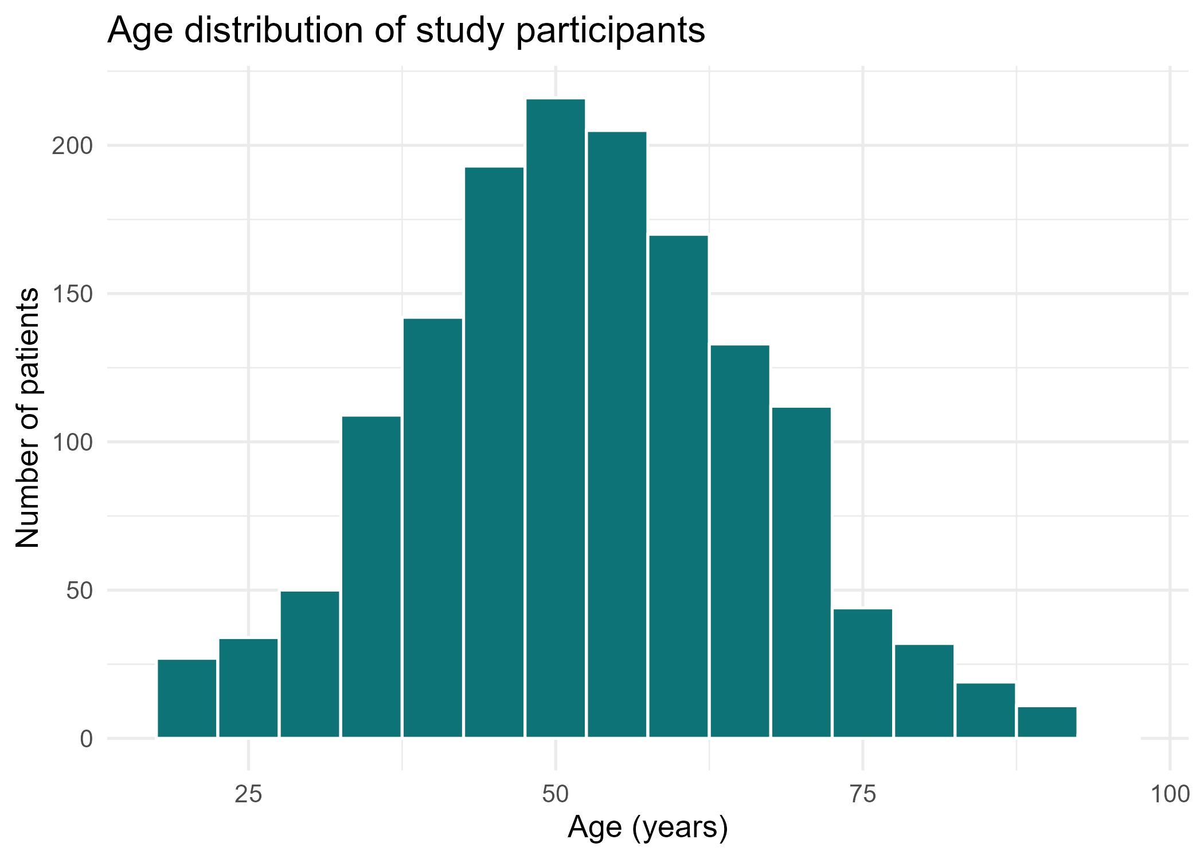
Histogram: age distribution
How to read it
Each bar counts patients in a 5-year band
The peak shows the most common age range
A roughly symmetric shape supports mean (SD)
Look for a long tail that would signal skew
Neudata | #ClearDataClearImpact
Notes:
This is the real figure produced by ggsave in the demo, section 7a.
Key teaching point: a histogram answers two questions at once: where is the centre, and is the distribution skewed?
Clinical interpretation: the sample concentrates in middle age, consistent with a hypertension primary-care population; the near-symmetry justifies reporting mean age.
Common mistake: choosing a binwidth so wide the shape disappears or so narrow it looks noisy. Here binwidth is 5 years.
Suggested question: from this shape, mean or median for age? Expected answer: either is fine because it is roughly symmetric.

Slide 66
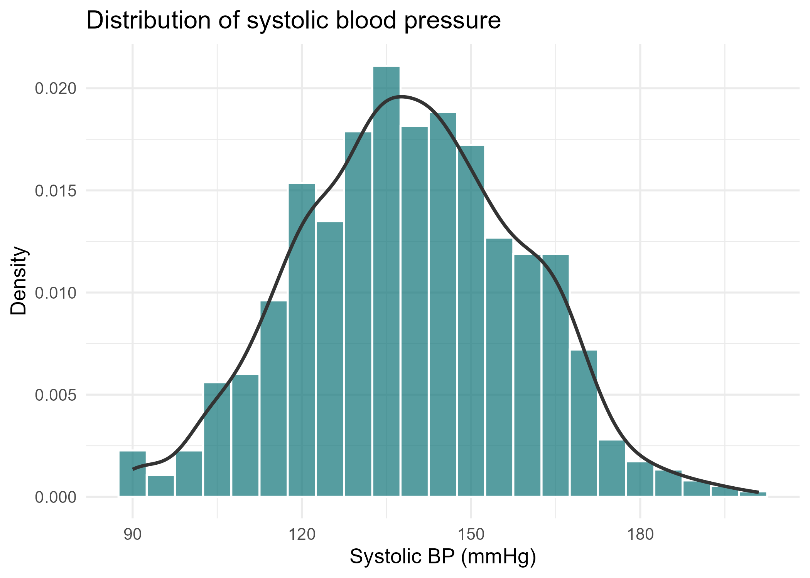
Histogram: systolic blood pressure
How to read it
The overlaid curve is a smoothed density
A tail to the right indicates right-skew
When skewed, prefer median (IQR) over mean (SD)
The bulk sits in the hypertensive range
Neudata | #ClearDataClearImpact
Notes:
Real figure from demo section 7b, with a density curve overlaid on the histogram.
Key teaching point: the density overlay smooths the bars so the shape, and any right-skew, is easier to see.
Clinical interpretation: SBP shows a right tail of high readings, so median (IQR) is the safer summary; this is the visual proof behind the earlier rule of thumb.
Common mistake: forgetting aes(y = after_stat(density)) so the histogram and density are on different scales and the curve looks flat.
Suggested question: what does the right tail mean clinically? Expected answer: a subgroup of patients with markedly elevated blood pressure.

Slide 67
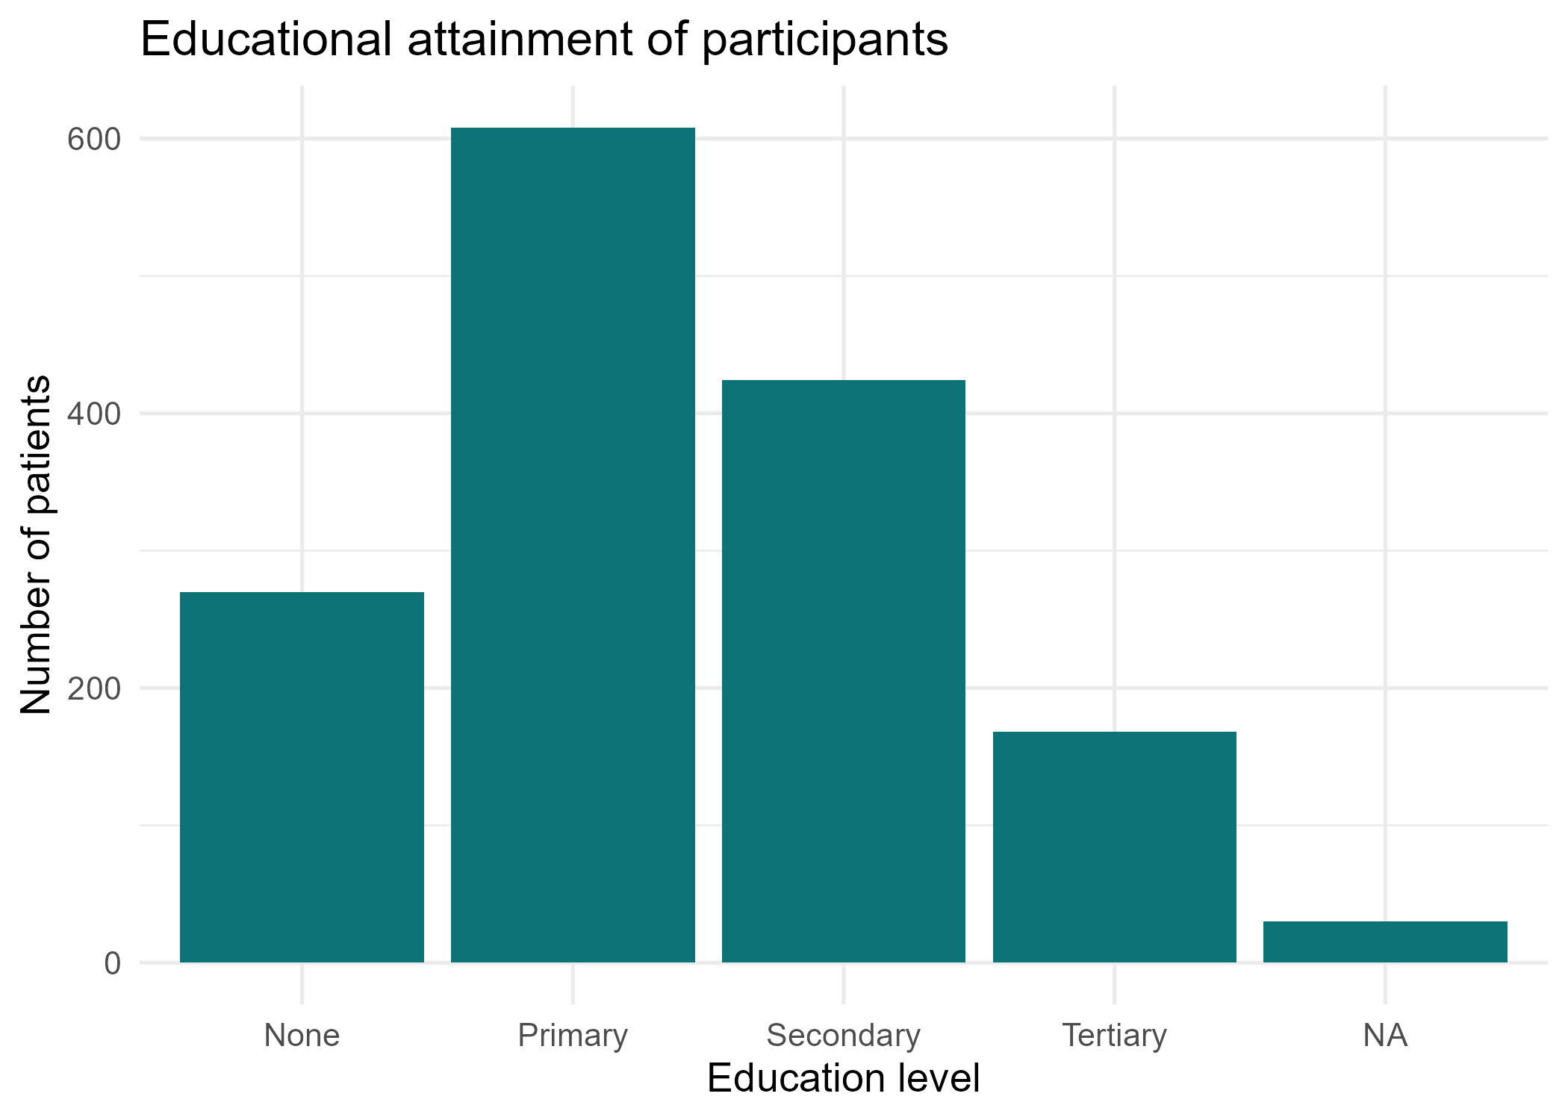
Bar chart: educational attainment
How to read it
Bar height is the number of patients per level
geom_bar counts categories for you
Compare bar heights, not areas
A baseline at zero keeps comparisons honest
Neudata | #ClearDataClearImpact
Notes:
Real figure from demo section 7c.
Key teaching point: geom_bar counts the categories itself, so you do not pre-summarise the data.
Clinical interpretation: the education distribution matters because higher education shows a trend toward greater treatment uptake, adjusted OR about 1.96; the bar chart shows how many patients sit in each level.
Common mistake: pre-aggregating then using geom_bar, which double-counts; use geom_col only when you already have counts.
Suggested question: why must the y-axis start at zero? Expected answer: a truncated axis exaggerates differences between bars.

Slide 68
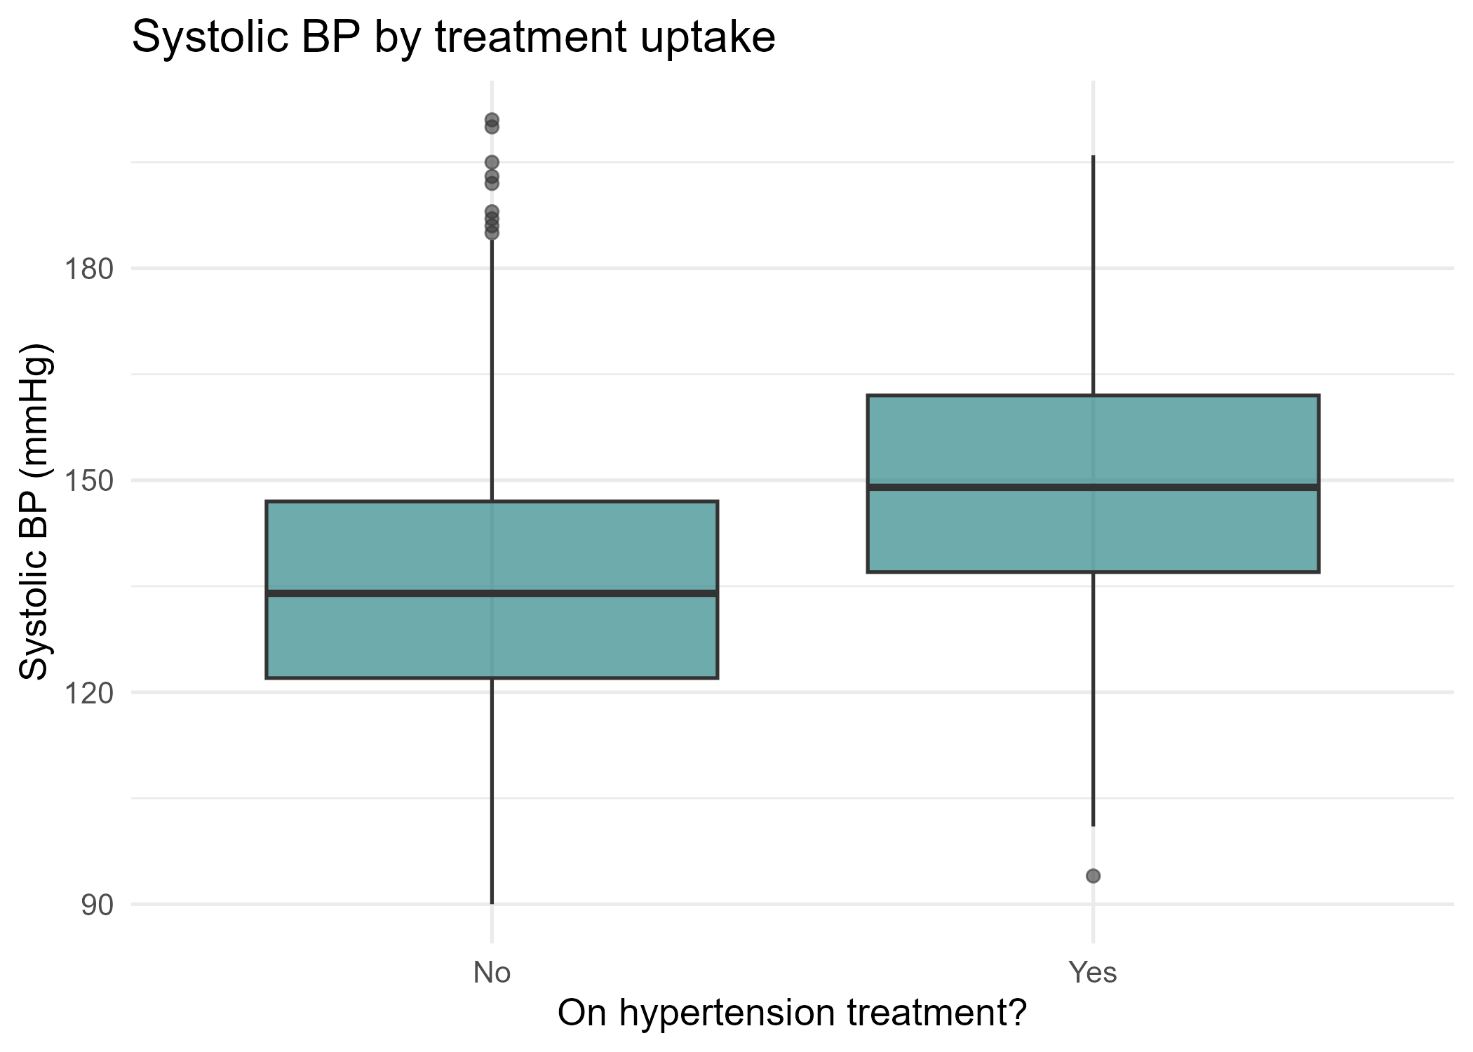
Boxplot: SBP by treatment uptake
How to read it
The box spans the IQR; the line is the median
Whiskers reach most of the data; dots are outliers
Compare the two medians side by side
Higher SBP among treated hints at sicker patients
Neudata | #ClearDataClearImpact
Notes:
Real figure from demo section 7d.
Key teaching point: a boxplot compresses a whole distribution into five numbers per group, ideal for comparing treated and untreated patients.
Clinical interpretation: if the treated group sits higher, it suggests treatment is started in patients with worse blood pressure, matching the higher mean SBP we saw in the grouped summary.
Common mistake: forgetting na.rm = TRUE, which makes ggplot drop rows with a warning.
Suggested question: what do the dots beyond the whiskers represent? Expected answer: outlying patients, not errors to delete automatically.

Slide 69
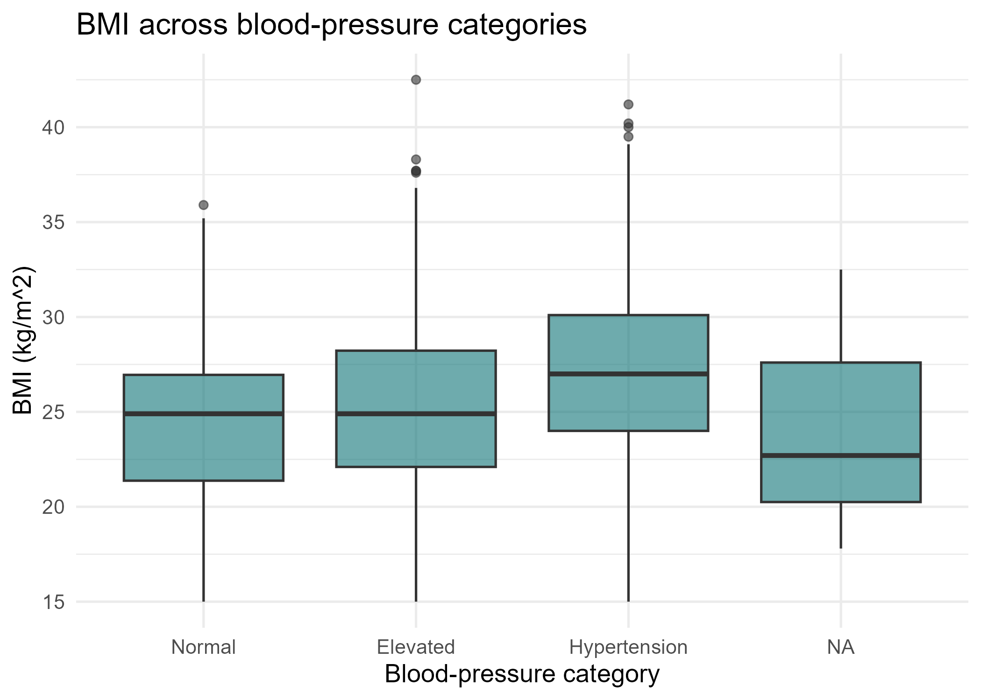
Boxplot: BMI by blood-pressure category
How to read it
One box per blood-pressure category
A rising median across categories suggests a gradient
Box width here reflects styling, not group size
Outliers flag unusually high or low BMI
Neudata | #ClearDataClearImpact
Notes:
Real figure from demo section 7e.
Key teaching point: boxplots across an ordered categorical variable reveal a dose-response style gradient at a glance.
Clinical interpretation: if median BMI rises from normal to hypertensive categories, it is consistent with obesity as a hypertension risk factor.
Common mistake: reading box width as sample size; by default it is not. Use varwidth = TRUE if you want that.
Suggested question: does this prove obesity causes hypertension? Expected answer: no, it shows association across categories, not causation.

Slide 70
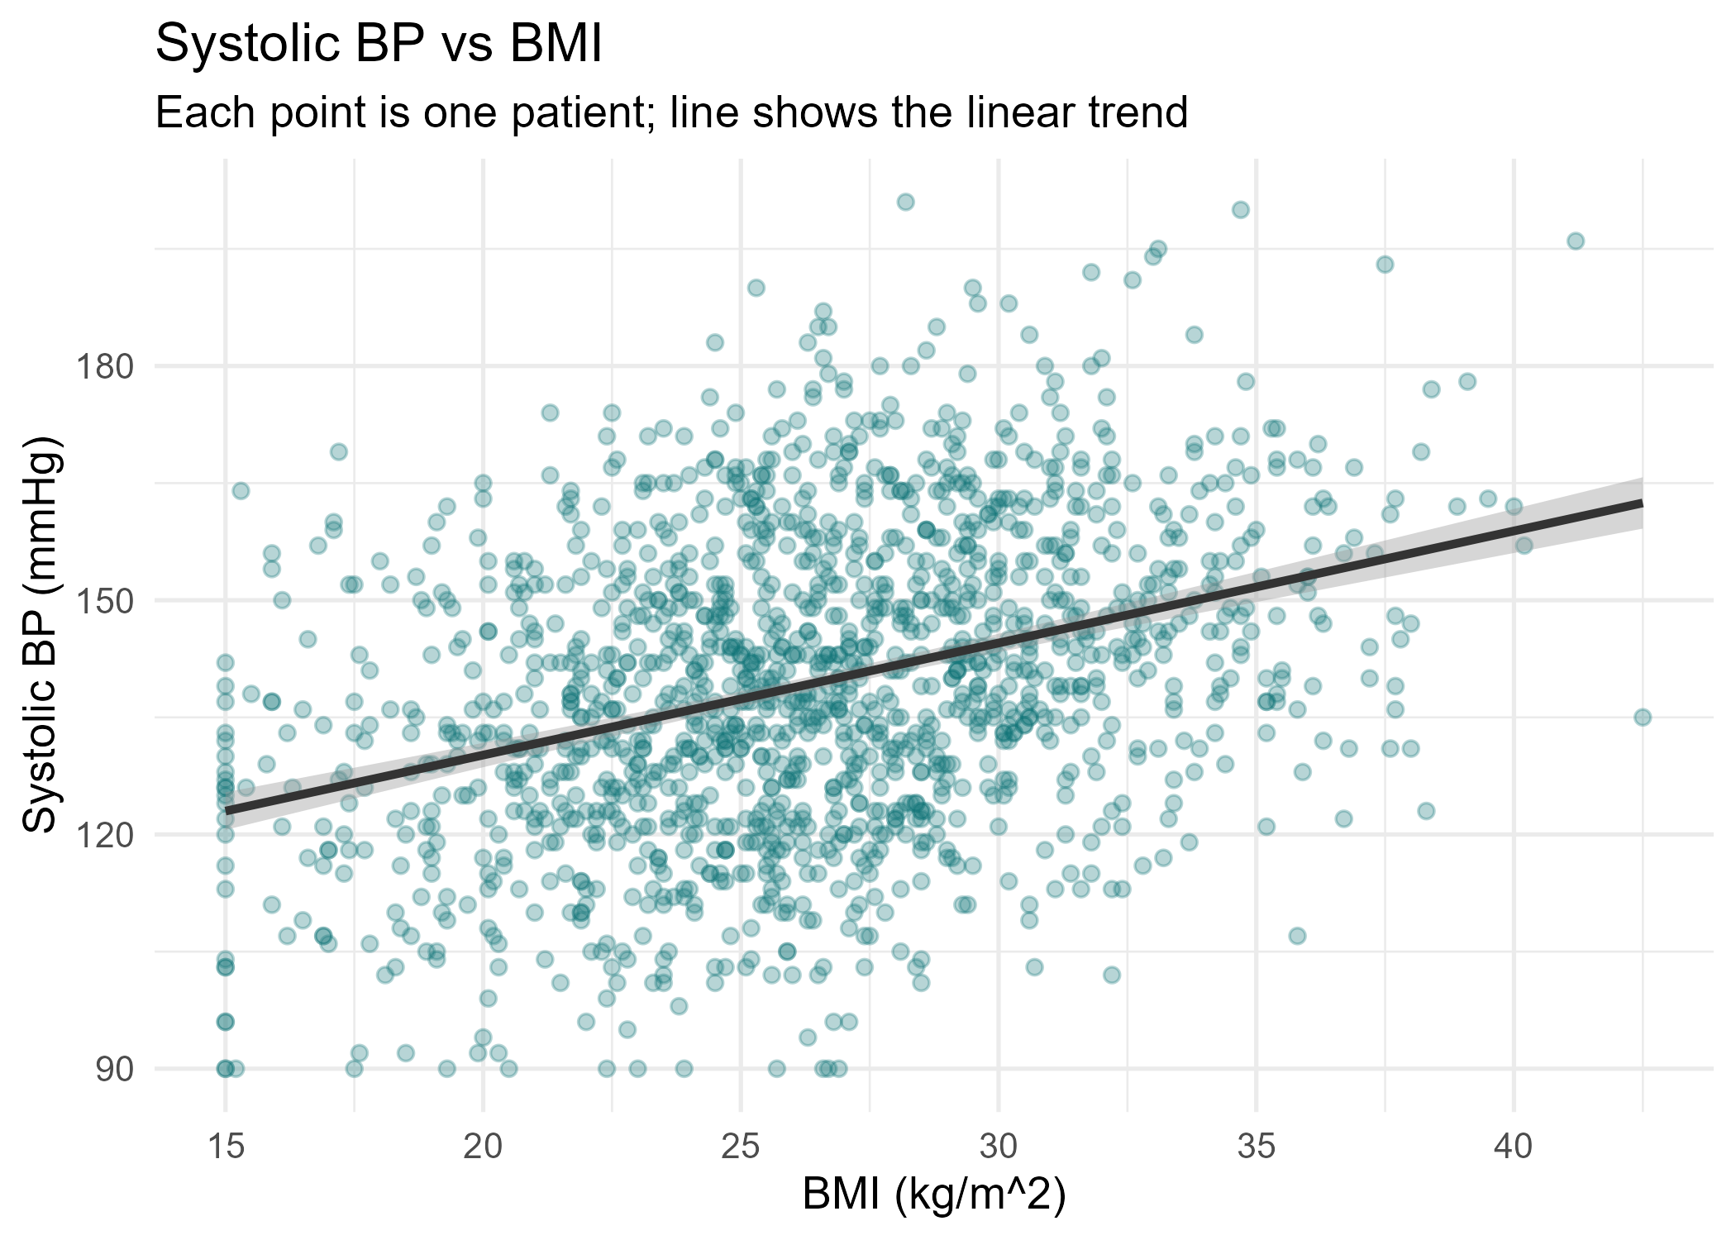
Scatterplot: SBP versus BMI
How to read it
Each point is one patient
The line is a fitted linear trend
An upward slope means higher BMI tracks higher SBP
Scatter around the line shows it is not deterministic
Neudata | #ClearDataClearImpact
Notes:
Real figure from demo section 7f.
Key teaching point: a scatterplot is the right chart for two continuous variables, and geom_smooth(method = lm) adds the trend line.
Clinical interpretation: an upward slope suggests higher BMI accompanies higher systolic BP, consistent with obesity as a risk factor. This is association, not proof of causation.
Common mistake: over-plotting so the cloud is solid; we use alpha = 0.3 transparency so density is visible.
Suggested question: does a clear line mean BMI causes high BP? Expected answer: no, confounders could drive both; a model is needed.

Slide 71
Demo: build and save a figure
One ggplot, then save it at publication quality.
p_age <- ggplot(analysis_data, aes(x = age)) +
geom_histogram(binwidth = 5, fill = "#0D7377",
colour = "white") +
labs(title = "Age distribution",
x = "Age (years)", y = "Number of patients") +
theme_minimal(base_size = 13)
ggsave("Resources/day3_hist_age.png", plot = p_age,
width = 7, height = 5, dpi = 300)
INTERPRETATION - dpi = 300 is the standard journals expect for raster figures.
Neudata | #ClearDataClearImpact
Notes:
This mirrors the figure-building pattern in demo section 7.
Key teaching point: build the plot as an object, then ggsave that object so the saved file matches what you reviewed on screen.
Clinical interpretation: 300 dpi ensures the figure stays sharp in print; axis labels carry units so the figure is self-explanatory.
Common mistake: relying on ggsave with no plot argument, which saves the last printed plot and can grab the wrong one.
Demonstration tip: open the saved PNG from the Resources folder so learners see the real output file.

Slide 72
Exporting reproducible outputs
Share results outside R
write_csv() sends a summary table to co-authors who do not use R
ggsave(..., dpi = 300) writes a publication-ready figure
gtsummary exports to Word via as_flex_table and save_as_docx
TIP - Reproducible by design
Save outputs to a folder, not by copy-paste.
Rerunning the script regenerates every table and figure.
Neudata | #ClearDataClearImpact
Notes:
This mirrors demo section 8 plus the gtsummary export comments.
Key teaching point: outputs should be generated by code into a folder, never assembled by hand, so they regenerate identically every time.
Clinical interpretation: a reviewer who asks for a corrected n can be answered by rerunning one script, not re-editing a Word table cell by cell.
Common mistake: pasting numbers from the console into the manuscript, which breaks when the data update.
Suggested question: where do our figures and tables land? Expected answer: the Resources folder, written by ggsave and write_csv.

Slide 73
Day 3 Exercise: produce Table 1 for a manuscript
Your tasks
1. readRDS the clean analysis data
2. Build a Table 1 with tbl_summary(by = treatment_uptake)
3. Add p-values and an overall column
4. Create a histogram and a boxplot, then ggsave both at 300 dpi
Expected output
A baseline characteristics table split by treatment uptake
Two saved PNG figures in the Resources folder
TIP - If you get stuck
Reuse the demo code; change only the variable names.
Neudata | #ClearDataClearImpact
Notes:
This is the hands-on consolidation of the whole day.
Key teaching point: the exercise reproduces the manuscript deliverables: one Table 1 and at least two figures.
Clinical interpretation: encourage learners to write one sentence interpreting their Table 1, for example which groups differ at baseline.
Common mistake: forgetting na.rm or library(gtsummary); remind them before they start.
Demonstration tip: circulate while learners work; the most common blocker is an un-loaded package or a typo in a variable name. Expected output is a rendered table plus two PNGs in Resources.

Slide 74
Recap and bridge to Day 4
What we locked in today, and where we go next:
Always use na.rm = TRUE; it is the number-one trap
Choose median (IQR) for skewed clinical variables
Pick the prop.table margin that matches your question
gtsummary turns raw data into a Table 1 in a few lines
Match the chart to the variable type, and save at 300 dpi
Day 4: from describing to testing, regression and odds ratios
Neudata | #ClearDataClearImpact
Notes:
Close the loop and set up Day 4.
Key teaching point: today was description; tomorrow is inference. Table 1 told us groups differ, but not whether differences are independent.
Clinical interpretation: Day 4 fits logistic regression for treatment uptake, where we will interpret adjusted odds ratios such as diabetes 3.56 and health insurance 2.05.
Common misconception: that a baseline p-value already answers the research question. It does not; adjustment is needed.
Suggested question: why move beyond Table 1? Expected answer: to adjust for confounders and estimate independent effects, which is Day 4.

Slide 75
Day 4: Common Medical Statistical Tests
Plan
Hypothesis testing basics
Comparing two groups: t-test and Wilcoxon
More than two groups: ANOVA
Categorical association: chi-square and Fisher
Correlation and choosing the right test
Neudata | #ClearDataClearImpact
Notes:
Welcome to Day 4. Yesterday we DESCRIBED the data; today we ASK QUESTIONS of it with statistical tests.
Key framing: every test answers a question - are two groups different? are two variables associated?
Reassure clinicians: the maths is automatic in R; your job is to choose the right test and interpret it.
Bridge: today is tests; next week (Day 5) we introduce regression to model several predictors at once.
Demo tip: keep the day4_demo.R script open and run blocks live as you reach each slide.

Slide 76
What We Will Cover Today
Choosing and running the common tests used in clinical research.
Hypothesis testing: null, alternative, p-values and significance
Checking normality before choosing a test
Comparing two groups: t-test and Wilcoxon
Comparing more than two groups: ANOVA and Tukey
Categorical association: chi-square and Fisher's exact
Correlation: Pearson and Spearman
A decision framework: matching the question to the test
Neudata | #ClearDataClearImpact
Notes:
Roadmap for the day: the common medical statistical tests, and how to choose between them.
Emphasise the logical thread: outcome type + number of groups + paired vs independent -> the right test.
Bridge: these tests compare groups two at a time; Day 5 introduces regression to study several predictors together.
Audience question: what decides which test we use? Answer: the type of the outcome and how many groups we compare.

Slide 77
The Analytic Question
Our research question
Do patients on treatment differ from those not on treatment?
Which characteristics (age, sex, comorbidity) differ between the two groups?
Define the analytic population FIRST
Uptake only makes sense for those already diagnosed.
We restrict to htn_diagnosed == "Yes" (about 1,089 patients).
Roughly 47% of diagnosed patients had taken up treatment.
COMMON MISTAKE - Do not analyse all 1,500
Including undiagnosed people, whose outcome is undefined, biases every result.
Neudata | #ClearDataClearImpact
Notes:
Key teaching point: define the analytic population explicitly and once, before any test.
Clinical logic: you cannot take up treatment for a disease you have not been diagnosed with.
Common mistake: running the analysis on the full 1,500 - it mixes in undefined outcomes and biases estimates.
Demo tip: show dx <- filter(analysis_data, htn_diagnosed == "Yes") then nrow(dx) and table(dx$treatment_uptake).

Slide 78
Hypothesis Testing in Plain Language
The two hypotheses
Null (H0): there is NO difference / NO association.
Alternative (H1): there IS a difference / association.
What a p-value actually is
The probability of data this extreme IF the null were true.
Small p (< 0.05) is evidence AGAINST the null.
It is NOT the probability that the null is true.
CLINICAL INTERPRETATION - Significance level
We pre-set alpha = 0.05 as the threshold for calling a result significant.
Neudata | #ClearDataClearImpact
Notes:
Key teaching point: a p-value answers 'how surprising is my data if nothing is going on?'
Common misinterpretation: p is NOT the chance the null is true, and (1 - p) is NOT the chance H1 is true.
Clinical interpretation: significance is about evidence against H0, not about importance or effect size.
Audience question: does p = 0.04 prove the effect is real? Answer: no - it is one piece of evidence, judged with the effect size and context.

Slide 79
p < 0.05 Is Not the Whole Story
Statistical vs clinical significance
A tiny, meaningless difference can be 'significant' in a large sample.
A large, important difference can be 'non-significant' if the sample is small.
Always report the effect size and its confidence interval, not just p.
WARNING - Beware p-value worship
Do not chase p < 0.05 or treat 0.049 and 0.051 as opposites.
A confidence interval tells you the size AND the uncertainty.
Neudata | #ClearDataClearImpact
Notes:
Key teaching point: the p-value is necessary but not sufficient - it ignores effect size.
Common mistake: dichotomising at 0.05 as if 0.049 and 0.051 are fundamentally different.
Clinical interpretation: a CI shows both the magnitude and the precision; prefer it to a bare p-value.
Audience question: which is more useful, 'p = 0.03' or 'OR 3.6 (95% CI 1.5 to 9.6)'? Answer: the second - it shows direction, size and uncertainty.

Slide 80
Is the Variable Normal? Look, Then Test
Look first (always)
Histogram shows the shape of the distribution.
Q-Q plot: points on the line means roughly normal.
Points curving away at the ends mean skew or heavy tails.
Then test
Shapiro-Wilk test: H0 is that data ARE normal.
Small p (< 0.05) means we reject normality.
Symmetric and bell-shaped means a parametric test is fine.
Clearly skewed means use the non-parametric test.
Neudata | #ClearDataClearImpact
Notes:
Key teaching point: plot before you test - the eye catches what a single p-value hides.
Common mistake: trusting Shapiro-Wilk alone in large samples; with ~1,089 rows it flags trivial departures as significant.
Clinical interpretation: a near-straight Q-Q plot and a symmetric histogram matter more than the Shapiro p here.
Demo tip: run hist(dx$age), qqnorm/qqline, then shapiro.test(dx$age) and contrast the verdicts.

Slide 81
Shapiro-Wilk: Use With Care in Big Samples
Why the test misleads here
Shapiro-Wilk gets more powerful as the sample grows.
In ~1,089 rows it detects tiny, clinically irrelevant departures.
It will almost always return p < 0.05 - even for usable data.
TIP - Rule of thumb for this course
Big sample + symmetric histogram + straight Q-Q means parametric is fine.
Let the plots, not the Shapiro p-value, drive the decision.
Neudata | #ClearDataClearImpact
Notes:
Key teaching point: statistical power is a double-edged sword - in large n the normality test over-flags.
Common mistake: switching to non-parametric tests purely because Shapiro returned p < 0.05.
Clinical interpretation: judge normality by shape and Q-Q linearity; reserve non-parametric tests for clear skew or small n.
Audience question: Shapiro says p < 0.001 but the Q-Q is straight - what do you do? Answer: trust the plot and use the parametric test.

Slide 82
Comparing Two Groups: a Continuous Outcome
t-test (parametric)
Compares MEANS of two groups.
Welch t-test is the safe default (unequal variances).
Use when data are roughly symmetric.
Formula: age ~ treatment_uptake.
Wilcoxon (non-parametric)
Compares RANKS, not means.
Robust to outliers and skew.
Use when data are clearly non-normal.
Report medians instead of means.
Neudata | #ClearDataClearImpact
Notes:
Key teaching point: the question is the same (do two groups differ?); the test depends on the data shape.
Clinical interpretation example: mean age is higher among those on treatment, consistent with older patients taking up more.
Common mistake: defaulting to the classic Student t-test - Welch is safer because it does not assume equal variances.
Demo tip: run both t.test and wilcox.test on age ~ treatment_uptake; note they usually agree for large, symmetric data.

Slide 83
Demo: t-test of Age by Treatment Uptake
Is mean age different between those who took up treatment and those who did not?
t.test(age ~ treatment_uptake, data = dx)
Console output
Welch Two Sample t-test
t = -8.9, df = 1011, p-value < 2.2e-16
95 percent CI: -6.4 to -4.1
mean in No mean in Yes
50.1 55.3
INTERPRETATION - Patients on treatment are about 5 years older on average; the CI excludes 0, so p < 0.05.
Neudata | #ClearDataClearImpact
Notes:
Key teaching point: read three things - the two group means, the 95% CI for their difference, and the p-value.
Clinical interpretation: a ~5-year mean age gap, with a CI that excludes zero, supports older patients taking up more.
Common mistake: reporting only the p-value and omitting the means and the CI for the difference.
Demo tip: run wilcox.test(age ~ treatment_uptake, data = dx) alongside and show they agree.

Slide 84
When Data Are Not Normal: Non-parametric Tests
The rank-based alternatives
Wilcoxon rank-sum (Mann-Whitney): compares two groups without assuming normality.
Fisher's exact test: for a 2x2 table when expected counts are small (< 5).
They use ranks and exact counts instead of means and the normal curve.
How to run them
wilcox.test(sbp_mmhg ~ treatment_uptake, data = dx)
fisher.test(table(dx$treatment_uptake, dx$diabetes))
TIP - Rule of thumb
Skewed or small data -> use the non-parametric test; it is the safe choice when in doubt.
Neudata | #ClearDataClearImpact
Notes:
Key teaching point: when the normality or sample-size assumptions of the t-test or chi-square fail, the rank-based Wilcoxon test and Fisher's exact test give valid answers.
Clinical interpretation: lab values and costs are often skewed - the Wilcoxon test on medians is frequently the honest choice.
Common mistake: forcing a t-test on clearly skewed data, or using chi-square when a cell has an expected count below 5.
Audience question: when would you prefer Fisher's exact over chi-square? Expected answer: small samples or sparse tables with low expected counts.
Demo tip: show that Wilcoxon and the t-test agree here (large, roughly symmetric sample), then contrive a small table to motivate Fisher's exact.

Slide 85
Comparing More Than Two Groups: ANOVA
Why not many t-tests?
Each pairwise t-test carries its own 5% false-positive risk.
Doing several inflates the overall error rate.
ANOVA tests all groups at once with one honest p-value.
After a significant ANOVA
A small p tells you SOME groups differ, not which ones.
TukeyHSD compares every pair and corrects for multiplicity.
Example: does age differ across education levels?
NOTE - If assumptions fail
Use the non-parametric kruskal.test() instead of aov().
Neudata | #ClearDataClearImpact
Notes:
Key teaching point: ANOVA is the multi-group t-test; it controls the family-wide error a stack of t-tests would not.
Common mistake: running every pairwise t-test - inflates false positives. Run ANOVA, then a post-hoc only if it is significant.
Clinical interpretation: a Tukey table shows which specific education pairs differ in mean age.
Audience question: ANOVA p is significant - are all groups different? Answer: no, at least one pair is; Tukey says which.

Slide 86
Association Between Two Categories
Chi-square test of independence
Question: is treatment uptake associated with diabetes?
Build a contingency table, then test it.
H0: the two variables are independent (no association).
When expected counts are small
Chi-square needs all expected cell counts >= 5.
Check with chisq.test(tab)$expected.
If any are too small, use Fisher's exact test instead.
CLINICAL INTERPRETATION - The table gives direction
The test gives a p-value; the table shows WHO had higher uptake.
Neudata | #ClearDataClearImpact
Notes:
Key teaching point: chi-square asks whether two categorical variables move together; the table shows the direction.
Common mistake: applying chi-square when expected counts are below 5 - switch to Fisher's exact in that case.
Clinical interpretation: a higher proportion of diabetics on treatment suggests a positive association, quantified later by the OR.
Demo tip: show table(dx$treatment_uptake, dx$diabetes), then chisq.test, its $expected, and fisher.test.

Slide 87
Correlation: Do Two Numbers Move Together?
Pearson
Measures LINEAR association.
Assumes roughly normal data.
Sensitive to outliers.
Example: sbp_mmhg vs bmi.
Spearman
Based on RANKS.
Robust to outliers and non-linearity.
Use when data are skewed.
Reports a rank correlation.
Neudata | #ClearDataClearImpact
Notes:
Key teaching point: r ranges from -1 to +1; ~0-0.3 weak, 0.3-0.7 moderate, 0.7-1.0 strong; the sign gives direction.
Common mistake: confusing a significant p with a strong relationship - in big samples a tiny r (0.08) is significant yet trivial.
Clinical interpretation: always report and judge r, not just the p-value; remember correlation is not causation.
Audience question: r = 0.1, p < 0.001 - strong link? Answer: no, statistically detectable but clinically negligible.

Slide 88
Demo: Correlation of SBP and BMI
Do systolic blood pressure and BMI move together?
cor.test(dx$sbp_mmhg, dx$bmi, method = "pearson")
Console output
Pearson's product-moment correlation
t = 6.1, df = 1087, p-value = 1.4e-09
95 percent CI: 0.12 to 0.24
cor = 0.18
INTERPRETATION - r = 0.18 is a weak positive link: highly significant, but clinically modest.
Neudata | #ClearDataClearImpact
Notes:
Key teaching point: the p-value confirms the link is real; r tells you it is weak.
Clinical interpretation: SBP and BMI rise together a little, but BMI explains very little of SBP variation.
Common mistake: headlining 'significant correlation' while hiding that r is only 0.18.
Demo tip: rerun with method = "spearman" and note the rank correlation is similar, confirming robustness.

Slide 89
Choosing the Right Test
Outcome | Predictor / 2nd variable | Test
Continuous | Two groups | t-test (Wilcoxon if skewed)
Continuous | More than two groups | ANOVA (Kruskal-Wallis if skewed)
Categorical | Categorical | Chi-square (Fisher if sparse)
Continuous | Continuous | Correlation (Pearson / Spearman)
Binary | One or more predictors | Logistic regression - Day 5
Match the QUESTION and the data types to the test; a binary outcome with predictors leads to regression (Day 5).
Neudata | #ClearDataClearImpact
Notes:
Key teaching point: the test is determined by the outcome type and the predictor type - not by habit.
Demo tip: keep this table on screen as a decision aid for the exercise.
Clinical interpretation: when the outcome is binary and we want several predictors at once, we move to logistic regression - that is Day 5.
Audience question: outcome is Yes/No and we want to adjust for several factors - which method? Answer: logistic regression, next session.

Slide 90
Day 4 Exercise: Choose and Run the Right Test
Your tasks
Compare age between treatment-uptake groups with a t-test.
Test the association between sex and treatment uptake (chi-square).
Test the correlation between SBP and BMI (Pearson or Spearman).
For each, state the question, the test, and a plain-language result.
Expected output
One test result per question, each with a p-value.
For the t-test and correlation, the estimate and its 95% CI.
One sentence interpreting each result clinically.
TIP - Let the data type choose the test
Check the outcome type and the number of groups before you pick a test.
Neudata | #ClearDataClearImpact
Notes:
Key teaching point: the deliverable is the reasoning - question -> variable types -> test -> interpretation.
Common mistake: reaching for a t-test out of habit without checking the outcome type or distribution.
Clinical interpretation: expect the SBP-BMI correlation to be weak but significant; sex-uptake association may be modest.
Demo tip: circulate and check that students report the estimate and CI, not just the p-value.

Slide 91
Recap and Bridge to Day 5
What you can now do
Match a question to the correct test using the data types.
Run and interpret t-tests, Wilcoxon, ANOVA, chi-square and correlation.
Read a p-value alongside the effect size and its confidence interval.
Tell statistical significance apart from clinical importance.
Day 5 takes it further
Introduction to regression: linear (numbers) and logistic (Yes/No).
Odds ratios, adjustment and confounding.
Turning model output into a Results section, reproducibly.
NOTE - Carry forward
Keep your decision-framework table - next session we model several predictors at once.
Neudata | #ClearDataClearImpact
Notes:
Key teaching point: today was about choosing and interpreting single tests; Day 5 introduces regression to handle many predictors together.
Clinical interpretation: tests compare two things at a time; regression adjusts for several factors simultaneously.
Common mistake: stopping at p-values; next session we focus on effect sizes and clear reporting.
Audience question: what if we want to study several predictors of a Yes/No outcome at once? Answer: logistic regression - that is Day 5.

Slide 92
Day 5: Introduction to Regression & Interpreting Output
Plan
Linear regression: modelling a continuous outcome
Logistic regression: odds ratios for a Yes/No outcome
Adjusting for several factors, and confounding
Publication-ready tables, figures and a Results section
Reproducibility: scripts, seeds and projects
Neudata | #ClearDataClearImpact
Notes:
Welcome to the capstone day.
Key point: today we turn a fitted model into a publishable, reproducible result.
This ties together everything from Days 1-4: importing, cleaning, summarising, and now modelling and reporting.
Tell the class the goal is not more statistics but better judgement and cleaner reporting.
Demonstration tip: keep day5_demo.R open in RStudio throughout.

Slide 93
Today's Objectives
By the end of Day 5 you will be able to:
Fit and read a linear regression for a continuous outcome.
Fit a logistic regression and read odds ratios with 95% CIs.
Understand why we adjust for several factors, and recognise confounding.
Present adjusted results as a clear table and a forest plot.
Write a short, honest Results section from your own numbers.
Make the whole analysis reproducible end to end.
Neudata | #ClearDataClearImpact
Notes:
Set concrete, checkable goals for the day.
Key teaching point: these objectives map one-to-one onto the exercise deliverable.
Clinical interpretation: each skill is something they will use on their own studies, not abstract theory.
Audience question: which of these feels least familiar? Use the show of hands to pace the day.
Demonstration tip: return to this list at the wrap-up and tick items off.

Slide 94
Where We Are in the Journey
Across the week
Sessions 1-2: import and clean the hypertension dataset.
Session 3: summarise and visualise (Table 1, figures).
Session 4: common statistical tests (t-test, chi-square, correlation).
Session 5: regression - model, interpret, report and reproduce.
Today's running example
Outcome: treatment_uptake among diagnosed hypertensives.
Analytic sample: 1,089 diagnosed; 992 complete cases modelled.
NOTE - One dataset, end to end
Every result today comes from the same study you cleaned earlier.
Neudata | #ClearDataClearImpact
Notes:
Orient the audience: this is a coherent pipeline, not isolated tricks.
Common misconception: that modelling is the hard part. The judgement (which variables, how to report) is harder.
Clinical interpretation: only diagnosed patients can take up treatment, so we restrict to them.
Audience question: why model only the 1,089 diagnosed and not all 1,500? Expected answer: people without a diagnosis cannot have a treatment-uptake decision; including them biases the estimates.

Slide 95
Linear Regression: Modelling a Number
When the outcome is a number
Linear regression models a CONTINUOUS outcome, such as blood pressure.
Outcome = a systematic part (the predictors) + unexplained variation.
It estimates how much the outcome changes per one unit of a predictor.
Reading the output
The coefficient (slope) is the change in the outcome per one-unit rise.
Each coefficient comes with a 95% CI and a p-value.
Adding predictors gives each one's ADJUSTED effect, holding the others constant.
CLINICAL INTERPRETATION - Clinical question
Is systolic blood pressure associated with age - and does it hold after adjusting for sex and BMI?
Neudata | #ClearDataClearImpact
Notes:
Key teaching point: linear regression is for a continuous outcome; the slope is a change per unit.
Clinical interpretation: the intercept is rarely meaningful; the slopes are what we report.
Common mistake: using linear regression for a Yes/No outcome - that needs logistic regression (next).
Audience question: outcome is systolic BP (a number) and predictor is age - which model? Answer: linear regression.

Slide 96
Demo: Linear Regression of SBP on Age
Does systolic blood pressure rise with age, adjusting for sex and BMI?
m1 <- lm(sbp_mmhg ~ age, data = analysis_data)
summary(m1)
# adjust for sex and BMI
m2 <- lm(sbp_mmhg ~ age + sex + bmi,
data = analysis_data)
tidy(m2, conf.int = TRUE)
Console output
term estimate conf.low conf.high p.value
(Intercept) 87.31 81.01 93.61 <0.001
age 0.26 0.19 0.33 <0.001
sexMale 0.33 -1.57 2.22 0.74
bmi 1.45 1.26 1.64 <0.001
INTERPRETATION - Each extra year adds ~0.26 mmHg to SBP and each BMI unit ~1.45 mmHg; sex is not significant.
Neudata | #ClearDataClearImpact
Notes:
Key teaching point: read each slope as an adjusted change per unit, with its 95% CI.
Clinical interpretation: age and BMI are independently associated with SBP; sex is not (CI crosses 0, p = 0.74).
Common mistake: reporting the intercept as if it were clinically meaningful.
Demo tip: run summary(m1) first (crude), then the adjusted m2, and note the age slope barely changes.

Slide 97
Why Logistic Regression?
The outcome is binary
Treatment uptake is Yes/No - not a number, so not linear regression.
Logistic regression models the ODDS of the 'Yes' outcome.
It handles one predictor or many at once.
Odds and odds ratios
Odds = probability of Yes divided by probability of No.
An odds ratio (OR) compares the odds between two groups.
The OR is the single number clinicians read from the model.
TIP - Why odds, not probability
Odds let us multiply effects cleanly and give a constant OR per group.
Neudata | #ClearDataClearImpact
Notes:
Key teaching point: a binary outcome calls for logistic regression, which models odds rather than a mean.
Clinical interpretation: the odds ratio is the deliverable - it travels straight into the manuscript and the forest plot.
Common mistake: trying to fit a linear model to a Yes/No outcome.
Audience question: what are the odds if 3 of 4 patients take up treatment? Answer: 3 to 1, i.e. odds = 3.

Slide 98
Reading an Odds Ratio
Direction of the effect
OR = 1: the predictor has no effect on the odds of uptake.
OR > 1: higher odds of uptake (a positive driver).
OR < 1: lower odds of uptake (a protective / negative driver).
Precision and significance
The 95% CI shows the plausible range for the true OR.
If the CI excludes 1, the effect is statistically significant.
A wide CI means an imprecise, uncertain estimate.
CLINICAL INTERPRETATION - Example phrasing
Diabetics had 3.6 times the odds of uptake (aOR 3.56, 95% CI 1.46 to 9.61).
Neudata | #ClearDataClearImpact
Notes:
Key teaching point: read an OR as direction (vs 1) plus significance (does the CI cross 1?).
Common mistake: reading the raw coefficient (log-odds) as if it were the OR - always exponentiate first.
Clinical interpretation: 'OR excludes 1' is the regression equivalent of p < 0.05, but with magnitude attached.
Audience question: OR 0.7 with CI 0.5 to 0.9 - what does it mean? Answer: a real protective effect, 30% lower odds.

Slide 99
Demo: Univariable Logistic Regression (Diabetes)
Does diabetes raise the odds of treatment uptake?
m_diab <- glm(treatment_uptake ~ diabetes,
data = dx, family = binomial)
exp(coef(m_diab)) # odds ratio
exp(confint(m_diab)) # 95% CI
Console output
(Intercept) diabetesYes
0.74 2.85
2.5 % 97.5 %
diabetesYes 2.01 4.07
INTERPRETATION - Unadjusted OR ~2.85: diabetics have roughly triple the odds of uptake; CI excludes 1.
Neudata | #ClearDataClearImpact
Notes:
Key teaching point: family = binomial tells glm the outcome is 0/1; exp() turns log-odds into an interpretable OR.
Common mistake: reporting exp(coef) but forgetting the reference level - here diabetesYes is compared with No.
Clinical interpretation: the unadjusted OR will shrink once we adjust for confounders such as age.
Demo tip: show summary(m_diab) first so they see the log-odds, then exp() to make it a clinician-friendly OR.

Slide 100
A Continuous Predictor: Age
OR per one unit
glm(treatment_uptake ~ age) gives the OR per ONE extra year.
That OR is close to 1 because one year is a tiny step.
Here about 1.03 per year - easy to overlook.
Rescale to a meaningful unit
OR per 10 years = the 1-year OR raised to the power 10.
exp(coef(m_age)["age"] * 10) gives the per-decade OR.
1.03 per year becomes roughly 1.34 per decade.
TIP - Communicate in clinical units
Per decade is far easier for a clinical audience than per year.
Neudata | #ClearDataClearImpact
Notes:
Key teaching point: for a continuous predictor the OR is per one-unit change - choose a unit people care about.
Common mistake: dismissing age as unimportant because OR ~1.03 looks trivial per single year.
Clinical interpretation: per-decade framing (about 1.34) shows age is a meaningful driver of uptake.
Demo tip: run exp(coef(m_age)['age'] * 10) live to convert per-year into per-decade.

Slide 101
Model Building: Clinical Knowledge First
Choose predictors before you look at p-values
Biological or clinical plausibility (diabetes drives clinic visits).
Known confounders from the literature (age, sex, education).
The study's stated determinants (distance, knowledge).
Then fit ONE pre-specified model
Decide the variable list first, fit once, report it.
This is the honest, replicable approach for a determinants study.
COMMON MISTAKE - Data dredging
Trying many models and reporting only significant ones inflates false positives.
Neudata | #ClearDataClearImpact
Notes:
Core philosophy slide: clinically-motivated selection beats blind automation.
Key teaching point: a pre-specified model is defensible to reviewers and reproducible.
Common mistake: letting the computer pick variables, then telling a clinical story around whatever survived.
Clinical interpretation: in an explanatory study we keep known confounders even if non-significant.
Audience question: should we drop a variable just because p > 0.05? Expected answer: no, not if it is a known confounder; dropping it can reintroduce bias.

Slide 102
Confounding: A Clinical Example
What confounding is
A third variable distorts the crude link between exposure and outcome.
Example: urban residents are younger and better insured.
Those factors also raise uptake - so crude residence looks too strong.
Adjusting for them isolates the true residence effect.
How we detect it
Compare the crude OR with the adjusted OR for residence.
If the estimate shifts noticeably (rule of thumb >10%), confounding is present.
Always report and interpret the ADJUSTED odds ratio.
The adjusted urban OR in our model is 1.87 (1.41-2.49).
Neudata | #ClearDataClearImpact
Notes:
Confounding is the single most important modelling concept for clinicians.
Key teaching point: adjustment is how observational studies approximate a fair comparison.
Common mistake: reporting and interpreting the crude OR.
Clinical interpretation: the crude urban effect is partly explained by age and insurance; after adjustment a genuine residual urban advantage of about 1.87 remains.
Demonstration tip: in the next slide we show the crude vs adjusted numbers from R.

Slide 103
Demo: Crude vs Adjusted OR for Residence
Fit a crude model, then compare with the full model.
crude <- glm(treatment_uptake ~ residence,
data = dx, family = binomial)
full <- glm(treatment_uptake ~ age + sex + education +
residence + diabetes + family_history_htn +
health_insurance + knowledge_score +
distance_to_facility_km,
data = dx, family = binomial)
exp(coef(crude))["residenceUrban"]
exp(coef(full))["residenceUrban"]
Console output
residenceUrban
2.34
residenceUrban
1.87
INTERPRETATION - The OR shrinks from 2.34 (crude) to 1.87 (adjusted): age and insurance were confounding it.
Neudata | #ClearDataClearImpact
Notes:
Live demo from day5_demo.R, sections 2-3.
Key teaching point: exp() converts log-odds to an odds ratio.
Common mistake: forgetting that glm needs family = binomial for a logistic model.
Clinical interpretation: a >10% drop confirms confounding; the adjusted 1.87 is what we report.
Audience question: why does the urban effect shrink? Expected answer: because urban residents differ on age and insurance, which independently raise uptake.

Slide 104
Demo: The Final Model and Tidy ORs
Fit once, then turn coefficients into odds ratios with CIs.
model_final <- full
library(broom)
or_table <- tidy(model_final,
exponentiate = TRUE,
conf.int = TRUE)
print(or_table, n = Inf)
Console output
term estimate conf.low conf.high
diabetesYes 3.56 1.46 9.61
health_insuranceYes 2.05 1.54 2.74
residenceUrban 1.87 1.41 2.49
age 1.03 1.02 1.04
INTERPRETATION - exponentiate = TRUE gives ORs; conf.int = TRUE adds 95% CIs - the exact table your reader needs.
Neudata | #ClearDataClearImpact
Notes:
Live demo from day5_demo.R, section 7.
Key teaching point: broom::tidy() converts a model object into a clean data frame, ready to plot or export.
Common mistake: hand-copying numbers from summary() into a Word table - error-prone and unreproducible.
Clinical interpretation: every CI shown excludes 1, so all are significant; diabetes has the largest OR but the widest CI.
Audience question: why is the diabetes CI so wide? Expected answer: diabetics are a smaller subgroup, so the estimate is less precise.

Slide 105
Final Multivariable Model: Adjusted ORs
Predictor | aOR | 95% CI | p
Age (per year) | 1.03 | 1.02-1.04 | <0.001
Sex: Male (vs Female) | 0.74 | 0.56-0.97 | 0.031
Education (linear trend) | 1.96 | 1.39-2.77 | <0.001
Residence: Urban (vs Rural) | 1.87 | 1.41-2.49 | <0.001
Diabetes: Yes | 3.56 | 1.46-9.61 | 0.007
Health insurance: Yes | 2.05 | 1.54-2.74 | <0.001
Distance to facility (per km) | 0.98 | 0.96-1.01 | 0.128
Logistic regression; n = 992 complete cases; AUC = 0.71. Family history aOR 1.91 (1.44-2.54); knowledge 1.10 (1.06-1.14) per point.
Neudata | #ClearDataClearImpact
Notes:
These are the canonical numbers from key_findings.md - cite them accurately.
Key teaching point: this is the manuscript's main results table.
Common mistake: omitting the CI or the n; reviewers always ask.
Clinical interpretation: distance is in the expected protective-against-uptake direction (OR 0.98) but not significant - report it as such, do not call it null.
Audience question: which predictor matters most? Expected answer: diabetes has the largest OR (3.56), but caution - its CI is widest, so precision is lower.
Demonstration tip: family history and knowledge are in the caption to keep the table within the row limit.

Slide 106
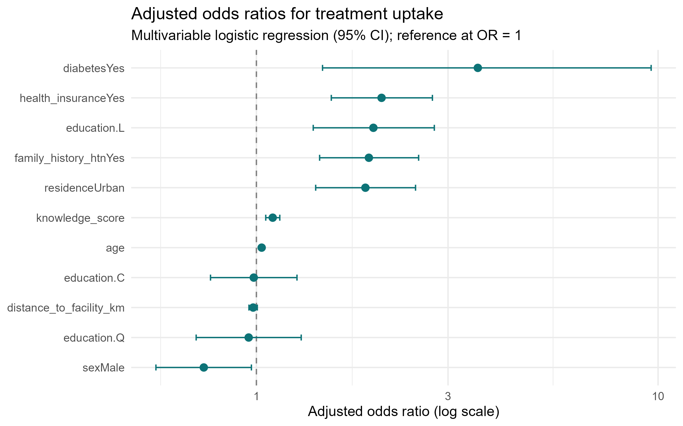
Visualising the Adjusted ORs
How to read it
Each point is an adjusted odds ratio.
Whiskers are the 95% confidence intervals.
Dashed line at 1 = no effect.
Right of 1 increases uptake; left decreases it.
Diabetes sits farthest right - largest effect.
Distance crosses 1 - not significant.
Neudata | #ClearDataClearImpact
Notes:
Key teaching point: a forest plot communicates the whole model at a glance.
The x-axis is on a log scale so the CIs appear symmetric around each point.
Common mistake: putting the OR axis on a linear scale, which squashes the small ORs.
Clinical interpretation: any CI whisker that crosses the dashed line at 1 is non-significant - here only distance does.
Audience question: why does distance look different from the others? Expected answer: its interval straddles 1, so we cannot rule out no effect.

Slide 107
Demo: Publication-Ready Table and Forest Plot
Build a journal-style table, then save the figure.
library(gtsummary)
tbl <- tbl_regression(model_final,
exponentiate = TRUE) |>
bold_p()
tbl
# save the forest plot built from or_table
ggsave("Resources/forest_plot_or.png",
plot = forest, width = 8, height = 5, dpi = 300)
INTERPRETATION - tbl_regression reads the model directly - no manual copying - and ggsave exports the figure for the manuscript.
Neudata | #ClearDataClearImpact
Notes:
Live demo from day5_demo.R, sections 8-9.
Key teaching point: tables and figures should be generated from code, never retyped.
Common mistake: editing numbers by hand in Word, which breaks reproducibility and invites transcription errors.
Clinical interpretation: the saved PNG is the exact figure on the previous slide.
Demonstration tip: show as_gt(tbl) |> gtsave("Resources/regression_table.html") to export the table too; mention a write_csv fallback if gtsummary is unavailable.

Slide 108
Exporting Outputs for the Manuscript
Save tables
gtsummary: as_gt(tbl) then gtsave() writes HTML, PNG or Word.
Fallback: write_csv(or_table, "Resources/regression_table.csv").
Save figures
ggsave() writes the forest plot at a fixed size and resolution.
Use dpi = 300 for print-quality figures in journals.
Why export from code
The report can be rebuilt from raw data with no manual steps.
No copy-paste means no transcription errors.
TIP - Keep a Resources/ folder
Send every table and figure there so outputs live in one place.
Neudata | #ClearDataClearImpact
Notes:
Key teaching point: outputs are artefacts of code, not hand-built files.
Common mistake: screenshotting a plot from the RStudio viewer instead of using ggsave - low resolution and not reproducible.
Clinical interpretation: a reviewer who asks for a tweak gets it by editing one line and re-running.
Audience question: what dpi for a print figure? Expected answer: 300.
Demonstration tip: run ggsave and gtsave live, then open the Resources/ folder to show the files appear.

Slide 109
From Odds Ratios to Prose
The numbers
Diabetes: aOR 3.56 (1.46-9.61).
Insurance: aOR 2.05 (1.54-2.74).
Urban: aOR 1.87 (1.41-2.49).
Education trend: aOR 1.96 (1.39-2.77).
Male sex: aOR 0.74 (0.56-0.97).
Distance: aOR 0.98 (0.96-1.01), NS.
Turning each OR into a sentence
State direction, size, comparison group and CI.
OR>1: 'X times the odds of uptake'.
OR<1: 'lower odds' - here men vs women.
Continuous: 'per 1-unit increase'.
Name the reference group explicitly.
Report NS findings honestly, with the CI.
Neudata | #ClearDataClearImpact
Notes:
Key teaching point: a Results section is structured translation, not invention.
Each OR becomes one clear clause: direction, magnitude, comparator, precision.
Common mistake: writing 'X caused Y' from an observational OR - use 'was associated with'.
Clinical interpretation: an OR of 0.74 for male sex means men had about 26% lower odds than women.
Audience question: how do you phrase a non-significant finding? Expected answer: report the estimate and CI and state it was not statistically significant - do not claim 'no effect'.

Slide 110
Worked Example: A Results Paragraph
Model results paragraph
Among 992 diagnosed hypertensives, treatment uptake was independently
associated with diabetes (aOR 3.56, 95% CI 1.46-9.61), health insurance
(2.05, 1.54-2.74), urban residence (1.87, 1.41-2.49) and higher education
(1.96, 1.39-2.77). Older age (1.03 per year) and greater knowledge (1.10
per point) also raised the odds, while men had lower odds than women
(0.74, 0.56-0.97). Distance to facility was not significant (0.98,
0.96-1.01). The model discriminated acceptably (AUC 0.71).
TIP - Always close with discrimination
Reporting the AUC tells the reader how well the model separates uptake from non-uptake.
Neudata | #ClearDataClearImpact
Notes:
This is a model answer the class can adapt for the exercise.
Key teaching point: lead with the analytic n, list significant determinants with ORs and CIs, then report the non-significant one and overall fit.
Common mistake: causal language ('diabetes increases uptake') from a cross-sectional study.
Clinical interpretation: the paragraph mirrors exactly the directions in key_findings.md.
Audience question: what belongs in the very first sentence? Expected answer: the sample size and outcome, so the reader knows the basis of every number that follows.

Slide 111
Reproducibility: The Capstone Message
Make your work re-runnable by anyone
Scripts over click-menus: the code is the permanent record.
set.seed() makes any randomness (bootstraps, splits) repeatable.
Use RStudio Projects and relative paths - never C:/Users/yourname/...
Save every table and figure to disk so the report rebuilds from code.
Record and share your environment
sessionInfo() captures your exact R and package versions.
R Markdown / Quarto knit code, text and figures into one report.
TIP - Best practice
One click should rebuild the whole report from raw data to PDF.
Neudata | #ClearDataClearImpact
Notes:
Key teaching point: a result you cannot reproduce is a result you cannot defend.
Click-menu analyses leave no trace; scripts do.
Common mistake: hard-coding an absolute path that only works on your laptop - it breaks for every collaborator.
Clinical interpretation: reproducibility is part of research integrity, not an optional extra.
Audience question: why set a seed if logistic regression is deterministic? Expected answer: so the whole script - including any resampling or simulation - reproduces identically end to end.
Demonstration tip: show the folder structure Data/ Scripts/ Solutions/ Resources/ References/.

Slide 112
Demo: A Reproducibility Snippet
Seed, relative path, and a recorded environment.
set.seed(2025)
analysis_data <- readRDS("Data/analysis_data.rds")
dx <- filter(analysis_data, htn_diagnosed == "Yes")
# record the exact software environment
writeLines(capture.output(sessionInfo()),
"References/session_info.txt")
Console output
R version 4.4.1 (2024-06-14)
attached: dplyr_1.1.4 broom_1.0.6 gtsummary_2.0
... (full environment written to References/session_info.txt)
INTERPRETATION - Relative paths plus a saved sessionInfo() let any colleague rerun this on any machine.
Neudata | #ClearDataClearImpact
Notes:
Live demo from day5_demo.R, sections 0-1 and 10.
Key teaching point: these three habits - seed, relative path, recorded environment - cover most reproducibility failures.
Common mistake: re-cleaning data inside the analysis script; cleaning belongs in its own script (separation of concerns).
Clinical interpretation: readRDS loads the already-cleaned, analysis-ready data.
Demonstration tip: open References/session_info.txt after running to show what was captured.

Slide 113
Day 5 Exercise: Complete the Analysis & Write a Results Section
Your tasks
Fit the pre-specified multivariable model on the diagnosed subset.
Produce a tidy OR table (exponentiate = TRUE, conf.int = TRUE).
Run the diagnostics: VIF, a linearity check, Cook's distance, AUC.
Build a gtsummary table and a forest plot, and save both to Resources/.
Write a 4-6 sentence Results section from your own ORs.
NOTE - Deliverable
A reproducible script plus a short Results paragraph citing aORs, 95% CIs and the AUC.
Neudata | #ClearDataClearImpact
Notes:
Key teaching point: this exercise integrates the whole week into one deliverable.
Common mistake: forgetting to restrict to htn_diagnosed == 'Yes', or reporting crude instead of adjusted ORs.
Clinical interpretation: the marking rubric (key_findings.md) rewards correct method and interpretation, not 2nd-decimal matches.
Audience question: how long should the Results paragraph be? Expected answer: a tight 4-6 sentences - n and outcome, significant determinants with ORs and CIs, the non-significant one, then AUC.
Demonstration tip: point them to day5_demo.R as a scaffold and circulate while they work.

Slide 114
Course Wrap-Up: What You Can Now Do
Five days, one real dataset, a full analysis pipeline.
Import messy clinical data into R and understand its structure.
Clean it: fix impossible values, standardise categories, handle missingness.
Summarise and visualise: Table 1, histograms, boxplots, bar charts.
Fit and interpret logistic regression with adjusted odds ratios.
Build models from clinical reasoning and check their assumptions.
Produce publication-ready tables and figures, and a Results section.
Work reproducibly with scripts, projects, seeds and Quarto reports.
Neudata | #ClearDataClearImpact
Notes:
Key teaching point: celebrate the distance travelled - they started with no programming background.
Reassure them that fluency comes with practice on their own data.
Clinical interpretation: they now own a defensible, reproducible workflow they can take to their own studies.
Audience question: what is the single most valuable habit to keep? Expected answer: do everything in a script so it is reproducible.
Demonstration tip: invite one or two participants to share what surprised them most.

Slide 115
What Phase II Might Cover
Deeper modelling
Confounding, interaction and effect modification in depth.
Model diagnostics: multicollinearity, fit and discrimination (AUC).
Variable selection and how to build a model responsibly.
New methods and skills
Survival analysis: Kaplan-Meier and Cox models for time-to-event data.
Mixed-effects models: patients clustered within facilities.
Missing data (multiple imputation) and automated Quarto reporting.
TIP - Keep practising
Bring your own dataset to Phase II and analyse it end to end.
Neudata | #ClearDataClearImpact
Notes:
Key teaching point: today's logistic model is the foundation; Phase II generalises it.
Clinical interpretation: their 6-facility study is naturally clustered, which motivates mixed models in Phase II.
Common misconception: that survival and logistic regression are unrelated - both are regression, just for different outcome types.
Audience question: which Phase II topic fits a study following patients over time? Expected answer: survival analysis, because the outcome is time-to-event.
Demonstration tip: thank the class, point to References/ for further reading, and close with #ClearDataClearImpact.

Slide 116
Final Assignment
Overview
An independent, take-home analysis
One week to complete
Uses the same study dataset
Marked out of 100%
Neudata | #ClearDataClearImpact
Notes:
Introduce the capstone assessment.
Key teaching point: this consolidates all five days into one independent analysis.
Clinical interpretation: it mirrors writing the analysis for a real paper.
Audience question: how long should you budget? Expected: a few focused sessions across the week.
Demo tip: encourage starting from their saved Day 2 cleaning script.

Slide 117
Final Assignment - What to Do
Task
Working independently, analyse the study dataset and identify the determinants of treatment uptake.
Your submission must
Import the raw data and clean/validate it.
Produce descriptive statistics and a publication-ready Table 1.
Create at least two publication-quality figures.
Perform appropriate statistical tests.
Fit simple and multiple logistic regression models.
Interpret the results and write a short Results section.
Be fully reproducible (a single script that runs start to finish).
Neudata | #ClearDataClearImpact
Notes:
Spell out exactly what to deliver.
Key teaching point: reproducibility is graded - the script must run on a clean machine.
Common mistake: submitting only output with no script, or a script with hard-coded absolute paths.
Clinical interpretation: the Results section should read like a journal submission.
Audience question: what makes a script reproducible? Expected: relative paths, library() calls, set.seed, no manual steps.
Demo tip: point them to the Day 5 results draft as a template.

Slide 118
Final Assignment - Deliverables & Submission
Submit
1. A single commented R script (.R) or R Markdown/Quarto file.
2. The exported Table 1 and figures.
3. A one-page Results section (about 250-400 words).
Format
Use an RStudio Project with relative paths.
Name files clearly: Surname_Phase1_Assignment.R
WARNING - Academic integrity
Work independently. You may use the course scripts and notes, but the analysis and writing must be your own.
Neudata | #ClearDataClearImpact
Notes:
Clarify the mechanics of submission.
Key teaching point: clear, commented code is part of the grade, not an afterthought.
Common mistake: figures saved at screen resolution - require 300 dpi via ggsave.
Clinical interpretation: a tidy submission reflects a tidy analyst.
Audience question: R script or Quarto? Expected: either - Quarto earns the reproducibility marks easily.
Demo tip: show the folder structure you expect.

Slide 119
Marking Rubric (out of 100%)
Component | What is assessed | Marks
Data import & cleaning | Correct import, missing codes, validation, recoding | 20
Descriptive statistics | Appropriate summaries and a correct Table 1 | 15
Figures | Two clear, correctly labelled, publication-quality figures | 10
Statistical tests | Right test chosen and correctly applied | 15
Regression modelling | Sound univariable & multivariable logistic models | 20
Interpretation & Results | Accurate ORs/CIs and clear clinical writing | 15
Reproducibility & code quality | Runs end-to-end; clean, commented, relative paths | 5
Total = 100%. A detailed marking guide is provided to instructors.
Neudata | #ClearDataClearImpact
Notes:
Make grading transparent.
Key teaching point: cleaning and regression carry the most weight (20 each) - spend time there.
Clinical interpretation: interpretation is explicitly rewarded, not just computation.
Common mistake: perfect code, wrong interpretation - you lose the 15 interpretation marks.
Audience question: where will you focus your effort? Expected: cleaning + modelling - correct.
Demo tip: the full marking guide with point-by-point criteria is in the instructor pack.

Slide 120
Marking Guide - What Earns Full Marks
Strong submission
Handles all messiness (dups, sentinels, impossible values).
Table 1 stratified by uptake with sensible tests.
Adjusted ORs with 95% CIs and correct reference levels.
Results paragraph matches the numbers and is clinically framed.
One script runs cleanly from raw data to outputs.
Common mark losses
Leaving 999 / -99 as real numbers.
Analysing all 1,500 instead of diagnosed patients.
Reporting log-odds instead of odds ratios.
Interpreting a non-significant result as 'no effect'.
Absolute paths that break on another computer.
Neudata | #ClearDataClearImpact
Notes:
Give participants a concrete picture of excellent vs weak work.
Key teaching point: most marks are lost on avoidable cleaning and interpretation errors.
Clinical interpretation: 'not significant' means 'insufficient evidence', not 'no effect'.
Common mistake: forgetting to restrict to htn_diagnosed == Yes for the uptake analysis.
Audience question: why analyse only diagnosed patients? Expected: uptake is only defined once diagnosed.
Demo tip: hand out this slide as a self-check before submission.

Slide 121
Resources & Further Reading
In your course pack
R command reference sheet and package installation guide.
All demonstration scripts and worked solutions.
The dataset, data dictionary and this slide deck.
To go further
R for Data Science (Wickham & Grolemund) - free online.
Regression Modeling Strategies (Harrell).
The gtsummary and ggplot2 documentation websites.
TIP - Keep practising
Re-run the week's scripts on your own data - that is where the skills become permanent.
Neudata | #ClearDataClearImpact
Notes:
Point to everything they can take away and where to grow next.
Key teaching point: the reference sheet answers 80% of day-to-day questions.
Clinical interpretation: applying R to their OWN data is the real test of learning.
Audience question: what will you analyse first after the course? Expected: an audit or a stalled project.
Demo tip: mention Phase II (survival analysis, mixed models) as the next step.

Slide 122
Thank You & Questions
Stay in touch
You can now import, clean, analyse and report clinical data in R
Practise on your own datasets
Phase II: survival analysis, mixed models and prediction
Contact: Neudata - #ClearDataClearImpact
Neudata | #ClearDataClearImpact
Notes:
Close warmly and open the floor.
Key teaching point: celebrate that everyone went from zero to a full analysis in five days.
Clinical interpretation: encourage them to embed reproducible analysis in their teams.
Audience question: what is your single biggest takeaway? Expected: varies - affirm each.
Demo tip: collect feedback and share contact details for follow-up.

Slide 123
Copyright © Neudata, 2026
All property rights and copyright are reserved.
This presentation contains proprietary data, information, and materials developed by Neudata for dedicated use only and may not be communicated, copied, reproduced, distributed, published, or cited, in whole or in part, without the prior written consent of Neudata.
Where explicit written permission has been granted, appropriate attribution must be included, followed by “by courtesy of Neudata”.
Any unauthorized use or infringement of these materials may give rise to legal action and claims for damages, without prejudice to any other rights of Neudata, including rights relating to patents, trademarks, or other forms of intellectual property protection.
Neudata | #ClearDataClearImpact
Notes:
COPYRIGHT / CLOSING SLIDE.
Standard Neudata copyright. Thank participants and the host institution.

