Slide 1

Foundations of Clinical Research
Level 1 - From Clinical Question to Publication
8 sessions - 4 weekends - 24 contact hours
Trainers: Vương Mỹ Lượng & Bernard Osang'ir
Date: [dd/mm/yyyy]
Notes:
TITLE SLIDE (0:00).
Welcome everyone. Introduce the trainers in one sentence each.
Key message: over four weekends we walk the whole road of research together - from a question at the bedside to a paper ready to submit.
No statistics software, no formulas to memorise: pictures, examples from your own wards, and a lot of group work. We go slowly - nobody is expected to know anything yet.
Facilitation: participants should already be sitting in their groups (name cards on tables).

Slide 2
Every day you make decisions that research could improve.
This course helps you ask those questions properly - answer them - and publish the answer.
Neudata | #ClearDataClearImpact
Notes:
Open with a question to the room: 'Think of one thing in your unit where colleagues do it differently and nobody knows which way is best.'
Take 2-3 answers. Expected: fluids, sedation, mobilisation, wound dressings, line care.
Key teaching point: research starts from clinical uncertainty, not from statistics.
Write the examples on the flip chart - they are candidate topics for the group proposals.

Slide 3
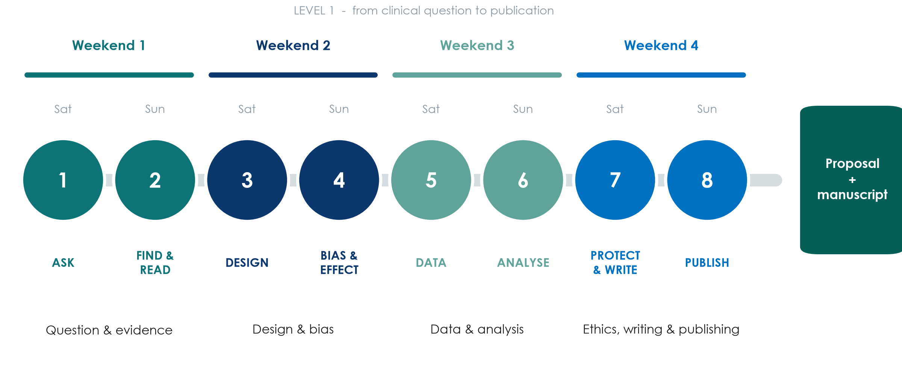
Four weekends, eight sessions
Neudata | #ClearDataClearImpact
Notes:
Walk along the road: Weekend 1 the question and the evidence; Weekend 2 design and bias; Weekend 3 data and analysis; Weekend 4 ethics, writing and publishing.
This whole course is Level 1: it covers every step from question to publication. Weeks 1-2 build understanding and design skills; Weekends 3-4 apply them to data, writing and publishing.
One running example travels with us: fluids in septic shock. Non-ICU colleagues: every concept is also shown with ward examples (pressure injuries, hand hygiene, medication errors, delirium).

Slide 4
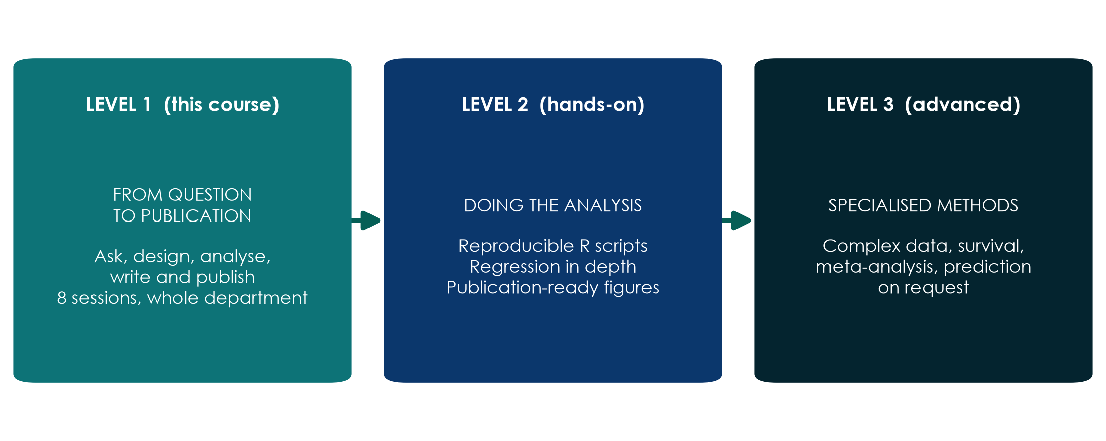
Where this course takes you
KEY MESSAGE Level 1 is this course; Level 2 is hands-on analysis in R; Level 3 is advanced methods.
Neudata | #ClearDataClearImpact
Notes:
This course (Level 1) takes you from a clinical question to a published paper. Level 2 is a hands-on course in R for those who want to run analyses themselves; Level 3 covers advanced, specialised methods.
Within Level 1 we use a realistic dataset of 620 ICU patients: we describe it, analyse it and write it up. The trainers run the software; you read and interpret the results.
Misconception to defuse: 'research is only for statisticians or professors'. Most good clinical questions come from nurses and doctors at the bedside.

Slide 5
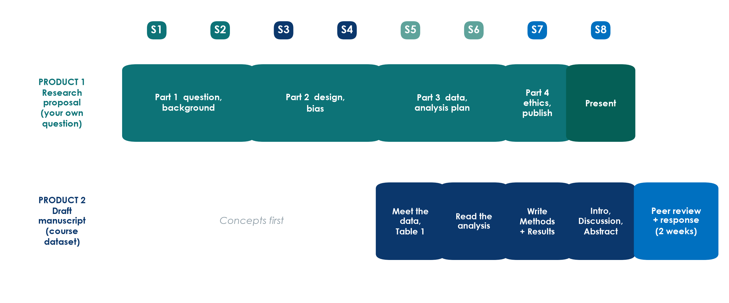
Two things your group will produce
Neudata | #ClearDataClearImpact
Notes:
Product 1: a research proposal on the group's own question, built one part per weekend and presented in Session 8.
Product 2: a draft manuscript written from the course dataset (FLUID-ICU). Each group answers a different question on the same data. We analyse in Weekend 3, write in Weekend 4, and after the course groups review each other's drafts and reply like real authors.
Point to Assignment/proposal_brief and Assignment/manuscript_brief.

Slide 6
By the end of the course you will be able to
ASK & FIND
DESIGN
ANALYSE
WRITE & PUBLISH
Turn a problem into a PICO question
Search PubMed, manage references
Read a paper in 15 minutes
Pick the right study design
Recognise bias and confounding
Read RR, OR, NNT and forest plots
Plan good data and a CRF
Read CIs, p-values, regression
Interpret a real dataset's results
Plan ethics and registration
Write each section of a paper
Submit and answer reviewers
KEY MESSAGE Understand and interpret - you will not be asked to calculate.
Neudata | #ClearDataClearImpact
Notes:
Walk across the four cards - one per weekend.
Key teaching point: the aim is understanding and interpretation, not computation. The trainers run the analyses; you learn to read them and write them up.
Audience question: which card worries you most? Expected: ANALYSE. Reassure: we go slowly, with pictures, and check understanding every 20 minutes.
Return to this slide in Session 8 to show progress.

Slide 7
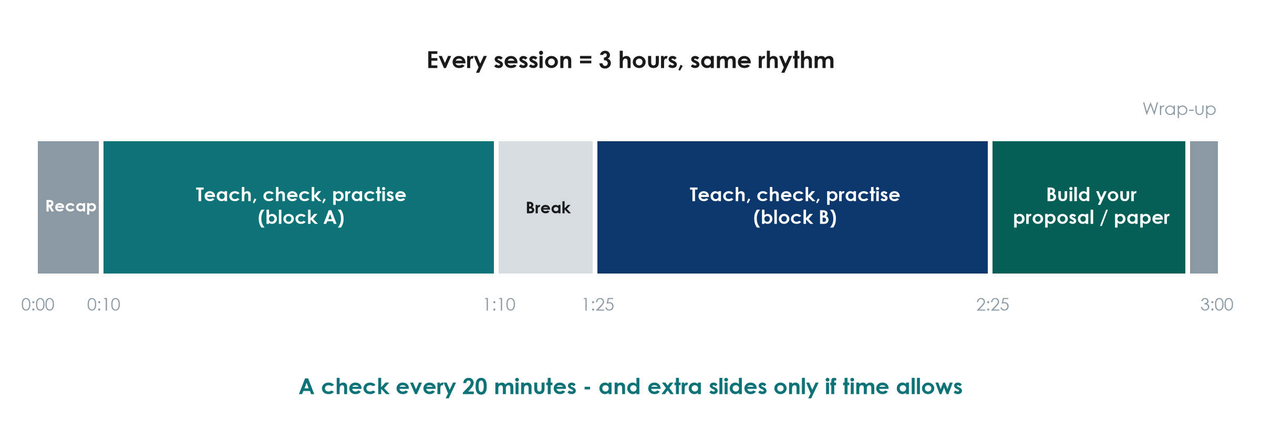
How each session runs
Neudata | #ClearDataClearImpact
Notes:
Same rhythm every session: recap, two teaching blocks with checks and activities, a 15-minute break, and time to build the proposal or the paper.
Every 20 minutes we stop for a quick check of understanding - if the room is not with us, we slow down. Each session ends with 'extra slides' that we only use if there is time; you can read them at home.
Keep the break to 15 minutes - start again on time.

Slide 8
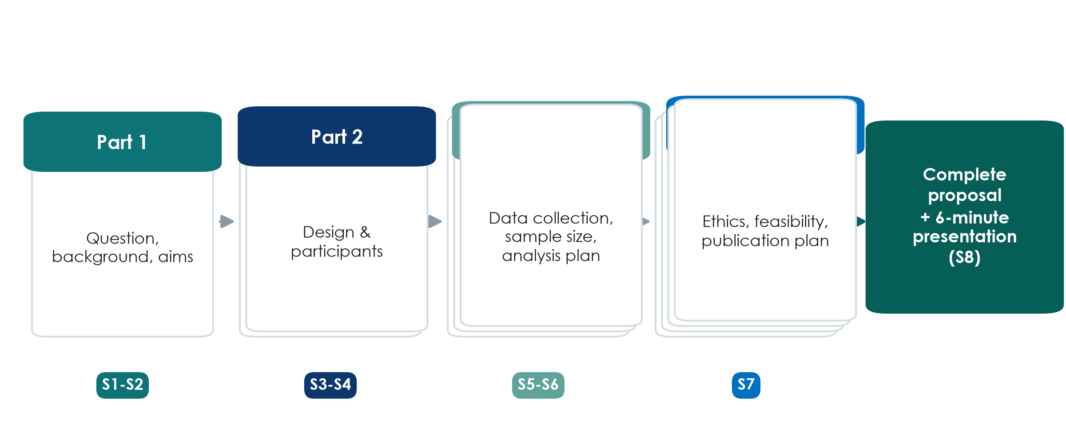
The proposal builder
KEY MESSAGE Same group, same template, one part per weekend, presented in Session 8.
Neudata | #ClearDataClearImpact
Notes:
Part 1 (Weekend 1): the question and the background. Part 2 (Weekend 2): the design. Part 3 (Weekend 3): the data and the analysis plan. Part 4 (Session 7): ethics, feasibility and a publication plan.
Each group presents its proposal in Session 8 (6 minutes + 2 minutes feedback).
Template: Templates/Research_Proposal_Template.docx.

Slide 9
Meet your group
GROUP WORK | 10 min
1. Sit with your group (5 groups of about 6, mixed professions)
2. Introduce yourselves: name, unit, one question you wish research could answer
3. Agree the roles below - they can rotate each weekend
4. Choose a group name
Group roles
Facilitator - keeps everyone talking
Scribe - fills in the template
Timekeeper
Literature lead
Methods & data lead
Presenter
OUTPUT Group name + roles written on the group sheet
Neudata | #ClearDataClearImpact
Notes:
Groups should mix doctors, nurses and pharmacists - different perspectives make better proposals.
Roles keep quieter members involved; suggest rotating the scribe.
Trainers: walk round, note each group's candidate topics.

Slide 10
How we learn together
Ask anything
Go slow
Bring your ward
Respect time
There are no silly questions
If you are lost, others are too
We check understanding often
Extra slides only if time allows
Use examples from your own practice
Your experience is the raw material
Start and finish on time
Phones silent, break at the break
Neudata | #ClearDataClearImpact
Notes:
Set the climate: this is a safe place to say 'I do not understand'.
Language: discussions can be in Vietnamese or English - whatever helps the group think.
Patient confidentiality applies to examples: no names or identifiable details.

Slide 11
Pre-course quiz
QUICK QUIZ | 15 min
1. Individual, no discussion, no phones (except for the online form)
2. 24 multiple-choice questions - one answer each
3. Guess if you are not sure: this is not an exam
4. Write only your participant number, not your name
Why a quiz now?
Shows where the room starts
Same quiz in Session 8
We measure the course, not you
OUTPUT Quiz handed in (participant number only)
Neudata | #ClearDataClearImpact
Notes:
Use the online form (recommended) or paper copies of Assessment/pre_post_quiz.
Reassure: results are anonymous and used only to measure what the COURSE achieved.
Collect after 15 minutes. Do not give answers today - the same quiz is repeated at the end of Session 8.

Slide 12
Session 1 · Ask: from clinical problem to research question
Weekend 1 · Saturday
1.1 Why research? Evidence, types of research, research vs audit, the road to publication
Break
1.2 From problem to question: PICO(T) with worked examples, FINER (pair task)
1.3 Aims, objectives and hypotheses (quick exercise)
Proposal builder 1: topic, PICO, question, FINER, aim and objectives
Wrap-up: key words, recap, homework for tomorrow
Neudata | #ClearDataClearImpact
Notes:
SESSION 1 OPENING (0:35). The front matter (welcome, course map, groups, pre-course quiz) has just finished.
Teaching point: today has one job - every group leaves with ONE clear, answerable research question and an aim with objectives. Tomorrow (Session 2) we search and read the literature for it.
Pace: this audience has little or no research background. Go slowly, use the worked examples, and stop at every 'Check your understanding' slide - they are short on purpose.
Show the shape of the session: three short teaching blocks, a break, a pair task, a quick exercise, then 30 minutes of group work on the proposal.
Ask the room: 'Who has ever taken part in a research study - as a researcher, data collector or participant?' Count hands; it tells you where to pitch the session.
Timing: 1 minute. Do not read the agenda aloud; point at it.

Slide 13
1.1 Why research?
Why do we need research when we already have experience?
35 minutes: evidence, the pyramid, types of research, research vs audit, and the road to publication
Neudata | #ClearDataClearImpact
Notes:
SEGMENT 1.1 (0:35-1:10).
Pause on the question and let the room answer before you click on. Take 2-3 answers.
Expected answers: experience is biased towards memorable cases; colleagues disagree; practice changes; we need to know whether what we do actually helps.
Teaching point: experience is valuable for generating questions, but it is a weak way of answering them.
Timing: 1 minute.

Slide 14
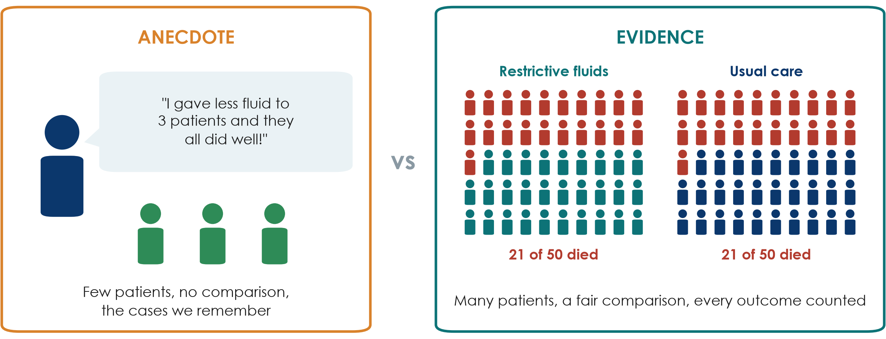
Anecdote vs evidence
KEY MESSAGE Experience suggests questions. Fair comparisons in many patients answer them.
Neudata | #ClearDataClearImpact
Notes:
Left: one clinician, three patients, a vivid memory, no comparison group.
Right: 50 patients per group, every death counted, the same outcome measured in both arms.
The numbers are illustrative, but the pattern is real: the large CLASSIC trial (Meyhoff, NEJM 2022, 1,554 septic shock patients) found 90-day mortality of 42.3% with restrictive fluids vs 42.1% with standard care. The three 'success' patients would have done well either way.
Misconception: 'if it worked in my patients it works'. Without a comparison we cannot tell what would have happened anyway (natural recovery, regression to the mean, selective memory).
Ask the room: 'Why do we remember the three good outcomes?' Expected answer: recall bias - dramatic and recent cases stick; we forget the failures.
Timing: 4 minutes. Go slowly - this is the idea the whole course rests on.

Slide 15
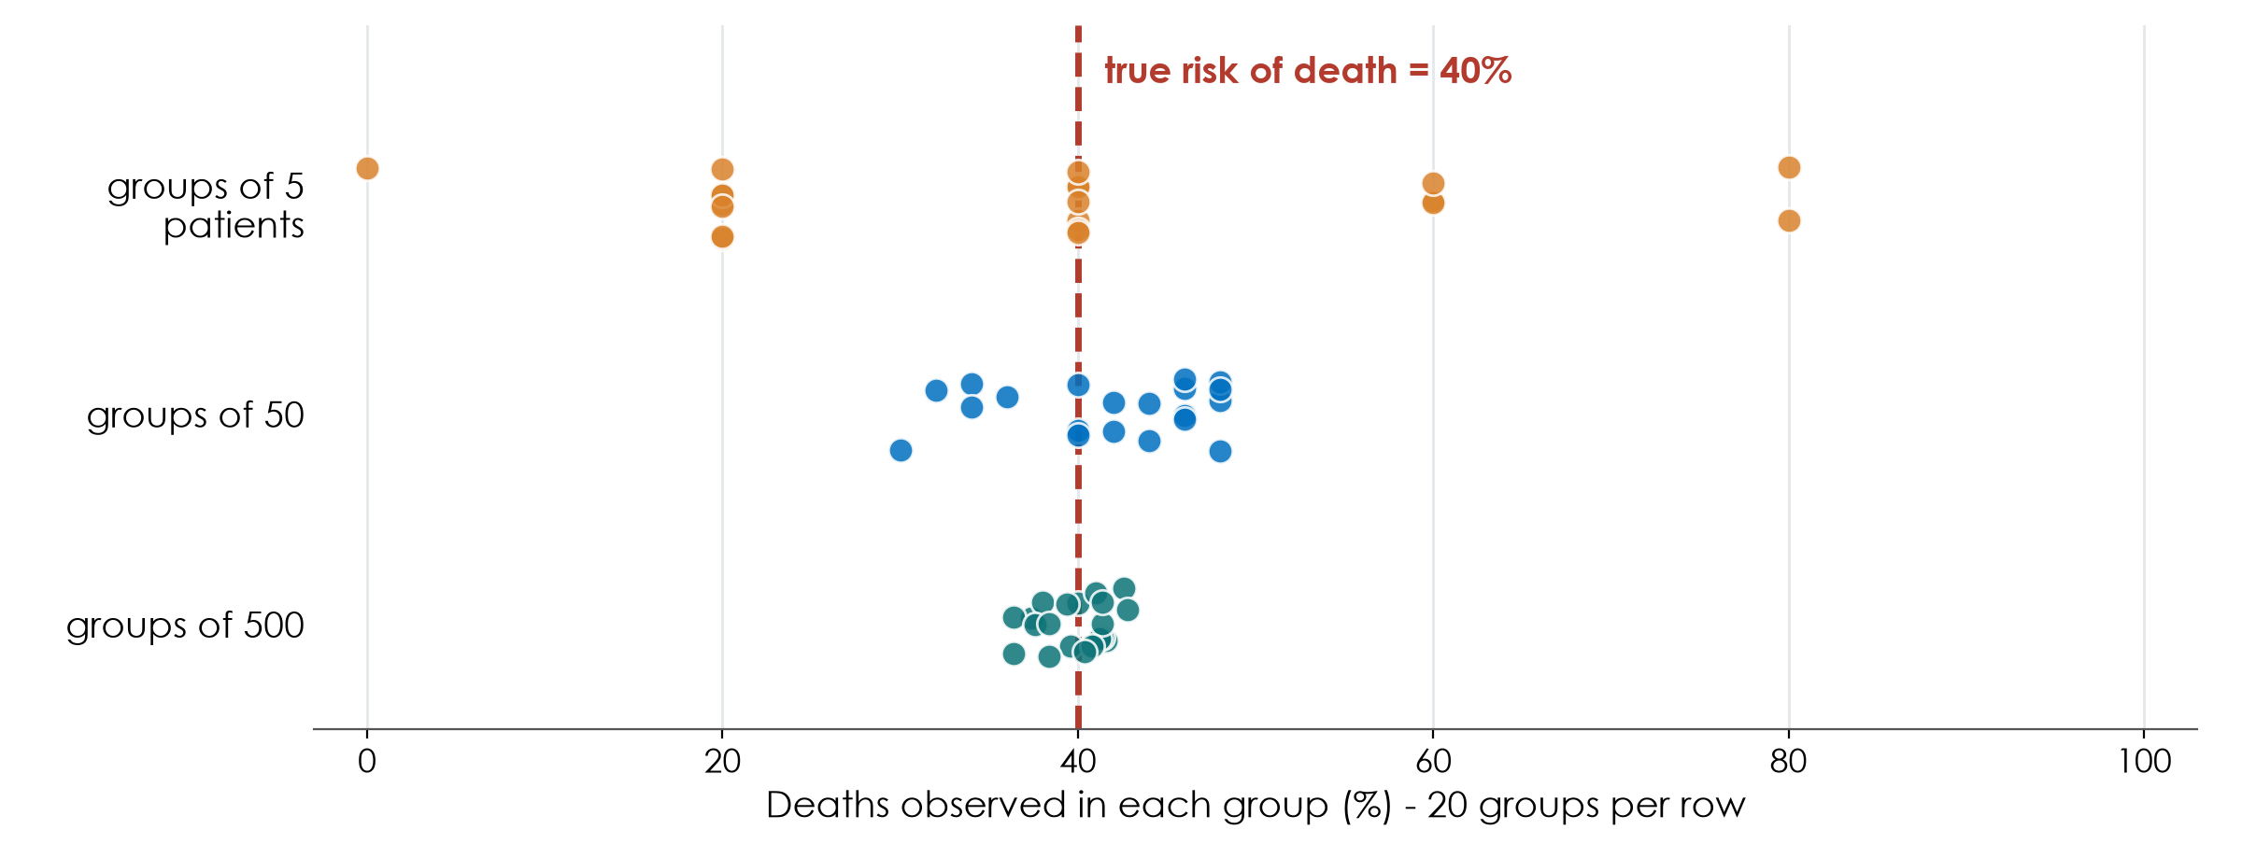
Why one ward's experience is not enough
KEY MESSAGE Small numbers jump around by chance. Large, fair comparisons settle down.
Neudata | #ClearDataClearImpact
Notes:
This picture is a simulation (fixed seed): imagine a disease where the TRUE risk of death is 40%.
Top row: 20 wards each see only 5 patients. By pure chance some see 0% deaths, others 80%. Each ward would 'learn' something different from its own experience.
Middle row: groups of 50 - closer to the truth but still scattered. Bottom row: groups of 500 cluster tightly around 40%.
Teaching point: chance alone produces impressive-looking differences in small numbers. This is why research needs enough patients and a comparison group - and why 'my last three patients' can mislead.
Misconception: 'a big difference in a small group must be real'. A big difference in a small group is exactly what chance produces.
Ask the room: 'One ward lost 0 of 5 patients after a new protocol. Does the protocol work?' Expected answer: we cannot tell - 0 of 5 happens often by chance even when the true risk is 40%.
Timing: 4 minutes. Sample size returns in Session 6.

Slide 16
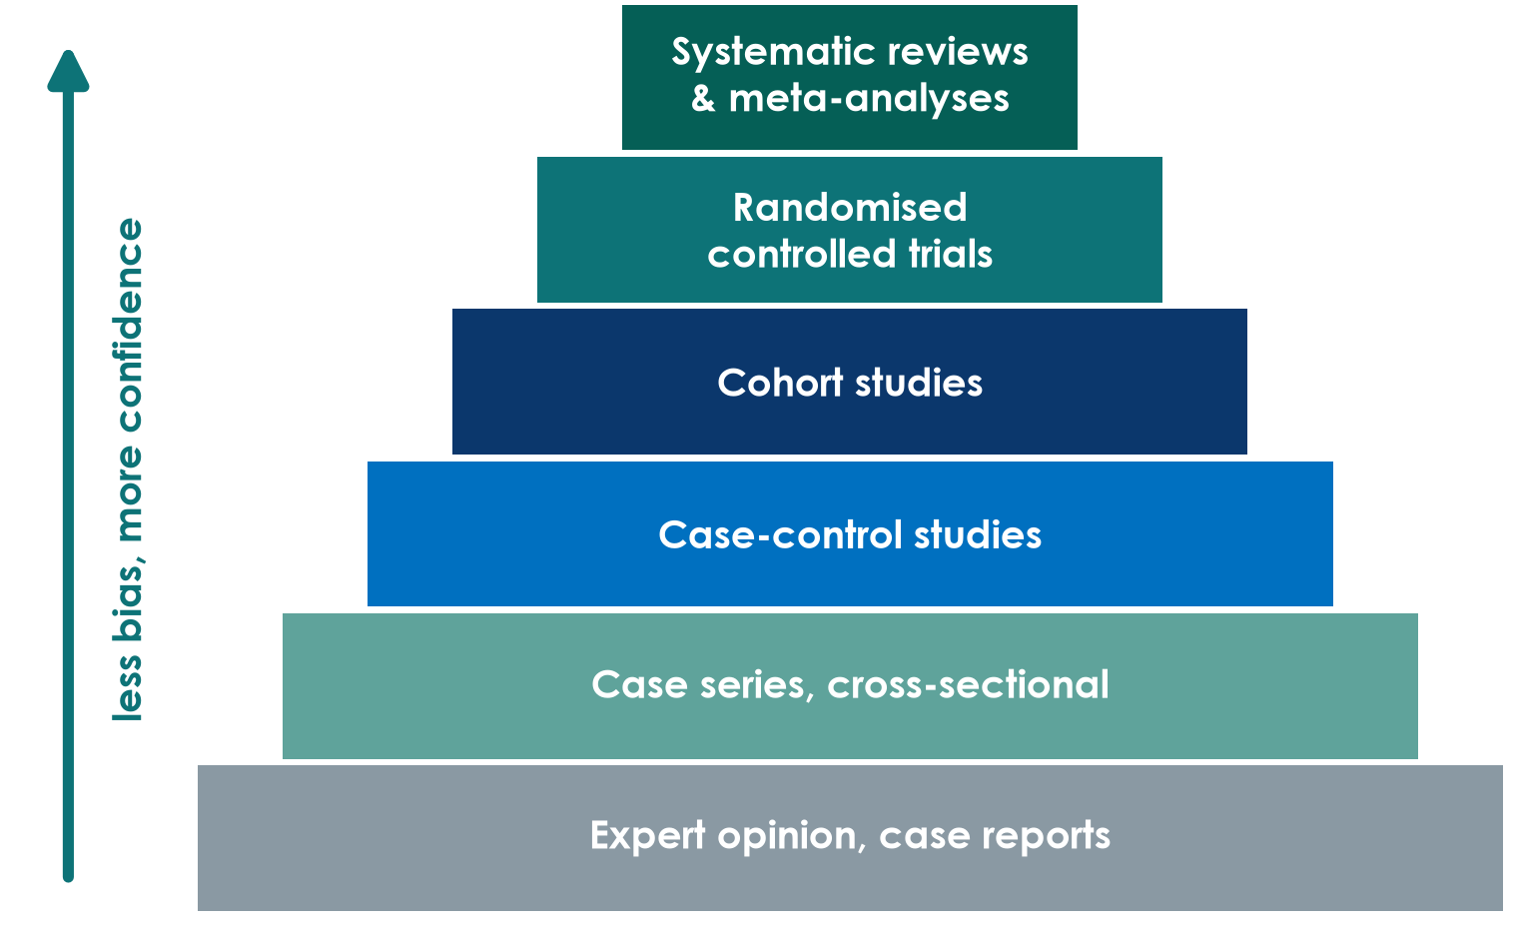
The evidence pyramid
How to read it
Higher = less risk of bias for questions about treatment effects
Paper 1 (Boulet) is an RCT; Paper 2 (Hyun) is a cohort
A well-done cohort can beat a poorly done RCT
Descriptive questions do not need an RCT
KEY MESSAGE The pyramid ranks designs, not individual papers: quality still has to be checked.
Neudata | #ClearDataClearImpact
Notes:
Build from the bottom: expert opinion and case reports, then case series and cross-sectional studies, case-control, cohort, randomised trials, and at the top systematic reviews and meta-analyses that combine several studies.
Teaching point: moving up, the design does more to protect against bias. That is why higher levels give more confidence for 'does treatment X work?' questions.
Misconception 1: 'an RCT is always right'. A small or badly run trial can mislead. Frameworks such as GRADE rate the certainty of a whole body of evidence, not the design label alone.
Misconception 2: 'only RCTs count'. For prevalence, harm and prognosis, observational designs are often the right (or only ethical) choice. Qualitative research sits outside this pyramid - it answers different questions.
Ask the room: 'Where would a systematic review of 10 poor-quality trials sit?' Expected answer: at the top by label, but its conclusions are only as strong as the trials inside it.
Timing: 4 minutes. Session 3 covers each design in detail - do not teach designs here.

Slide 17
Quick quiz: rank the evidence
QUICK QUIZ | 3 min
1. Four sources answer: 'Do restrictive fluids reduce deaths in septic shock?'
2. A: a senior colleague: 'In 20 years, my dry patients did better'
3. B: a registry cohort of thousands of ICU patients with sepsis
4. C: a trial that randomised 1,554 patients with septic shock
5. D: a review that pools every trial of fluid restriction
6. Rank them from weakest to strongest - show fingers on the count of 3
Then discuss
Which one would change your practice?
What could make C weaker than B?
OUTPUT One agreed ranking per table
Neudata | #ClearDataClearImpact
Notes:
Answer: A (expert opinion) < B (cohort) < C (RCT) < D (systematic review / meta-analysis).
C is the real CLASSIC trial (NEJM 2022) - no difference in 90-day mortality. B resembles Paper 2 (Hyun 2023): a positive fluid balance on days 2-3 was associated with higher 28-day mortality.
Why might a cohort find harm when a trial finds none? Expected answer: in a cohort, sicker patients get more fluid, so fluid looks harmful (confounding by indication) - a preview of Session 4.
Facilitation: count down '1-2-3' so tables show fingers at the same time.
Timing: 3 minutes, strictly.

Slide 18
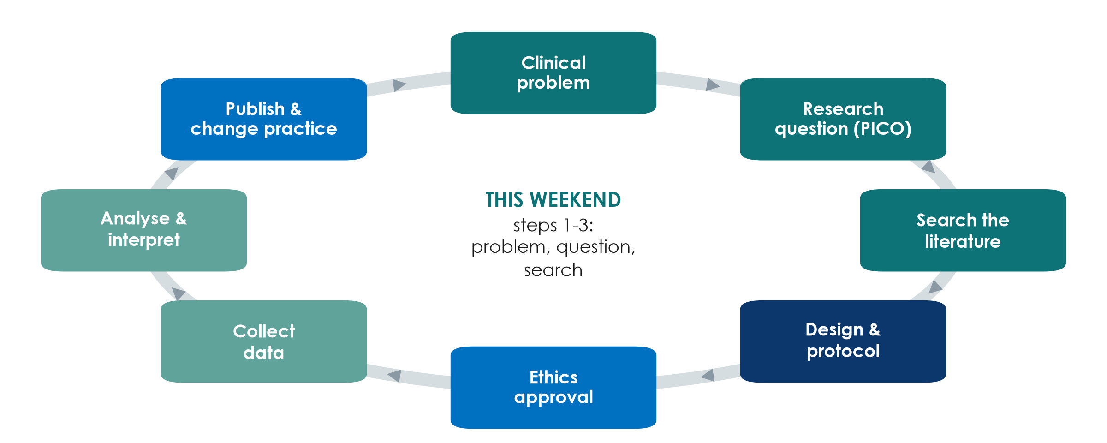
The research cycle
KEY MESSAGE Research is a cycle: published results change practice and raise new questions.
Neudata | #ClearDataClearImpact
Notes:
Walk round the cycle quickly, one sentence per box.
This weekend = clinical problem and research question (today), literature search (tomorrow) - the three teal boxes top right.
Teaching point: published results change practice, which creates new uncertainties and new questions.
Misconception: 'research = collecting data'. Data collection comes AFTER the question, design, protocol and ethics approval.
Timing: 2 minutes. The next slide zooms into the same journey in detail.

Slide 19
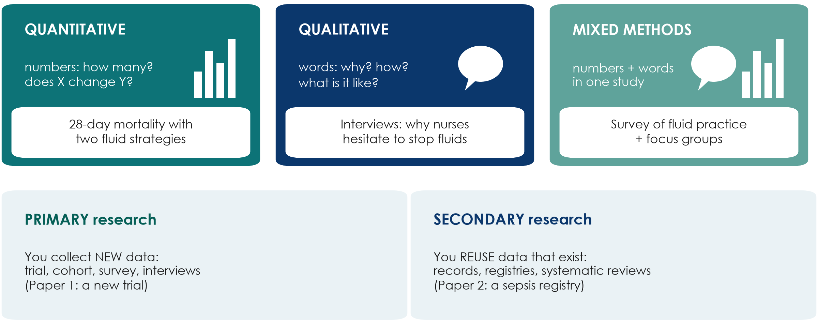
Types of research
KEY MESSAGE Numbers answer how many and how much; words answer why and how.
Neudata | #ClearDataClearImpact
Notes:
Top row: what kind of data. Quantitative research counts and measures (mortality, fluid balance). Qualitative research collects words - interviews, focus groups, observation - to understand experiences, reasons and barriers. Mixed methods combine both in one study.
Bottom row: where the data come from. Primary research collects new data for this study (Paper 1, a new trial). Secondary research reuses data that already exist - medical records, registries (Paper 2 used a sepsis registry) or published studies (a systematic review).
Teaching point: the question decides the type. 'Does restriction reduce deaths?' is quantitative; 'why do nurses hesitate to stop fluids?' is qualitative.
Misconception: 'qualitative research is just opinion'. It has its own rigorous methods and reporting guideline (COREQ for interviews and focus groups); it is the right tool when numbers cannot explain behaviour.
Ask the room: 'Which type would show why a new fluid protocol is not being followed?' Expected answer: qualitative, or mixed methods with an audit.
Timing: 3 minutes. Qualitative designs return in Session 3.

Slide 20
Check your understanding: which type of research?
QUICK QUIZ | 2 min
1. A: counting how many ICU patients develop pressure injuries this year
2. B: interviewing families about visiting rules in the ICU
3. C: re-analysing 3 years of discharge records for readmissions
4. D: a survey of hand-hygiene practice plus focus groups with nurses
5. For each: quantitative, qualitative or mixed? Primary or secondary?
OUTPUT Shout out the answers - the next slide shows them
Neudata | #ClearDataClearImpact
Notes:
Quick check, not a test. Read each item and let the room shout the answer.
Answers (next slide): A quantitative, primary. B qualitative, primary. C quantitative, secondary (records already exist). D mixed methods, primary.
If people hesitate on C: the data were collected for care, not for this study - reusing them is secondary research. It still needs ethics review.
Timing: 2 minutes.

Slide 21
Answers: which type of research?
A Counting
B Interviews
C Old records
D Survey + groups
Quantitative
Primary
(new counts)
Qualitative
Primary
(words, why)
Quantitative
Secondary
(data exist)
Mixed methods
Primary
(numbers + words)
KEY MESSAGE Ask two things: numbers or words? New data or existing data?
Neudata | #ClearDataClearImpact
Notes:
Go through the four cards quickly.
Teaching point: two simple questions classify almost any study - what kind of data (numbers or words) and where they come from (new or existing).
Secondary research is often the most feasible for a busy department - but data quality depends on how well the records were kept (Session 5).
Timing: 2 minutes.

Slide 22
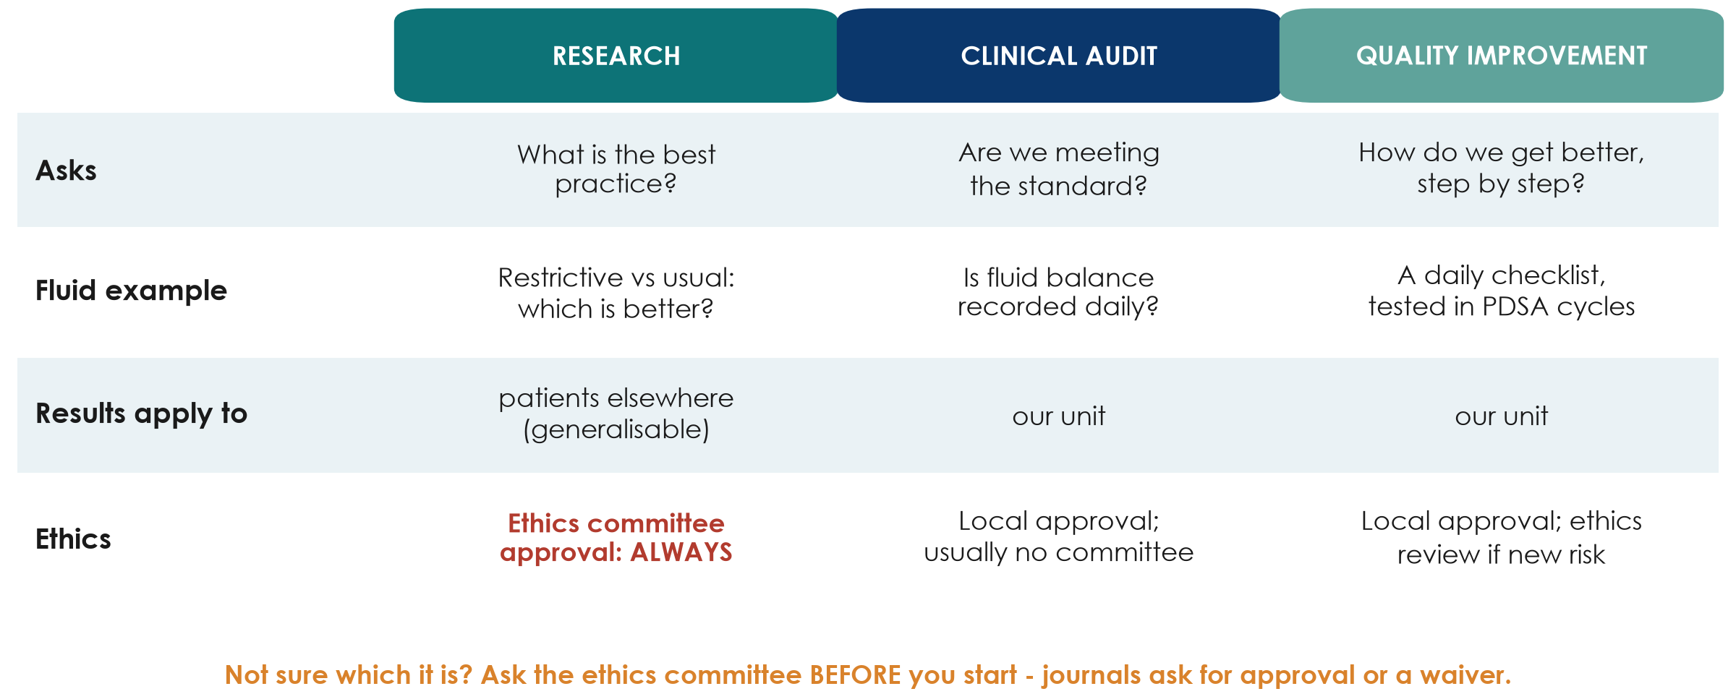
Research, audit or quality improvement?
KEY MESSAGE Research asks what is best; audit asks if we do it; QI makes it better.
Neudata | #ClearDataClearImpact
Notes:
Research generates new, generalisable knowledge - which option is best? Audit compares our practice with an agreed standard. Quality improvement (QI) changes a local process step by step, usually in Plan-Do-Study-Act (PDSA) cycles.
Why it matters: research always needs ethics committee approval before it starts. Audit and QI usually need local approval only - but if a project randomises patients, adds a new intervention or risk, or collects data beyond routine care, it is research and needs ethics review.
Publishing does not change what a project was. Journals ask for ethics approval or a formal waiver, so decide - and ask - at the start, not after the data are collected.
Misconception: 'audit and QI are lesser research'. They answer different questions and are essential; many good research questions start from an audit result.
Ask the room: 'Checking whether fluid balance is recorded daily as our protocol says - research, audit or QI?' Expected answer: audit.
Note: rules differ between institutions. Tell participants to check the local policy and, if in doubt, ask the ethics committee.
Timing: 3 minutes.

Slide 23
Check your understanding: research, audit or QI?
QUICK QUIZ | 2 min
1. A: checking whether fluid balance is charted daily, as our protocol says
2. B: randomising patients to restrictive or usual fluids
3. C: testing a new handover checklist in small PDSA cycles
4. D: interviewing nurses about why they hesitate to stop fluids
5. For each: research, audit or QI - and who must approve it?
OUTPUT Show 1 finger for research, 2 for audit, 3 for QI
Neudata | #ClearDataClearImpact
Notes:
Read each item; the room shows 1, 2 or 3 fingers.
Answers (next slide): A audit; B research (ethics committee + registration); C quality improvement; D research (qualitative - ethics committee).
Teaching point: the ethics route depends on WHAT you do, not on whether you plan to publish.
Timing: 2 minutes.

Slide 24
Answers: research, audit or QI?
Project | Type | Approval before you start
A Fluid balance charted daily? | Audit | Local / clinical governance
B Randomise restrictive vs usual fluids | Research | Ethics committee + trial registration
C Handover checklist in PDSA cycles | Quality improvement | Local; ethics review if new risk
D Interview nurses about stopping fluids | Research (qualitative) | Ethics committee
Rules differ between institutions: check your local policy, and ask the ethics committee when in doubt.
Neudata | #ClearDataClearImpact
Notes:
Walk through the four rows.
Common confusion: D feels like 'just talking to colleagues', but systematic interviews with recordings and analysis are research and need consent and ethics approval.
Misconception: 'if we only publish it later, we can get approval later'. Journals ask for approval or a formal waiver, and retrospective approval is often refused.
Timing: 2 minutes.

Slide 25
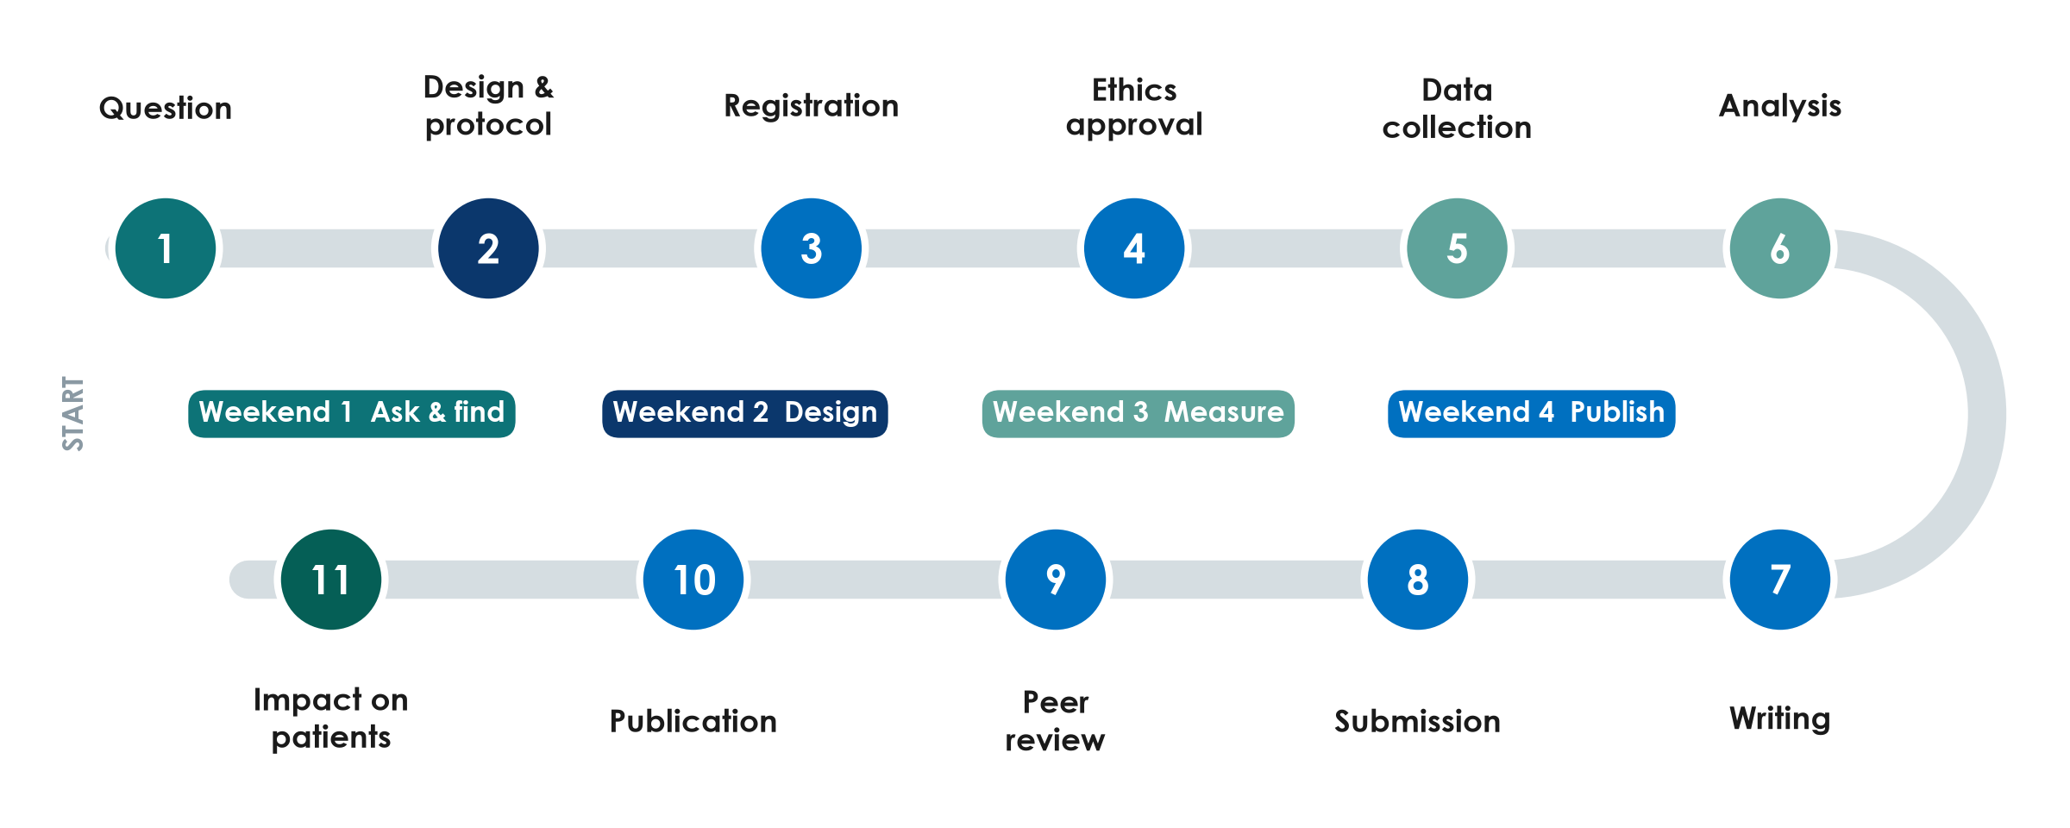
The whole road: from idea to publication
KEY MESSAGE This course walks the whole road - your group proposal covers stops 1 to 6.
Neudata | #ClearDataClearImpact
Notes:
Eleven stops from question to impact. The colours show which weekend of the course teaches each stop.
Stops 1-6 are planning and doing: question, design and protocol, registration (trials must be registered BEFORE the first patient - Paper 1 was registered in July 2021, recruitment began in September 2021), ethics approval, data collection, analysis.
Stops 7-11 are publishing: writing, submission, peer review, publication and impact on patients. The road usually takes one to three years; many good studies stall at stop 7.
Teaching point: every stop depends on stop 1. A vague question produces a weak protocol, an unanswerable analysis and a paper that is hard to publish.
Misconception: 'publication is the end'. The point is impact - a changed guideline, protocol or practice.
Ask the room: 'At which stop do you think most hospital studies get stuck?' Expected answers: ethics paperwork, data collection, or writing (stop 7) - we will tackle each one.
Timing: 3 minutes. Segment 1.1 ends at 1:10 - break.

Slide 26
Break
BREAK | 15 min
1. Stretch, coffee, talk to someone from another profession
2. Think: which problem from your ward could your group work on today?
Neudata | #ClearDataClearImpact
Notes:
BREAK (1:10-1:25).
During the break: put the Session 1 exercise sheets on the tables and write the pair-task scenarios on the flip chart.
Restart on time - say clearly what time you will begin again.

Slide 27
1.2 From problem to question
A good question is half of the answer.
40 minutes: where questions come from, PICO(T) with worked examples, question types, FINER - then a pair task
Neudata | #ClearDataClearImpact
Notes:
SEGMENT 1.2 (1:25-2:05).
Teaching point: a vague clinical worry ('are fluids bad?') must be turned into a precise, answerable question before anything else can happen.
We will build PICO slowly with several examples - ICU and ward - before you practise in pairs.
Timing: 30 seconds.

Slide 28
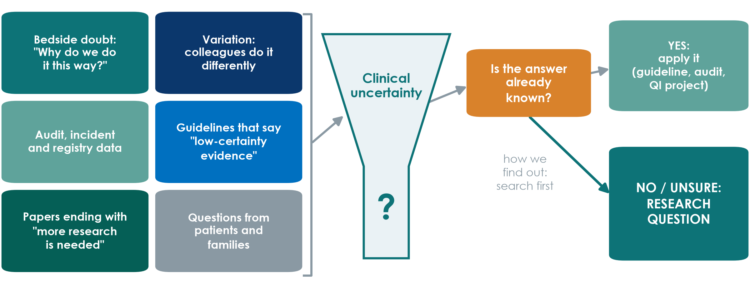
Where do research questions come from?
KEY MESSAGE If the answer is known, apply it. If it is not, you have a research question.
Neudata | #ClearDataClearImpact
Notes:
Six common sources of good questions, all from daily work.
The orange box is the key decision: before calling something research, check whether the answer already exists. If it does, the job is implementation - a guideline, an audit or a QI project (segment 1.1).
Teaching point: 'how we find out' is the literature search - that is tomorrow's Session 2.
Ask the room: 'Name one thing in your unit that colleagues do differently.' Expected: sedation targets, fluid volumes, dressing changes, mobilisation timing. Write them on the flip chart - they are candidate topics for the proposals.
Timing: 3 minutes.

Slide 29
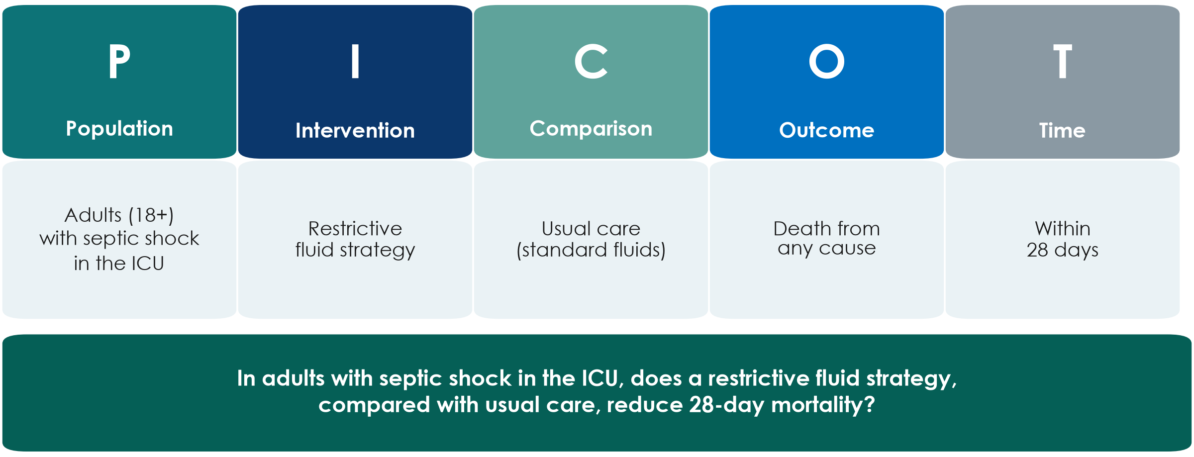
PICO(T): our running example
KEY MESSAGE Every session we come back to this one question.
Neudata | #ClearDataClearImpact
Notes:
PICO = Population, Intervention, Comparison, Outcome. The T (Time) states when the outcome is measured.
Read the five boxes, then the full sentence at the bottom. This is the running example for the whole course.
Teaching point: each letter forces a decision. Which patients exactly? Restrictive how? Compared with what? Which outcome, measured when?
Variants: for observational questions I becomes E (exposure), e.g. 'a positive fluid balance' - PECO. Descriptive questions may only need P and O.
Misconception: 'the comparison is obvious'. Usual care varies between hospitals and over time - it must be described.
Ask the room: 'Is 28-day mortality the only sensible outcome?' Expected: 90-day mortality, days alive without life support, kidney injury needing dialysis, fluid balance. The large trials used 90-day mortality.
Timing: 4 minutes.

Slide 30
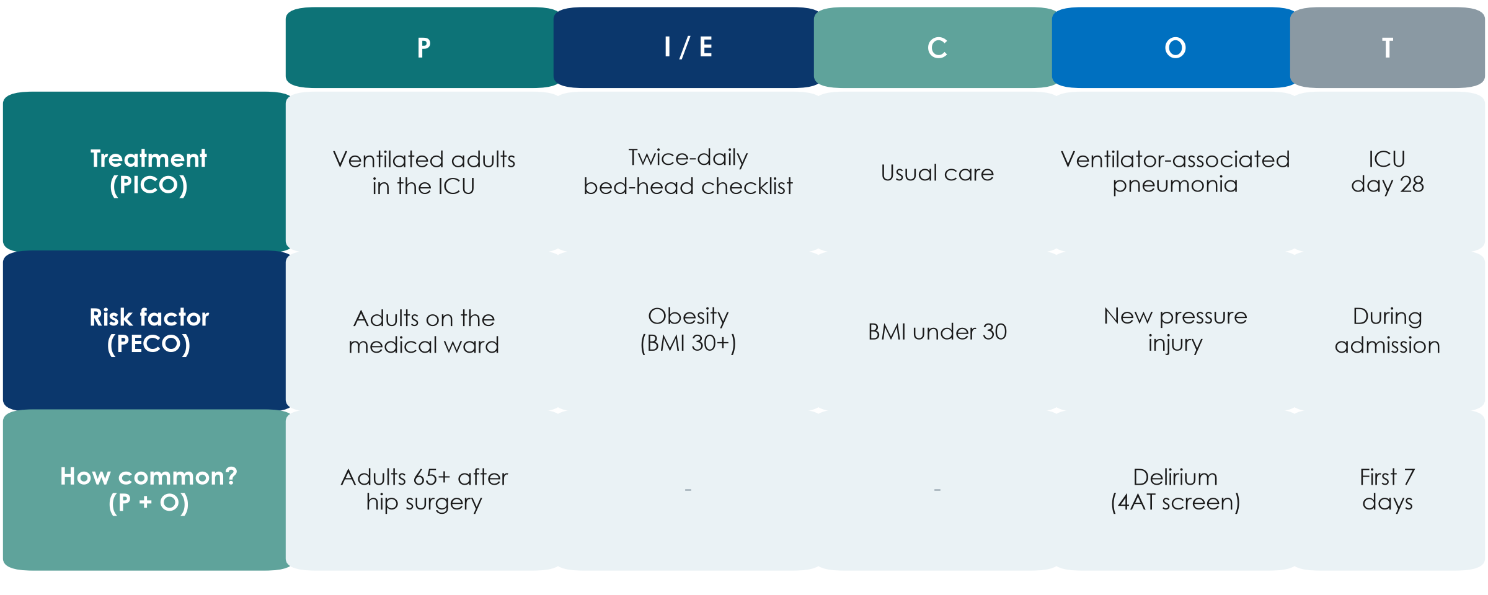
PICO(T) on the ward: three worked examples
KEY MESSAGE Treatment questions use PICO, risk questions PECO, 'how many?' questions only P and O.
Neudata | #ClearDataClearImpact
Notes:
Three examples that are NOT about fluids, so every profession sees itself.
Row 1 - treatment (PICO): ventilated adults; a twice-daily bed-head checklist vs usual care; ventilator-associated pneumonia by ICU day 28.
Row 2 - risk factor (PECO): we cannot assign obesity, so I becomes E (exposure). Adults on the medical ward; obese vs not; new pressure injury during admission.
Row 3 - how common? Only P and O (and T): adults 65 and over after hip-fracture surgery; delirium screened with the 4AT in the first 7 days.
Teaching point: the boxes you fill already tell you the type of question - and later the design.
Ask the room: 'Give me a PECO question from pharmacy.' Expected example: in ICU adults, is polypharmacy (10+ drugs) vs fewer associated with delirium?
Timing: 4 minutes.

Slide 31
Check your understanding: spot the PICO
QUICK QUIZ | 3 min
1. Read the question: 'In adults aged 65+ after hip-fracture surgery, does a daily non-drug bundle, compared with usual care, reduce delirium in the first 7 days?'
2. Which words are P? Which are I? C? O? T?
3. Write the five letters on your sheet (Exercise 1, warm-up)
4. Compare with your neighbour
OUTPUT Five labelled pieces - the answer is on the next slide
Neudata | #ClearDataClearImpact
Notes:
Give the room 2 minutes in silence, then 1 minute to compare.
Answer (next slide): P adults 65+ after hip-fracture surgery; I daily non-drug delirium bundle; C usual care; O delirium; T first 7 postoperative days.
Watch for people labelling 'hip fracture' as the outcome - it is part of the population.
Timing: 3 minutes.

Slide 32
Answer: spot the PICO
P
I
C
O
T
Adults 65+
after hip-fracture
surgery
Daily non-drug
delirium bundle
Usual care
Delirium
(screened daily)
First 7 days
after surgery
KEY MESSAGE The diagnosis that brings patients in is part of P, not O.
Neudata | #ClearDataClearImpact
Notes:
Reveal and ask how many got all five.
Teaching point: the outcome must be something that can happen AFTER the intervention starts. Hip fracture has already happened - it defines who is eligible.
Extra question for fast rooms: 'How would you measure delirium?' Expected: a validated screening tool (e.g. 4AT or CAM) at the same time each day.
Timing: 2 minutes.

Slide 33
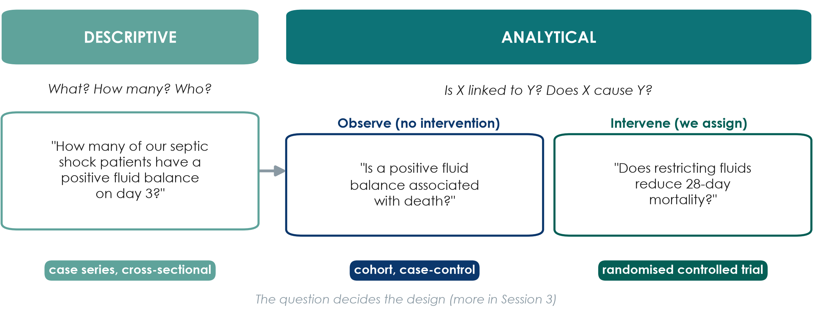
Two families of questions
KEY MESSAGE Descriptive questions describe. Analytical questions compare or test a cause.
Neudata | #ClearDataClearImpact
Notes:
Descriptive: what, how many, who - no comparison group needed.
Analytical: is X linked to Y (observational - we watch), or does X cause Y (experimental - we assign X).
Teaching point: the verbs give it away. 'How many' is descriptive; 'is associated with' is observational; 'does it reduce' implies an experiment.
Misconception: 'descriptive studies are not real research'. They often come first and show that the problem exists.
Ask the room: 'Paper 2 (Hyun) - which box?' Expected: analytical, observational (cohort).
Timing: 3 minutes. The full design menu is Session 3.

Slide 34
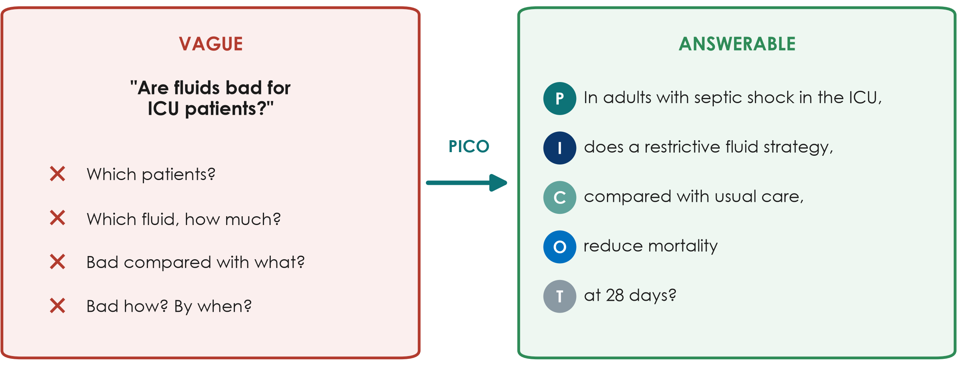
Vague vs answerable
KEY MESSAGE If you cannot fill all four PICO boxes, the question is not ready yet.
Neudata | #ClearDataClearImpact
Notes:
Left: the question we ask in the corridor - every word is undefined. Right: the same worry written with PICO(T).
Teaching point: a researchable question is specific, has one primary outcome, and implies the design.
Misconception: 'a broad question is more important'. Broad questions produce vague answers.
Ask the room: 'Make this answerable: Is hand hygiene good?' Expected direction: in ICU staff (P), does a feedback programme (I) vs no feedback (C) increase hand-hygiene compliance at 3 months (O, T)?
Timing: 3 minutes.

Slide 35
FINER: is the question worth asking?
Check every question against five tests before you invest time in it.
Feasible
Interesting
Novel
Ethical
Relevant
Enough patients
Time, money, skills
Data available
To you, your team
and to readers
Confirms, refutes
or extends what
is known
Approvable by the
ethics committee
Could change
practice, policy
or research
KEY MESSAGE If the question fails one letter, rewrite it before going further.
Neudata | #ClearDataClearImpact
Notes:
FINER comes from Hulley and colleagues, Designing Clinical Research.
Feasible fails most often in hospital research: not enough eligible patients, or an outcome that is too rare.
Novel does not mean 'never studied'. Repeating a study in a new setting, or with a better design, can be novel - which is why the literature search matters.
Ethical: is there genuine uncertainty (equipoise) about which option is better?
Ask the room: 'Which letter does our running example fail?' Let them guess - the next slide answers.
Timing: 3 minutes.

Slide 36
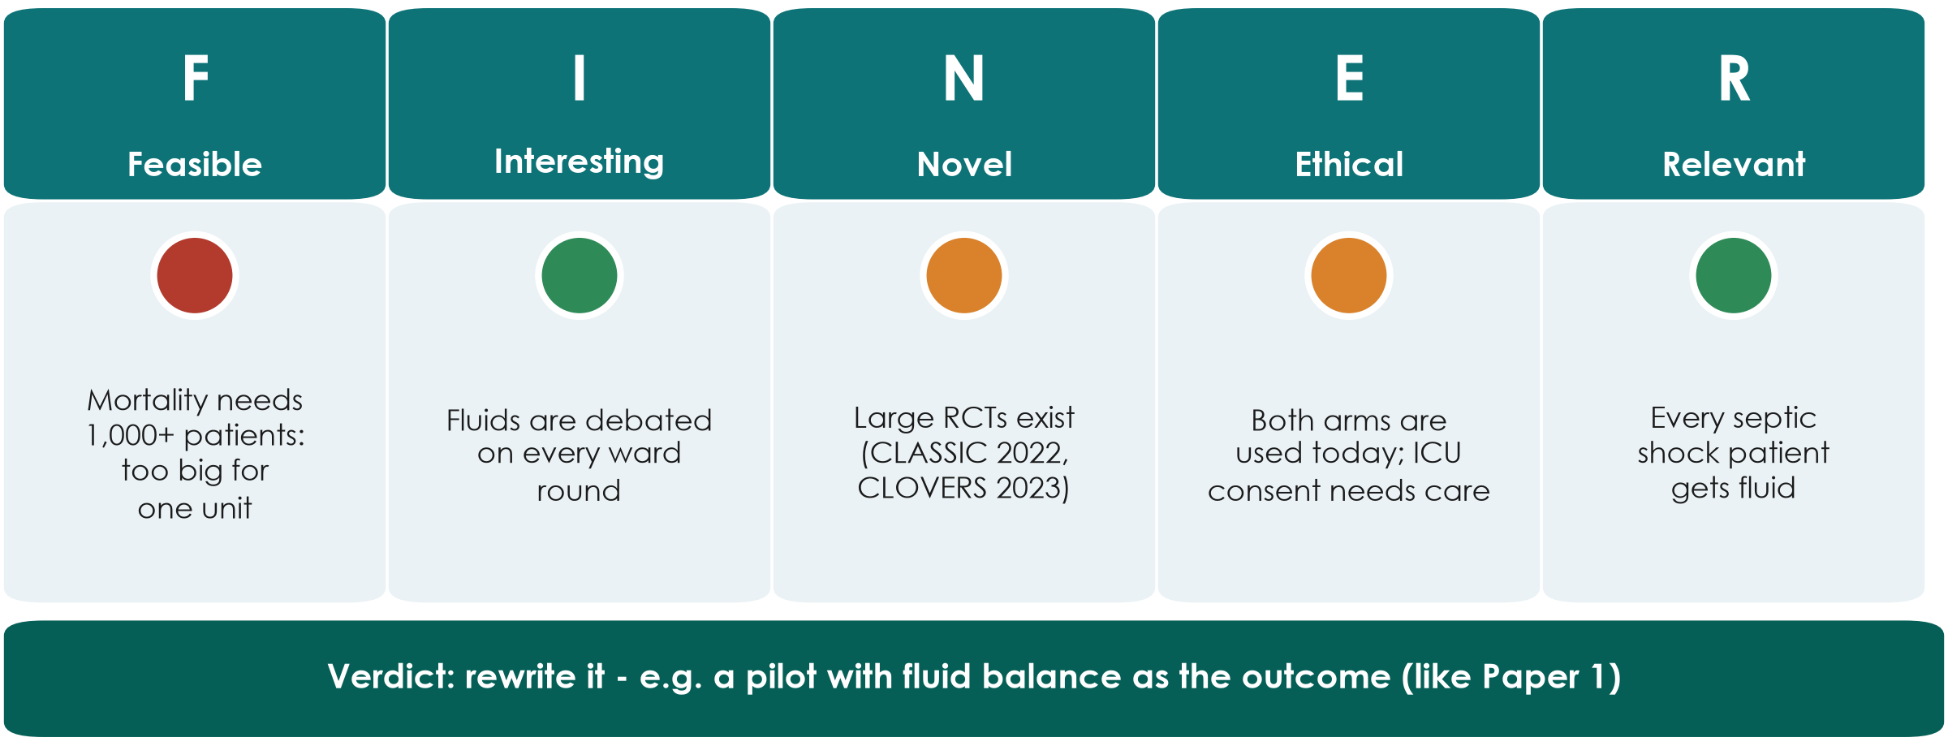
FINER check of our running example
KEY MESSAGE Our question is important but not feasible for one unit: rewrite it.
Neudata | #ClearDataClearImpact
Notes:
F is red: to show a few percentage points difference in mortality you need well over a thousand patients. CLASSIC randomised 1,554; CLOVERS (NEJM 2023) 1,563. One ICU cannot do this.
N is amber: large trials already exist and neither found a mortality difference.
E is amber: both strategies are used in practice so equipoise exists, but consent in septic shock is difficult (Session 7).
How to rescue it: change the outcome (fluid balance at day 5, as Paper 1 did), make it a feasibility pilot, or ask a descriptive question about our own practice.
Misconception: 'a failed FINER check means a bad idea'. It means the idea needs reshaping - normal and expected.
Ask the room: 'Suggest a feasible version for our unit.' Expected: a descriptive audit-style question, or a pilot like Paper 1.
Timing: 3 minutes.

Slide 37
Pair task: from scenario to question
GROUP WORK | 11 min
1. Pick ONE scenario from Exercise 1 on your sheet
2. Fill the PICO(T) boxes
3. Write the question as one sentence
4. Give it a quick FINER traffic light (green / amber / red)
5. Write H0 and H1 (or say why none is needed)
Scenarios
Ventilator pneumonia
Pressure injuries
Delirium
Stroke door-to-needle
Medication errors
OUTPUT One PICO question + FINER light + hypothesis, ready to read aloud
Neudata | #ClearDataClearImpact
Notes:
Pairs: one person from each profession where possible.
Facilitation: circulate with the 'what good looks like' box from Course/Solutions/s1_solutions.md. Commonest problems: a missing comparison, an outcome without a time point, two outcomes squeezed into one question.
At 8 minutes call time. Take three pairs to read their question aloud; ask the room to name each PICO letter and 'which FINER letter worries you?'.
Pressure-injury pairs often discover their first question should be descriptive - praise this explicitly.
Timing: 8 minutes work + 3 minutes debrief. Segment 1.3 starts at 2:05.

Slide 38
1.3 Aims, objectives, hypotheses
A question tells us what we want to know. Aims and objectives tell us what we will do.
20 minutes: aim, objectives, null and alternative hypotheses - and a quick exercise
Neudata | #ClearDataClearImpact
Notes:
SEGMENT 1.3 (2:05-2:25).
Teaching point: the aim, objectives and hypothesis are the question written as a plan. Ethics committees and grant reviewers read them first.
Keep it concrete: every example uses the running example or the pair-task scenarios.
Timing: 30 seconds.

Slide 39
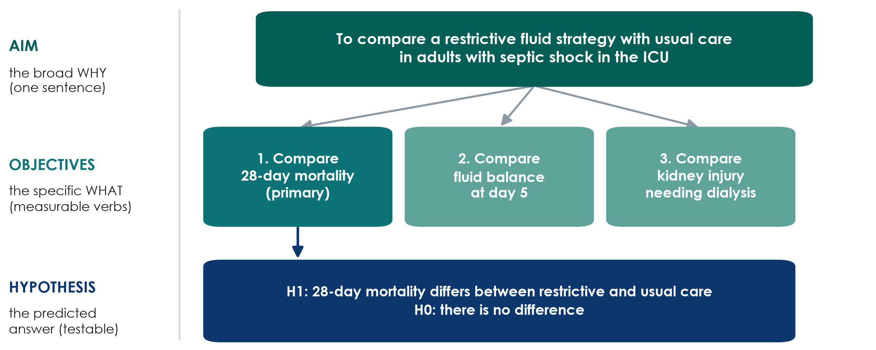
Aim, objectives, hypothesis
KEY MESSAGE One aim, 2-3 measurable objectives, one testable hypothesis per main objective.
Neudata | #ClearDataClearImpact
Notes:
Aim = the broad purpose in one sentence ('To compare...', 'To describe...').
Objectives = specific, measurable steps. Use measurable verbs: compare, estimate, describe, determine. Avoid 'understand', 'explore', 'study'.
Mark the primary objective - it drives the sample size (Session 6).
Hypothesis = the predicted answer to the main analytical objective, stated so data can reject it.
Misconception: 'every study needs a hypothesis'. Purely descriptive studies estimate; they do not test a hypothesis.
Timing: 3 minutes.

Slide 40
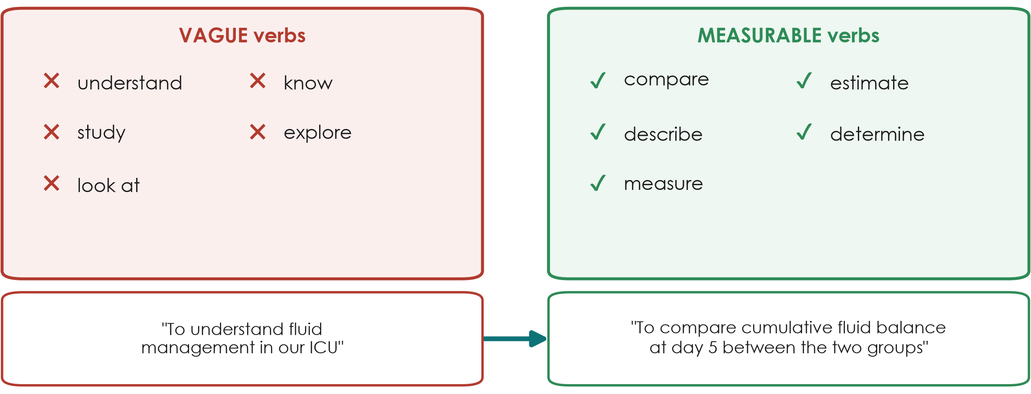
Objectives start with a measurable verb
KEY MESSAGE If you cannot say how you will measure it, it is not yet an objective.
Neudata | #ClearDataClearImpact
Notes:
Left: verbs that describe a wish, not an action you can check. Right: verbs that point to something you can count or measure.
Bottom: the same idea rewritten. 'To understand fluid management' cannot be finished or checked; 'to compare cumulative fluid balance at day 5 between groups' tells us the outcome, the time and the comparison.
Teaching point: each objective should match one outcome and, later, one analysis (Session 6).
Misconception: 'more objectives make a stronger proposal'. Two or three focused objectives are better than eight vague ones.
Ask the room: 'Rewrite: to study delirium in our ward.' Expected: to estimate the proportion of patients aged 65+ who develop delirium in the first 7 days after hip-fracture surgery.
Timing: 3 minutes.

Slide 41
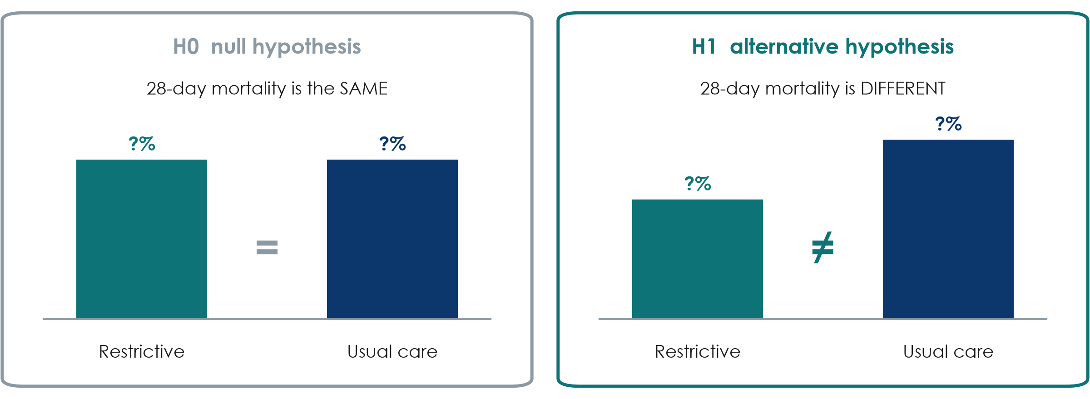
Null and alternative hypotheses
KEY MESSAGE We test H0. Data can reject it or fail to reject it - never prove it.
Neudata | #ClearDataClearImpact
Notes:
H0, the null hypothesis: no difference. H1, the alternative: a difference.
Analogy: a court assumes 'not guilty' (H0) until the evidence is strong enough. 'Not guilty' is not 'innocent' - and 'no significant difference' is not 'no difference'.
H1 is usually two-sided, even when we expect benefit, because restriction could also harm.
Misconception: 'p > 0.05 proves the treatments are equal'. Small studies like Paper 1 (48 patients) often cannot detect real differences. P-values are Session 6.
Timing: 3 minutes.

Slide 42
Quick exercise: aim, objectives, hypothesis
INDIVIDUAL TASK | 7 min
1. Use the question from your pair task (or the delirium example)
2. Write ONE aim: 'To compare...' or 'To describe...'
3. Write TWO objectives with measurable verbs; mark the primary one
4. Write H0 and H1 for the primary objective - or 'descriptive: no hypothesis'
5. Swap with your neighbour: is every verb measurable?
Verbs that work
compare
estimate
describe
determine
measure
OUTPUT Exercise 3 on the sheet - model answers on the next slide
Neudata | #ClearDataClearImpact
Notes:
Individual, 5 minutes writing + 2 minutes swapping.
Circulate and look for 'understand/know/study', objectives with no time point, and hypotheses about an outcome that is not in the objectives.
Model answers for the delirium example are on the next slide and in Course/Solutions/s1_solutions.md.
Timing: 7 minutes.

Slide 43
Model answer: the delirium example
Aim
Objectives
Hypothesis
To compare a daily
non-drug bundle with
usual care after
hip-fracture surgery
1. (Primary) Compare
delirium in 7 days
2. Compare length
of stay
H0: delirium is the
same in both groups
H1: it differs
KEY MESSAGE Aim, primary objective and hypothesis all name the same outcome.
Neudata | #ClearDataClearImpact
Notes:
Read the three cards.
Check the chain: the question's O (delirium in 7 days) = the primary objective = the outcome in H0/H1. If any of these differ, the proposal is inconsistent - reviewers spot this immediately.
A descriptive version needs no hypothesis: 'To estimate the proportion of patients aged 65+ who develop delirium in the first 7 days after hip-fracture surgery.'
Timing: 3 minutes. Segment 1.3 ends at 2:25.

Slide 44
Proposal builder 1
Now it is your group's turn: one topic, one question, one aim.
30 minutes of group work - the start of your research proposal
Neudata | #ClearDataClearImpact
Notes:
PROPOSAL BUILDER 1 (2:25-2:55).
Teaching point: everything taught today is now applied to the group's own topic. By 2:55 each group has a PICO question that passes FINER, an aim and 2-3 objectives in the proposal template.
Groups choose ONE problem. If a group cannot agree in 5 minutes, give them the running example or a secondary example (VAP, pressure injuries, hand hygiene, door-to-needle time, delirium, medication errors).
The search, the 5 references, the problem statement and the working title are tomorrow (Proposal builder 2).
Timing: 1 minute.

Slide 45
Proposal builder 1: your group's question
PROPOSAL BUILDER | 28 min
1. Choose ONE problem from your unit (list 3 ideas, vote, pick one)
2. Fill the PICO(T) table and write the question in one sentence
3. FINER traffic light for each letter; rewrite if anything is red
4. Research, audit or QI? Note the approval route
5. Aim + 2-3 objectives (mark the primary) + H0/H1
6. One group reads its question aloud
Timing
0-7 min: choose the topic
7-14: PICO + question
14-19: FINER + rewrite
19-25: aim, objectives, H0/H1
25-28: 1 group reads aloud
OUTPUT Proposal Part 1 started: PICO, question, FINER, aim, objectives
Neudata | #ClearDataClearImpact
Notes:
Groups of about 6, mixed professions. Suggested roles: chair, scribe (types into the template), timekeeper, and a 'devil's advocate' who checks FINER.
Trainers circulate. Spend the first 7 minutes making sure every group has ONE focused problem - this is where groups get stuck.
Check each group's question against PICO and FINER before they write objectives. A red F is the commonest problem - help them shrink the outcome, shorten the time frame or turn it into a descriptive question or pilot.
Second visit: does the primary objective name the same outcome as the question? Is the approval route (research / audit / QI) written down?
At 2:50 (minute 25), stop the work; one group reads its question and aim aloud; invite one improvement from the room.
What good looks like: Course/Solutions/s1_solutions.md (Exercise 4).
Timing: 28 minutes. Wrap-up starts at 2:55.

Slide 46
Key words of the day
Key word | In one line
Evidence pyramid | Ranks designs by how well they protect against bias
Research / audit / QI | What is best? / Do we do it? / How do we improve it?
PICO(T) / PECO | Population, Intervention (or Exposure), Comparison, Outcome, Time
FINER | Feasible, Interesting, Novel, Ethical, Relevant
Aim / objective | The broad why / the specific, measurable what
H0 / H1 | No difference / a difference - we test H0
Neudata | #ClearDataClearImpact
Notes:
WRAP-UP (2:55-3:00).
Read the six key words quickly; these are also in the course glossary (EN-VN).
Ask one participant to explain PICO in their own words.
Timing: 1 minute.

Slide 47
Session 1 recap
1. Why research
2. Ask precisely
3. Plan it
Experience asks;
fair comparisons
in enough patients answer
PICO(T) question,
one primary outcome,
FINER before you start
One aim, 2-3
measurable objectives,
a testable H0/H1
KEY MESSAGE Tomorrow: find and read what is already known about your question.
Neudata | #ClearDataClearImpact
Notes:
Read the three messages.
Link forward: tomorrow (Session 2) we search PubMed for each group's question, manage references, and learn to read a paper in 15 minutes.
Timing: 1.5 minutes.

Slide 48
Exit question
QUICK QUIZ | 2 min
1. Which FINER letter did our running example fail, and why?
2. Rewrite as an objective: 'To understand pressure injuries on our ward'
3. Write both answers on a sticky note (no names) and stick it on the door as you leave
OUTPUT One sticky note per person (we read them before tomorrow)
Neudata | #ClearDataClearImpact
Notes:
Answers: 1 - Feasible: a mortality outcome needs well over a thousand patients. 2 - e.g. 'To estimate the incidence of new stage 2+ pressure injuries among adults on our ward over 6 months'.
Read the notes tonight. If many still use vague verbs, open Session 2 with one extra minute on objectives.
Timing: 1.5 minutes.

Slide 49
Homework for tomorrow (Session 2)
INDIVIDUAL TASK
1. Group: finish the PICO, question, aim and objectives if not done
2. Everyone: for each PICO word, write 2-3 English synonyms (Exercise 5)
3. Everyone: think of one local number that shows the problem (an audit, a count)
4. Optional: install Zotero (free, zotero.org) on your laptop
Bring tomorrow
Your group's PICO question
Your synonym list
A laptop or phone per group
OUTPUT PICO question ready for tomorrow's search
Neudata | #ClearDataClearImpact
Notes:
Keep it light: about 30 minutes tonight.
The synonym list makes tomorrow's PubMed search much faster - PubMed searches in English.
The 'local number' becomes paragraph 3 of the problem statement tomorrow.
Close on time. Thank the room.
Timing: 1 minute.

Slide 50
Extra slides — Session 1
Use if time allows, or for self-study
Neudata | #ClearDataClearImpact
Notes:
EXTRA SLIDES (Session 1).
Everything after this slide is optional. Use it if the room is fast, if a group asks, or point participants to it for self-study.
The core session is complete without these slides.

Slide 51
PICO for other kinds of question
Diagnosis
Prognosis
Qualitative (SPIDER)
P: patients tested
I: new test
C: reference standard
O: accuracy
P: patients with X
E: a risk factor
O: what happens
T: by when
Sample, Phenomenon
of interest, Design,
Evaluation,
Research type
KEY MESSAGE The letters change; the idea - be explicit - stays the same.
Neudata | #ClearDataClearImpact
Notes:
EXTRA: diagnosis, prognosis and qualitative question frameworks.
Diagnostic questions: the index test is I, the reference standard is C, the outcome is accuracy (sensitivity, specificity - Session 4).
Prognosis: often PECO plus a time frame.
Qualitative questions often use SPIDER (Cooke and colleagues, 2012): Sample, Phenomenon of Interest, Design, Evaluation, Research type.
Timing: 2 minutes if used.

Slide 52
One-sided or two-sided H1?
Two-sided (usual)
One-sided (rare)
Non-inferiority
'Mortality differs'
Allows benefit
OR harm
'Mortality is lower'
Ignores possible harm
Needs strong reason
'Not worse by more
than a set margin'
(Session 3)
KEY MESSAGE When in doubt, write a two-sided H1.
Neudata | #ClearDataClearImpact
Notes:
EXTRA: one- vs two-sided hypotheses.
Two-sided hypotheses are the default in clinical research because a new intervention can harm as well as help.
One-sided tests must be pre-specified and justified; reviewers are suspicious of them.
Non-inferiority questions (is a cheaper or simpler option not much worse?) have their own design - Session 3.
Timing: 2 minutes if used.

Slide 53
More practice: which FINER letter fails?
QUICK QUIZ | 4 min
1. All hospitalised adults in the country: does vitamin D reduce mortality over 10 years?
2. Septic shock: does withholding antibiotics for 24 h reduce resistance?
3. Do our ICU nurses wash their hands? (already audited monthly for 5 years)
4. Pneumonia: does the colour of the drug chart affect 28-day mortality?
OUTPUT One letter per question
Neudata | #ClearDataClearImpact
Notes:
EXTRA: extra FINER practice.
Answers: 1 Feasible (huge, long, expensive; large vitamin D trials also exist - Novel). 2 Ethical (withholding antibiotics in septic shock causes harm - no equipoise). 3 Novel (the answer is already measured: an audit question). 4 Relevant (no plausible mechanism, no impact on practice).
Also in Exercise 2 Part B of the participant sheet.
Timing: 4 minutes if used.

Slide 54
Vague vs answerable: a ward example
KEY MESSAGE Practise on your own ward: take a corridor question and fill the PICO boxes.
Neudata | #ClearDataClearImpact
Notes:
EXTRA: more vague-to-answerable practice with a ward example.
Use this slide again with a ward example if the room needs more practice.
Ask: 'Make this answerable: Do night shifts cause medication errors?' Expected direction: in ward nurses (P), are night shifts (E) compared with day shifts (C) associated with more medication administration errors per 1,000 doses (O) over 6 months (T)?
Point out that this becomes a PECO (observational) question because we cannot randomise nurses to night shifts easily.
Timing: 3 minutes if used.

Slide 55
Copyright © Neudata, 2026
All property rights and copyright are reserved.
This presentation contains proprietary data, information, and materials developed by Neudata for dedicated use only and may not be communicated, copied, reproduced, distributed, published, or cited, in whole or in part, without the prior written consent of Neudata.
Where explicit written permission has been granted, appropriate attribution must be included, followed by “by courtesy of Neudata”.
Any unauthorized use or infringement of these materials may give rise to legal action and claims for damages, without prejudice to any other rights of Neudata, including rights relating to patents, trademarks, or other forms of intellectual property protection.
Neudata | #ClearDataClearImpact
Notes:
Copyright slide - leave on screen while participants leave.

