Slide 1

Session 3 · Design: choosing the right study
Weekend 2 · Saturday
Recap quiz on Session 2 (10 min)
3.1 Study designs in pictures (45 min) + exercise "Name that design" (15 min)
Break (15 min)
3.2 More designs: trial variants, pilots, quality improvement, qualitative (35 min)
Exercise: choose the design for 5 questions (20 min)
Proposal builder 3: design, setting and population (35 min) - wrap-up
Neudata | #ClearDataClearImpact
Notes:
SESSION 3 OPENING (0:00). Welcome to Weekend 2. In Sessions 1 and 2 we asked a question and found the evidence. Today we choose HOW a study answers a question; tomorrow (Session 4) we judge whether we can trust the answer and how big the effect is.
Teaching point: the design decides what you are allowed to claim at the end. A good question with the wrong design produces a weak study.
Pace: this is a slow session on purpose. Every design is shown as a picture on a timeline, then as a worked example, then checked with a quick quiz.
Running example: the fluid question answered twice - by a small randomised trial (Boulet 2024) and by a large cohort (Hyun 2023).
Ask the room: who has ever taken part in a study as a data collector? Expected: a few hands - use them as examples later.
Timing: 1 minute. The day: recap 10, 3.1 45, exercise 15, break 15, 3.2 35, exercise 20, proposal builder 35, wrap-up 5.

Slide 2
Recap quiz: three questions on Session 2
QUICK QUIZ | 10 min
1. Q1. Your PubMed search finds 3,000 papers. Add a concept with AND, or a synonym with OR?
2. Q2. After the title and abstract, what do you read next in a paper?
3. Q3. An abstract says 'a trend towards lower mortality (p = 0.42)'. What is this called?
4. Groups: re-read your research question and problem statement (2 min)
How we run it
Answer alone first (30 s each)
Show of hands, then reveal
No marks - just a warm-up
OUTPUT Each group's question, re-read and confirmed
Neudata | #ClearDataClearImpact
Notes:
Purpose: wake up Session 2 and put each group's own question back on the table - today's proposal builder chooses a design for it.
Answers. Q1: AND with another concept narrows the search; OR widens it. Q2: the figures and tables (reading order: title, abstract, figures and tables, then methods). Q3: spin - describing a non-significant result as if it were a benefit.
Misconception to catch: 'p = 0.42 is nearly significant'. It is not; the honest phrase is 'no clear difference'.
Ask the room after Q3: how should the sentence be rewritten? Expected answer: 'mortality did not differ clearly between groups (p = 0.42)'.
Timing: about 6 minutes for the questions, 3 minutes for groups to re-read their question. Note any group that changed its question.

Slide 3
Key words of the day
Ten words you will use all day - you do not need to memorise definitions
The pieces
Who decides?
Which way in time?
After the break
Exposure: what comes first
Outcome: what we count later
Comparison group
Observational: we watch
Experimental: we assign
Randomised: chance assigns
Cross-sectional: snapshot
Case-control: look back
Cohort: follow forward
Cluster, crossover trials
Non-inferiority, pilot
Time series, qualitative
KEY MESSAGE Two questions name most designs: who decided the exposure, and which way does time run?
Neudata | #ClearDataClearImpact
Notes:
Read the four headings only; the details come slide by slide. Tell the room this slide is printed in the handout as a glossary.
Teaching point: almost every design question becomes easy once people can name the EXPOSURE and the OUTCOME. We practise that first.
Misconception: 'design names must be memorised'. No - they can be worked out from the two questions on the takeaway.
Ask the room: in our fluid question, what is the exposure and what is the outcome? Expected answer: exposure = restrictive fluid strategy (vs usual care); outcome = death by day 28.
Timing: 1 minute.

Slide 4
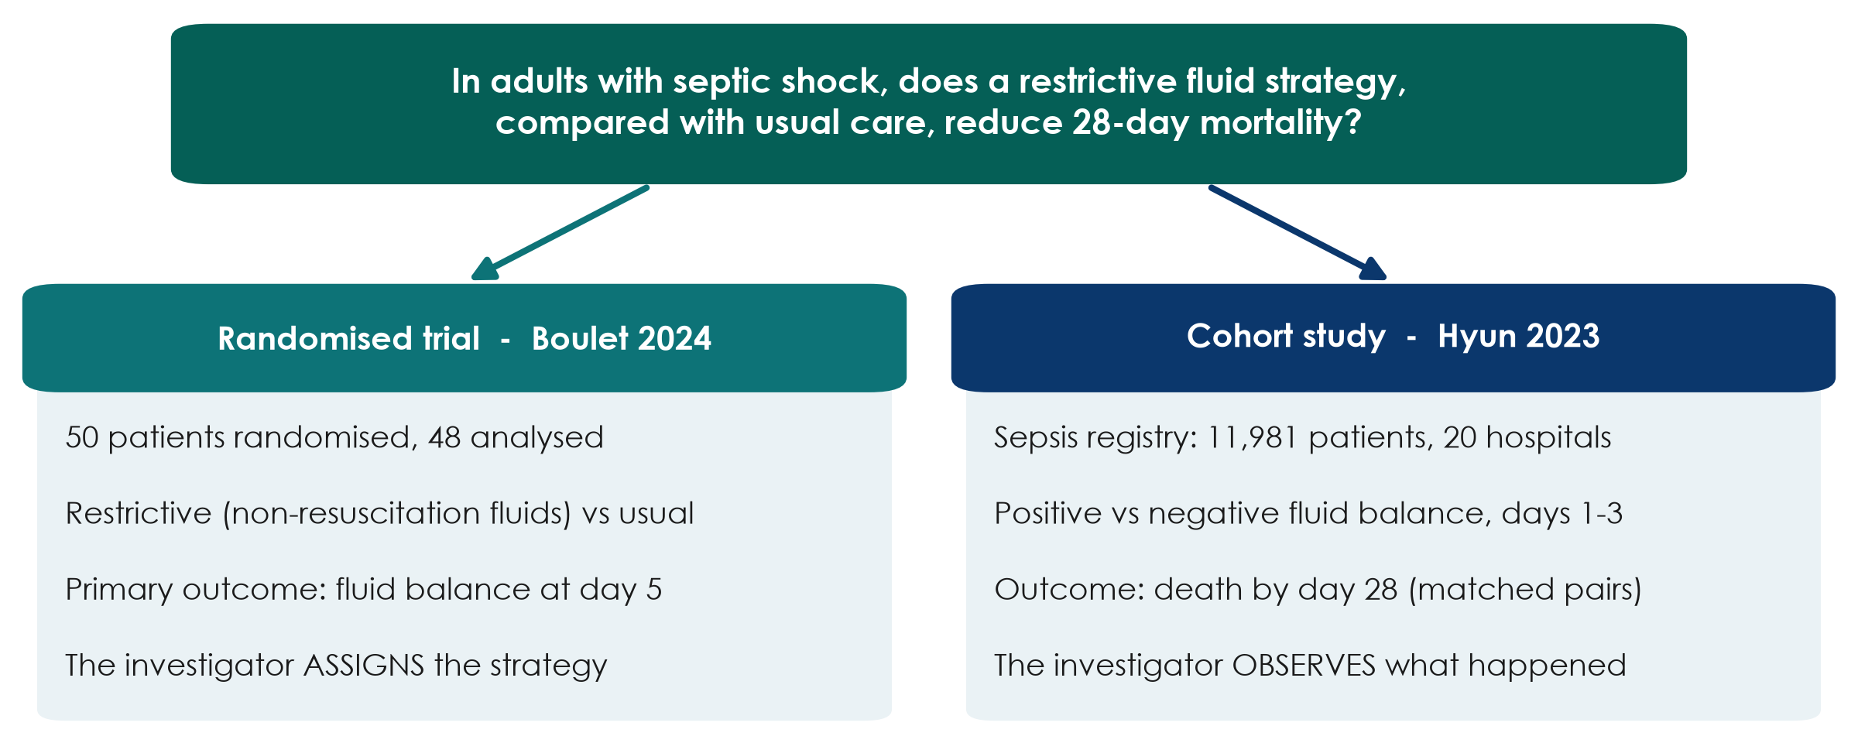
One question, two designs
KEY MESSAGE Same question, two designs: the design decides what you may claim.
Neudata | #ClearDataClearImpact
Notes:
This is the thread for the whole day. Read the question aloud - it is the PICO the room built in Session 1.
Teaching point: Boulet ASSIGNED the fluid strategy by chance (an experiment). Hyun only OBSERVED what clinicians did and what happened afterwards (an observational cohort).
Point out a detail people miss: Boulet's primary outcome was fluid balance at day 5, not mortality. It was a pilot trial. Hyun looked at 28-day mortality, which is our question, but could not assign anything.
Misconception: 'the bigger study is always the better study'. Size reduces random error; it does not remove bias. We come back to this in Session 4.
Ask the room: which study would you trust more to tell you whether restriction SAVES lives? Expected answer: mixed - that is the point; neither answers it fully. Keep the tension; we resolve it by the end of 3.1.
Timing: 2 minutes.

Slide 5
3.1 Study designs in pictures
Did the investigator assign the exposure, or just watch?
That one question sorts almost every study design. (45 minutes)
Neudata | #ClearDataClearImpact
Notes:
Section marker for 3.1 (45 minutes, including two short checks).
Teaching point: we learn designs as pictures on a timeline, not as definitions. For each design we ask: who decided the exposure, and in which direction does time run? Each picture is followed by a worked example in steps.
Tell the room they do not need to memorise names - by the end they will draw them.
Timing: 30 seconds.

Slide 6
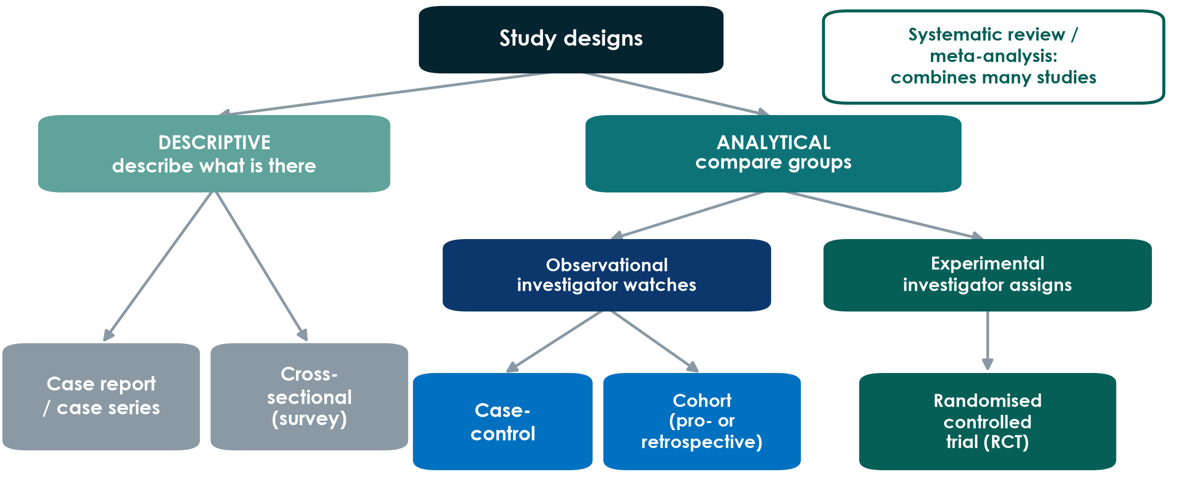
The family tree of study designs
KEY MESSAGE Descriptive designs describe; analytical designs compare groups.
Neudata | #ClearDataClearImpact
Notes:
Walk the tree from the top. Descriptive studies describe what is there - no comparison. Analytical studies compare groups to test an association.
Analytical splits again: observational (the investigator watches what happens in normal care) versus experimental (the investigator decides who gets what).
Systematic reviews sit outside the tree: they are studies of studies, combining many of the designs below.
Misconception: 'observational means bad'. No - many key questions (harm, prognosis, rare diseases) can only be answered observationally. It is about fit, not rank.
Ask the room: where does Boulet sit? Hyun? Expected answer: Boulet = experimental, RCT; Hyun = observational, cohort.
Timing: 2 minutes.

Slide 7
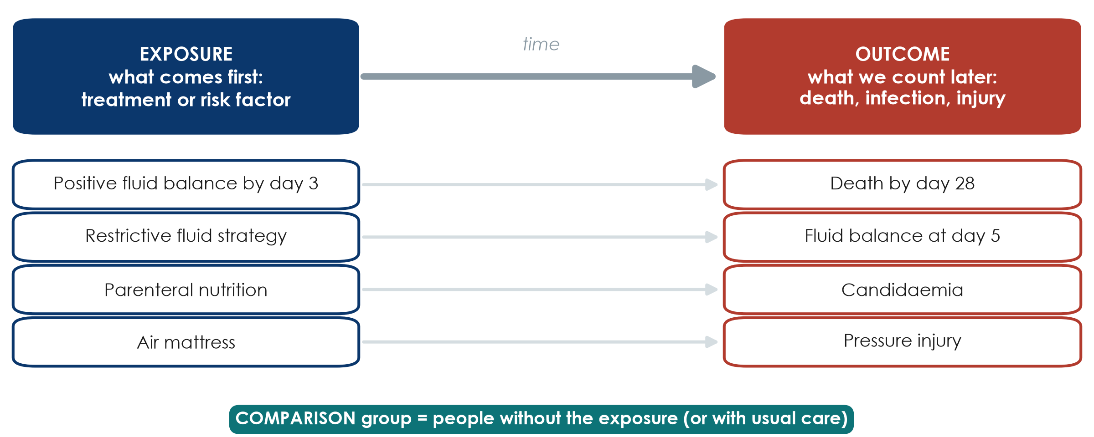
Exposure and outcome: the two words you need
KEY MESSAGE Name the exposure and the outcome first - the design follows.
Neudata | #ClearDataClearImpact
Notes:
Before any design, everyone must be able to name the two pieces of a question.
Exposure: what comes first - a treatment, a strategy, a risk factor, a behaviour. Outcome: what we count later - death, infection, injury, a lab value. The comparison group is people without the exposure, or with usual care.
Walk down the four examples. The same variable can play different roles: fluid balance is the OUTCOME in Boulet (day-5 balance) but the EXPOSURE in Hyun (balance by day 3, outcome death).
Misconception: 'the exposure must be harmful'. No - a treatment is an exposure too.
Ask the room: in 'Does early mobilisation reduce ICU delirium?', name the exposure, outcome and comparison. Expected: early mobilisation; delirium; usual (later) mobilisation.
Timing: 2.5 minutes.

Slide 8
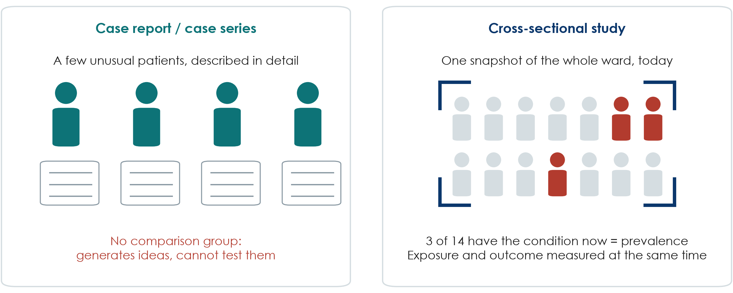
Descriptive designs: describe, do not compare
KEY MESSAGE Descriptive studies raise questions; they cannot answer 'does X cause Y?'
Neudata | #ClearDataClearImpact
Notes:
Case report or series: a few unusual patients written up in detail. Historically important (first reports of AIDS, thalidomide harms) because they raise alarms and hypotheses.
Cross-sectional study: one snapshot of a population at one moment - for example, a one-day survey of pressure injuries on every ward. It measures prevalence (how many have it NOW).
Teaching point: in a cross-sectional study exposure and outcome are measured at the same moment, so you usually cannot tell which came first.
Misconception: 'a cross-sectional study can show cause because it has two groups'. It can compare groups (analytical cross-sectional), but time order is missing.
Ask the room: give an example of a cross-sectional study you could run in your unit next week. Expected answer: a point-prevalence audit - catheter use, delirium screening, hand-hygiene compliance.
Timing: 2 minutes.

Slide 9
Worked example: a one-day point-prevalence survey
A cross-sectional study you could run next week
1. Choose a day
2. Examine everyone
3. Record both
4. Count
All inpatients on all wards, one weekday
Two trained nurses, one standard form
Pressure injury (yes/no) AND mattress type, at the same visit
e.g. 37 of 412 = 9% prevalence today
KEY MESSAGE A snapshot gives prevalence; it cannot show which came first.
Neudata | #ClearDataClearImpact
Notes:
A worked example to make 'cross-sectional' concrete. Hypothetical numbers.
Step 1-2: everyone present on one day, examined the same way (this protects against information bias - Session 4). Step 3: exposure (mattress) and outcome (pressure injury) are recorded at the same moment. Step 4: the result is a prevalence - 37 of 412 patients, 9%.
Teaching point: you can compare groups (injury on standard vs air mattress), but you cannot tell whether the mattress came first or whether patients with injuries were moved onto air mattresses.
Misconception: 'cross-sectional = low quality'. For 'how common is it now?' it is exactly the right design, and it is cheap and fast.
Ask the room: which other ward problem could you measure in one day? Expected: urinary catheters in place, delirium screening done, hand-hygiene compliance.
Timing: 2 minutes.

Slide 10
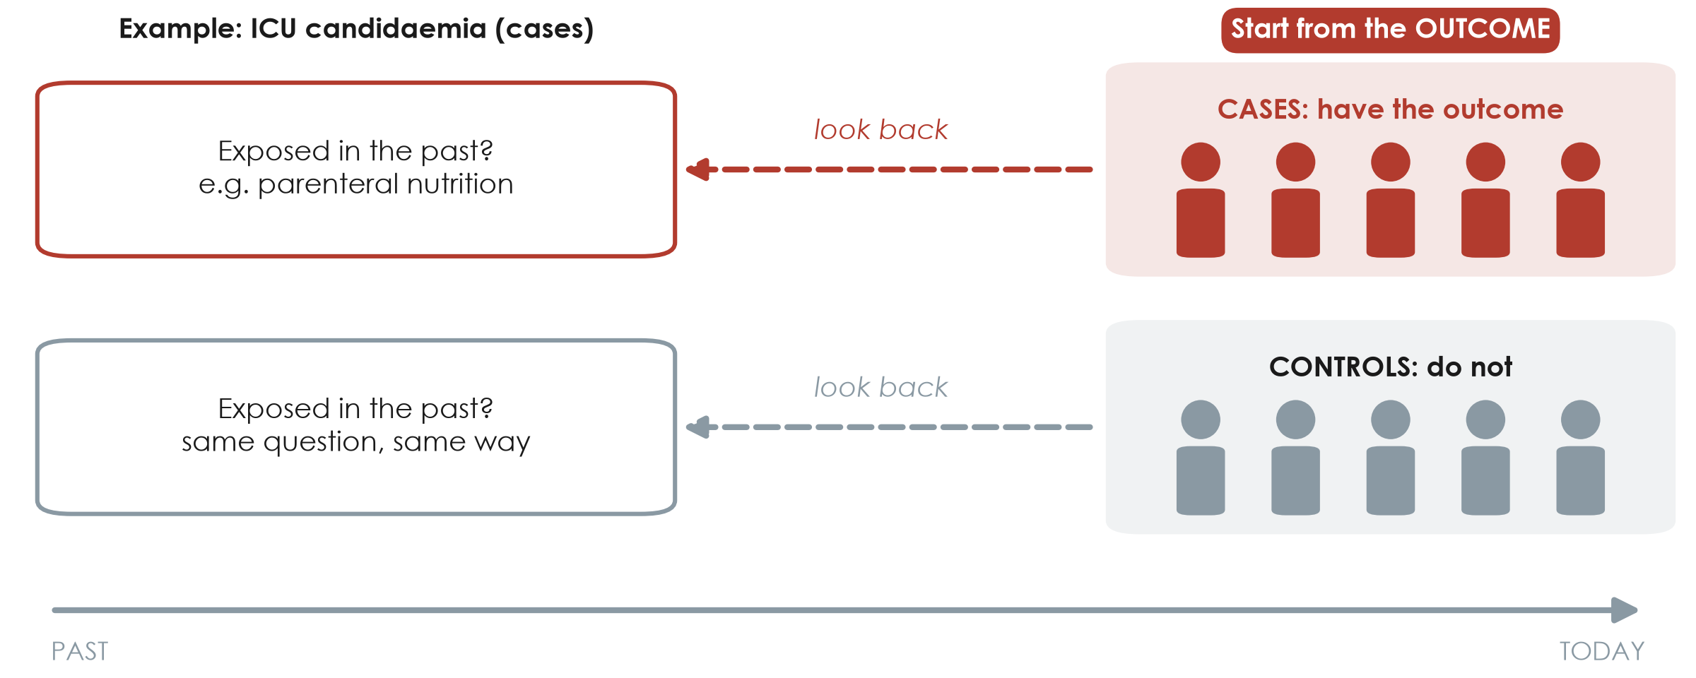
Case-control: start from the outcome, look back
KEY MESSAGE Case-control: pick people BY outcome, then compare their past exposures.
Neudata | #ClearDataClearImpact
Notes:
Draw the arrow with your hand from right to left. We start TODAY with people who already have the outcome (cases) and similar people who do not (controls). Then we look back for the exposure.
Example: ICU patients who developed candidaemia (cases) versus ICU patients who did not (controls); look back in the records for parenteral nutrition.
Strengths: efficient for RARE outcomes or long latency - you do not need to follow thousands of people. Weaknesses: recall bias, choosing good controls is hard, and you can only calculate an odds ratio, not risks.
Misconception: 'case-control is the same as a retrospective cohort because both use old records'. The difference is how people are selected: by OUTCOME in case-control, by EXPOSURE in a cohort.
Ask the room: why can you not calculate the risk of candidaemia from a case-control study? Expected answer: the investigator chose how many cases and controls to include, so the proportion with the outcome is set by design, not by nature.
Timing: 2.5 minutes.

Slide 11
Worked example: a case-control study in the ICU
Question: is parenteral nutrition a risk factor for ICU candidaemia?
1. Find cases
2. Find controls
3. Look back
4. Compare
5. Report
40 ICU patients with candidaemia (lab records)
80 ICU patients without it, same units and months
Parenteral nutrition in the 14 days before?
Exposed: 24 of 40 cases vs 16 of 80 controls
Odds ratio (calculated in Session 4)
KEY MESSAGE Cases and controls are chosen by OUTCOME; exposure is measured looking back.
Neudata | #ClearDataClearImpact
Notes:
The same example appears in the Session 4 calculation exercise, so take your time.
Step 1: cases are people WITH the outcome. Step 2: controls are similar people WITHOUT it, from the same source (same ICUs, same period) - choosing controls well is the hardest part. Step 3: look back for the exposure, the same way for both groups. Step 4: 60% of cases vs 20% of controls were exposed. Step 5: the result is an odds ratio (OR = 6.0, which we calculate tomorrow).
Misconception: 'controls should be healthy volunteers'. No - controls must come from the population that produced the cases, otherwise the comparison is unfair.
Ask the room: why can we not report the risk of candidaemia from this study? Expected answer: we chose how many cases and controls to include (1:2), so the proportion with candidaemia is set by us.
Timing: 2.5 minutes.

Slide 12
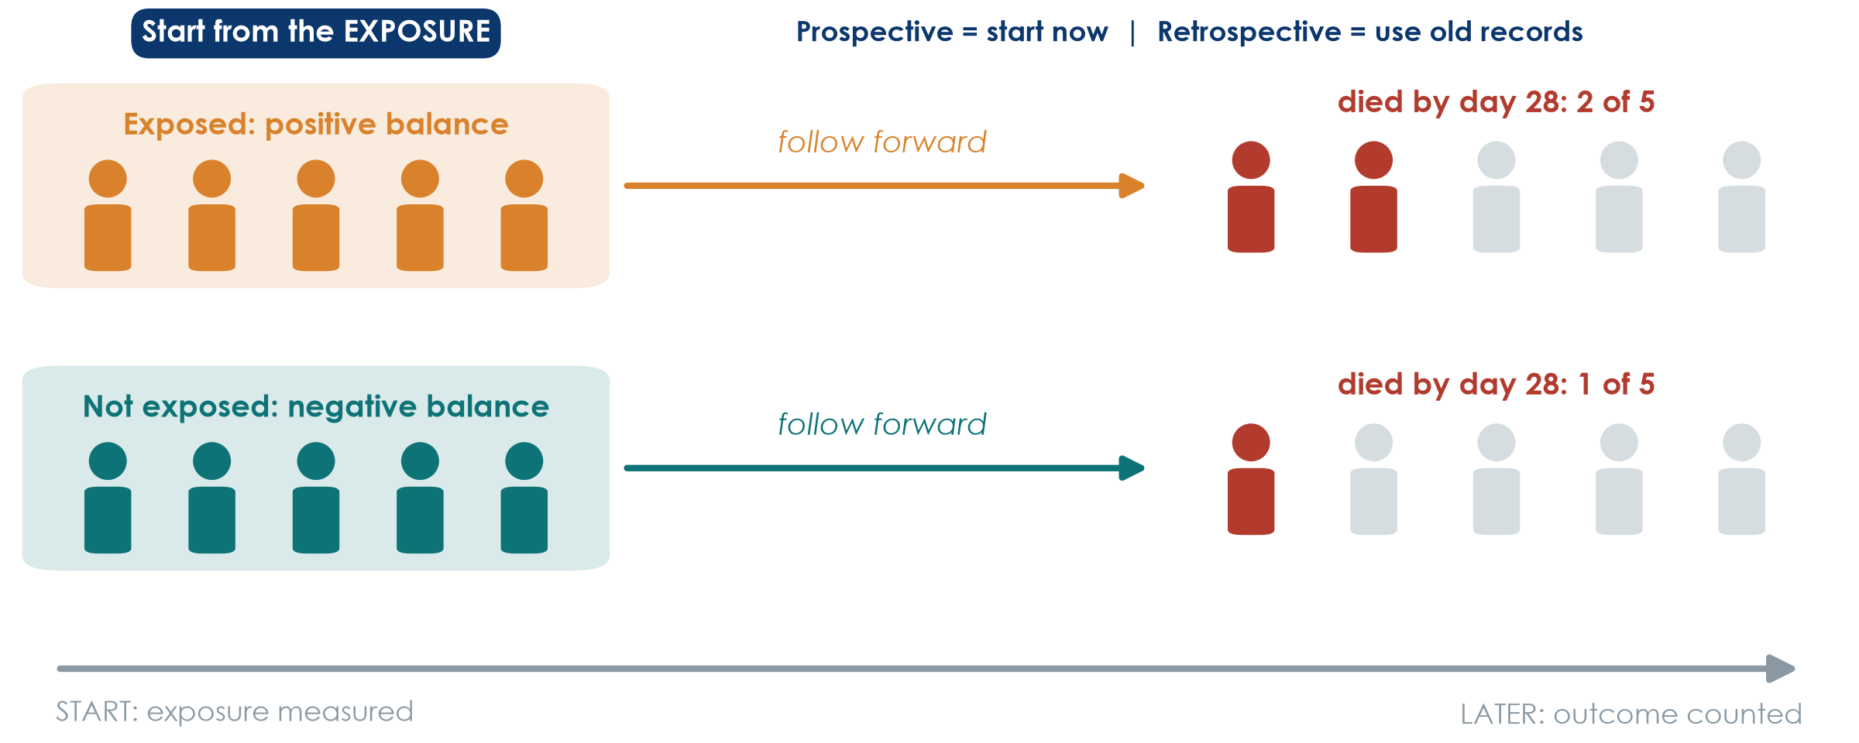
Cohort: start from the exposure, follow forward
KEY MESSAGE Cohort: exposure first, outcome later - time runs the right way.
Neudata | #ClearDataClearImpact
Notes:
Arrow left to right. Group people by EXPOSURE (here: positive versus negative fluid balance in the first ICU days) and count who develops the outcome (death by day 28). This is Hyun 2023.
Prospective cohort: you start now and follow into the future. Retrospective cohort: you start in old records, but the logic is still exposure then outcome. Hyun analysed a registry whose data were collected prospectively.
Strengths: clear time order, can study several outcomes, gives risks and incidence. Weaknesses: slow and costly if prospective, poor for rare outcomes, and confounding - the investigator did not choose who got more fluid.
Misconception: 'retrospective means poor quality'. Not necessarily - the quality depends on how well the data were recorded.
Ask the room: in Hyun, who decided which patients received more fluid? Expected answer: the treating clinicians, according to how sick the patient looked. Hold that thought for confounding in Session 4.
Timing: 2 minutes.

Slide 13
Worked example: the Hyun cohort, step by step
Question: is a positive fluid balance associated with death by day 28?
1. Define the cohort
2. Measure exposure
3. Follow forward
4. Compare
Adults with sepsis in 20 hospitals, ICU stay of 3+ days
Cumulative fluid balance, ICU days 1-3: positive or negative
Record who dies by day 28
Matched pairs; HR 2.13 for day 2
KEY MESSAGE A cohort groups people by EXPOSURE and follows them to the OUTCOME.
Neudata | #ClearDataClearImpact
Notes:
This is how Paper 2 (Hyun 2023) works - a good example of a cohort built from a registry whose data were collected prospectively.
Step 1: the cohort - who is followed (and who is left out: patients who left the ICU before day 3). Step 2: exposure measured BEFORE the outcome. Step 3: outcome counted later. Step 4: compare the groups; Hyun used propensity-score matching to make them similar (483, 373 and 392 matched pairs for days 1, 2 and 3). Day 2 result: HR 2.13 (95% CI 1.48-3.06); day 1 showed no clear difference.
Misconception: 'a cohort needs to start today'. A retrospective cohort uses old records but still goes exposure then outcome.
Ask the room: who decided which patients received more fluid? Expected: the treating clinicians, often because the patient was sicker - we come back to this in Session 4 (confounding).
Timing: 2.5 minutes.

Slide 14
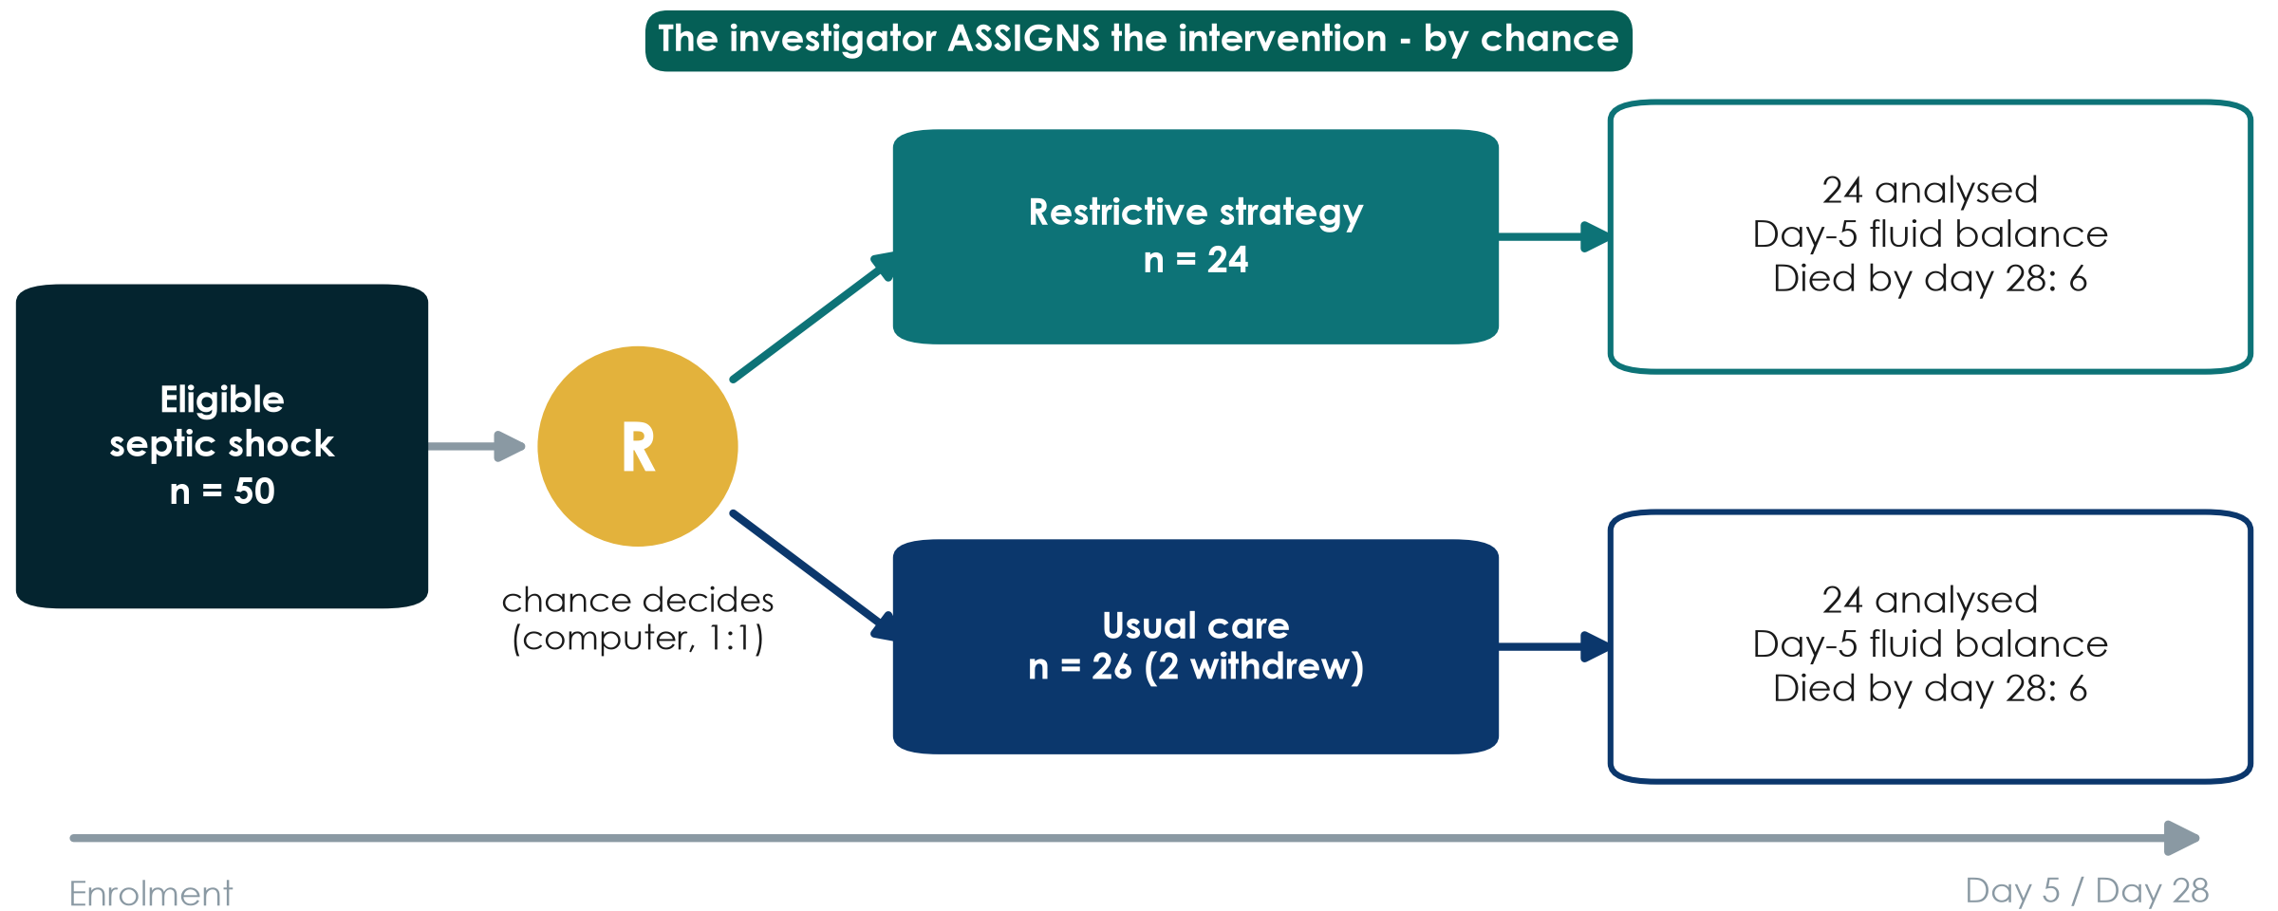
RCT: randomise, then follow forward
KEY MESSAGE In an RCT chance - not the clinician - decides who gets what.
Neudata | #ClearDataClearImpact
Notes:
Boulet 2024: 50 adults with septic shock randomised by a central computer, 1:1, to a restrictive strategy for non-resuscitation fluids or usual care. Two patients in the usual-care group withdrew consent, so 24 + 24 were analysed.
Teaching point: an RCT is a cohort in which the investigator assigns the exposure by chance. That is why groups are alike at the start, for factors we measured AND factors we did not.
Note the honest result: 6 deaths in each group by day 28. With 24 patients per arm this tells us almost nothing about mortality - the trial was a pilot powered for fluid balance.
Misconception: 'RCT = truth'. A small, unblinded or badly run RCT can still mislead. Design is necessary, not sufficient.
Ask the room: why not randomise everything? Expected answer: some exposures cannot ethically be assigned (smoking, harm), some outcomes are rare or take years, and trials are expensive.
Timing: 2 minutes. After the break, 3.2 shows the other ways a trial can be laid out.

Slide 15
Worked example: the Boulet trial, step by step
Question: does restricting non-resuscitation fluids reduce the day-5 fluid balance?
1. Eligibility
2. Consent
3. Randomise
4. Treat
5. Measure
Septic shock, age 18-85, vasopressor < 24 h
Patient or legal surrogate
Central computer, 1:1 - nobody can predict
Restrictive vs usual care for 7 days
Fluid balance at day 5; death by day 28
KEY MESSAGE In a trial the investigator assigns the exposure - by chance.
Neudata | #ClearDataClearImpact
Notes:
This is Paper 1 (Boulet 2024), a pilot randomised trial in 3 ICUs.
Step 1: strict eligibility criteria (we return to these in the proposal builder). Step 2: consent - in the ICU often from a surrogate, before or soon after randomisation. Step 3: randomisation by a central computer keeps the next allocation hidden (allocation concealment - Session 4). Step 4: the two strategies are delivered. Step 5: the primary outcome is the day-5 fluid balance; death by day 28 was 6 of 24 in each group.
Misconception: 'randomised = blinded'. Not here - clinicians knew the group; only patients and statisticians were blinded.
Ask the room: which step makes this an EXPERIMENT rather than a cohort? Expected: step 3 - the investigator assigns the exposure.
Timing: 2 minutes.

Slide 16
Check your understanding: name the design
QUICK QUIZ | 3 min
1. A. All 300 inpatients are checked today for a urinary catheter and for urinary infection
2. B. Patients with ventilator pneumonia are compared with patients without it for earlier sedation use
3. C. Patients who received early mobilisation (physiotherapist's decision) and those who did not are followed to discharge
Choose
Cross-sectional
Case-control
Cohort
RCT
OUTPUT One design named for each scenario - answers on the next slide
Neudata | #ClearDataClearImpact
Notes:
Give 1 minute alone, then show of hands for each scenario. Do not explain yet; the next slide shows the answers.
Watch for scenario C: some will say RCT because there are two groups. Ask: who decided who got mobilised? (The physiotherapist, not chance.)
Timing: 3 minutes including the answer slide.

Slide 17
Answers: name the design
A. Cross-sectional
B. Case-control
C. Cohort
One day, everyone
Exposure and outcome measured together
Gives prevalence
Chosen by OUTCOME (pneumonia)
Look back for exposure (sedation)
Gives an odds ratio
Grouped by EXPOSURE (mobilisation)
Followed forward to discharge
Not an RCT: nobody randomised
KEY MESSAGE Ask: chosen by exposure or by outcome? Assigned by chance or not?
Neudata | #ClearDataClearImpact
Notes:
Go card by card and ask one person to explain each answer in their own words.
Teaching point for C: two groups do not make a trial. If chance did not decide, it is observational.
Misconception: 'looking at old records makes it case-control'. Selection decides: by outcome = case-control; by exposure = cohort.
If most people got all three, move faster through the next slides; if not, redraw the three timelines on the whiteboard.
Timing: included in the 3-minute check.

Slide 18
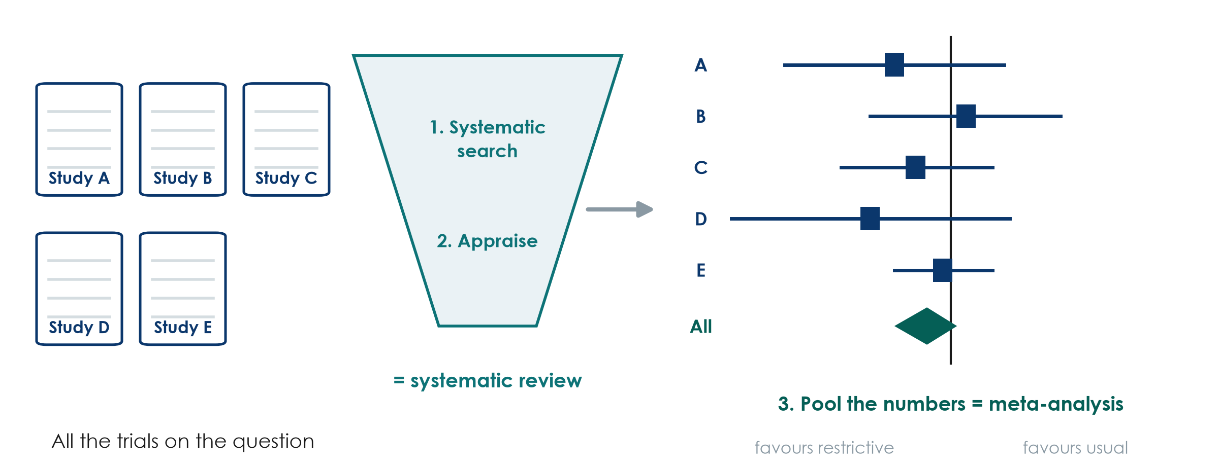
Systematic reviews and meta-analysis: studies of studies
KEY MESSAGE A systematic review searches and appraises; a meta-analysis pools the numbers.
Neudata | #ClearDataClearImpact
Notes:
A systematic review uses a pre-specified, reproducible search (remember PubMed and Boolean from Session 2) and appraises every study found. A meta-analysis then pools the results into one estimate - the diamond at the bottom of a forest plot.
The forest plot here is illustrative: each square is one trial, the line its 95% confidence interval, the vertical line 'no difference'. Session 4 reads a PRISMA flow and a forest plot step by step.
Misconception: 'a meta-analysis is always the best evidence'. It is only as good as the studies it pools - garbage in, garbage out. A review of small biased trials gives a precise wrong answer.
Ask the room: what is the difference between a narrative review and a systematic review? Expected answer: the systematic review has a stated, reproducible method for search and selection; a narrative review is the author's choice.
Timing: 2 minutes.

Slide 19
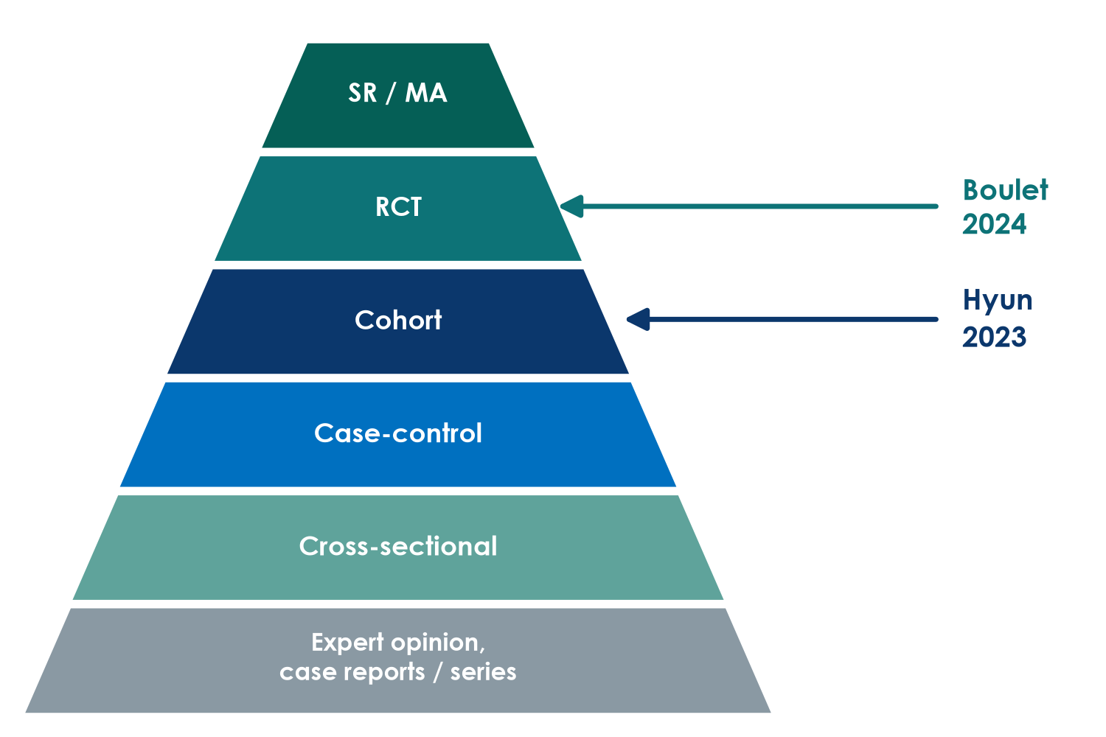
Where the two papers sit on the evidence pyramid
Read it with care
Higher = less prone to bias, on average
A rule of thumb, not a law
A good cohort can beat a poor RCT
The best design is the one that fits the question
Neudata | #ClearDataClearImpact
Notes:
Recap from Session 1, now with the two papers placed on it. Boulet is an RCT, Hyun a cohort.
Teaching point: the pyramid ranks designs by their typical protection against bias for questions about treatment effects. It does not rank questions about prevalence, prognosis or rare harms, where other designs are the right tool.
Misconception: 'anything on a higher level beats anything lower down'. A 48-patient pilot RCT does not overrule a careful multicentre cohort on mortality - they answer different parts of the question.
Ask the room: which paper is higher, and does that make it more useful for our mortality question? Expected answer: Boulet is higher, but it was not designed or powered for mortality, so for mortality it adds little.
Timing: 1.5 minutes.

Slide 20
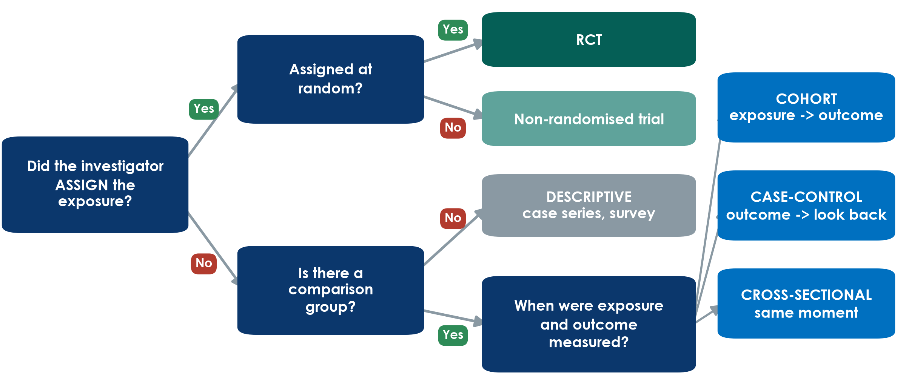
Name the design in three questions
KEY MESSAGE Assigned? Random? Which way does time run? Three questions name the design.
Neudata | #ClearDataClearImpact
Notes:
This is the tool they will use in the exercise at the end of 3.1. Walk it once slowly with Boulet, then with Hyun.
Boulet: did the investigator assign the strategy? Yes. At random? Yes. RCT.
Hyun: assigned? No. Comparison group? Yes (positive vs negative balance). Exposure measured first and outcome followed afterwards? Yes. Cohort.
Misconception: people name the design from words in the title ('prospective', 'registry', 'retrospective'). Titles can mislead - use the three questions instead.
Ask the room: a study compares nurses' hand-hygiene scores and infection rates on all wards on one day. What design? Expected answer: no assignment, comparison yes, same moment = cross-sectional. And a bundle introduced on one date, compared before and after? Assigned but not random: a non-randomised (quasi-experimental) study.
Timing: 3 minutes. Leave this slide up during the exercise if you can (or print it on the handout).

Slide 21
Strengths and weaknesses at a glance
Every design trades something away.
Cross-sectional
Case-control
Cohort
RCT
+ quick and cheap
+ gives prevalence
- which came first?
+ rare outcomes
+ few patients, fast
- recall bias
- odds ratio only
+ clear time order
+ risks, many outcomes
- slow if prospective
- confounding
+ balances the unknown
+ strongest for cause
- costly, ethical limits
- selected patients
KEY MESSAGE No design is perfect: choose the one whose weakness hurts your question least.
Neudata | #ClearDataClearImpact
Notes:
Do not read every line. Pick one strength and one weakness per card and link it to a picture they have just seen.
Teaching point: the RCT's unique strength is balancing UNKNOWN confounders. Its weakness is often generalisability - trial patients are selected (Boulet excluded patients over 85, those needing dialysis and the severely malnourished).
Misconception: 'case-control studies are weak'. For a rare outcome they are often the only feasible design, and they first linked smoking with lung cancer.
Ask the room: which design would you choose to find risk factors for a rare drug reaction? Expected answer: case-control.
Timing: 2 minutes. The handout repeats this table.

Slide 22
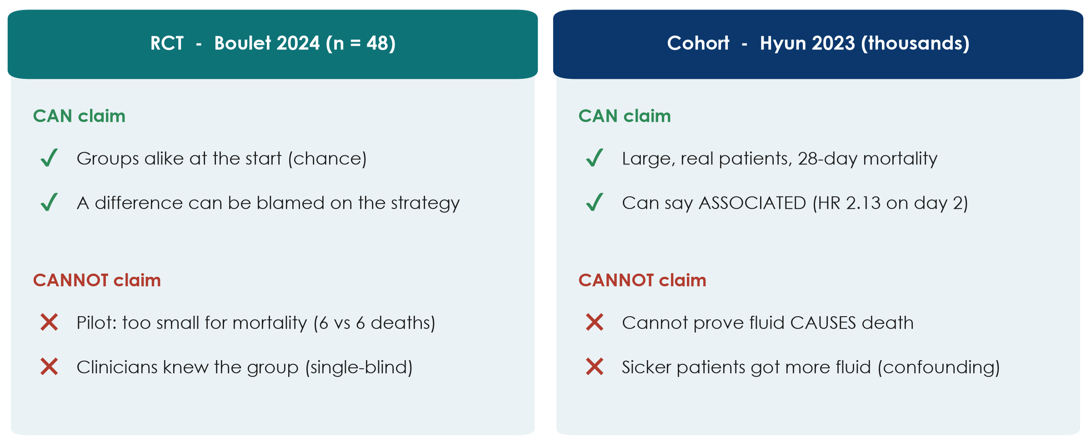
What can each design claim?
KEY MESSAGE RCTs can say 'caused'; cohorts should say 'associated'.
Neudata | #ClearDataClearImpact
Notes:
Back to the running example to close 3.1.
Boulet (RCT): because chance made the groups comparable, any difference in fluid balance can be attributed to the strategy. But with 48 patients and 6 deaths in each arm, it cannot tell us anything firm about mortality. Clinicians knew the allocation, which could influence how much fluid they gave.
Hyun (cohort): thousands of patients and the outcome we care about. A positive balance on days 2-3 was associated with higher 28-day mortality (HR 2.13 for day 2, 1.56 for day 3; no clear difference on day 1). But it cannot prove that the fluid caused the deaths - sicker patients receive more fluid.
Misconception: 'adjusted' or 'propensity-matched' turns an association into a cause. It reduces measured confounding only.
Ask the room: write one honest sentence for each paper's conclusion. Expected answer: Boulet - 'the strategy did not clearly reduce day-5 fluid balance'; Hyun - 'a positive balance on days 2-3 was associated with higher mortality'.
Timing: 3 minutes. Then a 2-minute check, then the exercise.

Slide 23
Check your understanding: caused or associated?
QUICK QUIZ | 2 min
1. A. Boulet (RCT): 'The restrictive strategy did not reduce the day-5 fluid balance'
2. B. Hyun (cohort): 'A positive fluid balance CAUSES higher 28-day mortality'
3. C. A one-day survey: 'Urinary catheters are associated with urinary infection'
For each
Is the wording right for the design?
Thumbs up or thumbs down
OUTPUT Thumbs up / down for each sentence
Neudata | #ClearDataClearImpact
Notes:
Read each sentence; the room shows thumbs up (wording fits the design) or down.
Answers. A: up - a randomised trial may make causal statements, and this one honestly reports a null result. B: DOWN - a cohort can say 'associated with', not 'causes' (Hyun's own abstract correctly says 'associated'). C: up - 'associated' is the right word for a cross-sectional survey; it cannot show which came first.
Teaching point: this is question 8 of the appraisal checklist used in Session 8: do the words match the design?
Timing: 2 minutes.

Slide 24
Exercise: Name that design
GROUP WORK | 15 min
1. Work in pairs with the handout: 8 short clinical abstracts
2. For each, ask the three questions: assigned? random? which way does time run?
3. Write the design and one word of evidence from the abstract
4. Star the one you found hardest - we discuss it together
Use the tree
Assigned + random = RCT
Outcome first, look back = case-control
Exposure first, follow = cohort
Same moment = cross-sectional
OUTPUT 8 designs named, each with one piece of evidence
Neudata | #ClearDataClearImpact
Notes:
Handout: Practicals/s3_exercises.md, Part A. Answer key: Solutions/s3_solutions.md.
Run it: 9 minutes in pairs, 6 minutes plenary. In plenary, do not go through all eight - ask which one pairs starred and discuss those. Abstracts 5 (retrospective cohort that sounds like a case-control), 7 (non-randomised before-after study) and 9 (cluster trial, optional - we meet cluster trials after the break) are usually the hardest.
Teaching point: the evidence word matters more than the label - 'randomly allocated', 'selected patients who developed', 'followed for 12 months', 'on a single day'.
Misconception to listen for: 'it used old records so it is case-control'. Ask: were people selected by outcome or by exposure?
Timing: if pairs finish early, ask them to name one strength and one weakness for each design. Announce the break at the end of this slide.

Slide 25
Break
BREAK | 15 min
1. Stretch, coffee, fresh air
2. Optional: look at your group's question - which design fits it best?
3. We restart with more study designs
Neudata | #ClearDataClearImpact
Notes:
15-minute break. Put a visible countdown on the screen.
During the break, walk past the groups and ask informally which design they are thinking of for their own question - it gives you a feel for who will need help in the proposal builder.
Restart on time: start the next slide even if a few people are still coming back.

Slide 26
3.2 More designs
Real projects bend the basic designs.
Trial variants, non-inferiority, pilots, quality-improvement designs and qualitative research. (35 minutes)
Neudata | #ClearDataClearImpact
Notes:
Section marker for 3.2 (35 minutes, including a 3-minute check).
Why this matters: most projects in a hospital department are not classic two-arm trials. They are ward-level changes, quality-improvement projects, pilots or interviews. Knowing these designs lets groups choose something feasible.
Timing: 30 seconds.

Slide 27
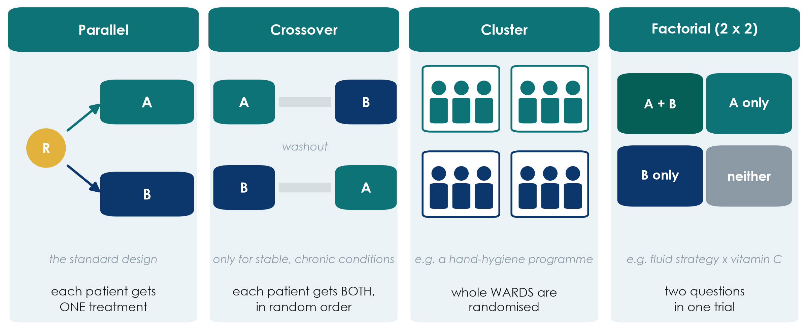
Not every trial is parallel: four layouts
KEY MESSAGE Choose the trial layout that fits the treatment and the unit of care.
Neudata | #ClearDataClearImpact
Notes:
Most trials are parallel: each patient gets one treatment (Boulet). Three variants solve particular problems.
Crossover: each patient receives both treatments in random order, with a washout in between, and acts as their own control - so fewer patients are needed. Only for stable, chronic conditions where the effect wears off (e.g. inhalers in COPD). Useless in septic shock: the patient is not the same on day 7.
Cluster: whole wards, ICUs or hospitals are randomised, not individual patients. Use it when the intervention works at unit level (a hand-hygiene programme, a sepsis bundle) or when patients in the same ward would 'contaminate' each other. Needs more patients, because patients in one cluster resemble each other.
Factorial: two questions in one trial - patients are randomised twice (e.g. fluid strategy AND vitamin C), giving four groups. Efficient if the two treatments do not interact.
Misconception: 'a cluster trial is a weaker trial'. It is a proper RCT; the analysis must account for clustering.
Ask the room: you want to test a new handover checklist for nurses. Which layout? Expected answer: cluster - randomise wards or shifts, not patients.
Timing: 6 minutes.

Slide 28
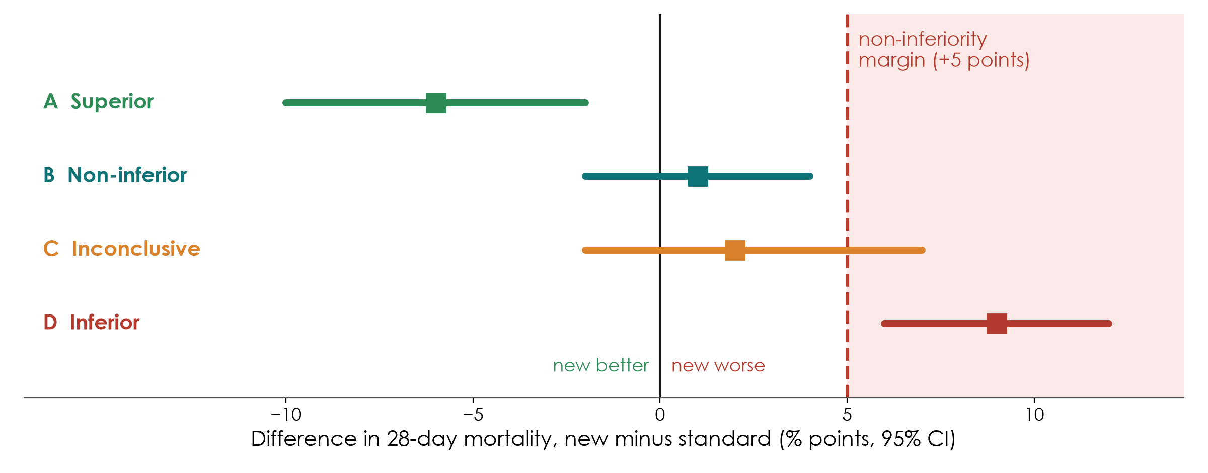
Superiority or non-inferiority? The margin picture
KEY MESSAGE Non-inferiority: the whole CI must stay below a margin fixed in advance.
Neudata | #ClearDataClearImpact
Notes:
A superiority trial asks: is the new treatment BETTER? A non-inferiority trial asks: is it NOT UNACCEPTABLY WORSE - usually because it is cheaper, safer, simpler or uses less fluid.
The margin (here +5 percentage points of mortality, hypothetical) is the largest loss we would accept. It is fixed in the protocol, before the data, with clinical reasoning.
Read the bars (difference and 95% CI). A: the whole CI is below 0 - superior. B: the CI crosses 0 but stays below the margin - non-inferior. C: the CI crosses the margin - inconclusive. D: the whole CI is above the margin - inferior.
Misconception: 'p > 0.05 in a superiority trial shows the treatments are equivalent'. No - absence of evidence is not evidence of absence. Boulet's p = 0.42 does not show that restriction is as good as usual care.
Ask the room: who should decide the margin - the statistician or the clinicians? Expected answer: clinicians (and patients), with the statistician; it is a clinical judgement.
Timing: 5 minutes.

Slide 29
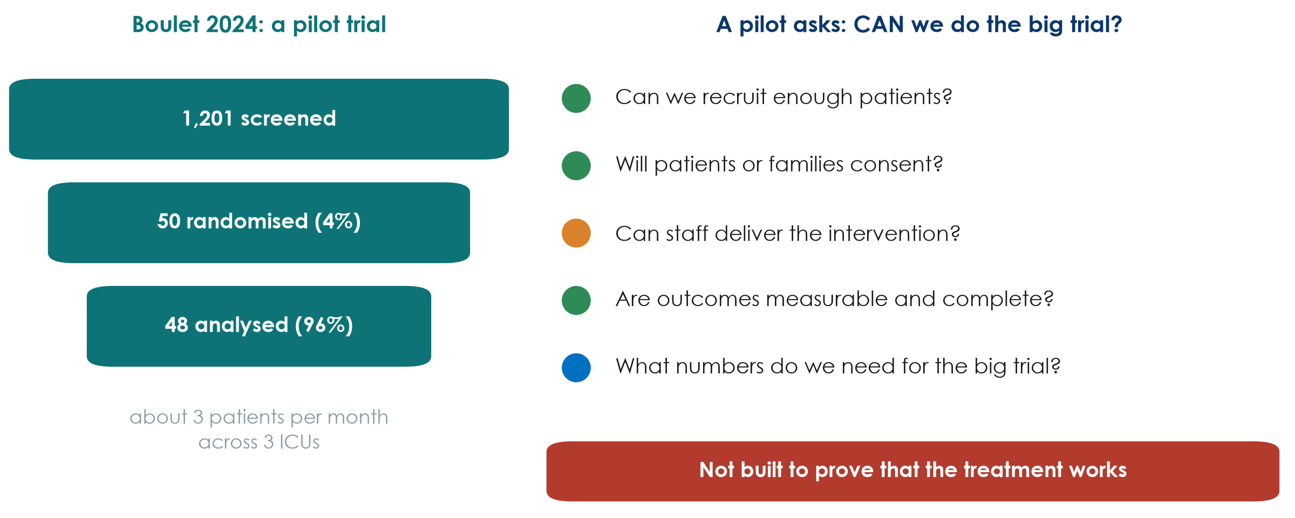
Pilot and feasibility studies: the rehearsal
KEY MESSAGE A pilot asks 'can we do it?', not 'does it work?'
Neudata | #ClearDataClearImpact
Notes:
Boulet 2024 calls itself a pilot. Its real value is in the numbers on the left: 1,201 patients screened for 50 randomised (about 4%), roughly 3 patients per month across 3 ICUs, 48 of 50 analysed.
A pilot or feasibility study tests the machinery of the big trial: recruitment, consent, whether staff can deliver the intervention, whether outcomes can be measured completely, and the numbers needed to calculate the sample size.
Teaching point: a pilot should not be used to claim effectiveness. Its success criteria are about feasibility (e.g. 'recruit 2 patients per site per month', 'over 90% data completeness').
Misconception: 'our small study did not find an effect, so we call it a pilot'. A pilot is planned as a pilot from the start, with feasibility objectives.
Ask the room: from these numbers, would you launch a 1,000-patient trial in the same 3 ICUs? Expected answer: not as designed - at 3 patients per month it would take decades; you need many more sites or broader eligibility.
Timing: 4.5 minutes.

Slide 30
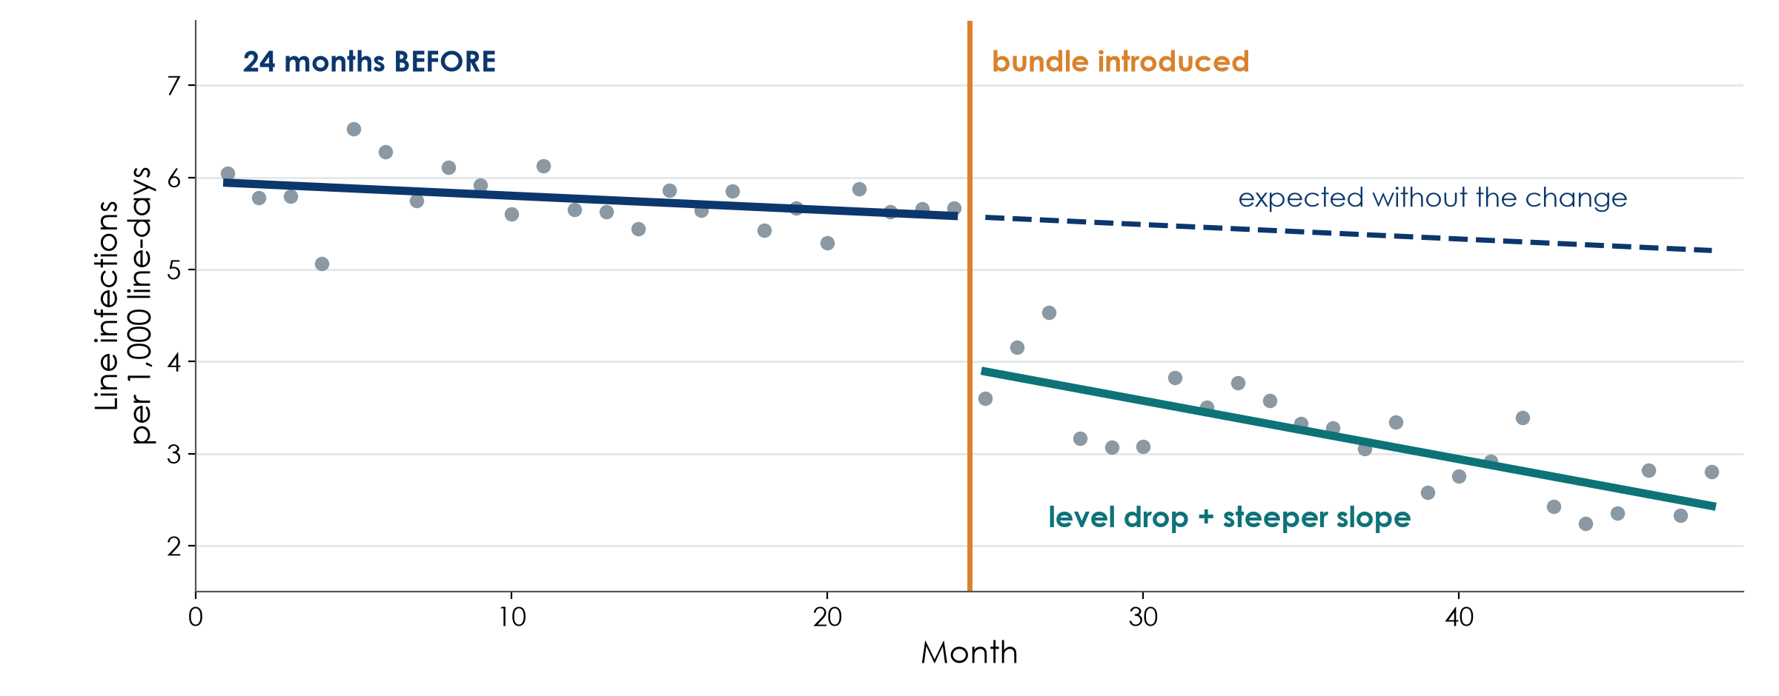
Quasi-experimental designs: before-after and interrupted time series
Simulated data for teaching
KEY MESSAGE Compare against the trend you expected, not against one 'before' average.
Neudata | #ClearDataClearImpact
Notes:
Most quality-improvement projects introduce a change for everyone at once - no randomisation, no parallel control. These are quasi-experimental designs.
The simple before-after study compares the average before with the average after. Weak: rates often fall anyway (seasons, new staff, other projects, regression to the mean after a bad month).
The interrupted time series (ITS) is much stronger: many measurements before and after (here 24 monthly points each). We compare what happened with what the pre-change trend predicted (dashed line). We look for a change in LEVEL (the drop) and in SLOPE (steeper fall).
Teaching point: ITS is the standard design for evaluating a bundle, a protocol or a policy in one hospital. Add a control series (a ward that did not change) to make it stronger.
Misconception: 'the infection rate fell after our bundle, so the bundle worked'. Only if the fall is bigger than the existing trend.
Ask the room: what else changed in your hospital in the same month as your last QI project? Expected answer: usually something - staff rotation, a new policy, an audit - which is exactly why a trend matters.
Timing: 5 minutes.

Slide 31
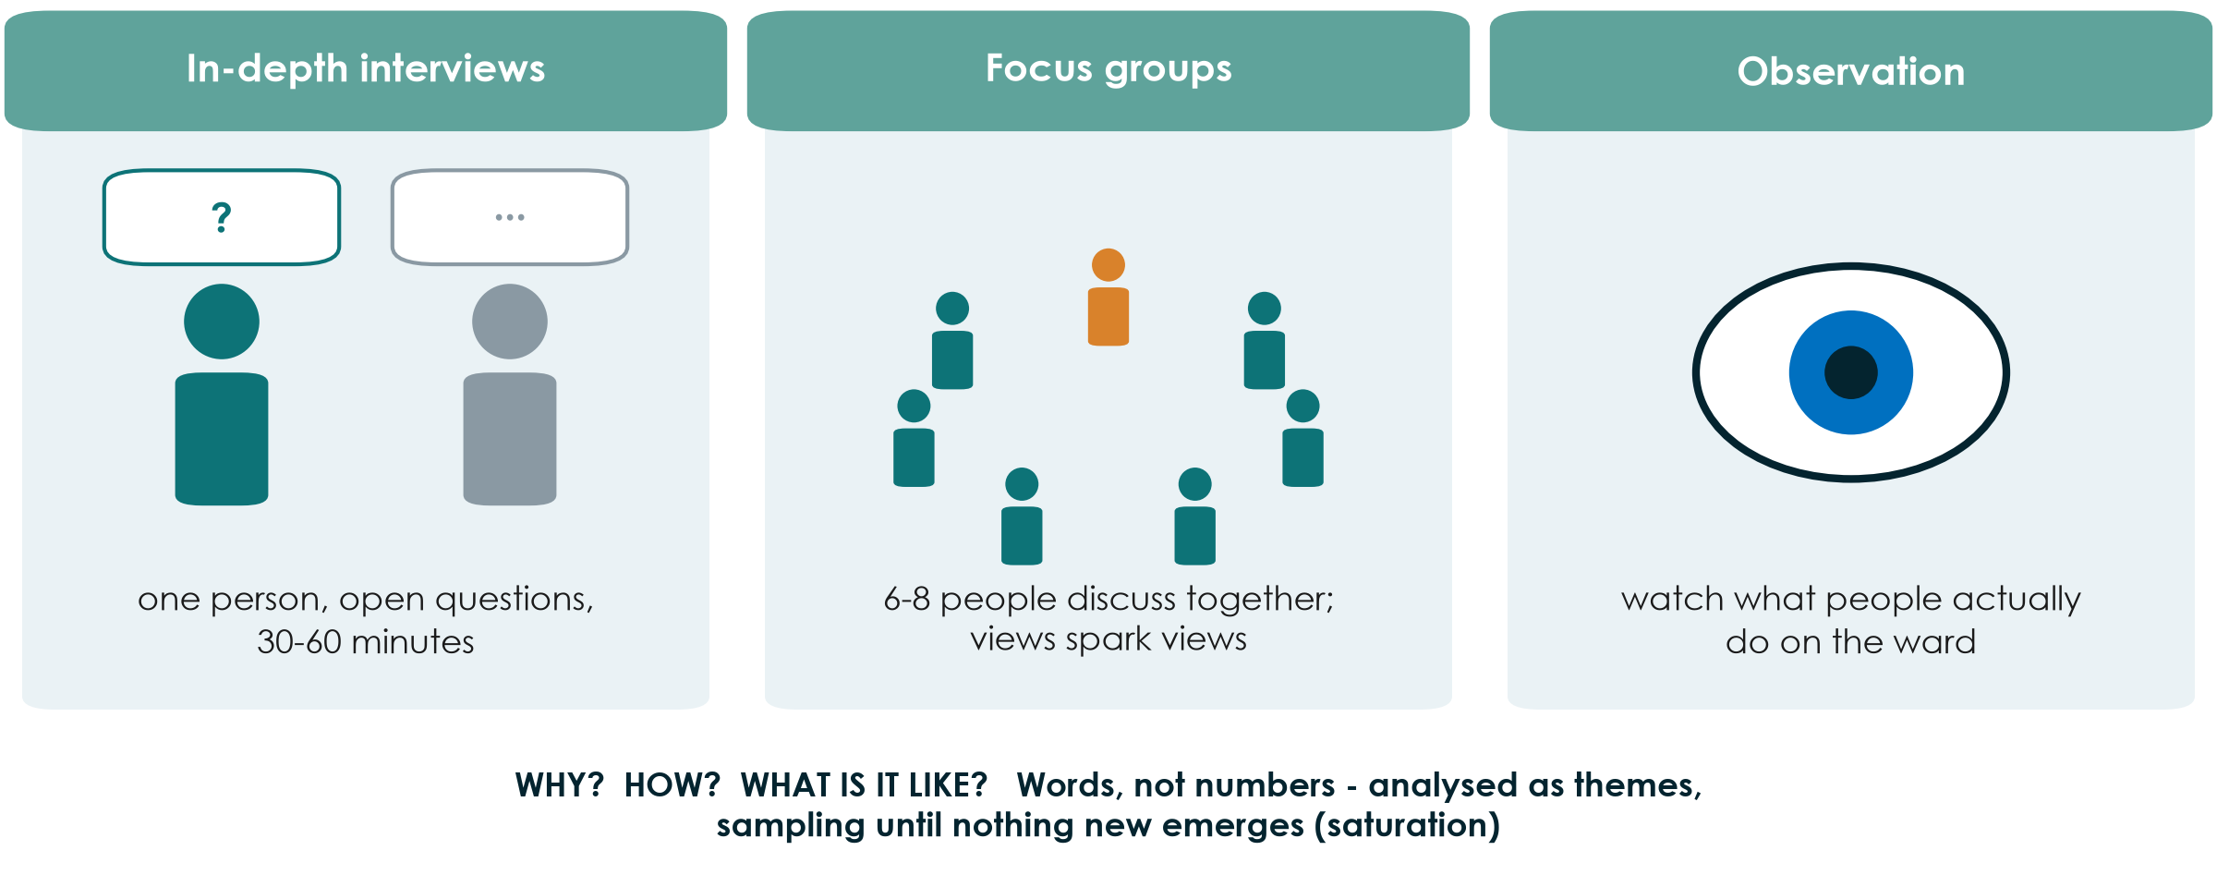
Qualitative designs: when numbers cannot answer
KEY MESSAGE Qualitative research explains WHY and HOW; it complements numbers.
Neudata | #ClearDataClearImpact
Notes:
Some questions are not about how many or how much but about why, how and what it is like. Why do nurses not chart urine output at night? How do families experience surrogate consent in the ICU? Numbers cannot answer these.
Three main methods: in-depth interviews (one person, open questions), focus groups (6-8 people; discussion reveals shared views and disagreements), and observation (what people actually do, which may differ from what they say).
Sampling is purposive (choose people who know the topic) and continues until no new themes emerge (saturation). Analysis looks for themes in transcripts. Reporting guideline: COREQ or SRQR.
Mixed methods combine both: a trial plus interviews to understand why an intervention was or was not delivered.
Misconception: 'qualitative means anecdotal'. Done properly it is systematic, transparent and peer-reviewed.
Ask the room: one question from your ward that only interviews could answer. Expected answer: barriers to early mobilisation, why handovers fail, patients' experience of delirium.
Timing: 4.5 minutes.

Slide 32
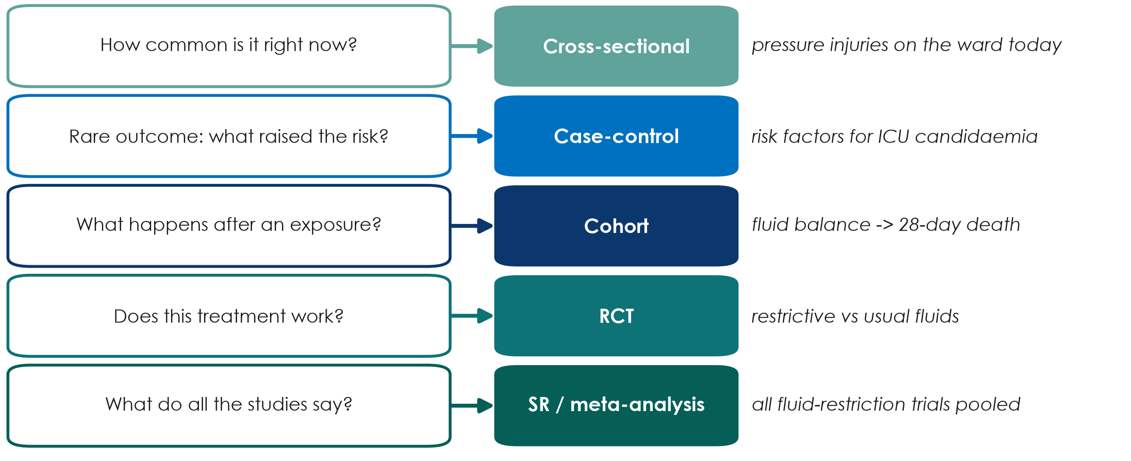
Match the design to the question
KEY MESSAGE Start from the question - the design follows from it.
Neudata | #ClearDataClearImpact
Notes:
This is the practical summary of both sections of today. Read each row as: if your question sounds like this, start with this design.
Teaching point: groups will justify their own design later today in the proposal builder with exactly this logic - 'our question is about X, so the best feasible design is Y'.
Note the word FEASIBLE: the ideal design for 'does restriction save lives?' is a large RCT, but a group with one ICU and no funding may honestly choose a retrospective cohort and state its limits.
Misconception: 'we must do an RCT to be taken seriously'. A well-done, honestly reported cohort is publishable and useful.
Ask the room: a group wants to know how many ICU patients have delirium today. Which design? Expected answer: cross-sectional (point prevalence).
Timing: 5 minutes.

Slide 33
Check your understanding: which design?
QUICK QUIZ | 3 min
1. A. A cheaper antibiotic schedule; we only need to show it is not worse
2. B. A hand-hygiene programme delivered to whole wards
3. C. A sepsis bundle started in 2023; we have 3 years of monthly mortality data
4. D. Why do families refuse research consent in the ICU?
Choose
Cluster trial
Non-inferiority trial
Interrupted time series
Qualitative interviews
OUTPUT One design for each - answers in the notes
Neudata | #ClearDataClearImpact
Notes:
1 minute alone, then hands up.
Answers. A: non-inferiority trial - define the margin in advance. B: cluster randomised trial - randomise wards, not patients. C: interrupted time series - compare the post-bundle months with the trend before the bundle. D: qualitative design - in-depth interviews (or focus groups) with families.
If the room struggles with C, go back to the ITS picture for 30 seconds.
Timing: 3 minutes.

Slide 34
Exercise: choose the design for 5 questions
GROUP WORK | 20 min
1. Handout Part B: four clinical questions + your group's own question
2. For each: name the best FEASIBLE design (use the decision tree)
3. Write one reason and the design's main weakness
4. Your own question: what will you be allowed to claim - caused or associated?
5. Two groups share their own question and design (1 minute each)
Remember
How common now? Cross-sectional
Rare outcome? Case-control
What happens after? Cohort
Does it work? RCT / cluster
Already changed? Time series
Why / how? Qualitative
OUTPUT 5 designs with a reason and a weakness - including your own question
Neudata | #ClearDataClearImpact
Notes:
Groups of 6 (the proposal groups). 12 minutes working, 8 minutes sharing.
Answers for the four given questions (handout Part B; key in Solutions/s3_solutions.md): 1 point-prevalence of pressure injuries - cross-sectional; 2 chlorhexidine bathing introduced unit by unit - cluster randomised trial; 3 sepsis bundle already in place, monthly data - interrupted time series; 4 why nurses do not report near misses - qualitative interviews or focus groups. Two optional bonus questions: case-control and non-inferiority.
The own-question item is the bridge to the proposal builder: the design they choose here is the one they justify after this exercise.
Common problem: groups choose an RCT for a harm or prognosis question. Ask: could you ethically assign this exposure?
Timing: give a 5-minute warning before sharing.

Slide 35
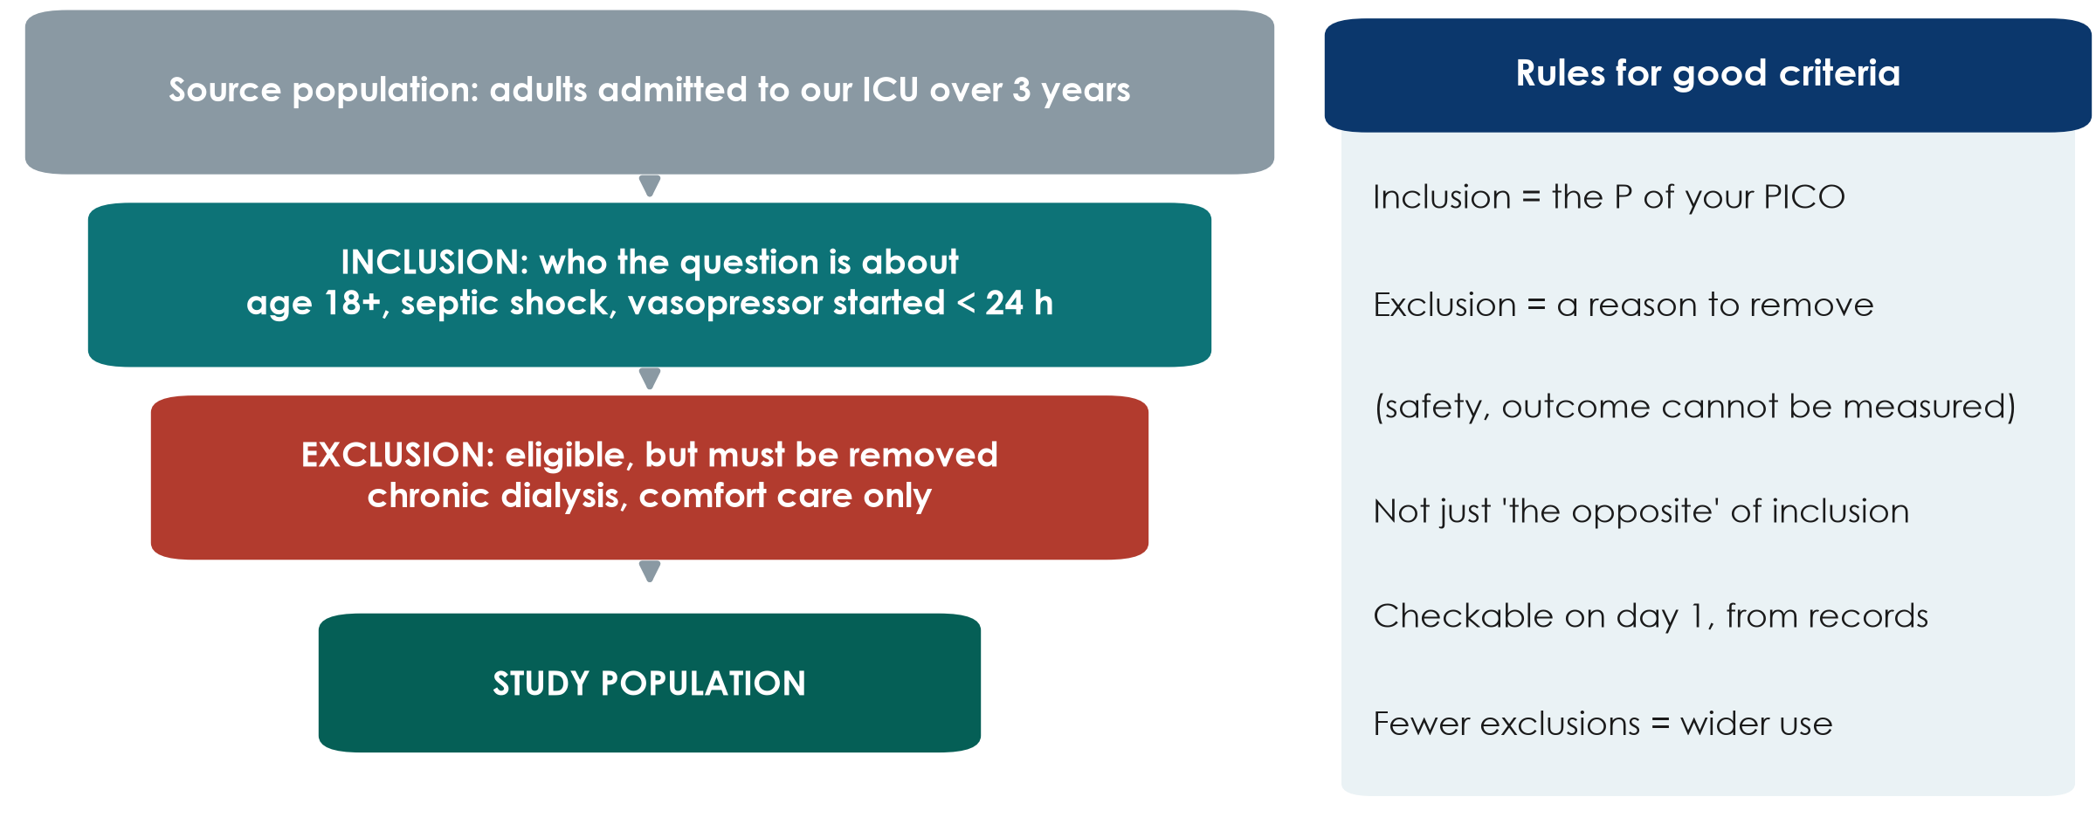
Who is in your study? Inclusion and exclusion criteria
KEY MESSAGE Inclusion describes your P; exclusion removes eligible people for a stated reason.
Neudata | #ClearDataClearImpact
Notes:
This slide prepares the proposal builder: groups must write their study population today.
Walk down the funnel with the ICU example (an observational version of our fluid question). Source population: everyone who could be studied. Inclusion criteria: the P of the PICO, made measurable (age 18+, septic shock, vasopressor started within 24 h). Exclusion criteria: people who meet the inclusion criteria but must be removed for a reason - safety, or the outcome cannot be measured (chronic dialysis, comfort care only).
Compare with Boulet: included septic shock, age 18-85, within 24 h of vasopressor start; excluded acute kidney injury needing RRT within 24 h, end-stage kidney disease, severe malnutrition (BMI < 18).
Misconception: writing exclusions as the opposite of inclusions ('age under 18' is not an exclusion; it is simply not included).
Teaching point: every extra exclusion makes the study cleaner but the result applies to fewer patients (external validity - Session 4).
Ask the room: give one good exclusion criterion for a study of early mobilisation. Expected: unstable spine fracture, or comfort care only.
Timing: 3 minutes.

Slide 36
Proposal builder 3: design, setting and population
PROPOSAL BUILDER | 35 min
1. Re-read your research question from Part 1
2. Choose the design with the decision tree; justify it in 3-5 sentences
3. Setting: where, when, which units, which data source
4. Population: 3-5 inclusion and 3-5 exclusion criteria (with reasons)
5. Draw your study on a timeline: exposure, then outcome
6. Ask the facilitator to check before you finish
Facilitator check
Design matches the question?
Feasible in your unit?
Inclusion = your P?
Each exclusion has a reason?
Caused or associated?
OUTPUT Proposal Part 2a written: design + justification, setting, population
Neudata | #ClearDataClearImpact
Notes:
Worksheet: Practicals/s3_exercises.md, Part C, and the proposal template (Part 2). 35 minutes.
Suggested rhythm (the criteria slide before this takes 3 minutes): 4 minutes to agree the design (most groups already chose it in the last exercise); 19 minutes writing, split between members (one writes the justification, one the setting, two the criteria, one draws the timeline); 9 minutes for the facilitator check and one group reading its justification aloud.
Model answer for the running example (observational version): retrospective cohort of adults with septic shock in our ICU over 3 years; justification - an RCT is ideal but not feasible for one ICU without funding; existing charts record fluid in/out and outcomes; we will say 'associated with'. Inclusion and exclusion as on the funnel slide.
Common problems: an RCT chosen for an exposure that cannot be assigned; a setting that is far too large; exclusions that repeat the inclusions in the negative.
The rest of Part 2 (exposure, comparator, outcomes, biases) is built in Session 4.
Timing: give a 10-minute and a 2-minute warning.

Slide 37
Session 3 in one slide
3.1 Basic designs
3.2 More designs
Your proposal
Snapshot, look back, follow forward
RCT = chance assigns the exposure
RCT may say 'caused'; cohort says 'associated'
Cluster, crossover, factorial
Non-inferiority needs a margin
Pilot, time series, qualitative
Design + justification
Setting
Inclusion and exclusion criteria
KEY MESSAGE The question picks the design; the design decides what you may claim.
Neudata | #ClearDataClearImpact
Notes:
Session recap. Ask three different people to explain one card each in their own words.
If time is short, read the takeaway only.
Timing: 2 minutes (part of the 5-minute wrap-up).

Slide 38
Wrap-up and homework
DISCUSSION | 5 min
1. Exit question: a study compares patients who chose to get a flu vaccine with those who did not. Design? Caused or associated?
2. Homework: finish Proposal Part 2a (design, setting, population)
3. Homework: read the 'Patients' paragraph of Boulet and the 'Data source' paragraph of Hyun
4. Tomorrow (Session 4): can we trust the result, and how big is the effect?
OUTPUT Exit answer on a sticky note
Neudata | #ClearDataClearImpact
Notes:
Exit question answer: a cohort (grouped by the exposure they chose, followed forward); it may only say 'associated' - people who choose vaccination differ in many ways (healthy-user effect), a preview of confounding tomorrow.
Collect the sticky notes; read three aloud at the start of Session 4.
Timing: 3 minutes after the recap slide. Finish on time.

Slide 39
Extra slides - Session 3
Extra slides - Session 3
Use if time allows, or for self-study
Neudata | #ClearDataClearImpact
Notes:
EXTRA: the slides after this point are optional. Use them if the room is quick, for questions, or point participants to them for self-study.
Timing: skip in the live session unless time allows.

Slide 40
The decision tree in action: Boulet and Hyun
Assigned?
Random?
Comparison?
Time order?
Design
Boulet: yes, the trial assigned the strategy
Hyun: no, clinicians decided
Boulet: yes, central computer
Hyun: yes, positive vs negative balance
Hyun: exposure days 1-3, then death by day 28
Boulet: RCT
Hyun: cohort
KEY MESSAGE Walk every paper through the same questions before reading its results.
Neudata | #ClearDataClearImpact
Notes:
EXTRA: a slow walk-through of the decision tree with the two running-example papers. Useful if the 'Name that design' exercise showed confusion.
Boulet: assigned - yes; random - yes; so RCT. Hyun: assigned - no; comparison group - yes; exposure measured before outcome - yes; so cohort.
Ask the room to do the same for any paper they brought.
Timing: 2 minutes if used.

Slide 41
Choosing good controls in a case-control study
Same source
Same measurement
Matching (optional)
Same hospital, units and period as the cases
Would have become a case if they had the outcome
Same records, same questions
Ideally assessor blind to case status
e.g. age, month of admission
Do not match on the exposure itself
KEY MESSAGE Bad controls make any case-control study meaningless.
Neudata | #ClearDataClearImpact
Notes:
EXTRA: for groups planning a case-control study.
Controls must come from the population that produced the cases: in our candidaemia example, other ICU patients in the same units and months - not healthy volunteers.
Exposure must be measured the same way in cases and controls, ideally by someone who does not know which is which.
Matching on a few factors can improve efficiency, but over-matching (on things linked to the exposure) hides the effect.
Timing: 2 minutes if used.

Slide 42
Superiority, equivalence and non-inferiority
Superiority
Equivalence
Non-inferiority
Is the new treatment BETTER?
Whole CI on the 'better' side of 0
Is it about the SAME?
Whole CI inside -margin to +margin
Is it NOT unacceptably worse?
Whole CI below +margin
KEY MESSAGE The question (better, same, not worse) is fixed in the protocol, before the data.
Neudata | #ClearDataClearImpact
Notes:
EXTRA: completes the margin picture from 3.2.
Superiority trials are the usual type. Equivalence trials (common for generic drugs) need the CI inside a margin on both sides. Non-inferiority trials need only the upper side.
Misconception: 'a failed superiority trial shows equivalence'. No - it was not designed with a margin.
Timing: 2 minutes if used.

Slide 43
Making a quality-improvement evaluation stronger
More time points
A control series
Record co-interventions
At least 8-12 points before and after
Same definition every month
A ward or hospital without the change
Same months, same measure
Staff changes, new policies, audits
Write them down as they happen
KEY MESSAGE A before-after average is weak; a long, controlled time series is much stronger.
Neudata | #ClearDataClearImpact
Notes:
EXTRA: for groups whose project evaluates a change already made on their ward.
The interrupted time series compares the post-change data with the trend before the change. More data points, a control series and a diary of other changes make it much more convincing.
Reporting guideline for QI projects: SQUIRE 2.0.
Timing: 2 minutes if used.

Slide 44
Copyright © Neudata, 2026
All property rights and copyright are reserved.
This presentation contains proprietary data, information, and materials developed by Neudata for dedicated use only and may not be communicated, copied, reproduced, distributed, published, or cited, in whole or in part, without the prior written consent of Neudata.
Where explicit written permission has been granted, appropriate attribution must be included, followed by “by courtesy of Neudata”.
Any unauthorized use or infringement of these materials may give rise to legal action and claims for damages, without prejudice to any other rights of Neudata, including rights relating to patents, trademarks, or other forms of intellectual property protection.
Neudata | #ClearDataClearImpact
Notes:
Copyright slide - leave on screen while participants leave.

