Slide 1

Session 7 · Protect & write: ethics, integrity, Methods and Results
Weekend 4 · Saturday
Recap quiz: Session 6
7.1 Protocol, ethics, consent, registration, feasibility
7.2 Research integrity: authorship, conflicts of interest, data sharing, AI
Proposal builder 7: ethics + publication plan
7.3 Writing the paper (I): Methods, Results, tables, STROBE
Manuscript workshop 1: draft Methods + Results
Neudata | #ClearDataClearImpact
Notes:
SESSION 7 (0:00). Weekend 4, Saturday. Two halves today: before the break we protect the patient and the science (ethics, integrity) and finish Proposal Part 4; after the break we start WRITING the FLUID-ICU manuscript.
Pace: slow. Every block has a worked example and a 1-minute check. If time is short, drop slides from the 'Extra slides - Session 7' section at the end, never the workshop.
Before you start: results packs (Course/Data/results_packs/Q1-Q5) printed, one per group; the manuscript template open on each group's laptop if they have one.
Timing: this slide 1 minute, then the 10-minute recap quiz.

Slide 2
Recap quiz: Session 6 in five questions
QUICK QUIZ | 10 min
1. A crude OR is 2.1; the adjusted OR is 1.4. What happened?
2. HR 0.85 (95% CI 0.60 to 1.20): clear benefit?
3. Lactate is missing for 15% of patients. Name one way to handle it
4. Kaplan-Meier: what does a 'censored' patient mean?
5. Your group's FLUID-ICU question: what is its main result?
Answers
1. Confounding: part of the crude link came from severity
2. No - the CI includes 1
3. Complete-case, or multiple imputation + sensitivity
4. Left the study alive, outcome unknown after that
5. From your results pack
OUTPUT Everyone re-activated: adjustment, CIs, missing data, survival
Neudata | #ClearDataClearImpact
Notes:
RECAP (0:01-0:10). Ask, wait, then reveal the answer panel.
Q1 links straight to today's writing: in the Results we report BOTH crude and adjusted estimates (STROBE item 16), and in the Discussion we explain why they differ.
Q5: ask one person per group - this is the number they will write about after the break. If a group cannot say it, sit with them during the break and go through their results pack.
Show of hands for each question; spend longest where the room is split.

Slide 3
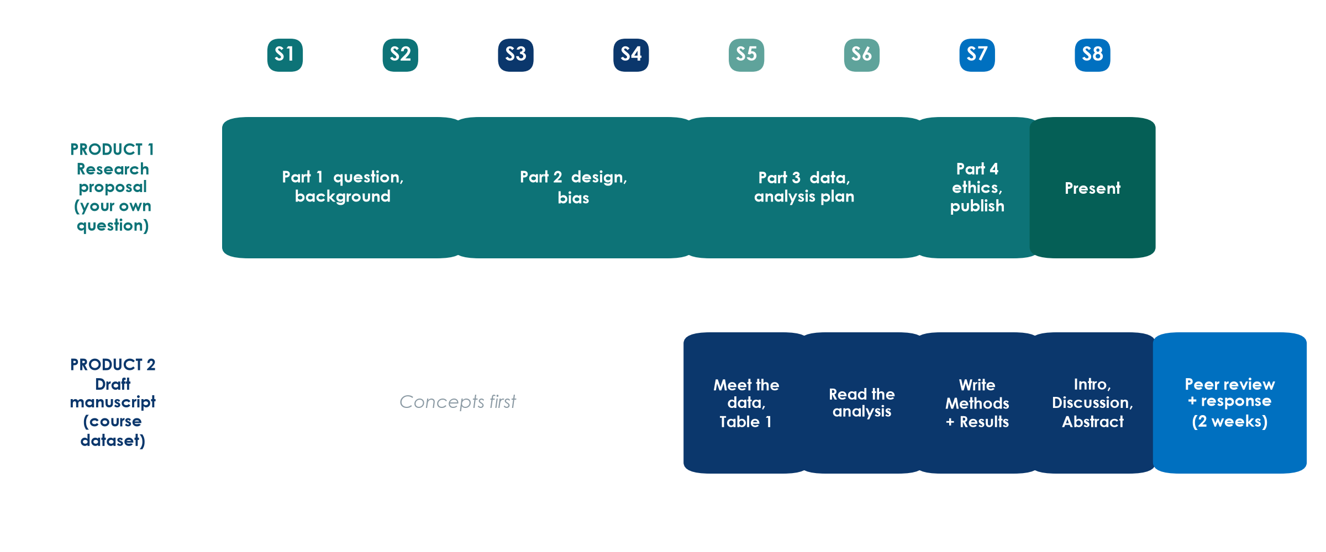
Today: finish the proposal, start the paper
KEY MESSAGE Before the break: Proposal Part 4. After the break: Methods and Results.
Neudata | #ClearDataClearImpact
Notes:
Two products, two rows. Product 1 - your own research proposal - gets its last part today (ethics, registration, feasibility, publication plan) and is presented tomorrow.
Product 2 - the FLUID-ICU draft manuscript - moves from 'reading the analysis' (Session 6) to WRITING: today Methods and Results, tomorrow Introduction, Discussion, Abstract and Title.
Ask: which group question does your group have? (Q1-Q5.) Make sure everyone knows.

Slide 4
7.1 | 30 minutes
Protocol, ethics and consent
Protect the patient before the first data point
Neudata | #ClearDataClearImpact
Notes:
SECTION 7.1 (0:10-0:40). Eleven slides including two worked examples and a 1-minute check.
About 2.5 minutes per slide. The ICU consent slide and its worked example deserve the most time - it is the real-life problem of this department.
Link: everything in this block becomes a paragraph of Proposal Part 4 (Proposal builder 7 at 1:00).

Slide 5
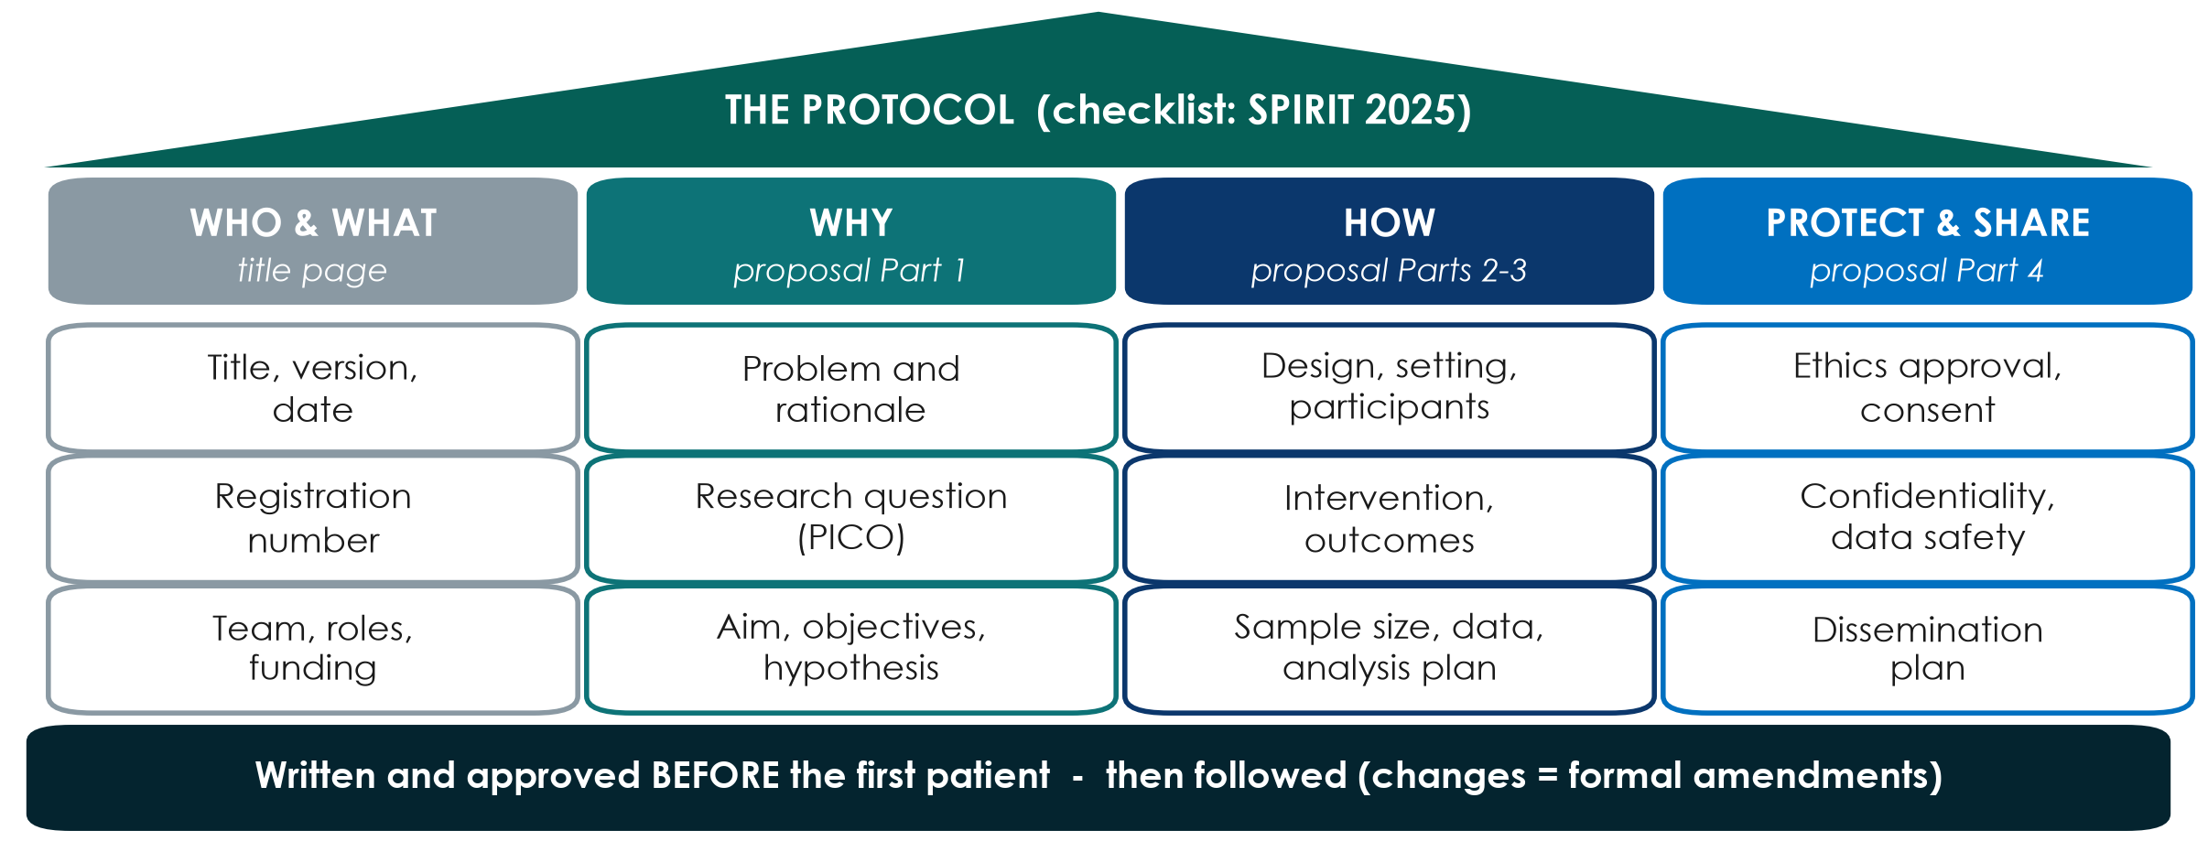
The protocol: your study's building plan
KEY MESSAGE Your four proposal parts ARE the skeleton of a protocol.
Neudata | #ClearDataClearImpact
Notes:
Teaching point: a protocol is the full written plan of the study, written and approved BEFORE the first patient is enrolled. SPIRIT 2025 is the international checklist for what a trial protocol should contain; observational studies follow the same logic.
Walk the four columns: WHO & WHAT (title page, registration, team, funding), WHY (Part 1), HOW (Parts 2 and 3), PROTECT & SHARE (Part 4, today).
Point to the foundation bar: changes after approval are made as formal amendments, approved before they are applied - not quietly.
Running example: Paper 1 says its protocol and statistical analysis plan were registered at ClinicalTrials.gov (NCT04947904) before the first patient - that is what lets a reader check the authors did what they planned.
Ask: which column of your proposal is weakest right now? Expected: HOW - sample size or analysis plan. Reassure: the template in Templates/ follows exactly this order.

Slide 6
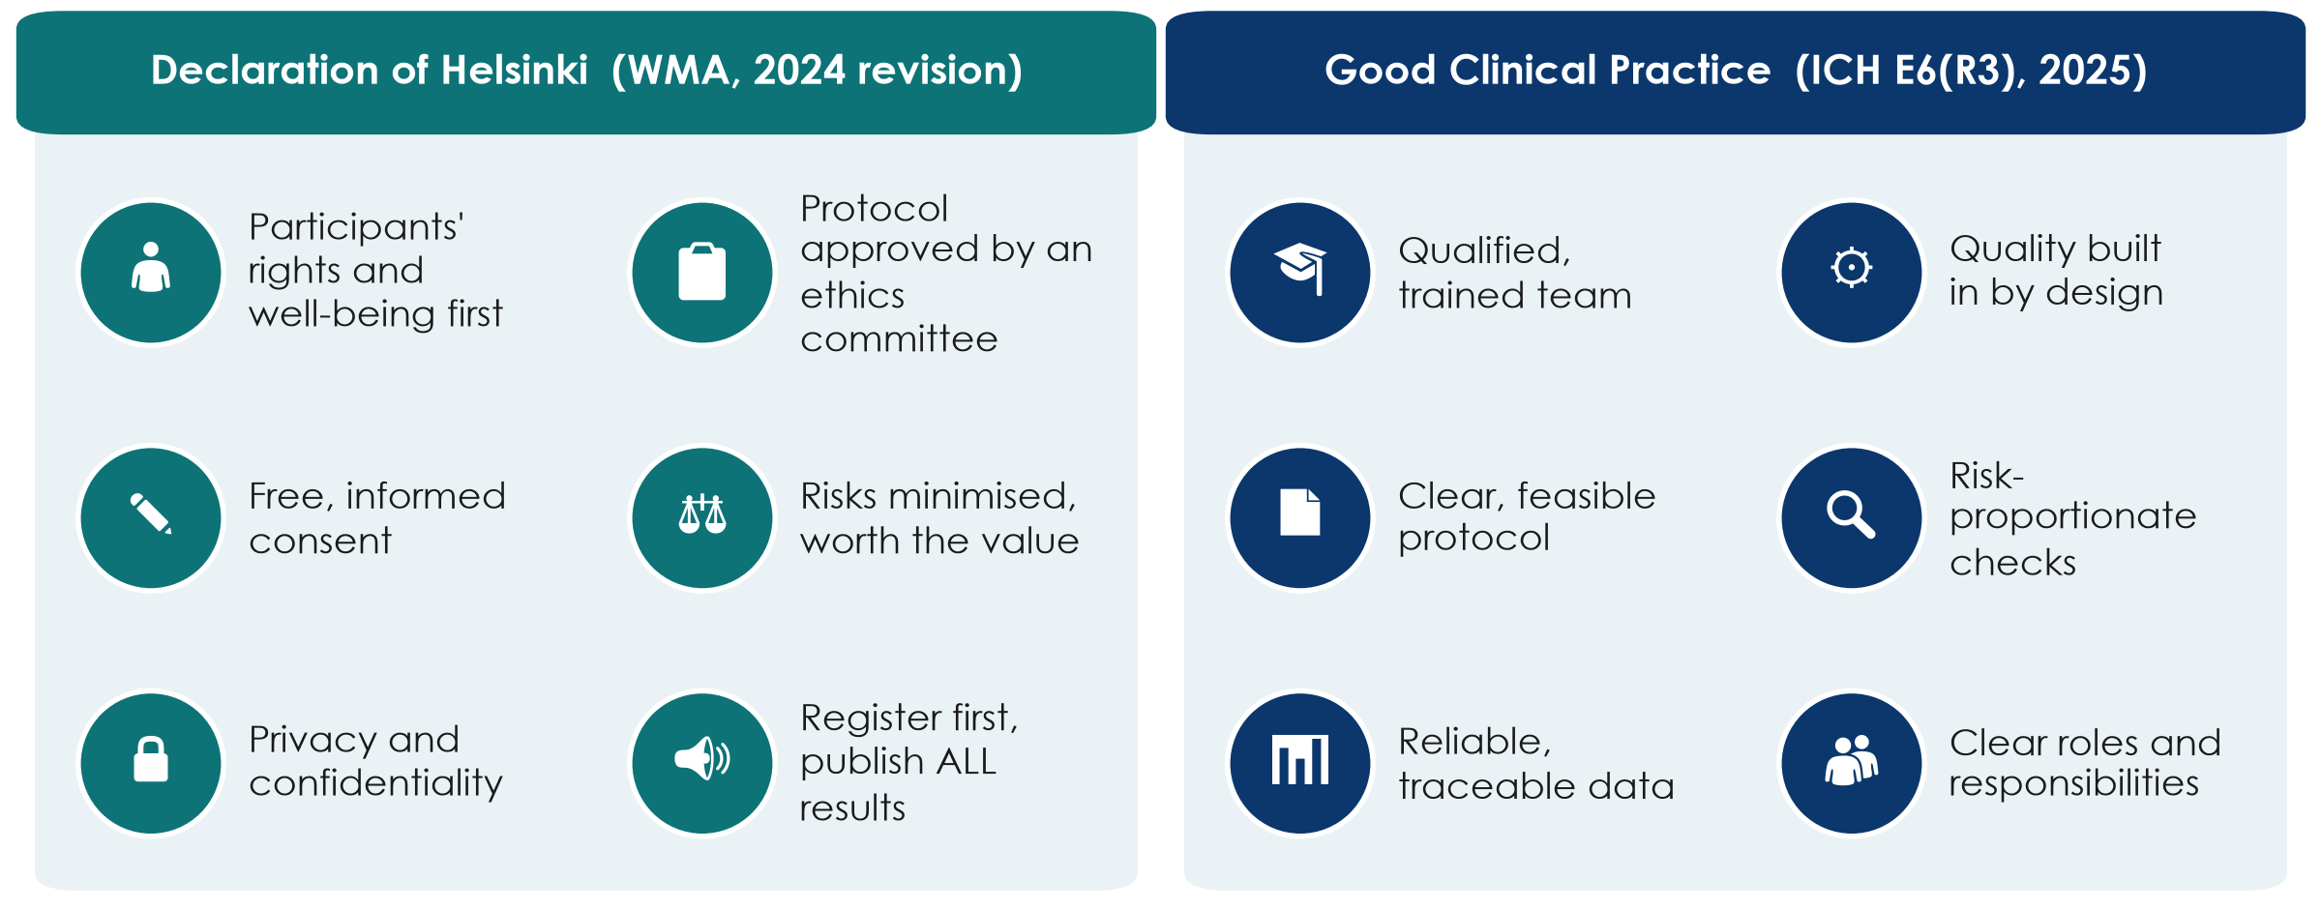
Two rule books: Helsinki and Good Clinical Practice
KEY MESSAGE Helsinki says WHY we protect participants; GCP says HOW we run a trial well.
Neudata | #ClearDataClearImpact
Notes:
Teaching point: the Declaration of Helsinki (World Medical Association, latest revision October 2024) is the ethical foundation for research with people. Its core: the rights and interests of the individual participant come before the goal of new knowledge; a protocol approved by an independent research ethics committee before the study starts; free, informed consent; risks minimised and justified; privacy protected; every study registered before the first participant and ALL results made public - including negative and inconclusive ones.
The 2024 revision speaks of 'participants' rather than 'subjects', strengthens the protection of vulnerable groups and of people who cannot consent, and stresses scientific integrity.
ICH E6(R3) Good Clinical Practice (adopted by ICH in January 2025) is the international quality standard for clinical trials: qualified people, quality built into the design, risk-proportionate monitoring, reliable and traceable data, clear roles. Its spirit applies to every study.
Misconception: 'GCP is only for drug companies'. Paper 1 - an academic ICU trial - states its analyses followed ICH-GCP.
Ask: which of these 12 icons would be hardest in our unit? Typical answer: reliable data (charts incomplete) or protected time.

Slide 7
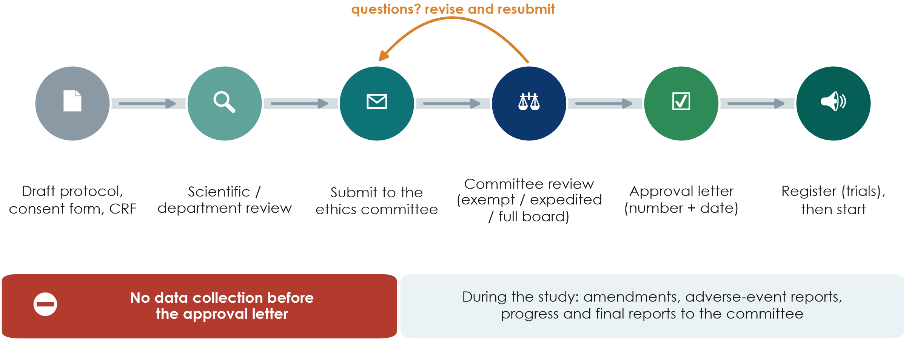
The ethics-committee journey
KEY MESSAGE No approval letter, no data collection - not even 'just a few patients'.
Neudata | #ClearDataClearImpact
Notes:
Walk the six stations left to right. Most institutions want a scientific or department review first; then the dossier goes to the research ethics committee (also called IRB or IEC).
The dossier: protocol, participant information and consent form, data collection form (CRF), investigator CVs and GCP training records, budget and insurance where required.
Review types: some low-risk studies are exempt or get an expedited review; trials and anything with more than minimal risk go to the full committee. Your committee decides the category - you do not.
Questions and revisions are normal - plan 1-3 months for the whole journey.
Trials are registered in a public registry (e.g. ClinicalTrials.gov or a WHO-recognised registry) before the first patient; journals refuse unregistered trials.
Misconception to kill: 'we can collect data now and ask for approval later'. Committees cannot approve retrospectively, and journals will reject the paper.
Running example: Paper 1 gives its committee name and approval number in the Methods; Paper 2 gives the IRB approval number in its Declarations.

Slide 8
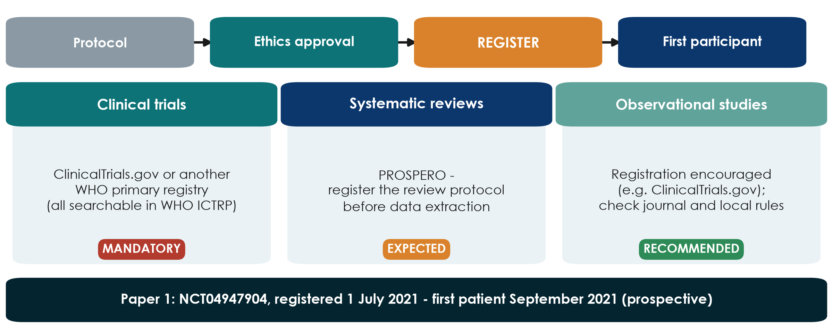
Register before the first participant
KEY MESSAGE Trials: no registration before the first patient, no publication.
Neudata | #ClearDataClearImpact
Notes:
Teaching point: registration puts the study's existence, design and primary outcome on a public record BEFORE anyone is enrolled. It prevents hidden negative studies and outcome switching.
Clinical trials: registration is mandatory. ICMJE journals will not publish a trial that was not registered before the first participant, and many countries require it by law. Use ClinicalTrials.gov or another WHO primary registry; the WHO ICTRP portal searches all of them at once - it is a search portal, not a registry itself.
Systematic reviews: register the protocol on PROSPERO before data extraction; many journals expect it.
Observational studies: registration is encouraged rather than required - check the target journal and local rules. The Declaration of Helsinki asks for every study with human participants to be registered.
Running example: Paper 1 was registered as NCT04947904 on 1 July 2021; the first patient was enrolled in September 2021 - prospective registration. Its registration number is in the abstract.
Ask: your group's study - does it need registration? Expected: trials yes; most cohort proposals 'recommended'.

Slide 9
Check: register or not?
QUICK QUIZ | 2 min
1. A randomised trial of two dressings for pressure injuries
2. A systematic review of fluid strategies in sepsis
3. A retrospective cohort from ICU charts (like FLUID-ICU)
4. A clinical audit of hand-hygiene compliance
5. Show: 1 finger = must, 2 = should, 3 = not needed
Answers
1. Must - trial registry, before patient 1
2. Should - PROSPERO
3. Recommended, not required
4. Audit: not research registration; local approval
Neudata | #ClearDataClearImpact
Notes:
CHECK (1 minute + 1 minute answers). Read each scenario, count fingers, then reveal.
Scenario 4 starts a useful discussion: audit compares practice with a standard and is usually approved through the quality office, not registered; but if you plan to publish it as research, ask the ethics committee first (Session 1: research vs audit vs QI).

Slide 10
Informed consent: four essentials
Consent is a conversation, not a signature.
Informed
Understood
Voluntary
Documented
Purpose and what will happen
Risks, benefits, alternatives
How data are protected
Who to contact
Plain, local language
Time to ask questions
Teach-back: 'tell me in your words'
No pressure
Free to refuse or withdraw
Care is NOT affected
Signed and dated form
A copy for the participant
Re-consent if the study changes
KEY MESSAGE If the patient cannot explain the study back to you, consent is not informed.
Neudata | #ClearDataClearImpact
Notes:
Teaching point: valid consent needs all four - information, understanding, voluntariness and a record.
Nurses and pharmacists are often the ones patients ask afterwards 'what did I sign?' - this is everybody's job, not only the investigator's.
Withdrawal: participants may leave at any time without giving a reason and without any effect on their care. Running example: in Paper 1, two control patients withdrew consent and were not analysed - that is the right respected, and it is why the trial analysed 48 of 50.
Common mistake: a consent form written at university reading level, in a language the family does not read fluently. Ask the committee for its template (there is also one in Templates/).
Ask: who in your group would take consent in your study, and when? Expected answer: a trained team member who is NOT the treating doctor under time pressure, if possible.

Slide 11
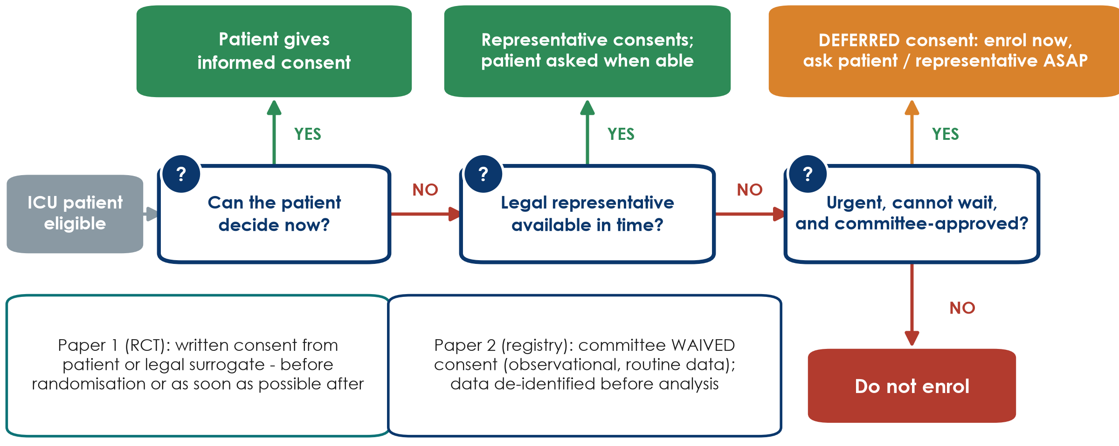
Consent in the ICU: when the patient cannot decide
KEY MESSAGE Patient, then legal representative, then deferred consent - and only if approved.
Neudata | #ClearDataClearImpact
Notes:
This is the real-life ICU problem: most of our patients are sedated, delirious or in shock when they become eligible.
Read the flowchart left to right. 1) Can the patient decide now? Then the patient consents. 2) If not, a legally authorised representative (surrogate - usually family, as defined by local law) consents, and the patient is asked again when able. 3) If no representative can be reached in time and the treatment cannot wait, research may proceed ONLY if the protocol explains why and the ethics committee approved this emergency procedure in advance; consent to continue is then sought as soon as possible. This is 'deferred consent'. The 2024 Declaration of Helsinki allows exactly this, under these conditions.
Paper 1 used this: written consent from the patient or legal surrogate 'before randomization or as soon as possible thereafter' (page 3).
Paper 2 is different: a registry using routine data - the committee waived individual consent and the data were de-identified before analysis (page 8).
Local law decides who may act as representative and whether deferred consent is allowed - check with your committee before you write the protocol.
Ask: if a family refuses after the patient was enrolled under deferred consent, what happens? Expected: the patient leaves the study; whether data already collected may be used depends on the approved protocol and what the family agrees to.

Slide 12
Worked example: who consents for these three ICU patients?
Walk each patient through the flowchart.
Mr A, 54
Mrs B, 71
Mr C, 38
Pneumonia, awake, oriented
Eligible for a fluid trial
Patient consents
Septic shock, sedated
Daughter at the bedside
Representative consents; ask Mrs B when awake
Shock at 03:00, no family yet
Treatment cannot wait; committee approved
Deferred consent: ask ASAP
KEY MESSAGE The pathway and the timing are written in the protocol before patient 1.
Neudata | #ClearDataClearImpact
Notes:
WORKED EXAMPLE. Ask the room for each card BEFORE revealing the bottom line (cover it or click through slowly).
Mr A: capacity present - the patient decides.
Mrs B: lacks capacity now; the legally authorised representative (here the daughter, if local law allows) consents; Mrs B is asked to continue when she regains capacity - she may withdraw.
Mr C: no representative in time, treatment cannot wait - deferred consent ONLY if the protocol describes it and the committee approved it; seek consent from family or patient as soon as possible. Paper 1 used this route.
Misconception: 'the treating doctor can consent for the patient'. No - the treating doctor is not the representative.

Slide 13
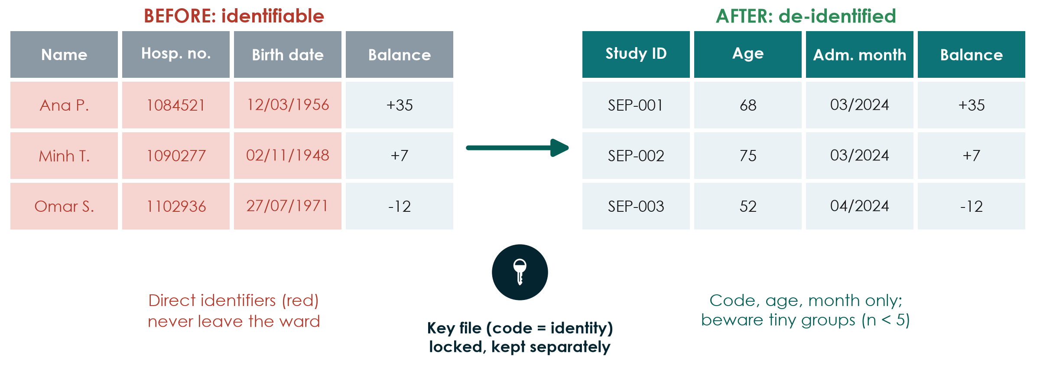
Confidentiality: de-identify before you analyse
KEY MESSAGE Names stay on the ward; only study codes travel.
Neudata | #ClearDataClearImpact
Notes:
Teaching point: confidentiality is protected by design, not by good intentions.
Before: direct identifiers - name, hospital number, exact date of birth, address, phone, photos. After: a study code, age instead of birth date, month instead of exact dates, and only the variables in your data dictionary.
The key file that links codes to identities is kept separately, password-protected and locked, with access for one or two named people only.
Beware indirect identification: 'the only 19-year-old with ECMO in March' is identifiable even without a name. Report very small groups with care.
Practical rules: no patient data on personal phones, messaging apps, private email or public cloud and AI tools; encrypted, institution-approved storage only.
Running example: Paper 2 states that patient information was anonymised and de-identified before analysis.
Ask: where would your group's key file live? Expected answer: an institution-approved, password-protected location - not a USB stick in a pocket.

Slide 14
Worked example: the ethics paragraph for a cohort like FLUID-ICU
FLUID-ICU is simulated - but if it were real, this is what the paper would say.
Approval
Consent
Confidentiality
Registration & sharing
Ethics committee of each ICU
Approval number + date
Before data collection
Routine data, minimal risk
Committee may WAIVE consent
(as in Paper 2)
Study codes only
Key file kept in each ICU
Data de-identified before analysis
Registration recommended
Data-sharing statement
Data dictionary shared
KEY MESSAGE Your manuscript's ethics paragraph answers four questions in four sentences.
Neudata | #ClearDataClearImpact
Notes:
WORKED EXAMPLE linking 7.1 to the manuscript. Make clear FLUID-ICU is a SIMULATED teaching dataset - there was no real approval - so in the course manuscripts groups write: 'This analysis uses a simulated teaching dataset; no ethics approval was required.' In a real cohort the paragraph would read like the four cards.
Model sentence (real study): 'The study was approved by the ethics committees of the four participating hospitals (number, date), which waived individual consent because data were collected during routine care and analysed after de-identification.'
Ask: which STROBE item does this belong to? Expected: the Methods (it is listed among other information; most journals ask for it in a 'Declarations' section too).

Slide 15
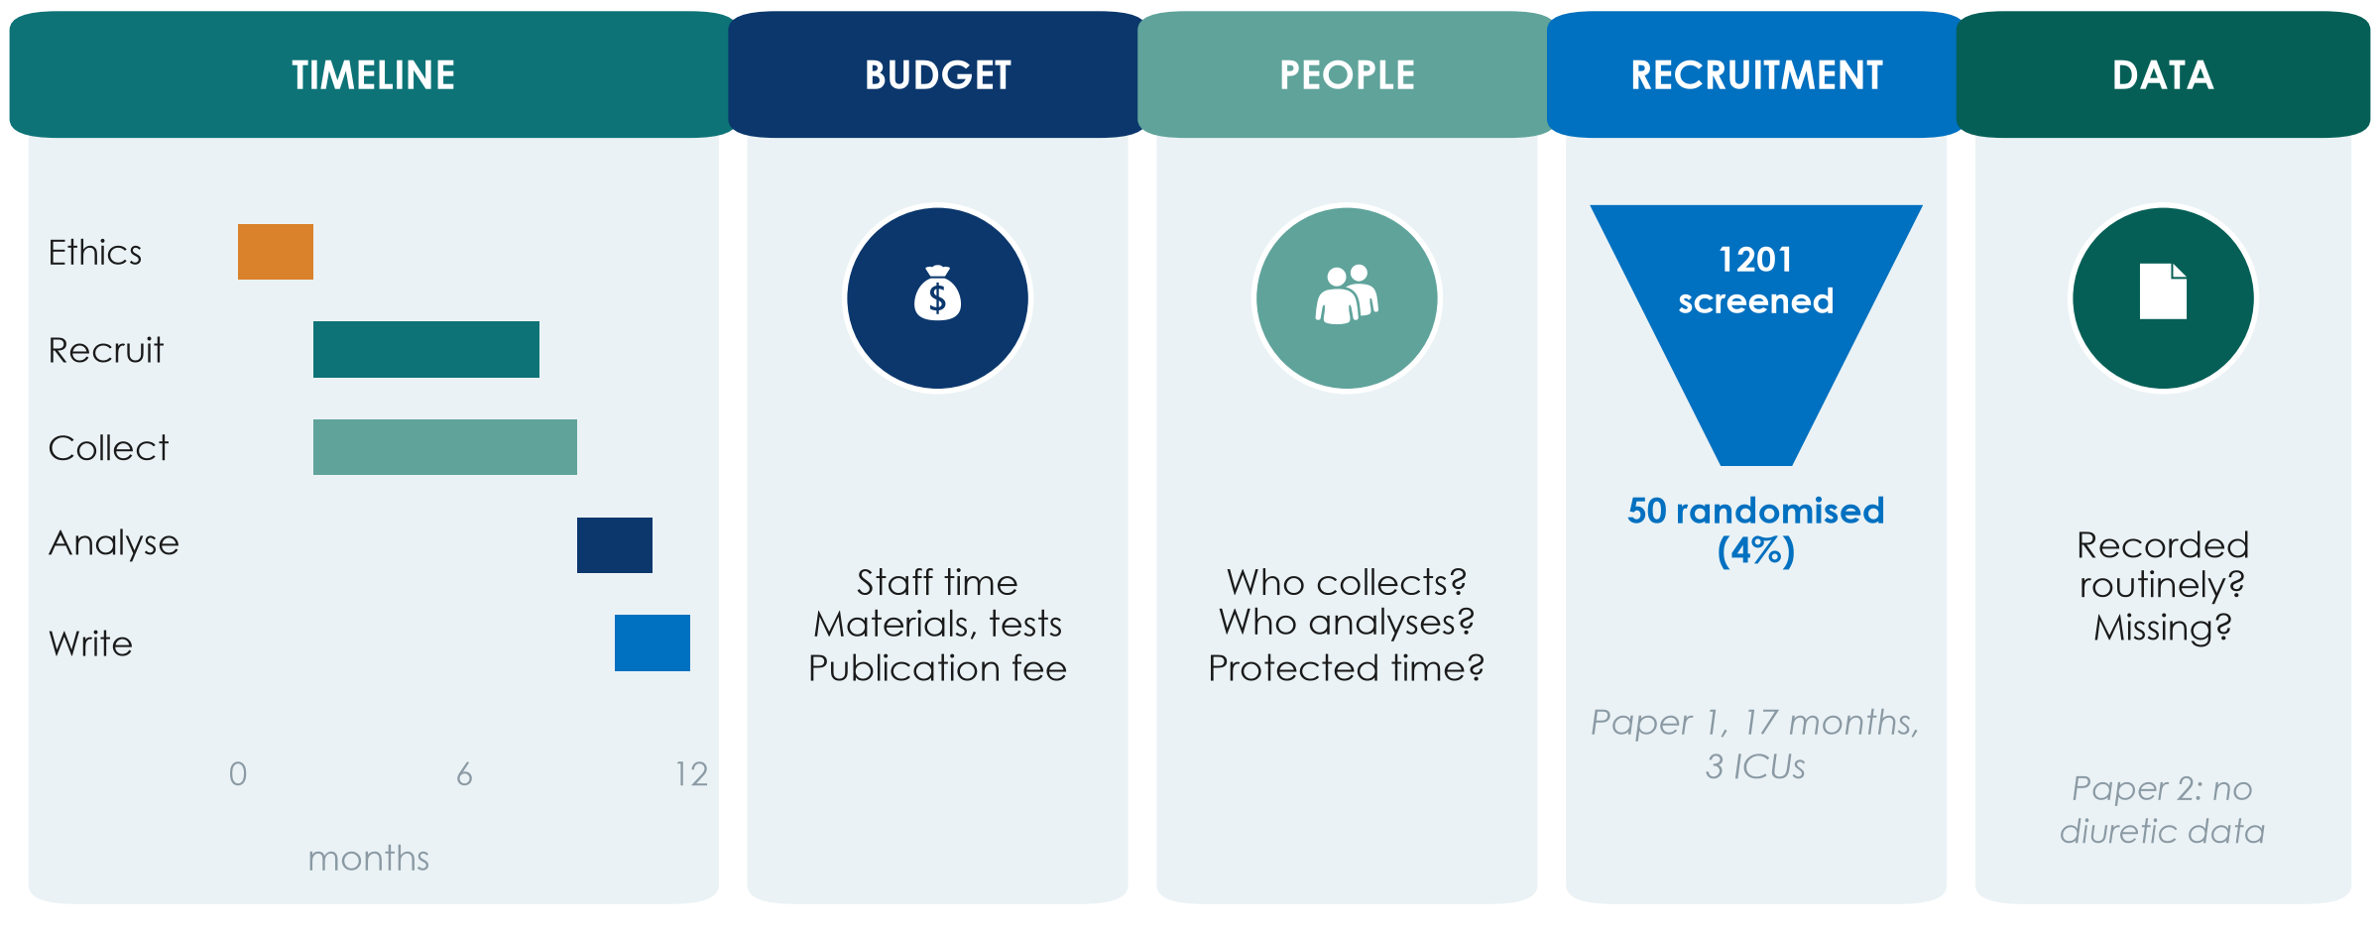
Feasibility in one picture: five honest questions
KEY MESSAGE Count the eligible patients in your unit BEFORE you write the sample size.
Neudata | #ClearDataClearImpact
Notes:
Walk the five tiles. TIMELINE: ethics approval alone can take 1-3 months; recruitment always takes longer than planned. BUDGET: name the headings even if the amounts are small - staff time, materials or tests, publication fee. PEOPLE: who collects data on night shifts and weekends, who analyses, and is there protected time? RECRUITMENT: Paper 1 screened 1201 patients in three ICUs over 17 months to randomise 50 (about 4%) - most eligible-looking patients are not eligible or not enrolled. DATA: is the variable already recorded routinely? Paper 2 could not study diuretics because the registry never recorded them.
Rule of thumb: count how many patients meeting your criteria your unit saw last year, then assume you will enrol a fraction of them.
Ask: which tile is the biggest risk for your group's study? Expected answers: recruitment and people (night-shift data collection).
This is the only feasibility slide in Level 1 - do not go deeper.

Slide 16
7.2 | 20 minutes
Research integrity
Honest data, honest credit, honest use of AI
Neudata | #ClearDataClearImpact
Notes:
SECTION 7.2 (0:40-1:00). Six slides (about 2 minutes each) and the 5-minute scenario quiz.
Tone: this is not about catching cheats. Most integrity problems start as small shortcuts under pressure - a missing value 'filled in', an outlier 'cleaned', a boss added as author. We want people to recognise the slope early.
Link to the manuscript: every group's draft will need an authorship (CRediT), conflicts-of-interest, data-availability and AI-use statement.

Slide 17
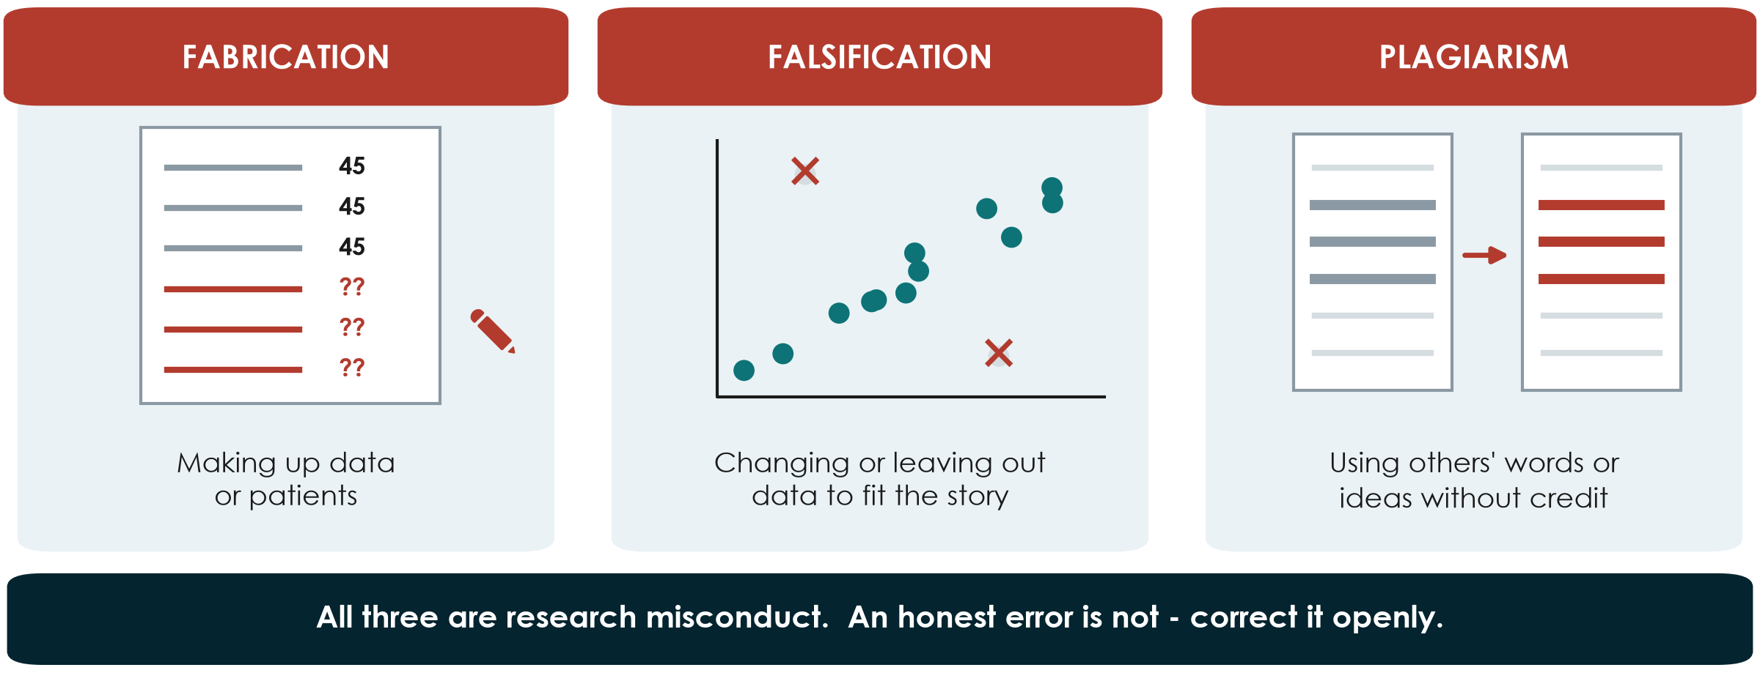
Fabrication, falsification, plagiarism (FFP)
KEY MESSAGE Missing data are reported as missing - never invented, never quietly removed.
Neudata | #ClearDataClearImpact
Notes:
Teaching point: the three classic forms of research misconduct.
Fabrication: making up data or patients (e.g. filling day-3 fluid balances 'from memory' because the chart is lost).
Falsification: changing, selecting or leaving out data, images or results so the story looks better (e.g. dropping two 'odd' patients after seeing they weaken the result).
Plagiarism: using other people's words, ideas or figures without credit - including copying a paragraph WITH a citation but without quotation marks.
Honest error is not misconduct - but it must be corrected openly (a correction or erratum).
Link to Session 5: the data-quality plan (range checks, pre-specified rules for outliers) is what protects you from accidental falsification.
Ask: which of these three is the most common in student theses? Expected answer: plagiarism - often copy-paste in the introduction. Similarity-check software will find it.

Slide 18
Also off-limits: tricks that distort the record
One study should tell one complete, honest story.
Duplicate publication
Salami slicing
Selective reporting
Same study, same results
in a second journal
without saying so
One study cut into thin papers
to multiply publications
Reader never sees the whole
Only the 'significant' outcomes
Primary outcome switched
after seeing the data
KEY MESSAGE Register first, pre-specify the primary outcome, report all of it.
Neudata | #ClearDataClearImpact
Notes:
Teaching point: these practices distort the evidence that doctors and guideline panels rely on.
Duplicate publication counts the same patients twice in a meta-analysis and can exaggerate an effect. A legitimate secondary paper is fine - if it is clearly cross-referenced and adds something new.
Salami slicing: e.g. mortality in one paper, length of stay in another and ventilation days in a third, from the same cohort, each without mentioning the others.
Selective reporting and outcome switching are why trials must be registered with ONE primary outcome before the first patient. Running example: Paper 1 registered its protocol at ClinicalTrials.gov on 1 July 2021, before recruitment began in September 2021, and reported its negative primary outcome plainly in the abstract. That is good practice.
Ask: Paper 1's primary outcome was negative. Why does it matter that it was published at all? Expected: publication bias - if only positive trials appear, the literature overstates benefit.

Slide 19
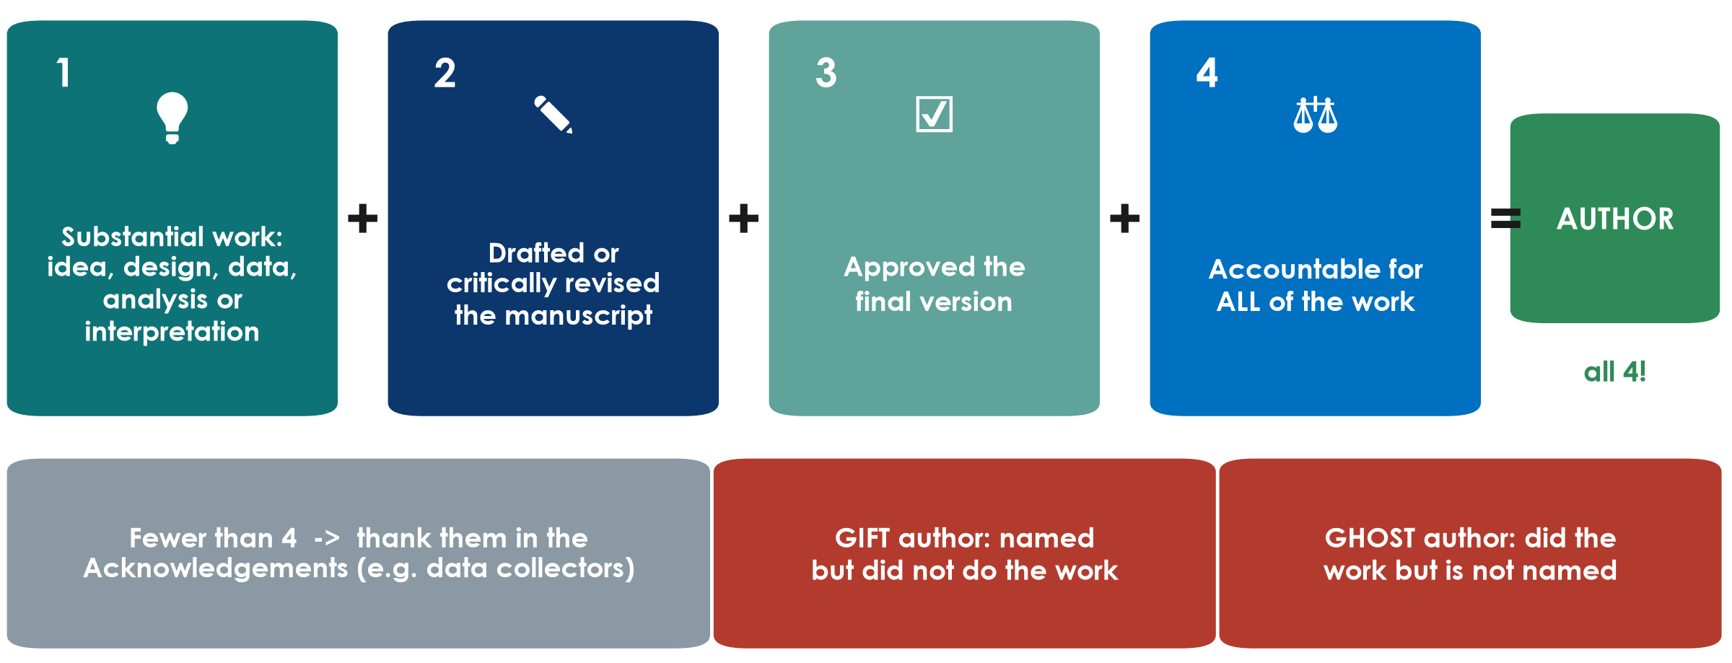
Who is an author? The four ICMJE criteria
KEY MESSAGE All four criteria, for every author - decide the list at the start.
Neudata | #ClearDataClearImpact
Notes:
Teaching point: the International Committee of Medical Journal Editors (ICMJE) requires ALL four criteria for authorship: 1) substantial contribution to conception or design, or to acquisition, analysis or interpretation of data; 2) drafting or critically revising the work; 3) final approval of the version to be published; 4) agreement to be accountable for all aspects of the work.
Anyone who contributed but does not meet all four goes in the Acknowledgements (data collectors, the pharmacist who checked adherence, the department head who provided support).
Gift author: a name added for seniority or friendship. Ghost author: someone who did the work - often a junior or a paid writer - but is not named. Both are misconduct.
Running example: Paper 2 is published 'on behalf of' a study group; the group members are listed in the Acknowledgements - a correct way to credit a large network.
Ask: data collection alone - is that enough for authorship? Expected answer: no, not without criteria 2, 3 and 4.
Practical tip: agree the author list and order in writing at the protocol stage and revisit it before submission.

Slide 20
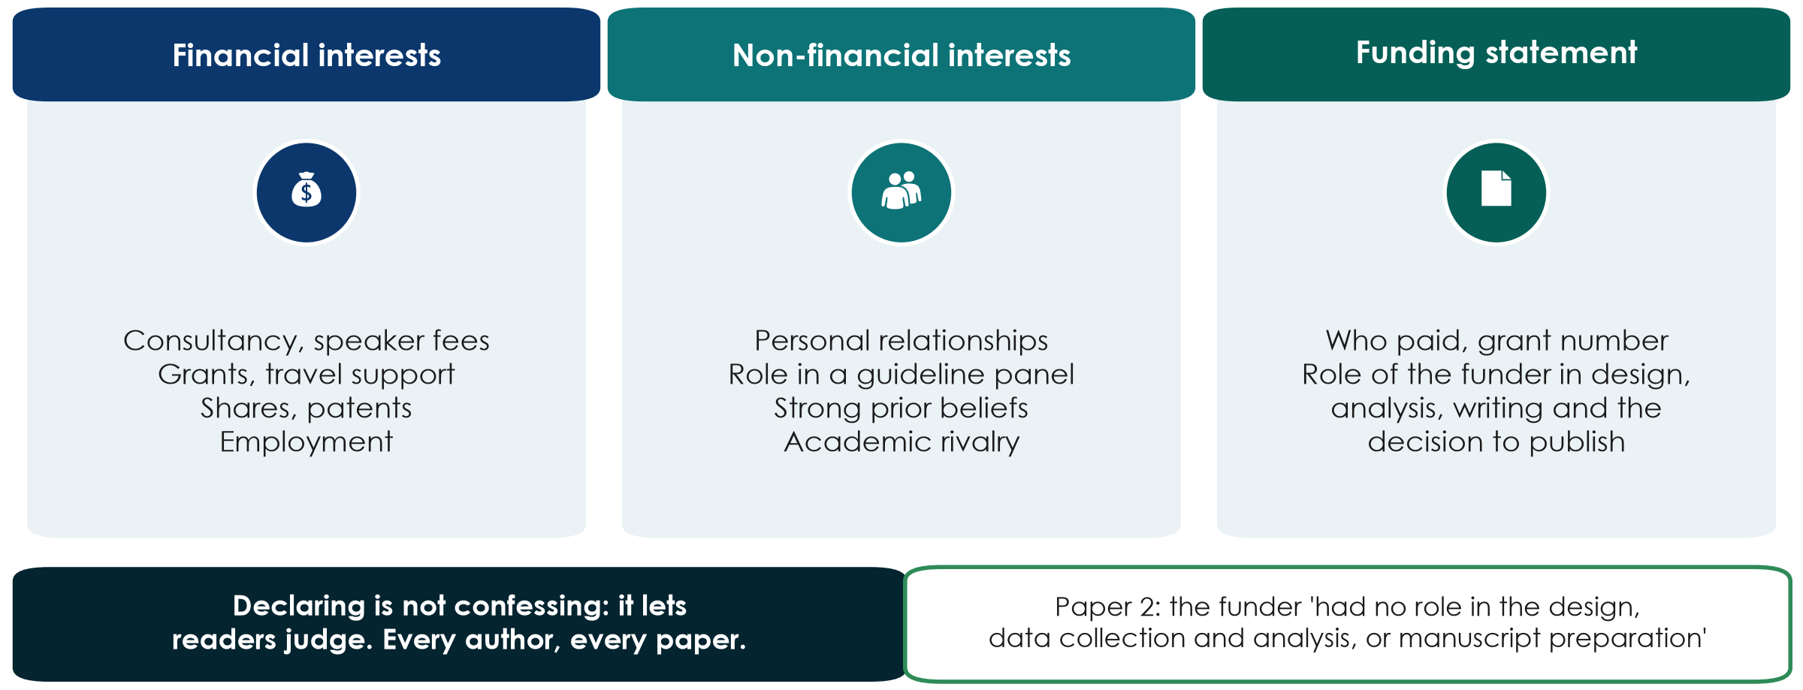
Conflicts of interest and funding: declare them all
KEY MESSAGE A declared interest is information; a hidden one is a scandal.
Neudata | #ClearDataClearImpact
Notes:
Teaching point: a conflict (competing) interest is anything that could be seen to influence your judgement - financial or not. Having one is common and not wrong; hiding it is.
Financial: consultancy, speaker fees, grants, travel support, shares, patents, employment. Non-financial: personal relationships, membership of a guideline panel, strong prior beliefs, academic rivalry.
Every author completes the journal's disclosure form (most journals use the ICMJE disclosure form), usually covering the last 36 months.
Funding statement: who paid, the grant number, and the role of the funder in design, data collection, analysis, writing and the decision to publish.
Running example: Paper 2 states its funder had no role in the design, data collection and analysis or manuscript preparation - an ICMJE requirement that is often forgotten (annotation #39). Paper 1 states an internal hospital grant and no competing interests (page 12).
Ask: a drug company paid your travel to a congress last year. Do you declare it on a fluids paper? Expected: yes if it could be perceived as relevant - when in doubt, declare.

Slide 21
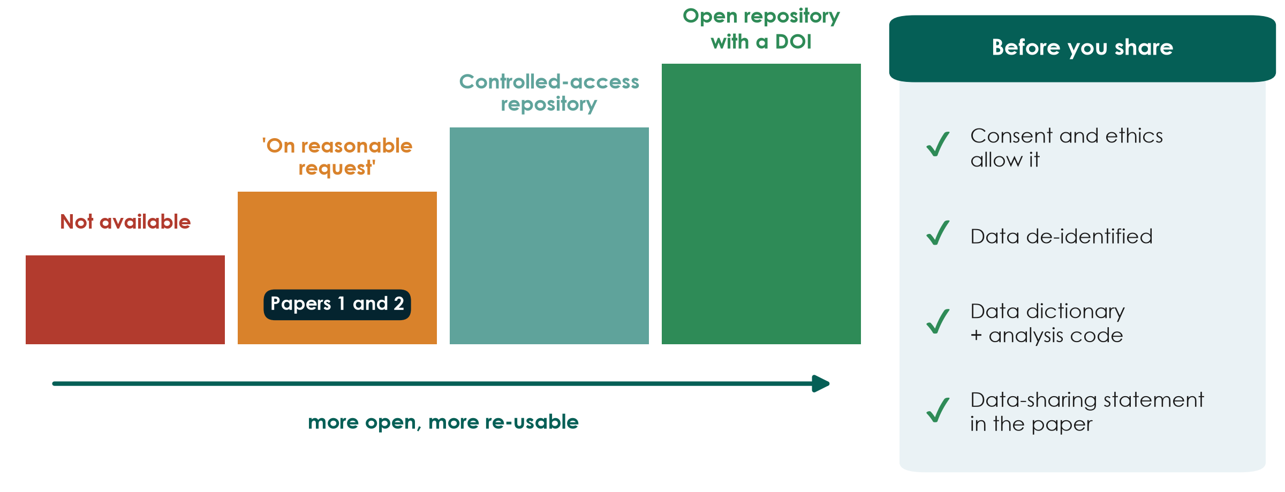
Data sharing: from 'on request' to open
KEY MESSAGE Plan data sharing at the protocol stage - consent must allow it.
Neudata | #ClearDataClearImpact
Notes:
Teaching point: journals increasingly ask for a data-sharing statement; ICMJE requires one for clinical trials, and trials must describe their data-sharing plan when they register.
The ladder: not available; 'available on reasonable request' (the weakest promise - both papers use it, pages 12 and 8); a controlled-access repository (researchers apply); an open repository with a DOI (for fully de-identified data).
Before you share: the consent form and the ethics approval must allow it, data are de-identified, and you share the data dictionary and analysis code with the data so others can use them.
Link to Session 5: a clean data dictionary is what makes shared data usable.
Ask: what would you need to write in your consent form today so your data can be shared tomorrow? Expected: a sentence asking permission for de-identified data to be shared for future research.

Slide 22
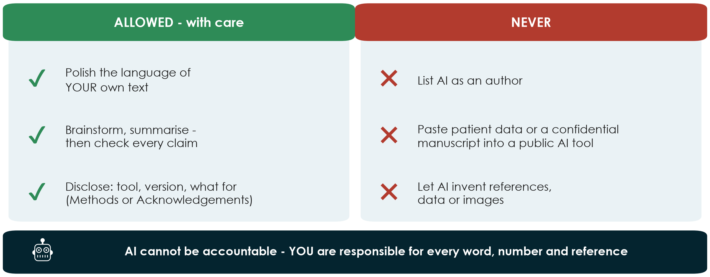
AI in research and writing: what is allowed
KEY MESSAGE Use AI like a junior assistant: check everything, disclose it, keep patient data out.
Neudata | #ClearDataClearImpact
Notes:
Teaching point - the current positions of ICMJE and COPE (Committee on Publication Ethics): AI tools cannot be authors, because they cannot take responsibility or be accountable for the work. Authors who use AI must disclose it - for writing help usually in the Acknowledgements, for use in data collection, analysis or figures in the Methods - and they remain fully responsible for every word, number and reference, including anything the tool produced.
Never paste identifiable patient data, or a manuscript you are reviewing, into a public AI tool: it breaches confidentiality, and reviewers are bound to keep manuscripts confidential.
AI tools can invent references that look real. Check every citation against PubMed.
Images: AI-generated or AI-altered images are not acceptable as data.
Always check the target journal's own AI policy in its Guide for Authors - policies change.
Ask: a colleague asks a chatbot to 'write the discussion' and submits it unread. Which of the three NEVER boxes does this hit? Expected: invented references and an unaccountable text - and it is undisclosed.

Slide 23
Integrity scenarios: green, amber or red?
QUICK QUIZ | 5 min
1. Read the scenario on the screen or in your handout (6 scenarios)
2. Each group holds up GREEN (fine), AMBER (fine only if fixed or disclosed) or RED (misconduct)
3. The instructor asks one group to justify its colour
4. We do 3 together now; the rest are in the handout
Example
A colleague lent you an ultrasound machine and asks to be an author.
Your colour?
OUTPUT Each participant can name FFP, gift/ghost authorship and the AI rules
Neudata | #ClearDataClearImpact
Notes:
QUIZ (0:55-1:00). Scenarios and answer key: Practicals/s7_exercises.md (Part A) and Solutions/s7_solutions.md.
Choose three: 1 (missing data 'filled from memory' - RED, fabrication), 3 (head of department as last author without contributing - RED, gift authorship, offer Acknowledgements), 4 (AI polish of the English, checked and disclosed - GREEN; same chatbot fed the patient spreadsheet - RED).
Example on the slide: lending equipment is not authorship - AMBER/RED: thank them in the Acknowledgements.
Facilitation: coloured cards (or coloured paper) on each table; if you have none, use fingers - 1 = green, 2 = amber, 3 = red.
If groups disagree, that is the teaching moment - ask each side for one reason.

Slide 24
Proposal builder 7: ethics, registration, feasibility, publication plan
PROPOSAL BUILDER | 15 min
1. Who consents in your study? Use the ICU flowchart (5 min)
2. Registration: needed? which registry? Where is the key file?
3. Feasibility: biggest risk and one fix (3 min)
4. Publication plan: target journal, guideline, authors + CRediT (5 min)
5. Working title from your PICO (2 min)
Worksheet
Practicals/s7_exercises.md, Part B
Your slide 5 and 6 for tomorrow
Finish at home tonight
OUTPUT Proposal Part 4 drafted; slides 5-6 of the presentation outlined
Neudata | #ClearDataClearImpact
Notes:
PROPOSAL BUILDER 7 (1:00-1:15). Call the sub-timings aloud.
Circulate. Typical problems: (1) 'consent will be obtained' with no who/when/how - push for the ICU pathway; (2) retrospective chart reviews assuming no ethics review is needed - wrong, the committee decides and may grant a waiver; (3) recruitment numbers taken from the sample-size calculation instead of the unit's admissions; (4) CONSORT chosen for an observational proposal.
The journal choice and EQUATOR checklist will be checked again in 8.2 tomorrow - a provisional answer is fine today.
Remind: tomorrow each group presents (6 minutes, 6 slides) - slides 5 (ethics & feasibility) and 6 (publication plan) come from this worksheet.

Slide 25
Break
BREAK | 15 min
1. Collect your group's FLUID-ICU results pack
2. Open the manuscript template (or take paper)
3. Decide who writes Methods, who writes Results
4. Back at 1:30 sharp
After the break
7.3 Writing the paper (35 min)
Manuscript workshop 1 (50 min)
Neudata | #ClearDataClearImpact
Notes:
BREAK (1:15-1:30).
During the break: put one printed results pack on each table (Q1 on table 1 ... Q5 on table 5) and the s7 exercise sheet (Part C, workshop instructions).
Use the break to visit any group that could not say its main result in the recap.

Slide 26
7.3 | 35 minutes
Writing the paper (I): Methods and Results
Write what you did and what you found - nothing more
Neudata | #ClearDataClearImpact
Notes:
SECTION 7.3 (1:30-2:05). Ten slides: writing order, Methods, a worked Methods example from FLUID-ICU, Results, a worked Results example, tables, STROBE, and a 3-minute check.
Every example now comes from the course dataset (Q1, the primary question) or from the two papers.
Pace: 3 minutes per slide. The two worked examples are the heart of the block - read them slowly with the room.

Slide 27
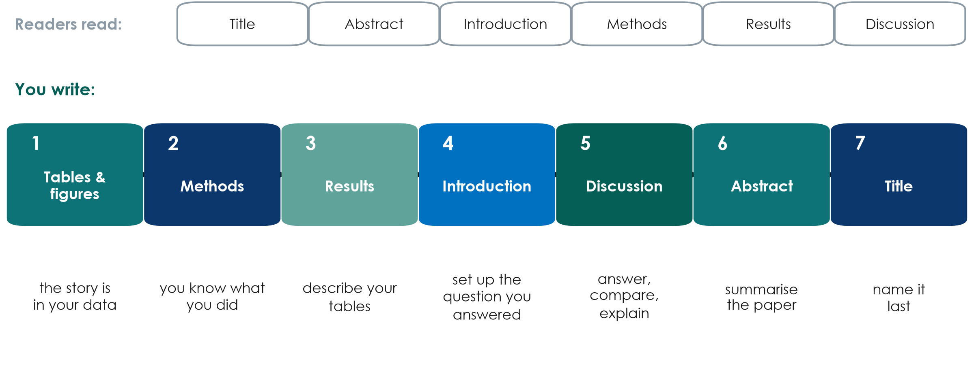
Write in a different order from the one readers read
KEY MESSAGE Start with your tables; write the title last.
Neudata | #ClearDataClearImpact
Notes:
Teaching point: readers go title - abstract - introduction - methods - results - discussion. Writers should not. Start from the evidence: draft the tables and figures (the story is in your data), then the Methods (you know what you did - it can be drafted from the protocol even before the data), then Results (describe the tables), then the Introduction (set up exactly the question you answered), then the Discussion, and only then the abstract and the title.
Why it works: each section is written from something that already exists, and the abstract and title summarise a paper that is finished - so they cannot promise more than the paper delivers.
Misconception: 'I must finish the introduction before I can start'. Many first-time writers stall on the introduction for months.
Ask: which part of your proposal could already become the Methods of your paper? Expected: Parts 2 and 3 - design, participants, variables, analysis plan.

Slide 28
Methods: enough detail for someone to repeat it
If a colleague could not redo your study from the Methods, add detail.
Who and where
What was done
Outcomes and size
Statistical analysis
Design, setting, dates
Eligibility criteria
Ethics no. and consent
Registration no.
Intervention in full
Variables defined
P1: training, daily pharmacist check
ONE primary outcome: how, when
Sample size: assumptions + source
P2: no sample-size statement
A test for each comparison
Estimate matches the test
Missing data, multiplicity
Software and version
KEY MESSAGE The statistical paragraph names a method for every comparison you report.
Neudata | #ClearDataClearImpact
Notes:
Teaching point: Methods = enough detail to repeat the study, in the order of the reporting checklist (CONSORT or STROBE).
Good practice: Paper 1 puts the ethics committee, approval number, consent procedure and funding inside the Methods (annotation #13); describes the intervention well enough to replicate - staff training, a daily pharmacist check, dilution charts in a supplement (#16); separates one primary outcome from secondary and safety outcomes (#17); states the software and version (#21). Paper 2 defines exactly which inputs and outputs make up fluid balance (#13) and cites its cohort-profile paper instead of repeating it (#12).
To fix: Paper 1 is a 'pilot' with an efficacy sample size whose assumptions (70 vs 40 ml/kg) were not met (#18); it names a Mann-Whitney test but reports mean differences with CIs (#19); about 40 secondary p-values with no word on multiplicity (#20). Paper 2: 'caliper of 0.1' of what? How were missing covariates handled? Clustered by what? (#15, #17); no sample-size statement (#19).
The statistical analysis paragraph: for each comparison, the summary, the test or model, the effect measure with 95% CI, how missing data and multiple comparisons were handled, and the software.

Slide 29
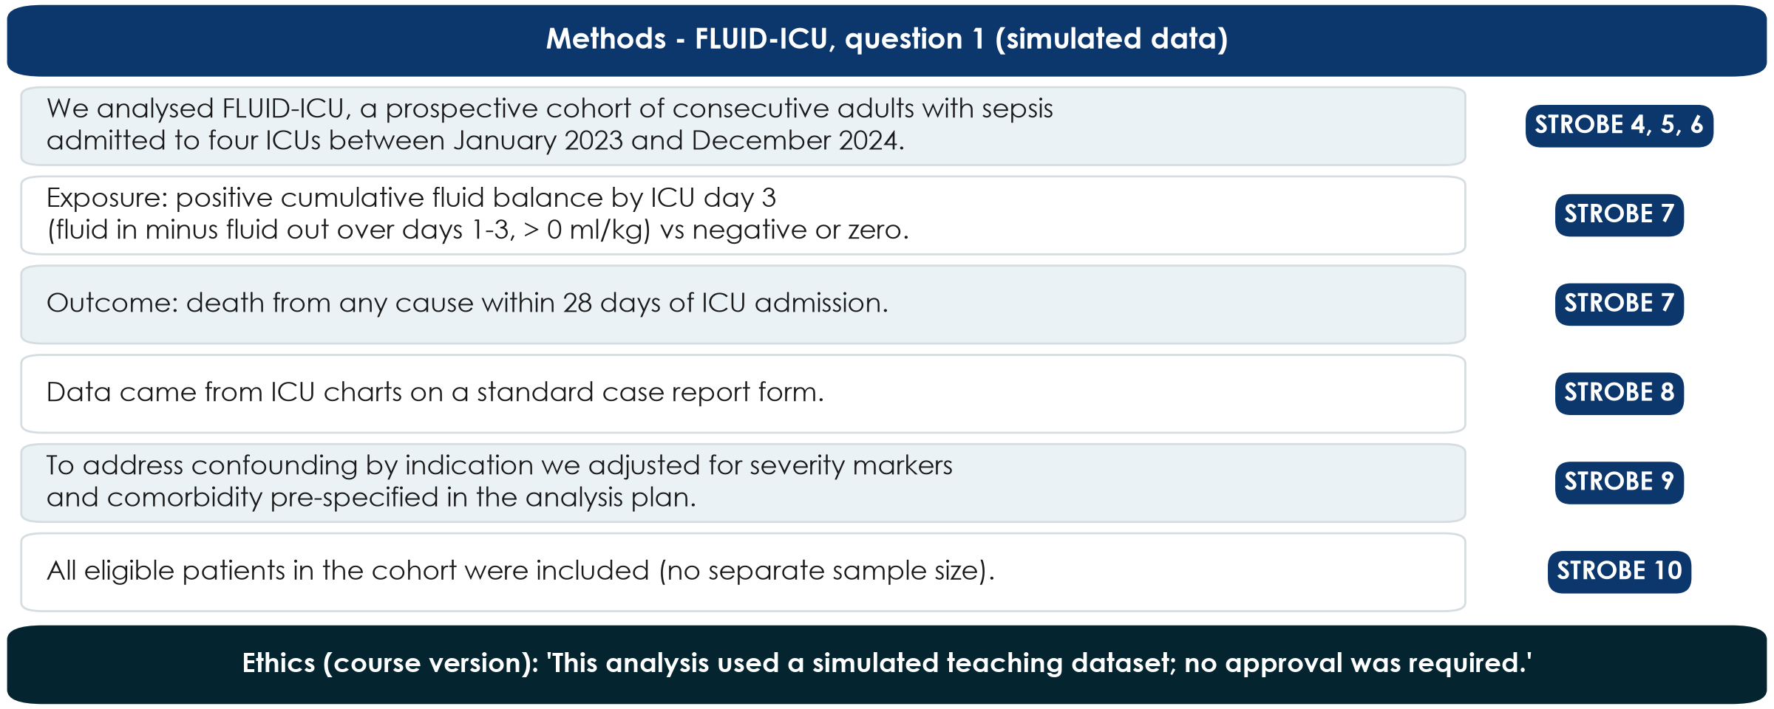
Worked example: Methods for FLUID-ICU question 1
KEY MESSAGE One sentence per STROBE item - and say plainly that the data are simulated.
Neudata | #ClearDataClearImpact
Notes:
WORKED EXAMPLE (course dataset). Read each sentence and point to its STROBE item on the right.
All facts come from results pack Q1, section 2: prospective multicentre cohort, 4 ICUs, consecutive adults with sepsis, January 2023 - December 2024; exposure = cumulative balance (in minus out, days 1-3) > 0 ml/kg; outcome = death within 28 days of ICU admission.
STROBE 10 (study size): for a fixed cohort we do not invent a sample-size calculation; we say all eligible patients were included.
The ethics sentence is specific to the course: FLUID-ICU is SIMULATED - every manuscript must say so.
Ask: which sentence would a reader need to repeat the study? Expected: the exposure definition - how fluid balance was calculated.

Slide 30
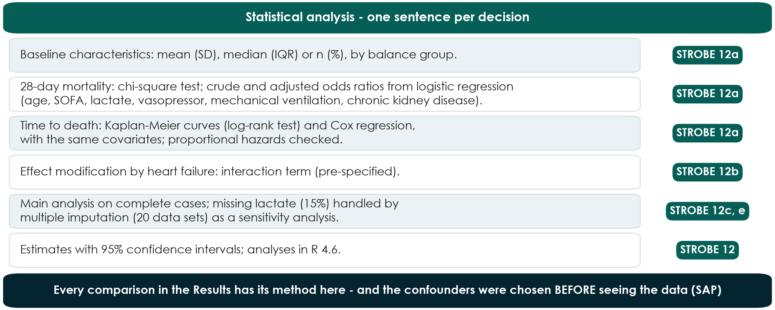
Worked example: the statistical-analysis paragraph
KEY MESSAGE Name a method for every comparison you report - chosen before you saw the data.
Neudata | #ClearDataClearImpact
Notes:
WORKED EXAMPLE. This is STROBE item 12 written out for Q1 (results pack Q1, sections 2 and 4-5).
Covariates: age, SOFA, lactate, vasopressor, mechanical ventilation, chronic kidney disease - pre-specified in the statistical analysis plan (Session 6), not chosen by looking at p-values.
Missing data: lactate missing in 93/620 (15.0%); main analysis on complete cases (n = 527), multiple imputation (m = 20) as sensitivity.
Effect modification: heart failure, pre-specified.
Misconception: 'the statistics paragraph is for the statistician'. Reviewers read it first; every number in the Results must be traceable to one sentence here.

Slide 31
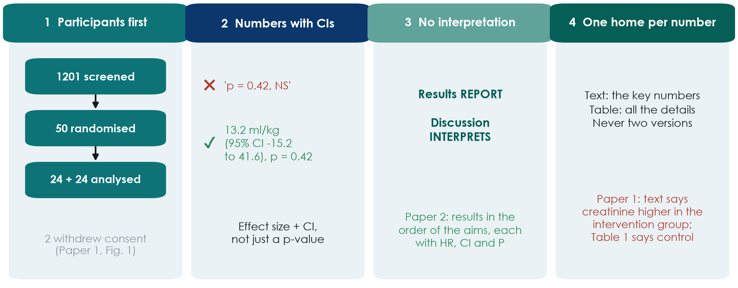
Results: report, do not interpret
KEY MESSAGE Participants first, then each outcome as an effect size with its 95% CI.
Neudata | #ClearDataClearImpact
Notes:
Four rules. 1) Participants first: how many were screened, included, analysed and why some were lost - with a flow diagram. Paper 1 has its CONSORT flow chart in the main text (annotations #23, #27); Paper 2 keeps it in the supplement although 79% of the registry was excluded (#20).
2) Numbers with confidence intervals, not 'p = 0.42, NS'. Analysing 48 of 50 randomised patients is a modified intention-to-treat analysis and should be called that (#24).
3) No interpretation in the Results. Paper 2 reports its results in the order of the aims, each with HR, CI and P, and no comment (#25).
4) One home for each number: key numbers in the text, all details in the tables - and they must agree. Paper 1's text says creatinine was higher in the intervention group; Table 1 shows the opposite (#25). Text-table contradictions are a classic rejection reason.
Ask: who in your group will check every number in the text against the tables before submission? Name the person now.

Slide 32
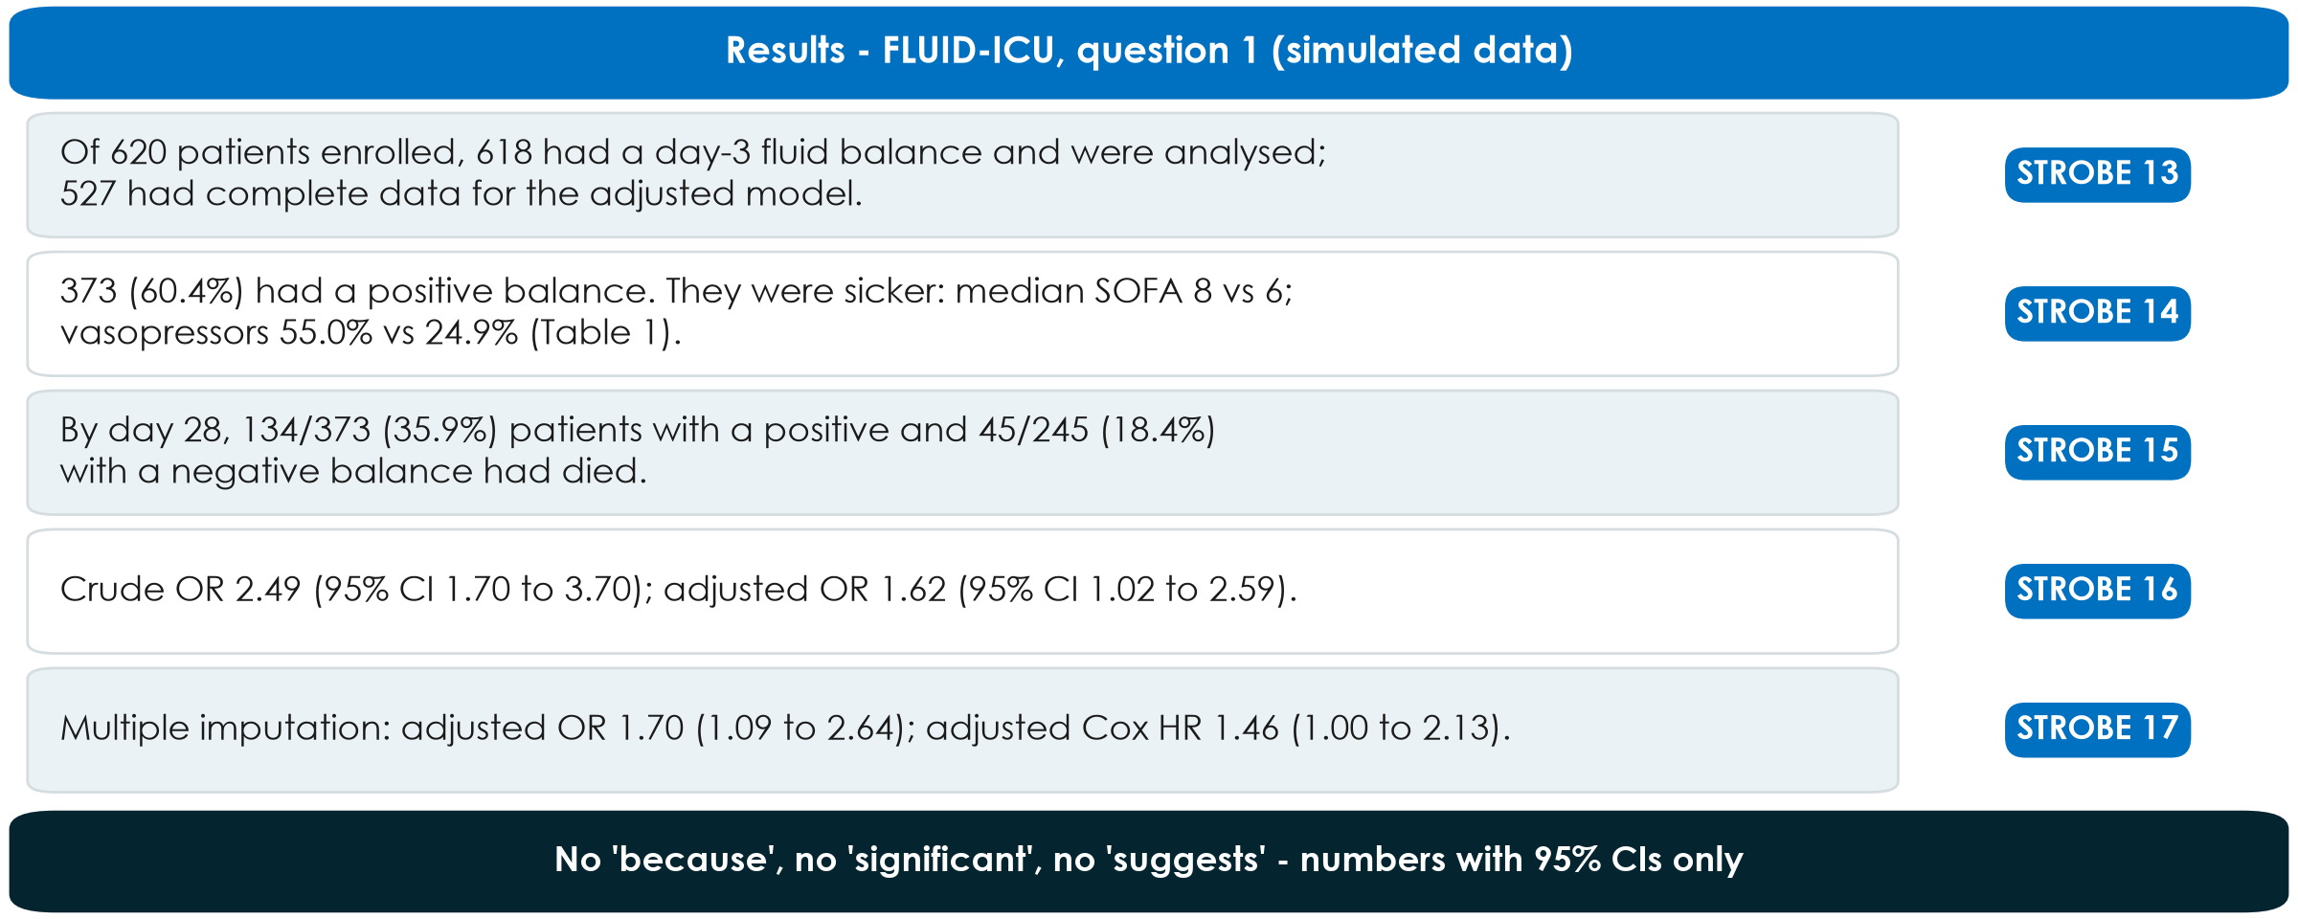
Worked example: Results for FLUID-ICU question 1
KEY MESSAGE Participants, Table 1, outcome numbers, crude and adjusted estimates - in that order.
Neudata | #ClearDataClearImpact
Notes:
WORKED EXAMPLE. All numbers from Course/Data/key_results.md (SIMULATED data):
Flow: 620 enrolled -> 618 with a day-3 balance -> 527 in the complete-case adjusted model (91 without lactate or age).
Positive balance 373/618 (60.4%); SOFA median 8 (6 to 10) vs 6 (4 to 8); vasopressor 205/373 (55.0%) vs 61/245 (24.9%).
Deaths: 134/373 (35.9%) vs 45/245 (18.4%). Crude OR 2.49 (1.70 to 3.70); adjusted OR 1.62 (1.02 to 2.59), p 0.044. Sensitivity: multiple imputation OR 1.70 (1.09 to 2.64); adjusted Cox HR 1.46 (1.00 to 2.13).
Point out what is NOT in the paragraph: no 'because', no 'significant', no explanation of why the OR shrank - that belongs to the Discussion tomorrow.
Ask: which STROBE item does the crude-AND-adjusted sentence satisfy? Expected: 16.

Slide 33
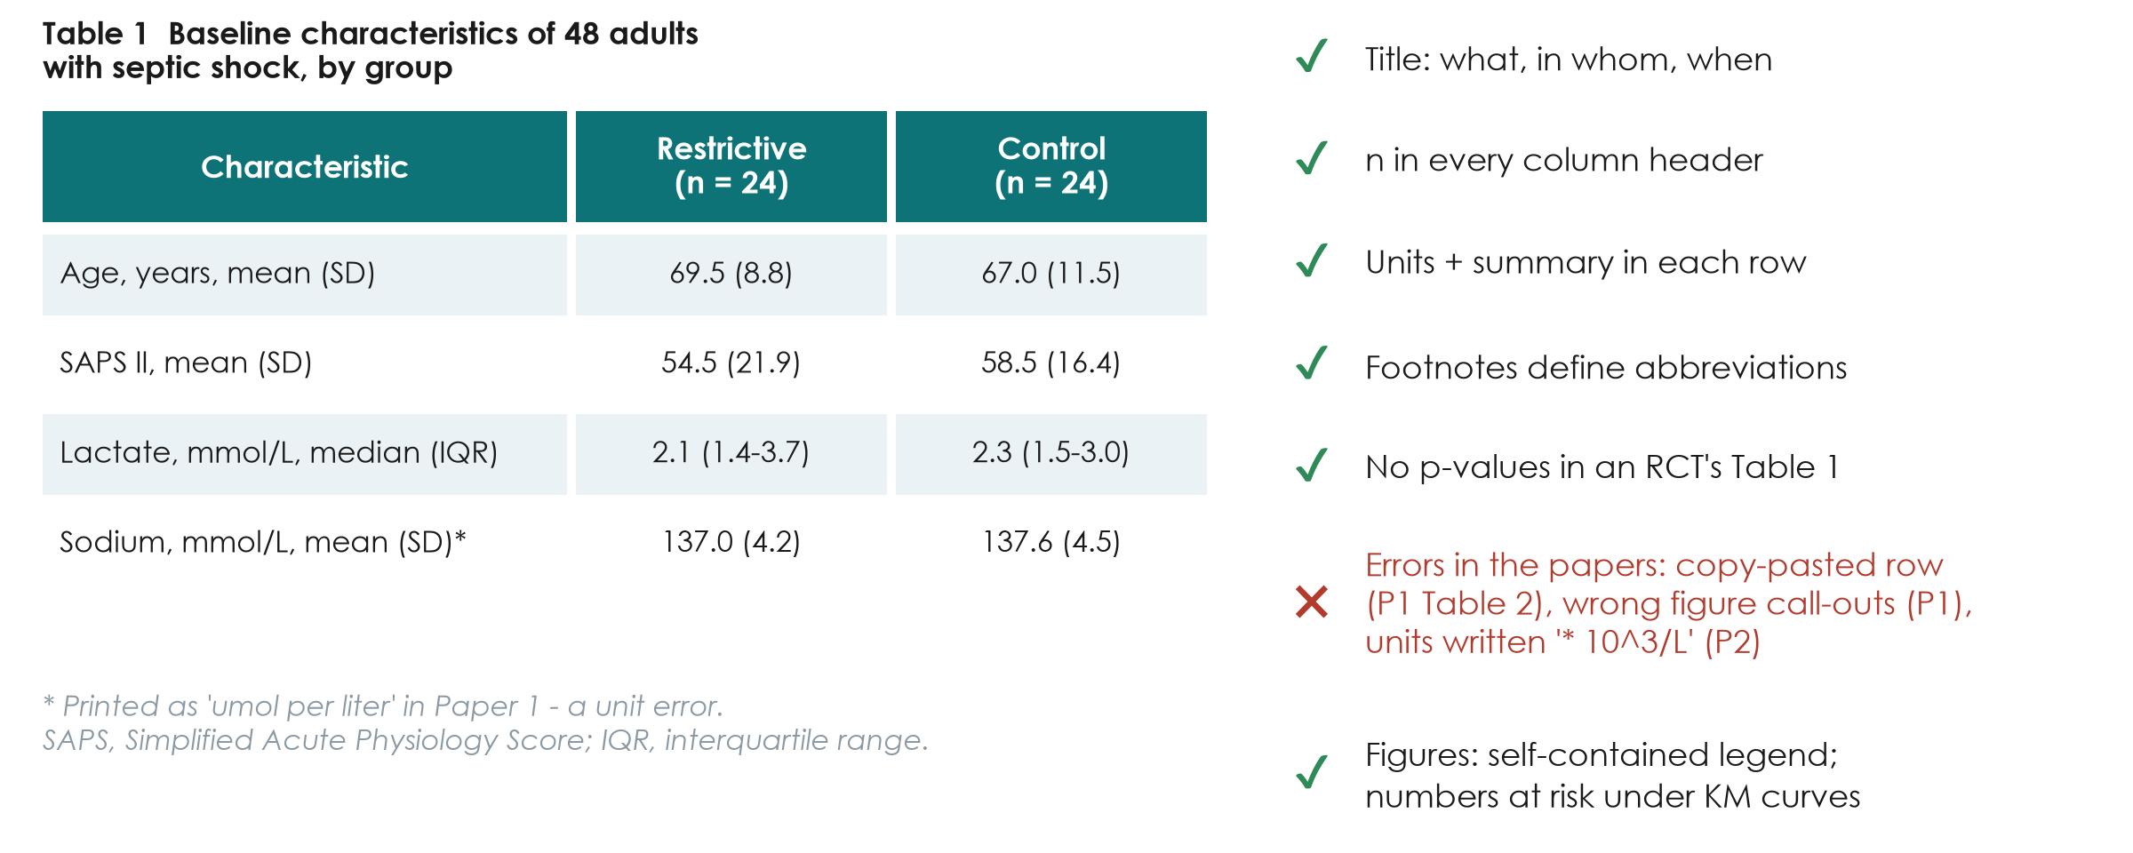
Tables and figures that stand alone
KEY MESSAGE A reader should understand each table without reading the text.
Neudata | #ClearDataClearImpact
Notes:
Teaching point: reviewers and clinicians read tables more carefully than text. A table must stand alone: a title that says what, in whom and when; n in every column header; units and the summary statistic in each row; footnotes defining abbreviations and missing data.
Good practice: Paper 1's Table 1 has n in each column, SD or IQR per row and no baseline p-values - correct for a randomised trial (annotation #31). Paper 2's Table 1 adds SMDs and footnotes with the number of patients with missing data (#30); its timeline figure has a self-contained legend (#21).
Errors to avoid: sodium and potassium printed in umol per liter (should be mmol/L) in Paper 1 (#30); a copy-pasted row in Paper 1's Table 2 (#32); wrong figure call-outs in Paper 1 (#28, #41); a vague table title (#34); white-cell units written '* 10^3/L' in Paper 2 (#30). Kaplan-Meier curves should show numbers at risk (Paper 2, #31).
Link to Session 5: the publication-quality table rules. Your FLUID-ICU Table 1 in the results pack already follows them - check it against this list in the workshop.
Ask: what is wrong with a table titled 'Results'? Expected: it says nothing about what, who or when.

Slide 34
Worked example: FLUID-ICU Table 1 in one sentence
Characteristic | Negative balance (n = 245) | Positive balance (n = 373)
Age, years, mean | 64.6 | 61.4
SOFA score, median (IQR) | 6 (4 to 8) | 8 (6 to 10)
Vasopressor, n (%) | 61 (24.9%) | 205 (55.0%)
Mechanical ventilation, n (%) | 97 (39.6%) | 216 (57.9%)
Lactate, mmol/L, median (IQR) | 2.2 (1.4 to 3.0) | 2.9 (1.9 to 4.0)
Heart failure, n (%) | 54 (22.0%) | 43 (11.5%)
SIMULATED data (results pack Q1, Table 1). Sentence: 'Patients with a positive balance were sicker at baseline.'
Neudata | #ClearDataClearImpact
Notes:
WORKED EXAMPLE: from Table 1 to one Results sentence (STROBE 14).
Model sentence: 'Patients with a positive balance were sicker at baseline (median SOFA 8 vs 6; vasopressors 55.0% vs 24.9%) and less often had heart failure (11.5% vs 22.0%).'
Teaching point: the Table 1 sentence describes, it does not test - no p-values needed (observational Table 1s often show SMDs instead).
Heart failure is lower in the positive group because clinicians give less fluid in heart failure - a nice example of how treatment decisions shape the data.
The full Table 1 with missing-data rows is in each results pack.

Slide 35
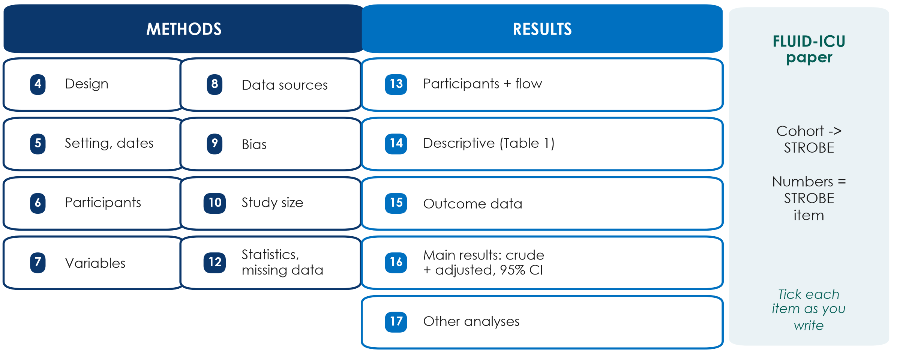
STROBE for the FLUID-ICU paper: which item goes where
KEY MESSAGE Write with the STROBE checklist open - tick each item as you write it.
Neudata | #ClearDataClearImpact
Notes:
Teaching point: FLUID-ICU is a cohort, so the paper follows STROBE (cohort version). The numbers in the boxes are the STROBE item numbers for the Methods (4-12) and Results (13-17).
Items groups most often forget: 9 (bias - say how you addressed confounding by indication: adjustment for severity); 10 (study size - for a fixed dataset say 'all eligible patients in the cohort were included'); 12 (missing data - how lactate was handled); 16 (give BOTH crude and adjusted estimates, with the variables adjusted for).
The full checklist is in the s7 exercise sheet and on equator-network.org (demo tomorrow).
Ask: which item covers Table 1? Expected: 14 (descriptive data).

Slide 36
Check: Methods, Results or Discussion?
QUICK QUIZ | 3 min
1. 'We used logistic regression adjusted for SOFA and age.'
2. 'Of 640 patients screened, 600 were included.'
3. 'This may be because sicker patients received more fluid.'
4. 'Lactate was missing in 15% and was imputed.'
5. '28-day mortality was higher with a positive balance (OR ..., 95% CI ...).'
Answers
1 Methods
2 Results (participants)
3 Discussion (explain)
4 Methods (+ Results: how many)
5 Results
Neudata | #ClearDataClearImpact
Notes:
CHECK (2:02-2:05). Read each sentence; the room calls out M, R or D.
The numbers in sentences 2, 4 and 5 are illustrative ('...'), not FLUID-ICU results.
Sentence 4 is the trick: HOW missing data were handled is Methods; HOW MANY were missing is Results.
Sentence 3 is the classic error - an interpretation slipped into the Results. Move it to the Discussion.

Slide 37
Manuscript workshop 1 | 50 minutes
Write your Methods and Results
About 600 words, Table 1 and one figure or table - from your results pack
Neudata | #ClearDataClearImpact
Notes:
MANUSCRIPT WORKSHOP 1 (2:05-2:55). Course dataset. Each group writes the Methods and Results of its FLUID-ICU paper (Q1-Q5) from its results pack.
Instructions for participants: Practicals/s7_exercises.md, Part C. Model paragraphs for Q1: Solutions/s7_solutions.md (do NOT hand these out before the workshop - show only the worked examples on the slides).

Slide 38
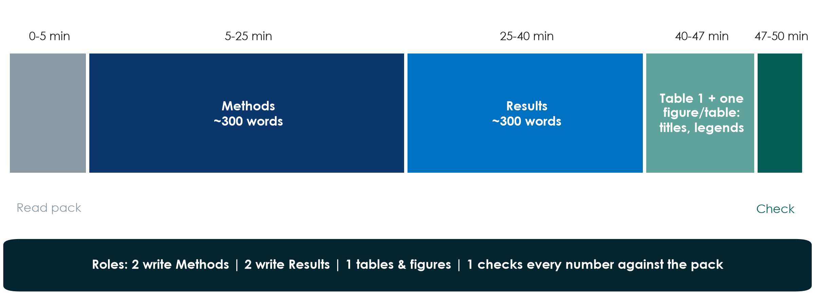
Fifty minutes, six people, one draft
KEY MESSAGE Every number in your text must come from your results pack - nobody calculates anything.
Neudata | #ClearDataClearImpact
Notes:
Show the plan and assign roles in 1 minute: two write Methods, two write Results, one prepares Table 1 and one figure or table (title, column headers with n, units, footnotes), and one 'number checker' who compares every number in the text with the results pack.
Word budget: Methods ~300 words (design and setting, participants, variables, statistical analysis); Results ~300 words (participants, Table 1 in one sentence, main result crude and adjusted, one secondary or sensitivity result).
Instructors circulate from minute 5: check each Methods has the statistical paragraph and each Results starts with the participants.

Slide 39
Manuscript workshop 1: draft Methods + Results
GROUP WORK | 50 min
1. 0-5: read your results pack; agree the main result in one sentence
2. 5-25: Methods - design, setting, participants, variables, statistics
3. 25-40: Results - participants, Table 1, main result (crude + adjusted)
4. 40-47: Table 1 + one figure/table with titles and footnotes
5. 47-50: tick STROBE items 4-17; check every number
Use
Your results pack (Q1-Q5)
Manuscript template
Worked examples (slides)
STROBE items 4-17
OUTPUT Methods + Results (~600 words) + Table 1 + one figure/table, saved and shared
Neudata | #ClearDataClearImpact
Notes:
WORKSHOP (2:05-2:55). Start a visible 50-minute timer; call each phase.
Circulate in a fixed order (table 1 to 5) so every group gets two visits.
Prompts: 'Where is your statistical paragraph?' 'What was adjusted for?' 'Where are the participants?' 'Is there a number without a confidence interval?' 'Is there an adjective ("significant", "strong") that should be a number?' 'Is there any interpretation in your Results?'
Q4 group (lactate): make sure they report BOTH complete-case and imputed estimates. Q5 group (length of stay): medians and IQR, not means. Q3 group: ventilator-free days are skewed - check the summary they chose.
At 2:52 ask each group to save and send its draft (email or shared folder) - it is the starting file for tomorrow's workshop 2.

Slide 40
Key words of Session 7
Term | In plain words
Deferred consent | Enrol first in an emergency, ask consent as soon as possible (committee-approved)
Registration | Public record of a study before patient 1 (mandatory for trials)
FFP | Fabrication, falsification, plagiarism - research misconduct
ICMJE criteria / CRediT | Who may be an author / who did what
Conflict of interest | Anything that could be seen to influence your judgement - declare it
STROBE | Reporting checklist for observational studies: Methods items 4-12, Results 13-17
Full glossary (EN-VN): Course/References/
Neudata | #ClearDataClearImpact
Notes:
Read the six terms with the room - ask someone to explain each in their own words before you read the right-hand column.
These are also the words most likely to appear in the post-course quiz tomorrow.

Slide 41
Wrap-up and homework for tomorrow
DISCUSSION | 5 min
1. Three take-home messages (next to this list)
2. Tonight: finish Proposal Part 4 and your 6 presentation slides
3. Tonight: read your Methods + Results draft once, aloud
4. Tomorrow: Introduction, Discussion, Abstract, Title - then present
Take home
No approval, no data - not even 'a few patients'
Every author meets all four criteria; declare every interest
Methods = what you did; Results = numbers with CIs, no opinions
OUTPUT Proposal slides ready; Methods + Results draft saved
Neudata | #ClearDataClearImpact
Notes:
WRAP-UP (2:55-3:00). Read the three take-home messages; ask one person to add a fourth.
Homework: proposal slides (presentation guide: 6 minutes, 6 slides), and a read-through of the manuscript draft. Tomorrow starts with a 5-minute recap and goes straight into writing.

Slide 42
Extra slides | Session 7
Extra slides - Session 7
Use only if time allows, or for self-study
Neudata | #ClearDataClearImpact
Notes:
EXTRA: the slides after this divider are optional. Use them if the room moves faster than planned, or point participants to them for self-study.

Slide 43
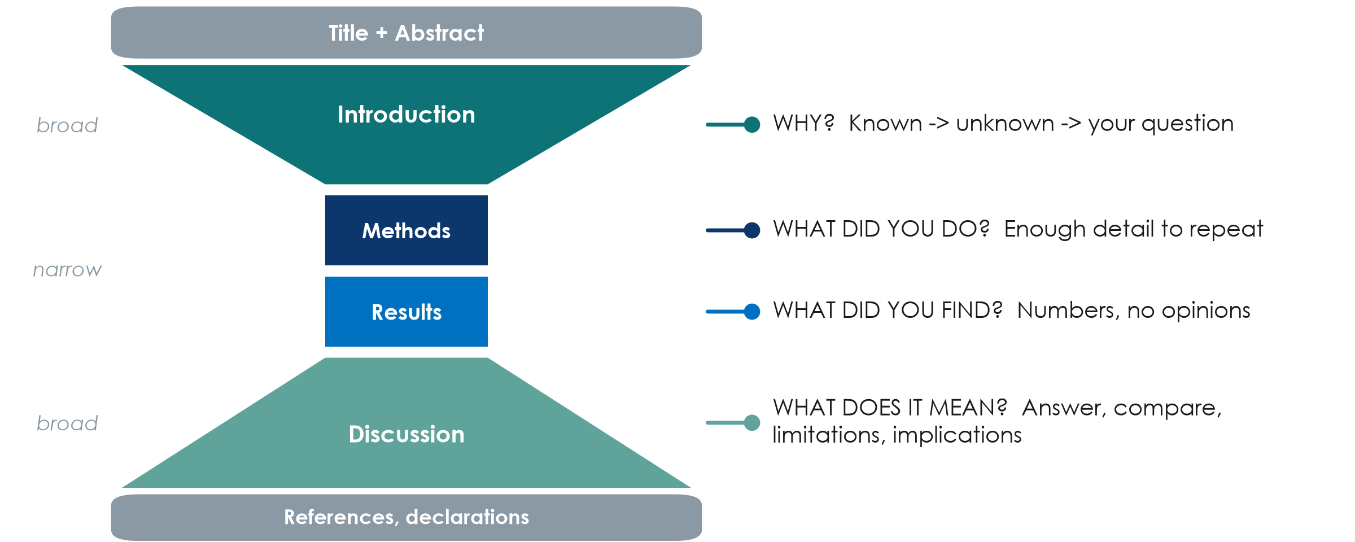
IMRaD: the hourglass shape of every paper
KEY MESSAGE Introduction narrows to your question; Discussion widens back to practice.
Neudata | #ClearDataClearImpact
Notes:
EXTRA: Teaching point: almost every clinical paper follows IMRaD - Introduction, Methods, Results and Discussion - framed by the title and abstract and closed by references and declarations.
Introduction: from what is known, to what is not known, to your question (a funnel). Methods: enough detail for someone else to repeat the study. Results: numbers, without opinions. Discussion: answer the question first, compare with other studies, state the limitations, then say what it means.
Running example: Paper 1's introduction is a textbook funnel in three paragraphs (pages 2-3), ending 'The primary objective was to assess the fluid balance after the first 5 days'. Its Discussion opens by answering that question (page 8).
Tip for the appraisal after the break: the hourglass tells you where to look - PICO in the last paragraph of the Introduction, design and outcome in the Methods, the main effect in the first paragraph of the Results, limitations near the end of the Discussion.
Ask: which section do you read first in a paper? Many will say the abstract and conclusion - fine, but the answer to 'can I believe it?' is in the Methods.

Slide 44
CRediT: say who did what
Journals now ask for each author's role in standard words.
The 14 CRediT roles
Paper 1 did it
Your group, today
Conceptualization, Methodology
Investigation, Formal analysis
Writing - original draft
Writing - review & editing
Supervision, Funding ...
NB: Writing - original draft
CS: Methodology, Formal analysis
SDB: Conceptualization, Supervision, Funding acquisition
Agree the author list now
Write each person's roles
Revisit before submission
KEY MESSAGE Transparent roles prevent gift and ghost authorship.
Neudata | #ClearDataClearImpact
Notes:
EXTRA: CRediT (Contributor Roles Taxonomy) is a list of 14 standard roles. It does not replace the ICMJE criteria; it makes each person's contribution visible.
Running example: Paper 1 (page 12) gives a CRediT statement - e.g. the statistician is credited for Methodology and Formal analysis. Paper 2 (page 8) describes contributions in free text and states that all authors read and approved the final manuscript - acceptable, but CRediT is the format most journals now ask for.
Facilitation: ask each group to write, in their proposal, who would be first author and who would do what. It prevents painful conversations later.
Question: in a hospital, who usually ends up as last author, and why? Expected: the senior supervisor - legitimate if they meet all four criteria, a gift if they do not.

Slide 45
Copyright © Neudata, 2026
All property rights and copyright are reserved.
This presentation contains proprietary data, information, and materials developed by Neudata for dedicated use only and may not be communicated, copied, reproduced, distributed, published, or cited, in whole or in part, without the prior written consent of Neudata.
Where explicit written permission has been granted, appropriate attribution must be included, followed by “by courtesy of Neudata”.
Any unauthorized use or infringement of these materials may give rise to legal action and claims for damages, without prejudice to any other rights of Neudata, including rights relating to patents, trademarks, or other forms of intellectual property protection.
Neudata | #ClearDataClearImpact
Notes:
Copyright slide - leave on screen while participants leave.

