Slide 1
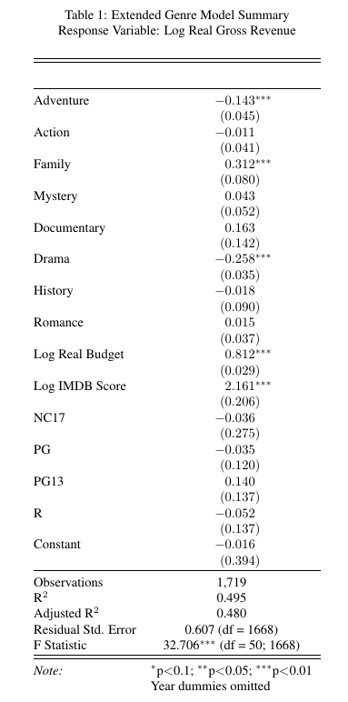
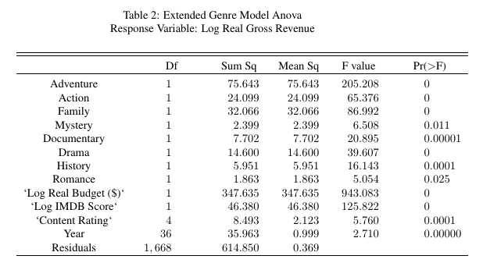
Genre Model
Step-wise / don’t include all genres:
Some genres have no or very little effect on revenue
Some genres almost entirely explain others (one movie can have multiple genres)
No priors about which genres to include
Most variables had (at least somewhat) non-random relationship with log residuals
Step-wise model selection starting with genre model
Included variables are also the variables with the most obviously non-random relationships with log residuals
Notes:
Variable 10 were Musical and War. RMSE from .873 to .872. Insignificant War and Musical.
93 out of 101 Animation movies are also Family

Slide 2
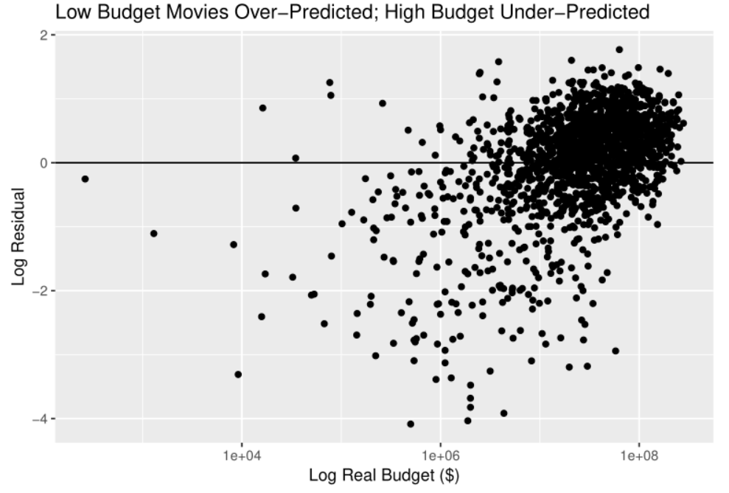
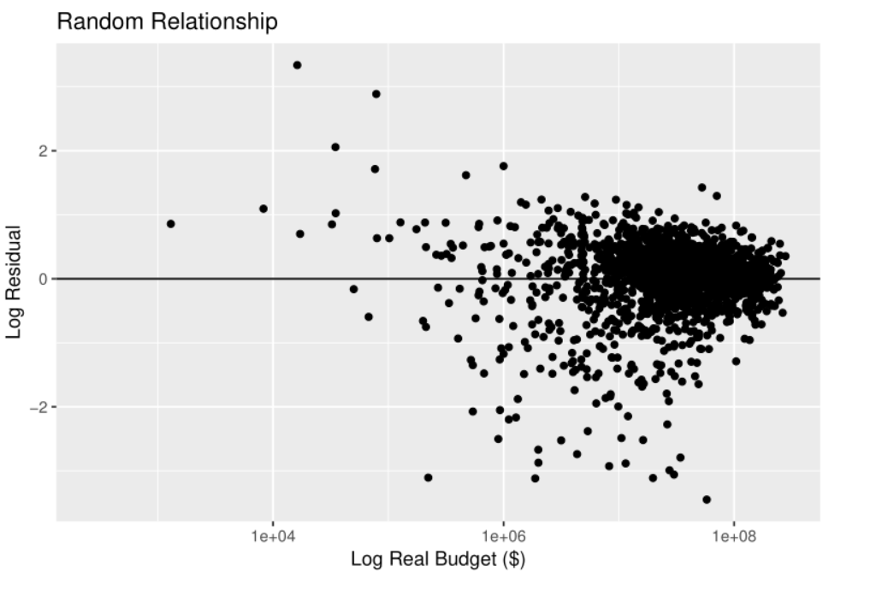
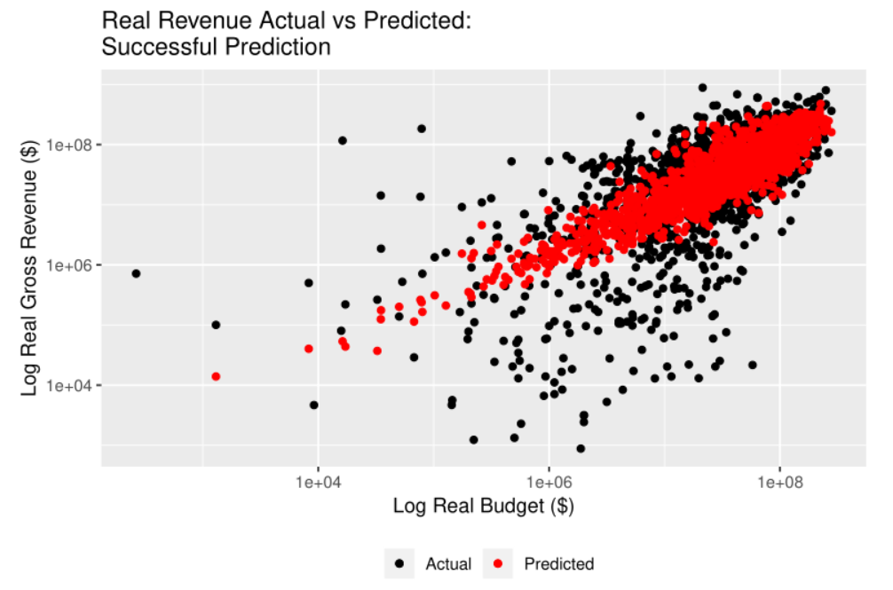
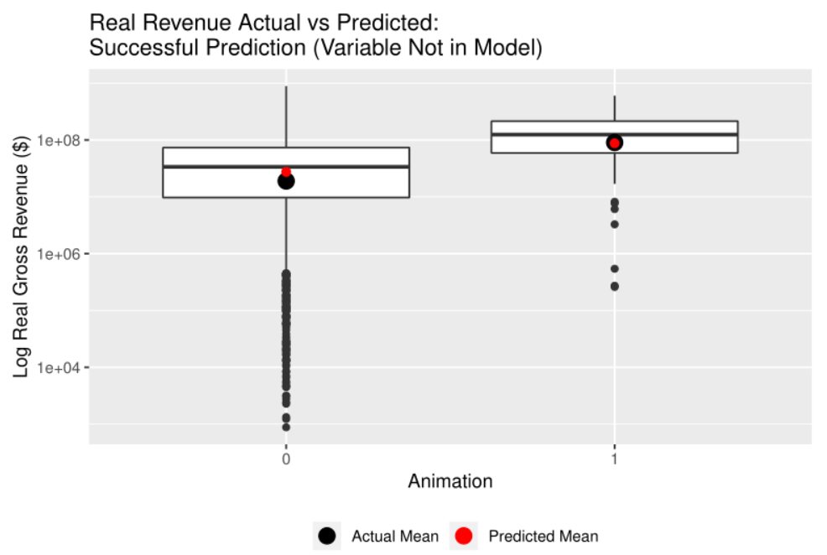
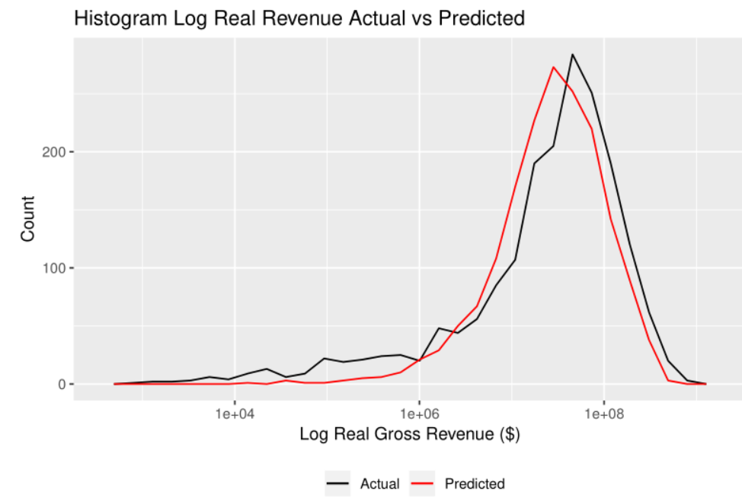
Genre Model: Evaluation
Residuals Before & After Model Extended
Relationships between included and excluded variables and log residuals are all centered around zero / random
Reasonable QQ Plot
Good predictions of all individual variables (including variables not included in the model) vs log revenue & of overall log revenue distribution

Slide 3
Budget Model
Concerns about over-fitting with genre model
Some genres have low observation numbers (ex Documentary), significant variation in revenue by genre (large IQR)
Genres do not capture other variables: non-random residuals → Instead other variables capture genre?
Log real budget had the strongest, most obvious relationship with revenue in EDA (log-log)
Fit a model with only log real budget and look at residuals
Variables with non-random relationship with log residual: IMDB score, content rating, year
None are drastically non-random however: budget does a good job of capturing relationship with revenue by itself
All genres have random relationship with log residuals
Final Model
$$log real revenue=β_{0}+β_{1}log real budget{+β_{2}log IMDB Score+β_{3}content rating+β_{4}\operatorname{year}{ }{ }{}}$$
Very similar RMSE, R², visualization to extended genre model → Parsimonious model better
Genre fully explained by budget alone
Notes:
Verified the non-random relationship variables with step wise mode selection. All 4 should be included based on RMSE
Not showing residual, prediction etc. plots here for final model. Did check them: all residuals random. Prediction looks good. Instead going to show you some of these plots with the test set.

Slide 4
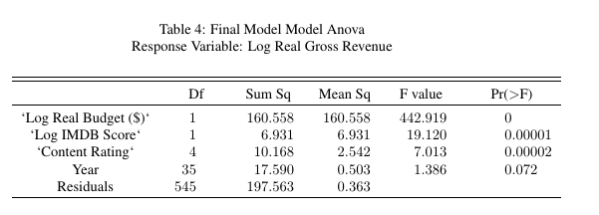
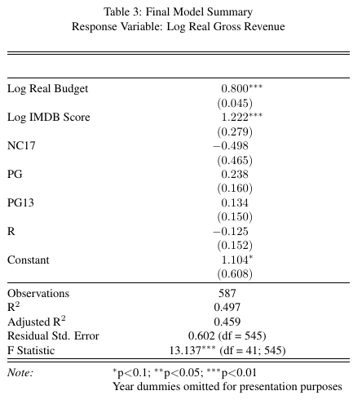
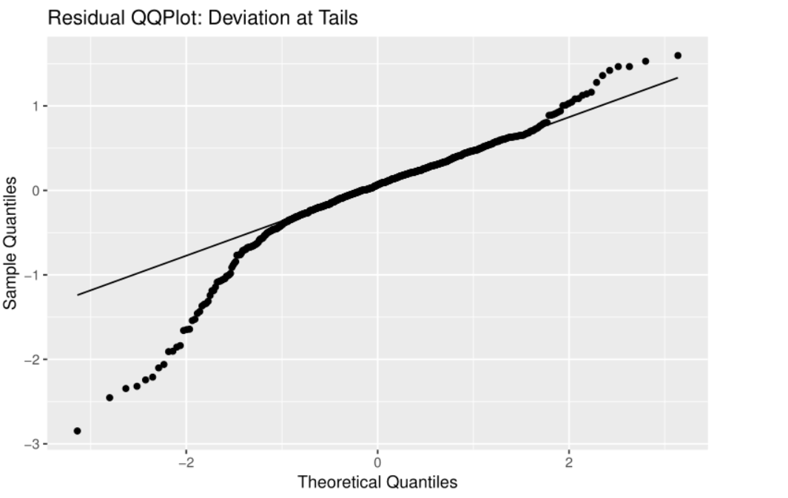
Final Model: Test Set
Notes:
Adventure is a genre that was in the original genre model but is now excluded: still predicted very well
Note that year is not significant at the .05 level – only .1 (was significant in training set)

Slide 5
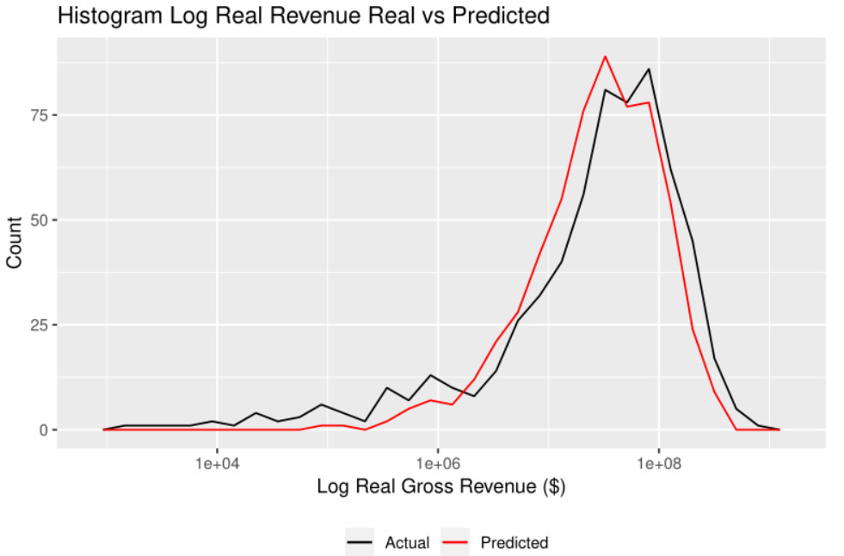
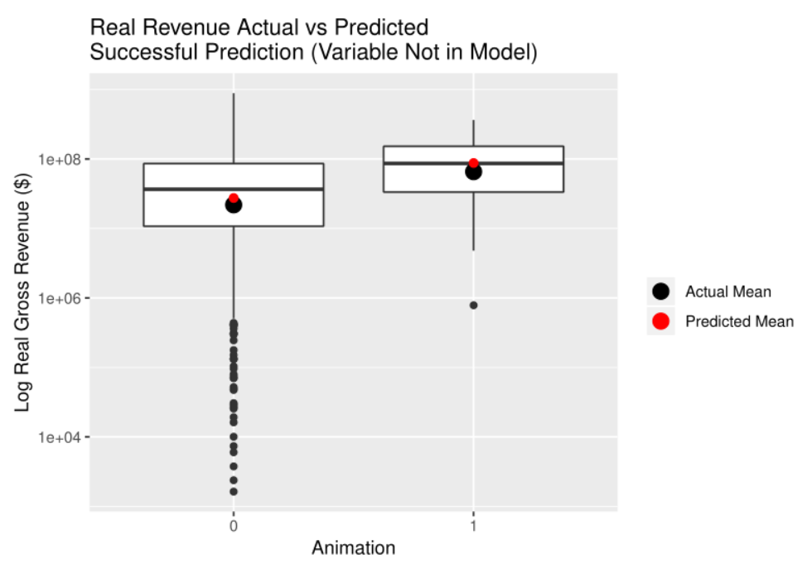
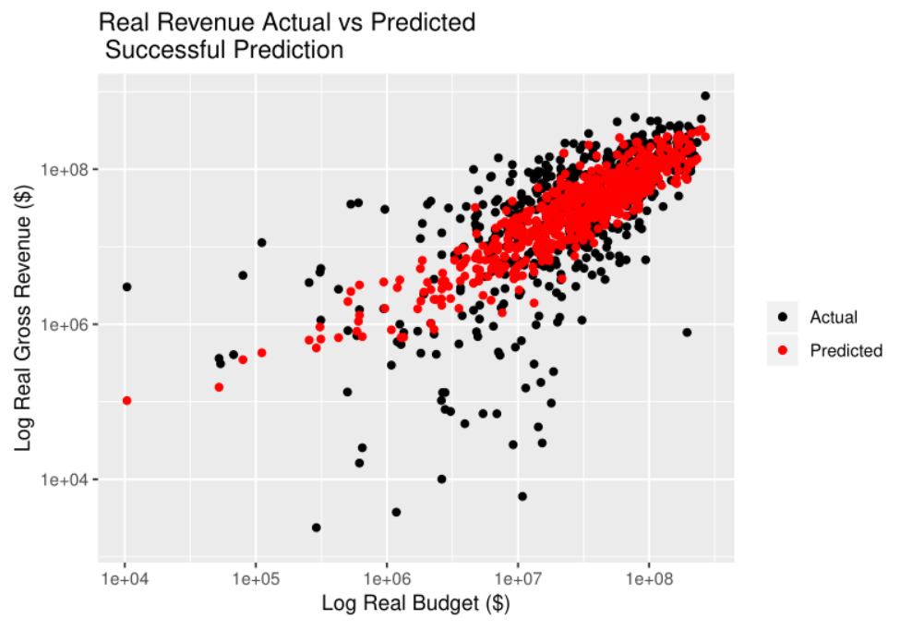
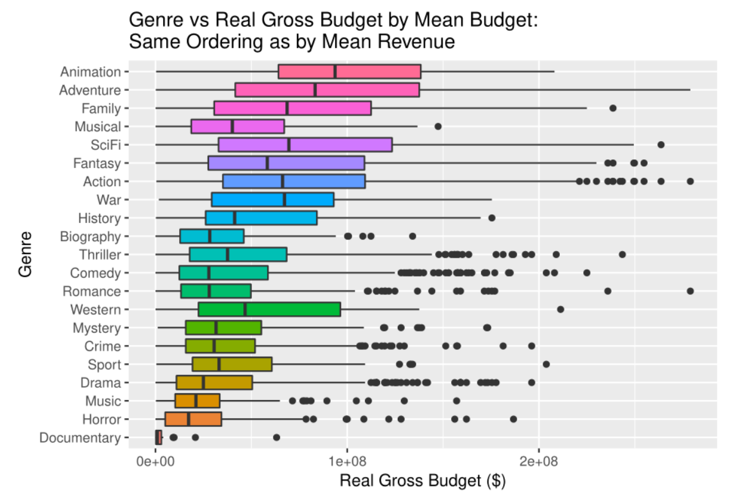
Final Model: Test Set
Notes:
Adventure is a genre that was in the original genre model but is now excluded: still predicted very well
Note that year is not significant at the .05 level – only .1 (was significant in training set)

Slide 6
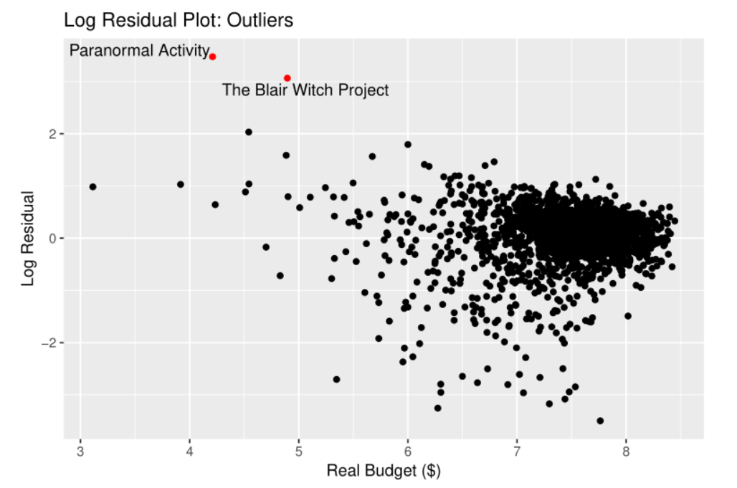
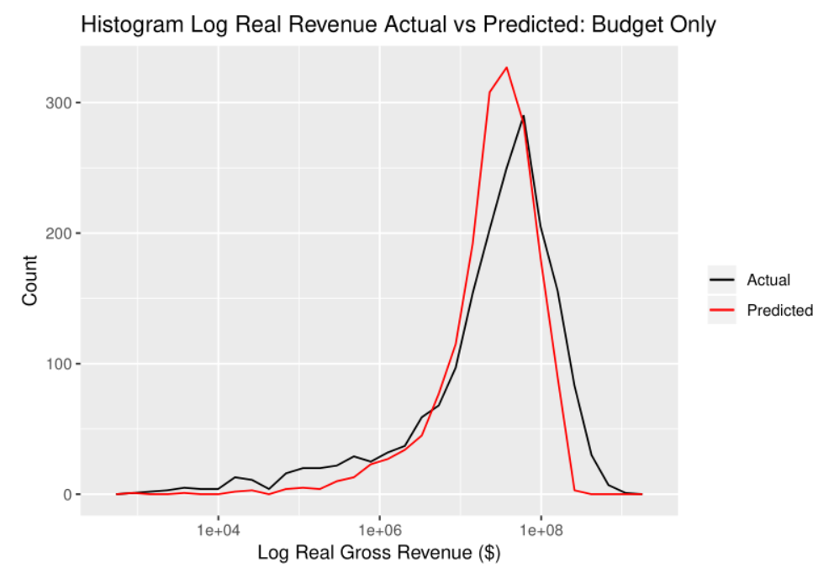
Take-aways
Budget fully captures genre
Budget almost fully captures entire relationship with revenue.
If fit a model with just log real budget as explanatory, the RMSE is .64 (final model: .58) and the R² is .43 (final model: .5)
However, our final model is better:
Anova comparsion: the more complex model is significantly different
Predicted vs actual revenue histogram with budget does not look nearly as good as when you include the other variables.
All models are wrong, but some are useful
Always movies that don’t fit these general patterns: Paranormal Activity and the Blair Witch Project have low budget, but high revenue
Notes:
Blair Witch Project and Paranormal Activity graphs are from final model on train set

Slide 7
$$log real revenue=β_{0}+β_{1}log real budget{+β_{2}log IMDB Score+β_{3}content rating+β_{4}\operatorname{year}{ }{ }{}}$$
Interpret the final model:
The Content Rating
Rating can break into 4 parts
PG and PG13 increase by 1 unit
Log Real Revenue increase by 0.238 and 0.134
NC17 and R increase by 1 unit
Log Real Revenue decrease by 0.498 and 0.125
The constant is the positive
We would have a revenue if all other variable equal to zero.
Not realistic for all variable equal to zero
Coefficients of Log Real Budget and Log IMDB Score are positive
Log Real Budget increase by one unit
Log Real Revenue increase by 0.800
Log IMDB Score increase by one unit
Log Real Revenue increase by 1.222
Coefficients for Content Rating

Slide 8
$$log real revenue=β_{0}+β_{1}log real budget{+β_{2}log IMDB Score+β_{3}content rating+β_{4}\operatorname{year}{ }{ }{}}$$
Interpret the final model(continue)
Year
We have a coefficient for every value of year.
Way too big to display in the slide
All individually insignificant
Significant altogether with ANOVA at 0.1 level
Genre is not included
All genres have random relationships with residual.
Do not need to include genre

Slide 9
Why these variable are in the model?
Real Budget
More money put in the budget
Better actors
Better visualization
Etc…
IMDB Score
Higher rating attracts more viewers
Reflect the overall quality of a movie
Content Rating
PG and PG13
Most of the people can watch the movie without any restriction
Cause a positive coefficient since more people can watch
NC17 and R
Only certain group of people can watch the movie
Put a restriction on the audience
Cause a relatively small negative coefficient
Real revenue can be positive if IMDB score and real budget are high

