Slide 1
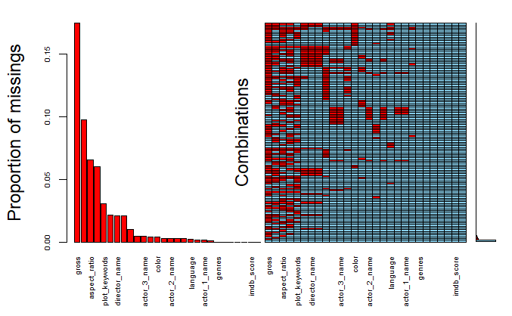
Data Tidying and Transformation
Trim white space from all character variables
Remove duplicated rows
The budget and revenue data are not in consistently US or local currency and there is no way to tell. Thus instead of the original plan to use an exchange rate and local deflator to get real US dollars, we are only using US films
Tidy genre column. Create one column per genre such that each is a dummy variable
Convert nominal US dollars to real dollars considering currency inflation

Slide 2
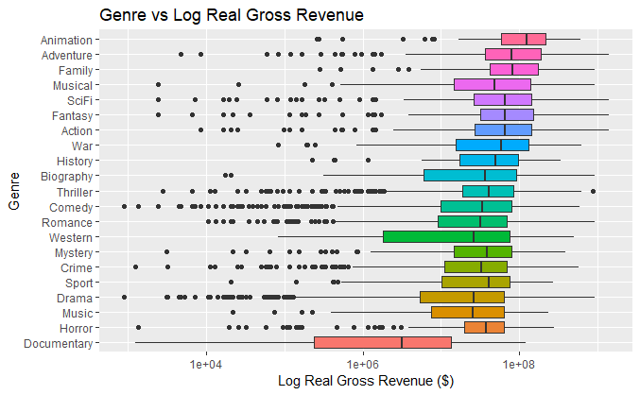
Exploratory Data Analysis
Bar graph of genre vs real revenue. Try boxplot and bar graph against average real revenue.Fairly clear differences in relationship with revenue by genre. Good candidate to include in model.

Slide 3
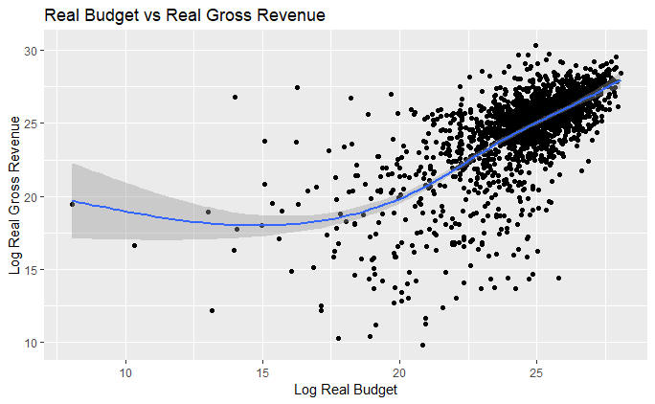
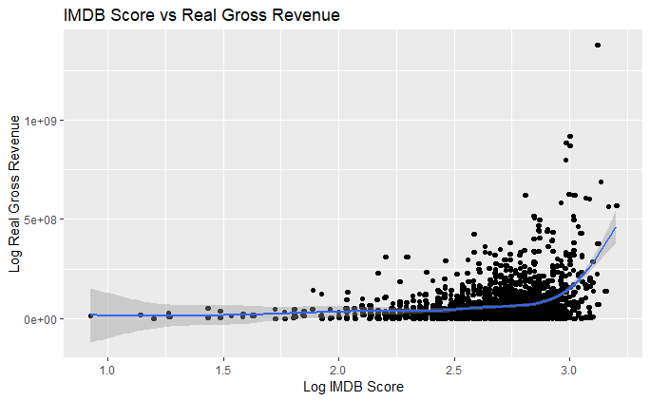
Exploratory Data Analysis
There is a positive linear relationship between log real gross revenue and real budget, IMDB score. Good candidate to include in model.

Slide 4
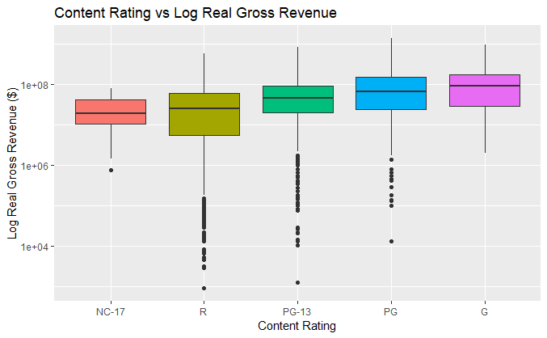
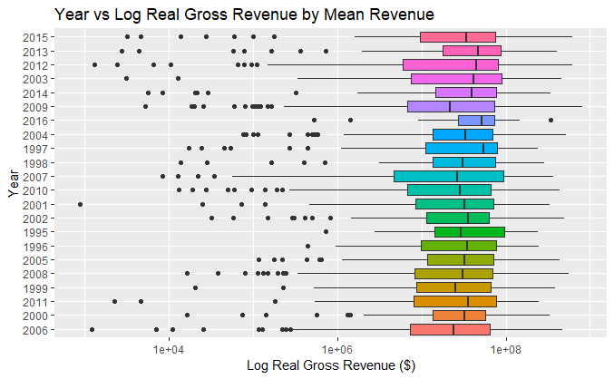
Exploratory Data Analysis
There is pattern between log real gross revenue and content rating, year. Good candidate to include in model.

