Slide 1

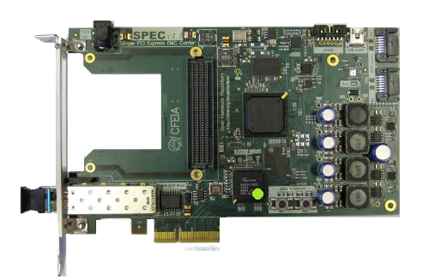
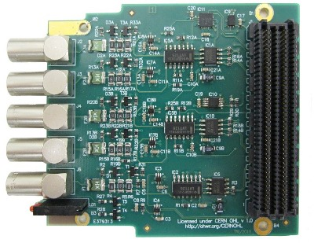
NIC project elements
Application
GN4124 drivers
FPGA gateware
Software (Linux PC)
Hardware
(2 SPEC + 2 FMC-DIO)
+

Slide 2
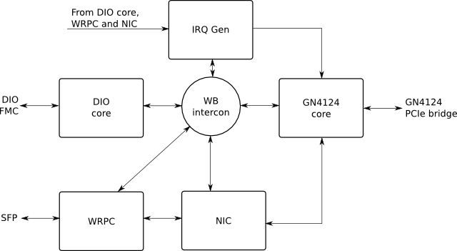
Basic on-chip architecture
From DIO, TxTSU and NIC
TxTSU

Slide 3
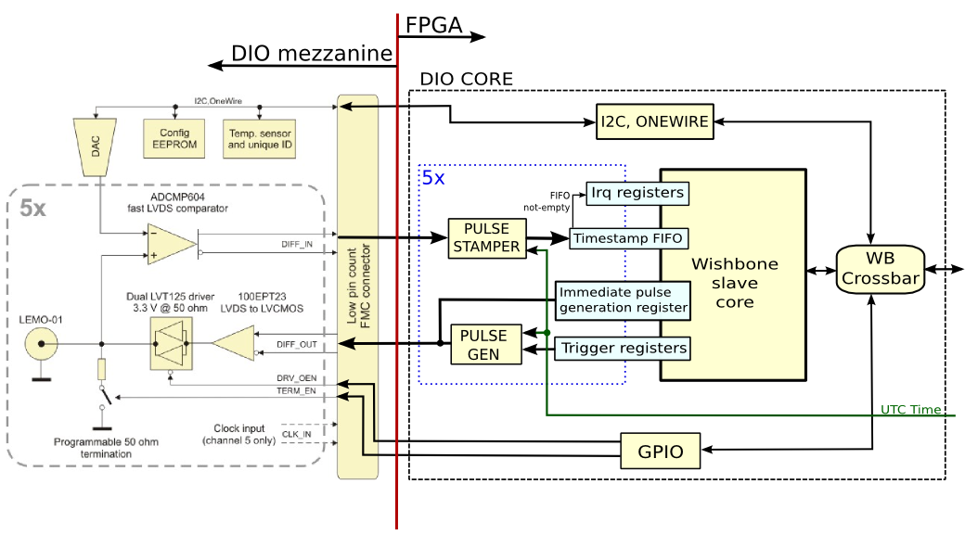
DIO core architecture
Open original → svg file with Inkscape

Slide 4
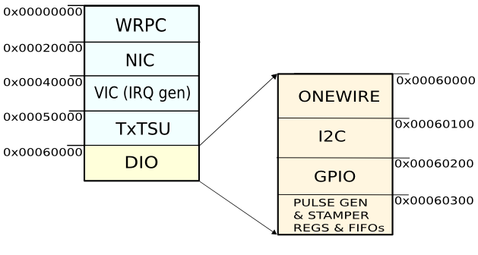
DIO core memory map
Within that memory space, the DIO core has mapped each one of the different modules that make up its architecture. Furthermore, any address within this memory space may be addressed by the PC to configure that modules (Onewire, I2C, GPIO ...).
0x00000000
0x00040000
Relative offsets
0x00060000
0x00000000
0x00061000
0x00000100
0x00062000
0x00000200
0x00000300
Open original → svg file with Inkscape

