Slide 1
Overview of ADB
Software Engineering CSE435
Michigan State University
Fall 2025
Team members:
  Project Manager: Anthony Ghaith
  Facilitator: Naod Ghebredngl
  Artifacts Manager: Seth Neubauer
  Customer Liaison: Almostafa Aalabdulrasul
  Configuration Manager: Matthew Vazquez
Customer: Mr. Jacob Rhodes
Instructor: Dr. Betty H.C. Cheng*
*Please direct all inquiries to the instructor.
Notes:
‹#›

Slide 2
Project Overview
The Adaptive Driving Beam (ADB) System provides maximum visibility while preventing glare to drivers
Motivation for project
  Better visibility at night
  Improve safety and comfort during nighttime driving
Notes:
‹#›

Slide 3
Overview of Features
Aligns beam angle with curvature of the road
Adjusts illumination levels to improve visibility
Updates beam pattern according to the current weather conditions
Notes:
‹#›

Slide 4
Domain Research
Investigated headlight functionality and restrictions
Needed to apply functionality to scenarios
Project Constraints
  Must minimize glare to oncoming vehicles
  Must fail safely if sensor fault detected
  Detect conditions with vehicle’s built in detection hardware
Notes:
‹#›

Slide 5
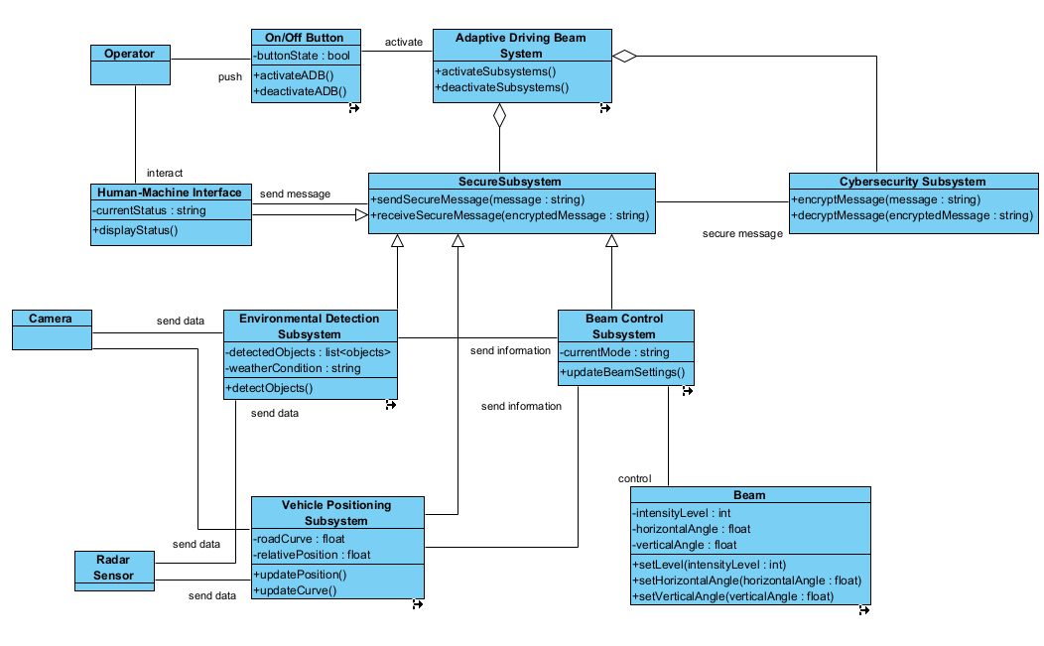
Part II: Model-based View of System
Notes:
‹#›

Slide 6
Activating System
Notes:
‹#›

Slide 7
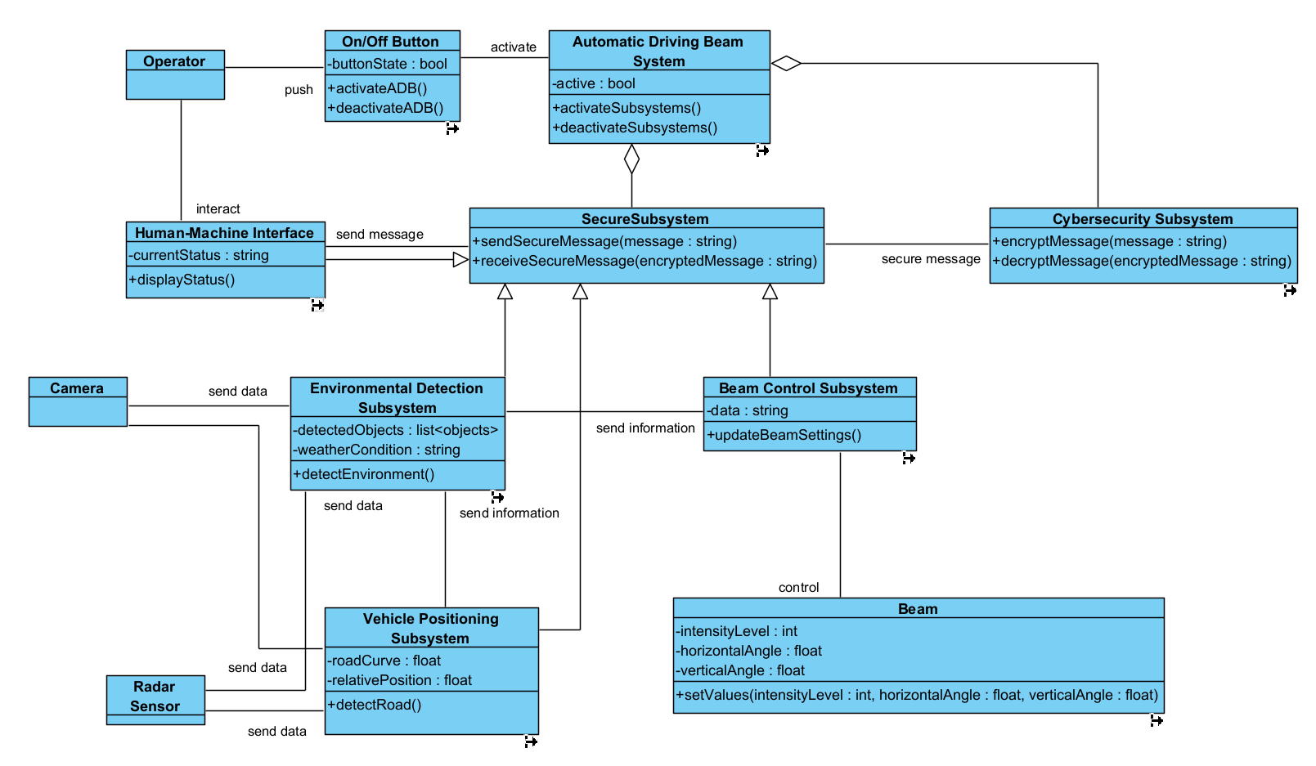
Securing Messages
Notes:
‹#›

Slide 8
Sending Commands to Beam
Notes:
‹#›

Slide 9
Alerting Driver
Notes:
‹#›

Slide 10
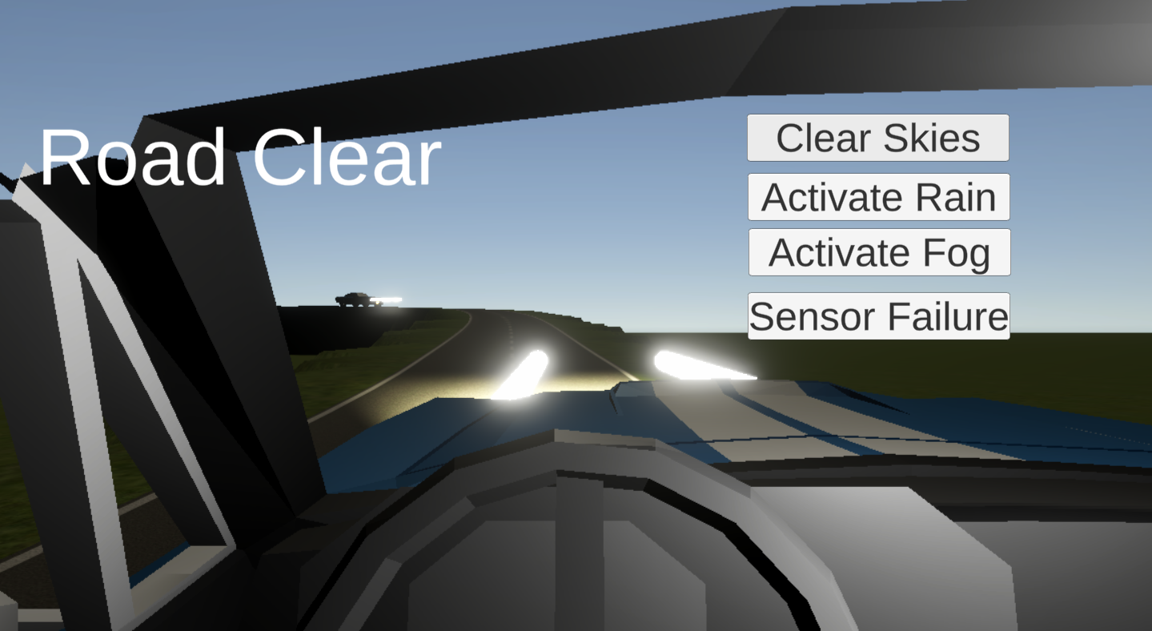
Part III: Demonstration
The demo showcases a car on a track
Buttons allow user to interact with environment
Notes:
‹#›

Slide 11
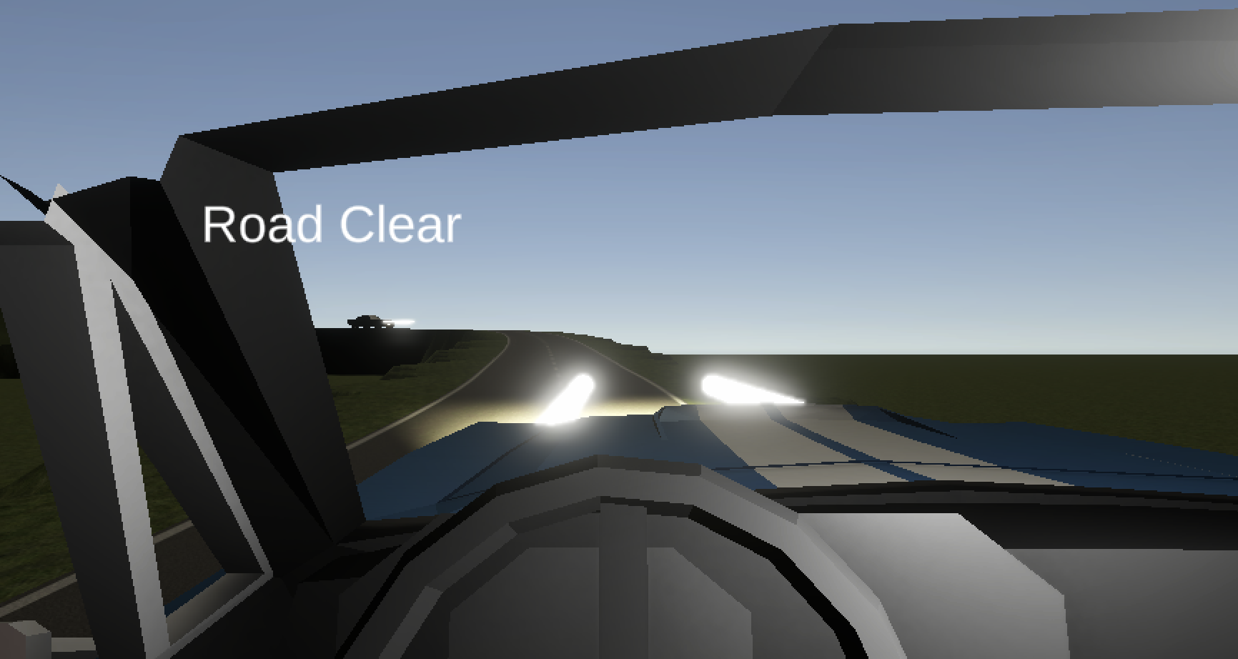
Scenario 1
ADB system with road clear
Notes:
‹#›

Slide 12
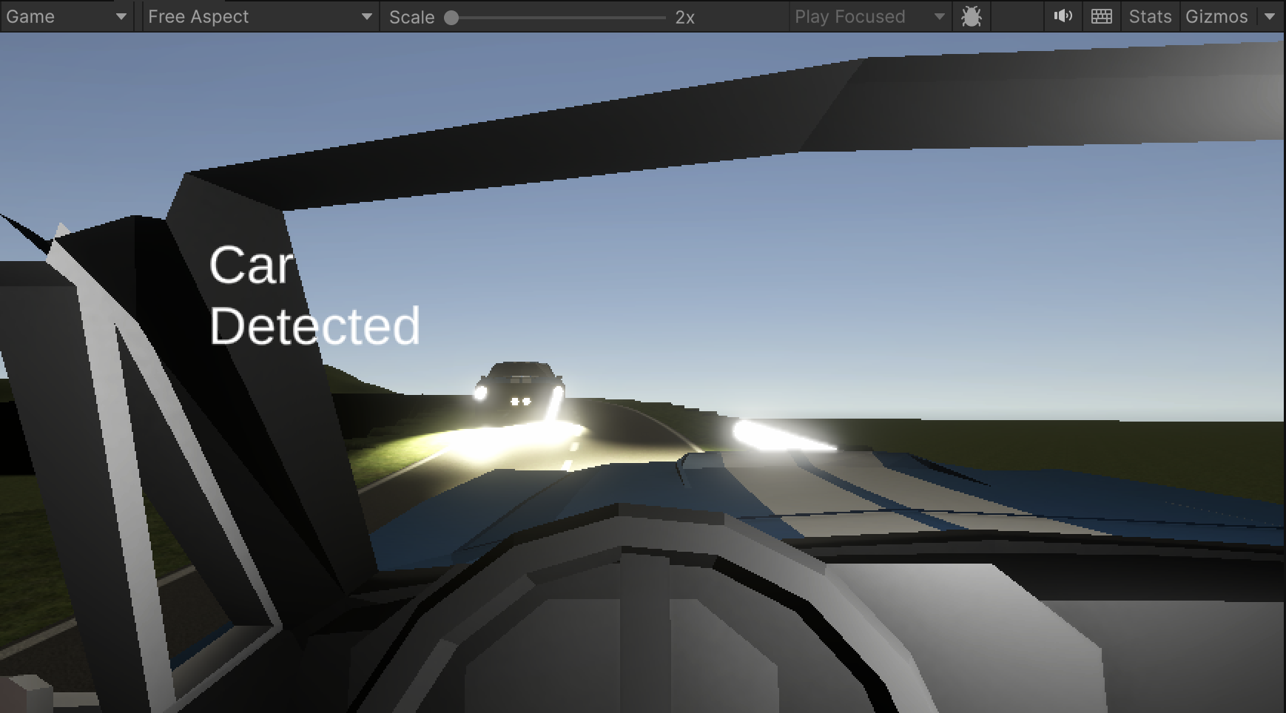
Scenario 2
ADB system when car detected
Notes:
‹#›

Slide 13
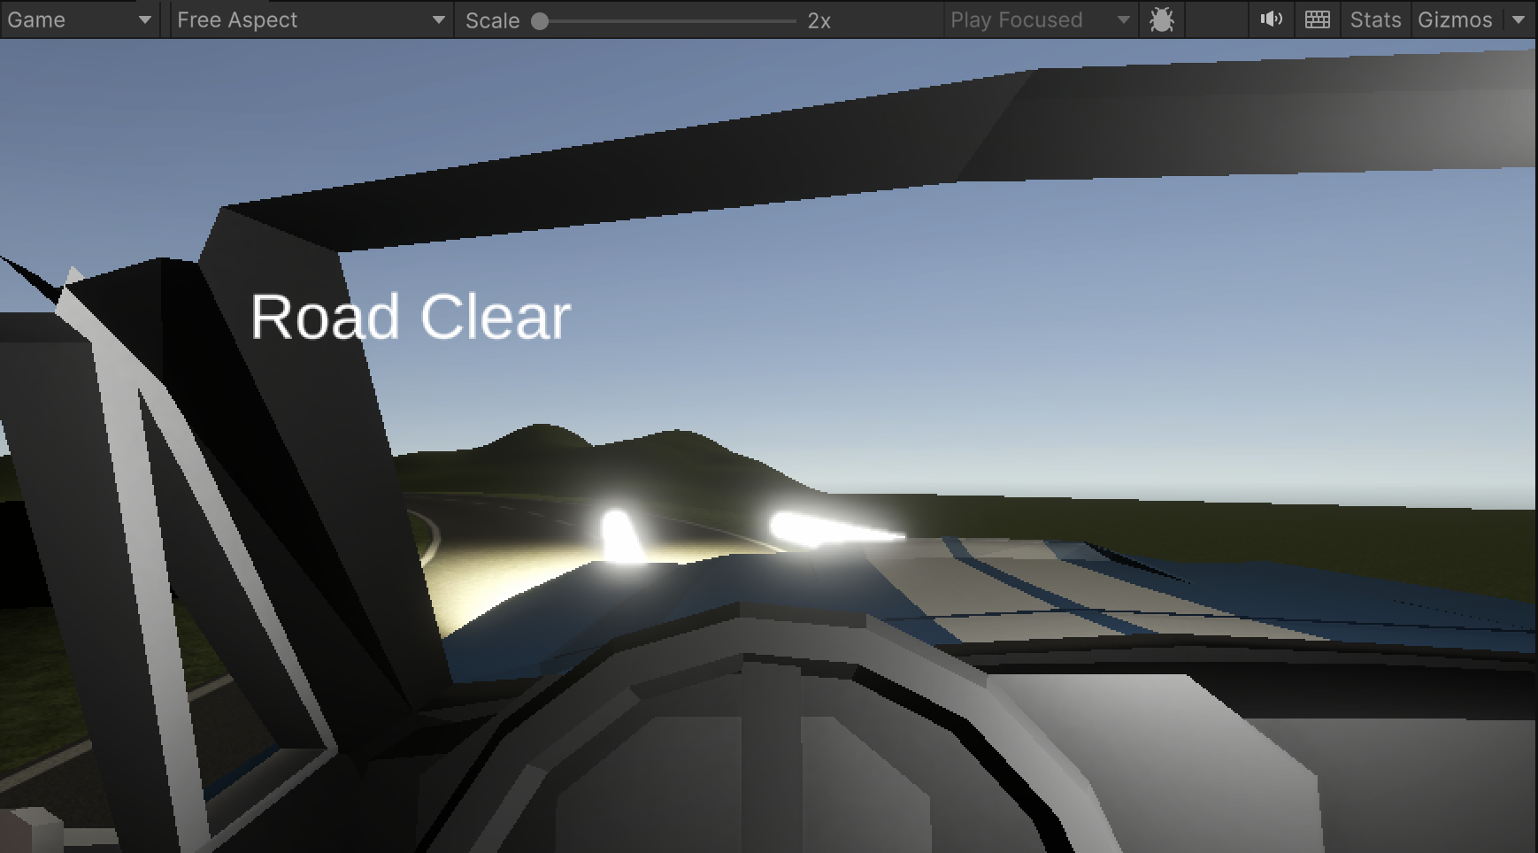
Scenario 3
ADB system when curves/elevation change detected
Notes:
‹#›

Slide 14
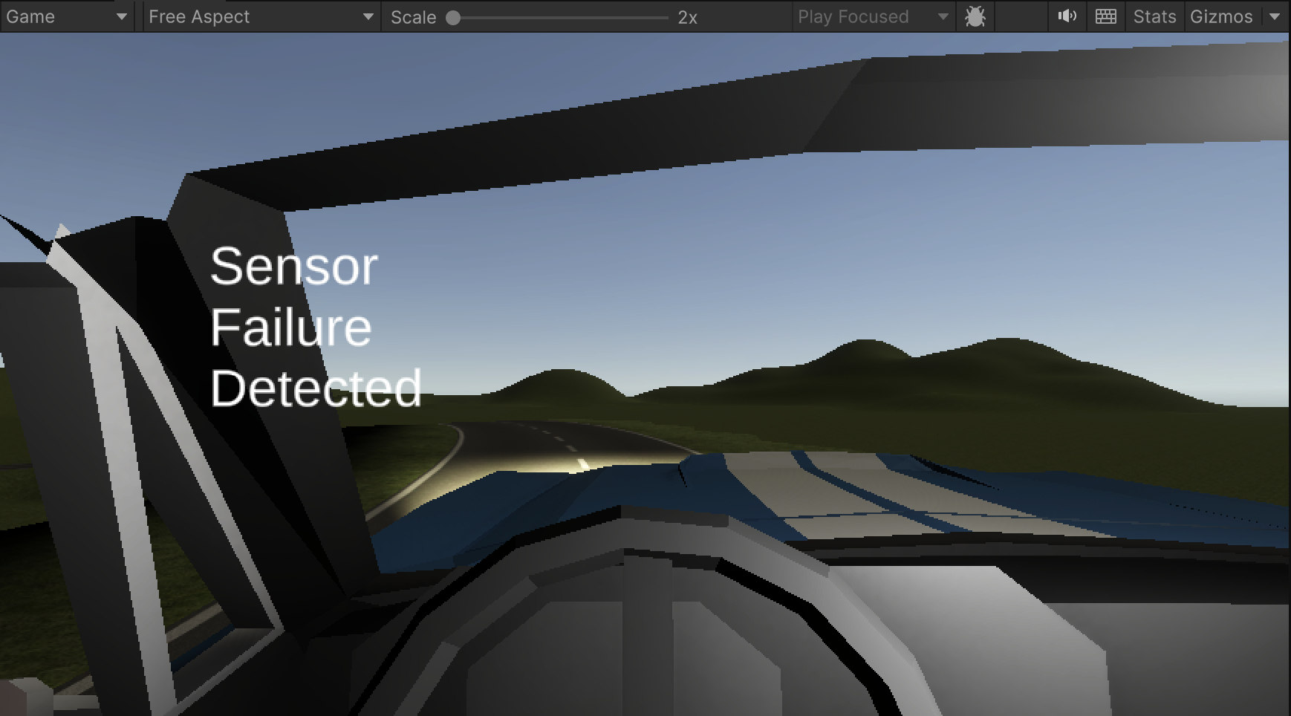
Scenario 4
ADB system when failure detected
Notes:
‹#›

Slide 15
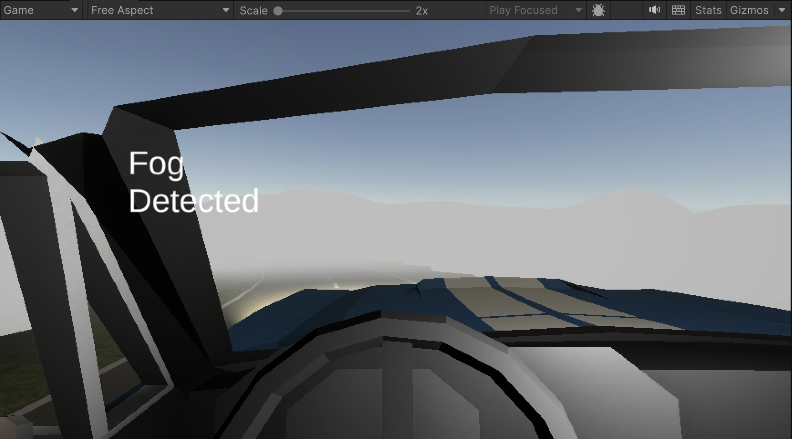
Scenario 5
ADB system when fog detected
Notes:
‹#›

Slide 16
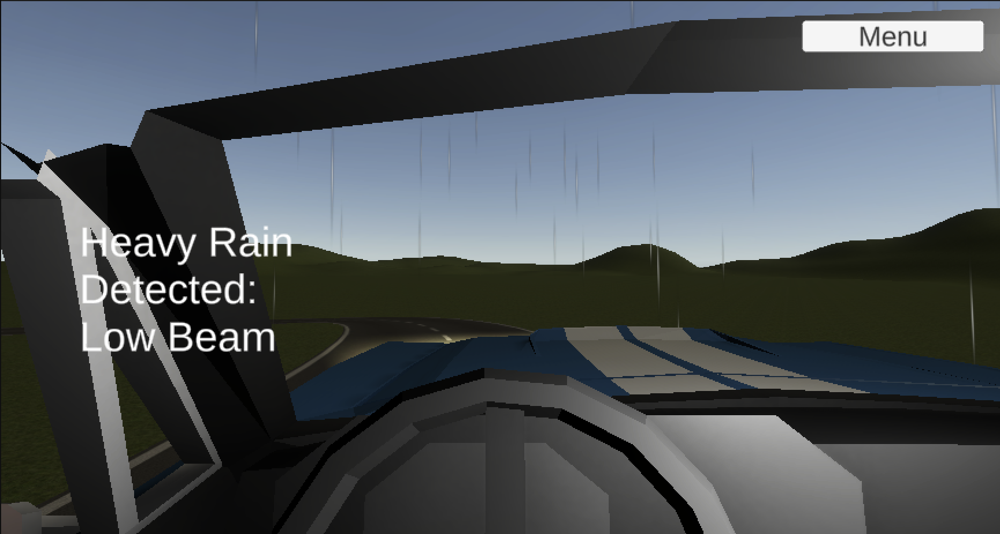
Scenario 6
ADB system when heavy rain detected
Notes:
‹#›

Slide 17
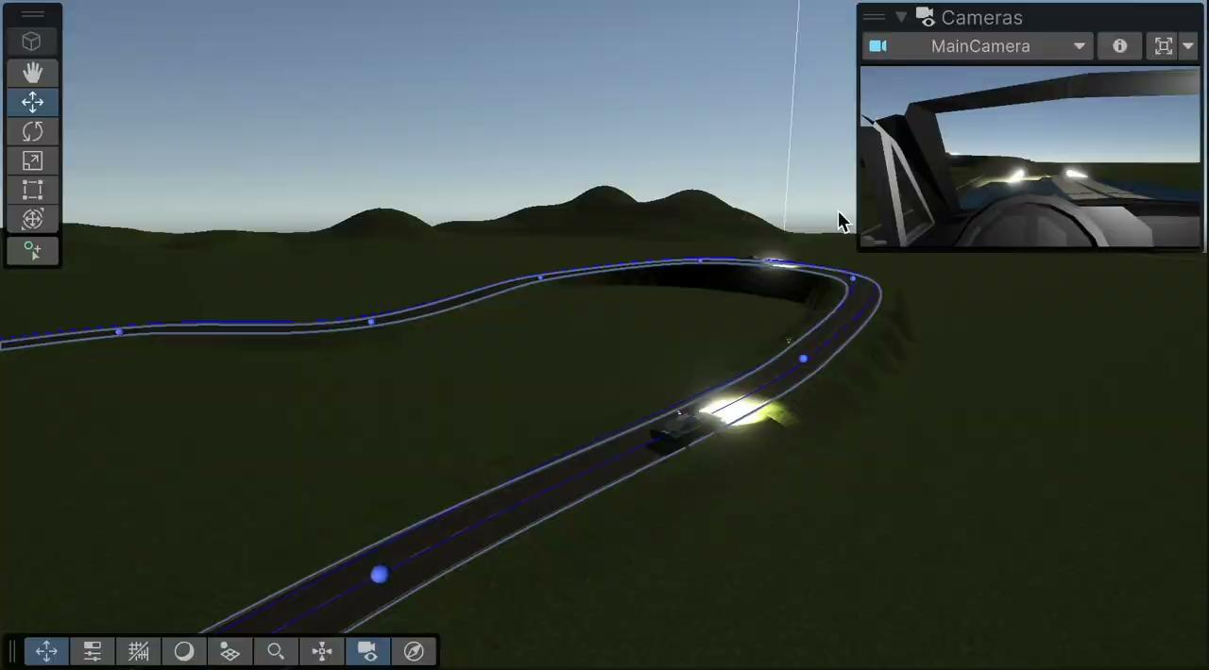
Part III: Demonstration
Notes:
‹#›

Slide 18
Acknowledgements
We gratefully acknowledge and appreciate the participation of our customer, Mr. Jacob Rhodes from Flex-N-Gate
Thank you to Professor Cheng, Kira, and Sol for teaching us this semester

