Slide 1
NLP Programming Tutorial 0 -
Python Programming Basics
Graham Neubig
Nara Institute of Science and Technology (NAIST)

Slide 2
About this Tutorial
14 parts, starting from easier topics
Each time:
  During the tutorial: Learn something new
  At home or here: Do a programming exercise
  Next week: Talk about results with your neighbor
Programming language is your choice
  Examples will be in Python, so it is recommended
  I can help with Python, C++, Java, Perl
Working in pairs is encouraged

Slide 3
Setting Up Your Environment

Slide 4
Open a Terminal
If you are on Linux or Mac
  From the program menu select “terminal”
If you are on Windows
  Install cygwin
  or use “ssh” to log in to a Linux machine

Slide 5
Install Software (if necessary)
3 types of software:
  python: the programming language
  a text editor (gvim, emacs, etc.)
  git: A version control system
Linux:
  sudo apt-get install git vim-gnome python
Windows:
  Run cygwin setup.exe, select “git”, “gvim”, and “python”

Slide 6
Download the Tutorial Files from Github
Use the git “clone” command to download the code
You should find this PDF in the downloaded directory
$ git clone https://github.com/neubig/nlptutorial.git
$ cd nlptutorial
$ ls download/00-intro/nlp-programming-en-00-intro.pdf

Slide 7
Using gvim
You can use any text editor, but if you are using vim:
If it is your first time, you may want to copy my vim settings file, which will make vim easier to use:
Open vim:
Press “i” to start input and write “test”
Press escape, and type “:wq” to save and quit
(“:w” is save, “:q” is quit)
$ cp misc/vimrc ~/.vimrc
$ gvim test.txt

Slide 8
Using git
You can use git to save your progress
First, add the changed file
And save your change
(Enter a message like “added a test file”)
Using git, you can do things like go back to your last commit (git reset), download the latest updates (git pull), or upload code to github (git push)
$ git add test.txt
$ git commit

Slide 9
Basic Programming

Slide 10

Hello World!
Open my-program.py in an editor (gvim, emacs, gedit)
Type in the following program
Make the program executable
Run the program
$ gvim my-program.py
$ chmod 755 my-program.py
$ ./my-program.py
Hello World!

Slide 11
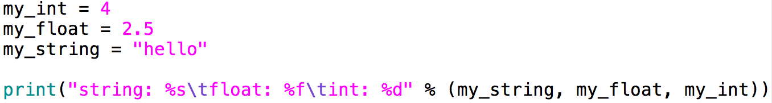
Main data types used
Strings: “hello”, “goodbye”
Integers: -1, 0, 1, 3
Floats: -4.2, 0.0, 3.14
$ ./my-program.py
string: hello float: 2.500000 int: 4

Slide 12
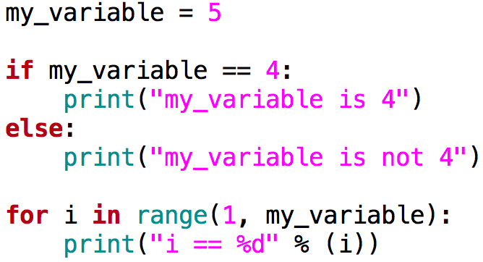
if/else, for
if this condition is true
then do this
otherwise
do this
for every element in this
do this
$ ./my-program.py
my_variable is not 4
i == 1
i == 2
i == 3
i == 4
Be careful!
range(1, 5) == (1, 2, 3, 4)

Slide 13
Storing many pieces of data
Dense Storage
Sparse Storage
Index | Value
0 | 20
1 | 94
2 | 10
3 | 2
4 | 0
5 | 19
6 | 3
Index | Value
49 | 20
81 | 94
96 | 10
104 | 2
or
Index | Value
apple | 20
banana | 94
cherry | 10
date | 2

Slide 14
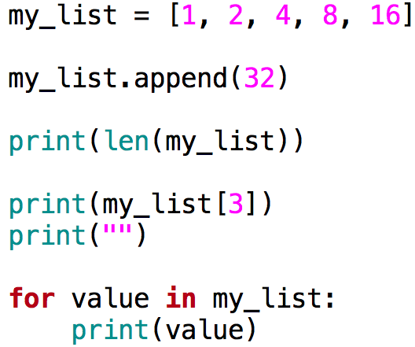
Arrays (or “lists” in Python)
Good for dense storage
Index is an integer, starting at 0
Make a list with 5 elements
Add one more element to
the end of the list
Print the length of the list
Print the 4th element
Loop through and print
every element of the list

Slide 15
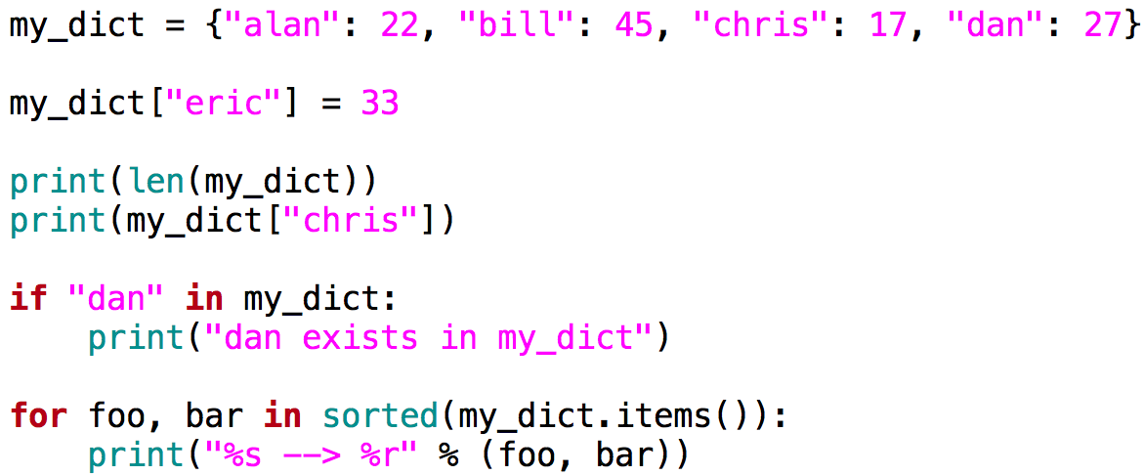
Maps (or “dictionaries” in Python)
Good for sparse storage:
create pairs of key/value
add a new entry
print size
print one entry
check whether a
key exists
print key/value
pairs in order

Slide 16
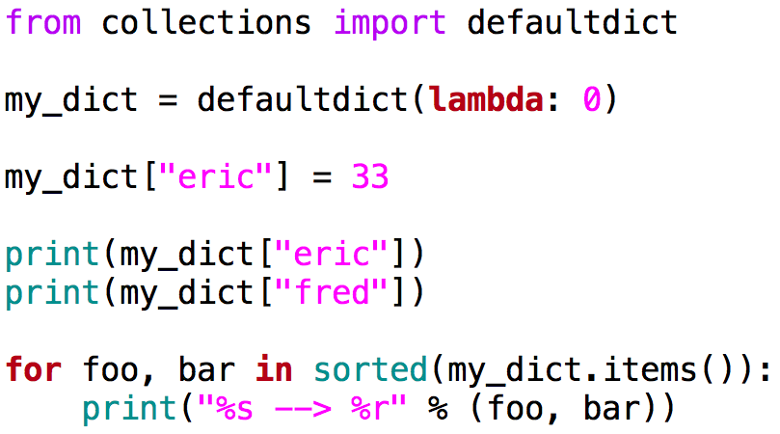
defaultdict
A useful expansion on dictionary with a default value
import library
default value of zero
print existing key
print non-existent key

Slide 17
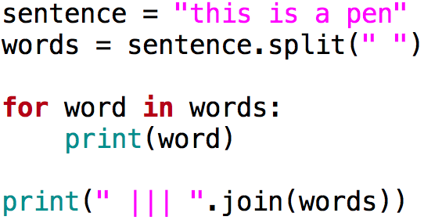
Splitting and joining strings
In NLP: often split sentences into words
Split string at white space
into an array of words
Combine the array into
a single string, separating
with “ ||| “
$ ./my-program.py
...
this ||| is ||| a ||| pen

Slide 18
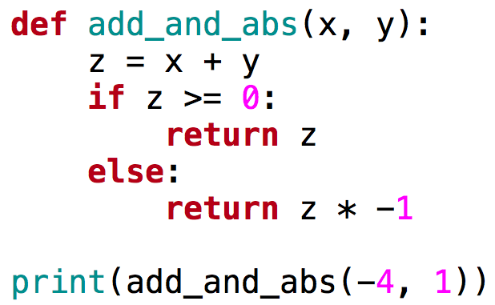
Functions
Functions take an input, transform the input, and return an output
function add_and_abs takes
“x” and “y” as input
add x and y together and
return the absolute value
call add_and_abs with
x=-4 and y=1

Slide 19
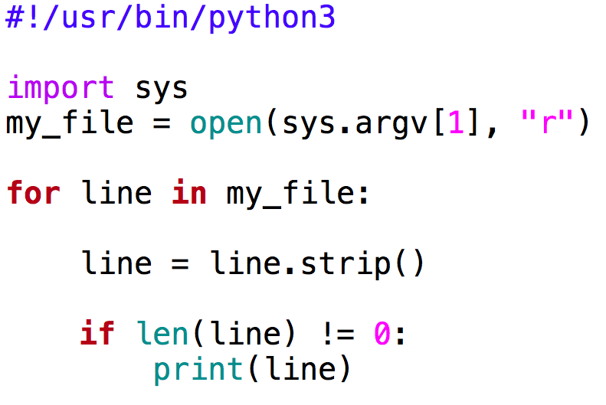
Using command line arguments/
Reading files
First argument
Open file for reading with “r”
Read the file one line at a time
Delete the line end symbol “\n”
If the line is not empty, print
$ ./my-program.py test.txt

Slide 20
Testing Your Code

Slide 21
Simple Input/Output Tests
Example:
Program word-count.py should count the words in a file
1) Create a small input file
2) Count the words by hand, write them in an output file
3) Run the program
4) Compare the results
test-word-count-in.txt
test-word-count-out.txt
a b c
b c d
a 1
b 2
c 2
d 1
$ ./word-count.py test-word-count-in.txt > word-count-out.txt
$ diff test-word-count-out.txt word-count-out.txt

Slide 22
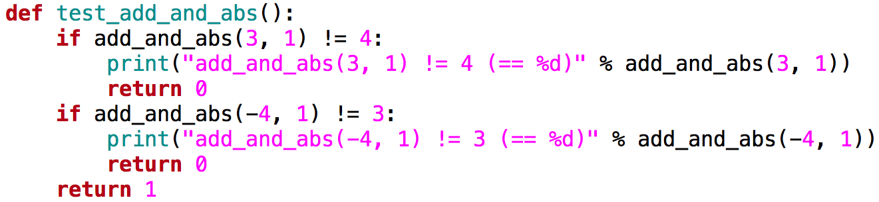
Unit Tests
Write code to test each function
Test several cases, and print an error if result is wrong
Return 1 if all tests passed, 0 otherwise

Slide 23
ALWAYS Test your Code
Creating tests:
  Makes you think about the problem before writing code
  Will reduce your debugging time drastically
  Will make your code easier to understand later

Slide 24
Practice Exercise

Slide 25
Practice Exercise
Make a program that counts the frequency of words in a file
Test it on test/00-input.txt, test/00-answer.txt
Run the program on the file data/wiki-en-train.word
Report:
  The number of unique words
  The frequencies of the first few words in the list
a 1
is 2
my 1
pen 3
this 2
this is a pen
this pen is my pen

Slide 26
Pseudo-code
create a dictionary counts create a map to hold counts
open a file
for each line in the file
split line into words
for w in words
if w exists in counts, add 1 to counts[w]
else set counts[w] = 1
print key, value of counts

