Slide 1

FORMATION / CUDA C++
neudinger / formation
Original NVIDIA figures
Editable lesson text and code
DAY 1
CUDA Foundations
Programming model. Correct kernels. Memory access. Cooperation.
Original CUDA cover artwork · supplied NVIDIA Programming Guide, PDF p. 1
FORMATION / INDEPENDENT CUDA TRAINING
01
Notes:
Welcome. This revision retains the original Day 1 learning path, code examples and labs, but replaces the original deck's redrawn technical diagrams and analytical chart with original NVIDIA figures extracted from the uploaded guide. The guide is Release 13.4.2, dated 10 September 2026. The teaching deck is independently authored and is not an official NVIDIA course. No source artwork is redrawn, recolored or generated.
SOURCE AND ATTRIBUTION
NVIDIA source edition: CUDA Programming Guide, Release 13.4.2, NVIDIA Corporation, 10 September 2026. Source of figure pixels: user-supplied cuda-programming-guide.pdf.
Original CUDA cover artwork · supplied NVIDIA Programming Guide, PDF p. 1
Cover artwork: printed page cover; PDF page 1; embedded image xref 9; 948×317 pixels.
Image SHA-256: 8525c91f9095219325160e8e7d53cf9a5529ecf10ed3f8c3ada8d3c11260a5a0
Embedded image with PDF transparency mask restored; no redraw or recoloring.
COURSE / TOOLING REFERENCES (distinct from the PDF artwork)
https://github.com/neudinger/formation
IMAGE REVISION
Technical illustrations are original NVIDIA artwork from the uploaded PDF; none are redrawn or generated. Native text, code, source captions and layout elements are independently authored. Full source figures are kept intact and scaled proportionally. No claim of NVIDIA affiliation or endorsement.
VALIDATION BOUNDARY
This revision validates presentation layout and image provenance. It does not establish successful compilation or execution of the retained CUDA examples on a GPU.

Slide 2
LEARNING OUTCOMES
By 17:00, explain the kernel—not just the command
01
02
03
Explain
Implement
Verify
Locate a thread in its grid.
Distinguish software groups
from GPU hardware.
Turn a CPU reference into
a bounded CUDA kernel
and a clear host workflow.
Test boundaries, inspect
access patterns, and justify
a synchronization point.
Evidence: correct output, a thread/data explanation, and a justified memory-access prediction.
Course learning objectives; guide alignment: §§1.2, 2.1 and 2.3
FORMATION / INDEPENDENT CUDA TRAINING
02
Notes:
By 17:00, explain the kernel—not just the command
Preserve the three outcome groups from the first deck. These are course objectives, not quotations from NVIDIA. Students should give an ownership explanation, a host/device data-path explanation, and a test-based correctness argument. Memory-access statements should be identified as predictions unless supported by measurements.
SOURCE AND ATTRIBUTION
NVIDIA source edition: CUDA Programming Guide, Release 13.4.2, NVIDIA Corporation, 10 September 2026. Source of figure pixels: user-supplied cuda-programming-guide.pdf.
Course learning objectives; guide alignment: §§1.2, 2.1 and 2.3
No illustration on this slide: editable explanatory text/code only.
COURSE / TOOLING REFERENCES (distinct from the PDF artwork)
https://github.com/neudinger/formation
IMAGE REVISION
Technical illustrations are original NVIDIA artwork from the uploaded PDF; none are redrawn or generated. Native text, code, source captions and layout elements are independently authored. Full source figures are kept intact and scaled proportionally. No claim of NVIDIA affiliation or endorsement.
VALIDATION BOUNDARY
This revision validates presentation layout and image provenance. It does not establish successful compilation or execution of the retained CUDA examples on a GPU.

Slide 3
SCHEDULE
One day. Four connected learning blocks.
TIME
LEARNING BLOCK
PRACTICE
09:00–10:15
Programming model
GPU/CPU checkpoint · Lab 1
10:30–12:15
First CUDA feature
Kernel + correctness · Lab 2
13:15–15:00
Memory-access patterns
Transpose investigation · Lab 3
15:15–16:40
Thread cooperation
Reduction investigation · Lab 4
16:40–17:00
Review and evidence check
Prepare for Day 2
Breaks: 10:15–10:30 and 15:00–15:15 | Lunch: 12:15–13:15
Workshop schedule; the underlying concepts are mapped to the guide in the speaker notes.
FORMATION / INDEPENDENT CUDA TRAINING
03
Notes:
One day. Four connected learning blocks.
The existing four labs and pacing are retained. Allocate 25 minutes to Lab 1, 55 minutes to Lab 2, 40 minutes to Lab 3, and 35 minutes to Lab 4. Protect debrief time. Slides 49–54 are reference material, not an additional required teaching block.
SOURCE AND ATTRIBUTION
NVIDIA source edition: CUDA Programming Guide, Release 13.4.2, NVIDIA Corporation, 10 September 2026. Source of figure pixels: user-supplied cuda-programming-guide.pdf.
Workshop schedule; the underlying concepts are mapped to the guide in the speaker notes.
No illustration on this slide: editable explanatory text/code only.
COURSE / TOOLING REFERENCES (distinct from the PDF artwork)
https://github.com/neudinger/formation/blob/main/followup/presentation-1-followup.md
IMAGE REVISION
Technical illustrations are original NVIDIA artwork from the uploaded PDF; none are redrawn or generated. Native text, code, source captions and layout elements are independently authored. Full source figures are kept intact and scaled proportionally. No claim of NVIDIA affiliation or endorsement.
VALIDATION BOUNDARY
This revision validates presentation layout and image provenance. It does not establish successful compilation or execution of the retained CUDA examples on a GPU.

Slide 4
BEFORE THE FIRST LAB
Prepare the machine once; focus on CUDA today
EXISTING REPOSITORY
COMPANION LAB PACK
Use projects/detailed for the reference.
Run its declared toolchain and targets.
Labs 3–4 use day1_extensions.
Install one starter or solution copy.
EXISTING EXERCISE MODULES
TRAINER PREFLIGHT
Use tp/day1/ex01…ex05 for starter work.
Each is a separate Bazel module.
Check driver, GPU access, compilation,
correctness tests and diagnostic tools.
Guide edition ≠ lab toolchain version. Revalidate the actual teaching machine before delivery.
Existing Day 1 course setup; uploaded guide is Release 13.4.2, not a change to the lab toolchain.
FORMATION / INDEPENDENT CUDA TRAINING
04
Notes:
Prepare the machine once; focus on CUDA today
The previous course baseline was projects/detailed with CUDA 12.8.0 and Clang 20.1.8 on its documented Linux path. The newer source-guide edition does not upgrade that project. Preserve the original lab pack and its limitations. It still requires a real-GPU preflight. The present revision validates slide composition and original-figure provenance only; no new CUDA compilation or GPU execution is claimed.
SOURCE AND ATTRIBUTION
NVIDIA source edition: CUDA Programming Guide, Release 13.4.2, NVIDIA Corporation, 10 September 2026. Source of figure pixels: user-supplied cuda-programming-guide.pdf.
Existing Day 1 course setup; uploaded guide is Release 13.4.2, not a change to the lab toolchain.
No illustration on this slide: editable explanatory text/code only.
COURSE / TOOLING REFERENCES (distinct from the PDF artwork)
https://github.com/neudinger/formation/blob/main/projects/detailed/MODULE.bazel
https://github.com/neudinger/formation/blob/main/projects/detailed/.bazelrc
https://github.com/neudinger/formation/blob/main/.devcontainer/README.md
IMAGE REVISION
Technical illustrations are original NVIDIA artwork from the uploaded PDF; none are redrawn or generated. Native text, code, source captions and layout elements are independently authored. Full source figures are kept intact and scaled proportionally. No claim of NVIDIA affiliation or endorsement.
VALIDATION BOUNDARY
This revision validates presentation layout and image provenance. It does not establish successful compilation or execution of the retained CUDA examples on a GPU.

Slide 5
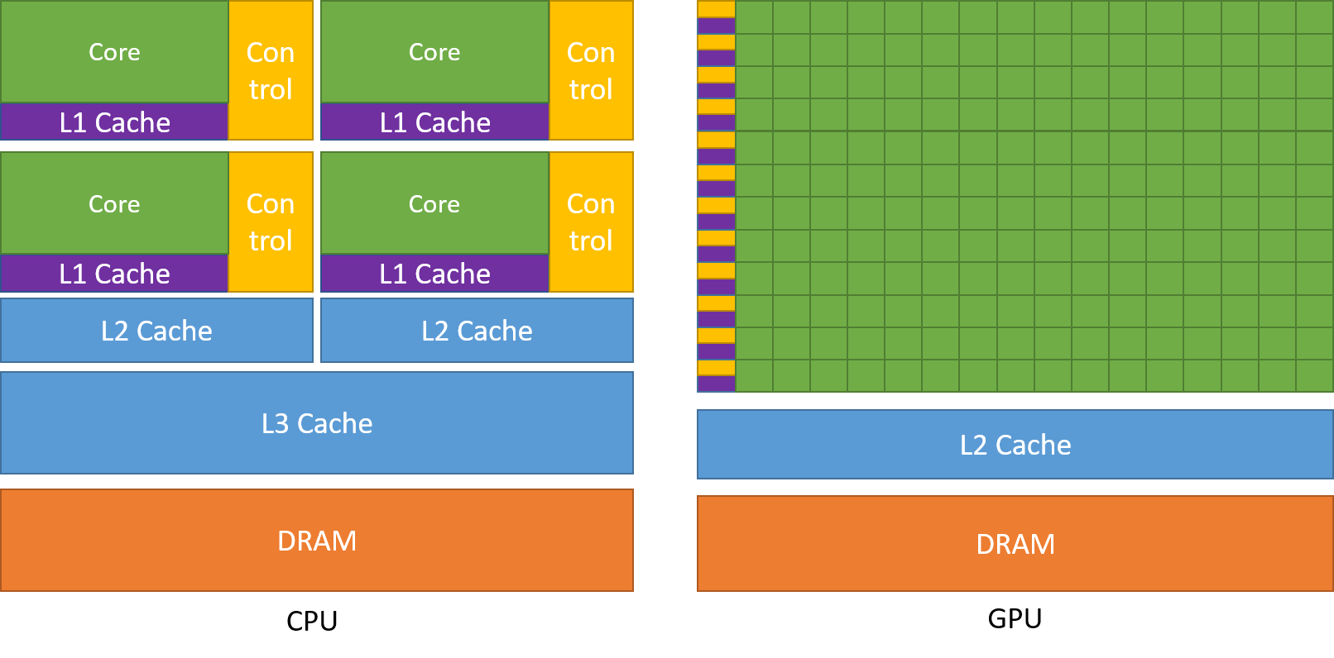
DAY 1 / 01
Think in parallel
01
CPU and GPU designs prioritize
different kinds of work.
NVIDIA Figure 1 · Guide p. 4 / PDF p. 22
NVIDIA Figure 1 · Guide §1.1.2, p. 4 / PDF p. 22
FORMATION / INDEPENDENT CUDA TRAINING
05
Notes:
Think in parallel
Use NVIDIA Figure 1 as a conceptual comparison of resource distribution, not as a die photograph or a numerical performance comparison. The text in §1.1.2 contrasts fast serial execution with much greater aggregate throughput from many GPU threads. No universal application speedup follows from the figure.
SOURCE AND ATTRIBUTION
NVIDIA source edition: CUDA Programming Guide, Release 13.4.2, NVIDIA Corporation, 10 September 2026. Source of figure pixels: user-supplied cuda-programming-guide.pdf.
NVIDIA Figure 1 · Guide §1.1.2, p. 4 / PDF p. 22
Figure 1: printed page 4; PDF page 22; embedded image xref 840; 1612×796 pixels.
Image SHA-256: 8701a6d804899af083e57dcb6c3afda46e79bb67a4273954c72ce92de7421719
Embedded image with PDF transparency mask restored; no redraw or recoloring.
IMAGE REVISION
Technical illustrations are original NVIDIA artwork from the uploaded PDF; none are redrawn or generated. Native text, code, source captions and layout elements are independently authored. Full source figures are kept intact and scaled proportionally. No claim of NVIDIA affiliation or endorsement.
VALIDATION BOUNDARY
This revision validates presentation layout and image provenance. It does not establish successful compilation or execution of the retained CUDA examples on a GPU.

Slide 6
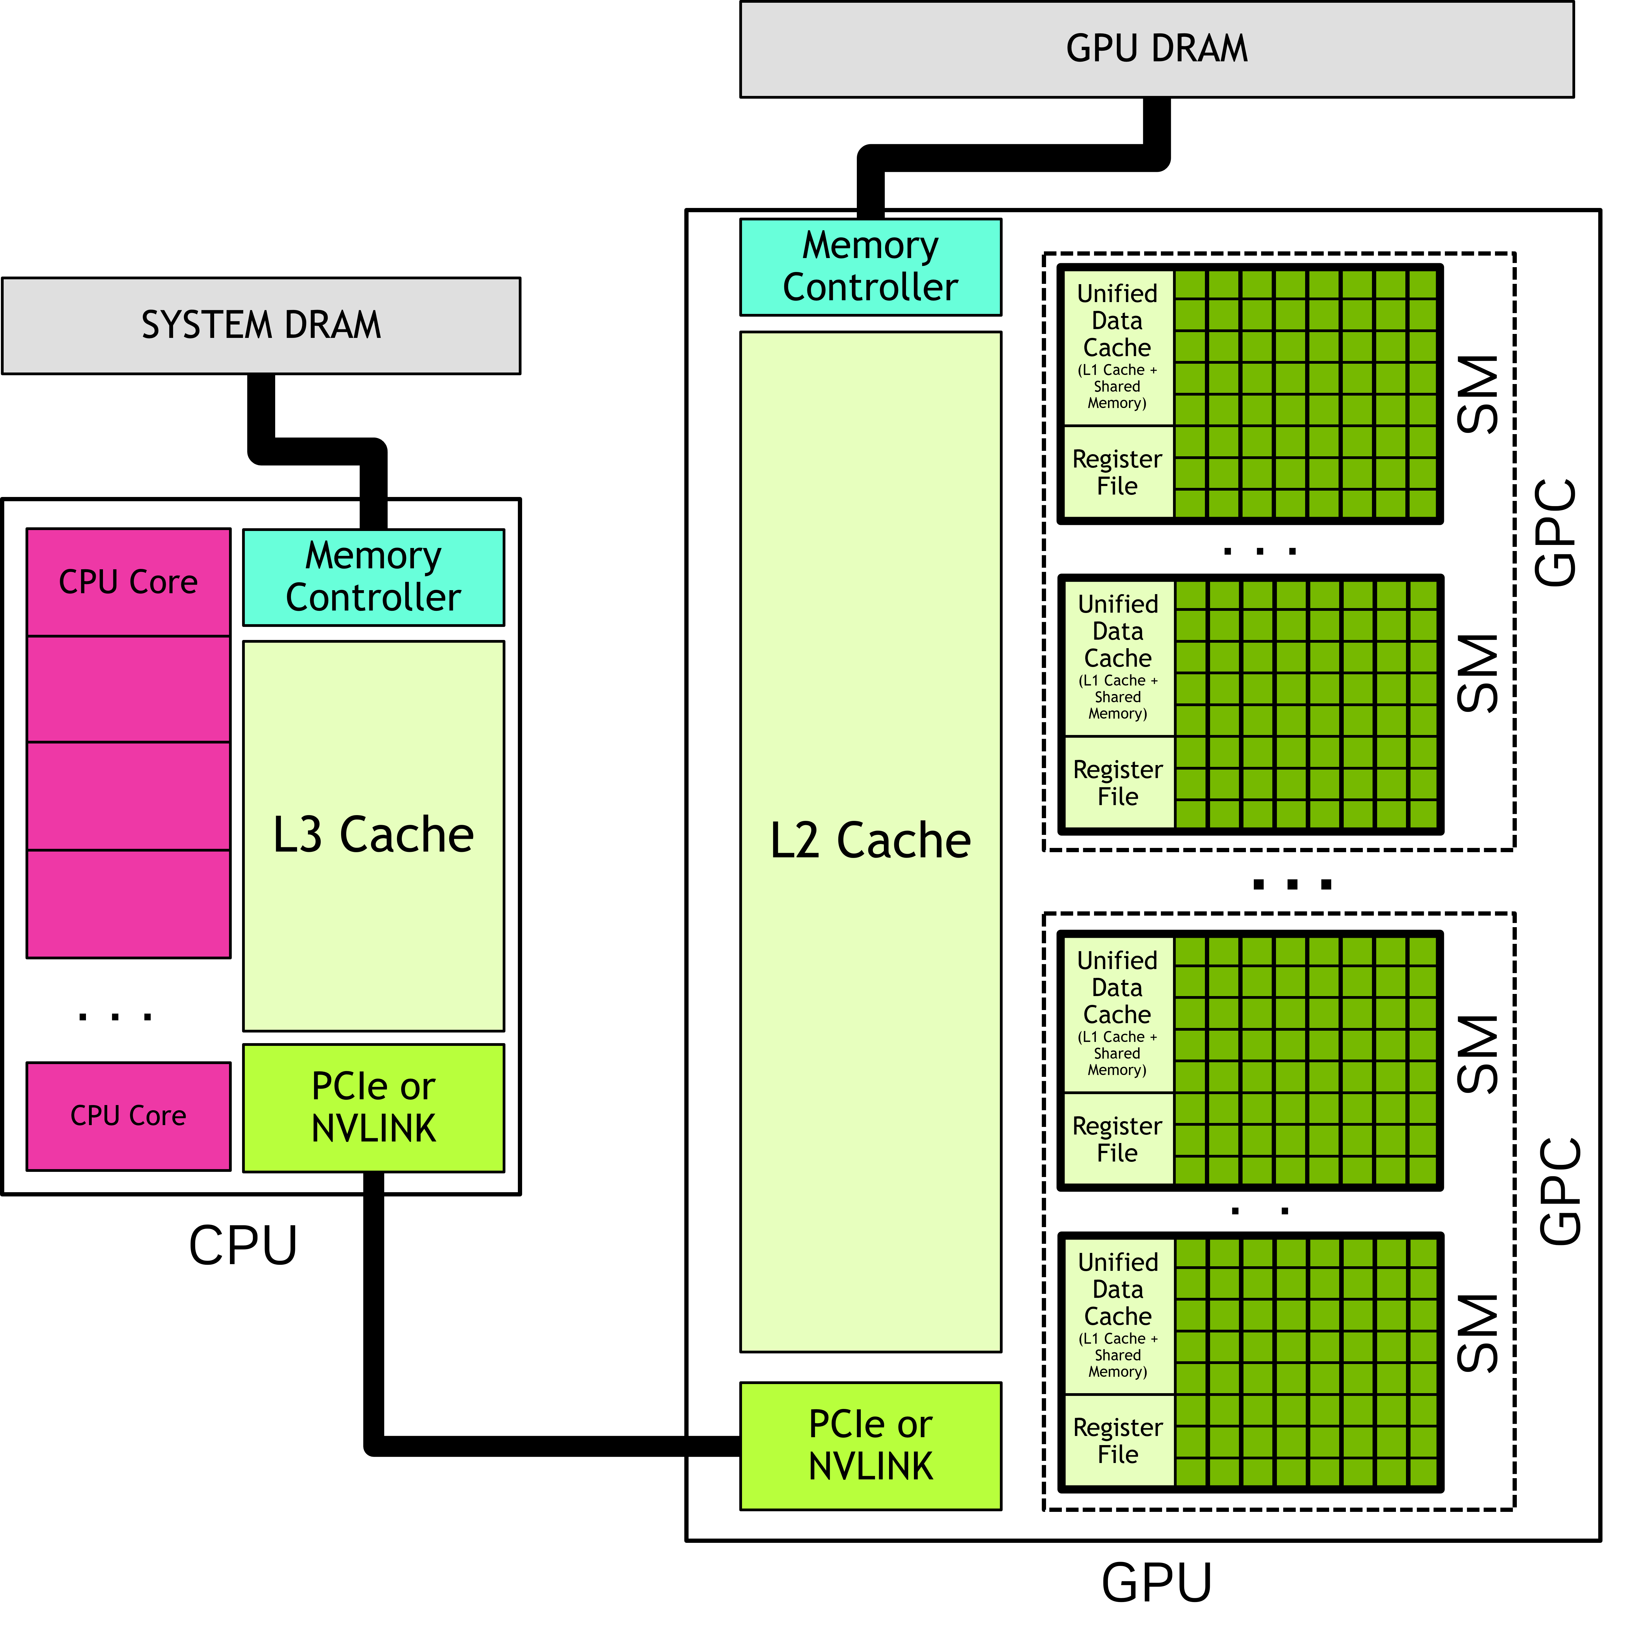
PROGRAMMING MODEL
The host orchestrates. The device executes kernels.
HOST
CPU code starts the application
and submits work.
DEVICE
Many GPU threads execute
the kernel code.
COMPLETION
Submitting a kernel is not the same
as waiting for its result.
NVIDIA Figure 2 · Guide p. 6 / PDF p. 24
Keep the execution location, memory location and completion point explicit.
NVIDIA Figure 2 · §1.2.1–1.2.2, pp. 5–6 / PDF pp. 23–24
FORMATION / INDEPENDENT CUDA TRAINING
06
Notes:
The host orchestrates. The device executes kernels.
Read the original figure from the CPU and system DRAM across the PCIe or NVLINK interconnect to the GPU and GPU DRAM. The guide names the CPU side the host and the GPU side the device. Applications start on the CPU; the host can launch kernels, move data and wait for completion. The drawing is the guide's conceptual model; do not present it as a photograph of the training GPU.
SOURCE AND ATTRIBUTION
NVIDIA source edition: CUDA Programming Guide, Release 13.4.2, NVIDIA Corporation, 10 September 2026. Source of figure pixels: user-supplied cuda-programming-guide.pdf.
NVIDIA Figure 2 · §1.2.1–1.2.2, pp. 5–6 / PDF pp. 23–24
Figure 2: printed page 6; PDF page 24; embedded image xref 851; 5360×5435 pixels.
Image SHA-256: aa9c3f35405463c71f034218aece33d4fe0f28e4c4c3807e1a8ed86745418d0a
Embedded image with PDF transparency mask restored; no redraw or recoloring.
IMAGE REVISION
Technical illustrations are original NVIDIA artwork from the uploaded PDF; none are redrawn or generated. Native text, code, source captions and layout elements are independently authored. Full source figures are kept intact and scaled proportionally. No claim of NVIDIA affiliation or endorsement.
VALIDATION BOUNDARY
This revision validates presentation layout and image provenance. It does not establish successful compilation or execution of the retained CUDA examples on a GPU.

Slide 7
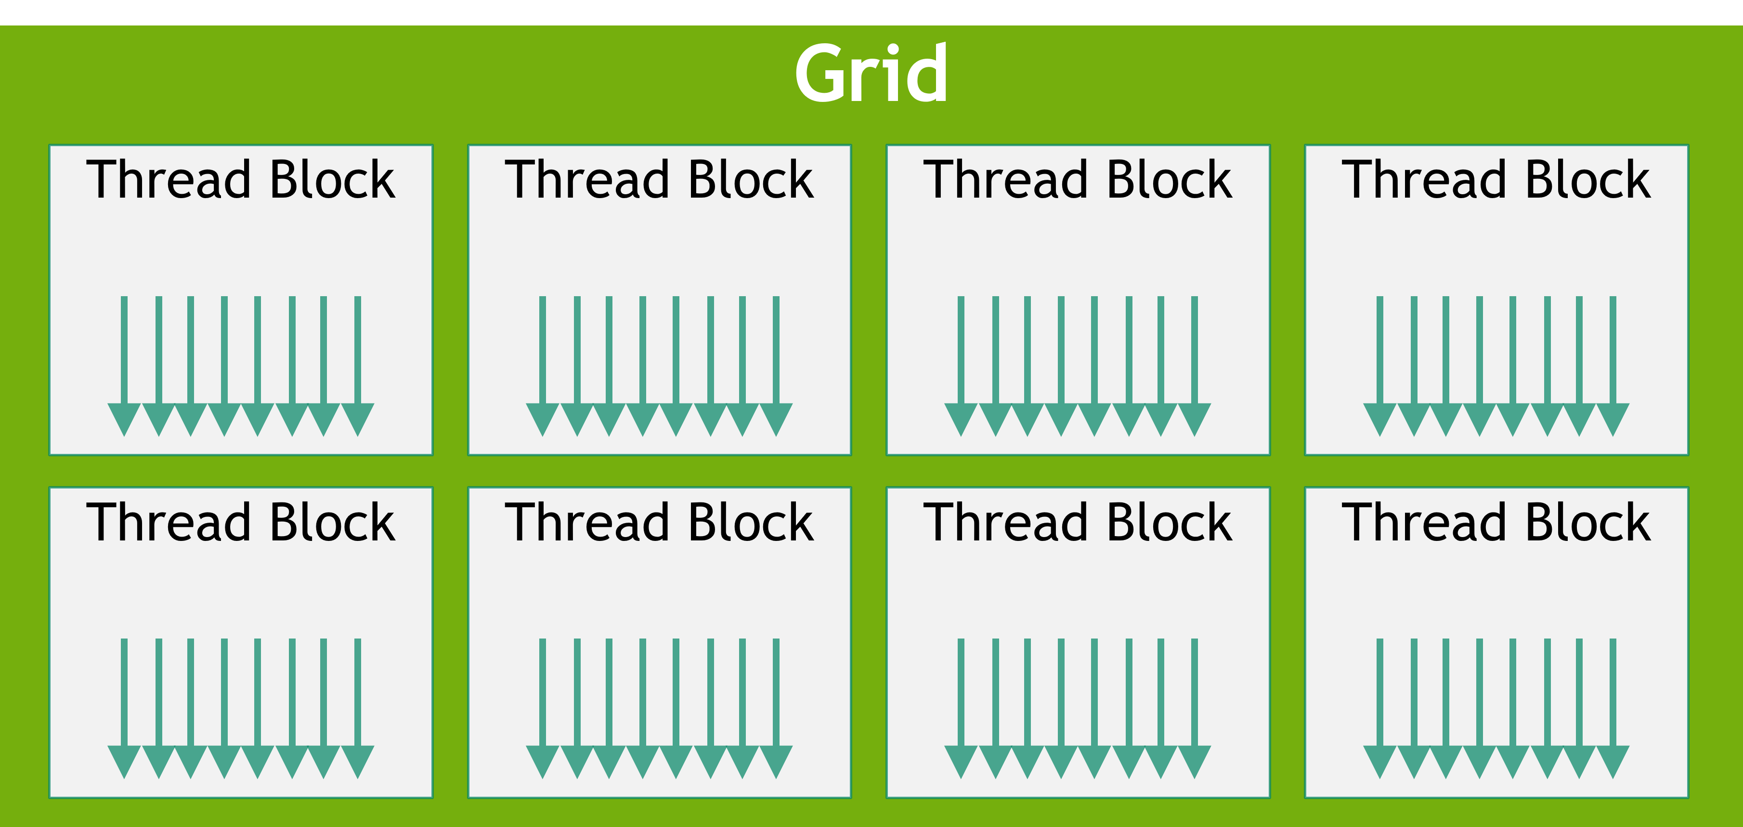
PROGRAMMING MODEL
Do not confuse software groups with hardware
THE PROGRAM DESCRIBES
Grid dimensions.
Block dimensions.
Per-thread work.
THE HARDWARE EXECUTES
Blocks on SMs, subject to
available resources.
NVIDIA Figure 3 · Guide p. 6 / PDF p. 24
A block is a software grouping. An SM is a hardware execution resource.
NVIDIA Figures 2–3 · §1.2.2, pp. 5–7 / PDF pp. 23–25
FORMATION / INDEPENDENT CUDA TRAINING
07
Notes:
Do not confuse software groups with hardware
The grid diagram below is NVIDIA Figure 3, unchanged. The programmer describes threads, thread blocks and the grid. All threads of an ordinary block execute on a single SM. Multiple blocks may reside on an SM when the required resources fit. Neither the number of blocks nor this schematic guarantees which SM will run a particular block.
SOURCE AND ATTRIBUTION
NVIDIA source edition: CUDA Programming Guide, Release 13.4.2, NVIDIA Corporation, 10 September 2026. Source of figure pixels: user-supplied cuda-programming-guide.pdf.
NVIDIA Figures 2–3 · §1.2.2, pp. 5–7 / PDF pp. 23–25
Figure 3: printed page 6; PDF page 24; embedded image xref 853; 3620×1720 pixels.
Image SHA-256: 3d12755cf2edf428ae367c0ae1b5eba3c4d8618271ce54e628504fc1efe8b00f
Embedded image with PDF transparency mask restored; no redraw or recoloring.
IMAGE REVISION
Technical illustrations are original NVIDIA artwork from the uploaded PDF; none are redrawn or generated. Native text, code, source captions and layout elements are independently authored. Full source figures are kept intact and scaled proportionally. No claim of NVIDIA affiliation or endorsement.
VALIDATION BOUNDARY
This revision validates presentation layout and image provenance. It does not establish successful compilation or execution of the retained CUDA examples on a GPU.

Slide 8
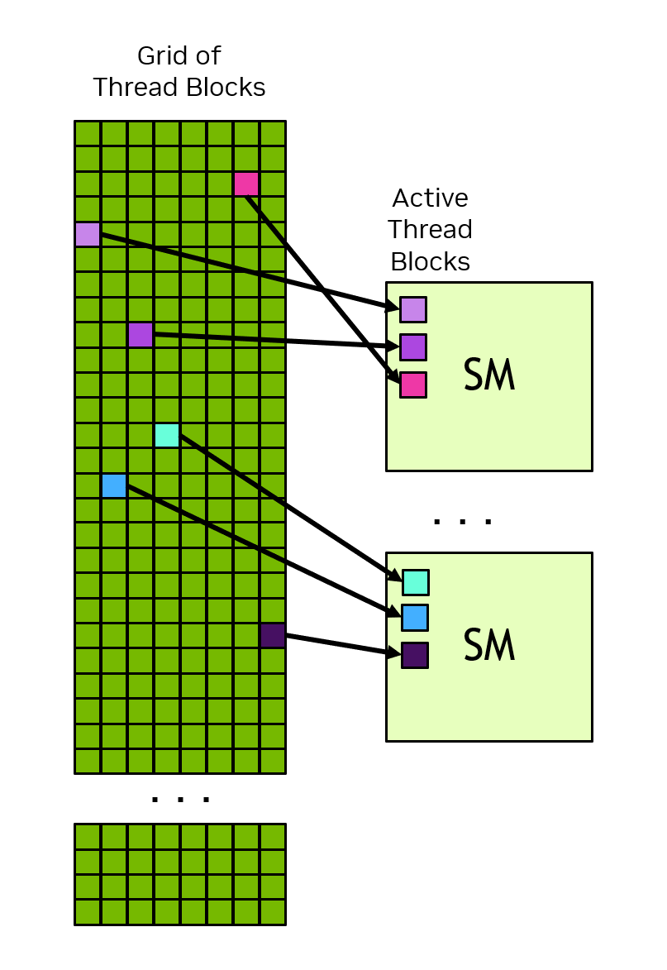
PROGRAMMING MODEL
Independent blocks let the same program scale
No block-order guarantee
A grid can be much larger than
the GPU’s available SMs.
Correctness must not depend on
a particular block assignment
or execution order.
NVIDIA Figure 4 · Guide p. 8 / PDF p. 26
The schedule is an implementation detail; independence is part of the programming contract.
NVIDIA Figure 4 · §1.2.2.1, pp. 7–8 / PDF pp. 25–26
FORMATION / INDEPENDENT CUDA TRAINING
08
Notes:
Independent blocks let the same program scale
Use NVIDIA's actual scheduling figure rather than the previous two-SM/four-SM redraw. The colored blocks show assignments in one illustrative scheduling state. The source says each SM can have one or more active blocks and makes no promise about assignment order. An ordinary block cannot spin waiting for another block whose scheduling is not guaranteed.
SOURCE AND ATTRIBUTION
NVIDIA source edition: CUDA Programming Guide, Release 13.4.2, NVIDIA Corporation, 10 September 2026. Source of figure pixels: user-supplied cuda-programming-guide.pdf.
NVIDIA Figure 4 · §1.2.2.1, pp. 7–8 / PDF pp. 25–26
Figure 4: printed page 8; PDF page 26; embedded image xref 870; 807×1173 pixels.
Image SHA-256: 05d96c154f594f659ed245eb94a8b5a16c15fb92f57ea09f21692fdcbeea88db
Embedded image with PDF transparency mask restored; no redraw or recoloring.
IMAGE REVISION
Technical illustrations are original NVIDIA artwork from the uploaded PDF; none are redrawn or generated. Native text, code, source captions and layout elements are independently authored. Full source figures are kept intact and scaled proportionally. No claim of NVIDIA affiliation or endorsement.
VALIDATION BOUNDARY
This revision validates presentation layout and image provenance. It does not establish successful compilation or execution of the retained CUDA examples on a GPU.

Slide 9
PROGRAMMING MODEL
Grid, block and thread form a coordinate system
NVIDIA Figure 3 · Guide p. 6 / PDF p. 24
gridDim
How many blocks?
blockDim
How many threads in each block?
blockIdx / threadIdx
Which block and which thread am I?
Dimensions organize the work; an address expression determines which data each thread uses.
NVIDIA Figure 3 · §1.2.2.1; index intrinsics: §2.1.2.3, pp. 23–24 / PDF pp. 41–42
FORMATION / INDEPENDENT CUDA TRAINING
09
Notes:
Grid, block and thread form a coordinate system
The original grid illustration does not encode a particular launch size: the arrows are explicitly illustrative. Explain the four intrinsics using the text below, not by interpreting the number of arrows. Grid and block dimensions may be one, two or three dimensional. In the later 2D example, x is the fastest-changing thread coordinate, as described in §2.3.2.
SOURCE AND ATTRIBUTION
NVIDIA source edition: CUDA Programming Guide, Release 13.4.2, NVIDIA Corporation, 10 September 2026. Source of figure pixels: user-supplied cuda-programming-guide.pdf.
NVIDIA Figure 3 · §1.2.2.1; index intrinsics: §2.1.2.3, pp. 23–24 / PDF pp. 41–42
Figure 3: printed page 6; PDF page 24; embedded image xref 853; 3620×1720 pixels.
Image SHA-256: 3d12755cf2edf428ae367c0ae1b5eba3c4d8618271ce54e628504fc1efe8b00f
Embedded image with PDF transparency mask restored; no redraw or recoloring.
IMAGE REVISION
Technical illustrations are original NVIDIA artwork from the uploaded PDF; none are redrawn or generated. Native text, code, source captions and layout elements are independently authored. Full source figures are kept intact and scaled proportionally. No claim of NVIDIA affiliation or endorsement.
VALIDATION BOUNDARY
This revision validates presentation layout and image provenance. It does not establish successful compilation or execution of the retained CUDA examples on a GPU.

Slide 10
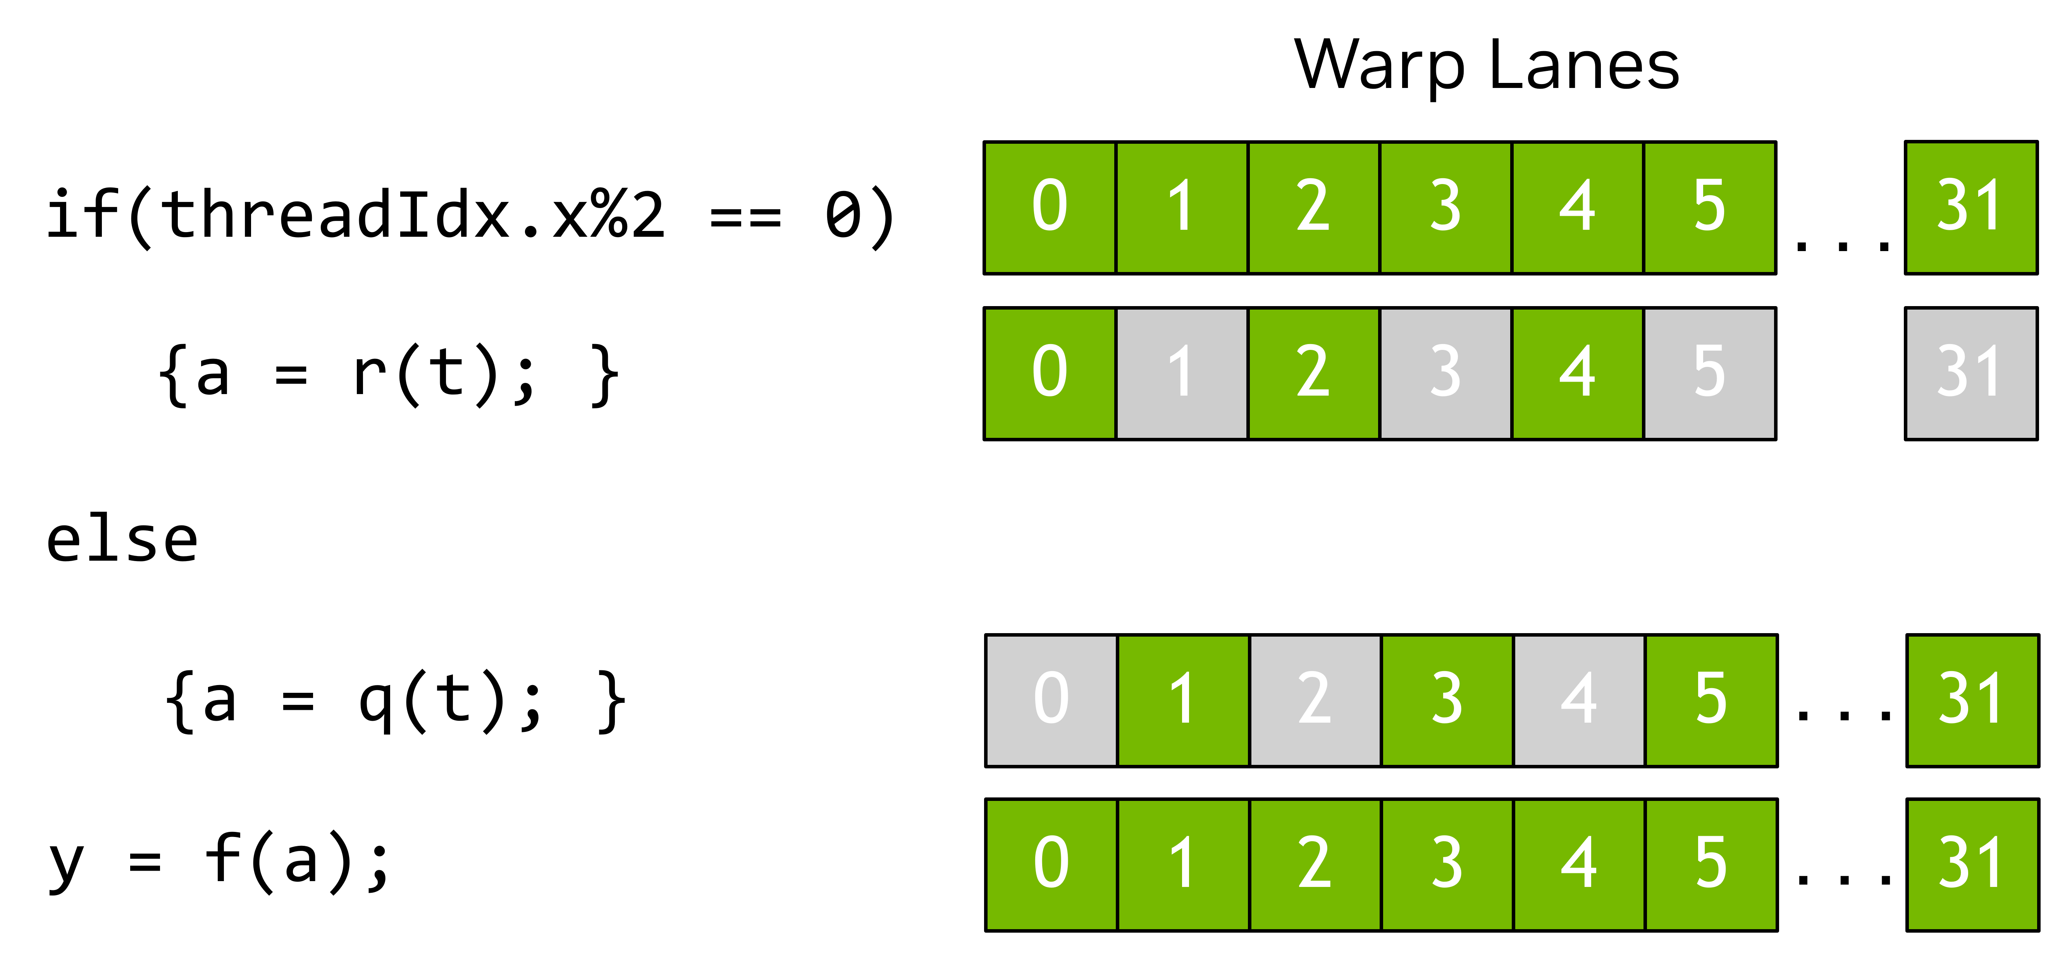
PROGRAMMING MODEL
A warp has 32 lanes; branches change active lanes
NVIDIA Figure 7 · Guide p. 11 / PDF p. 29
Same kernel code
Different control-flow paths
Reason about the active lanes for an instruction—not just the total number of launched threads.
NVIDIA Figure 7 · §1.2.2.2, pp. 9–11 / PDF pp. 27–29
FORMATION / INDEPENDENT CUDA TRAINING
10
Notes:
A warp has 32 lanes; branches change active lanes
Walk through the unmodified NVIDIA illustration. Even-indexed lanes execute one branch while the other lanes are masked; the opposite lanes execute the other path. The guide calls this warp divergence. The figure does not establish synchronization between producers and consumers. Keep block synchronization explicit in later shared-memory examples, and do not infer hardware timing from a conceptual SIMT diagram.
SOURCE AND ATTRIBUTION
NVIDIA source edition: CUDA Programming Guide, Release 13.4.2, NVIDIA Corporation, 10 September 2026. Source of figure pixels: user-supplied cuda-programming-guide.pdf.
NVIDIA Figure 7 · §1.2.2.2, pp. 9–11 / PDF pp. 27–29
Figure 7: printed page 11; PDF page 29; embedded image xref 894; 5299×2475 pixels.
Image SHA-256: d786513da6bd0fecbf55e859d2cab2cdcceda8e7fd71c3ca9a58eee700234486
Embedded image with PDF transparency mask restored; no redraw or recoloring.
IMAGE REVISION
Technical illustrations are original NVIDIA artwork from the uploaded PDF; none are redrawn or generated. Native text, code, source captions and layout elements are independently authored. Full source figures are kept intact and scaled proportionally. No claim of NVIDIA affiliation or endorsement.
VALIDATION BOUNDARY
This revision validates presentation layout and image provenance. It does not establish successful compilation or execution of the retained CUDA examples on a GPU.

Slide 11
INDEXING CHECKPOINT
1,000 elements do not fit exactly into 256-thread blocks
N = 1,000 B = 256
BLOCK
GLOBAL INDICES
MEMORY ACCESS
0
0–255
All valid
1
256–511
All valid
2
512–767
All valid
3
768–1,023
Only 768–999 are valid
4 × 256 = 1,024 launched threads; 24 must skip the access.
The guard is i < n. The launch size and the data size are different quantities.
Course arithmetic derived from the index and ceiling-division pattern in §2.1.2.3, p. 24 / PDF p. 42
FORMATION / INDEPENDENT CUDA TRAINING
11
Notes:
1,000 elements do not fit exactly into 256-thread blocks
This is editable calculation text, not a substituted diagram. Four blocks launch 1,024 threads. Indices 0 through 999 are valid; 1,000 through 1,023 must not access the arrays. Ask students to explain why i < n is necessary. The companion implementation handles N = 0 without launching a zero-sized grid.
SOURCE AND ATTRIBUTION
NVIDIA source edition: CUDA Programming Guide, Release 13.4.2, NVIDIA Corporation, 10 September 2026. Source of figure pixels: user-supplied cuda-programming-guide.pdf.
Course arithmetic derived from the index and ceiling-division pattern in §2.1.2.3, p. 24 / PDF p. 42
No illustration on this slide: editable explanatory text/code only.
COURSE / TOOLING REFERENCES (distinct from the PDF artwork)
https://github.com/neudinger/formation/blob/main/projects/detailed/gpu/vector_add_device.cu
https://github.com/neudinger/formation/blob/main/projects/detailed/gpu/vector_add_cuda.cc
IMAGE REVISION
Technical illustrations are original NVIDIA artwork from the uploaded PDF; none are redrawn or generated. Native text, code, source captions and layout elements are independently authored. Full source figures are kept intact and scaled proportionally. No claim of NVIDIA affiliation or endorsement.
VALIDATION BOUNDARY
This revision validates presentation layout and image provenance. It does not establish successful compilation or execution of the retained CUDA examples on a GPU.

Slide 12
PROGRAMMING MODEL
Name both the scope and the location of memory
MEMORY
SCOPE
LOCATION
Registers
Thread-local
On the SM
Shared memory
Block in today’s labs
On the SM
Global memory
Accessible across device threads
Device memory
Local memory
Thread-local
Device memory
“Local” names the scope. It does not mean the value stays in a register.
Guide §1.2.3 and §2.3.3, pp. 13–15 and 49–55 / PDF pp. 31–33 and 67–73
FORMATION / INDEPENDENT CUDA TRAINING
12
Notes:
Name both the scope and the location of memory
Summarize the source's memory categories using text, rather than recreating a hierarchy diagram. The guide's Table 1 distinguishes scope, lifetime and location. Shared memory is block-scoped for today's non-cluster labs; cluster-wide distributed shared memory is an explicitly separate feature. Local memory is thread-local by scope but resides in device memory. Register allocation and spilling are compiler-managed.
SOURCE AND ATTRIBUTION
NVIDIA source edition: CUDA Programming Guide, Release 13.4.2, NVIDIA Corporation, 10 September 2026. Source of figure pixels: user-supplied cuda-programming-guide.pdf.
Guide §1.2.3 and §2.3.3, pp. 13–15 and 49–55 / PDF pp. 31–33 and 67–73
No illustration on this slide: editable explanatory text/code only.
IMAGE REVISION
Technical illustrations are original NVIDIA artwork from the uploaded PDF; none are redrawn or generated. Native text, code, source captions and layout elements are independently authored. Full source figures are kept intact and scaled proportionally. No claim of NVIDIA affiliation or endorsement.
VALIDATION BOUNDARY
This revision validates presentation layout and image provenance. It does not establish successful compilation or execution of the retained CUDA examples on a GPU.

Slide 13
25-MINUTE CHECKPOINT
Lab 1 · Prove the environment and the reference
HANDS-ON / COURSE EXERCISE
RECORD
GPU name and compute capability
RUN FROM THE MODULE SHOWN
cd formation/projects/detailed
bazel run //runtime:device_info
bazel test //cpp:vector_cpu_test
DISTINGUISH
Runtime and driver versions
CHECK
One hand-calculated SAXPY result
Deliverable: environment facts and a CPU result you can explain.
Record what you tested, why you trust the result, and what remains unverified.
Existing course targets · projects/detailed/runtime and cpp; guide §§1.2–1.3
FORMATION / INDEPENDENT CUDA TRAINING
13
Notes:
Lab 1 · Prove the environment and the reference
These are the existing course commands, retained from the earlier deck. Do not claim the supplied NVIDIA PDF contains Bazel commands. Ask students to note their actual GPU and compiler/toolkit environment. Build and driver failures are environment problems, not intended exercise TODO failures.
SOURCE AND ATTRIBUTION
NVIDIA source edition: CUDA Programming Guide, Release 13.4.2, NVIDIA Corporation, 10 September 2026. Source of figure pixels: user-supplied cuda-programming-guide.pdf.
Existing course targets · projects/detailed/runtime and cpp; guide §§1.2–1.3
No illustration on this slide: editable explanatory text/code only.
COURSE / TOOLING REFERENCES (distinct from the PDF artwork)
https://github.com/neudinger/formation/blob/main/projects/detailed/README.md
https://github.com/neudinger/formation/blob/main/tp/README.md
IMAGE REVISION
Technical illustrations are original NVIDIA artwork from the uploaded PDF; none are redrawn or generated. Native text, code, source captions and layout elements are independently authored. Full source figures are kept intact and scaled proportionally. No claim of NVIDIA affiliation or endorsement.
VALIDATION BOUNDARY
This revision validates presentation layout and image provenance. It does not establish successful compilation or execution of the retained CUDA examples on a GPU.

Slide 14
DAY 1 / 02
Build a first CUDA feature
02
A CPU oracle, a small kernel,
and an explicit host workflow.
NVIDIA Figure 3 · Guide p. 6 / PDF p. 24
NVIDIA Figure 3 · §1.2.2.1, p. 6 / PDF p. 24; C++ implementation concepts: §2.1
FORMATION / INDEPENDENT CUDA TRAINING
14
Notes:
Build a first CUDA feature
Section transition: A CPU oracle, a small kernel,
and an explicit host workflow.
SOURCE AND ATTRIBUTION
NVIDIA source edition: CUDA Programming Guide, Release 13.4.2, NVIDIA Corporation, 10 September 2026. Source of figure pixels: user-supplied cuda-programming-guide.pdf.
NVIDIA Figure 3 · §1.2.2.1, p. 6 / PDF p. 24; C++ implementation concepts: §2.1
Figure 3: printed page 6; PDF page 24; embedded image xref 853; 3620×1720 pixels.
Image SHA-256: 3d12755cf2edf428ae367c0ae1b5eba3c4d8618271ce54e628504fc1efe8b00f
Embedded image with PDF transparency mask restored; no redraw or recoloring.
IMAGE REVISION
Technical illustrations are original NVIDIA artwork from the uploaded PDF; none are redrawn or generated. Native text, code, source captions and layout elements are independently authored. Full source figures are kept intact and scaled proportionally. No claim of NVIDIA affiliation or endorsement.
VALIDATION BOUNDARY
This revision validates presentation layout and image provenance. It does not establish successful compilation or execution of the retained CUDA examples on a GPU.

Slide 15
FIRST CUDA FEATURE
Start with a contract that can be checked by hand
out[i] = α × a[i] + b[i]
COURSE CPU REFERENCE · EXCERPT
α = 2
a = [1, 2, 3]
b = [4, 5, 6]
out = [6, 9, 12]
if (a.size() != b.size())
throw std::invalid_argument("size mismatch");
for (size_t i = 0; i < a.size(); ++i)
out[i] = alpha * a[i] + b[i];
Scaled addition becomes ordinary vector addition when α = 1.
Course SAXPY implementation; guide §2.1.5 illustrates the CPU/GPU comparison pattern.
FORMATION / INDEPENDENT CUDA TRAINING
15
Notes:
Start with a contract that can be checked by hand
The course operation is SAXPY-style scaled addition, not the guide's plain vector addition except when alpha = 1. Keep that distinction explicit. This excerpt and the numerical example are retained course material, not a quote from NVIDIA. The reference function should validate sizes and produce an output used to check the full GPU result.
SOURCE AND ATTRIBUTION
NVIDIA source edition: CUDA Programming Guide, Release 13.4.2, NVIDIA Corporation, 10 September 2026. Source of figure pixels: user-supplied cuda-programming-guide.pdf.
Course SAXPY implementation; guide §2.1.5 illustrates the CPU/GPU comparison pattern.
No illustration on this slide: editable explanatory text/code only.
COURSE / TOOLING REFERENCES (distinct from the PDF artwork)
https://github.com/neudinger/formation/blob/main/projects/detailed/cpp/vector_cpu.cc
https://github.com/neudinger/formation/blob/main/projects/detailed/gpu/vector_add_device.cu
IMAGE REVISION
Technical illustrations are original NVIDIA artwork from the uploaded PDF; none are redrawn or generated. Native text, code, source captions and layout elements are independently authored. Full source figures are kept intact and scaled proportionally. No claim of NVIDIA affiliation or endorsement.
VALIDATION BOUNDARY
This revision validates presentation layout and image provenance. It does not establish successful compilation or execution of the retained CUDA examples on a GPU.

Slide 16
FIRST CUDA FEATURE
The device kernel assigns one result to one thread
REPOSITORY KERNEL · FORMATTING ADAPTED
INDEX
__global__ void vector_add_kernel(
const float* a, const float* b, float* out,
float alpha, int n) {
const int i = blockIdx.x * blockDim.x + threadIdx.x;
if (i < n) {
out[i] = alpha * a[i] + b[i];
}
}
Find my element.
BOUNDARY
Check it exists.
OWNERSHIP
Write my result.
The kernel body is short because each valid thread owns a different result.
Course repository: gpu/vector_add_device.cu; guide §2.1.2, pp. 21–25 / PDF pp. 39–43
FORMATION / INDEPENDENT CUDA TRAINING
16
Notes:
The device kernel assigns one result to one thread
This is the original repository kernel with presentation formatting. The __global__ declaration marks a kernel entry point; the launch executes that body for each thread. The expression selects an output element, and the bounds check protects the tail. No block barrier is needed for this kernel because valid threads write distinct elements. Pointer validity and sufficient allocation remain host-side responsibilities.
SOURCE AND ATTRIBUTION
NVIDIA source edition: CUDA Programming Guide, Release 13.4.2, NVIDIA Corporation, 10 September 2026. Source of figure pixels: user-supplied cuda-programming-guide.pdf.
Course repository: gpu/vector_add_device.cu; guide §2.1.2, pp. 21–25 / PDF pp. 39–43
No illustration on this slide: editable explanatory text/code only.
COURSE / TOOLING REFERENCES (distinct from the PDF artwork)
https://github.com/neudinger/formation/blob/main/projects/detailed/gpu/vector_add_device.cu
IMAGE REVISION
Technical illustrations are original NVIDIA artwork from the uploaded PDF; none are redrawn or generated. Native text, code, source captions and layout elements are independently authored. Full source figures are kept intact and scaled proportionally. No claim of NVIDIA affiliation or endorsement.
VALIDATION BOUNDARY
This revision validates presentation layout and image provenance. It does not establish successful compilation or execution of the retained CUDA examples on a GPU.

Slide 17
FIRST CUDA FEATURE
Read the index as “block offset + local offset”
2 × 256 + 13 = 525
blockIdx.x = 2 blockDim.x = 256 threadIdx.x = 13
Your turn
Block 3, thread 231:
which output element?
NVIDIA Figure 3 · Guide p. 6 / PDF p. 24
The same expression identifies both valid work and out-of-range tail threads.
Worked course example derived from §2.1.2.3, pp. 23–24 / PDF pp. 41–42
FORMATION / INDEPENDENT CUDA TRAINING
17
Notes:
Read the index as “block offset + local offset”
Ask students to calculate the global index before displaying the result. For blockIdx.x = 2, blockDim.x = 256 and threadIdx.x = 13 the index is 525. For block 3 and local thread 231 it is 999, the last valid index when N = 1000. NVIDIA Figure 3 remains an illustrative grid; its arrows are not the number of threads used in this arithmetic.
SOURCE AND ATTRIBUTION
NVIDIA source edition: CUDA Programming Guide, Release 13.4.2, NVIDIA Corporation, 10 September 2026. Source of figure pixels: user-supplied cuda-programming-guide.pdf.
Worked course example derived from §2.1.2.3, pp. 23–24 / PDF pp. 41–42
Figure 3: printed page 6; PDF page 24; embedded image xref 853; 3620×1720 pixels.
Image SHA-256: 3d12755cf2edf428ae367c0ae1b5eba3c4d8618271ce54e628504fc1efe8b00f
Embedded image with PDF transparency mask restored; no redraw or recoloring.
COURSE / TOOLING REFERENCES (distinct from the PDF artwork)
https://github.com/neudinger/formation/blob/main/projects/detailed/gpu/vector_add_device.cu
IMAGE REVISION
Technical illustrations are original NVIDIA artwork from the uploaded PDF; none are redrawn or generated. Native text, code, source captions and layout elements are independently authored. Full source figures are kept intact and scaled proportionally. No claim of NVIDIA affiliation or endorsement.
VALIDATION BOUNDARY
This revision validates presentation layout and image provenance. It does not establish successful compilation or execution of the retained CUDA examples on a GPU.

Slide 18
FIRST CUDA FEATURE
A launch specifies the grid, the block and the stream
COURSE LAUNCH EXPRESSION
vector_add_kernel<<<grid, block, 0, stream>>>(
d_a, d_b, d_out, alpha, n);
grid
Number of blocks
block
Threads in each block
0
Extra dynamic shared-memory bytes
stream
Ordering context for submitted work
For N > 0, choose enough blocks to cover N elements, then guard the tail.
Guide §2.1.2.2, §2.3.3.2.2 and §2.5.2.2; course launch expression
FORMATION / INDEPENDENT CUDA TRAINING
18
Notes:
A launch specifies the grid, the block and the stream
The first argument is grid shape and the second is block shape. The third is the number of dynamic shared-memory bytes per block; the value 0 does not mean static shared memory is impossible. The fourth identifies the stream. The repository uses 256 threads per block. For positive sizes, ceiling division selects enough blocks; do not generalize the illustrative arithmetic to unchecked integer extremes.
SOURCE AND ATTRIBUTION
NVIDIA source edition: CUDA Programming Guide, Release 13.4.2, NVIDIA Corporation, 10 September 2026. Source of figure pixels: user-supplied cuda-programming-guide.pdf.
Guide §2.1.2.2, §2.3.3.2.2 and §2.5.2.2; course launch expression
No illustration on this slide: editable explanatory text/code only.
COURSE / TOOLING REFERENCES (distinct from the PDF artwork)
https://github.com/neudinger/formation/blob/main/projects/detailed/gpu/vector_add_device.cu
IMAGE REVISION
Technical illustrations are original NVIDIA artwork from the uploaded PDF; none are redrawn or generated. Native text, code, source captions and layout elements are independently authored. Full source figures are kept intact and scaled proportionally. No claim of NVIDIA affiliation or endorsement.
VALIDATION BOUNDARY
This revision validates presentation layout and image provenance. It does not establish successful compilation or execution of the retained CUDA examples on a GPU.

Slide 19
FIRST CUDA FEATURE
The kernel is one step in a complete operation
01 / VALIDATE
Sizes and empty input.
02 / PREPARE
Create stream and device buffers.
03 / TRANSFER
Make both inputs available on the GPU.
04 / EXECUTE
Launch, return the result, then wait.
NVIDIA Figure 2 · Guide p. 6 / PDF p. 24
Timing the whole function is not the same as timing only its kernel.
Course host wrapper: gpu/vector_add_cuda.cc; NVIDIA Figure 2, p. 6 / PDF p. 24
FORMATION / INDEPENDENT CUDA TRAINING
19
Notes:
The kernel is one step in a complete operation
Keep the source diagram unchanged and describe the wrapper with text. The repository validates inputs, allocates three device buffers, copies the inputs, launches the kernel, copies the result, and synchronizes before returning. Creating the stream and device buffers happens on each call. End-to-end timing therefore measures more than device computation.
SOURCE AND ATTRIBUTION
NVIDIA source edition: CUDA Programming Guide, Release 13.4.2, NVIDIA Corporation, 10 September 2026. Source of figure pixels: user-supplied cuda-programming-guide.pdf.
Course host wrapper: gpu/vector_add_cuda.cc; NVIDIA Figure 2, p. 6 / PDF p. 24
Figure 2: printed page 6; PDF page 24; embedded image xref 851; 5360×5435 pixels.
Image SHA-256: aa9c3f35405463c71f034218aece33d4fe0f28e4c4c3807e1a8ed86745418d0a
Embedded image with PDF transparency mask restored; no redraw or recoloring.
COURSE / TOOLING REFERENCES (distinct from the PDF artwork)
https://github.com/neudinger/formation/blob/main/projects/detailed/gpu/vector_add_cuda.cc
IMAGE REVISION
Technical illustrations are original NVIDIA artwork from the uploaded PDF; none are redrawn or generated. Native text, code, source captions and layout elements are independently authored. Full source figures are kept intact and scaled proportionally. No claim of NVIDIA affiliation or endorsement.
VALIDATION BOUNDARY
This revision validates presentation layout and image provenance. It does not establish successful compilation or execution of the retained CUDA examples on a GPU.

Slide 20
FIRST CUDA FEATURE
One explicit stream gives an ordered baseline
ORDERED
COURSE EXCERPT · BUFFERS ALREADY ALLOCATED
Inputs precede
the kernel.
CUDA_CHECK(cudaMemcpyAsync(d_a, a, bytes,
cudaMemcpyHostToDevice, stream));
CUDA_CHECK(cudaMemcpyAsync(d_b, b, bytes,
cudaMemcpyHostToDevice, stream));
launch_vector_add_kernel(d_a, d_b, d_out,
alpha, n, stream, launch_api);
CUDA_CHECK(cudaMemcpyAsync(out, d_out, bytes,
cudaMemcpyDeviceToHost, stream));
CUDA_CHECK(cudaStreamSynchronize(stream));
HOST-VISIBLE
The result is ready
after the wait.
NOT PROVEN
Async names alone
do not show overlap.
The wrapper waits before returning the result to its caller.
Course wrapper; guide §2.5.2 and §2.5.5, pp. 105–106 and 114 / PDF pp. 123–124 and 132
FORMATION / INDEPENDENT CUDA TRAINING
20
Notes:
One explicit stream gives an ordered baseline
All operations shown are submitted in one stream. The host waits for that stream before consuming the result. The course wrapper uses ordinary vector-backed host storage, so its use of cudaMemcpyAsync alone is not an overlap demonstration. Day 2 adds explicit discussion of pinned host buffers, independent chunks and timeline evidence. This slide intentionally uses text and code rather than a redrawn stream timeline.
SOURCE AND ATTRIBUTION
NVIDIA source edition: CUDA Programming Guide, Release 13.4.2, NVIDIA Corporation, 10 September 2026. Source of figure pixels: user-supplied cuda-programming-guide.pdf.
Course wrapper; guide §2.5.2 and §2.5.5, pp. 105–106 and 114 / PDF pp. 123–124 and 132
No illustration on this slide: editable explanatory text/code only.
COURSE / TOOLING REFERENCES (distinct from the PDF artwork)
https://github.com/neudinger/formation/blob/main/projects/detailed/gpu/vector_add_cuda.cc
IMAGE REVISION
Technical illustrations are original NVIDIA artwork from the uploaded PDF; none are redrawn or generated. Native text, code, source captions and layout elements are independently authored. Full source figures are kept intact and scaled proportionally. No claim of NVIDIA affiliation or endorsement.
VALIDATION BOUNDARY
This revision validates presentation layout and image provenance. It does not establish successful compilation or execution of the retained CUDA examples on a GPU.

Slide 21
FIRST CUDA FEATURE
Resource lifetime is part of correctness
OWN ALLOCATIONS
DeviceBuffer owns a device allocation.
Stream owns a CUDA stream handle.
MAKE COMPLETION EXPLICIT
The first API returns only when the
host-visible output is ready.
CLEAN UP PREDICTABLY
Resource ownership keeps cleanup local
to the code that created the resource.
Do not reuse or release storage while outstanding work still needs it.
Course DeviceBuffer and Stream wrappers; guide §2.1.3–2.1.4
FORMATION / INDEPENDENT CUDA TRAINING
21
Notes:
Resource lifetime is part of correctness
RAII is part of the course engineering implementation, not an illustration copied from the NVIDIA guide. Retain the simple synchronous-return contract for this first feature. In the repository code, resource-owning wrappers clean up streams and device allocations. Later asynchronous APIs need an explicit lifetime contract: callers must not recycle storage still needed by submitted work.
SOURCE AND ATTRIBUTION
NVIDIA source edition: CUDA Programming Guide, Release 13.4.2, NVIDIA Corporation, 10 September 2026. Source of figure pixels: user-supplied cuda-programming-guide.pdf.
Course DeviceBuffer and Stream wrappers; guide §2.1.3–2.1.4
No illustration on this slide: editable explanatory text/code only.
COURSE / TOOLING REFERENCES (distinct from the PDF artwork)
https://github.com/neudinger/formation/blob/main/projects/detailed/gpu/vector_add_cuda.cc
https://github.com/neudinger/formation/blob/main/projects/detailed/runtime/cuda_launch.h
IMAGE REVISION
Technical illustrations are original NVIDIA artwork from the uploaded PDF; none are redrawn or generated. Native text, code, source captions and layout elements are independently authored. Full source figures are kept intact and scaled proportionally. No claim of NVIDIA affiliation or endorsement.
VALIDATION BOUNDARY
This revision validates presentation layout and image provenance. It does not establish successful compilation or execution of the retained CUDA examples on a GPU.

Slide 22
REPOSITORY MAP
Four layers keep the feature understandable
LAYER
FILE
RESPONSIBILITY
Public API
gpu/vector_add.h
What the caller requests
Host workflow
gpu/vector_add_cuda.cc
Validation, buffers, transfers
Device computation
gpu/vector_add_device.cu
Indexing, kernel and launch
Evidence
gpu/vector_add_test.cc
Compare every result to the CPU
BUILD.bazel connects the code layers; it does not define the CUDA execution model.
Existing Day 1 course map: projects/detailed/gpu; not an NVIDIA repository diagram.
FORMATION / INDEPENDENT CUDA TRAINING
22
Notes:
Four layers keep the feature understandable
This native text table preserves the original repository navigation. It is course-specific, not part of the Programming Guide. Public API, host workflow, device computation and evidence are separate responsibilities. Open BUILD.bazel only after students can explain that separation. The build graph controls compilation dependencies, not the scheduling of CUDA thread blocks.
SOURCE AND ATTRIBUTION
NVIDIA source edition: CUDA Programming Guide, Release 13.4.2, NVIDIA Corporation, 10 September 2026. Source of figure pixels: user-supplied cuda-programming-guide.pdf.
Existing Day 1 course map: projects/detailed/gpu; not an NVIDIA repository diagram.
No illustration on this slide: editable explanatory text/code only.
COURSE / TOOLING REFERENCES (distinct from the PDF artwork)
https://github.com/neudinger/formation/blob/main/projects/detailed/gpu/BUILD.bazel
https://github.com/neudinger/formation/blob/main/followup/presentation-1-followup.md
IMAGE REVISION
Technical illustrations are original NVIDIA artwork from the uploaded PDF; none are redrawn or generated. Native text, code, source captions and layout elements are independently authored. Full source figures are kept intact and scaled proportionally. No claim of NVIDIA affiliation or endorsement.
VALIDATION BOUNDARY
This revision validates presentation layout and image provenance. It does not establish successful compilation or execution of the retained CUDA examples on a GPU.

Slide 23
CORRECTNESS
Test the boundaries—not only a convenient power of two
N = 0, 1, 255, 256, 257, 1,000
INPUT CONTRACT
Reject mismatched sizes.
Handle empty inputs explicitly.
VALUE CONTRACT
Use signed and non-integer values.
Compare the whole output, not one sample.
A passing aligned-size test is not evidence that partial blocks are safe.
Course test additions; guide bounds checking §2.1.2.3.1 and CPU comparison §2.1.5
FORMATION / INDEPENDENT CUDA TRAINING
23
Notes:
Test the boundaries—not only a convenient power of two
These are workshop additions, not a claim that the existing upstream test suite already contains them. Include empty input, near-block-boundary sizes and a non-aligned larger size. Check size mismatch handling and use signed/non-integer data. Select the numerical tolerance based on the operation and data; do not present one fixed tolerance as universal.
SOURCE AND ATTRIBUTION
NVIDIA source edition: CUDA Programming Guide, Release 13.4.2, NVIDIA Corporation, 10 September 2026. Source of figure pixels: user-supplied cuda-programming-guide.pdf.
Course test additions; guide bounds checking §2.1.2.3.1 and CPU comparison §2.1.5
No illustration on this slide: editable explanatory text/code only.
COURSE / TOOLING REFERENCES (distinct from the PDF artwork)
https://github.com/neudinger/formation/blob/main/projects/detailed/gpu/vector_add_test.cc
IMAGE REVISION
Technical illustrations are original NVIDIA artwork from the uploaded PDF; none are redrawn or generated. Native text, code, source captions and layout elements are independently authored. Full source figures are kept intact and scaled proportionally. No claim of NVIDIA affiliation or endorsement.
VALIDATION BOUNDARY
This revision validates presentation layout and image provenance. It does not establish successful compilation or execution of the retained CUDA examples on a GPU.

Slide 24
DEBUGGING
Check launch submission and execution separately
TWO ERROR-OBSERVATION POINTS
kernel<<<grid, block, 0, stream>>>(...);
CUDA_CHECK(cudaGetLastError());
CUDA_CHECK(cudaStreamSynchronize(stream));
Launch accepted ≠ kernel completed successfully
RETAINED COURSE TOOLING · NOT A PERFORMANCE RUN
compute-sanitizer --tool memcheck <binary>
compute-sanitizer --tool racecheck <binary>
Check errors close to the operation, then check the completion point.
Guide §2.1.7.1–2.1.7.2, pp. 35–36 / PDF pp. 53–54; existing diagnostic commands retained.
FORMATION / INDEPENDENT CUDA TRAINING
24
Notes:
Check launch submission and execution separately
The guide distinguishes launch-error state checks from completion checks. A successful cudaGetLastError immediately after launch does not show that execution has completed. The sanitizer commands below are retained course tooling material, not commands reproduced from this PDF. Run diagnostics separately from performance collection and check tool availability in the trainer preflight.
SOURCE AND ATTRIBUTION
NVIDIA source edition: CUDA Programming Guide, Release 13.4.2, NVIDIA Corporation, 10 September 2026. Source of figure pixels: user-supplied cuda-programming-guide.pdf.
Guide §2.1.7.1–2.1.7.2, pp. 35–36 / PDF pp. 53–54; existing diagnostic commands retained.
No illustration on this slide: editable explanatory text/code only.
COURSE / TOOLING REFERENCES (distinct from the PDF artwork)
https://docs.nvidia.com/compute-sanitizer/ComputeSanitizer/index.html
IMAGE REVISION
Technical illustrations are original NVIDIA artwork from the uploaded PDF; none are redrawn or generated. Native text, code, source captions and layout elements are independently authored. Full source figures are kept intact and scaled proportionally. No claim of NVIDIA affiliation or endorsement.
VALIDATION BOUNDARY
This revision validates presentation layout and image provenance. It does not establish successful compilation or execution of the retained CUDA examples on a GPU.

Slide 25
55-MINUTE LAB
Lab 2 · Implement, test, then explain the first kernel
HANDS-ON / COURSE EXERCISE
IMPLEMENT
Finish the starter TODOs.
RUN FROM THE MODULE SHOWN
cd formation/tp/day1/ex04_cuda_vector_add
bazel build //...
bazel test //src:vector_add_test
VERIFY
Add boundary cases.
EXPLAIN
Trace one complete output element.
Reference: tp/solutions/day1/ex04_cuda_vector_add
Record what you tested, why you trust the result, and what remains unverified.
Existing exercise module; guide §2.1 supplies the CUDA concepts, not the Bazel target names.
FORMATION / INDEPENDENT CUDA TRAINING
25
Notes:
Lab 2 · Implement, test, then explain the first kernel
This starter is a separate Bazel module. The intended failures are the exercise TODOs, not missing device or build-tool failures. Require students to connect input preparation, the kernel index, the output write and host completion. The reference solution should be opened during debrief, not before the implementation attempt.
SOURCE AND ATTRIBUTION
NVIDIA source edition: CUDA Programming Guide, Release 13.4.2, NVIDIA Corporation, 10 September 2026. Source of figure pixels: user-supplied cuda-programming-guide.pdf.
Existing exercise module; guide §2.1 supplies the CUDA concepts, not the Bazel target names.
No illustration on this slide: editable explanatory text/code only.
COURSE / TOOLING REFERENCES (distinct from the PDF artwork)
https://github.com/neudinger/formation/blob/main/tp/README.md
https://github.com/neudinger/formation/blob/main/tp/day1/ex04_cuda_vector_add/README.md
IMAGE REVISION
Technical illustrations are original NVIDIA artwork from the uploaded PDF; none are redrawn or generated. Native text, code, source captions and layout elements are independently authored. Full source figures are kept intact and scaled proportionally. No claim of NVIDIA affiliation or endorsement.
VALIDATION BOUNDARY
This revision validates presentation layout and image provenance. It does not establish successful compilation or execution of the retained CUDA examples on a GPU.

Slide 26
FIRST CUDA FEATURE
Two launch styles. One algorithm.
CUDA C++ LAUNCH SYNTAX
kernel<<<grid, block, 0, stream>>>(...);
CUDA RUNTIME API · REPOSITORY COMPARISON
cudaLaunchKernel(...);
Both paths execute vector_add_kernel.
Do not compare a cold first call with a warm second call and call it a syntax speedup.
Course: gpu/vector_add_device.cu and vector_launch_benchmark.cc
FORMATION / INDEPENDENT CUDA TRAINING
26
Notes:
Two launch styles. One algorithm.
The two expressions select the same repository kernel. cudaLaunchKernel is a Runtime API function, not the similarly named Driver API function. This is a repository-specific comparison: the supplied guide introduces triple-chevron syntax and the newer cudaLaunchKernelEx path in its teaching sequence. Retain this slide as a short demonstration, not a claim that syntax alone determines performance.
SOURCE AND ATTRIBUTION
NVIDIA source edition: CUDA Programming Guide, Release 13.4.2, NVIDIA Corporation, 10 September 2026. Source of figure pixels: user-supplied cuda-programming-guide.pdf.
Course: gpu/vector_add_device.cu and vector_launch_benchmark.cc
No illustration on this slide: editable explanatory text/code only.
COURSE / TOOLING REFERENCES (distinct from the PDF artwork)
https://github.com/neudinger/formation/blob/main/projects/detailed/gpu/vector_add_device.cu
https://github.com/neudinger/formation/blob/main/projects/detailed/gpu/vector_launch_benchmark.cc
IMAGE REVISION
Technical illustrations are original NVIDIA artwork from the uploaded PDF; none are redrawn or generated. Native text, code, source captions and layout elements are independently authored. Full source figures are kept intact and scaled proportionally. No claim of NVIDIA affiliation or endorsement.
VALIDATION BOUNDARY
This revision validates presentation layout and image provenance. It does not establish successful compilation or execution of the retained CUDA examples on a GPU.

Slide 27
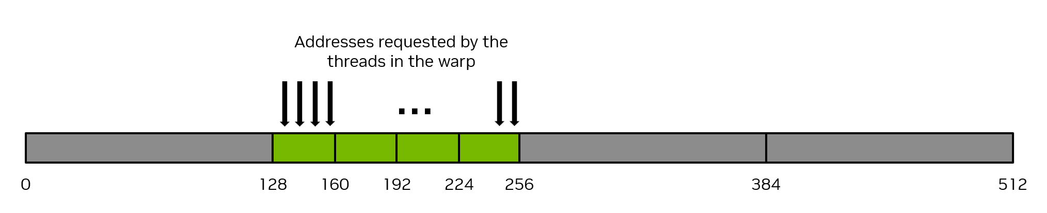
DAY 1 / 03
Make memory access visible
03
Predict the addresses first.
Then measure the implementation.
NVIDIA Figure 12 · Guide p. 59 / PDF p. 77
NVIDIA Figure 12 · §2.3.4.1, p. 59 / PDF p. 77
FORMATION / INDEPENDENT CUDA TRAINING
27
Notes:
Make memory access visible
Transition from independent correctness to the access pattern of a whole warp. This section uses only the guide's original coalescing, transpose and shared-memory-bank figures. Their numerical examples are explanations of access patterns, not new benchmark results. These figures come from the SIMT chapter rather than Part 1 because the retained Day 1 memory labs require those topics.
SOURCE AND ATTRIBUTION
NVIDIA source edition: CUDA Programming Guide, Release 13.4.2, NVIDIA Corporation, 10 September 2026. Source of figure pixels: user-supplied cuda-programming-guide.pdf.
NVIDIA Figure 12 · §2.3.4.1, p. 59 / PDF p. 77
Figure 12: printed page 59; PDF page 77; embedded image xref 1199; 2028×414 pixels.
Image SHA-256: d0fee1460b32304c3713bf111477c23f88691d01097626374c4fd2f882bc8694
Embedded image with PDF transparency mask restored; no redraw or recoloring.
IMAGE REVISION
Technical illustrations are original NVIDIA artwork from the uploaded PDF; none are redrawn or generated. Native text, code, source captions and layout elements are independently authored. Full source figures are kept intact and scaled proportionally. No claim of NVIDIA affiliation or endorsement.
VALIDATION BOUNDARY
This revision validates presentation layout and image provenance. It does not establish successful compilation or execution of the retained CUDA examples on a GPU.

Slide 28
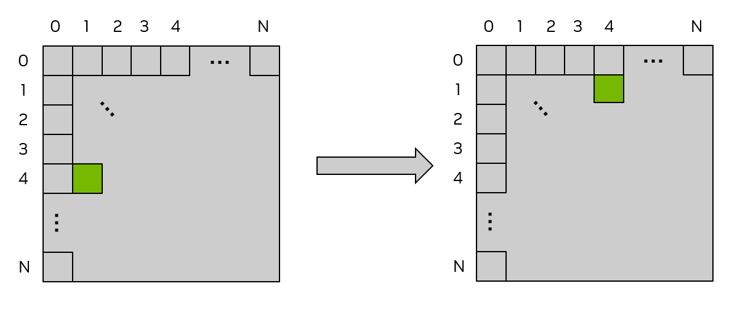
MEMORY ACCESS
For row-major matrices, x follows the column index
ROW-MAJOR ADDRESS EXPRESSION
col = blockIdx.x * blockDim.x
+ threadIdx.x;
row = blockIdx.y * blockDim.y
+ threadIdx.y;
A[row * width + col]
NVIDIA Figure 14 · Guide p. 61 / PDF p. 79
Consecutive x indices can address consecutive columns; inspect the actual array expression.
Guide §2.3.2 and §2.3.4.1.1, pp. 48 and 60–62 / PDF pp. 66 and 78–80
FORMATION / INDEPENDENT CUDA TRAINING
28
Notes:
For row-major matrices, x follows the column index
The code is the retained rectangular course mapping. In the guide's naive transpose example, x changes the column and adjacent threadIdx.x values read neighboring row-major elements. The source figure uses a square matrix; the course lab extends the contract to rectangular shapes. The layout expression, rather than the fact that a launch is 2D, establishes the access pattern.
SOURCE AND ATTRIBUTION
NVIDIA source edition: CUDA Programming Guide, Release 13.4.2, NVIDIA Corporation, 10 September 2026. Source of figure pixels: user-supplied cuda-programming-guide.pdf.
Guide §2.3.2 and §2.3.4.1.1, pp. 48 and 60–62 / PDF pp. 66 and 78–80
Figure 14: printed page 61; PDF page 79; embedded image xref 1211; 1228×523 pixels.
Image SHA-256: 225a5ad91f0892ba7e0cab87b6f745513a9b12eefc4ca9b9373109c3311e8399
Embedded image with PDF transparency mask restored; no redraw or recoloring.
IMAGE REVISION
Technical illustrations are original NVIDIA artwork from the uploaded PDF; none are redrawn or generated. Native text, code, source captions and layout elements are independently authored. Full source figures are kept intact and scaled proportionally. No claim of NVIDIA affiliation or endorsement.
VALIDATION BOUNDARY
This revision validates presentation layout and image provenance. It does not establish successful compilation or execution of the retained CUDA examples on a GPU.

Slide 29
MEMORY ACCESS
Coalescing combines addresses requested by a warp
NVIDIA Figure 12 · Guide p. 59 / PDF p. 77
32 threads × 4 bytes = 128 useful bytes
Four 32-byte transactions in the guide’s aligned example.
Reason about the full set of addresses requested by the warp.
NVIDIA Figure 12 · §2.3.4.1, p. 59 / PDF p. 77
FORMATION / INDEPENDENT CUDA TRAINING
29
Notes:
Coalescing combines addresses requested by a warp
Use the guide's original coalesced-memory image unchanged. In its aligned example, 32 threads each request one four-byte word. The 128 useful bytes fit into four 32-byte transactions. Emphasize the stated example conditions and distinguish the transaction accounting from measured DRAM traffic or elapsed application time.
SOURCE AND ATTRIBUTION
NVIDIA source edition: CUDA Programming Guide, Release 13.4.2, NVIDIA Corporation, 10 September 2026. Source of figure pixels: user-supplied cuda-programming-guide.pdf.
NVIDIA Figure 12 · §2.3.4.1, p. 59 / PDF p. 77
Figure 12: printed page 59; PDF page 77; embedded image xref 1199; 2028×414 pixels.
Image SHA-256: d0fee1460b32304c3713bf111477c23f88691d01097626374c4fd2f882bc8694
Embedded image with PDF transparency mask restored; no redraw or recoloring.
IMAGE REVISION
Technical illustrations are original NVIDIA artwork from the uploaded PDF; none are redrawn or generated. Native text, code, source captions and layout elements are independently authored. Full source figures are kept intact and scaled proportionally. No claim of NVIDIA affiliation or endorsement.
VALIDATION BOUNDARY
This revision validates presentation layout and image provenance. It does not establish successful compilation or execution of the retained CUDA examples on a GPU.

Slide 30
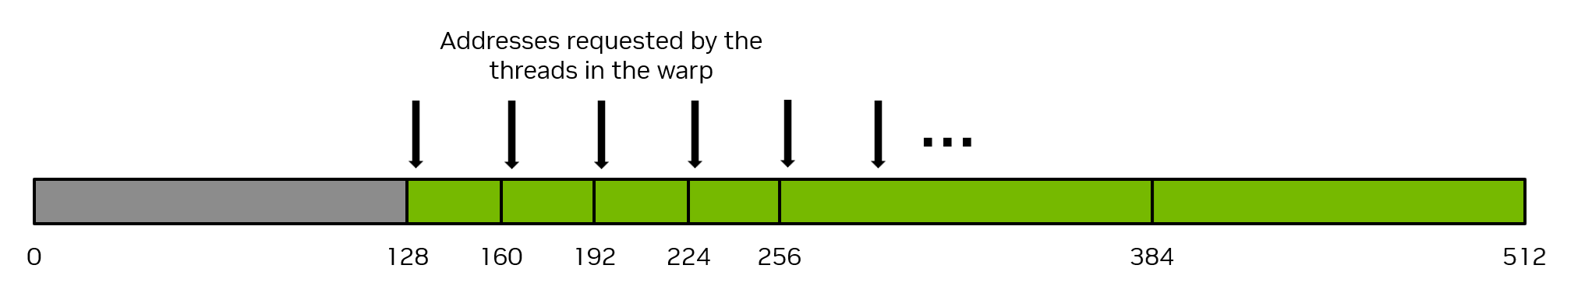
MEMORY ACCESS
Scattered addresses can waste most transferred bytes
NVIDIA Figure 13 · Guide p. 59 / PDF p. 77
128 useful bytes / 1,024 transaction bytes
12.5% utilization in this access example
This is NVIDIA’s transaction-accounting example—not benchmark data or an application speedup.
NVIDIA Figure 13 · §2.3.4.1, p. 59 / PDF p. 77; original custom chart removed.
FORMATION / INDEPENDENT CUDA TRAINING
30
Notes:
Scattered addresses can waste most transferred bytes
This replaces the previous authored stride bar chart with NVIDIA Figure 13, extracted from the PDF. The guide's worst-case example has 32 threads requesting four-byte values whose addresses lie in separate 32-byte segments. The accounting is 32 × 32 = 1024 transaction bytes for 128 useful bytes, giving 12.5% utilization in the example. It is not a measured performance percentage, nor a claimed 8× application slowdown.
SOURCE AND ATTRIBUTION
NVIDIA source edition: CUDA Programming Guide, Release 13.4.2, NVIDIA Corporation, 10 September 2026. Source of figure pixels: user-supplied cuda-programming-guide.pdf.
NVIDIA Figure 13 · §2.3.4.1, p. 59 / PDF p. 77; original custom chart removed.
Figure 13: printed page 59; PDF page 77; embedded image xref 1202; 2028×390 pixels.
Image SHA-256: 4d849e39b6a73ab24370d19d7ce8b35303c02730298ecb6429049d30bee277e3
Embedded image with PDF transparency mask restored; no redraw or recoloring.
IMAGE REVISION
Technical illustrations are original NVIDIA artwork from the uploaded PDF; none are redrawn or generated. Native text, code, source captions and layout elements are independently authored. Full source figures are kept intact and scaled proportionally. No claim of NVIDIA affiliation or endorsement.
VALIDATION BOUNDARY
This revision validates presentation layout and image provenance. It does not establish successful compilation or execution of the retained CUDA examples on a GPU.

Slide 31
MEMORY ACCESS
Transpose moves values to different coordinates
NVIDIA Figure 14 · Guide p. 61 / PDF p. 79
A[row, col] becomes B[col, row].
NVIDIA’s picture is square. The companion lab also tests rectangular and partial-tile shapes.
NVIDIA Figure 14 · §2.3.4.1.1, pp. 60–61 / PDF pp. 78–79
FORMATION / INDEPENDENT CUDA TRAINING
31
Notes:
Transpose moves values to different coordinates
The square-matrix picture is the original Figure 14. Do not replace its matrices with the old handcrafted 4×6 example. Explain the mapping A[row, col] to B[col, row]. In the rectangular companion lab, the output has cols rows and rows columns, so its leading dimension changes. The visible guide picture remains explicitly a square example.
SOURCE AND ATTRIBUTION
NVIDIA source edition: CUDA Programming Guide, Release 13.4.2, NVIDIA Corporation, 10 September 2026. Source of figure pixels: user-supplied cuda-programming-guide.pdf.
NVIDIA Figure 14 · §2.3.4.1.1, pp. 60–61 / PDF pp. 78–79
Figure 14: printed page 61; PDF page 79; embedded image xref 1211; 1228×523 pixels.
Image SHA-256: 225a5ad91f0892ba7e0cab87b6f745513a9b12eefc4ca9b9373109c3311e8399
Embedded image with PDF transparency mask restored; no redraw or recoloring.
IMAGE REVISION
Technical illustrations are original NVIDIA artwork from the uploaded PDF; none are redrawn or generated. Native text, code, source captions and layout elements are independently authored. Full source figures are kept intact and scaled proportionally. No claim of NVIDIA affiliation or endorsement.
VALIDATION BOUNDARY
This revision validates presentation layout and image provenance. It does not establish successful compilation or execution of the retained CUDA examples on a GPU.

Slide 32
MEMORY ACCESS
A naive transpose has easy loads and strided stores
COMPANION LAB · RECTANGULAR EXTENSION
__global__ void transpose_naive(
const float* in, float* out, int rows, int cols) {
int x = blockIdx.x * blockDim.x + threadIdx.x;
int y = blockIdx.y * blockDim.y + threadIdx.y;
if (x < cols && y < rows)
out[x * rows + y] = in[y * cols + x];
}
LOAD
Adjacent x:
adjacent input.
STORE
Adjacent x:
strided output.
The arithmetic is tiny. The mapping of memory addresses is the lesson.
Course rectangular extension; concept: guide §2.3.4.1.1, pp. 60–62 / PDF pp. 78–80
FORMATION / INDEPENDENT CUDA TRAINING
32
Notes:
A naive transpose has easy loads and strided stores
This is the existing companion kernel excerpt, not a verbatim transcription of the guide's square-matrix code. It retains row-major storage on both sides and protects arbitrary positive rectangular extents. Neighboring x values load adjacent input elements but write output addresses rows elements apart. Learners should verify indexing first and measure separately; no speedup is assumed.
SOURCE AND ATTRIBUTION
NVIDIA source edition: CUDA Programming Guide, Release 13.4.2, NVIDIA Corporation, 10 September 2026. Source of figure pixels: user-supplied cuda-programming-guide.pdf.
Course rectangular extension; concept: guide §2.3.4.1.1, pp. 60–62 / PDF pp. 78–80
No illustration on this slide: editable explanatory text/code only.
IMAGE REVISION
Technical illustrations are original NVIDIA artwork from the uploaded PDF; none are redrawn or generated. Native text, code, source captions and layout elements are independently authored. Full source figures are kept intact and scaled proportionally. No claim of NVIDIA affiliation or endorsement.
VALIDATION BOUNDARY
This revision validates presentation layout and image provenance. It does not establish successful compilation or execution of the retained CUDA examples on a GPU.

Slide 33
MEMORY ACCESS
Shared memory lets threads exchange staged data
CONCEPTUAL COURSE PATTERN · INDICES OMITTED
STAGE
tile[ty][tx] = in[...];
__syncthreads();
out[...] = tile[tx][ty];
Threads load a shared tile.
WAIT
Peers finish producing values.
STORE
Threads read exchanged values.
Shared memory enables cooperation; it still needs a correct access pattern and synchronization.
Concept: guide §2.3.4.2.1, pp. 65–67 / PDF pp. 83–85; course pattern below.
FORMATION / INDEPENDENT CUDA TRAINING
33
Notes:
Shared memory lets threads exchange staged data
The prior hand-drawn tile-transfer diagram is replaced with explicit code and explanation, not a new illustration. These three statements are a conceptual course excerpt; ellipses intentionally omit coordinate calculations and boundary guards. The actual rectangular implementation is in slide 50 and the existing lab pack. Its 32×8 thread block processes a 32×32 tile, unlike the guide's 32×32-thread square example. The source example changes indexing convention across listings, so do not mix pieces from it without reviewing the full layout contract.
SOURCE AND ATTRIBUTION
NVIDIA source edition: CUDA Programming Guide, Release 13.4.2, NVIDIA Corporation, 10 September 2026. Source of figure pixels: user-supplied cuda-programming-guide.pdf.
Concept: guide §2.3.4.2.1, pp. 65–67 / PDF pp. 83–85; course pattern below.
No illustration on this slide: editable explanatory text/code only.
IMAGE REVISION
Technical illustrations are original NVIDIA artwork from the uploaded PDF; none are redrawn or generated. Native text, code, source captions and layout elements are independently authored. Full source figures are kept intact and scaled proportionally. No claim of NVIDIA affiliation or endorsement.
VALIDATION BOUNDARY
This revision validates presentation layout and image provenance. It does not establish successful compilation or execution of the retained CUDA examples on a GPU.

Slide 34
SYNCHRONIZATION
Guard the data access, not a block-wide barrier
DO NOT STRUCTURE THIS LAB THIS WAY
COORDINATE PARTICIPATING THREADS
// Nonuniform control flow
if (i < n) {
tile[t] = input[i];
__syncthreads();
use(tile);
}
// Uniform barrier structure
tile[t] = (i < n) ? input[i] : 0.0f;
__syncthreads();
if (valid_output) {
write_result(...);
}
The participating threads must follow a compatible barrier sequence.
Guide block synchronization: §§2.1.5 and 2.3.3.2; course patterns shown.
FORMATION / INDEPENDENT CUDA TRAINING
34
Notes:
Guard the data access, not a block-wide barrier
These are simplified course patterns retained from the first deck. The unsafe example places the barrier under a condition that differs among participating threads of a partial block. The safe pattern supplies the additive identity for missing elements, reaches the barrier uniformly, and guards the output. Students must reason about which threads are participating and which values peers can read. This lesson is about the structure of the lab kernel, not a comprehensive account of every synchronization primitive.
SOURCE AND ATTRIBUTION
NVIDIA source edition: CUDA Programming Guide, Release 13.4.2, NVIDIA Corporation, 10 September 2026. Source of figure pixels: user-supplied cuda-programming-guide.pdf.
Guide block synchronization: §§2.1.5 and 2.3.3.2; course patterns shown.
No illustration on this slide: editable explanatory text/code only.
IMAGE REVISION
Technical illustrations are original NVIDIA artwork from the uploaded PDF; none are redrawn or generated. Native text, code, source captions and layout elements are independently authored. Full source figures are kept intact and scaled proportionally. No claim of NVIDIA affiliation or endorsement.
VALIDATION BOUNDARY
This revision validates presentation layout and image provenance. It does not establish successful compilation or execution of the retained CUDA examples on a GPU.

Slide 35
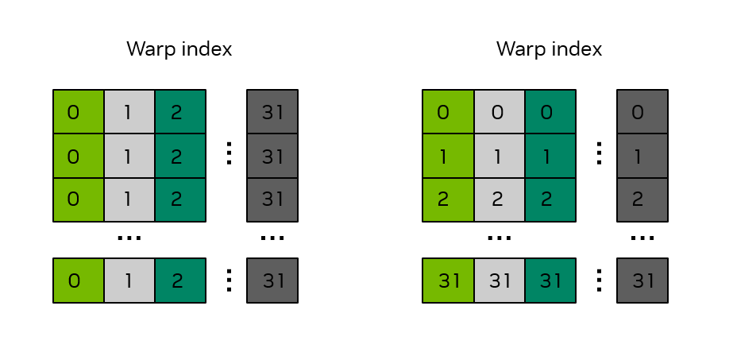
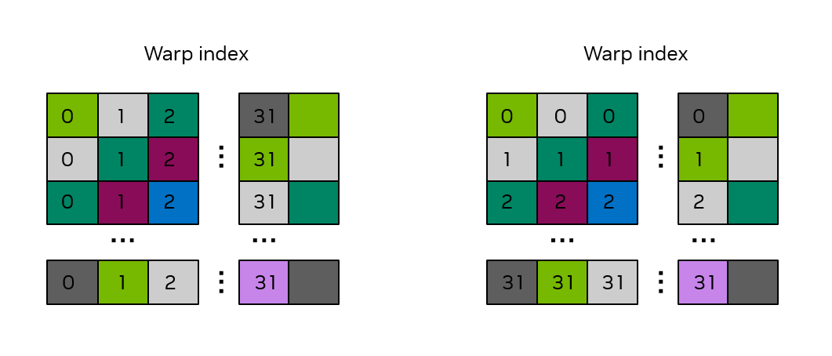
MEMORY ACCESS
One padding column changes the bank mapping
float tile[32][32]
float tile[32][33]
NVIDIA Figure 17 · Guide p. 68 / PDF p. 86
NVIDIA Figure 18 · Guide p. 70 / PDF p. 88
Padding changes the shared-memory layout without adding values to the matrix.
NVIDIA Figures 17–18 · §2.3.4.2.2, pp. 68–70 / PDF pp. 86–88
FORMATION / INDEPENDENT CUDA TRAINING
35
Notes:
One padding column changes the bank mapping
Both panels are original NVIDIA figures, not reconstructed arrays. Figure 17 shows the bank mapping for a 32×32 shared array; Figure 18 shows 32×33. The figures color the banks and label warp indices. Under the guide's 32-bit-word and 32-bank assumptions, padding removes the column-access bank conflict in this pattern. Padding is internal storage, not another input or output column. The companion uses a 32×8 block and loops over the tile, so its thread-to-value mapping is an explicit course extension.
SOURCE AND ATTRIBUTION
NVIDIA source edition: CUDA Programming Guide, Release 13.4.2, NVIDIA Corporation, 10 September 2026. Source of figure pixels: user-supplied cuda-programming-guide.pdf.
NVIDIA Figures 17–18 · §2.3.4.2.2, pp. 68–70 / PDF pp. 86–88
Figure 17: printed page 68; PDF page 86; embedded image xref 1246; 923×453 pixels.
Image SHA-256: 340047c1776e5889ce3315d3abcfba24e33bf5a20352bfbc96ced6e9b40e6ae1
Embedded image with PDF transparency mask restored; no redraw or recoloring.
Figure 18: printed page 70; PDF page 88; embedded image xref 1260; 1061×454 pixels.
Image SHA-256: 052595148967cecb839716d8b9b46778ac60333fc0c37924e170ca4e6680639b
Embedded image with PDF transparency mask restored; no redraw or recoloring.
IMAGE REVISION
Technical illustrations are original NVIDIA artwork from the uploaded PDF; none are redrawn or generated. Native text, code, source captions and layout elements are independently authored. Full source figures are kept intact and scaled proportionally. No claim of NVIDIA affiliation or endorsement.
VALIDATION BOUNDARY
This revision validates presentation layout and image provenance. It does not establish successful compilation or execution of the retained CUDA examples on a GPU.

Slide 36
MEMORY ACCESS
Resource use limits the number of active warps
PER THREAD
Register demand can limit residency.
PER BLOCK
Shared-memory demand can limit residency.
LAUNCH CONFIGURATION
Block size also consumes finite SM resources.
NVIDIA Figure 4 · Guide p. 8 / PDF p. 26
Calculate resource limits, then measure the implementation you actually intend to run.
NVIDIA Figure 4; guide §2.3.7 and register discussion §2.3.3.3, pp. 53 and 72–74.
FORMATION / INDEPENDENT CUDA TRAINING
36
Notes:
Resource use limits the number of active warps
Occupancy is the ratio of active warps to the SM's supported maximum. The guide explains limits from threads, blocks, registers and shared memory. It also notes that reducing register use can cause spilling and change performance characteristics. Use the source scheduling figure without inferring that exactly three blocks will reside for this kernel. Ask learners to measure the actual time rather than equate a theoretical occupancy calculation with performance.
SOURCE AND ATTRIBUTION
NVIDIA source edition: CUDA Programming Guide, Release 13.4.2, NVIDIA Corporation, 10 September 2026. Source of figure pixels: user-supplied cuda-programming-guide.pdf.
NVIDIA Figure 4; guide §2.3.7 and register discussion §2.3.3.3, pp. 53 and 72–74.
Figure 4: printed page 8; PDF page 26; embedded image xref 870; 807×1173 pixels.
Image SHA-256: 05d96c154f594f659ed245eb94a8b5a16c15fb92f57ea09f21692fdcbeea88db
Embedded image with PDF transparency mask restored; no redraw or recoloring.
IMAGE REVISION
Technical illustrations are original NVIDIA artwork from the uploaded PDF; none are redrawn or generated. Native text, code, source captions and layout elements are independently authored. Full source figures are kept intact and scaled proportionally. No claim of NVIDIA affiliation or endorsement.
VALIDATION BOUNDARY
This revision validates presentation layout and image provenance. It does not establish successful compilation or execution of the retained CUDA examples on a GPU.

Slide 37
40-MINUTE LAB
Lab 3 · Predict, implement and verify a transpose
HANDS-ON / COURSE EXERCISE
COMPARE
Naive, tiled and padded.
RUN FROM THE MODULE SHOWN
# After installing the supplied starter:
cd formation/projects/detailed
bazel test //day1_extensions:transpose_test
bazel run -c opt //day1_extensions:transpose_lab
CHECK
Rectangular and partial tiles.
REPORT
Prediction and measured outcome.
Deliverable: correct outputs and an explanation of the observed access behavior.
Record what you tested, why you trust the result, and what remains unverified.
Existing companion pack: starter/day1_extensions; source concepts: guide §2.3.4.
FORMATION / INDEPENDENT CUDA TRAINING
37
Notes:
Lab 3 · Predict, implement and verify a transpose
The existing Day 1 lab pack remains unchanged. These targets exist only after installing day1_extensions in the detailed module. Explain explicitly that the lab uses dim3(32,8) to process a 32×32 data tile, whereas the guide's square illustration uses a different thread-block shape. Do not confuse a teaching adaptation with an exact source listing. Require correctness before timing and accept an outcome with no speedup when it is honestly explained.
SOURCE AND ATTRIBUTION
NVIDIA source edition: CUDA Programming Guide, Release 13.4.2, NVIDIA Corporation, 10 September 2026. Source of figure pixels: user-supplied cuda-programming-guide.pdf.
Existing companion pack: starter/day1_extensions; source concepts: guide §2.3.4.
No illustration on this slide: editable explanatory text/code only.
IMAGE REVISION
Technical illustrations are original NVIDIA artwork from the uploaded PDF; none are redrawn or generated. Native text, code, source captions and layout elements are independently authored. Full source figures are kept intact and scaled proportionally. No claim of NVIDIA affiliation or endorsement.
VALIDATION BOUNDARY
This revision validates presentation layout and image provenance. It does not establish successful compilation or execution of the retained CUDA examples on a GPU.

Slide 38
MEMORY-ACCESS DEBRIEF
Describe useful traffic before interpreting the timing
Read M × N floats + write M × N floats
8 × M × N bytes
Effective bandwidth = useful bytes / elapsed time
Keep cache residency and timing scope in the report.
Useful traffic is an algorithmic count—not a direct measurement of DRAM transfers.
Course arithmetic for the retained float32 transpose lab; guide §2.3.4 motivates access efficiency.
FORMATION / INDEPENDENT CUDA TRAINING
38
Notes:
Describe useful traffic before interpreting the timing
This is a course-derived count, not a NVIDIA benchmark chart. An out-of-place float32 transpose must account for one useful four-byte input read and one useful four-byte output write per matrix element. For M×N elements that is 8MN useful bytes. Effective bandwidth based on this count is not necessarily physical DRAM traffic, and repeat runs may access data from cache. State the measured interval and units explicitly.
SOURCE AND ATTRIBUTION
NVIDIA source edition: CUDA Programming Guide, Release 13.4.2, NVIDIA Corporation, 10 September 2026. Source of figure pixels: user-supplied cuda-programming-guide.pdf.
Course arithmetic for the retained float32 transpose lab; guide §2.3.4 motivates access efficiency.
No illustration on this slide: editable explanatory text/code only.
IMAGE REVISION
Technical illustrations are original NVIDIA artwork from the uploaded PDF; none are redrawn or generated. Native text, code, source captions and layout elements are independently authored. Full source figures are kept intact and scaled proportionally. No claim of NVIDIA affiliation or endorsement.
VALIDATION BOUNDARY
This revision validates presentation layout and image provenance. It does not establish successful compilation or execution of the retained CUDA examples on a GPU.

Slide 39
DAY 1 / 04
Cooperate safely
04
When many inputs produce fewer outputs,
independent writes are not enough.
NVIDIA Figure 3 · Guide p. 6 / PDF p. 24
NVIDIA Figure 3 · cooperative work: guide §§2.3.3.2 and 2.3.5
FORMATION / INDEPENDENT CUDA TRAINING
39
Notes:
Cooperate safely
Section transition: When many inputs produce fewer outputs,
independent writes are not enough.
SOURCE AND ATTRIBUTION
NVIDIA source edition: CUDA Programming Guide, Release 13.4.2, NVIDIA Corporation, 10 September 2026. Source of figure pixels: user-supplied cuda-programming-guide.pdf.
NVIDIA Figure 3 · cooperative work: guide §§2.3.3.2 and 2.3.5
Figure 3: printed page 6; PDF page 24; embedded image xref 853; 3620×1720 pixels.
Image SHA-256: 3d12755cf2edf428ae367c0ae1b5eba3c4d8618271ce54e628504fc1efe8b00f
Embedded image with PDF transparency mask restored; no redraw or recoloring.
IMAGE REVISION
Technical illustrations are original NVIDIA artwork from the uploaded PDF; none are redrawn or generated. Native text, code, source captions and layout elements are independently authored. Full source figures are kept intact and scaled proportionally. No claim of NVIDIA affiliation or endorsement.
VALIDATION BOUNDARY
This revision validates presentation layout and image provenance. It does not establish successful compilation or execution of the retained CUDA examples on a GPU.

Slide 40
THREAD COOPERATION
A reduction changes ownership of the result
1 + 2 + 3 + 4 + 5 + 6 + 7 + 8 = 36
Several contributors,
one final answer.
Who combines each partial,
and when is it ready?
NVIDIA Figure 3 · Guide p. 6 / PDF p. 24
Each shared result needs a defined producer, consumer and ordering relationship.
NVIDIA Figure 3; reduction and shared-memory concepts: §§2.3.3.2 and 2.3.5.
FORMATION / INDEPENDENT CUDA TRAINING
40
Notes:
A reduction changes ownership of the result
The old original reduction tree is removed. Use the guide's grid figure to emphasize the grouping of work and use text arithmetic for the simple sum. The course exercise first computes block partials and then combines them on the host. This is a teaching strategy, not the peak-performance reduction implementation recommended by the guide, which points readers toward optimized library primitives.
SOURCE AND ATTRIBUTION
NVIDIA source edition: CUDA Programming Guide, Release 13.4.2, NVIDIA Corporation, 10 September 2026. Source of figure pixels: user-supplied cuda-programming-guide.pdf.
NVIDIA Figure 3; reduction and shared-memory concepts: §§2.3.3.2 and 2.3.5.
Figure 3: printed page 6; PDF page 24; embedded image xref 853; 3620×1720 pixels.
Image SHA-256: 3d12755cf2edf428ae367c0ae1b5eba3c4d8618271ce54e628504fc1efe8b00f
Embedded image with PDF transparency mask restored; no redraw or recoloring.
IMAGE REVISION
Technical illustrations are original NVIDIA artwork from the uploaded PDF; none are redrawn or generated. Native text, code, source captions and layout elements are independently authored. Full source figures are kept intact and scaled proportionally. No claim of NVIDIA affiliation or endorsement.
VALIDATION BOUNDARY
This revision validates presentation layout and image provenance. It does not establish successful compilation or execution of the retained CUDA examples on a GPU.

Slide 41
THREAD COOPERATION
An atomic update protects one read–modify–write
COMPANION BASELINE · LEGACY atomicAdd
if (i < n)
atomicAdd(total, input[i]);
INITIALIZE
Set total to the initial value before launch.
INTERPRET
Many threads contend for the same location.
DO NOT INFER
An atomic update is not a grid-wide barrier.
Atomicity of the update does not replace the rest of the synchronization contract.
Course atomicAdd baseline; guide §§2.3.5 and 5.4.5.1. Floating-point ordering: §5.5.1.4.
FORMATION / INDEPENDENT CUDA TRAINING
41
Notes:
An atomic update protects one read–modify–write
The course baseline uses the legacy atomicAdd interface and is retained for continuity with the supplied code. The supplied guide prefers std::atomic-like CUDA C++ interfaces for new code; the retained snippet is not presented as that newer example. The output must be initialized before each invocation. An atomic addition does not create a grid-wide barrier. Floating-point update order may change the final rounding result. The purpose is a simple correctness baseline, not a production-optimal reduction.
SOURCE AND ATTRIBUTION
NVIDIA source edition: CUDA Programming Guide, Release 13.4.2, NVIDIA Corporation, 10 September 2026. Source of figure pixels: user-supplied cuda-programming-guide.pdf.
Course atomicAdd baseline; guide §§2.3.5 and 5.4.5.1. Floating-point ordering: §5.5.1.4.
No illustration on this slide: editable explanatory text/code only.
IMAGE REVISION
Technical illustrations are original NVIDIA artwork from the uploaded PDF; none are redrawn or generated. Native text, code, source captions and layout elements are independently authored. Full source figures are kept intact and scaled proportionally. No claim of NVIDIA affiliation or endorsement.
VALIDATION BOUNDARY
This revision validates presentation layout and image provenance. It does not establish successful compilation or execution of the retained CUDA examples on a GPU.

Slide 42
THREAD COOPERATION
Reduce in a block, then emit one partial result
COURSE KERNEL BODY · EXACTLY 256 THREADS PER BLOCK
LOAD
__shared__ float s[256];
int t = threadIdx.x;
int i = blockIdx.x * 256 + t;
s[t] = (i < n) ? input[i] : 0.0f;
__syncthreads();
for (int stride = 128; stride > 0; stride /= 2) {
if (t < stride) s[t] += s[t + stride];
__syncthreads();
}
if (t == 0) partial[blockIdx.x] = s[0];
Missing input
becomes zero.
COOPERATE
Follow the same
barrier sequence.
EMIT
One partial
per block.
The supplied lab combines block partials on the host after the GPU work completes.
Retained companion implementation; source concepts: guide §§2.3.3.2 and 2.3.5.
FORMATION / INDEPENDENT CUDA TRAINING
42
Notes:
Reduce in a block, then emit one partial result
This is the original companion tree-reduction kernel body, not a figure or verbatim listing from NVIDIA. It requires exactly 256 threads per block. Each valid lane loads one input; other lanes load zero. All participating threads reach the same barriers. Only thread zero stores the partial. The companion harness copies these partials to the host and finishes there; timing only the GPU stage therefore does not time the complete strategy.
SOURCE AND ATTRIBUTION
NVIDIA source edition: CUDA Programming Guide, Release 13.4.2, NVIDIA Corporation, 10 September 2026. Source of figure pixels: user-supplied cuda-programming-guide.pdf.
Retained companion implementation; source concepts: guide §§2.3.3.2 and 2.3.5.
No illustration on this slide: editable explanatory text/code only.
IMAGE REVISION
Technical illustrations are original NVIDIA artwork from the uploaded PDF; none are redrawn or generated. Native text, code, source captions and layout elements are independently authored. Full source figures are kept intact and scaled proportionally. No claim of NVIDIA affiliation or endorsement.
VALIDATION BOUNDARY
This revision validates presentation layout and image provenance. It does not establish successful compilation or execution of the retained CUDA examples on a GPU.

Slide 43
THREAD COOPERATION
Use a stage boundary to consume other blocks’ results
GPU STAGE
Kernel A writes independent block partials.
COMPLETION
Wait for the required work and transfer.
NEXT STAGE
The host combines partials in this lab.
NVIDIA Figure 4 · Guide p. 8 / PDF p. 26
__syncthreads() coordinates a block—not all ordinary blocks in the grid.
NVIDIA Figure 4; ordinary block independence §1.2.2.1; completion and streams §§2.1.4, 2.5.
FORMATION / INDEPENDENT CUDA TRAINING
43
Notes:
Use a stage boundary to consume other blocks’ results
Replace the original three-box pipeline drawing with NVIDIA's scheduling figure and explicit text. Ordinary blocks must not depend on a particular scheduling order. In the retained lab, one GPU kernel writes per-block partials; a completion and copy boundary makes them available to host reduction. Another valid design can launch a second GPU kernel with an appropriate stream dependency. __syncthreads remains block-scoped; special cooperative/cluster mechanisms are outside this ordinary-launch example.
SOURCE AND ATTRIBUTION
NVIDIA source edition: CUDA Programming Guide, Release 13.4.2, NVIDIA Corporation, 10 September 2026. Source of figure pixels: user-supplied cuda-programming-guide.pdf.
NVIDIA Figure 4; ordinary block independence §1.2.2.1; completion and streams §§2.1.4, 2.5.
Figure 4: printed page 8; PDF page 26; embedded image xref 870; 807×1173 pixels.
Image SHA-256: 05d96c154f594f659ed245eb94a8b5a16c15fb92f57ea09f21692fdcbeea88db
Embedded image with PDF transparency mask restored; no redraw or recoloring.
IMAGE REVISION
Technical illustrations are original NVIDIA artwork from the uploaded PDF; none are redrawn or generated. Native text, code, source captions and layout elements are independently authored. Full source figures are kept intact and scaled proportionally. No claim of NVIDIA affiliation or endorsement.
VALIDATION BOUNDARY
This revision validates presentation layout and image provenance. It does not establish successful compilation or execution of the retained CUDA examples on a GPU.

Slide 44
35-MINUTE LAB
Lab 4 · Compare atomic and block-partial reductions
HANDS-ON / COURSE EXERCISE
INPUTS
Empty, partial and signed.
RUN FROM THE MODULE SHOWN
cd formation/projects/detailed
bazel test //day1_extensions:reduction_test
bazel run -c opt //day1_extensions:reduction_lab
NUMERICS
Check the error tolerance.
SCOPE
Separate GPU stage from full result.
Deliverable: correct sums and a reason for every synchronization point.
Record what you tested, why you trust the result, and what remains unverified.
Existing companion pack: starter/day1_extensions and solution/day1_extensions.
FORMATION / INDEPENDENT CUDA TRAINING
44
Notes:
Lab 4 · Compare atomic and block-partial reductions
Retain the existing lab. Do not compare the atomic and block-partial strategies using only a GPU-stage time when one strategy still needs host finalization. Initialize the atomic destination for every trial. The source guide explicitly states that its simple reduction examples are instructional and points to CCCL for tuned implementations; the same limitation applies to these course kernels.
SOURCE AND ATTRIBUTION
NVIDIA source edition: CUDA Programming Guide, Release 13.4.2, NVIDIA Corporation, 10 September 2026. Source of figure pixels: user-supplied cuda-programming-guide.pdf.
Existing companion pack: starter/day1_extensions and solution/day1_extensions.
No illustration on this slide: editable explanatory text/code only.
IMAGE REVISION
Technical illustrations are original NVIDIA artwork from the uploaded PDF; none are redrawn or generated. Native text, code, source captions and layout elements are independently authored. Full source figures are kept intact and scaled proportionally. No claim of NVIDIA affiliation or endorsement.
VALIDATION BOUNDARY
This revision validates presentation layout and image provenance. It does not establish successful compilation or execution of the retained CUDA examples on a GPU.

Slide 45
EVIDENCE CHECK
Explain the result before the next optimization
Ownership
Which thread writes each output or partial?
Visibility
Which writes must finish before the next read?
Boundaries
What happens in incomplete blocks and tiles?
Measurement
Which work is included—and excluded—from the number?
Correctness evidence and a declared timing scope are stronger than a single speedup.
Course assessment framework; guide concepts: ownership, synchronization, bounds and memory access.
FORMATION / INDEPENDENT CUDA TRAINING
45
Notes:
Explain the result before the next optimization
Use this as a debrief rather than a new concept slide. Each learner should answer all four questions for either transpose or reduction. Encourage them to distinguish an address-based prediction from a measured observation. A test failure is not explained away by a fast time. This is a course assessment, not an official NVIDIA certification requirement.
SOURCE AND ATTRIBUTION
NVIDIA source edition: CUDA Programming Guide, Release 13.4.2, NVIDIA Corporation, 10 September 2026. Source of figure pixels: user-supplied cuda-programming-guide.pdf.
Course assessment framework; guide concepts: ownership, synchronization, bounds and memory access.
No illustration on this slide: editable explanatory text/code only.
COURSE / TOOLING REFERENCES (distinct from the PDF artwork)
https://github.com/neudinger/formation
IMAGE REVISION
Technical illustrations are original NVIDIA artwork from the uploaded PDF; none are redrawn or generated. Native text, code, source captions and layout elements are independently authored. Full source figures are kept intact and scaled proportionally. No claim of NVIDIA affiliation or endorsement.
VALIDATION BOUNDARY
This revision validates presentation layout and image provenance. It does not establish successful compilation or execution of the retained CUDA examples on a GPU.

Slide 46
DAY 1 RECAP
Five ideas to carry into every CUDA feature
Map work
A thread index selects data.
Own data
Pointers need valid memory.
Respect scope
Block cooperation requires ordering.
Test edges
Aligned input sizes are not enough.
Seek evidence
Predict the accesses, then measure.
You now have the vocabulary to explain why a CUDA implementation is correct.
Course recap of guide §§1.2, 2.1 and 2.3.
FORMATION / INDEPENDENT CUDA TRAINING
46
Notes:
Five ideas to carry into every CUDA feature
Invite a learner to explain each phrase using one of today's examples. Map work: vector index. Own data: valid allocations. Respect scope: shared-memory synchronization. Test edges: partial tiles and blocks. Seek evidence: a prediction and its measurement. Do not introduce another optimization before these ideas are clear.
SOURCE AND ATTRIBUTION
NVIDIA source edition: CUDA Programming Guide, Release 13.4.2, NVIDIA Corporation, 10 September 2026. Source of figure pixels: user-supplied cuda-programming-guide.pdf.
Course recap of guide §§1.2, 2.1 and 2.3.
No illustration on this slide: editable explanatory text/code only.
COURSE / TOOLING REFERENCES (distinct from the PDF artwork)
https://github.com/neudinger/formation
IMAGE REVISION
Technical illustrations are original NVIDIA artwork from the uploaded PDF; none are redrawn or generated. Native text, code, source captions and layout elements are independently authored. Full source figures are kept intact and scaled proportionally. No claim of NVIDIA affiliation or endorsement.
VALIDATION BOUNDARY
This revision validates presentation layout and image provenance. It does not establish successful compilation or execution of the retained CUDA examples on a GPU.

Slide 47
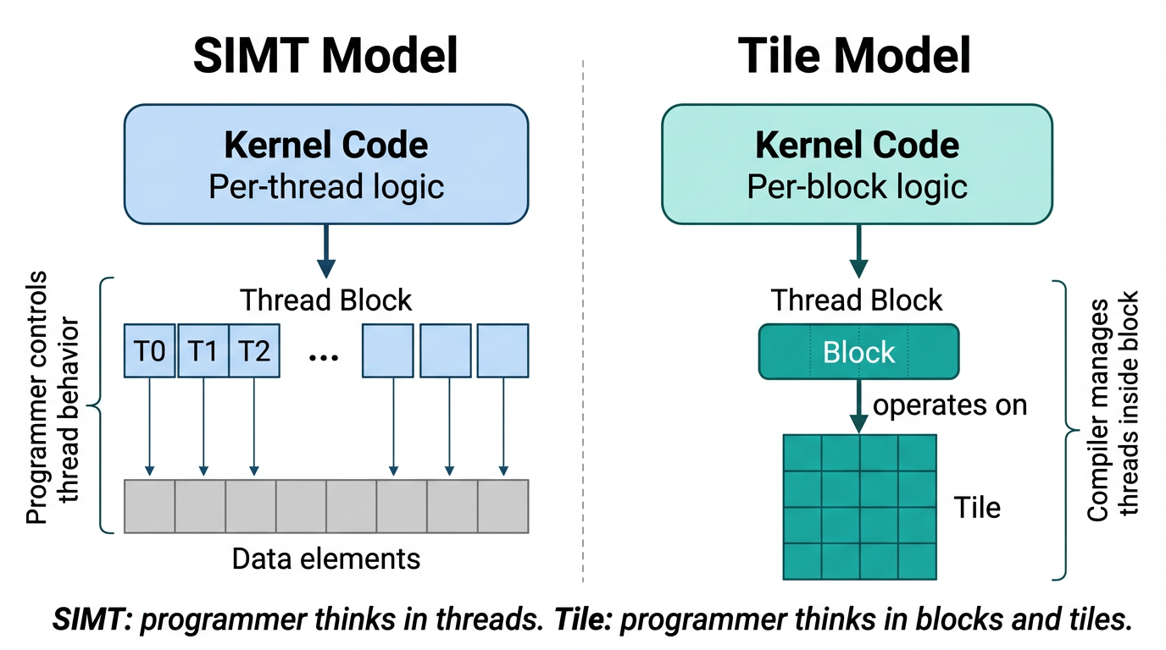
NEXT
Day 2 connects kernels to measured applications
MEASURE
Warmup, events and timing scope.
PIPELINE
Persistent buffers and streams.
EXTEND
MatMul and a library baseline.
INTEGRATE
Builds, packaging and abstractions.
NVIDIA Figure 8 · Guide p. 11 / PDF p. 29
A hand-written shared-memory tiled kernel is still SIMT code—not automatically CUDA Tile.
NVIDIA Figure 8 · §1.2.2.3, p. 11 / PDF p. 29; existing Day 2 course roadmap.
FORMATION / INDEPENDENT CUDA TRAINING
47
Notes:
Day 2 connects kernels to measured applications
Use the official SIMT/tile comparison only for the abstraction distinction. The figure says a SIMT programmer writes per-thread code while a tile programmer writes per-block tile operations. Today's tiled shared-memory transpose remains a SIMT implementation, not a CUDA Tile kernel. Day 2 covers measurement, streams, MatMul and deployment; JAX, Triton and CUDA Tile are separate comparisons, not interchangeable names for the same API.
SOURCE AND ATTRIBUTION
NVIDIA source edition: CUDA Programming Guide, Release 13.4.2, NVIDIA Corporation, 10 September 2026. Source of figure pixels: user-supplied cuda-programming-guide.pdf.
NVIDIA Figure 8 · §1.2.2.3, p. 11 / PDF p. 29; existing Day 2 course roadmap.
Figure 8: printed page 11; PDF page 29; embedded image xref 898; 1376×768 pixels.
Image SHA-256: 4c5ed5a0b1dea2cb5d96ed85e7af7fd69fd4a1a56d767b3bcefdccd25461701d
Original embedded figure pixels, PNG extraction; no redraw or recoloring.
COURSE / TOOLING REFERENCES (distinct from the PDF artwork)
https://github.com/neudinger/formation/blob/main/followup/presentation-2-followup.md
IMAGE REVISION
Technical illustrations are original NVIDIA artwork from the uploaded PDF; none are redrawn or generated. Native text, code, source captions and layout elements are independently authored. Full source figures are kept intact and scaled proportionally. No claim of NVIDIA affiliation or endorsement.
VALIDATION BOUNDARY
This revision validates presentation layout and image provenance. It does not establish successful compilation or execution of the retained CUDA examples on a GPU.

Slide 48
END OF DAY 1
Correctness first. Finish with evidence.
FROM formation/projects/detailed
bazel test //cpp:vector_cpu_test //gpu:vector_add_test
# After installing the existing companion extensions:
bazel test //day1_extensions:transpose_test \
//day1_extensions:reduction_test
Slides 49–54: instructor setup, reference code, timing, answers and source attribution.
Original CUDA cover artwork from PDF p. 1; existing course commands below.
FORMATION / INDEPENDENT CUDA TRAINING
48
Notes:
Correctness first. Finish with evidence.
Close the taught portion. Ask learners to show their test and explain a memory-access or synchronization choice. The following reference slides are available for setup, code review, timing and source attribution. This slide does not claim the commands have been run in the authoring environment.
SOURCE AND ATTRIBUTION
NVIDIA source edition: CUDA Programming Guide, Release 13.4.2, NVIDIA Corporation, 10 September 2026. Source of figure pixels: user-supplied cuda-programming-guide.pdf.
Original CUDA cover artwork from PDF p. 1; existing course commands below.
Cover artwork: printed page cover; PDF page 1; embedded image xref 9; 948×317 pixels.
Image SHA-256: 8525c91f9095219325160e8e7d53cf9a5529ecf10ed3f8c3ada8d3c11260a5a0
Embedded image with PDF transparency mask restored; no redraw or recoloring.
COURSE / TOOLING REFERENCES (distinct from the PDF artwork)
https://github.com/neudinger/formation/blob/main/projects/detailed/README.md
IMAGE REVISION
Technical illustrations are original NVIDIA artwork from the uploaded PDF; none are redrawn or generated. Native text, code, source captions and layout elements are independently authored. Full source figures are kept intact and scaled proportionally. No claim of NVIDIA affiliation or endorsement.
VALIDATION BOUNDARY
This revision validates presentation layout and image provenance. It does not establish successful compilation or execution of the retained CUDA examples on a GPU.

Slide 49
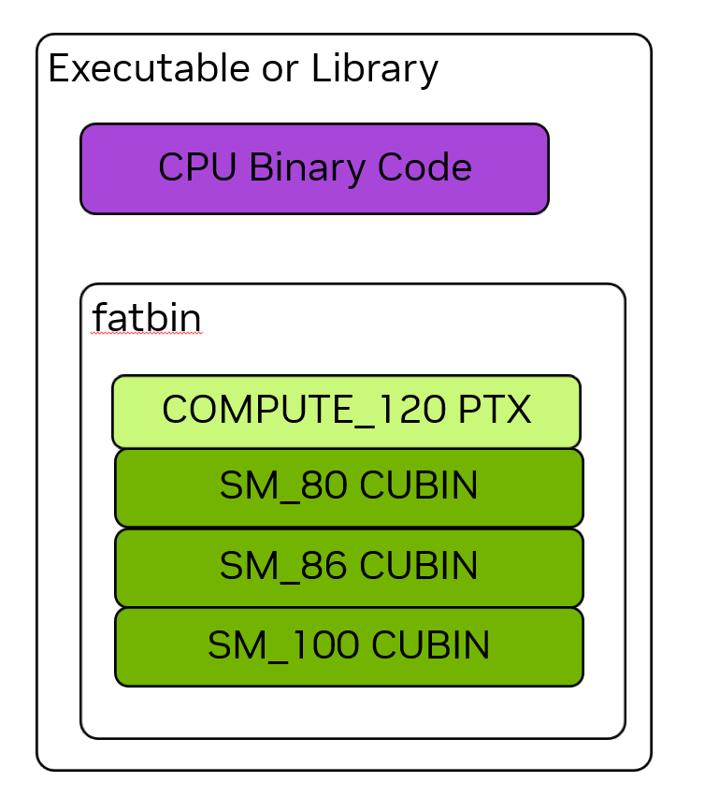
APPENDIX / INSTRUCTOR
Keep source edition, build inputs and runtime separate
REFERENCE PROJECT
projects/detailed
EXERCISE MODULES
tp/day1/… and tp/solutions/day1/…
EXISTING COMPANION
Copy one day1_extensions folder.
VERIFY BEFORE TEACHING
Driver, GPU, build, tests and diagnostics.
NVIDIA Figure 10 · Guide p. 17 / PDF p. 35
The guide’s fatbin illustration does not identify the exact binaries produced by your build.
NVIDIA Figure 10 · §1.3.4, p. 17 / PDF p. 35; existing course module boundaries.
FORMATION / INDEPENDENT CUDA TRAINING
49
Notes:
Keep source edition, build inputs and runtime separate
The figure is the original NVIDIA fatbin illustration. It depicts CPU code and several GPU representations in an executable or library; it is not a literal inventory of the repository's generated binary. The supplied PDF is Release 13.4.2. The earlier course baseline pins a different toolkit/compiler pair. Students must also have a suitable runtime driver and device. The original lab zip is not changed by this image revision. Newer guide features are not automatically available in older lab environments.
SOURCE AND ATTRIBUTION
NVIDIA source edition: CUDA Programming Guide, Release 13.4.2, NVIDIA Corporation, 10 September 2026. Source of figure pixels: user-supplied cuda-programming-guide.pdf.
NVIDIA Figure 10 · §1.3.4, p. 17 / PDF p. 35; existing course module boundaries.
Figure 10: printed page 17; PDF page 35; embedded image xref 947; 754×867 pixels.
Image SHA-256: 51b81d6bc5779b73fe4c229c722116d6fa1eb093b05e0aa9891305aa24512cab
Embedded image with PDF transparency mask restored; no redraw or recoloring.
COURSE / TOOLING REFERENCES (distinct from the PDF artwork)
https://github.com/neudinger/formation/blob/main/tp/README.md
https://github.com/neudinger/formation/blob/main/projects/detailed/.bazelrc
IMAGE REVISION
Technical illustrations are original NVIDIA artwork from the uploaded PDF; none are redrawn or generated. Native text, code, source captions and layout elements are independently authored. Full source figures are kept intact and scaled proportionally. No claim of NVIDIA affiliation or endorsement.
VALIDATION BOUNDARY
This revision validates presentation layout and image provenance. It does not establish successful compilation or execution of the retained CUDA examples on a GPU.

Slide 50
APPENDIX / REFERENCE CODE
The padded shared-memory transpose body
COURSE REFERENCE · dim3(32,8) · NON-ALIASED INPUT/OUTPUT
__shared__ float tile[32][33];
int x = blockIdx.x * 32 + threadIdx.x;
int y = blockIdx.y * 32 + threadIdx.y;
for (int j = 0; j < 32; j += 8)
if (x < cols && y + j < rows)
tile[threadIdx.y + j][threadIdx.x] = in[(y + j) * cols + x];
__syncthreads();
x = blockIdx.y * 32 + threadIdx.x;
y = blockIdx.x * 32 + threadIdx.y;
for (int j = 0; j < 32; j += 8)
if (x < rows && y + j < cols)
out[(y + j) * rows + x] = tile[threadIdx.x][threadIdx.y + j];
Each valid store reads a shared entry produced by a valid input load.
Retained companion code; NVIDIA transpose concepts §2.3.4.2. This is not an exact guide listing.
FORMATION / INDEPENDENT CUDA TRAINING
50
Notes:
The padded shared-memory transpose body
Keep the original lab implementation. Launch exactly dim3(32,8) threads per block, with each block covering 32×32 data values. Input and output are distinct buffers. The first loop checks the input extents, the barrier is uniform, coordinates are exchanged, and the output guard reflects the transposed shape. Each valid output reads a shared-memory entry written by a valid input load. This course code extends the guide's square-matrix discussion to rectangular shapes. Full host validation and launch code remain in the companion pack.
SOURCE AND ATTRIBUTION
NVIDIA source edition: CUDA Programming Guide, Release 13.4.2, NVIDIA Corporation, 10 September 2026. Source of figure pixels: user-supplied cuda-programming-guide.pdf.
Retained companion code; NVIDIA transpose concepts §2.3.4.2. This is not an exact guide listing.
No illustration on this slide: editable explanatory text/code only.
IMAGE REVISION
Technical illustrations are original NVIDIA artwork from the uploaded PDF; none are redrawn or generated. Native text, code, source captions and layout elements are independently authored. Full source figures are kept intact and scaled proportionally. No claim of NVIDIA affiliation or endorsement.
VALIDATION BOUNDARY
This revision validates presentation layout and image provenance. It does not establish successful compilation or execution of the retained CUDA examples on a GPU.

Slide 51
APPENDIX / TIMING
Measure a warm device-work interval
TEACHING EXCERPT · EVENTS ALREADY CREATED
// Allocate and upload before this scope; warm up first.
CUDA_CHECK(cudaEventRecord(start, stream));
for (int repeat = 0; repeat < repeats; ++repeat)
launch(..., stream);
CUDA_CHECK(cudaEventRecord(stop, stream));
CUDA_CHECK(cudaEventSynchronize(stop));
CUDA_CHECK(cudaEventElapsedTime(&ms, start, stop));
float ms_per_iteration = ms / repeats;
Name what the interval includes, what it excludes, and how completion was established.
Guide §2.5.3.3, pp. 108–109 / PDF pp. 126–127; course timing excerpt.
FORMATION / INDEPENDENT CUDA TRAINING
51
Notes:
Measure a warm device-work interval
This is a retained teaching excerpt. Events must exist and repeats must be positive. Setup, upload and warmup happen before this interval. The event stream orders the markers with the launched work. The elapsed interval may include submission gaps between kernels, so it is not a promise of a pure instruction-only measurement. Separate this GPU interval from a complete host-visible result time.
SOURCE AND ATTRIBUTION
NVIDIA source edition: CUDA Programming Guide, Release 13.4.2, NVIDIA Corporation, 10 September 2026. Source of figure pixels: user-supplied cuda-programming-guide.pdf.
Guide §2.5.3.3, pp. 108–109 / PDF pp. 126–127; course timing excerpt.
No illustration on this slide: editable explanatory text/code only.
IMAGE REVISION
Technical illustrations are original NVIDIA artwork from the uploaded PDF; none are redrawn or generated. Native text, code, source captions and layout elements are independently authored. Full source figures are kept intact and scaled proportionally. No claim of NVIDIA affiliation or endorsement.
VALIDATION BOUNDARY
This revision validates presentation layout and image provenance. It does not establish successful compilation or execution of the retained CUDA examples on a GPU.

Slide 52
APPENDIX / ANSWER KEY
Answers to the day’s conceptual checks
1,000 elements / 256 threads
Four blocks; 24 threads must skip memory access.
Block 3 / local thread 231
Global index 999: the final valid element.
Why no SAXPY block barrier?
Each valid thread writes a distinct output element.
Why a shared-memory barrier?
Consumers must not read unfinished peer writes.
What does occupancy describe?
Active warps relative to the SM’s supported maximum.
Is 12.5% a measured speedup?
No: useful bytes / transaction bytes in one guide example.
An accurate explanation must preserve the assumptions of the example.
Derived course answers; transaction utilization example: guide §2.3.4.1, p. 59 / PDF p. 77.
FORMATION / INDEPENDENT CUDA TRAINING
52
Notes:
Answers to the day’s conceptual checks
The previous question about the custom sector chart has been removed with that chart. The replacement question distinguishes the guide's 12.5% transaction-utilization example from a measured speed ratio. Ask students to explain, not just recite, the index and synchronization answers.
SOURCE AND ATTRIBUTION
NVIDIA source edition: CUDA Programming Guide, Release 13.4.2, NVIDIA Corporation, 10 September 2026. Source of figure pixels: user-supplied cuda-programming-guide.pdf.
Derived course answers; transaction utilization example: guide §2.3.4.1, p. 59 / PDF p. 77.
No illustration on this slide: editable explanatory text/code only.
COURSE / TOOLING REFERENCES (distinct from the PDF artwork)
https://github.com/neudinger/formation/blob/main/projects/detailed/gpu/vector_add_device.cu
IMAGE REVISION
Technical illustrations are original NVIDIA artwork from the uploaded PDF; none are redrawn or generated. Native text, code, source captions and layout elements are independently authored. Full source figures are kept intact and scaled proportionally. No claim of NVIDIA affiliation or endorsement.
VALIDATION BOUNDARY
This revision validates presentation layout and image provenance. It does not establish successful compilation or execution of the retained CUDA examples on a GPU.

Slide 53
APPENDIX / SOURCE MAP
Find the original figure in the supplied NVIDIA guide
FIGURE
SUBJECT
PDF PAGE
Cover
CUDA artwork
1
1–4
CPU/GPU, system, grid and scheduling
22, 24, 26
7–8
Warp lanes and SIMT/tile comparison
29
10
Fatbin container
35
12–14
Coalesced access, scattered access, transpose
77, 79
17–18
Shared-memory bank mapping and padding
86, 88
Text and code also refer to §§1.2, 1.3, 2.1, 2.3 and 2.5.
Course-specific examples and Bazel commands are labelled separately.
CUDA Programming Guide, Release 13.4.2, 10 September 2026 · page numbers below are PDF page numbers.
FORMATION / INDEPENDENT CUDA TRAINING
53
Notes:
Find the original figure in the supplied NVIDIA guide
All technical image artwork comes from embedded images in the user-uploaded cuda-programming-guide.pdf. Part 1 supplies the introduction, hardware, scheduling, warps, SIMT/tile and fatbin imagery. The SIMT chapter supplies original memory-access and transpose figures for the retained afternoon lessons. Figure 3 is repeated by NVIDIA as Figure 11; this deck cites its first occurrence. Full per-slide provenance, original-image xrefs and SHA-256 identifiers are recorded in the accompanying source map and the notes.
SOURCE AND ATTRIBUTION
NVIDIA source edition: CUDA Programming Guide, Release 13.4.2, NVIDIA Corporation, 10 September 2026. Source of figure pixels: user-supplied cuda-programming-guide.pdf.
CUDA Programming Guide, Release 13.4.2, 10 September 2026 · page numbers below are PDF page numbers.
No illustration on this slide: editable explanatory text/code only.
COURSE / TOOLING REFERENCES (distinct from the PDF artwork)
https://github.com/neudinger/formation
IMAGE REVISION
Technical illustrations are original NVIDIA artwork from the uploaded PDF; none are redrawn or generated. Native text, code, source captions and layout elements are independently authored. Full source figures are kept intact and scaled proportionally. No claim of NVIDIA affiliation or endorsement.
VALIDATION BOUNDARY
This revision validates presentation layout and image provenance. It does not establish successful compilation or execution of the retained CUDA examples on a GPU.

Slide 54
APPENDIX / CREDITS
Original NVIDIA artwork. Independent course material.
ILLUSTRATIONS
Original figures extracted from the uploaded guide.
TEACHING MATERIAL
Editable course text, examples, code and speaker notes.
BOUNDARY
Independent training—not an official NVIDIA course.
No redrawn technical illustrations, substitute images or custom chart artwork are included.
Source PDF: CUDA Programming Guide, Release 13.4.2 · NVIDIA Corporation · 10 September 2026.
FORMATION / INDEPENDENT CUDA TRAINING
54
Notes:
Original NVIDIA artwork. Independent course material.
Source artwork: only figures and cover artwork extracted from the supplied NVIDIA PDF. Embedded images are used without redraw, recoloring or alteration of labels; images may be scaled proportionally for slide layout. The source PDF's transparency masks are restored on extraction where present. White figure panels preserve their intended display. No media from third-party mirrors, stock sites or AI generation is included. No custom charts or connector-based technical diagrams remain. Lesson text, code and layout are course adaptations and remain editable. The existing companion lab pack is unchanged. No new GPU tests or performance measurements were performed for this visual revision. NVIDIA and CUDA trademarks remain with NVIDIA. This presentation is independently prepared for neudinger/formation, not an official NVIDIA course.
SOURCE AND ATTRIBUTION
NVIDIA source edition: CUDA Programming Guide, Release 13.4.2, NVIDIA Corporation, 10 September 2026. Source of figure pixels: user-supplied cuda-programming-guide.pdf.
Source PDF: CUDA Programming Guide, Release 13.4.2 · NVIDIA Corporation · 10 September 2026.
Cover artwork: printed page cover; PDF page 1; embedded image xref 9; 948×317 pixels.
Image SHA-256: 8525c91f9095219325160e8e7d53cf9a5529ecf10ed3f8c3ada8d3c11260a5a0
Embedded image with PDF transparency mask restored; no redraw or recoloring.
COURSE / TOOLING REFERENCES (distinct from the PDF artwork)
https://github.com/neudinger/formation
IMAGE REVISION
Technical illustrations are original NVIDIA artwork from the uploaded PDF; none are redrawn or generated. Native text, code, source captions and layout elements are independently authored. Full source figures are kept intact and scaled proportionally. No claim of NVIDIA affiliation or endorsement.
VALIDATION BOUNDARY
This revision validates presentation layout and image provenance. It does not establish successful compilation or execution of the retained CUDA examples on a GPU.

