Slide 1

FORMATION / REPOSITORY-DRIVEN CUDA ENGINEERING
DAY 01
Parallel Programming in Modern C++ with CUDA, Bazel, and Clang
Day 1 - Repository foundation and first CUDA feature
Core operation: out[i] = alpha * a[i] + b[i]
Project path: projects/
C++ CPU
›
Bazel
›
Clang
›
CUDA
›
test
›
benchmark
›
container
Repository-driven CUDA/Bazel course
Independent training · Original CUDA artwork: supplied NVIDIA guide, PDF p. 1
01/49
Notes:
VISUAL REDESIGN / SOURCE PROVENANCE
Content source: user-supplied Day1_Repository_Foundation_First_CUDA_Feature.pptx, original slide 1.
Original slide order, wording, tables, commands and embedded code excerpts are retained. This is a visual-only redesign, not a technical review or software update.
Original visual labels (retained as editable text where appropriate, or replaced by the cited NVIDIA figure for illustration):
Repository-driven CUDA course
C++ CPU
Bazel
Clang
CUDA
test
benchmark
container
ORIGINAL NVIDIA FIGURES
CUDA cover artwork: user-supplied cuda-programming-guide.pdf, Release 13.4.2, PDF page 1. Extracted original image, PDF image xref 9; original labels, colors and proportions preserved.
NVIDIA artwork is used as source illustration; the deck is independently prepared training, not an official NVIDIA course.

Slide 2
FORMATION / DAY 1 / COURSE & REPOSITORY
Why This Course Was Reworked
From machine-specific IDE setup to reproducible GPU engineering
Old course: Visual Studio project files, local CUDA SDK assumptions, debugger-first flow.
Old flow
New flow
Visual Studio project
manual CUDA SDK install
local machine settings
debugger-first flow
Bazel target graph
hermetic Clang/CUDA
tests + benchmarks
artifact packaging
New course: Bazel target graph, hermetic Clang/CUDA, tests, benchmarks, deployable artifacts.
Editor choice remains flexible; the repository defines the build.
source.md -> reworked.md | Source: Bazel Hermeticity
FORMATION / INDEPENDENT CUDA TRAINING
02/49
Notes:
VISUAL REDESIGN / SOURCE PROVENANCE
Content source: user-supplied Day1_Repository_Foundation_First_CUDA_Feature.pptx, original slide 2.
Original slide order, wording, tables, commands and embedded code excerpts are retained. This is a visual-only redesign, not a technical review or software update.

Slide 3
FORMATION / DAY 1 / COURSE & REPOSITORY
Two-Day Roadmap
Day 1 builds; Day 2 measures, packages, compares
Two-day practical roadmap
Day 1: GPU model, Bazel, Clang/CUDA, CPU oracle, first kernel, launch APIs, tests.
01
Day 1 · repo + kernel
02
Day 1 · tests + launch API
Day 2: runtime measurement, streams, OCI packaging, remote build model, JAX/XLA, MatMul.
03
Day 2 · measure + streams
04
Day 2 · OCI + remote
Each block reconnects to a runnable Bazel target.
05
Day 2 · JAX + MatMul
targets: //runtime:device_info, //cpp:vector_cpu_test, //gpu:vector_add_test
FORMATION / INDEPENDENT CUDA TRAINING
03/49
Notes:
VISUAL REDESIGN / SOURCE PROVENANCE
Content source: user-supplied Day1_Repository_Foundation_First_CUDA_Feature.pptx, original slide 3.
Original slide order, wording, tables, commands and embedded code excerpts are retained. This is a visual-only redesign, not a technical review or software update.
Original visual labels (retained as editable text where appropriate, or replaced by the cited NVIDIA figure for illustration):
Two-day practical roadmap
Day 1
repo + kernel
Day 1
tests + launch API
Day 2
measure + streams
Day 2
OCI + remote
Day 2
JAX + MatMul

Slide 4
FORMATION / DAY 1 / COURSE & REPOSITORY
Final Repository Shape
The repository is organized by learning responsibility
projects/detailed repository map
projects/simple: tiny GPU info + OCI image path.
cpp/
CPU oracle + threaded baseline
projects/detailed: full CPU/CUDA/runtime/python/deploy/linear algebra project.
gpu/
CUDA API + host wrapper + device kernel
runtime/
CUDA helpers: device info, errors, events
The deck follows the actual files and targets.
python/
Benchmark orchestrator + JAX/XLA hook
deploy/
Bazel runtime file aggregation
linear_algebra/
MatMul module: CPU/basic/tiled
projects/detailed
FORMATION / INDEPENDENT CUDA TRAINING
04/49
Notes:
VISUAL REDESIGN / SOURCE PROVENANCE
Content source: user-supplied Day1_Repository_Foundation_First_CUDA_Feature.pptx, original slide 4.
Original slide order, wording, tables, commands and embedded code excerpts are retained. This is a visual-only redesign, not a technical review or software update.
Original visual labels (retained as editable text where appropriate, or replaced by the cited NVIDIA figure for illustration):
projects/detailed repository map
cpp/ | CPU oracle + threaded baseline
gpu/ | CUDA API + host wrapper + device kernel
runtime/ | CUDA helpers: device info, errors, events
python/ | Benchmark orchestrator + JAX/XLA hook
deploy/ | Bazel runtime file aggregation
linear_algebra/ | MatMul module: CPU/basic/tiled

Slide 5
FORMATION / DAY 1 / COURSE & REPOSITORY
Learning Contract
Correctness first, performance second, packaging third
Correctness before speed, speed before deployment
CPU oracle before CUDA.
01
CPU oracle
Test before benchmark.
02
test
Build graph before deployment.
03
benchmark
Avoid fast wrong code by making verification a target.
04
package
05
compare
bazel test //...
FORMATION / INDEPENDENT CUDA TRAINING
05/49
Notes:
VISUAL REDESIGN / SOURCE PROVENANCE
Content source: user-supplied Day1_Repository_Foundation_First_CUDA_Feature.pptx, original slide 5.
Original slide order, wording, tables, commands and embedded code excerpts are retained. This is a visual-only redesign, not a technical review or software update.
Original visual labels (retained as editable text where appropriate, or replaced by the cited NVIDIA figure for illustration):
Correctness before speed, speed before deployment
CPU oracle
test
benchmark
package
compare

Slide 6
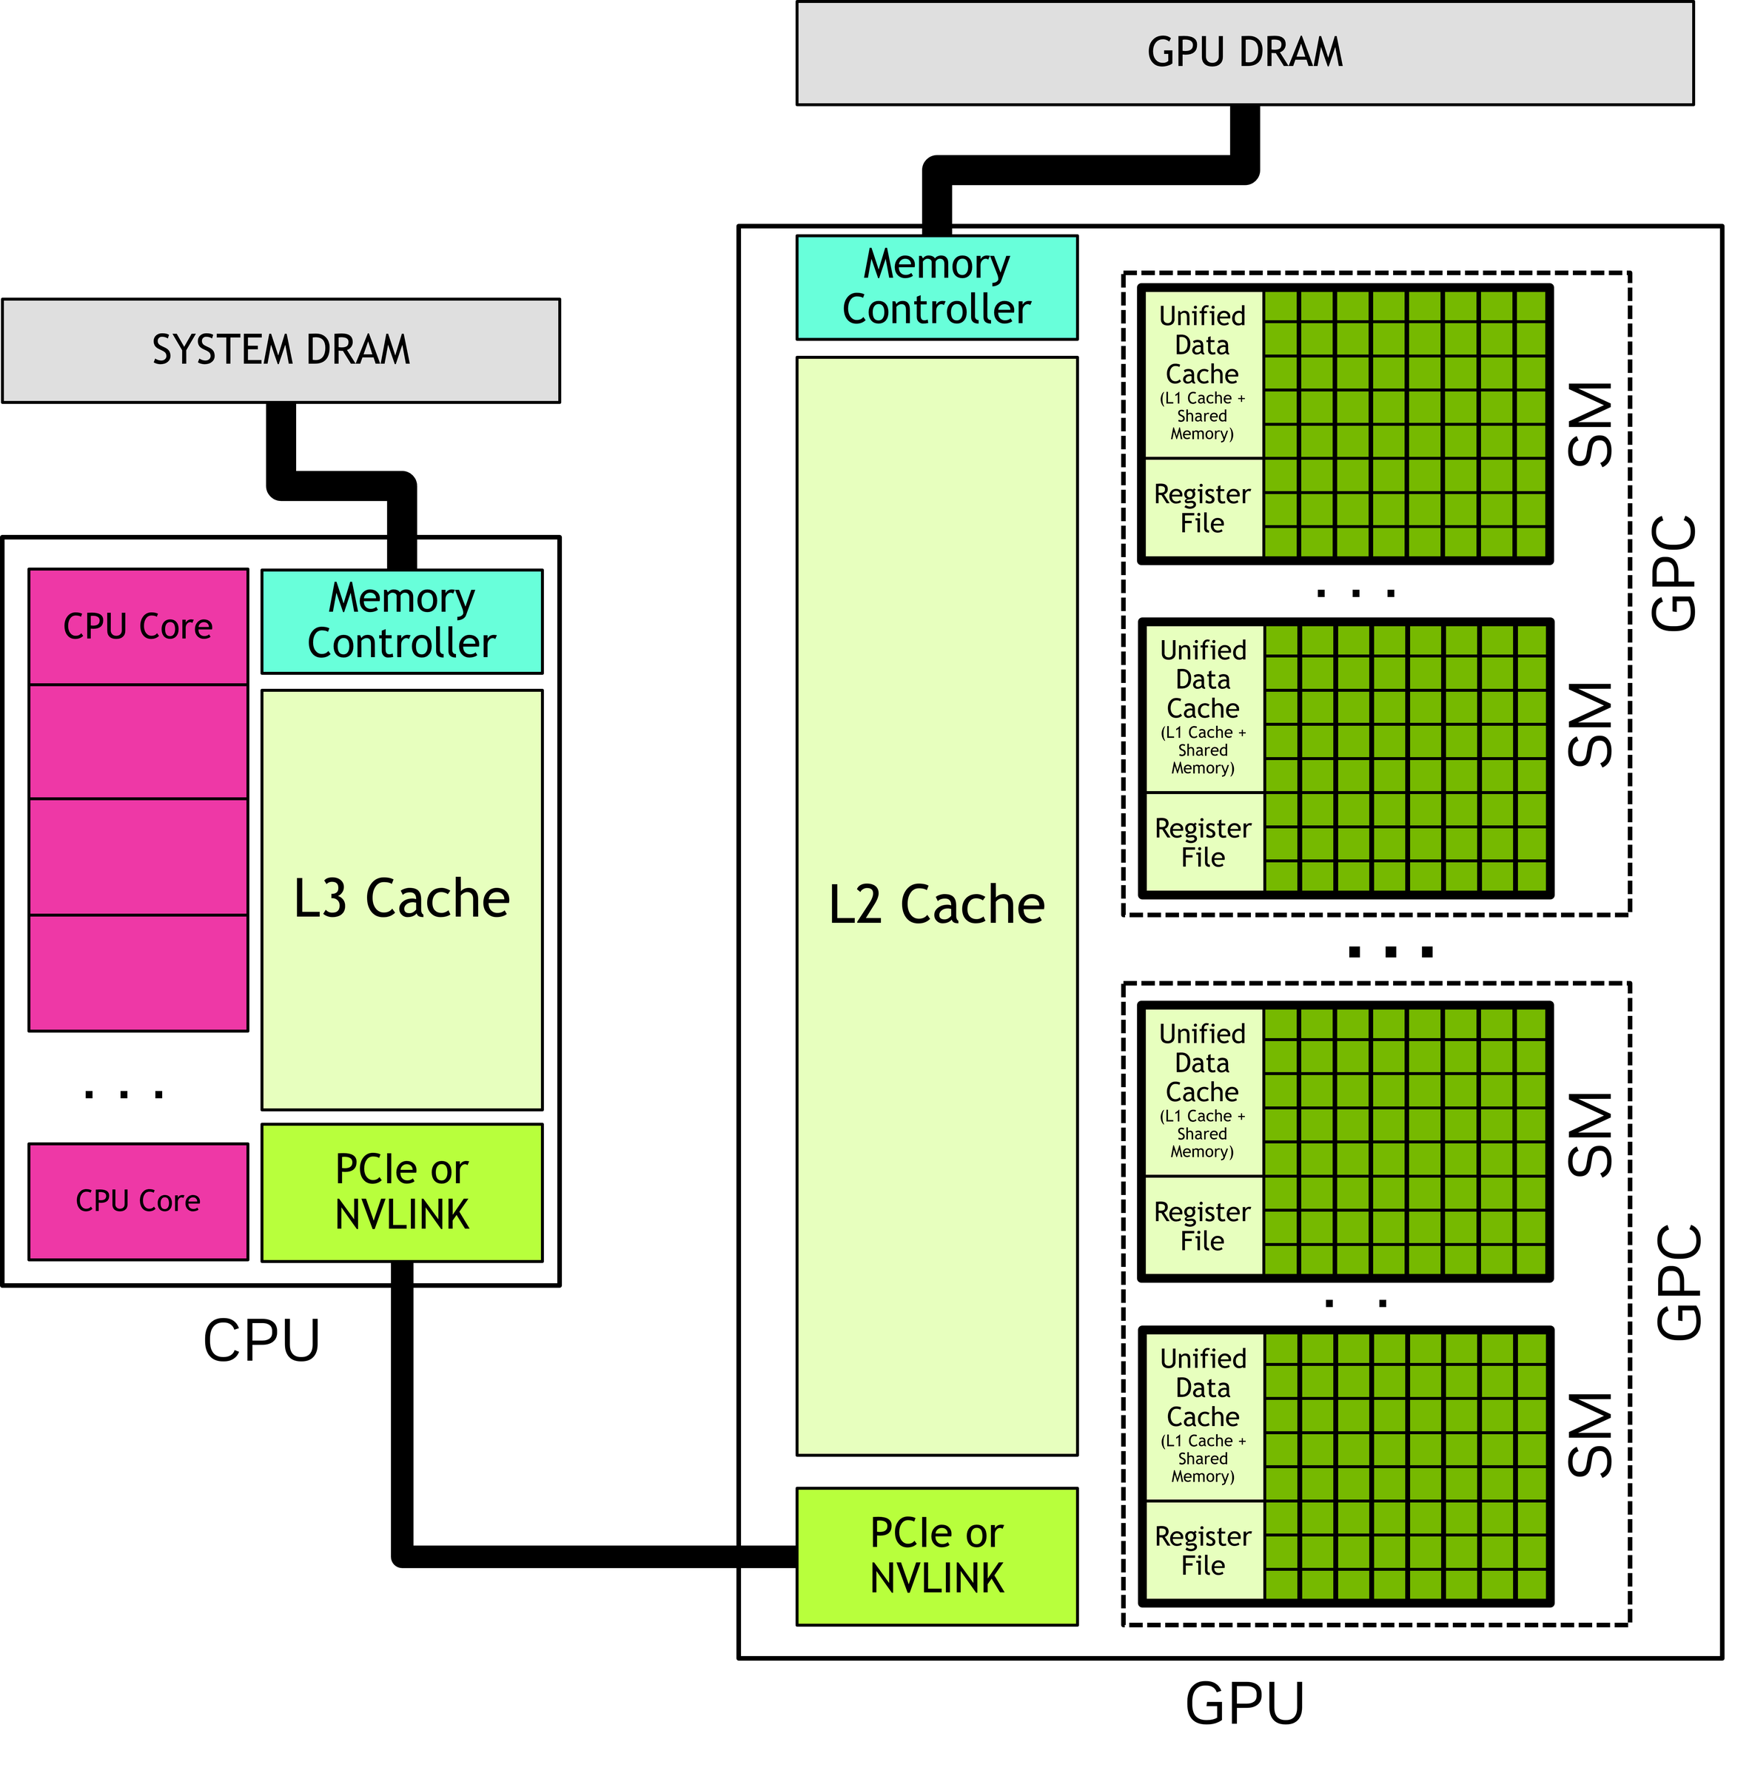
FORMATION / DAY 1 / GPU MODEL & FIRST DEMO
GPU as a Separate Compute Resource
Host code orchestrates device work across a memory boundary
CPU code prepares data and launches kernels.
GPU device code runs many threads over device memory.
Data movement is part of the program, not a detail.
NVIDIA Fig. 2 | Guide p. 6 / PDF p. 24
runtime/device_info.cc | Source: CUDA C++ Programming Guide
FORMATION / INDEPENDENT CUDA TRAINING
06/49
Notes:
VISUAL REDESIGN / SOURCE PROVENANCE
Content source: user-supplied Day1_Repository_Foundation_First_CUDA_Feature.pptx, original slide 6.
Original slide order, wording, tables, commands and embedded code excerpts are retained. This is a visual-only redesign, not a technical review or software update.
Original visual labels (retained as editable text where appropriate, or replaced by the cited NVIDIA figure for illustration):
Host/device execution model
CPU Host
C++ orchestration
std::vector
Bazel-built binary
kernel launch
GPU Device
CUDA kernel
global memory
thread grid
cudaMemcpy / result
PCIe / NVLink boundary
ORIGINAL NVIDIA FIGURES
Figure 2: user-supplied cuda-programming-guide.pdf, Release 13.4.2, PDF page 24, printed guide page 6. Extracted original image, PDF image xref 851; original labels, colors and proportions preserved.
NVIDIA artwork is used as source illustration; the deck is independently prepared training, not an official NVIDIA course.

Slide 7
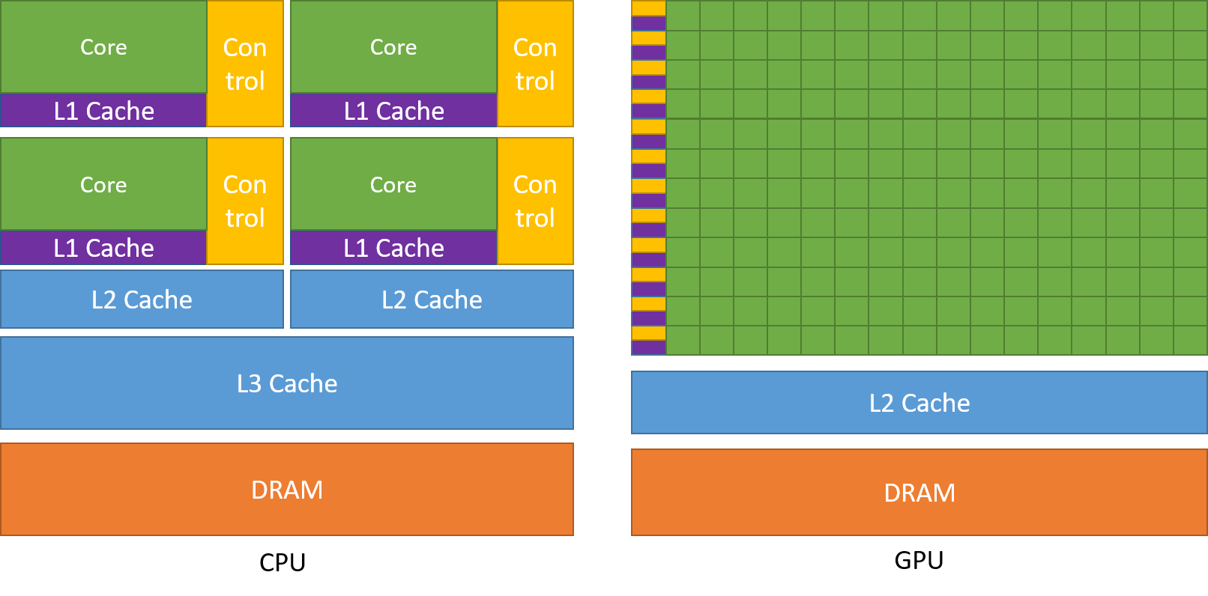
FORMATION / DAY 1 / GPU MODEL & FIRST DEMO
CPU vs GPU Work Shape
GPUs like lots of similar work; CPUs handle mixed latency-sensitive work
Serial CPU: one loop does all work.
CPU threads: a few workers process chunks.
CUDA grid: many threads map naturally to many elements.
NVIDIA Fig. 1 | Guide p. 4 / PDF p. 22
Serial CPU vs CPU threads vs GPU grid
Serial CPU
for (i)
work(i)
›
CPU threads
chunks of N
std::thread
›
CUDA grid
blocks x threads
many elements
cpp/vector_threaded.cc -> gpu/vector_add_device.cu | Source: CUDA C++ Programming Guide
FORMATION / INDEPENDENT CUDA TRAINING
07/49
Notes:
VISUAL REDESIGN / SOURCE PROVENANCE
Content source: user-supplied Day1_Repository_Foundation_First_CUDA_Feature.pptx, original slide 7.
Original slide order, wording, tables, commands and embedded code excerpts are retained. This is a visual-only redesign, not a technical review or software update.
ORIGINAL NVIDIA FIGURES
Figure 1: user-supplied cuda-programming-guide.pdf, Release 13.4.2, PDF page 22, printed guide page 4. Extracted original image, PDF image xref 840; original labels, colors and proportions preserved.
NVIDIA artwork is used as source illustration; the deck is independently prepared training, not an official NVIDIA course.

Slide 8
FORMATION / DAY 1 / GPU MODEL & FIRST DEMO
The Course Operation: SAXPY-Like Vector Add
One small operation teaches the complete path
SAXPY-like vector add
Inputs: a[N], b[N], scalar alpha.
out[i] =
alpha * a[i] + b[i]
Output: out[i] = alpha * a[i] + b[i].
Same semantics are implemented on CPU, CPU threads, CUDA, and JAX.
a[N]
›
alpha
›
b[N]
›
CPU/GPU
compare
cpp/vector_cpu.cc
FORMATION / INDEPENDENT CUDA TRAINING
08/49
Notes:
VISUAL REDESIGN / SOURCE PROVENANCE
Content source: user-supplied Day1_Repository_Foundation_First_CUDA_Feature.pptx, original slide 8.
Original slide order, wording, tables, commands and embedded code excerpts are retained. This is a visual-only redesign, not a technical review or software update.
Original visual labels (retained as editable text where appropriate, or replaced by the cited NVIDIA figure for illustration):
SAXPY-like vector add
a[N]
alpha
b[N]
out[i] = alpha*a[i] + b[i]
CPU/GPU compare

Slide 9
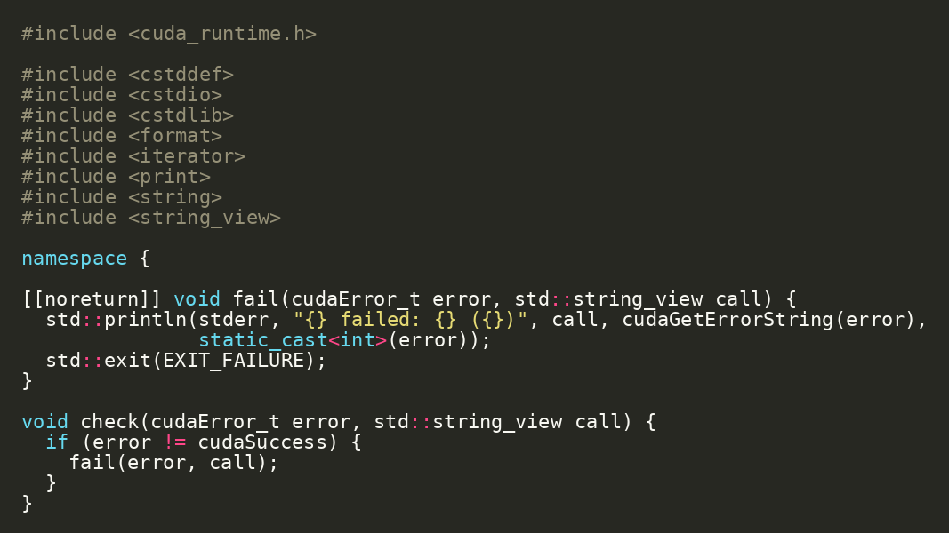
FORMATION / DAY 1 / GPU MODEL & FIRST DEMO
First Live Demo: Ask the GPU Who It Is
Before kernels, inspect the CUDA runtime environment
ORIGINAL SOURCE EXCERPT
Run the smallest CUDA-aware target first.
This confirms runtime access, driver visibility, and device enumeration.
RUN / INSPECT
cd projects/simple
bazel run //src:gpu_info
projects/simple/src/main.cc
FORMATION / INDEPENDENT CUDA TRAINING
09/49
Notes:
VISUAL REDESIGN / SOURCE PROVENANCE
Content source: user-supplied Day1_Repository_Foundation_First_CUDA_Feature.pptx, original slide 9.
Original slide order, wording, tables, commands and embedded code excerpts are retained. This is a visual-only redesign, not a technical review or software update.
The code image is the original embedded source excerpt; no code text was edited. Where it is shown in two panes, the same original image is cropped at a blank line without omitting pixels.

Slide 10
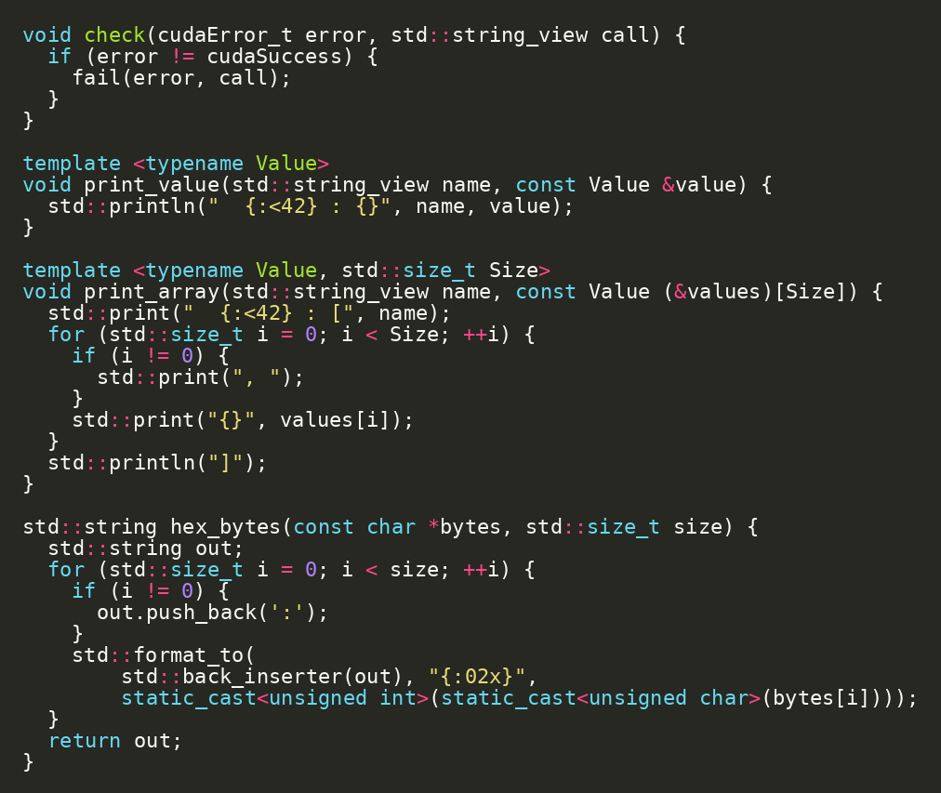
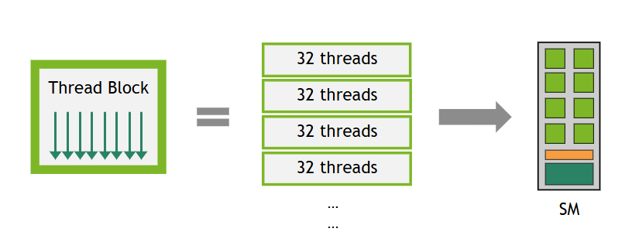
FORMATION / DAY 1 / GPU MODEL & FIRST DEMO
What cudaDeviceProp Teaches
Device properties connect hardware constraints to code choices
ORIGINAL SOURCE EXCERPT
major/minor: compute capability.
multiProcessorCount: parallel capacity.
warpSize: scheduling granularity.
maxThreadsPerBlock and shared memory guide later launch choices.
projects/simple/src/main.cc | Source: CUDA C++ Programming Guide
FORMATION / INDEPENDENT CUDA TRAINING
10/49
Notes:
SOURCE SLIDE: Original Day 1 slide 10 — What cudaDeviceProp Teaches.
Original title, subtitle, explanations and original code screenshot retained.
The warp-partitioning visual formerly placed here is moved to the following dedicated visual-explanation slide to keep this source excerpt readable.
No course code or factual source wording changed.
VISUAL REDESIGN / SOURCE PROVENANCE
Content source: user-supplied Day1_Repository_Foundation_First_CUDA_Feature.pptx, original slide 10.
Original slide order, wording, tables, commands and embedded code excerpts are retained. This is a visual-only redesign, not a technical review or software update.
The code image is the original embedded source excerpt; no code text was edited. Where it is shown in two panes, the same original image is cropped at a blank line without omitting pixels.

Slide 11
FORMATION / DAY 1 / GPU MODEL & FIRST DEMO / VISUAL EXPLANATION
A Thread Block Is Partitioned into Warps
warpSize describes the grouping of threads—not your chosen block size.
READ THE FIGURE
A thread block is divided into groups of 32 threads.
Warps from resident blocks use the execution resources of an SM.
COURSE EXAMPLE
256 threads per block / 32 threads per warp = 8 warps
NVIDIA Fig. 22 | Guide p. 151 / PDF p. 169 | CUDA Programming Guide 13.4.2
FORMATION / INDEPENDENT CUDA TRAINING
11/49
Notes:
ADDED VISUAL EXPLANATION
Inserted after original Day 1 slide 10. The original course slides remain in their original relative sequence. No original code, commands, exercises, or benchmark values are changed.
SOURCE
User-supplied cuda-programming-guide.pdf, CUDA Programming Guide, Release 13.4.2, September 10, 2026.
Figure 22, physical PDF page 169, printed page 151; original image xref 1757. Also §1.2.2.2, printed pages 7–9.
https://docs.nvidia.com/cuda/cuda-programming-guide/
Original PDF figure image(s), proportionally resized; native labels and colors retained. No redrawing or generated illustration.
PRESENTER NOTES
First point to the block, then the groups of 32 threads, then the SM. The figure is a conceptual partitioning, not a cycle-by-cycle schedule. The 256/32=8 statement is a derived course example using the existing block-size choice from original Day 1 slide 25. Do not identify a software thread with a permanently dedicated physical core. Reconnect to warpSize in the device-property output.
PACING
Allow approximately two minutes; focus on reading the figure rather than introducing a new lab.
SCOPE
New explanatory text paraphrases the cited guide. Course-connection examples are identified in the notes as instructional applications, not new measurements or claims of validated repository behavior.

Slide 12
FORMATION / DAY 1 / BAZEL & HERMETIC TOOLCHAINS
Why Hermetic Builds Matter
Works-on-my-machine is not a course architecture
Hermetic builds
Bazel isolates build inputs from host machine drift.
01
source repo
Tool versions and dependencies are declared in the repository.
02
MODULE.bazel
03
toolchains
The same source/config should produce the same artifact.
04
Bazel actions
05
cached artifacts
MODULE.bazel + .bazelrc | Source: Bazel Hermeticity
FORMATION / INDEPENDENT CUDA TRAINING
12/49
Notes:
VISUAL REDESIGN / SOURCE PROVENANCE
Content source: user-supplied Day1_Repository_Foundation_First_CUDA_Feature.pptx, original slide 11.
Original slide order, wording, tables, commands and embedded code excerpts are retained. This is a visual-only redesign, not a technical review or software update.
Original visual labels (retained as editable text where appropriate, or replaced by the cited NVIDIA figure for illustration):
Hermetic builds
source repo
MODULE.bazel
toolchains
Bazel actions
cached artifacts

Slide 13
FORMATION / DAY 1 / BAZEL & HERMETIC TOOLCHAINS
Bazel Vocabulary
Four words make the repository readable
Operational Bazel vocabulary
MODULE.bazel: external dependencies and toolchain extensions.
01
MODULE.bazel
BUILD.bazel
BUILD.bazel: package targets.
02
03
package
target: buildable unit.
label: canonical address such as //gpu:vector_add_test.
04
target
05
label //gpu:test
//cpp:vector_cpu_test, //gpu:vector_add_benchmark | Source: Bazel concepts
FORMATION / INDEPENDENT CUDA TRAINING
13/49
Notes:
VISUAL REDESIGN / SOURCE PROVENANCE
Content source: user-supplied Day1_Repository_Foundation_First_CUDA_Feature.pptx, original slide 12.
Original slide order, wording, tables, commands and embedded code excerpts are retained. This is a visual-only redesign, not a technical review or software update.
Original visual labels (retained as editable text where appropriate, or replaced by the cited NVIDIA figure for illustration):
Operational Bazel vocabulary
MODULE.bazel
BUILD.bazel
package
target
label //gpu:test

Slide 14
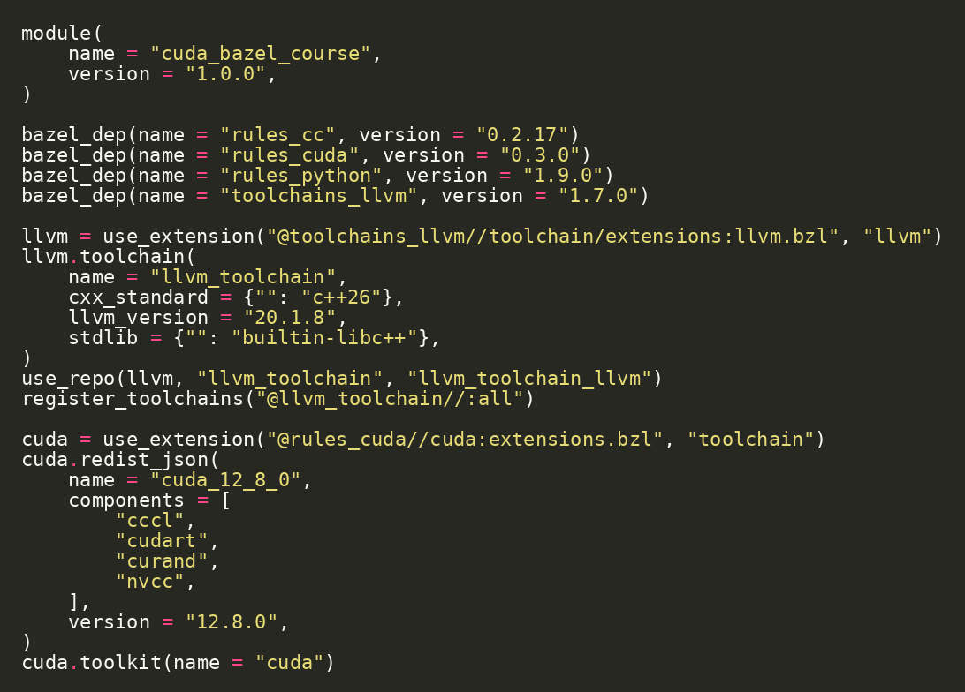
FORMATION / DAY 1 / BAZEL & HERMETIC TOOLCHAINS
Module File: Dependencies and Toolchains
MODULE.bazel declares the external universe
ORIGINAL SOURCE EXCERPT
rules_cc for C++ targets.
rules_cuda for CUDA targets and hermetic toolkit support.
rules_python for Python hooks.
toolchains_llvm for Clang C++26.
projects/detailed/MODULE.bazel | Source: rules_cuda
FORMATION / INDEPENDENT CUDA TRAINING
14/49
Notes:
VISUAL REDESIGN / SOURCE PROVENANCE
Content source: user-supplied Day1_Repository_Foundation_First_CUDA_Feature.pptx, original slide 13.
Original slide order, wording, tables, commands and embedded code excerpts are retained. This is a visual-only redesign, not a technical review or software update.
The code image is the original embedded source excerpt; no code text was edited. Where it is shown in two panes, the same original image is cropped at a blank line without omitting pixels.

Slide 15
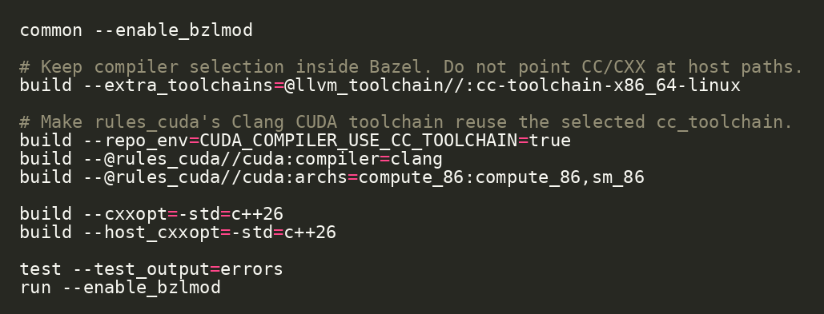
FORMATION / DAY 1 / BAZEL & HERMETIC TOOLCHAINS
.bazelrc: Build Policy
The repo chooses compiler and CUDA mode consistently
ORIGINAL SOURCE EXCERPT
extra_toolchains selects the LLVM toolchain.
rules_cuda compiler is set to clang.
archs selects device code generation target.
Build policy stays outside source files.
projects/detailed/.bazelrc | Source: rules_cuda
FORMATION / INDEPENDENT CUDA TRAINING
15/49
Notes:
VISUAL REDESIGN / SOURCE PROVENANCE
Content source: user-supplied Day1_Repository_Foundation_First_CUDA_Feature.pptx, original slide 14.
Original slide order, wording, tables, commands and embedded code excerpts are retained. This is a visual-only redesign, not a technical review or software update.
The code image is the original embedded source excerpt; no code text was edited. Where it is shown in two panes, the same original image is cropped at a blank line without omitting pixels.

Slide 16
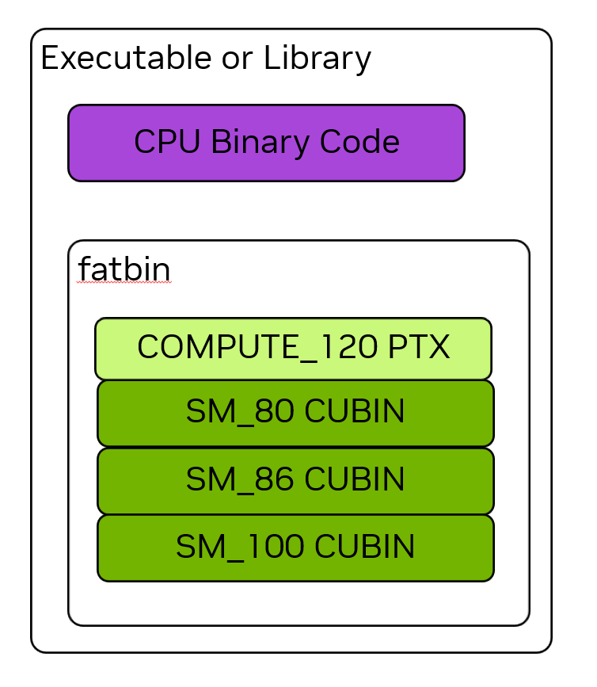
FORMATION / DAY 1 / BAZEL & HERMETIC TOOLCHAINS
Clang CUDA Compilation Path
Clang compiles host and device sides; ptxas generates device code
Clang CUDA compilation path
Clang parses CUDA and separates host/device compilation.
.cu source · host + device code
Clang · parse + split
PTX · virtual ISA
ptxas · PTX -> SASS
link · host + fatbin
binary · run on GPU host
PTX is the device intermediate form.
ptxas assembles PTX to architecture-specific device code.
NVIDIA Fig. 10 | Guide p. 17 / PDF p. 35
--@rules_cuda//cuda:compiler=clang | Source: LLVM: Compiling CUDA with Clang
FORMATION / INDEPENDENT CUDA TRAINING
16/49
Notes:
VISUAL REDESIGN / SOURCE PROVENANCE
Content source: user-supplied Day1_Repository_Foundation_First_CUDA_Feature.pptx, original slide 15.
Original slide order, wording, tables, commands and embedded code excerpts are retained. This is a visual-only redesign, not a technical review or software update.
Original visual labels (retained as editable text where appropriate, or replaced by the cited NVIDIA figure for illustration):
Clang CUDA compilation path
.cu source
host + device code
Clang
parse + split
PTX
virtual ISA
ptxas
PTX -> SASS
link
host + fatbin
binary
run on GPU host
Bazel selects the toolchain and arch flags; ptxas produces architecture-specific device code.
ORIGINAL NVIDIA FIGURES
Figure 10: user-supplied cuda-programming-guide.pdf, Release 13.4.2, PDF page 35, printed guide page 17. Extracted original image, PDF image xref 947; original labels, colors and proportions preserved.
NVIDIA artwork is used as source illustration; the deck is independently prepared training, not an official NVIDIA course.

Slide 17
FORMATION / DAY 1 / BAZEL & HERMETIC TOOLCHAINS
Lab 1 Checkpoint: Build the World
The repository gives a reproducible baseline before changes
Checkpoint / exercise
RUN / INSPECT
Move into the detailed project.
cd projects/detailed
bazel test //...
Run the full test set.
Confirm which targets need runtime GPU access.
Bazel target graph mirrors project architecture
Record any environment blockers.
vector_cpu
benchmark
vector_add
device_lib
runtime
projects/detailed
FORMATION / INDEPENDENT CUDA TRAINING
17/49
Notes:
VISUAL REDESIGN / SOURCE PROVENANCE
Content source: user-supplied Day1_Repository_Foundation_First_CUDA_Feature.pptx, original slide 16.
Original slide order, wording, tables, commands and embedded code excerpts are retained. This is a visual-only redesign, not a technical review or software update.
Original visual labels (retained as editable text where appropriate, or replaced by the cited NVIDIA figure for illustration):
Bazel target graph mirrors project architecture
benchmark
vector_cpu
vector_add
device_lib
runtime

Slide 18
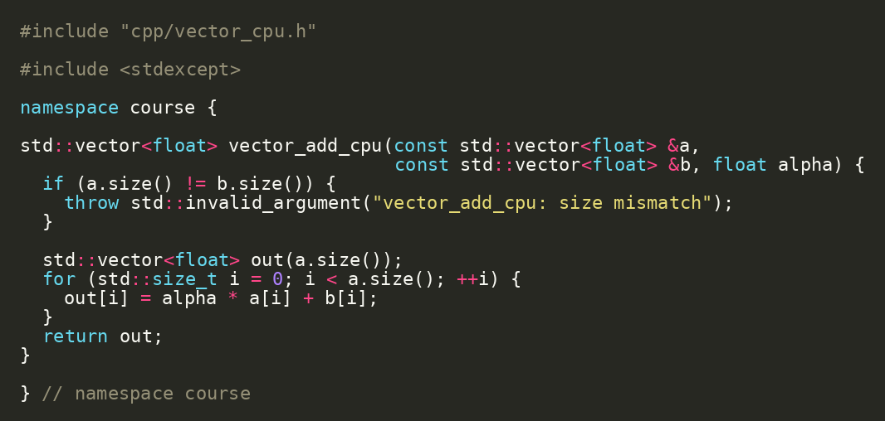
FORMATION / DAY 1 / CPU CORRECTNESS BASELINE
CPU Oracle Source
CUDA correctness starts with a boring CPU implementation
ORIGINAL SOURCE EXCERPT
Validate input sizes before work.
Use a simple loop to express the contract.
This result becomes the comparison baseline.
projects/detailed/cpp/vector_cpu.cc | Source: CUDA C++ Best Practices Guide
FORMATION / INDEPENDENT CUDA TRAINING
18/49
Notes:
VISUAL REDESIGN / SOURCE PROVENANCE
Content source: user-supplied Day1_Repository_Foundation_First_CUDA_Feature.pptx, original slide 17.
Original slide order, wording, tables, commands and embedded code excerpts are retained. This is a visual-only redesign, not a technical review or software update.
The code image is the original embedded source excerpt; no code text was edited. Where it is shown in two panes, the same original image is cropped at a blank line without omitting pixels.

Slide 19
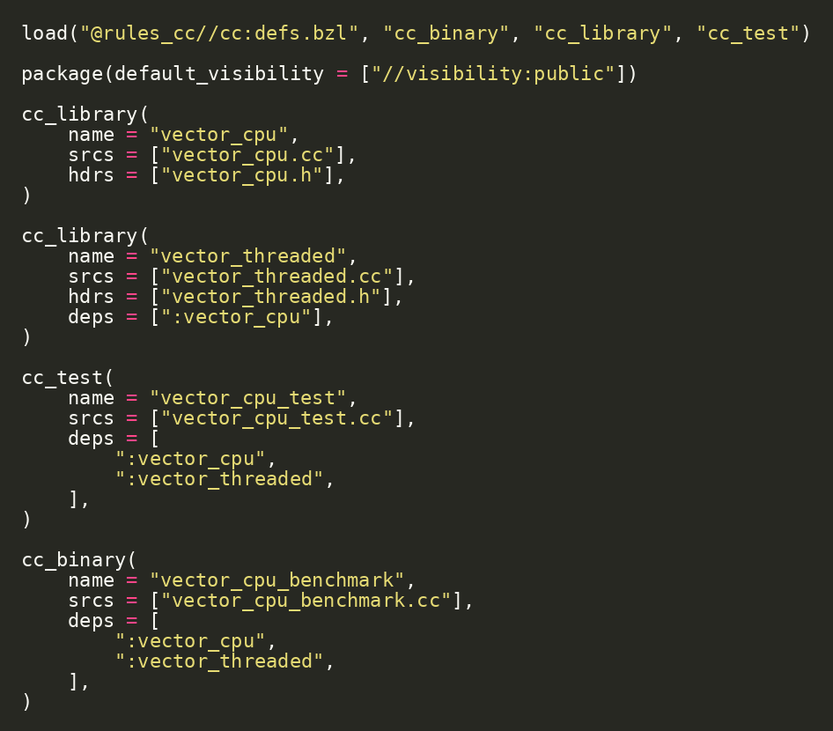
FORMATION / DAY 1 / CPU CORRECTNESS BASELINE
CPU Test Target
Tests capture the contract before acceleration
ORIGINAL SOURCE EXCERPT
cc_test makes the CPU oracle executable in the build graph.
The test target depends on CPU libraries, not on CUDA.
This separates semantics from acceleration.
bazel test //cpp:vector_cpu_test
FORMATION / INDEPENDENT CUDA TRAINING
19/49
Notes:
VISUAL REDESIGN / SOURCE PROVENANCE
Content source: user-supplied Day1_Repository_Foundation_First_CUDA_Feature.pptx, original slide 18.
Original slide order, wording, tables, commands and embedded code excerpts are retained. This is a visual-only redesign, not a technical review or software update.
The code image is the original embedded source excerpt; no code text was edited. Where it is shown in two panes, the same original image is cropped at a blank line without omitting pixels.

Slide 20
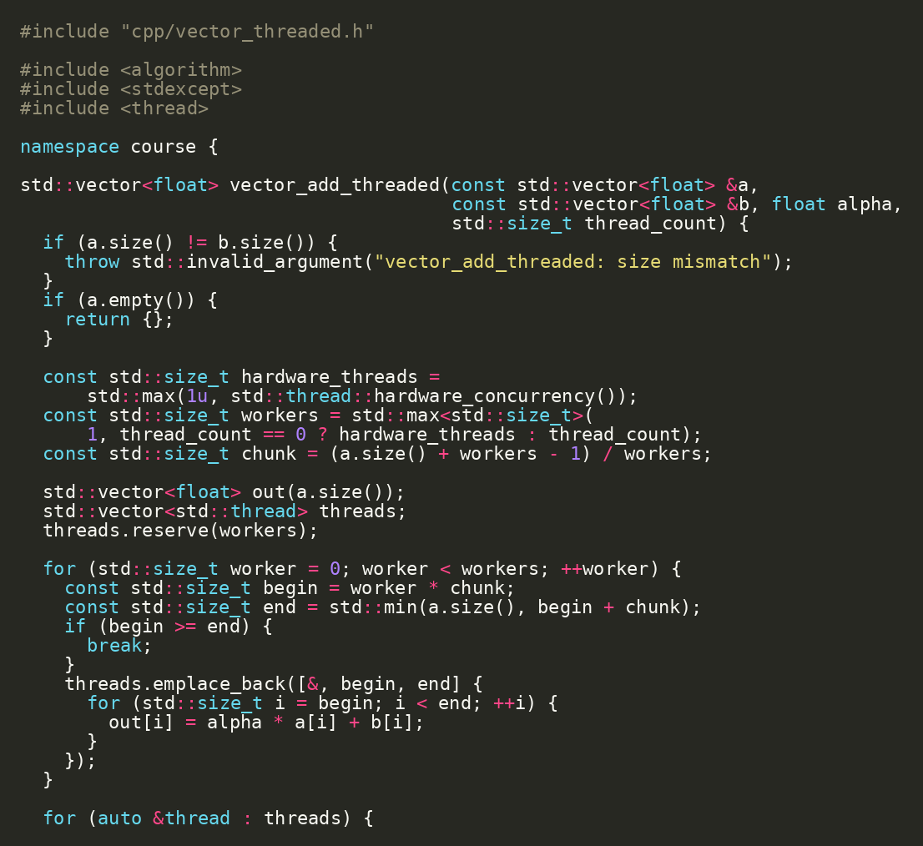
FORMATION / DAY 1 / CPU CORRECTNESS BASELINE
CPU Threaded Baseline
GPU comparison should include CPU parallelism, not only serial CPU
ORIGINAL SOURCE EXCERPT
Split N elements into chunks.
Use host threads to show CPU parallel work.
This bridges C++ concurrency and GPU parallelism.
projects/detailed/cpp/vector_threaded.cc
FORMATION / INDEPENDENT CUDA TRAINING
20/49
Notes:
VISUAL REDESIGN / SOURCE PROVENANCE
Content source: user-supplied Day1_Repository_Foundation_First_CUDA_Feature.pptx, original slide 19.
Original slide order, wording, tables, commands and embedded code excerpts are retained. This is a visual-only redesign, not a technical review or software update.
The code image is the original embedded source excerpt; no code text was edited. Where it is shown in two panes, the same original image is cropped at a blank line without omitting pixels.

Slide 21
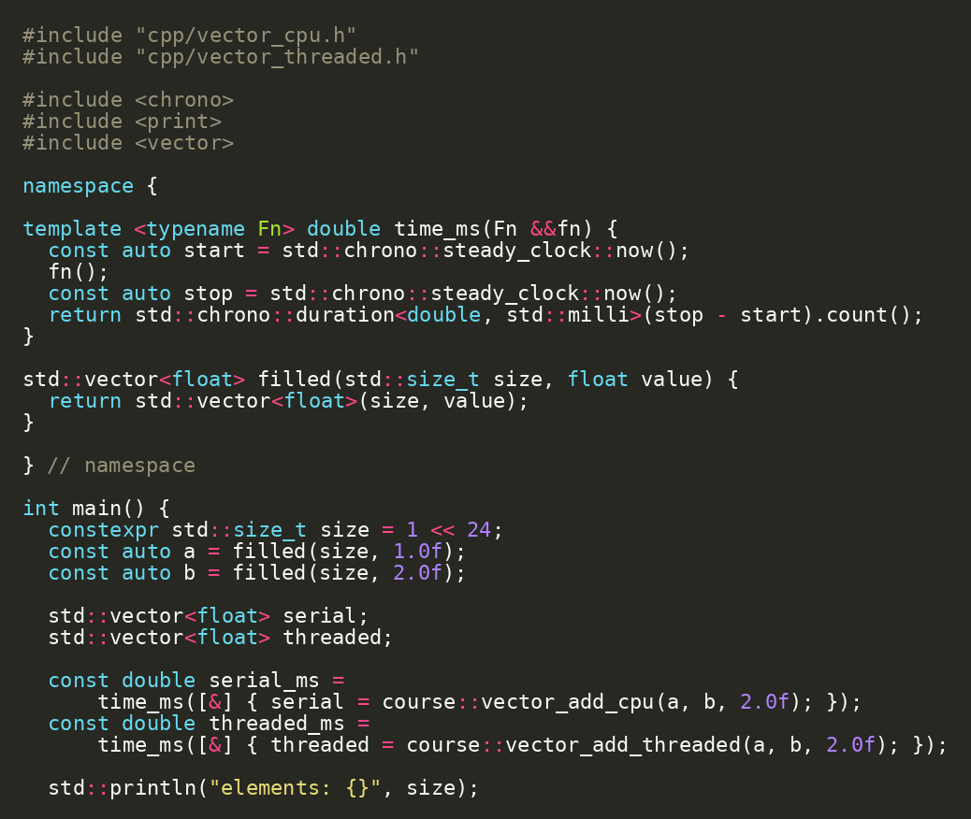
FORMATION / DAY 1 / CPU CORRECTNESS BASELINE
Benchmark Output Reading
A benchmark teaches only if we know what was measured
ORIGINAL SOURCE EXCERPT
Record input size.
Separate serial and threaded paths.
Treat first-run and machine variance carefully.
RUN / INSPECT
bazel run //cpp:vector_cpu_benchmark
projects/detailed/cpp/vector_cpu_benchmark.cc | Source: CUDA C++ Best Practices Guide
FORMATION / INDEPENDENT CUDA TRAINING
21/49
Notes:
VISUAL REDESIGN / SOURCE PROVENANCE
Content source: user-supplied Day1_Repository_Foundation_First_CUDA_Feature.pptx, original slide 20.
Original slide order, wording, tables, commands and embedded code excerpts are retained. This is a visual-only redesign, not a technical review or software update.
The code image is the original embedded source excerpt; no code text was edited. Where it is shown in two panes, the same original image is cropped at a blank line without omitting pixels.

Slide 22
FORMATION / DAY 1 / FIRST CUDA FEATURE
CUDA Source Separation
Keep host orchestration and device kernel code cleanly separated
Clean CUDA source separation
Public API: gpu/vector_add.h.
01
vector_add.h · public API
Host wrapper: gpu/vector_add_cuda.cc.
02
vector_add_cuda.cc · host wrapper
Device launcher + kernel: gpu/vector_add_device.{h,cu}.
03
vector_add_device.h · launcher decl
This prevents one tangled .cu file.
04
vector_add_device.cu · kernel
projects/detailed/gpu
FORMATION / INDEPENDENT CUDA TRAINING
22/49
Notes:
VISUAL REDESIGN / SOURCE PROVENANCE
Content source: user-supplied Day1_Repository_Foundation_First_CUDA_Feature.pptx, original slide 21.
Original slide order, wording, tables, commands and embedded code excerpts are retained. This is a visual-only redesign, not a technical review or software update.
Original visual labels (retained as editable text where appropriate, or replaced by the cited NVIDIA figure for illustration):
Clean CUDA source separation
vector_add.h
public API
vector_add_cuda.cc
host wrapper
vector_add_device.h
launcher decl
vector_add_device.cu
kernel

Slide 23
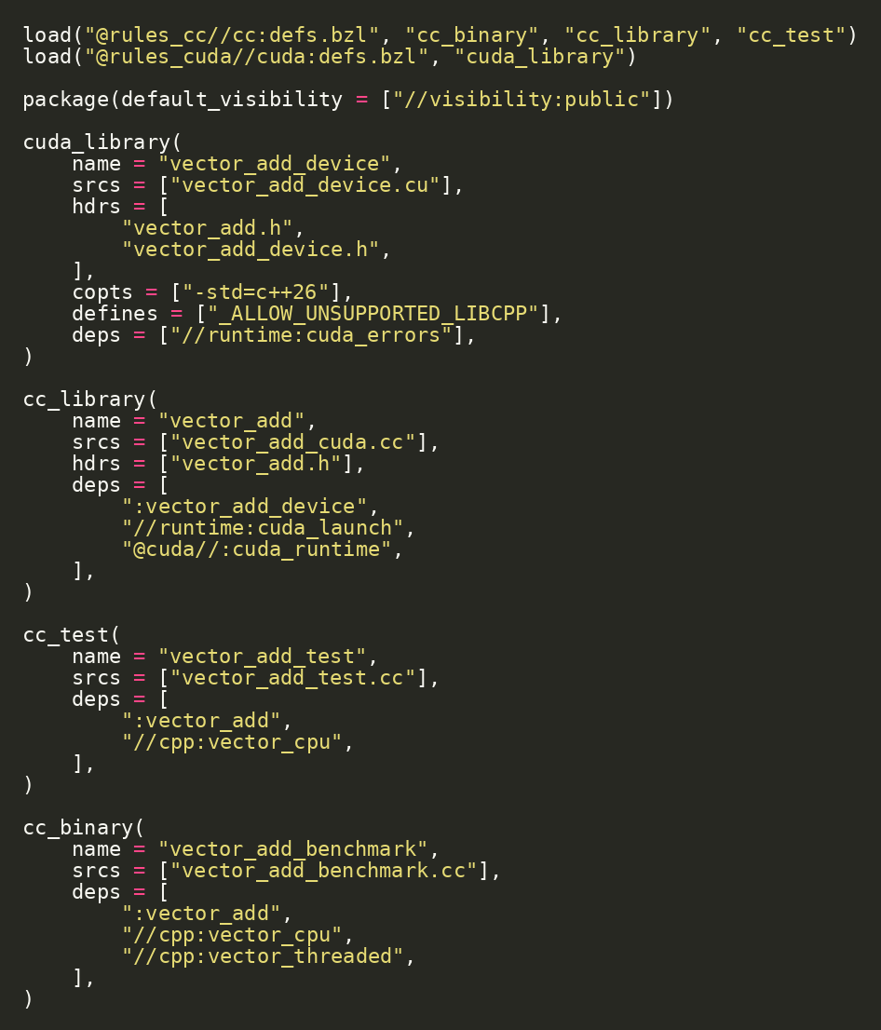
FORMATION / DAY 1 / FIRST CUDA FEATURE
CUDA Target in Bazel
CUDA source becomes a Bazel target like everything else
cuda_library compiles device code.
cc_library wraps host-side logic.
Tests and benchmarks depend on the API target, not raw files.
SOURCE EXCERPT
CONTINUED
projects/detailed/gpu/BUILD.bazel | Source: rules_cuda
FORMATION / INDEPENDENT CUDA TRAINING
23/49
Notes:
VISUAL REDESIGN / SOURCE PROVENANCE
Content source: user-supplied Day1_Repository_Foundation_First_CUDA_Feature.pptx, original slide 22.
Original slide order, wording, tables, commands and embedded code excerpts are retained. This is a visual-only redesign, not a technical review or software update.
The code image is the original embedded source excerpt; no code text was edited. Where it is shown in two panes, the same original image is cropped at a blank line without omitting pixels.

Slide 24
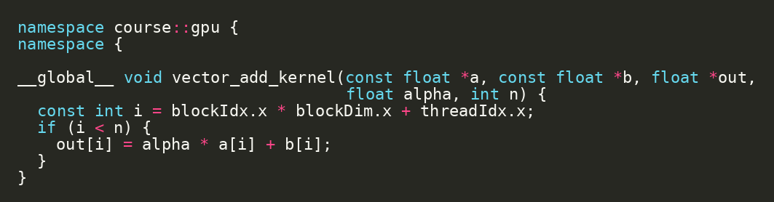
FORMATION / DAY 1 / FIRST CUDA FEATURE
Kernel Code: One Thread, One Element
Global thread index maps CUDA threads to vector elements
ORIGINAL SOURCE EXCERPT
blockIdx.x identifies the block.
blockDim.x is the block size.
threadIdx.x identifies the thread inside the block.
The bounds check protects the final partial block.
projects/detailed/gpu/vector_add_device.cu | Source: CUDA C++ Programming Guide
FORMATION / INDEPENDENT CUDA TRAINING
24/49
Notes:
VISUAL REDESIGN / SOURCE PROVENANCE
Content source: user-supplied Day1_Repository_Foundation_First_CUDA_Feature.pptx, original slide 23.
Original slide order, wording, tables, commands and embedded code excerpts are retained. This is a visual-only redesign, not a technical review or software update.
The code image is the original embedded source excerpt; no code text was edited. Where it is shown in two panes, the same original image is cropped at a blank line without omitting pixels.

Slide 25
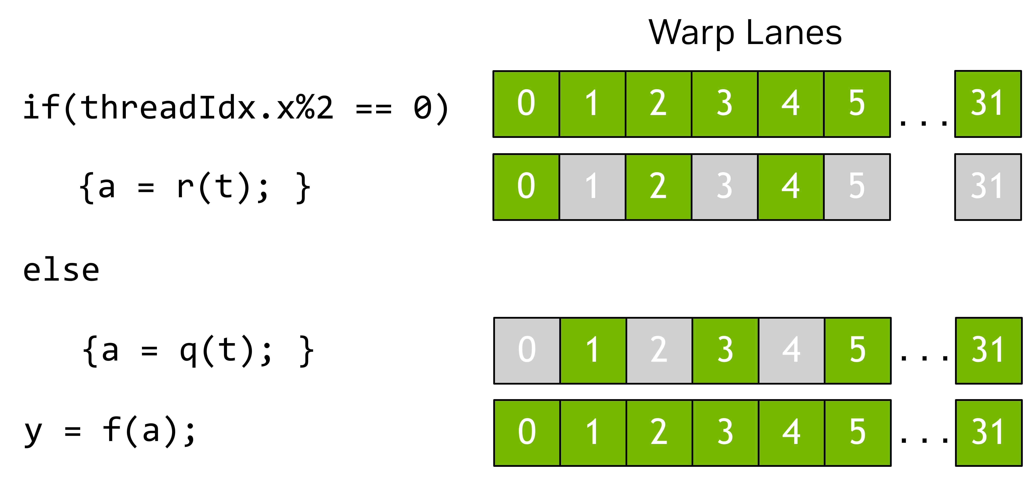
FORMATION / DAY 1 / FIRST CUDA FEATURE / VISUAL EXPLANATION
One Kernel, Different Active Lanes
A condition can select which lanes execute a branch.
NVIDIA’S EXAMPLE
Even-index lanes execute the if branch. Other lanes are masked during that branch.
COURSE CONNECTION
The vector kernel uses if (i < n) to protect its final partial block.
The figure shows an even/odd predicate—not the vector kernel’s exact bounds check.
OPTIONAL EXPLANATION
NVIDIA Fig. 7 | Guide p. 11 / PDF p. 29 | CUDA Programming Guide 13.4.2
FORMATION / INDEPENDENT CUDA TRAINING
25/49
Notes:
ADDED VISUAL EXPLANATION
Inserted after original Day 1 slide 23. The original course slides remain in their original relative sequence. No original code, commands, exercises, or benchmark values are changed.
SOURCE
User-supplied cuda-programming-guide.pdf, CUDA Programming Guide, Release 13.4.2, September 10, 2026.
Figure 7, physical PDF page 29, printed page 11; original image xref 894. §1.2.2.2, printed page 9.
https://docs.nvidia.com/cuda/cuda-programming-guide/
Original PDF figure image(s), proportionally resized; native labels and colors retained. No redrawing or generated illustration.
PRESENTER NOTES
This is NVIDIA’s original illustration, including its code labels. Explain the even/odd example as drawn. The connection to if (i < n) is an instructional analogy to the existing course bounds check, not a relabelling of NVIDIA’s image. The source describes divergence as threads following different paths. Keep the discussion on the programming model; do not imply a specific hardware instruction sequence or that branches automatically constitute synchronization.
PACING
Optional two-minute explanation; omit in a shorter session.
SCOPE
New explanatory text paraphrases the cited guide. Course-connection examples are identified in the notes as instructional applications, not new measurements or claims of validated repository behavior.

Slide 26
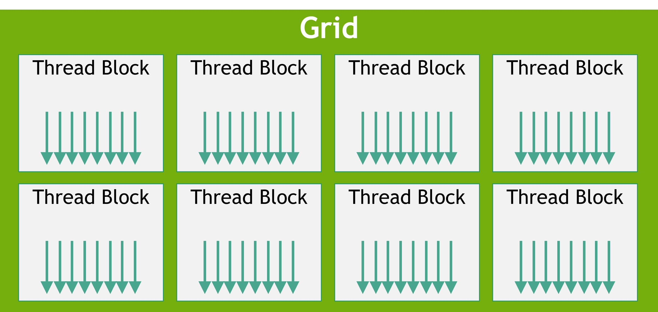
FORMATION / DAY 1 / FIRST CUDA FEATURE
Thread Hierarchy
CUDA exposes grid -> block -> thread hierarchy
A kernel launch creates a grid.
A grid contains blocks.
Blocks contain threads.
Threads in a block can cooperate with shared memory.
NVIDIA Fig. 3 | Guide p. 6 / PDF p. 24
blockIdx.x * blockDim.x + threadIdx.x
Threads in a block can cooperate with shared memory + __syncthreads()
blockIdx, blockDim, threadIdx | Source: CUDA C++ Programming Guide
FORMATION / INDEPENDENT CUDA TRAINING
26/49
Notes:
VISUAL REDESIGN / SOURCE PROVENANCE
Content source: user-supplied Day1_Repository_Foundation_First_CUDA_Feature.pptx, original slide 24.
Original slide order, wording, tables, commands and embedded code excerpts are retained. This is a visual-only redesign, not a technical review or software update.
Original visual labels (retained as editable text where appropriate, or replaced by the cited NVIDIA figure for illustration):
CUDA thread hierarchy
Grid
block 0,0
block 0,1
block 0,2
block 1,0
block 1,1
block 1,2
blockIdx.x * blockDim.x + threadIdx.x
Threads in a block can cooperate with shared memory + __syncthreads()
ORIGINAL NVIDIA FIGURES
Figure 3: user-supplied cuda-programming-guide.pdf, Release 13.4.2, PDF page 24, printed guide page 6. Extracted original image, PDF image xref 853; original labels, colors and proportions preserved.
NVIDIA artwork is used as source illustration; the deck is independently prepared training, not an official NVIDIA course.

Slide 27
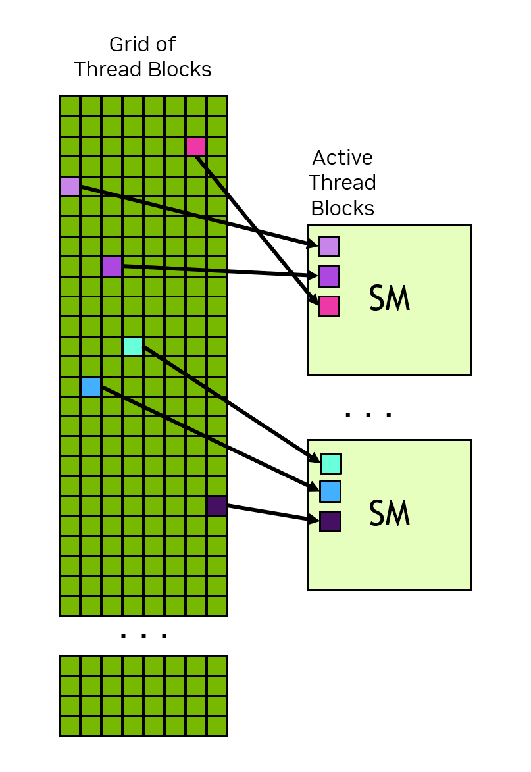
FORMATION / DAY 1 / FIRST CUDA FEATURE
Choosing Block and Grid Size
Launch configuration controls how many threads run
Use a fixed block size for the first kernel.
Round grid size up to cover all N elements.
Keep if (i < n) inside the kernel.
blocks = (n + block_size - 1) / block_size
last block may be partial -> if (i < n)
constexpr int block_size = 256
FORMATION / INDEPENDENT CUDA TRAINING
27/49
Notes:
SOURCE SLIDE: Original Day 1 slide 25 — Choosing Block and Grid Size.
Original explanation text, formula and bounds-check reminder retained.
NVIDIA Figure 4 has moved to the following full-size scheduling explanation. This separates launch geometry from hardware scheduling.
Formula line wrapping changed; code tokens unchanged.
No new benchmark or runtime validation.

Slide 28
FORMATION / DAY 1 / FIRST CUDA FEATURE / VISUAL EXPLANATION
A Grid Is Scheduled onto the Available SMs
The grid size is a work description—not a prescribed hardware assignment.
MULTIPLE ACTIVE BLOCKS
An SM may have more than one active block when resources permit.
ILLUSTRATION, NOT A LIMIT
NVIDIA shows three blocks per SM here. This is an example, not a fixed capacity.
NO ASSIGNMENT ORDER
Do not rely on a particular order in which blocks are assigned to SMs.
NVIDIA Fig. 4 | Guide p. 8 / PDF p. 26 | CUDA Programming Guide 13.4.2
FORMATION / INDEPENDENT CUDA TRAINING
28/49
Notes:
ADDED VISUAL EXPLANATION
Inserted after original Day 1 slide 25. The original course slides remain in their original relative sequence. No original code, commands, exercises, or benchmark values are changed.
SOURCE
User-supplied cuda-programming-guide.pdf, CUDA Programming Guide, Release 13.4.2, September 10, 2026.
Figure 4, physical PDF page 26, printed page 8; original image xref 870. §1.2.2.1, printed page 7, and §2.3.7, printed pages 72–73.
https://docs.nvidia.com/cuda/cuda-programming-guide/
Original PDF figure image(s), proportionally resized; native labels and colors retained. No redrawing or generated illustration.
PRESENTER NOTES
Use this slide immediately after launch geometry to separate software configuration from scheduling. The caption says the example places three active blocks on each SM, without an assignment-order guarantee. Ask: does launching eight blocks guarantee use of eight SMs? No such mapping is promised by the illustrated model. The figure does not show a measured trace, scheduling policy, or device-specific capacity.
PACING
Allow approximately two minutes; focus on reading the figure rather than introducing a new lab.
SCOPE
New explanatory text paraphrases the cited guide. Course-connection examples are identified in the notes as instructional applications, not new measurements or claims of validated repository behavior.

Slide 29
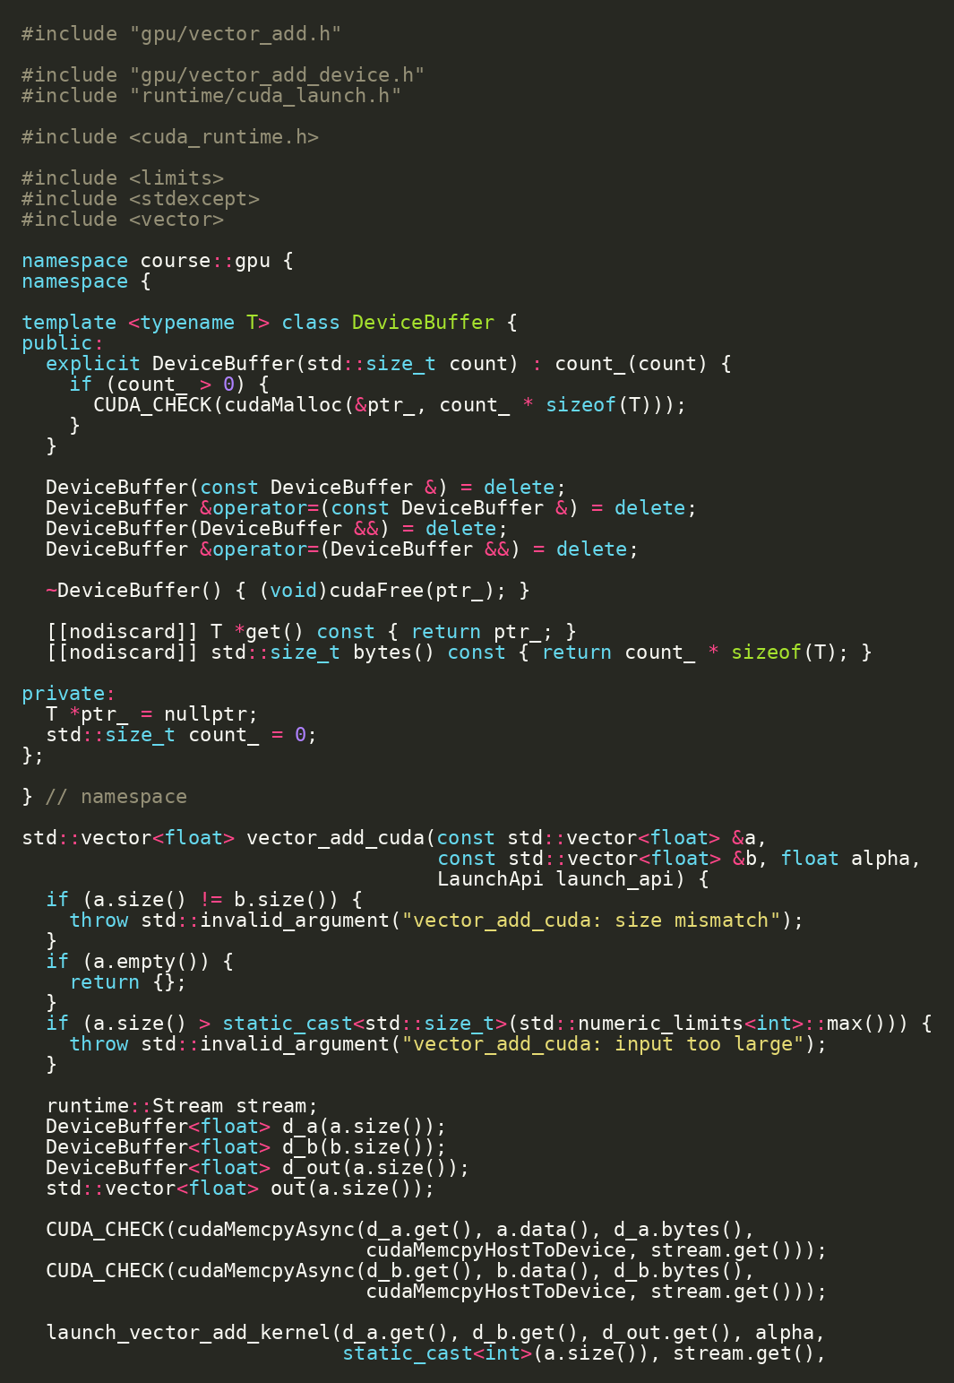
FORMATION / DAY 1 / FIRST CUDA FEATURE
Host Wrapper: Memory and Launch Ownership
Host C++ owns allocation, copies, launch, sync, and result transfer
Validate inputs and compute byte counts.
Allocate device buffers.
Copy host-to-device, launch, synchronize, copy back.
Free device buffers.
SOURCE EXCERPT
CONTINUED
projects/detailed/gpu/vector_add_cuda.cc | Source: CUDA Runtime API - Execution Control
FORMATION / INDEPENDENT CUDA TRAINING
29/49
Notes:
VISUAL REDESIGN / SOURCE PROVENANCE
Content source: user-supplied Day1_Repository_Foundation_First_CUDA_Feature.pptx, original slide 26.
Original slide order, wording, tables, commands and embedded code excerpts are retained. This is a visual-only redesign, not a technical review or software update.
The code image is the original embedded source excerpt; no code text was edited. Where it is shown in two panes, the same original image is cropped at a blank line without omitting pixels.

Slide 30
FORMATION / DAY 1 / FIRST CUDA FEATURE
CUDA Runtime API Calls
CUDA Runtime API is the control surface for device work
CUDA Runtime API control flow
cudaMalloc creates device buffers.
01
cudaMalloc
cudaMemcpy moves data.
02
cudaMemcpy H2D
cudaLaunchKernel launches work explicitly.
03
cudaLaunchKernel
cudaDeviceSynchronize waits for completion.
04
cudaDeviceSynchronize
05
cudaMemcpy D2H
cudaFree releases device memory.
06
cudaFree
gpu/vector_add_cuda.cc + gpu/vector_add_device.cu | Source: CUDA Runtime API - Execution Control
FORMATION / INDEPENDENT CUDA TRAINING
30/49
Notes:
VISUAL REDESIGN / SOURCE PROVENANCE
Content source: user-supplied Day1_Repository_Foundation_First_CUDA_Feature.pptx, original slide 27.
Original slide order, wording, tables, commands and embedded code excerpts are retained. This is a visual-only redesign, not a technical review or software update.
Original visual labels (retained as editable text where appropriate, or replaced by the cited NVIDIA figure for illustration):
CUDA Runtime API control flow
cudaMalloc
cudaMemcpy H2D
cudaLaunchKernel
cudaDeviceSynchronize
cudaMemcpy D2H
cudaFree

Slide 31
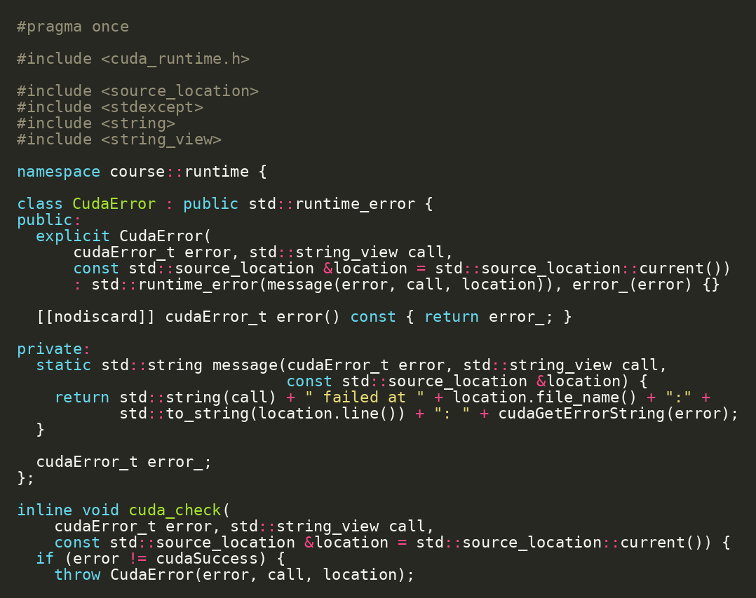
FORMATION / DAY 1 / FIRST CUDA FEATURE
Error Handling Helper
Every CUDA call should be checked
ORIGINAL SOURCE EXCERPT
Unchecked CUDA errors make debugging unreliable.
The helper captures file and line context.
Use it around allocation, copies, synchronization, and runtime launches.
projects/detailed/runtime/cuda_errors.h | Source: CUDA C++ Best Practices Guide
FORMATION / INDEPENDENT CUDA TRAINING
31/49
Notes:
VISUAL REDESIGN / SOURCE PROVENANCE
Content source: user-supplied Day1_Repository_Foundation_First_CUDA_Feature.pptx, original slide 28.
Original slide order, wording, tables, commands and embedded code excerpts are retained. This is a visual-only redesign, not a technical review or software update.
The code image is the original embedded source excerpt; no code text was edited. Where it is shown in two panes, the same original image is cropped at a blank line without omitting pixels.

Slide 32
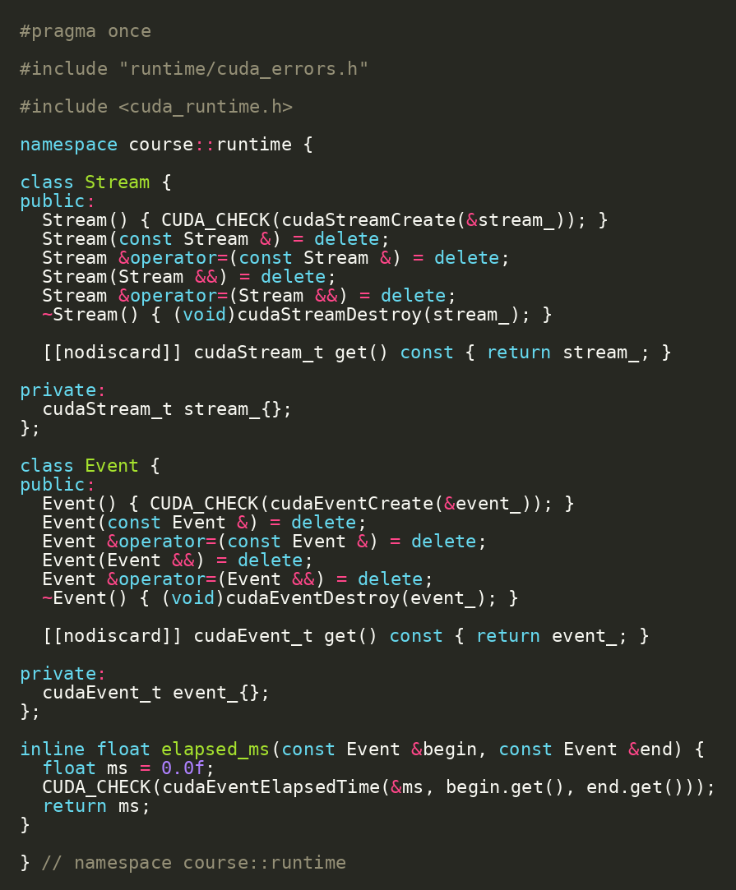
FORMATION / DAY 1 / FIRST CUDA FEATURE
Stream and Event Helpers
Small RAII helpers make CUDA runtime objects safer
Stream wrapper owns cudaStreamCreate/cudaStreamDestroy.
Event wrapper owns cudaEventCreate/cudaEventDestroy.
elapsed_ms centralizes CUDA event timing.
SOURCE EXCERPT
CONTINUED
projects/detailed/runtime/cuda_launch.h | Source: CUDA C++ Programming Guide
FORMATION / INDEPENDENT CUDA TRAINING
32/49
Notes:
VISUAL REDESIGN / SOURCE PROVENANCE
Content source: user-supplied Day1_Repository_Foundation_First_CUDA_Feature.pptx, original slide 29.
Original slide order, wording, tables, commands and embedded code excerpts are retained. This is a visual-only redesign, not a technical review or software update.
The code image is the original embedded source excerpt; no code text was edited. Where it is shown in two panes, the same original image is cropped at a blank line without omitting pixels.

Slide 33
FORMATION / DAY 1 / FIRST CUDA FEATURE
Two Launch Styles
Triple-chevron syntax and cudaLaunchKernel launch the same device function
Two kernel launch styles, one device function
Triple-chevron is the normal readable CUDA C++ syntax.
CUDA C++
cudaLaunchKernel exposes the Runtime API mechanism explicitly.
kernel<<<grid, block, 0, stream>>>(args);
CUDA RUNTIME API
The project lets both paths be benchmarked and tested.
cudaLaunchKernel(func, grid, block, args, 0, stream);
__global__ vector_add_kernel
LaunchApi enum + vector_add_device.cu | Source: CUDA Runtime API - Execution Control
FORMATION / INDEPENDENT CUDA TRAINING
33/49
Notes:
VISUAL REDESIGN / SOURCE PROVENANCE
Content source: user-supplied Day1_Repository_Foundation_First_CUDA_Feature.pptx, original slide 30.
Original slide order, wording, tables, commands and embedded code excerpts are retained. This is a visual-only redesign, not a technical review or software update.
Original visual labels (retained as editable text where appropriate, or replaced by the cited NVIDIA figure for illustration):
Two kernel launch styles, one device function
kernel<<<grid, block, 0, stream>>>(args);
cudaLaunchKernel(func, grid, block, args, 0, stream);
__global__ vector_add_kernel

Slide 34
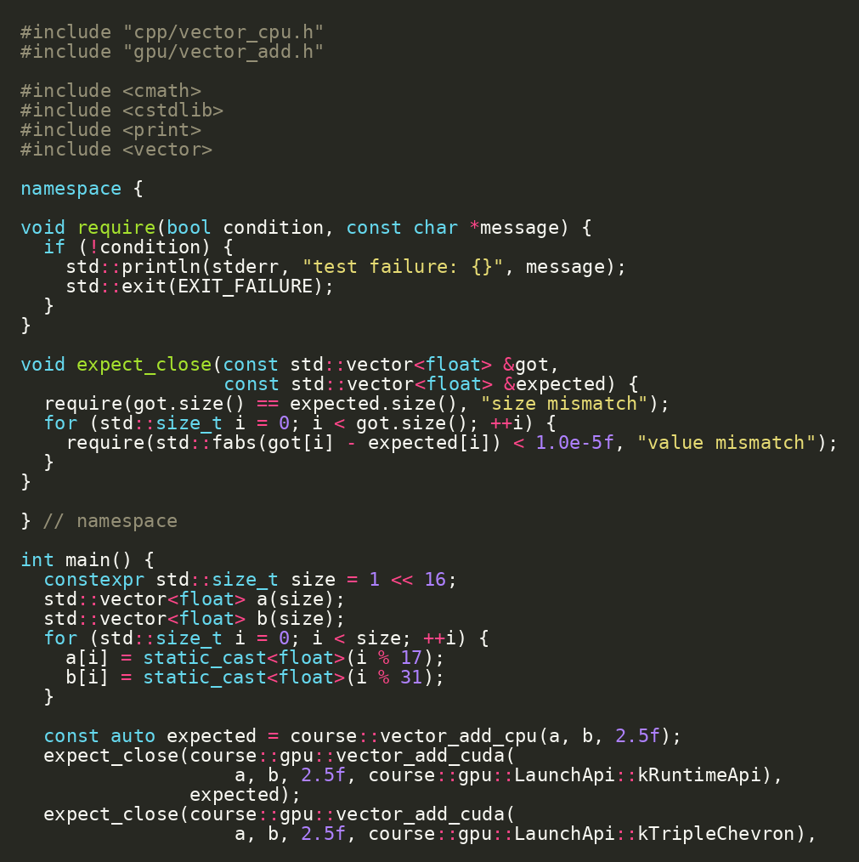
FORMATION / DAY 1 / VERIFICATION & BUILD INSPECTION
Correctness Test: CPU vs CUDA
The GPU result must match the CPU oracle
ORIGINAL SOURCE EXCERPT
CPU and CUDA paths share the same inputs.
Outputs are compared element by element.
No performance discussion until this target passes.
RUN / INSPECT
bazel test //gpu:vector_add_test
projects/detailed/gpu/vector_add_test.cc
FORMATION / INDEPENDENT CUDA TRAINING
34/49
Notes:
VISUAL REDESIGN / SOURCE PROVENANCE
Content source: user-supplied Day1_Repository_Foundation_First_CUDA_Feature.pptx, original slide 31.
Original slide order, wording, tables, commands and embedded code excerpts are retained. This is a visual-only redesign, not a technical review or software update.
The code image is the original embedded source excerpt; no code text was edited. Where it is shown in two panes, the same original image is cropped at a blank line without omitting pixels.

Slide 35
FORMATION / DAY 1 / VERIFICATION & BUILD INSPECTION
Live Demo: Run the CUDA Test
The first CUDA feature is now real
Checkpoint / exercise
RUN / INSPECT
Run the test target.
cd projects/detailed
bazel test //gpu:vector_add_test
# optional: --nocache_test_results
If cached, use --nocache_test_results for a live run.
Confirm both launch styles are covered by tests.
Two kernel launch styles, one device function
kernel<<<grid, block, 0, stream>>>(args);
cudaLaunchKernel(func, grid, block, args, 0, stream);
__global__ vector_add_kernel
//gpu:vector_add_test
FORMATION / INDEPENDENT CUDA TRAINING
35/49
Notes:
VISUAL REDESIGN / SOURCE PROVENANCE
Content source: user-supplied Day1_Repository_Foundation_First_CUDA_Feature.pptx, original slide 32.
Original slide order, wording, tables, commands and embedded code excerpts are retained. This is a visual-only redesign, not a technical review or software update.
Original visual labels (retained as editable text where appropriate, or replaced by the cited NVIDIA figure for illustration):
Two kernel launch styles, one device function
kernel<<<grid, block, 0, stream>>>(args);
cudaLaunchKernel(func, grid, block, args, 0, stream);
__global__ vector_add_kernel

Slide 36
FORMATION / DAY 1 / VERIFICATION & BUILD INSPECTION
Aquery: Proving Hermetic Clang
Trust, then inspect the action graph
Checkpoint / exercise
RUN / INSPECT
aquery reveals the compile actions Bazel will run.
bazel aquery 'mnemonic("CppCompile", //gpu:vector_add_test)'
Look for external LLVM toolchain paths.
The goal is to prove the compiler is not an ambient /usr/bin guess.
Clang CUDA compilation path
.cu source host + device code › Clang parse + split › PTX virtual ISA › ptxas PTX -> SASS › link host + fatbin › binary run on GPU host › Bazel selects the toolchain and arch flags; ptxas produces architecture-specific device code.
Bazel action graph | Source: Bazel Hermeticity
FORMATION / INDEPENDENT CUDA TRAINING
36/49
Notes:
VISUAL REDESIGN / SOURCE PROVENANCE
Content source: user-supplied Day1_Repository_Foundation_First_CUDA_Feature.pptx, original slide 33.
Original slide order, wording, tables, commands and embedded code excerpts are retained. This is a visual-only redesign, not a technical review or software update.
Original visual labels (retained as editable text where appropriate, or replaced by the cited NVIDIA figure for illustration):
Clang CUDA compilation path
.cu source
host + device code
Clang
parse + split
PTX
virtual ISA
ptxas
PTX -> SASS
link
host + fatbin
binary
run on GPU host
Bazel selects the toolchain and arch flags; ptxas produces architecture-specific device code.

Slide 37
FORMATION / DAY 1 / VERIFICATION & BUILD INSPECTION
Build Graph as a Teaching Tool
Build dependencies mirror architecture decisions
Bazel target graph mirrors project architecture
Benchmark target depends on CPU and CUDA implementations.
vector_cpu
CUDA wrapper depends on device library.
benchmark
Device library uses runtime helpers.
vector_add
device_lib
runtime
The target graph is a design diagram.
projects/detailed/gpu/BUILD.bazel
FORMATION / INDEPENDENT CUDA TRAINING
37/49
Notes:
VISUAL REDESIGN / SOURCE PROVENANCE
Content source: user-supplied Day1_Repository_Foundation_First_CUDA_Feature.pptx, original slide 34.
Original slide order, wording, tables, commands and embedded code excerpts are retained. This is a visual-only redesign, not a technical review or software update.

Slide 38
FORMATION / DAY 1 / VERIFICATION & BUILD INSPECTION
CUDA Architecture Flag
Device code is compiled for GPU architecture choices
Architecture selection from Bazel
Bazel config selects compute/PTX and sm/SASS targets.
@rules_cuda//cuda:archs
compute_86
PTX path
sm_86
SASS path
ptxas
device code
PTX path gives compatibility; SASS path is architecture-specific.
Labs may change this for a different GPU fleet.
NVIDIA Fig. 10 | Guide p. 17 / PDF p. 35
projects/detailed/.bazelrc | Source: rules_cuda
FORMATION / INDEPENDENT CUDA TRAINING
38/49
Notes:
VISUAL REDESIGN / SOURCE PROVENANCE
Content source: user-supplied Day1_Repository_Foundation_First_CUDA_Feature.pptx, original slide 35.
Original slide order, wording, tables, commands and embedded code excerpts are retained. This is a visual-only redesign, not a technical review or software update.
Original visual labels (retained as editable text where appropriate, or replaced by the cited NVIDIA figure for illustration):
Architecture selection from Bazel
@rules_cuda//cuda:archs
compute_86
PTX path
sm_86
SASS path
ptxas
device code
ORIGINAL NVIDIA FIGURES
Figure 10: user-supplied cuda-programming-guide.pdf, Release 13.4.2, PDF page 35, printed guide page 17. Extracted original image, PDF image xref 947; original labels, colors and proportions preserved.
NVIDIA artwork is used as source illustration; the deck is independently prepared training, not an official NVIDIA course.

Slide 39
FORMATION / DAY 1 / VERIFICATION & BUILD INSPECTION
What Can Go Wrong
CUDA failures are usually environment, architecture, memory, or launch bugs
Systematic CUDA diagnostics
No driver or no GPU access.
01
device_info
Architecture flag mismatch.
02
small test
Wrong copy size or direction.
03
CUDA_CHECK
Unchecked launch failure.
check archs
Use device_info and CUDA_CHECK to localize.
04
05
reduce input
06
profiler/sanitizer
runtime/device_info + runtime/cuda_errors.h
FORMATION / INDEPENDENT CUDA TRAINING
39/49
Notes:
VISUAL REDESIGN / SOURCE PROVENANCE
Content source: user-supplied Day1_Repository_Foundation_First_CUDA_Feature.pptx, original slide 36.
Original slide order, wording, tables, commands and embedded code excerpts are retained. This is a visual-only redesign, not a technical review or software update.
Original visual labels (retained as editable text where appropriate, or replaced by the cited NVIDIA figure for illustration):
Systematic CUDA diagnostics
device_info
small test
CUDA_CHECK
check archs
reduce input
profiler/sanitizer

Slide 40
FORMATION / DAY 1 / LABS & DAY 1 INTEGRATION
Lab 2: Read and Explain the Kernel
Be able to narrate the CUDA kernel line by line
Checkpoint / exercise
RUN / INSPECT
Open gpu/vector_add_device.cu.
code projects/detailed/gpu/vector_add_device.cu
Identify the index calculation.
Identify the bounds check.
Identify where grid and block sizes are chosen.
NVIDIA Fig. 3 | Guide p. 6 / PDF p. 24
gpu/vector_add_device.cu
FORMATION / INDEPENDENT CUDA TRAINING
40/49
Notes:
VISUAL REDESIGN / SOURCE PROVENANCE
Content source: user-supplied Day1_Repository_Foundation_First_CUDA_Feature.pptx, original slide 37.
Original slide order, wording, tables, commands and embedded code excerpts are retained. This is a visual-only redesign, not a technical review or software update.
Original visual labels (retained as editable text where appropriate, or replaced by the cited NVIDIA figure for illustration):
CUDA thread hierarchy
Grid
block 0,0
block 0,1
block 0,2
block 1,0
block 1,1
block 1,2
blockIdx.x * blockDim.x + threadIdx.x
Threads in a block can cooperate with shared memory + __syncthreads()
ORIGINAL NVIDIA FIGURES
Figure 3: user-supplied cuda-programming-guide.pdf, Release 13.4.2, PDF page 24, printed guide page 6. Extracted original image, PDF image xref 853; original labels, colors and proportions preserved.
NVIDIA artwork is used as source illustration; the deck is independently prepared training, not an official NVIDIA course.

Slide 41
FORMATION / DAY 1 / LABS & DAY 1 INTEGRATION
Lab 3: Change Vector Size
Configuration changes should preserve correctness
Checkpoint / exercise
RUN / INSPECT
Change the benchmark vector size.
bazel test //gpu:vector_add_test
bazel run //gpu:vector_add_benchmark
Re-run the CUDA test.
Run the benchmark.
Record serial CPU, threaded CPU, runtime API CUDA, and triple-chevron CUDA times.
SAXPY-like vector add
a[N] › alpha › b[N] › out[i] = alpha*a[i] + b[i] › CPU/GPU compare
gpu/vector_add_benchmark.cc
FORMATION / INDEPENDENT CUDA TRAINING
41/49
Notes:
VISUAL REDESIGN / SOURCE PROVENANCE
Content source: user-supplied Day1_Repository_Foundation_First_CUDA_Feature.pptx, original slide 38.
Original slide order, wording, tables, commands and embedded code excerpts are retained. This is a visual-only redesign, not a technical review or software update.
Original visual labels (retained as editable text where appropriate, or replaced by the cited NVIDIA figure for illustration):
SAXPY-like vector add
a[N]
alpha
b[N]
out[i] = alpha*a[i] + b[i]
CPU/GPU compare

Slide 42
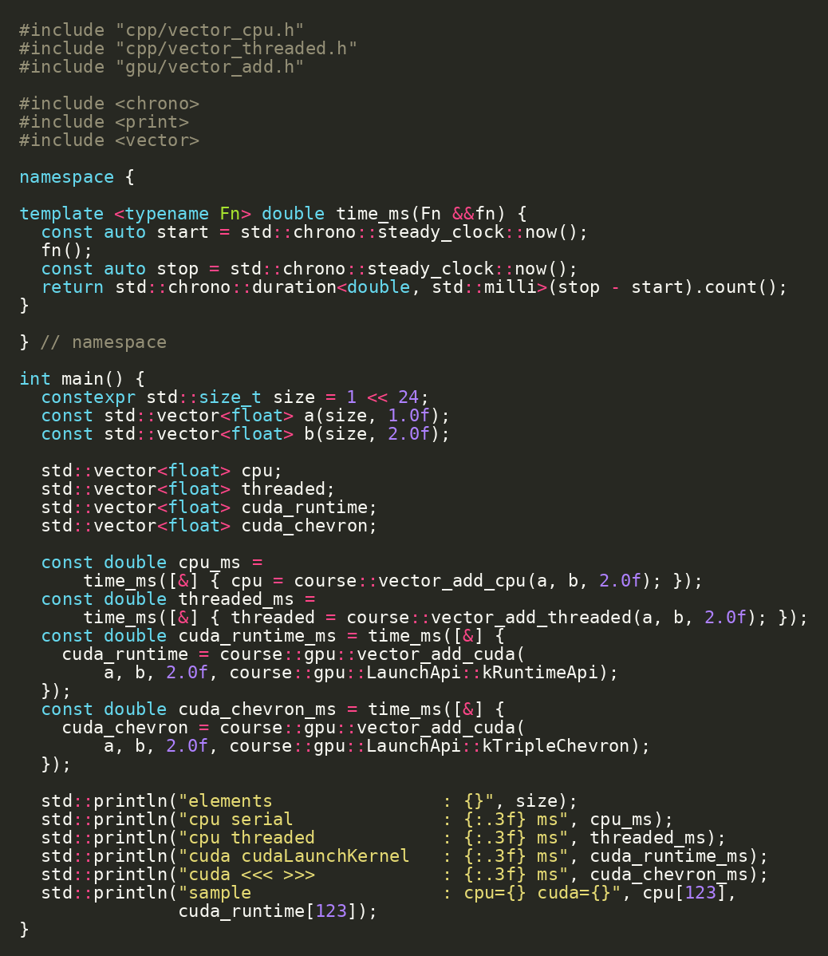
FORMATION / DAY 1 / LABS & DAY 1 INTEGRATION
Benchmark Target Preview
Day 1 ends with the benchmark target ready for deeper analysis
The benchmark invokes CPU serial, CPU threaded, and CUDA variants.
Day 2 will explain timing, memory cost, and interpretation.
SOURCE EXCERPT
CONTINUED
bazel run //gpu:vector_add_benchmark
projects/detailed/gpu/vector_add_benchmark.cc | Source: CUDA C++ Best Practices Guide
FORMATION / INDEPENDENT CUDA TRAINING
42/49
Notes:
VISUAL REDESIGN / SOURCE PROVENANCE
Content source: user-supplied Day1_Repository_Foundation_First_CUDA_Feature.pptx, original slide 39.
Original slide order, wording, tables, commands and embedded code excerpts are retained. This is a visual-only redesign, not a technical review or software update.
The code image is the original embedded source excerpt; no code text was edited. Where it is shown in two panes, the same original image is cropped at a blank line without omitting pixels.

Slide 43
FORMATION / DAY 1 / LABS & DAY 1 INTEGRATION
From Visual Studio Debugger to Repository Workflow
The old debugger-first flow becomes build/test/run first
Old course step | Repository-driven replacement
Install CUDA SDK manually | cuda.redist_json + rules_cuda toolchain
Create Visual Studio project | BUILD.bazel targets
Run a sample app | bazel run //runtime:device_info
Compare CPU/GPU manually | bazel test //gpu:vector_add_test
Package by copying files | rules_oci image target
Editor choice stays independent from build definition.
source.md -> reworked repository
FORMATION / INDEPENDENT CUDA TRAINING
43/49
Notes:
VISUAL REDESIGN / SOURCE PROVENANCE
Content source: user-supplied Day1_Repository_Foundation_First_CUDA_Feature.pptx, original slide 40.
Original slide order, wording, tables, commands and embedded code excerpts are retained. This is a visual-only redesign, not a technical review or software update.

Slide 44
FORMATION / DAY 1 / LABS & DAY 1 INTEGRATION
Day 1 Architecture Recap
The foundation for a real CUDA project is now in place
Bazel target graph mirrors project architecture
Hermetic C++ compiler.
Hermetic CUDA toolkit.
vector_cpu
CPU oracle and threaded baseline.
benchmark
CUDA device kernel and host wrapper.
vector_add
device_lib
runtime
Error helper and runtime launch path.
Tests and benchmark target.
projects/detailed
FORMATION / INDEPENDENT CUDA TRAINING
44/49
Notes:
VISUAL REDESIGN / SOURCE PROVENANCE
Content source: user-supplied Day1_Repository_Foundation_First_CUDA_Feature.pptx, original slide 41.
Original slide order, wording, tables, commands and embedded code excerpts are retained. This is a visual-only redesign, not a technical review or software update.

Slide 45
FORMATION / DAY 1 / LABS & DAY 1 INTEGRATION
Documentation Anchors for Day 1
Use official docs to support the repository decisions
Topic | Primary source | Repository anchor
CUDA programming model | CUDA C++ Programming Guide | gpu/vector_add_device.cu
Runtime launch API | CUDA Runtime API execution control | cudaLaunchKernel path
Clang CUDA | LLVM Clang CUDA docs | .bazelrc + rules_cuda
Hermetic build | Bazel hermeticity | MODULE.bazel + toolchains
CUDA Bazel rules | rules_cuda | gpu/BUILD.bazel
docs-to-code mapping | Source: CUDA / LLVM / Bazel official docs
FORMATION / INDEPENDENT CUDA TRAINING
45/49
Notes:
VISUAL REDESIGN / SOURCE PROVENANCE
Content source: user-supplied Day1_Repository_Foundation_First_CUDA_Feature.pptx, original slide 42.
Original slide order, wording, tables, commands and embedded code excerpts are retained. This is a visual-only redesign, not a technical review or software update.

Slide 46
FORMATION / DAY 1 / LABS & DAY 1 INTEGRATION
Day 1 Integration Demo
Run the end-to-end Day 1 path in four commands
Checkpoint / exercise
RUN / INSPECT
Inspect the device.
cd projects/detailed
bazel run //runtime:device_info
bazel test //cpp:vector_cpu_test
bazel test //gpu:vector_add_test
bazel run //gpu:vector_add_benchmark
Run the CPU test.
Run the CUDA test.
Run the vector-add benchmark preview.
End-to-end course payoff
build › test › benchmark › package › run container › compare JAX/MatMul
projects/detailed
FORMATION / INDEPENDENT CUDA TRAINING
46/49
Notes:
VISUAL REDESIGN / SOURCE PROVENANCE
Content source: user-supplied Day1_Repository_Foundation_First_CUDA_Feature.pptx, original slide 43.
Original slide order, wording, tables, commands and embedded code excerpts are retained. This is a visual-only redesign, not a technical review or software update.
Original visual labels (retained as editable text where appropriate, or replaced by the cited NVIDIA figure for illustration):
End-to-end course payoff
build
test
benchmark
package
run container
compare JAX/MatMul

Slide 47
FORMATION / DAY 1 / LABS & DAY 1 INTEGRATION
Prepare for Day 2
Day 2 asks what the GPU work costs and how we deploy it
Two-day practical roadmap
How much time is launch vs transfer vs compute?
01
Day 1 · repo + kernel
How do streams overlap work?
02
Day 1 · tests + launch API
What belongs in a container?
03
Day 2 · measure + streams
How does JAX/XLA compare?
04
Day 2 · OCI + remote
Why is MatMul different from vector add?
05
Day 2 · JAX + MatMul
Day 2 targets: benchmark, deploy, JAX, MatMul
FORMATION / INDEPENDENT CUDA TRAINING
47/49
Notes:
VISUAL REDESIGN / SOURCE PROVENANCE
Content source: user-supplied Day1_Repository_Foundation_First_CUDA_Feature.pptx, original slide 44.
Original slide order, wording, tables, commands and embedded code excerpts are retained. This is a visual-only redesign, not a technical review or software update.
Original visual labels (retained as editable text where appropriate, or replaced by the cited NVIDIA figure for illustration):
Two-day practical roadmap
Day 1
repo + kernel
Day 1
tests + launch API
Day 2
measure + streams
Day 2
OCI + remote
Day 2
JAX + MatMul

Slide 48
FORMATION / DAY 1 / LABS & DAY 1 INTEGRATION
Day 1 Exercise Pack
Concrete practice tasks that extend the repository without changing architecture
Checkpoint / exercise
RUN / INSPECT
Re-run //runtime:device_info and identify three hardware fields.
bazel run //runtime:device_info
bazel test //gpu:vector_add_test
bazel aquery 'mnemonic("CppCompile", //gpu:vector_add_test)'
Add one new assertion to vector_add_test.
Change benchmark size and record timings.
Systematic CUDA diagnostics
Inspect the compiler path with aquery.
device_info › small test › CUDA_CHECK › check archs › reduce input › profiler/sanitizer
projects/detailed
FORMATION / INDEPENDENT CUDA TRAINING
48/49
Notes:
VISUAL REDESIGN / SOURCE PROVENANCE
Content source: user-supplied Day1_Repository_Foundation_First_CUDA_Feature.pptx, original slide 45.
Original slide order, wording, tables, commands and embedded code excerpts are retained. This is a visual-only redesign, not a technical review or software update.
Original visual labels (retained as editable text where appropriate, or replaced by the cited NVIDIA figure for illustration):
Systematic CUDA diagnostics
device_info
small test
CUDA_CHECK
check archs
reduce input
profiler/sanitizer

Slide 49
FORMATION / DAY 1 / LABS & DAY 1 INTEGRATION
Day 1 Closing
Foundation complete: code, build, test, and first GPU feature
The repository declares the build.
End-to-end course payoff
The CPU verifies CUDA.
01
build
Clang compiles host and CUDA code.
test
02
ptxas is part of device code generation.
03
benchmark
Day 2 measures, overlaps, packages, and compares.
04
package
05
run container
06
compare JAX/MatMul
bazel test //...
FORMATION / INDEPENDENT CUDA TRAINING
49/49
Notes:
VISUAL REDESIGN / SOURCE PROVENANCE
Content source: user-supplied Day1_Repository_Foundation_First_CUDA_Feature.pptx, original slide 46.
Original slide order, wording, tables, commands and embedded code excerpts are retained. This is a visual-only redesign, not a technical review or software update.
Original visual labels (retained as editable text where appropriate, or replaced by the cited NVIDIA figure for illustration):
End-to-end course payoff
build
test
benchmark
package
run container
compare JAX/MatMul

