Slide 1

FORMATION / REPOSITORY-DRIVEN CUDA ENGINEERING
DAY 02
Day 2 - Measure, Package, Compare, and Scale the Mental Model
Runtime, performance, deployment, JAX/XLA, and MatMul
Today: measure -> overlap -> package -> compare -> extend to MatMul
build
›
test
›
benchmark
›
package
›
run container
›
compare JAX/MatMul
Repository-driven CUDA/Bazel course
Independent training · Original CUDA artwork: supplied NVIDIA guide, PDF p. 1
01/52
Notes:
VISUAL REDESIGN / SOURCE PROVENANCE
Content source: user-supplied Day2_Runtime_Performance_Deployment_JAX_MatMul.pptx, original slide 1.
Original slide order, wording, tables, commands and embedded code excerpts are retained. This is a visual-only redesign, not a technical review or software update.
Original visual labels (retained as editable text where appropriate, or replaced by the cited NVIDIA figure for illustration):
End-to-end course payoff
build
test
benchmark
package
run container
compare JAX/MatMul
ORIGINAL NVIDIA FIGURES
CUDA cover artwork: user-supplied cuda-programming-guide.pdf, Release 13.4.2, PDF page 1. Extracted original image, PDF image xref 9; original labels, colors and proportions preserved.
NVIDIA artwork is used as source illustration; the deck is independently prepared training, not an official NVIDIA course.

Slide 2
FORMATION / DAY 2 / DEVICE & COURSE RECAP
Day 1 Recap in One Graph
The repo now has CPU, threaded CPU, and CUDA implementations
Bazel target graph mirrors project architecture
vector_add_benchmark depends on CPU and CUDA implementations.
vector_cpu
The CUDA path is split into host wrapper, device library, and runtime helpers.
benchmark
vector_add
device_lib
runtime
This is the graph we now measure and package.
//gpu:vector_add_benchmark
FORMATION / INDEPENDENT CUDA TRAINING
02/52
Notes:
VISUAL REDESIGN / SOURCE PROVENANCE
Content source: user-supplied Day2_Runtime_Performance_Deployment_JAX_MatMul.pptx, original slide 2.
Original slide order, wording, tables, commands and embedded code excerpts are retained. This is a visual-only redesign, not a technical review or software update.

Slide 3
FORMATION / DAY 2 / DEVICE & COURSE RECAP
Day 2 Outcomes
Reason about runtime cost and deployment
01
Read benchmark output responsibly.
02
Explain host/device memory movement.
03
Use timing and synchronization correctly.
04
Build/load a tiny GPU container.
05
Explain JAX/XLA compiler path.
06
Use MatMul as a separate performance ladder.
projects/detailed + projects/simple
FORMATION / INDEPENDENT CUDA TRAINING
03/52
Notes:
VISUAL REDESIGN / SOURCE PROVENANCE
Content source: user-supplied Day2_Runtime_Performance_Deployment_JAX_MatMul.pptx, original slide 3.
Original slide order, wording, tables, commands and embedded code excerpts are retained. This is a visual-only redesign, not a technical review or software update.

Slide 4
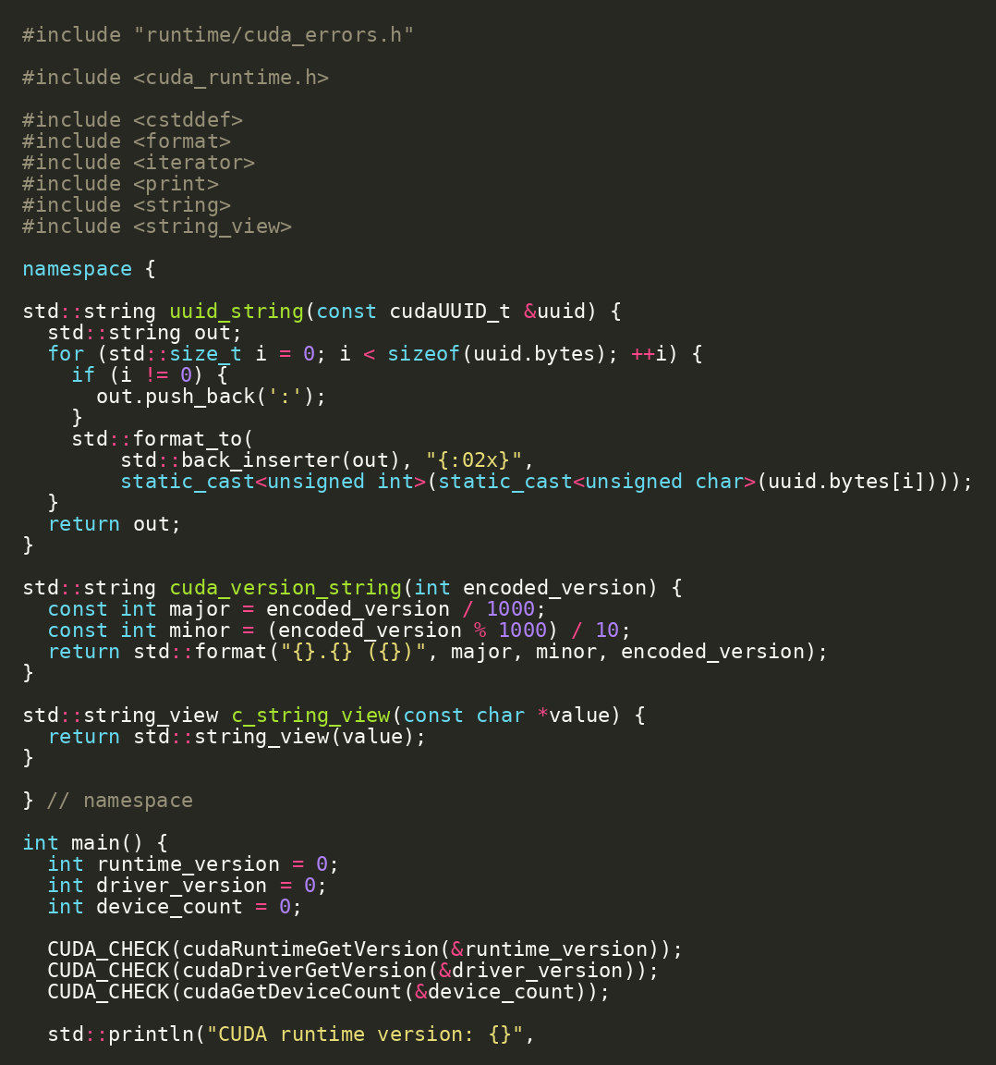
FORMATION / DAY 2 / DEVICE & COURSE RECAP
Start with Device Reality
Runtime facts decide what experiments mean
Run device_info before drawing conclusions.
Capture CUDA runtime, driver, device count, SM count, and warp size.
SOURCE EXCERPT
CONTINUED
cd projects/detailed
bazel run //runtime:device_info
projects/detailed/runtime/device_info.cc | Source: CUDA C++ Programming Guide
FORMATION / INDEPENDENT CUDA TRAINING
04/52
Notes:
VISUAL REDESIGN / SOURCE PROVENANCE
Content source: user-supplied Day2_Runtime_Performance_Deployment_JAX_MatMul.pptx, original slide 4.
Original slide order, wording, tables, commands and embedded code excerpts are retained. This is a visual-only redesign, not a technical review or software update.
The code image is the original embedded source excerpt; no code text was edited. Where it is shown in two panes, the same original image is cropped at a blank line without omitting pixels.

Slide 5
FORMATION / DAY 2 / DEVICE & COURSE RECAP
Hardware Fields That Matter Today
Not every device property matters equally for beginner kernels
Field | Why it matters today
multiProcessorCount | Parallel capacity for kernels
warpSize | Scheduling granularity and MatMul discussion
sharedMemPerBlock | Tiled MatMul and shared-memory limits
asyncEngineCount | Potential copy/compute overlap
maxThreadsPerBlock | Launch constraints
cudaDeviceProp | Source: CUDA C++ Programming Guide
FORMATION / INDEPENDENT CUDA TRAINING
05/52
Notes:
VISUAL REDESIGN / SOURCE PROVENANCE
Content source: user-supplied Day2_Runtime_Performance_Deployment_JAX_MatMul.pptx, original slide 5.
Original slide order, wording, tables, commands and embedded code excerpts are retained. This is a visual-only redesign, not a technical review or software update.

Slide 6
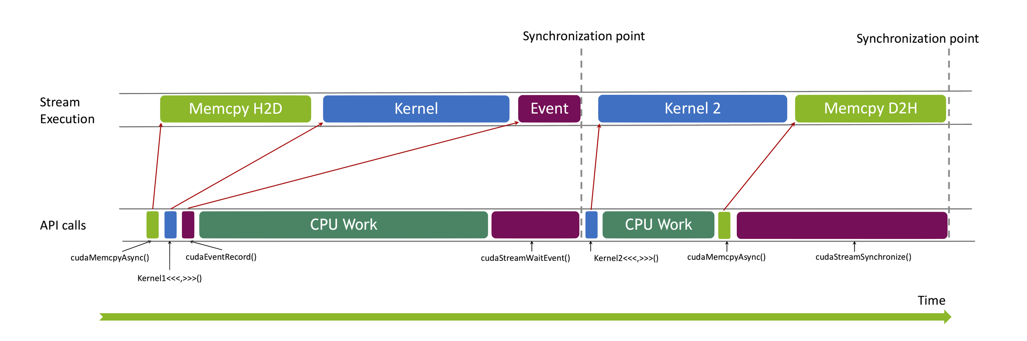
FORMATION / DAY 2 / RUNTIME MEASUREMENT
Measurement Before Optimization
You need a timing model before changing code
Warm up before measuring.
Know the sync point.
Know whether copies/allocation are included.
Avoid comparing first-run cache effects.
NVIDIA Fig. 20 | Guide p. 104 / PDF p. 122
Keep sample correctness visible.
Host timer: enqueue copies + kernel
host timer can stop too early without sync
gpu/vector_add_benchmark.cc | Source: CUDA C++ Best Practices Guide
FORMATION / INDEPENDENT CUDA TRAINING
06/52
Notes:
VISUAL REDESIGN / SOURCE PROVENANCE
Content source: user-supplied Day2_Runtime_Performance_Deployment_JAX_MatMul.pptx, original slide 6.
Original slide order, wording, tables, commands and embedded code excerpts are retained. This is a visual-only redesign, not a technical review or software update.
Original visual labels (retained as editable text where appropriate, or replaced by the cited NVIDIA figure for illustration):
Timing gotcha: host enqueue vs GPU execution
Host timer
enqueue copies + kernel
host timer can stop too early without sync
GPU stream
H2D
kernel
D2H
ORIGINAL NVIDIA FIGURES
Figure 20: user-supplied cuda-programming-guide.pdf, Release 13.4.2, PDF page 122, printed guide page 104. Extracted original image, PDF image xref 1439; original labels, colors and proportions preserved.
NVIDIA artwork is used as source illustration; the deck is independently prepared training, not an official NVIDIA course.

Slide 7
FORMATION / DAY 2 / RUNTIME MEASUREMENT
CUDA Timing Gotcha
GPU work is asynchronous from the host point of view
A host timer can stop before GPU work is complete.
Synchronize intentionally or use events.
Measure the same scope for every implementation.
NVIDIA Fig. 20 | Guide p. 104 / PDF p. 122
Host timer: enqueue copies + kernel
host timer can stop too early without sync
runtime/cuda_launch.h | Source: CUDA C++ Programming Guide
FORMATION / INDEPENDENT CUDA TRAINING
07/52
Notes:
VISUAL REDESIGN / SOURCE PROVENANCE
Content source: user-supplied Day2_Runtime_Performance_Deployment_JAX_MatMul.pptx, original slide 7.
Original slide order, wording, tables, commands and embedded code excerpts are retained. This is a visual-only redesign, not a technical review or software update.
Original visual labels (retained as editable text where appropriate, or replaced by the cited NVIDIA figure for illustration):
Timing gotcha: host enqueue vs GPU execution
Host timer
enqueue copies + kernel
host timer can stop too early without sync
GPU stream
H2D
kernel
D2H
ORIGINAL NVIDIA FIGURES
Figure 20: user-supplied cuda-programming-guide.pdf, Release 13.4.2, PDF page 122, printed guide page 104. Extracted original image, PDF image xref 1439; original labels, colors and proportions preserved.
NVIDIA artwork is used as source illustration; the deck is independently prepared training, not an official NVIDIA course.

Slide 8
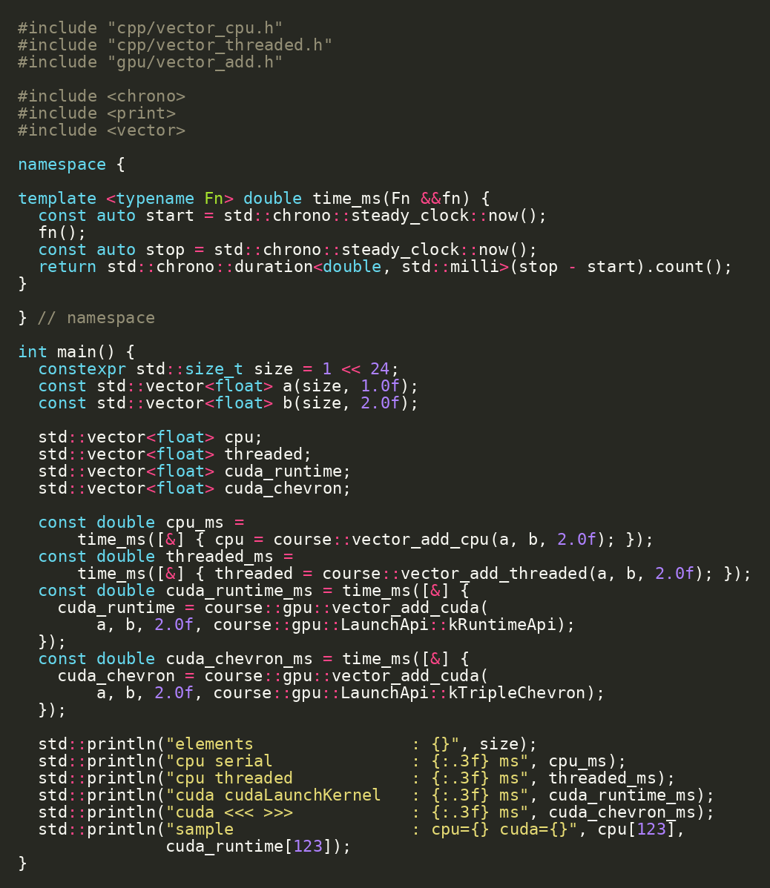
FORMATION / DAY 2 / RUNTIME MEASUREMENT
Vector Add Benchmark Target
The benchmark compares four paths in one executable
CPU serial.
CPU threaded.
CUDA Runtime API launch.
CUDA triple-chevron launch.
SOURCE EXCERPT
CONTINUED
bazel run //gpu:vector_add_benchmark
projects/detailed/gpu/vector_add_benchmark.cc
FORMATION / INDEPENDENT CUDA TRAINING
08/52
Notes:
VISUAL REDESIGN / SOURCE PROVENANCE
Content source: user-supplied Day2_Runtime_Performance_Deployment_JAX_MatMul.pptx, original slide 8.
Original slide order, wording, tables, commands and embedded code excerpts are retained. This is a visual-only redesign, not a technical review or software update.
The code image is the original embedded source excerpt; no code text was edited. Where it is shown in two panes, the same original image is cropped at a blank line without omitting pixels.

Slide 9
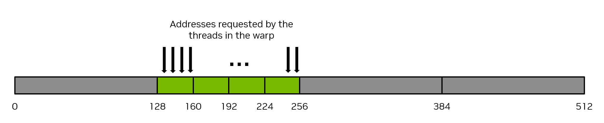
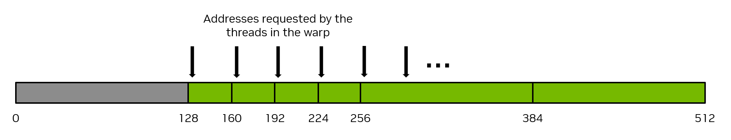
FORMATION / DAY 2 / RUNTIME MEASUREMENT
Reading the Benchmark Output
Interpret vector add as memory-bound and transfer-sensitive
Path | What the time includes | Interpretation
CPU serial | single-loop host work | baseline semantics
CPU threaded | thread startup + chunk work | CPU parallelism
CUDA runtime API | allocation + copies + launch + sync | full GPU call cost
CUDA chevron | same work, different launch syntax | API comparison
benchmark_results.md | Source: CUDA C++ Best Practices Guide
FORMATION / INDEPENDENT CUDA TRAINING
09/52
Notes:
SOURCE SLIDE: Original Day 2 slide 9 — Reading the Benchmark Output.
Original title, subtitle, editable benchmark table and source reference retained.
NVIDIA Figures 12 and 13 have moved to the next dedicated visual-explanation slide, allowing this table to return to its larger readable size.
No original benchmark labels, statements or timings changed.

Slide 10
FORMATION / DAY 2 / RUNTIME MEASUREMENT / VISUAL EXPLANATION
Coalesced vs Uncoalesced Global-Memory Access
The same useful data can require a different number of memory transactions.
NVIDIA FIG. 12 / COALESCED
4 transactions
32 lanes × 4 bytes
= 128 useful bytes
4 × 32-byte transactions
= 128 bytes transferred
NVIDIA FIG. 13 / UNCOALESCED
32 transactions
The same 128 useful bytes
32 × 32-byte transactions
= 1024 bytes transferred
GPU global-memory access patterns — separate from host–device transfers.
NVIDIA Figs. 12–13 | Guide p. 59 / PDF p. 77 | CUDA Programming Guide 13.4.2
FORMATION / INDEPENDENT CUDA TRAINING
10/52
Notes:
ADDED VISUAL EXPLANATION
Inserted after original Day 2 slide 9. The original course slides remain in their original relative sequence. No original code, commands, exercises, or benchmark values are changed.
SOURCE
User-supplied cuda-programming-guide.pdf, CUDA Programming Guide, Release 13.4.2, September 10, 2026.
Figures 12 and 13, physical PDF page 77, printed page 59; image xrefs 1199 and 1202. §2.3.4.1, printed pages 58–60.
https://docs.nvidia.com/cuda/cuda-programming-guide/
Original PDF figure image(s), proportionally resized; native labels and colors retained. No redrawing or generated illustration.
PRESENTER NOTES
Read the two original figures as the guide’s examples of 32-bit requests by 32 lanes. The numbers are the source’s memory-transaction model: 128 useful bytes with 128 transferred in the aligned, coalesced case, versus 1024 transferred in the illustrated worst case. These numbers are not GPU benchmark results, nor a universal speedup factor. Explain that these are GPU global-memory transactions, not the H2D and D2H byte totals in the next course topic. The source also notes that coalescing can occur for suitable permutations; consecutive lane-to-address order is common, not necessary.
PACING
Allow approximately two minutes; focus on reading the figure rather than introducing a new lab.
SCOPE
New explanatory text paraphrases the cited guide. Course-connection examples are identified in the notes as instructional applications, not new measurements or claims of validated repository behavior.

Slide 11
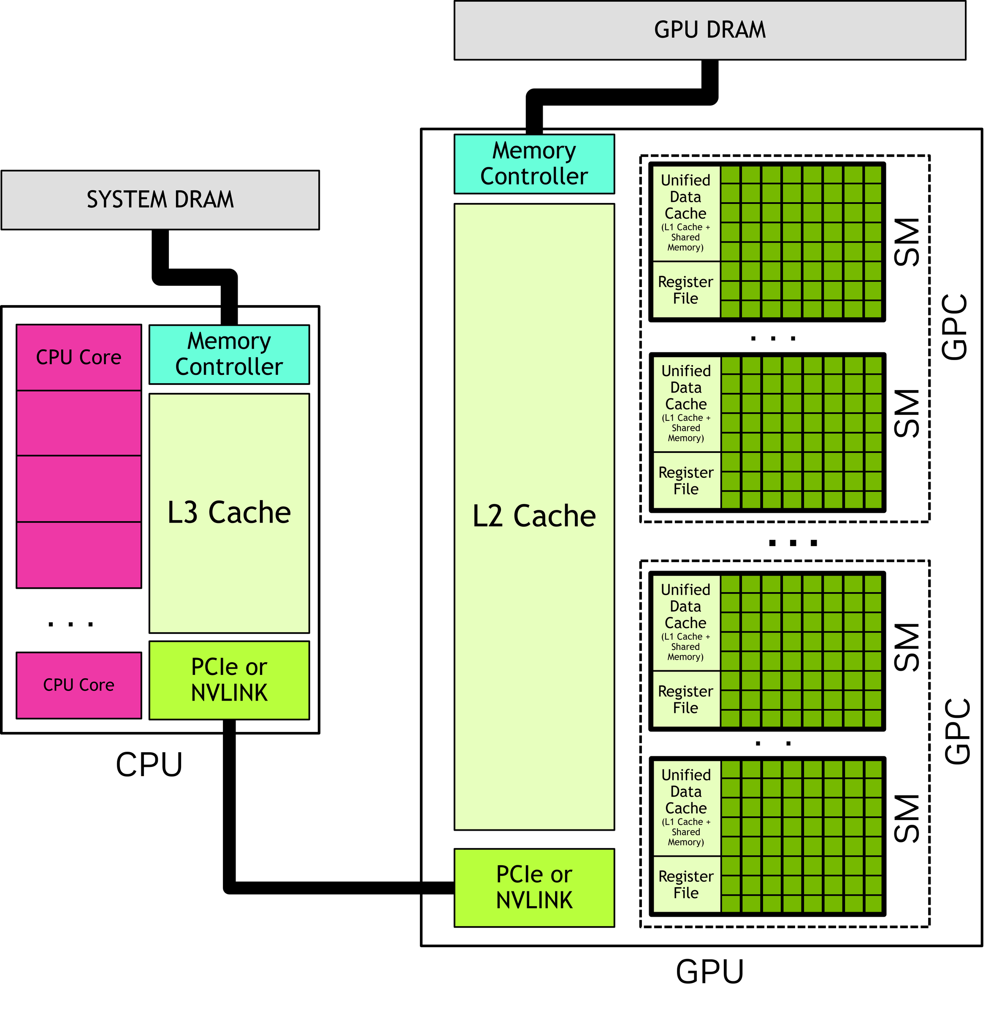
FORMATION / DAY 2 / RUNTIME MEASUREMENT
Host/Device Memory Flow
CUDA performance often begins with data movement
a and b move host-to-device.
The kernel writes d_out.
out moves device-to-host.
For vector add, bytes moved can dominate arithmetic.
NVIDIA Fig. 2 | Guide p. 6 / PDF p. 24
2 x H2D copies · 1 x D2H copy
gpu/vector_add_cuda.cc | Source: CUDA C++ Programming Guide
FORMATION / INDEPENDENT CUDA TRAINING
11/52
Notes:
VISUAL REDESIGN / SOURCE PROVENANCE
Content source: user-supplied Day2_Runtime_Performance_Deployment_JAX_MatMul.pptx, original slide 10.
Original slide order, wording, tables, commands and embedded code excerpts are retained. This is a visual-only redesign, not a technical review or software update.
Original visual labels (retained as editable text where appropriate, or replaced by the cited NVIDIA figure for illustration):
Host/device memory movement for vector add
Host arrays
a[N], b[N], out[N]
2 x H2D copies
Device arrays
d_a, d_b, d_out
1 x D2H copy
Total bytes ~= 3 * N * sizeof(float)
ORIGINAL NVIDIA FIGURES
Figure 2: user-supplied cuda-programming-guide.pdf, Release 13.4.2, PDF page 24, printed guide page 6. Extracted original image, PDF image xref 851; original labels, colors and proportions preserved.
NVIDIA artwork is used as source illustration; the deck is independently prepared training, not an official NVIDIA course.

Slide 12
FORMATION / DAY 2 / RUNTIME MEASUREMENT
Lab 1: Estimate Bytes Moved
Performance reasoning starts on paper
Checkpoint / exercise
RUN / INSPECT
For size = 1 << 24 and sizeof(float) = 4: estimate H2D for a and b.
N = 1 << 24
bytes = 3 * N * sizeof(float)
Estimate D2H for out.
Compute total bytes moved.
Host/device memory movement for vector add
Compare that with benchmark time.
Host arrays a[N], b[N], out[N] › 2 x H2D copies › Device arrays d_a, d_b, d_out › 1 x D2H copy › Total bytes ~= 3 * N * sizeof(float)
docs/benchmark_results.md
FORMATION / INDEPENDENT CUDA TRAINING
12/52
Notes:
VISUAL REDESIGN / SOURCE PROVENANCE
Content source: user-supplied Day2_Runtime_Performance_Deployment_JAX_MatMul.pptx, original slide 11.
Original slide order, wording, tables, commands and embedded code excerpts are retained. This is a visual-only redesign, not a technical review or software update.
Original visual labels (retained as editable text where appropriate, or replaced by the cited NVIDIA figure for illustration):
Host/device memory movement for vector add
Host arrays
a[N], b[N], out[N]
2 x H2D copies
Device arrays
d_a, d_b, d_out
1 x D2H copy
Total bytes ~= 3 * N * sizeof(float)

Slide 13
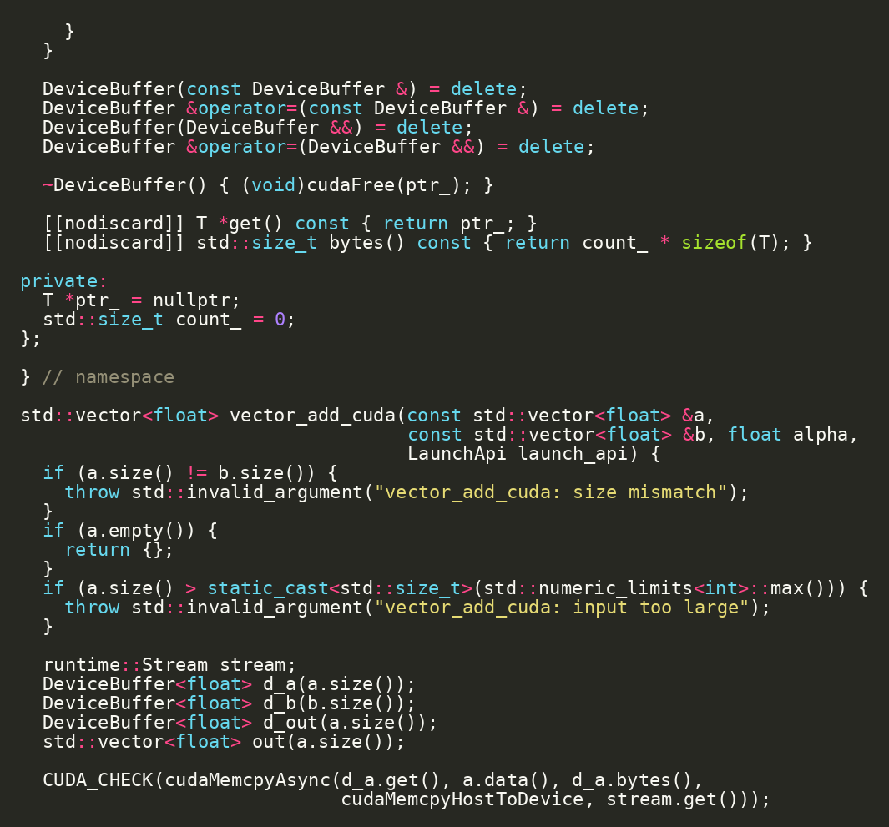
FORMATION / DAY 2 / RUNTIME MEASUREMENT
cudaMalloc and Allocation Cost
Allocation is not free and should not be hidden in a kernel-only story
ORIGINAL SOURCE EXCERPT
Full-function timing includes allocation and free.
Real applications often reuse buffers.
Separate allocation cost when investigating performance.
gpu/vector_add_cuda.cc | Source: CUDA Runtime API - Execution Control
FORMATION / INDEPENDENT CUDA TRAINING
13/52
Notes:
VISUAL REDESIGN / SOURCE PROVENANCE
Content source: user-supplied Day2_Runtime_Performance_Deployment_JAX_MatMul.pptx, original slide 12.
Original slide order, wording, tables, commands and embedded code excerpts are retained. This is a visual-only redesign, not a technical review or software update.
The code image is the original embedded source excerpt; no code text was edited. Where it is shown in two panes, the same original image is cropped at a blank line without omitting pixels.

Slide 14
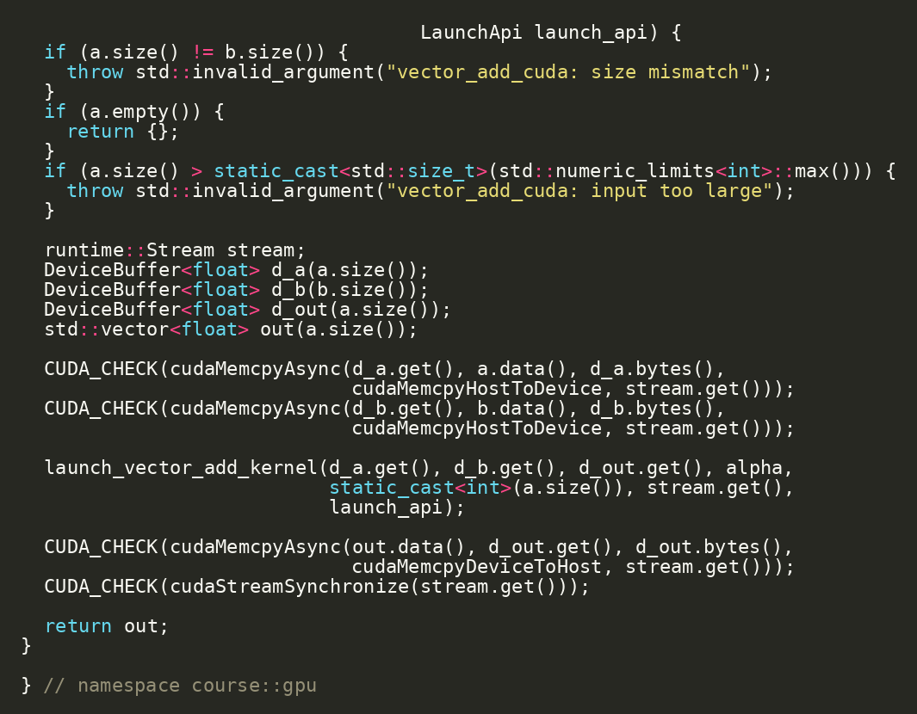
FORMATION / DAY 2 / RUNTIME MEASUREMENT
cudaMemcpy Direction and Intent
Direction flags make host/device ownership explicit
ORIGINAL SOURCE EXCERPT
HostToDevice for input arrays.
DeviceToHost for output arrays.
Wrong direction can fail or silently invalidate results.
cudaMemcpy in vector_add_cuda.cc | Source: CUDA Runtime API - Execution Control
FORMATION / INDEPENDENT CUDA TRAINING
14/52
Notes:
VISUAL REDESIGN / SOURCE PROVENANCE
Content source: user-supplied Day2_Runtime_Performance_Deployment_JAX_MatMul.pptx, original slide 13.
Original slide order, wording, tables, commands and embedded code excerpts are retained. This is a visual-only redesign, not a technical review or software update.
The code image is the original embedded source excerpt; no code text was edited. Where it is shown in two panes, the same original image is cropped at a blank line without omitting pixels.

Slide 15
FORMATION / DAY 2 / RUNTIME MEASUREMENT
Kernel Launch Cost
Launch overhead means tiny work can lose to CPU
Host enqueues work.
GPU dispatches the kernel.
Synchronization brings errors and completion back to host.
Batching and larger work sizes amortize launch cost.
NVIDIA Fig. 20 | Guide p. 104 / PDF p. 122
Host timer: enqueue copies + kernel
host timer can stop too early without sync
gpu/vector_add_benchmark.cc | Source: CUDA C++ Best Practices Guide
FORMATION / INDEPENDENT CUDA TRAINING
15/52
Notes:
VISUAL REDESIGN / SOURCE PROVENANCE
Content source: user-supplied Day2_Runtime_Performance_Deployment_JAX_MatMul.pptx, original slide 14.
Original slide order, wording, tables, commands and embedded code excerpts are retained. This is a visual-only redesign, not a technical review or software update.
Original visual labels (retained as editable text where appropriate, or replaced by the cited NVIDIA figure for illustration):
Timing gotcha: host enqueue vs GPU execution
Host timer
enqueue copies + kernel
host timer can stop too early without sync
GPU stream
H2D
kernel
D2H
ORIGINAL NVIDIA FIGURES
Figure 20: user-supplied cuda-programming-guide.pdf, Release 13.4.2, PDF page 122, printed guide page 104. Extracted original image, PDF image xref 1439; original labels, colors and proportions preserved.
NVIDIA artwork is used as source illustration; the deck is independently prepared training, not an official NVIDIA course.

Slide 16
FORMATION / DAY 2 / STREAMS & ROBUSTNESS
Default Stream Mental Model
The baseline code is intentionally serialized for correctness
Synchronous copies and simple launch form a clear baseline.
The default stream makes first correctness easier.
Overlap is a second step, not the first step.
NVIDIA Fig. 20 | Guide p. 104 / PDF p. 122
a[N], b[N], out[N] | d_a, d_b, d_out
2 x H2D copies · 1 x D2H copy
gpu/vector_add_cuda.cc | Source: CUDA C++ Programming Guide
FORMATION / INDEPENDENT CUDA TRAINING
16/52
Notes:
VISUAL REDESIGN / SOURCE PROVENANCE
Content source: user-supplied Day2_Runtime_Performance_Deployment_JAX_MatMul.pptx, original slide 15.
Original slide order, wording, tables, commands and embedded code excerpts are retained. This is a visual-only redesign, not a technical review or software update.
Original visual labels (retained as editable text where appropriate, or replaced by the cited NVIDIA figure for illustration):
Host/device memory movement for vector add
Host arrays
a[N], b[N], out[N]
2 x H2D copies
Device arrays
d_a, d_b, d_out
1 x D2H copy
Total bytes ~= 3 * N * sizeof(float)
ORIGINAL NVIDIA FIGURES
Figure 20: user-supplied cuda-programming-guide.pdf, Release 13.4.2, PDF page 122, printed guide page 104. Extracted original image, PDF image xref 1439; original labels, colors and proportions preserved.
NVIDIA artwork is used as source illustration; the deck is independently prepared training, not an official NVIDIA course.

Slide 17
FORMATION / DAY 2 / STREAMS & ROBUSTNESS
Streams: Why We Need Them
Streams allow independent queues of work
Split data into chunks.
Enqueue H2D, kernel, and D2H per stream.
Overlap requires hardware and memory prerequisites.
NVIDIA Fig. 20 | Guide p. 104 / PDF p. 122
Stream 0: H2D -> kernel -> D2H
Stream 1: H2D -> kernel -> D2H
Stream 2: H2D -> kernel -> D2H
runtime/cuda_launch.h | Source: CUDA C++ Programming Guide
FORMATION / INDEPENDENT CUDA TRAINING
17/52
Notes:
VISUAL REDESIGN / SOURCE PROVENANCE
Content source: user-supplied Day2_Runtime_Performance_Deployment_JAX_MatMul.pptx, original slide 16.
Original slide order, wording, tables, commands and embedded code excerpts are retained. This is a visual-only redesign, not a technical review or software update.
Original visual labels (retained as editable text where appropriate, or replaced by the cited NVIDIA figure for illustration):
Streams: independent queues can overlap work
Stream 0: H2D -> kernel -> D2H
Stream 1: H2D -> kernel -> D2H
Stream 2: H2D -> kernel -> D2H
ORIGINAL NVIDIA FIGURES
Figure 20: user-supplied cuda-programming-guide.pdf, Release 13.4.2, PDF page 122, printed guide page 104. Extracted original image, PDF image xref 1439; original labels, colors and proportions preserved.
NVIDIA artwork is used as source illustration; the deck is independently prepared training, not an official NVIDIA course.

Slide 18
FORMATION / DAY 2 / STREAMS & ROBUSTNESS
Async Copy Requirements
cudaMemcpyAsync is not magic by itself
Requirement | Reason
Pinned host memory | enables efficient async transfer
Non-default streams | allows independent queues
Independent chunks | prevents data dependency serialization
copy engines | hardware support for overlap
explicit synchronization | makes results reliable
device_info asyncEngineCount | Source: CUDA C++ Programming Guide
FORMATION / INDEPENDENT CUDA TRAINING
18/52
Notes:
VISUAL REDESIGN / SOURCE PROVENANCE
Content source: user-supplied Day2_Runtime_Performance_Deployment_JAX_MatMul.pptx, original slide 17.
Original slide order, wording, tables, commands and embedded code excerpts are retained. This is a visual-only redesign, not a technical review or software update.

Slide 19
FORMATION / DAY 2 / STREAMS & ROBUSTNESS
Lab 2 Design: Chunked Vector Add
Design stream overlap before implementing it
Checkpoint / exercise
RUN / INSPECT
Split the vector into chunks.
for stream in streams:
cudaMemcpyAsync(..., stream)
kernel<<<grid, block, 0, stream>>>(...)
cudaMemcpyAsync(..., stream)
Allocate or reuse device buffers per stream.
Enqueue H2D -> kernel -> D2H per chunk.
Synchronize streams and compare with CPU oracle.
NVIDIA Fig. 20 | Guide p. 104 / PDF p. 122
future extension of gpu/vector_add_cuda.cc
FORMATION / INDEPENDENT CUDA TRAINING
19/52
Notes:
VISUAL REDESIGN / SOURCE PROVENANCE
Content source: user-supplied Day2_Runtime_Performance_Deployment_JAX_MatMul.pptx, original slide 18.
Original slide order, wording, tables, commands and embedded code excerpts are retained. This is a visual-only redesign, not a technical review or software update.
Original visual labels (retained as editable text where appropriate, or replaced by the cited NVIDIA figure for illustration):
Streams: independent queues can overlap work
Stream 0: H2D -> kernel -> D2H
Stream 1: H2D -> kernel -> D2H
Stream 2: H2D -> kernel -> D2H
ORIGINAL NVIDIA FIGURES
Figure 20: user-supplied cuda-programming-guide.pdf, Release 13.4.2, PDF page 122, printed guide page 104. Extracted original image, PDF image xref 1439; original labels, colors and proportions preserved.
NVIDIA artwork is used as source illustration; the deck is independently prepared training, not an official NVIDIA course.

Slide 20
FORMATION / DAY 2 / STREAMS & ROBUSTNESS
Error Handling Under Asynchrony
Launch-time and execution-time errors surface at different points
Systematic CUDA diagnostics
cudaGetLastError catches launch configuration issues.
01
device_info
Synchronization catches many execution errors.
02
small test
03
CUDA_CHECK
A later CUDA call may report an earlier asynchronous failure.
04
check archs
05
reduce input
06
profiler/sanitizer
runtime/cuda_errors.h | Source: CUDA Runtime API - Execution Control
FORMATION / INDEPENDENT CUDA TRAINING
20/52
Notes:
VISUAL REDESIGN / SOURCE PROVENANCE
Content source: user-supplied Day2_Runtime_Performance_Deployment_JAX_MatMul.pptx, original slide 19.
Original slide order, wording, tables, commands and embedded code excerpts are retained. This is a visual-only redesign, not a technical review or software update.
Original visual labels (retained as editable text where appropriate, or replaced by the cited NVIDIA figure for illustration):
Systematic CUDA diagnostics
device_info
small test
CUDA_CHECK
check archs
reduce input
profiler/sanitizer

Slide 21
FORMATION / DAY 2 / STREAMS & ROBUSTNESS
Debugging Workflow
Use a repeatable diagnosis order
Systematic CUDA diagnostics
Run //runtime:device_info.
device_info
Run the smallest correctness test.
01
02
small test
Check CUDA_CHECK failure location.
03
CUDA_CHECK
Reduce input size.
04
check archs
Inspect architecture flags.
05
reduce input
Use compute-sanitizer or Nsight when available.
06
profiler/sanitizer
runtime + gpu tests | Source: Nsight / CUDA runtime docs
FORMATION / INDEPENDENT CUDA TRAINING
21/52
Notes:
VISUAL REDESIGN / SOURCE PROVENANCE
Content source: user-supplied Day2_Runtime_Performance_Deployment_JAX_MatMul.pptx, original slide 20.
Original slide order, wording, tables, commands and embedded code excerpts are retained. This is a visual-only redesign, not a technical review or software update.
Original visual labels (retained as editable text where appropriate, or replaced by the cited NVIDIA figure for illustration):
Systematic CUDA diagnostics
device_info
small test
CUDA_CHECK
check archs
reduce input
profiler/sanitizer

Slide 22
FORMATION / DAY 2 / PACKAGING & DEPLOYMENT
Packaging Motivation
Deployment should preserve the build contract
Bazel-built OCI image flow
A working local binary is not a deployment artifact.
01
cc_binary
The runtime image should contain only what is needed to run.
02
pkg_tar · runfiles
03
oci_image · base digest
Bazel can build the binary and assemble the image.
04
oci_load
05
docker run · --gpus all
projects/simple/src/BUILD.bazel | Source: rules_oci
FORMATION / INDEPENDENT CUDA TRAINING
22/52
Notes:
VISUAL REDESIGN / SOURCE PROVENANCE
Content source: user-supplied Day2_Runtime_Performance_Deployment_JAX_MatMul.pptx, original slide 21.
Original slide order, wording, tables, commands and embedded code excerpts are retained. This is a visual-only redesign, not a technical review or software update.
Original visual labels (retained as editable text where appropriate, or replaced by the cited NVIDIA figure for illustration):
Bazel-built OCI image flow
cc_binary
pkg_tar
runfiles
oci_image
base digest
oci_load
docker run
--gpus all

Slide 23
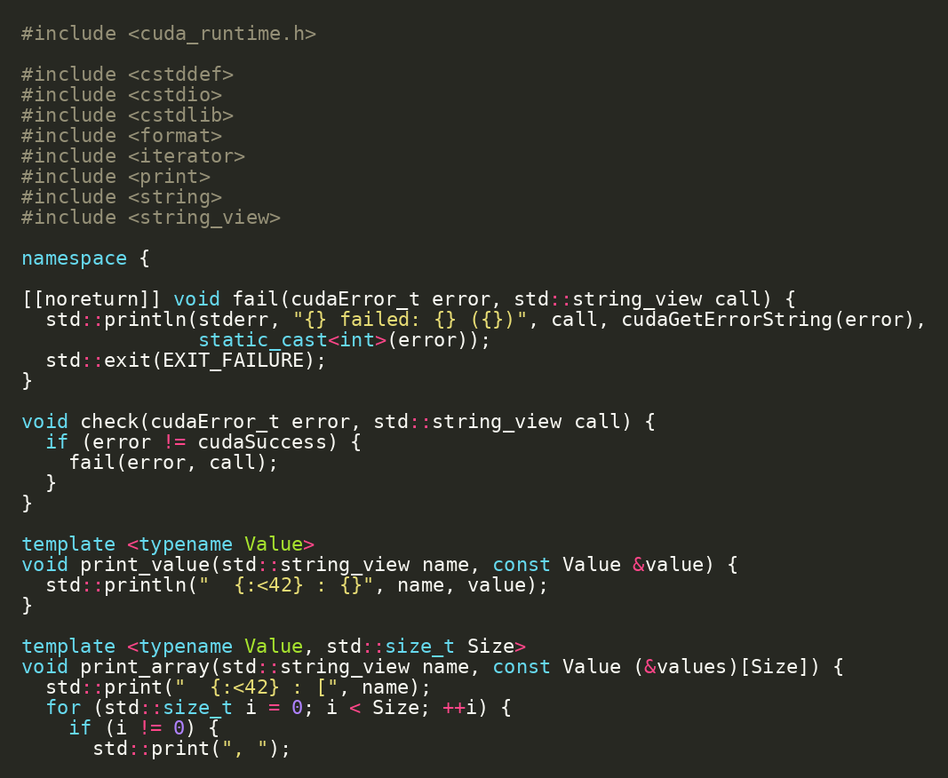
FORMATION / DAY 2 / PACKAGING & DEPLOYMENT
Simple Project as Deployment Specimen
projects/simple is the minimal hermetic CUDA image project
ORIGINAL SOURCE EXCERPT
Small GPU info binary.
CUDA runtime dependency.
OCI target is easy to inspect.
RUN / INSPECT
cd projects/simple
bazel run //src:gpu_info
projects/simple
FORMATION / INDEPENDENT CUDA TRAINING
23/52
Notes:
VISUAL REDESIGN / SOURCE PROVENANCE
Content source: user-supplied Day2_Runtime_Performance_Deployment_JAX_MatMul.pptx, original slide 22.
Original slide order, wording, tables, commands and embedded code excerpts are retained. This is a visual-only redesign, not a technical review or software update.
The code image is the original embedded source excerpt; no code text was edited. Where it is shown in two panes, the same original image is cropped at a blank line without omitting pixels.

Slide 24
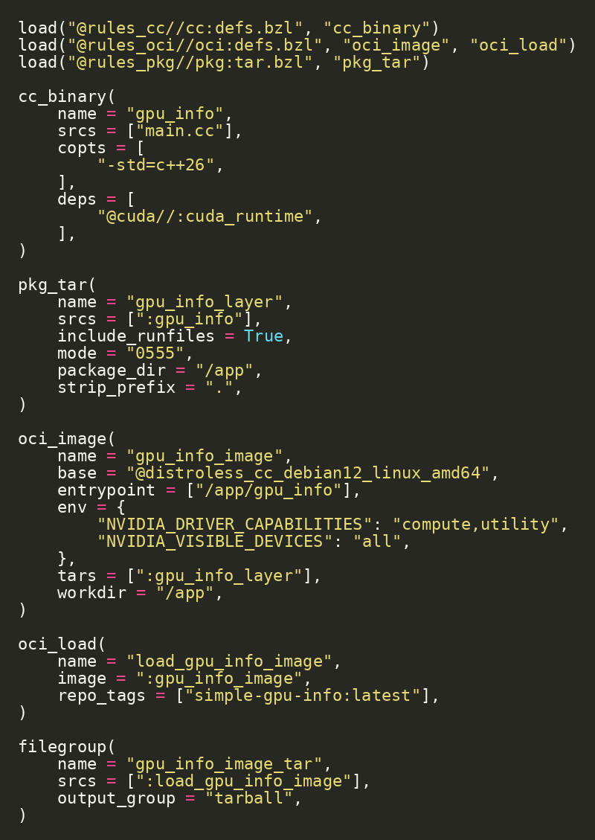
FORMATION / DAY 2 / PACKAGING & DEPLOYMENT
Container Target in Bazel
The image is a Bazel target, not a hand-written Dockerfile
cc_binary builds the app.
pkg_tar packages binary/runfiles.
oci_image creates the image.
oci_load loads it into Docker.
SOURCE EXCERPT
CONTINUED
projects/simple/src/BUILD.bazel | Source: rules_oci
FORMATION / INDEPENDENT CUDA TRAINING
24/52
Notes:
VISUAL REDESIGN / SOURCE PROVENANCE
Content source: user-supplied Day2_Runtime_Performance_Deployment_JAX_MatMul.pptx, original slide 23.
Original slide order, wording, tables, commands and embedded code excerpts are retained. This is a visual-only redesign, not a technical review or software update.
The code image is the original embedded source excerpt; no code text was edited. Where it is shown in two panes, the same original image is cropped at a blank line without omitting pixels.

Slide 25
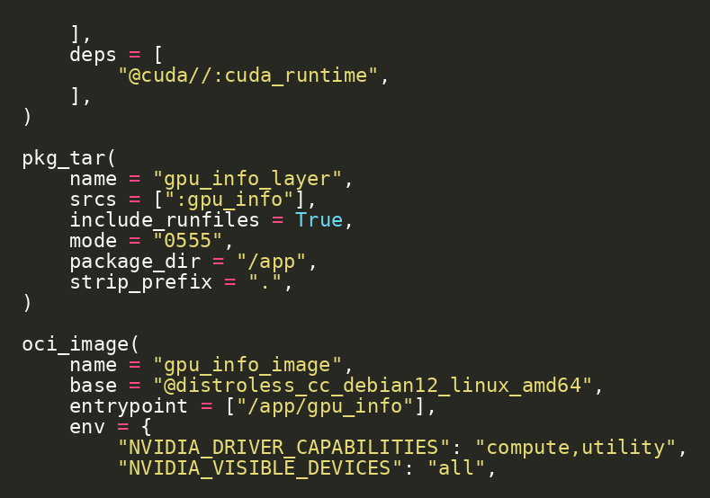
FORMATION / DAY 2 / PACKAGING & DEPLOYMENT
Packaging Runtime Files
Bazel runfiles make runtime shared libraries explicit
ORIGINAL SOURCE EXCERPT
include_runfiles brings runtime dependencies into the layer.
The executable lands under /app.
The container entrypoint points to the packaged binary.
pkg_tar + oci_image
FORMATION / INDEPENDENT CUDA TRAINING
25/52
Notes:
VISUAL REDESIGN / SOURCE PROVENANCE
Content source: user-supplied Day2_Runtime_Performance_Deployment_JAX_MatMul.pptx, original slide 24.
Original slide order, wording, tables, commands and embedded code excerpts are retained. This is a visual-only redesign, not a technical review or software update.
The code image is the original embedded source excerpt; no code text was edited. Where it is shown in two panes, the same original image is cropped at a blank line without omitting pixels.

Slide 26
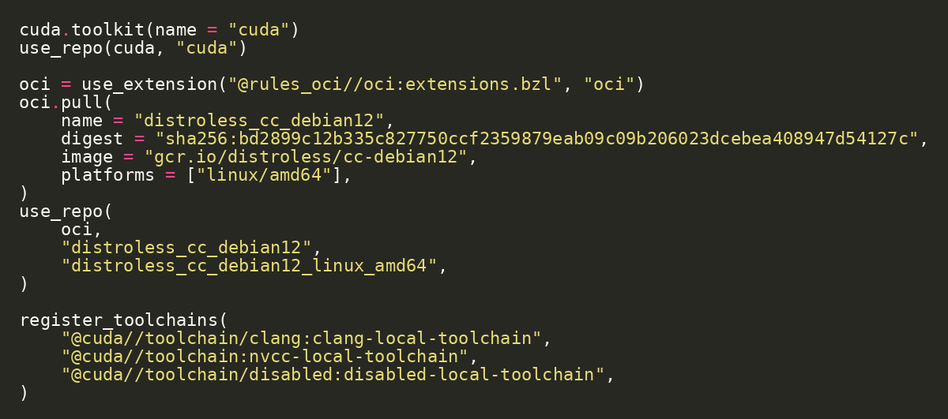
FORMATION / DAY 2 / PACKAGING & DEPLOYMENT
Digest-Pinned Base Image
Container reproducibility includes the base image
ORIGINAL SOURCE EXCERPT
Pin the base image by digest, not only by tag.
This keeps the image input stable over time.
rules_oci pulls the OCI base as a declared repository input.
projects/simple/MODULE.bazel | Source: rules_oci
FORMATION / INDEPENDENT CUDA TRAINING
26/52
Notes:
VISUAL REDESIGN / SOURCE PROVENANCE
Content source: user-supplied Day2_Runtime_Performance_Deployment_JAX_MatMul.pptx, original slide 25.
Original slide order, wording, tables, commands and embedded code excerpts are retained. This is a visual-only redesign, not a technical review or software update.
The code image is the original embedded source excerpt; no code text was edited. Where it is shown in two panes, the same original image is cropped at a blank line without omitting pixels.

Slide 27
FORMATION / DAY 2 / PACKAGING & DEPLOYMENT
Live Demo: Load and Run the Tiny GPU Image
The GPU info tool runs inside a small container
Checkpoint / exercise
RUN / INSPECT
Build and load the OCI image.
cd projects/simple
bazel run //src:load_gpu_info_image
docker run --rm --gpus all simple-gpu-info:latest
Run the image with GPU access.
Confirm the host runtime provides the NVIDIA driver/GPU.
Bazel-built OCI image flow
cc_binary › pkg_tar runfiles › oci_image base digest › oci_load › docker run --gpus all
//src:load_gpu_info_image
FORMATION / INDEPENDENT CUDA TRAINING
27/52
Notes:
VISUAL REDESIGN / SOURCE PROVENANCE
Content source: user-supplied Day2_Runtime_Performance_Deployment_JAX_MatMul.pptx, original slide 26.
Original slide order, wording, tables, commands and embedded code excerpts are retained. This is a visual-only redesign, not a technical review or software update.
Original visual labels (retained as editable text where appropriate, or replaced by the cited NVIDIA figure for illustration):
Bazel-built OCI image flow
cc_binary
pkg_tar
runfiles
oci_image
base digest
oci_load
docker run
--gpus all

Slide 28
FORMATION / DAY 2 / PACKAGING & DEPLOYMENT
Image Size and Artifact
The deployable image is a build artifact and a loaded Docker image
Checkpoint / exercise
RUN / INSPECT
Build the tarball output group.
bazel build //src:gpu_info_image_tar
docker image ls simple-gpu-info:latest
Inspect the Docker image list.
Distinguish Bazel artifact from Docker daemon image.
Bazel-built OCI image flow
cc_binary › pkg_tar runfiles › oci_image base digest › oci_load › docker run --gpus all
bazel-bin/src/load_gpu_info_image/tarball.tar
FORMATION / INDEPENDENT CUDA TRAINING
28/52
Notes:
VISUAL REDESIGN / SOURCE PROVENANCE
Content source: user-supplied Day2_Runtime_Performance_Deployment_JAX_MatMul.pptx, original slide 27.
Original slide order, wording, tables, commands and embedded code excerpts are retained. This is a visual-only redesign, not a technical review or software update.
Original visual labels (retained as editable text where appropriate, or replaced by the cited NVIDIA figure for illustration):
Bazel-built OCI image flow
cc_binary
pkg_tar
runfiles
oci_image
base digest
oci_load
docker run
--gpus all

Slide 29
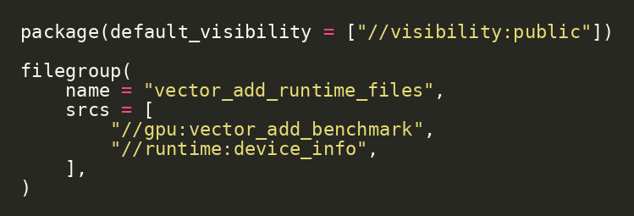
FORMATION / DAY 2 / PACKAGING & DEPLOYMENT
Detailed Deploy Target
Deployment starts by deciding which runtime files belong together
ORIGINAL SOURCE EXCERPT
The detailed project collects benchmark and device-info runtime files.
This can evolve into a full detailed project image target.
Keep deployment explicit.
projects/detailed/deploy/BUILD.bazel
FORMATION / INDEPENDENT CUDA TRAINING
29/52
Notes:
VISUAL REDESIGN / SOURCE PROVENANCE
Content source: user-supplied Day2_Runtime_Performance_Deployment_JAX_MatMul.pptx, original slide 28.
Original slide order, wording, tables, commands and embedded code excerpts are retained. This is a visual-only redesign, not a technical review or software update.
The code image is the original embedded source excerpt; no code text was edited. Where it is shown in two panes, the same original image is cropped at a blank line without omitting pixels.

Slide 30
FORMATION / DAY 2 / PACKAGING & DEPLOYMENT
Remote Build Model
Hermetic targets are the prerequisite for remote build confidence
Remote build model: build and runtime are separate
Local developer invokes Bazel.
01
Developer laptop
Remote executor runs declared actions.
02
Remote executor
Remote cache stores reusable outputs.
03
Remote cache
GPU runtime host remains a separate concern.
04
Artifact
05
GPU runtime host
remote execution concept | Source: Bazel Remote Execution
FORMATION / INDEPENDENT CUDA TRAINING
30/52
Notes:
VISUAL REDESIGN / SOURCE PROVENANCE
Content source: user-supplied Day2_Runtime_Performance_Deployment_JAX_MatMul.pptx, original slide 29.
Original slide order, wording, tables, commands and embedded code excerpts are retained. This is a visual-only redesign, not a technical review or software update.
Original visual labels (retained as editable text where appropriate, or replaced by the cited NVIDIA figure for illustration):
Remote build model: build and runtime are separate
Developer laptop
Remote executor
Remote cache
Artifact
GPU runtime host

Slide 31
FORMATION / DAY 2 / PACKAGING & DEPLOYMENT
What Remote Build Does Not Solve
A remote build machine is not automatically a GPU runtime machine
Remote build model: build and runtime are separate
Build-time CUDA headers/toolchains can be hermetic.
01
Developer laptop
02
Remote executor
Runtime GPU driver and device access are environment-specific.
03
Remote cache
Validate GPU execution on compatible runtime hosts.
04
Artifact
05
GPU runtime host
build machine vs runtime machine | Source: Bazel Remote Execution
FORMATION / INDEPENDENT CUDA TRAINING
31/52
Notes:
VISUAL REDESIGN / SOURCE PROVENANCE
Content source: user-supplied Day2_Runtime_Performance_Deployment_JAX_MatMul.pptx, original slide 30.
Original slide order, wording, tables, commands and embedded code excerpts are retained. This is a visual-only redesign, not a technical review or software update.
Original visual labels (retained as editable text where appropriate, or replaced by the cited NVIDIA figure for illustration):
Remote build model: build and runtime are separate
Developer laptop
Remote executor
Remote cache
Artifact
GPU runtime host

Slide 32
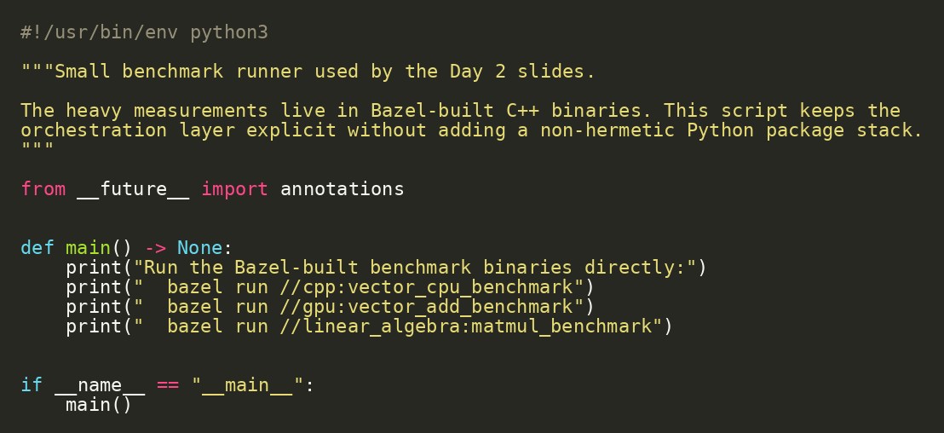
FORMATION / DAY 2 / PYTHON & JAX / XLA
Python Hook: Benchmark Orchestration
Python can orchestrate without owning the heavy compute path
ORIGINAL SOURCE EXCERPT
Python runs Bazel-built binaries.
The compute path stays in C++/CUDA.
This keeps measurement automation lightweight.
RUN / INSPECT
bazel run //python:benchmark
projects/detailed/python/benchmark.py
FORMATION / INDEPENDENT CUDA TRAINING
32/52
Notes:
VISUAL REDESIGN / SOURCE PROVENANCE
Content source: user-supplied Day2_Runtime_Performance_Deployment_JAX_MatMul.pptx, original slide 31.
Original slide order, wording, tables, commands and embedded code excerpts are retained. This is a visual-only redesign, not a technical review or software update.
The code image is the original embedded source excerpt; no code text was edited. Where it is shown in two panes, the same original image is cropped at a blank line without omitting pixels.

Slide 33
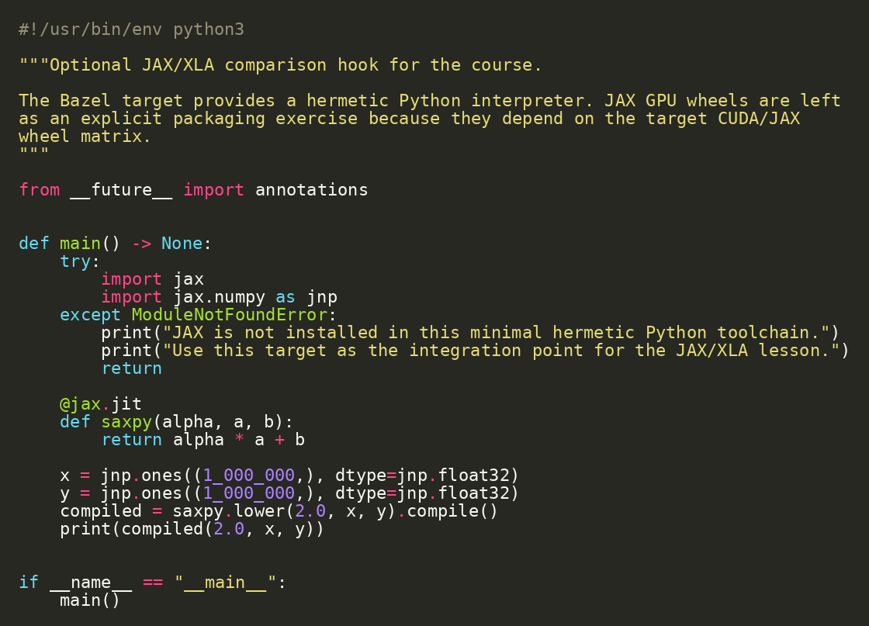
FORMATION / DAY 2 / PYTHON & JAX / XLA
JAX/XLA Comparison Hook
JAX expresses computation and lets the compiler lower it
ORIGINAL SOURCE EXCERPT
jax.jit traces a Python function.
lower() exposes the lowered form.
compile() produces an executable for a target backend.
RUN / INSPECT
bazel run //python:jax_xla_demo
projects/detailed/python/jax_xla_demo.py | Source: JAX AOT lowering and compilation
FORMATION / INDEPENDENT CUDA TRAINING
33/52
Notes:
VISUAL REDESIGN / SOURCE PROVENANCE
Content source: user-supplied Day2_Runtime_Performance_Deployment_JAX_MatMul.pptx, original slide 32.
Original slide order, wording, tables, commands and embedded code excerpts are retained. This is a visual-only redesign, not a technical review or software update.
The code image is the original embedded source excerpt; no code text was edited. Where it is shown in two panes, the same original image is cropped at a blank line without omitting pixels.

Slide 34
FORMATION / DAY 2 / PYTHON & JAX / XLA
Manual CUDA vs JAX/XLA
Manual CUDA exposes control; JAX exposes compiler-managed array programs
JAX/XLA high-level compiler path
Manual CUDA: explicit memory, launch geometry, and runtime calls.
01
Python function
02
jax.jit
JAX/XLA: array semantics, tracing, lowering, and compilation.
03
lower() · StableHLO
This is a layer comparison, not a winner-take-all decision.
04
compile() · executable
05
run on CPU/GPU
gpu/vector_add_device.cu vs python/jax_xla_demo.py | Source: JAX AOT lowering and compilation
FORMATION / INDEPENDENT CUDA TRAINING
34/52
Notes:
VISUAL REDESIGN / SOURCE PROVENANCE
Content source: user-supplied Day2_Runtime_Performance_Deployment_JAX_MatMul.pptx, original slide 33.
Original slide order, wording, tables, commands and embedded code excerpts are retained. This is a visual-only redesign, not a technical review or software update.
Original visual labels (retained as editable text where appropriate, or replaced by the cited NVIDIA figure for illustration):
JAX/XLA high-level compiler path
Python function
jax.jit
lower()
StableHLO
compile()
executable
run on CPU/GPU

Slide 35
FORMATION / DAY 2 / MATMUL & DATA REUSE
Transition to MatMul
Vector add teaches mechanics; MatMul teaches reuse and hierarchy
Matrix multiply: one output cell is a dot product
Vector add is memory-bound and simple.
A[M,K] B[K,N] C[M,N]
MatMul reuses rows and columns.
The linear algebra module is separate by design.
C[row,col] = sum_k A[row,k] * B[k,col]
projects/detailed/linear_algebra
FORMATION / INDEPENDENT CUDA TRAINING
35/52
Notes:
VISUAL REDESIGN / SOURCE PROVENANCE
Content source: user-supplied Day2_Runtime_Performance_Deployment_JAX_MatMul.pptx, original slide 34.
Original slide order, wording, tables, commands and embedded code excerpts are retained. This is a visual-only redesign, not a technical review or software update.
Original visual labels (retained as editable text where appropriate, or replaced by the cited NVIDIA figure for illustration):
Matrix multiply: one output cell is a dot product
A[M,K]
B[K,N]
C[M,N]
C[row,col] = sum_k A[row,k] * B[k,col]

Slide 36
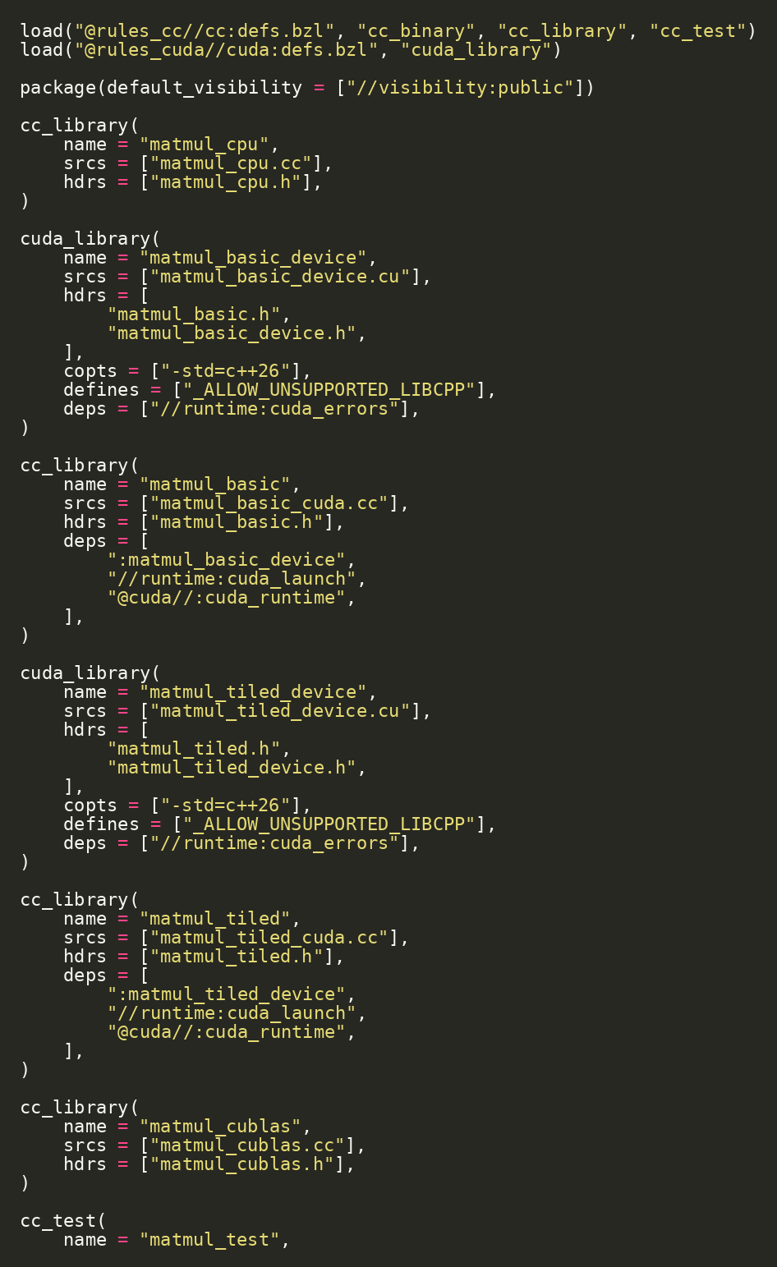
FORMATION / DAY 2 / MATMUL & DATA REUSE
Linear Algebra Module Map
MatMul has a CPU oracle and two CUDA implementations
CPU MatMul oracle.
Basic CUDA one-thread-per-output kernel.
Tiled CUDA shared-memory kernel.
Test and benchmark targets.
SOURCE EXCERPT
CONTINUED
projects/detailed/linear_algebra/BUILD.bazel
FORMATION / INDEPENDENT CUDA TRAINING
36/52
Notes:
VISUAL REDESIGN / SOURCE PROVENANCE
Content source: user-supplied Day2_Runtime_Performance_Deployment_JAX_MatMul.pptx, original slide 35.
Original slide order, wording, tables, commands and embedded code excerpts are retained. This is a visual-only redesign, not a technical review or software update.
The code image is the original embedded source excerpt; no code text was edited. Where it is shown in two panes, the same original image is cropped at a blank line without omitting pixels.

Slide 37
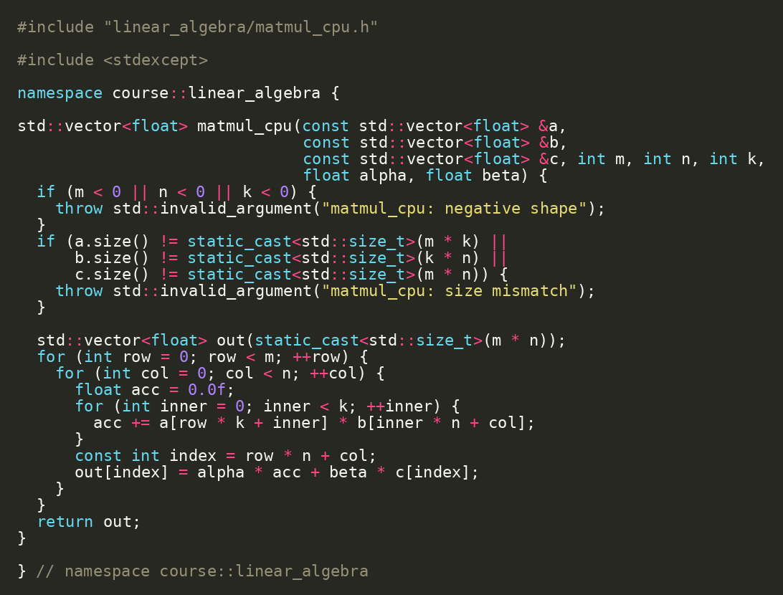
FORMATION / DAY 2 / MATMUL & DATA REUSE
CPU MatMul Oracle
Even MatMul starts with CPU correctness
ORIGINAL SOURCE EXCERPT
Nested loops over M, N, and K.
Defines exact semantics for small test sizes.
Used by matmul_test before benchmark interpretation.
RUN / INSPECT
bazel test //linear_algebra:matmul_test
linear_algebra/matmul_cpu.cc
FORMATION / INDEPENDENT CUDA TRAINING
37/52
Notes:
VISUAL REDESIGN / SOURCE PROVENANCE
Content source: user-supplied Day2_Runtime_Performance_Deployment_JAX_MatMul.pptx, original slide 36.
Original slide order, wording, tables, commands and embedded code excerpts are retained. This is a visual-only redesign, not a technical review or software update.
The code image is the original embedded source excerpt; no code text was edited. Where it is shown in two panes, the same original image is cropped at a blank line without omitting pixels.

Slide 38
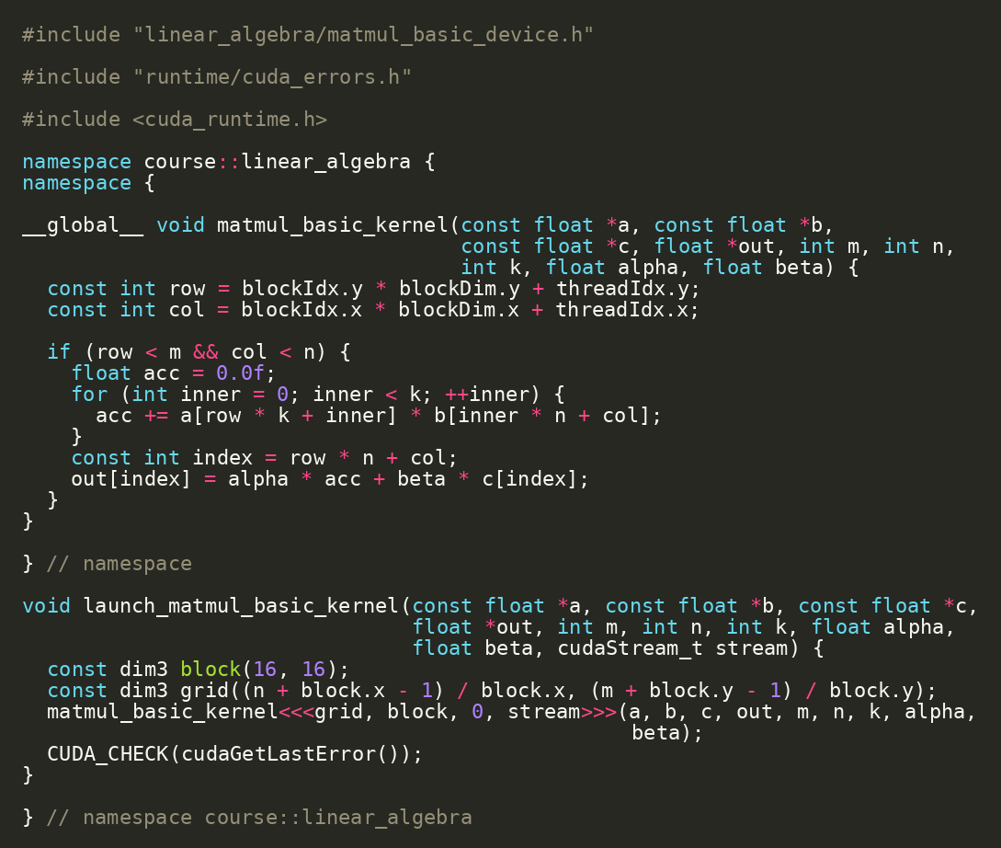
FORMATION / DAY 2 / MATMUL & DATA REUSE
Basic CUDA MatMul
One thread computes one output element
ORIGINAL SOURCE EXCERPT
Map 2D thread coordinates to row and column.
Each thread loops over K.
Correct and parallel, but global-memory reuse is poor.
linear_algebra/matmul_basic_device.cu | Source: CUDA C++ Programming Guide
FORMATION / INDEPENDENT CUDA TRAINING
38/52
Notes:
VISUAL REDESIGN / SOURCE PROVENANCE
Content source: user-supplied Day2_Runtime_Performance_Deployment_JAX_MatMul.pptx, original slide 37.
Original slide order, wording, tables, commands and embedded code excerpts are retained. This is a visual-only redesign, not a technical review or software update.
The code image is the original embedded source excerpt; no code text was edited. Where it is shown in two panes, the same original image is cropped at a blank line without omitting pixels.

Slide 39
FORMATION / DAY 2 / MATMUL & DATA REUSE
Why Basic MatMul Leaves Performance Behind
Re-reading global memory wastes bandwidth
Basic MatMul: correct, parallel, but poor reuse
Neighboring threads repeatedly read overlapping A/B data.
Thread C[0,0]
reads A row 0
reads B col 0
Thread C[0,1]
reads A row 0
again
reads B col 1
Memory bandwidth becomes the limit.
This motivates shared-memory tiling.
Neighbor threads repeat global reads for overlapping data
matmul_basic_device.cu | Source: CUDA C++ Best Practices Guide
FORMATION / INDEPENDENT CUDA TRAINING
39/52
Notes:
VISUAL REDESIGN / SOURCE PROVENANCE
Content source: user-supplied Day2_Runtime_Performance_Deployment_JAX_MatMul.pptx, original slide 38.
Original slide order, wording, tables, commands and embedded code excerpts are retained. This is a visual-only redesign, not a technical review or software update.
Original visual labels (retained as editable text where appropriate, or replaced by the cited NVIDIA figure for illustration):
Basic MatMul: correct, parallel, but poor reuse
Thread C[0,0]
reads A row 0
reads B col 0
Thread C[0,1]
reads A row 0
again
reads B col 1
Neighbor threads repeat global reads for overlapping data

Slide 40
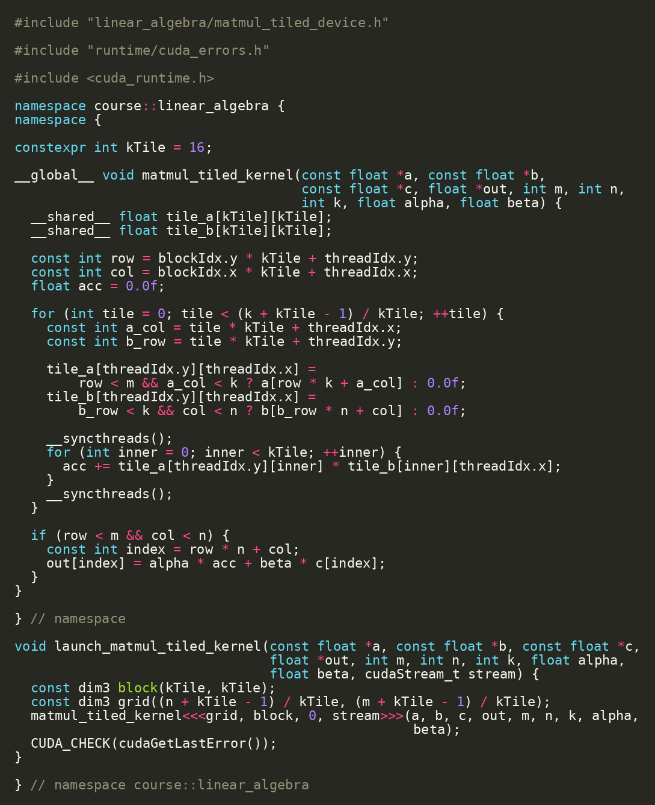
FORMATION / DAY 2 / MATMUL & DATA REUSE
Tiled MatMul
Shared memory lets a block reuse tiles of A and B
Threads cooperatively load A and B tiles.
__syncthreads() creates a block barrier.
Each tile is reused across multiple multiply-adds.
SOURCE EXCERPT
CONTINUED
linear_algebra/matmul_tiled_device.cu | Source: CUDA C++ Best Practices Guide
FORMATION / INDEPENDENT CUDA TRAINING
40/52
Notes:
VISUAL REDESIGN / SOURCE PROVENANCE
Content source: user-supplied Day2_Runtime_Performance_Deployment_JAX_MatMul.pptx, original slide 39.
Original slide order, wording, tables, commands and embedded code excerpts are retained. This is a visual-only redesign, not a technical review or software update.
The code image is the original embedded source excerpt; no code text was edited. Where it is shown in two panes, the same original image is cropped at a blank line without omitting pixels.

Slide 41
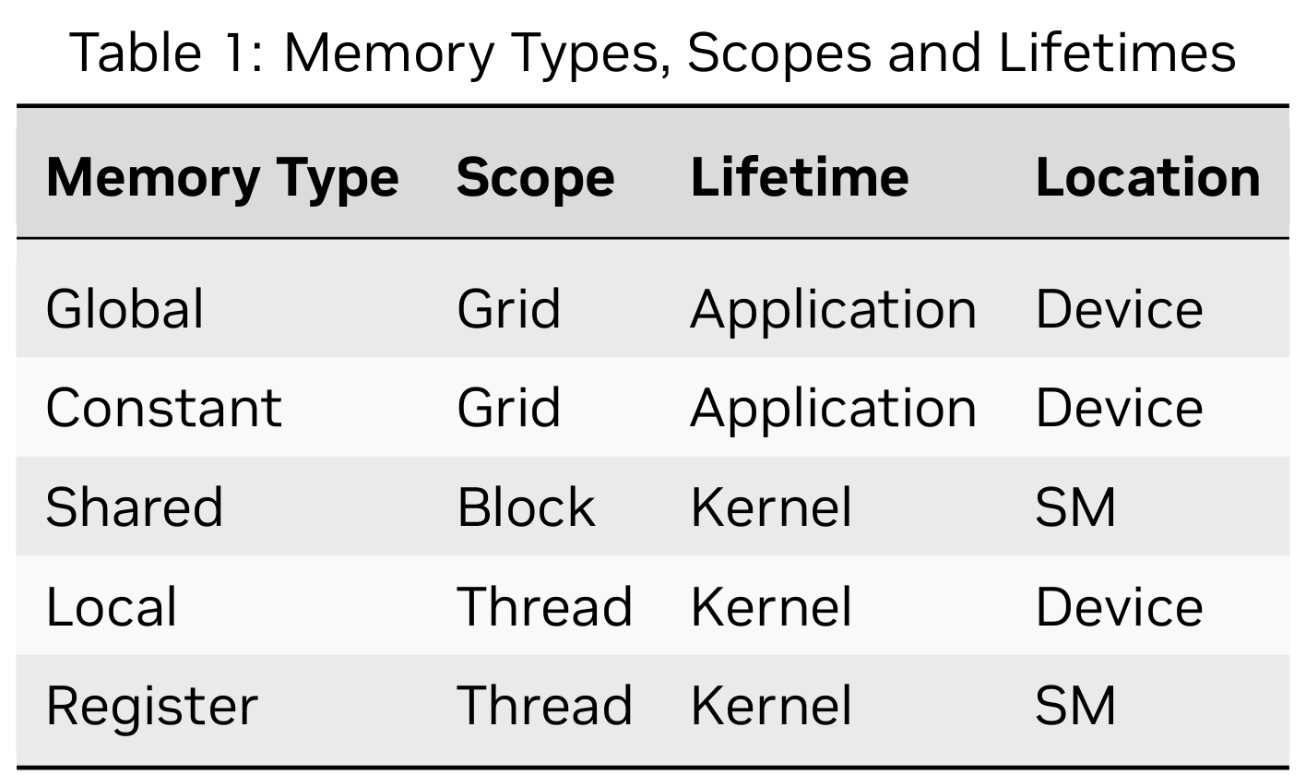
FORMATION / DAY 2 / MATMUL & DATA REUSE
Shared Memory Mental Model
Shared memory is per-block scratchpad with explicit cooperation
Scope: one thread block.
Global A tile
Global B tile
Lifetime: one kernel block execution.
Shared memory
A_s tile + B_s tile
__syncthreads()
Use: cooperative data reuse.
Cost: limited capacity and synchronization constraints.
Registers
accumulate C tile
__shared__ + __syncthreads | Source: CUDA C++ Programming Guide
FORMATION / INDEPENDENT CUDA TRAINING
41/52
Notes:
SOURCE SLIDE: Original Day 2 slide 40 — Shared Memory Mental Model.
The original four explanations and original course diagram labels are retained as editable text.
NVIDIA Table 1 has moved to the next dedicated memory-spaces reference slide. The source course labels Global A tile, Global B tile, Shared memory, A_s tile + B_s tile, __syncthreads(), Registers, and accumulate C tile remain here.
The following two optional explanation slides use NVIDIA Figures 15 and 16; they do not assert a specific bank-access pattern or measured performance for this course’s MatMul implementation.
No original code or source claims changed.

Slide 42
FORMATION / DAY 2 / MATMUL & DATA REUSE / VISUAL EXPLANATION
Memory Types, Scopes and Lifetimes
Memory scope and physical location are different properties.
GLOBAL MEMORY
Storage persists until freed or the application terminates.
SHARED MEMORY
Block-scoped scratchpad for cooperative work.
LOCAL ≠ ON-CHIP
“Local” means thread scope. The table places local memory on the device, not the SM.
NVIDIA Table 1 | Guide p. 49 / PDF p. 67 | CUDA Programming Guide 13.4.2
FORMATION / INDEPENDENT CUDA TRAINING
42/52
Notes:
ADDED VISUAL EXPLANATION
Inserted after original Day 2 slide 40. The original course slides remain in their original relative sequence. No original code, commands, exercises, or benchmark values are changed.
SOURCE
User-supplied cuda-programming-guide.pdf, CUDA Programming Guide, Release 13.4.2, September 10, 2026.
Table 1, physical PDF page 67, printed page 49; original caption and table cropped at PDF coordinates [188,353,424,493], rendered at 432 dpi. Explanatory text draws on §2.3.3.1–2.3.3.4, printed pages 49–53.
https://docs.nvidia.com/cuda/cuda-programming-guide/
Original PDF figure image(s), proportionally resized; native labels and colors retained. No redrawing or generated illustration.
PRESENTER NOTES
Read the columns separately: memory type, scope, lifetime, and location. Preserve NVIDIA’s summary wording rather than silently rewriting the table. Explain shared memory in terms of a block execution, as the existing preceding course slide does. The memory table is a reference summary, not a MatMul data-flow figure. The phrase “Local ≠ on-chip” paraphrases the guide’s local-memory section: local refers to logical thread scope rather than physical placement. Return to the A/B tiles and register accumulator in the existing course.
PACING
Allow approximately two minutes; focus on reading the figure rather than introducing a new lab.
SCOPE
New explanatory text paraphrases the cited guide. Course-connection examples are identified in the notes as instructional applications, not new measurements or claims of validated repository behavior.

Slide 43
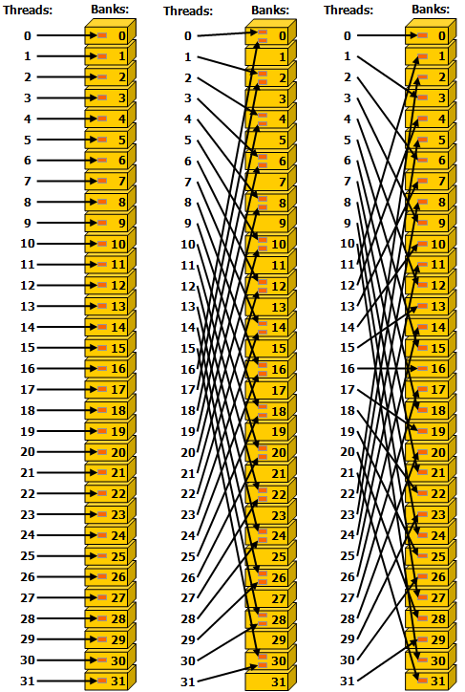
FORMATION / DAY 2 / MATMUL & DATA REUSE / VISUAL EXPLANATION
Shared-Memory Accesses Can Conflict
Different words in the same bank can serialize a warp’s access.
LEFT / STRIDE 1
Successive 32-bit words: no bank conflict.
MIDDLE / STRIDE 2
Different words reuse banks: two-way conflicts.
RIGHT / STRIDE 3
The illustrated pattern is conflict-free despite its stride.
Read the exact addresses—not just the word “strided”.
OPTIONAL EXPLANATION
NVIDIA Fig. 15 | Guide p. 63 / PDF p. 81 | CUDA Programming Guide 13.4.2
FORMATION / INDEPENDENT CUDA TRAINING
43/52
Notes:
ADDED VISUAL EXPLANATION
Inserted after original Day 2 slide 40. The original course slides remain in their original relative sequence. No original code, commands, exercises, or benchmark values are changed.
SOURCE
User-supplied cuda-programming-guide.pdf, CUDA Programming Guide, Release 13.4.2, September 10, 2026.
Figure 15, physical PDF page 81, printed page 63; original image xref 1224. §2.3.4.2, printed page 62.
https://docs.nvidia.com/cuda/cuda-programming-guide/
Original PDF figure image(s), proportionally resized; native labels and colors retained. No redrawing or generated illustration.
PRESENTER NOTES
This is optional supporting material for the existing shared-memory discussion, not a new lab. Present the guide’s 32-bit bank-mode example panel by panel. The key distinction is different words mapped to the same bank. Do not claim every strided access conflicts: the original figure explicitly labels stride three as conflict-free. Do not infer that the course’s tiled MatMul has the same conflict pattern; that requires analysis of its actual accesses. Transition to the following slide’s same-word read exception.
PACING
Optional two-minute explanation; omit in a shorter session.
SCOPE
New explanatory text paraphrases the cited guide. Course-connection examples are identified in the notes as instructional applications, not new measurements or claims of validated repository behavior.

Slide 44
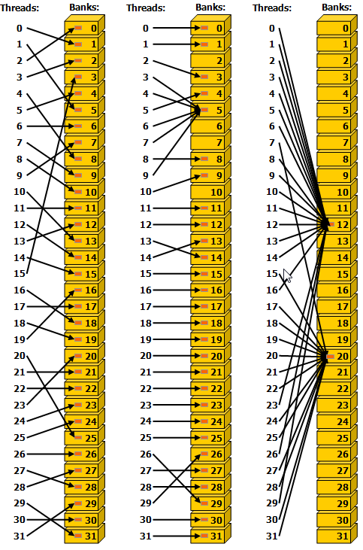
FORMATION / DAY 2 / MATMUL & DATA REUSE / VISUAL EXPLANATION
Same-Word Reads Can Use Broadcast
Several readers of one shared-memory word are not the same as a bank conflict.
LEFT / PERMUTATION
Irregular addressing can still be conflict-free.
MIDDLE / SHARED WORD
Several requesting threads read the same word in bank 5.
RIGHT / BROADCAST
All requesting threads read one word. The read can be broadcast.
This figure explains reads, not safe concurrent writes.
OPTIONAL EXPLANATION
NVIDIA Fig. 16 | Guide p. 64 / PDF p. 82 | CUDA Programming Guide 13.4.2
FORMATION / INDEPENDENT CUDA TRAINING
44/52
Notes:
ADDED VISUAL EXPLANATION
Inserted after original Day 2 slide 40. The original course slides remain in their original relative sequence. No original code, commands, exercises, or benchmark values are changed.
SOURCE
User-supplied cuda-programming-guide.pdf, CUDA Programming Guide, Release 13.4.2, September 10, 2026.
Figure 16, physical PDF page 82, printed page 64; original image xref 1229. §2.3.4.2, printed page 62.
https://docs.nvidia.com/cuda/cuda-programming-guide/
Original PDF figure image(s), proportionally resized; native labels and colors retained. No redrawing or generated illustration.
PRESENTER NOTES
Contrast this figure with the preceding bank-conflict example. NVIDIA identifies all three panels as conflict-free reads. In the middle panel, threads 3, 4, 6, 7 and 9 request the same word in bank 5; the right panel is broadcast. This is a read-access behavior, not permission for unsynchronized concurrent writes. Reconnect to cooperative reuse in MatMul without asserting a measured speedup or an exact correspondence with the pictured access pattern.
PACING
Optional two-minute explanation; omit in a shorter session.
SCOPE
New explanatory text paraphrases the cited guide. Course-connection examples are identified in the notes as instructional applications, not new measurements or claims of validated repository behavior.

Slide 45
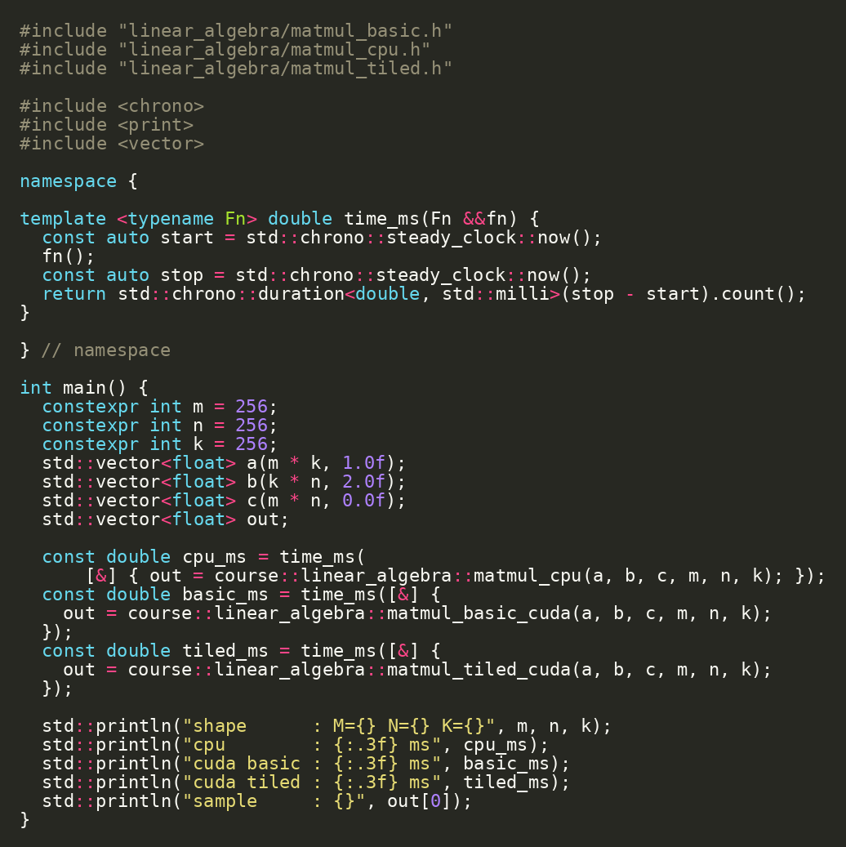
FORMATION / DAY 2 / MATMUL & DATA REUSE
MatMul Benchmark
The benchmark shows the ladder: CPU, basic CUDA, tiled CUDA
ORIGINAL SOURCE EXCERPT
Use small enough sizes for lab turnaround.
Record correctness and timing.
Interpret tiled performance through reuse, not just thread count.
RUN / INSPECT
bazel run //linear_algebra:matmul_benchmark
linear_algebra/matmul_benchmark.cc
FORMATION / INDEPENDENT CUDA TRAINING
45/52
Notes:
VISUAL REDESIGN / SOURCE PROVENANCE
Content source: user-supplied Day2_Runtime_Performance_Deployment_JAX_MatMul.pptx, original slide 41.
Original slide order, wording, tables, commands and embedded code excerpts are retained. This is a visual-only redesign, not a technical review or software update.
The code image is the original embedded source excerpt; no code text was edited. Where it is shown in two panes, the same original image is cropped at a blank line without omitting pixels.

Slide 46
FORMATION / DAY 2 / MATMUL & DATA REUSE
Lab 3: Fill the Benchmark Results Table
Runs become a small performance report
Checkpoint / exercise
RUN / INSPECT
Open docs/benchmark_results.md.
bazel run //gpu:vector_add_benchmark
bazel run //linear_algebra:matmul_benchmark
Run vector-add benchmark.
Run MatMul benchmark.
Record CPU serial, CPU threaded, CUDA vector add, MatMul CPU, MatMul basic, MatMul tiled.
Production GEMM ladder
CPU oracle › basic CUDA › tiled CUDA › cuBLAS/cuBLASLt › CUTLASS/CuTe › JAX/Triton
projects/detailed/docs/benchmark_results.md
FORMATION / INDEPENDENT CUDA TRAINING
46/52
Notes:
VISUAL REDESIGN / SOURCE PROVENANCE
Content source: user-supplied Day2_Runtime_Performance_Deployment_JAX_MatMul.pptx, original slide 42.
Original slide order, wording, tables, commands and embedded code excerpts are retained. This is a visual-only redesign, not a technical review or software update.
Original visual labels (retained as editable text where appropriate, or replaced by the cited NVIDIA figure for illustration):
Production GEMM ladder
CPU oracle
basic CUDA
tiled CUDA
cuBLAS/cuBLASLt
CUTLASS/CuTe
JAX/Triton

Slide 47
FORMATION / DAY 2 / MATMUL & DATA REUSE
Production GEMM: Why Libraries Exist
Real GEMM performance is a library engineering problem
Production GEMM ladder
Basic kernels teach the machine.
01
CPU oracle
Tiled kernels teach data reuse.
02
basic CUDA
tiled CUDA
cuBLAS/cuBLASLt define production baselines.
03
04
cuBLAS/cuBLASLt
CUTLASS/CuTe show production-style customizable GEMM.
05
CUTLASS/CuTe
06
JAX/Triton
linear_algebra/matmul_cublas.cc hook | Source: cuBLAS/cuBLASLt + CUTLASS docs
FORMATION / INDEPENDENT CUDA TRAINING
47/52
Notes:
VISUAL REDESIGN / SOURCE PROVENANCE
Content source: user-supplied Day2_Runtime_Performance_Deployment_JAX_MatMul.pptx, original slide 43.
Original slide order, wording, tables, commands and embedded code excerpts are retained. This is a visual-only redesign, not a technical review or software update.
Original visual labels (retained as editable text where appropriate, or replaced by the cited NVIDIA figure for illustration):
Production GEMM ladder
CPU oracle
basic CUDA
tiled CUDA
cuBLAS/cuBLASLt
CUTLASS/CuTe
JAX/Triton

Slide 48
FORMATION / DAY 2 / INTEGRATION & CAPSTONE
Choosing the Right Level of CUDA
Use the lowest level only when the control is worth it
Custom CUDA C++ kernel: maximum control.
More control
More productivity
Thrust/CUB: reusable parallel primitives.
custom CUDA
explicit memory
kernel launch
debug lower level
Thrust/CUB
cuBLAS/cuDNN
JAX/XLA
PyTorch / TF / MLIR
cuBLAS/cuDNN: production libraries.
JAX/XLA and frameworks: high-level compiler-managed math.
alternatives and complements
FORMATION / INDEPENDENT CUDA TRAINING
48/52
Notes:
VISUAL REDESIGN / SOURCE PROVENANCE
Content source: user-supplied Day2_Runtime_Performance_Deployment_JAX_MatMul.pptx, original slide 44.
Original slide order, wording, tables, commands and embedded code excerpts are retained. This is a visual-only redesign, not a technical review or software update.

Slide 49
FORMATION / DAY 2 / INTEGRATION & CAPSTONE
Final End-to-End Demo
The complete project can build, test, benchmark, and package
Checkpoint / exercise
RUN / INSPECT
Run all tests.
cd projects/detailed
bazel test //...
bazel run //gpu:vector_add_benchmark
bazel run //linear_algebra:matmul_benchmark
cd ../simple
bazel run //src:load_gpu_info_image
docker run --rm --gpus all simple-gpu-info:latest
Run vector-add and MatMul benchmarks.
Load the simple GPU info image.
Run the image with GPU access.
End-to-end course payoff
build › test › benchmark › package › run container › compare JAX/MatMul
projects/detailed + projects/simple
FORMATION / INDEPENDENT CUDA TRAINING
49/52
Notes:
VISUAL REDESIGN / SOURCE PROVENANCE
Content source: user-supplied Day2_Runtime_Performance_Deployment_JAX_MatMul.pptx, original slide 45.
Original slide order, wording, tables, commands and embedded code excerpts are retained. This is a visual-only redesign, not a technical review or software update.
Original visual labels (retained as editable text where appropriate, or replaced by the cited NVIDIA figure for illustration):
End-to-end course payoff
build
test
benchmark
package
run container
compare JAX/MatMul

Slide 50
FORMATION / DAY 2 / INTEGRATION & CAPSTONE
What to Reuse in Your Own Project
The reusable assets are patterns, not only files
projects/detailed repository map
Hermetic toolchain declaration.
cpp/
CPU oracle + threaded baseline
CPU oracle + test.
gpu/
CUDA API + host wrapper + device kernel
CUDA host/device split.
runtime/
CUDA helpers: device info, errors, events
Error checking helpers.
Benchmark target.
python/
Benchmark orchestrator + JAX/XLA hook
Container target.
deploy/
Bazel runtime file aggregation
Results worksheet.
linear_algebra/
MatMul module: CPU/basic/tiled
copy patterns, not only source files
FORMATION / INDEPENDENT CUDA TRAINING
50/52
Notes:
VISUAL REDESIGN / SOURCE PROVENANCE
Content source: user-supplied Day2_Runtime_Performance_Deployment_JAX_MatMul.pptx, original slide 46.
Original slide order, wording, tables, commands and embedded code excerpts are retained. This is a visual-only redesign, not a technical review or software update.
Original visual labels (retained as editable text where appropriate, or replaced by the cited NVIDIA figure for illustration):
projects/detailed repository map
cpp/ | CPU oracle + threaded baseline
gpu/ | CUDA API + host wrapper + device kernel
runtime/ | CUDA helpers: device info, errors, events
python/ | Benchmark orchestrator + JAX/XLA hook
deploy/ | Bazel runtime file aggregation
linear_algebra/ | MatMul module: CPU/basic/tiled

Slide 51
FORMATION / DAY 2 / INTEGRATION & CAPSTONE
Capstone Exercise
Extend the repository without changing its architecture
Checkpoint / exercise
RUN / INSPECT
Option 1: add a scalar multiply CUDA operation.
bazel test //...
bazel run //gpu:vector_add_benchmark
Option 2: add stream design notes to vector add.
Option 3: add an OCI image target for detailed benchmark files.
Bazel target graph
Option 4: add a benchmark row and explain it.
vector_cpu
benchmark
vector_add
device_lib
runtime
capstone extension
FORMATION / INDEPENDENT CUDA TRAINING
51/52
Notes:
VISUAL REDESIGN / SOURCE PROVENANCE
Content source: user-supplied Day2_Runtime_Performance_Deployment_JAX_MatMul.pptx, original slide 47.
Original slide order, wording, tables, commands and embedded code excerpts are retained. This is a visual-only redesign, not a technical review or software update.

Slide 52
FORMATION / DAY 2 / INTEGRATION & CAPSTONE
Closing: From Installed SDK to Reproducible GPU Project
The course goal is a reproducible GPU engineering workflow
Repository declares the build.
End-to-end course payoff
CPU verifies CUDA.
01
build
Benchmarks explain tradeoffs.
test
02
Containers package runtime.
03
benchmark
JAX/XLA and libraries provide higher-level options.
04
package
05
run container
06
compare JAX/MatMul
//runtime:device_info, //gpu:vector_add_test, //gpu:vector_add_benchmark, //linear_algebra:matmul_benchmark, //src:load_gpu_info_image
FORMATION / INDEPENDENT CUDA TRAINING
52/52
Notes:
VISUAL REDESIGN / SOURCE PROVENANCE
Content source: user-supplied Day2_Runtime_Performance_Deployment_JAX_MatMul.pptx, original slide 48.
Original slide order, wording, tables, commands and embedded code excerpts are retained. This is a visual-only redesign, not a technical review or software update.
Original visual labels (retained as editable text where appropriate, or replaced by the cited NVIDIA figure for illustration):
End-to-end course payoff
build
test
benchmark
package
run container
compare JAX/MatMul

