Slide 1
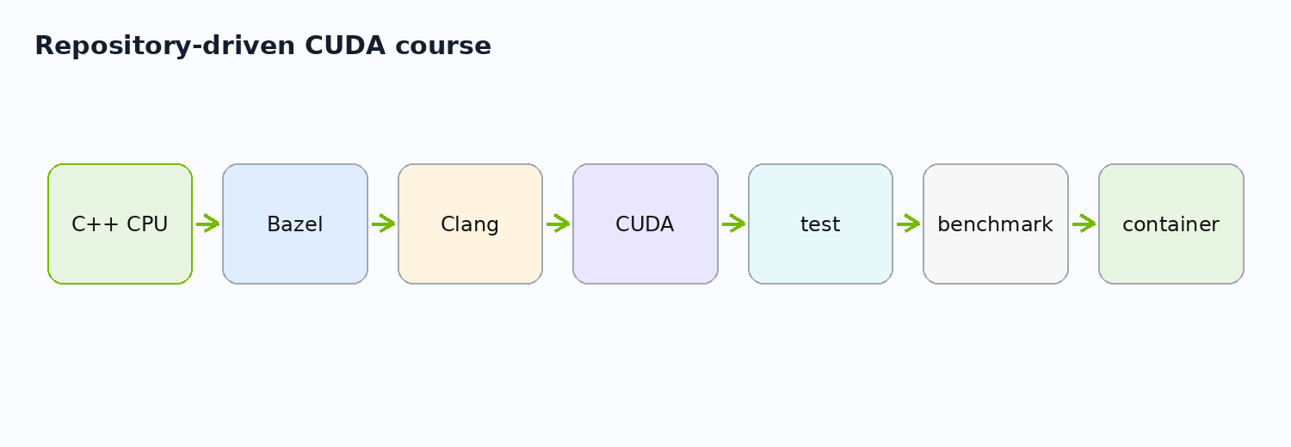
Parallel Programming in Modern C++ with CUDA, Bazel, and Clang
Day 1 - Repository foundation and first CUDA feature
Core operation: out[i] = alpha * a[i] + b[i]
Project path: projects/
Repository-driven CUDA/Bazel course

Slide 2
Why This Course Was Reworked
02/46
From machine-specific IDE setup to reproducible GPU engineering
Old course: Visual Studio project files, local CUDA SDK assumptions, debugger-first flow.
New course: Bazel target graph, hermetic Clang/CUDA, tests, benchmarks, deployable artifacts.
Editor choice remains flexible; the repository defines the build.
Old flow
New flow
Visual Studio project
manual CUDA SDK install
local machine settings
debugger-first flow
Bazel target graph
hermetic Clang/CUDA
tests + benchmarks
artifact packaging
source.md -> reworked.md | Source: Bazel Hermeticity

Slide 3
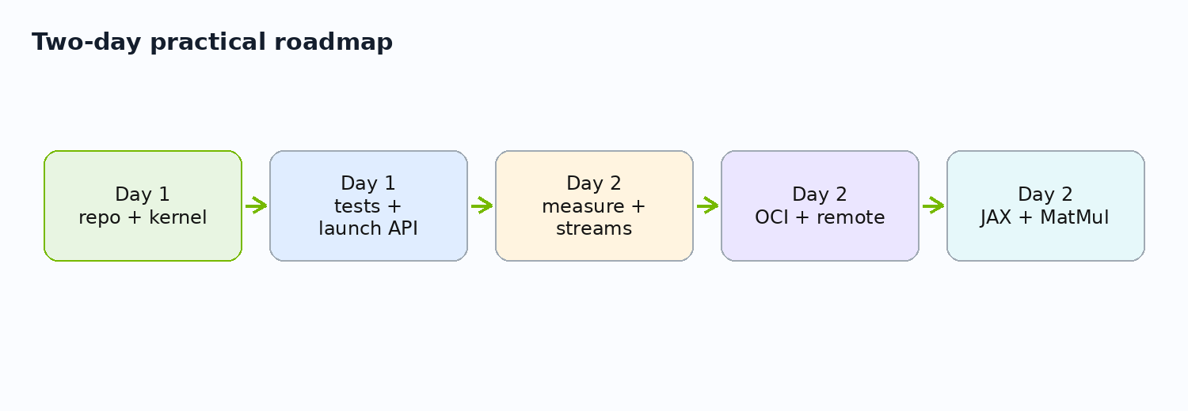
Two-Day Roadmap
03/46
Day 1 builds; Day 2 measures, packages, compares
Day 1: GPU model, Bazel, Clang/CUDA, CPU oracle, first kernel, launch APIs, tests.
Day 2: runtime measurement, streams, OCI packaging, remote build model, JAX/XLA, MatMul.
Each block reconnects to a runnable Bazel target.
targets: //runtime:device_info, //cpp:vector_cpu_test, //gpu:vector_add_test

Slide 4
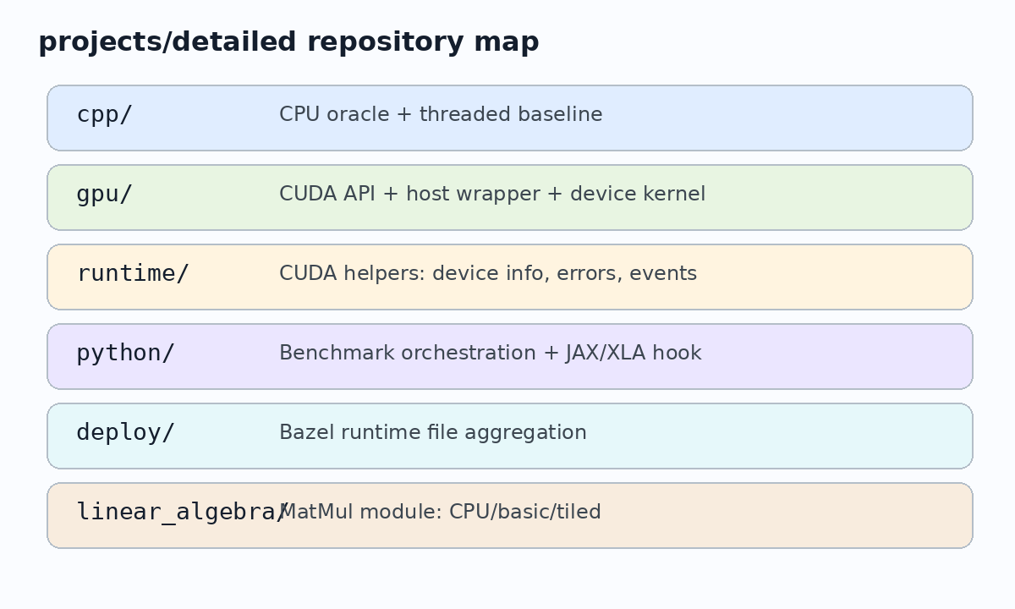
Final Repository Shape
04/46
The repository is organized by learning responsibility
projects/simple: tiny GPU info + OCI image path.
projects/detailed: full CPU/CUDA/runtime/python/deploy/linear algebra project.
The deck follows the actual files and targets.
projects/detailed

Slide 5
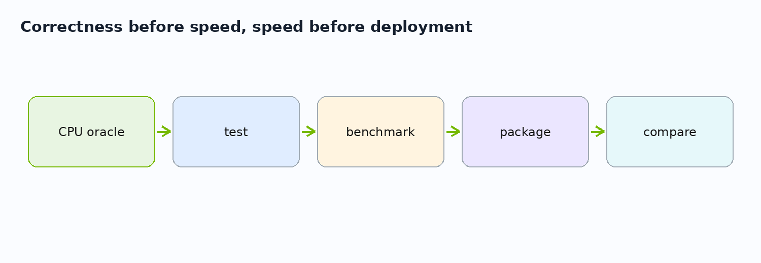
Learning Contract
05/46
Correctness first, performance second, packaging third
CPU oracle before CUDA.
Test before benchmark.
Build graph before deployment.
Avoid fast wrong code by making verification a target.
bazel test //...

Slide 6
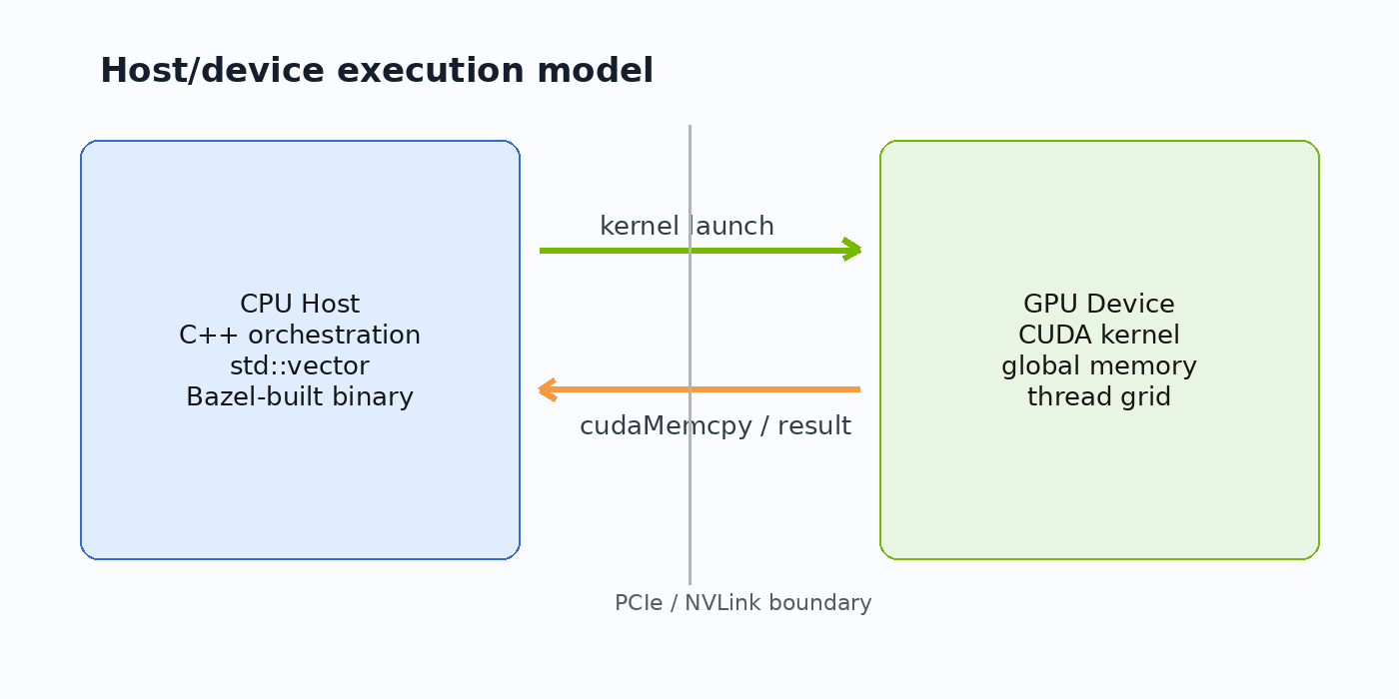
GPU as a Separate Compute Resource
06/46
Host code orchestrates device work across a memory boundary
CPU code prepares data and launches kernels.
GPU device code runs many threads over device memory.
Data movement is part of the program, not a detail.
runtime/device_info.cc | Source: CUDA C++ Programming Guide

Slide 7
CPU vs GPU Work Shape
07/46
GPUs like lots of similar work; CPUs handle mixed latency-sensitive work
Serial CPU: one loop does all work.
CPU threads: a few workers process chunks.
CUDA grid: many threads map naturally to many elements.
Serial CPU vs CPU threads vs GPU grid
CPU threads
chunks of N
std::thread
CUDA grid
blocks x threads
Serial CPU
for (i)
work(i)
many elements
cpp/vector_threaded.cc -> gpu/vector_add_device.cu | Source: CUDA C++ Programming Guide

Slide 8
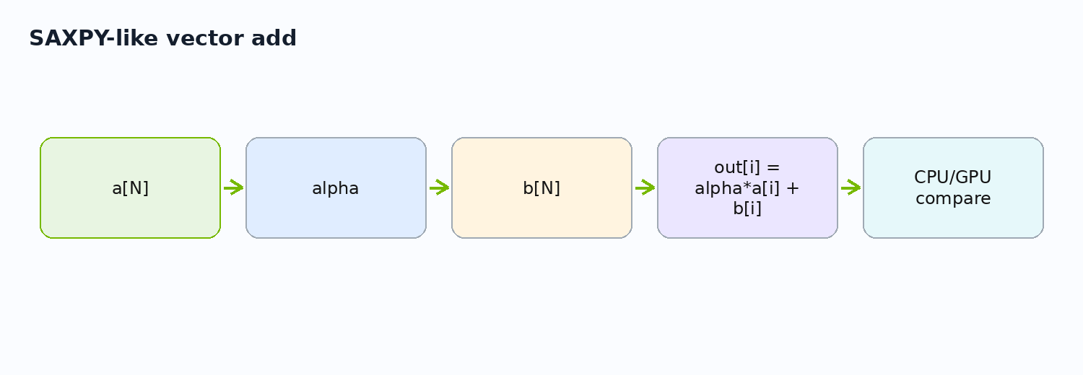
The Course Operation: SAXPY-Like Vector Add
08/46
One small operation teaches the complete path
Inputs: a[N], b[N], scalar alpha.
Output: out[i] = alpha * a[i] + b[i].
Same semantics are implemented on CPU, CPU threads, CUDA, and JAX.
cpp/vector_cpu.cc

Slide 9
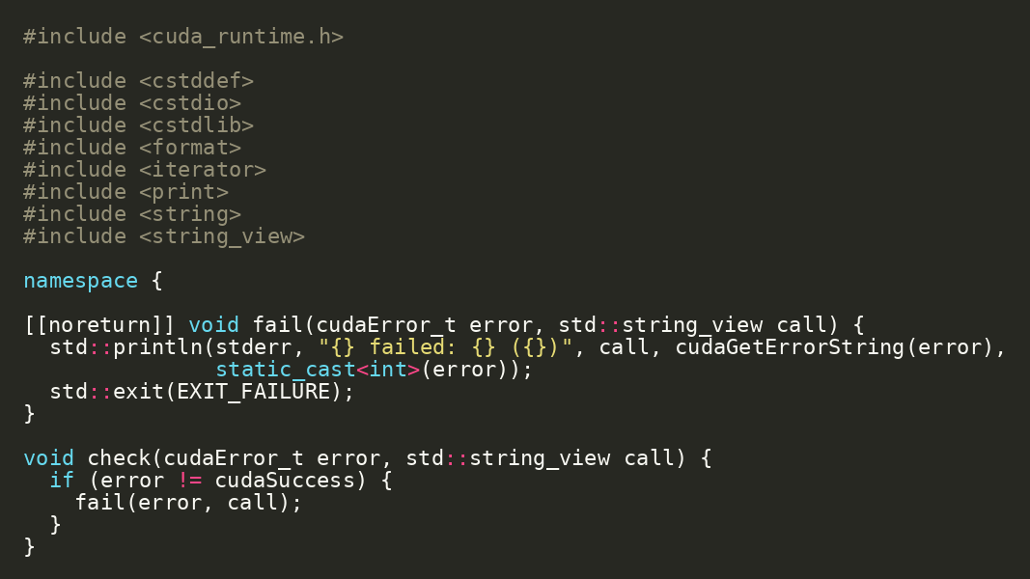
First Live Demo: Ask the GPU Who It Is
09/46
Before kernels, inspect the CUDA runtime environment
Run the smallest CUDA-aware target first.
This confirms runtime access, driver visibility, and device enumeration.
cd projects/simple bazel run //src:gpu_info
projects/simple/src/main.cc

Slide 10
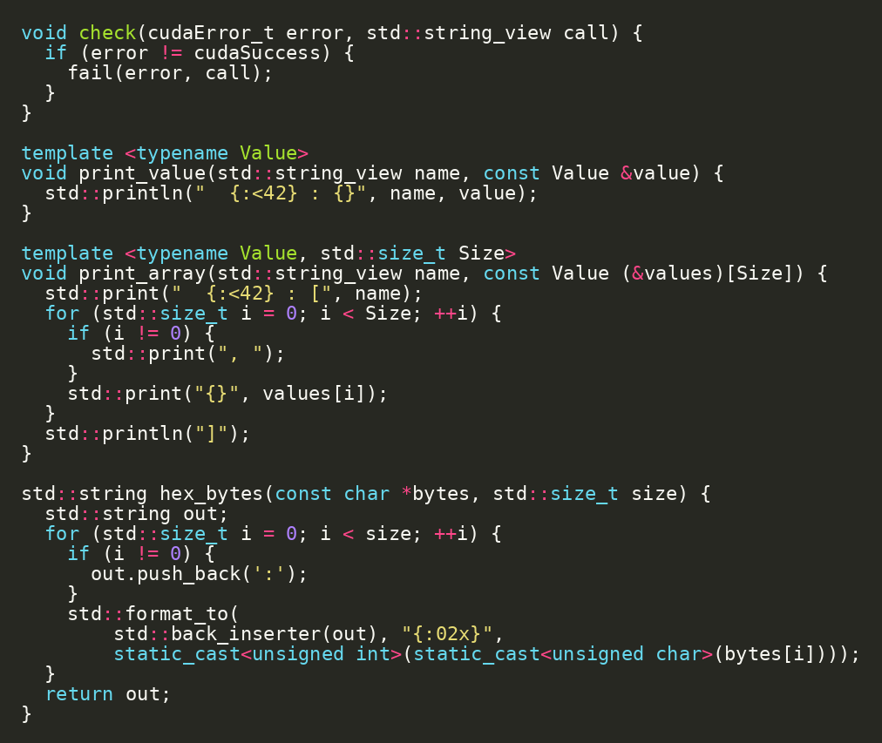
What cudaDeviceProp Teaches
10/46
Device properties connect hardware constraints to code choices
major/minor: compute capability.
multiProcessorCount: parallel capacity.
warpSize: scheduling granularity.
maxThreadsPerBlock and shared memory guide later launch choices.
projects/simple/src/main.cc | Source: CUDA C++ Programming Guide

Slide 11
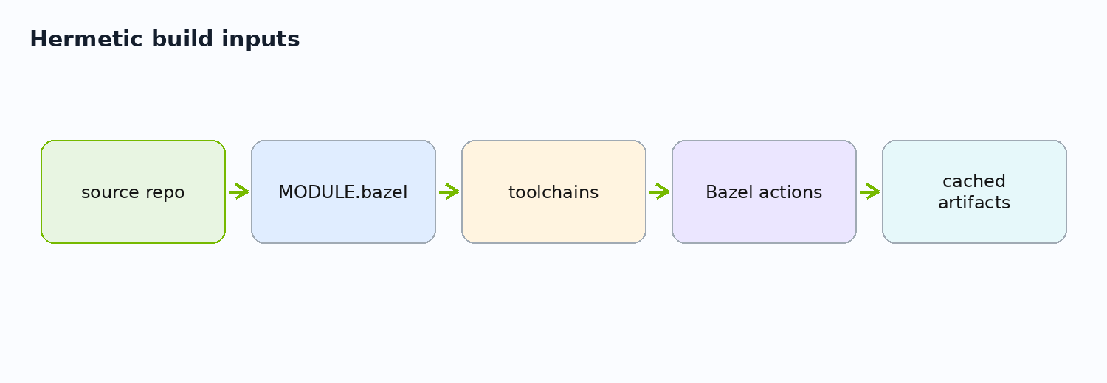
Why Hermetic Builds Matter
11/46
Works-on-my-machine is not a course architecture
Bazel isolates build inputs from host machine drift.
Tool versions and dependencies are declared in the repository.
The same source/config should produce the same artifact.
MODULE.bazel + .bazelrc | Source: Bazel Hermeticity

Slide 12
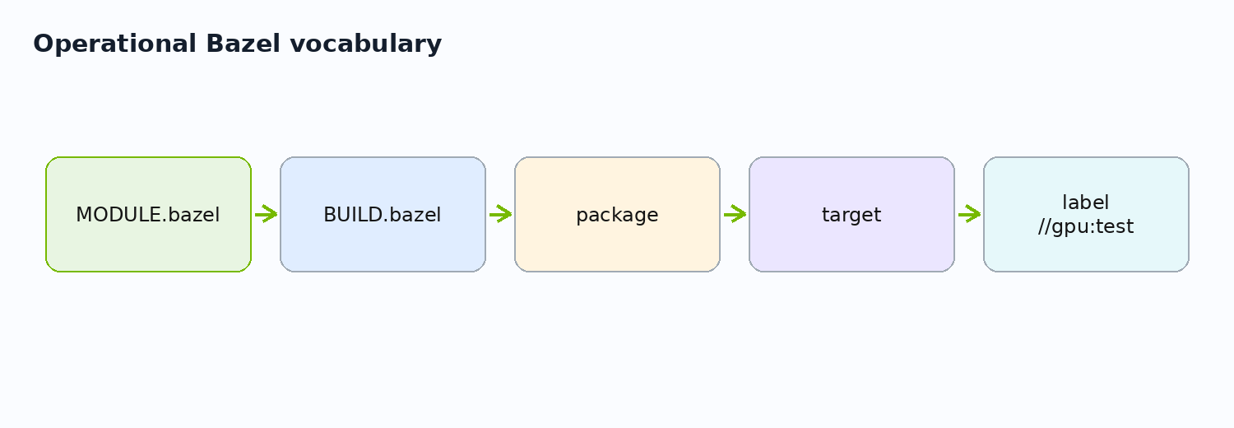
Bazel Vocabulary
12/46
Four words make the repository readable
MODULE.bazel: external dependencies and toolchain extensions.
BUILD.bazel: package targets.
target: buildable unit.
label: canonical address such as //gpu:vector_add_test.
//cpp:vector_cpu_test, //gpu:vector_add_benchmark | Source: Bazel concepts

Slide 13
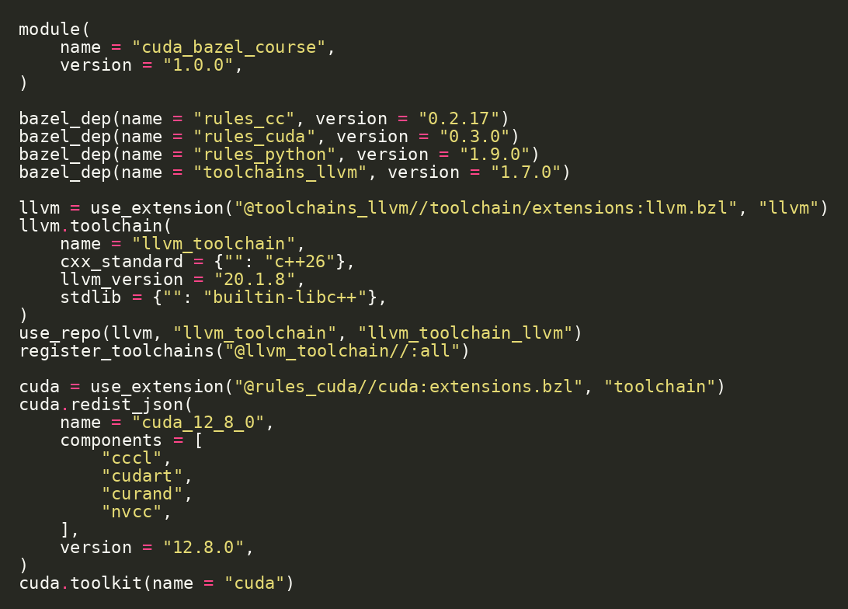
Module File: Dependencies and Toolchains
13/46
MODULE.bazel declares the external universe
rules_cc for C++ targets.
rules_cuda for CUDA targets and hermetic toolkit support.
rules_python for Python hooks.
toolchains_llvm for Clang C++26.
projects/detailed/MODULE.bazel | Source: rules_cuda

Slide 14
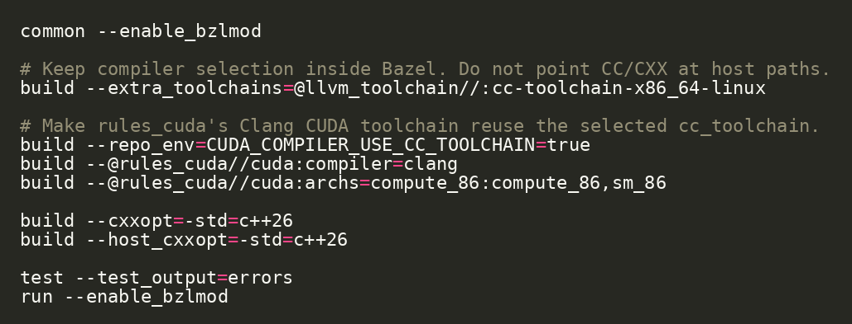
.bazelrc: Build Policy
14/46
The repo chooses compiler and CUDA mode consistently
extra_toolchains selects the LLVM toolchain.
rules_cuda compiler is set to clang.
archs selects device code generation target.
Build policy stays outside source files.
projects/detailed/.bazelrc | Source: rules_cuda

Slide 15
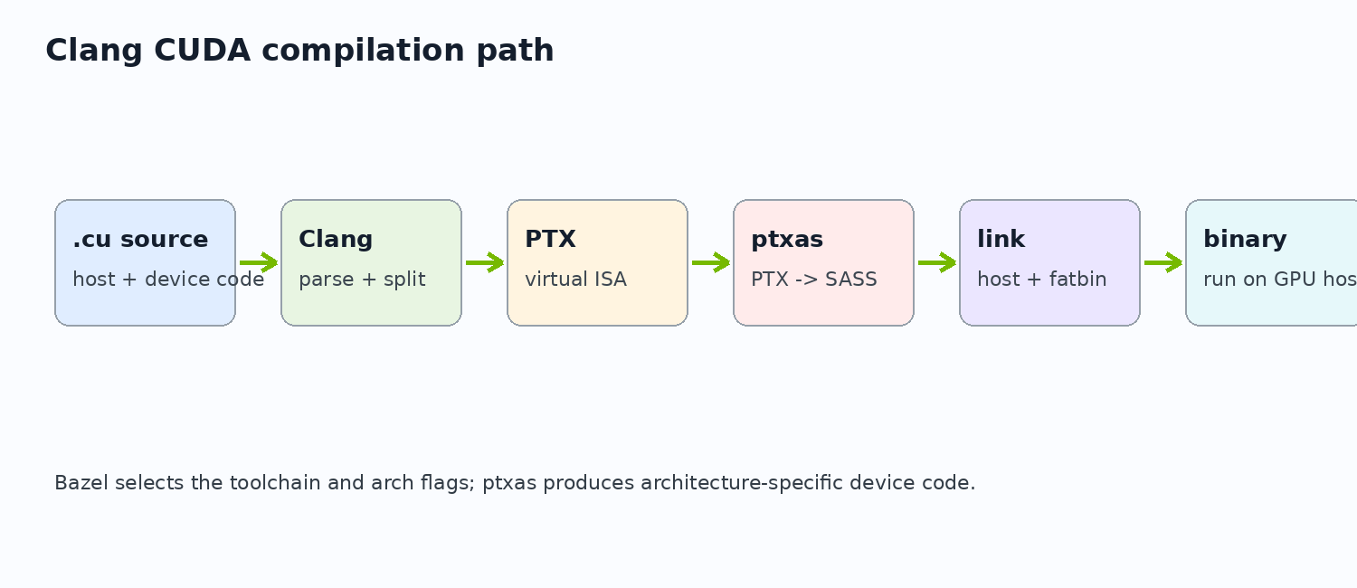
Clang CUDA Compilation Path
15/46
Clang compiles host and device sides; ptxas generates device code
Clang parses CUDA and separates host/device compilation.
PTX is the device intermediate form.
ptxas assembles PTX to architecture-specific device code.
--@rules_cuda//cuda:compiler=clang | Source: LLVM: Compiling CUDA with Clang

Slide 16
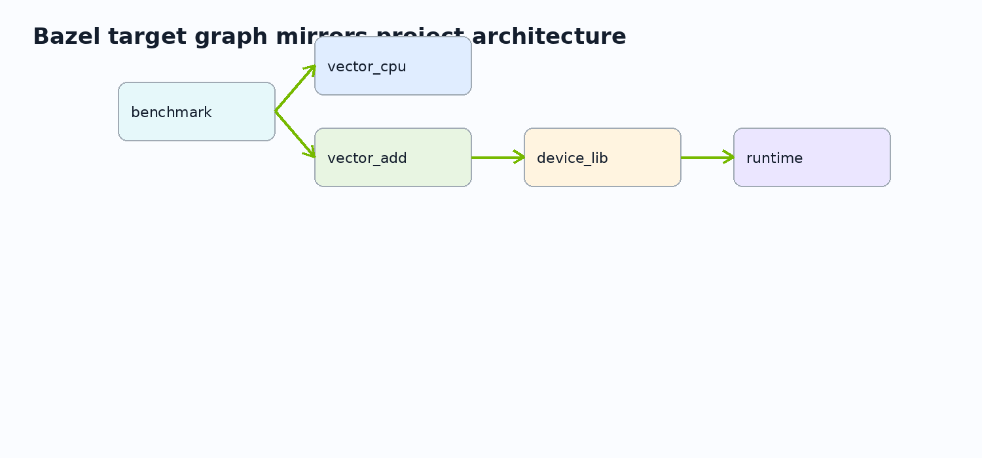
Lab 1 Checkpoint: Build the World
16/46
The repository gives a reproducible baseline before changes
Checkpoint / exercise
cd projects/detailed bazel test //...
Move into the detailed project.
Run the full test set.
Confirm which targets need runtime GPU access.
Record any environment blockers.
projects/detailed

Slide 17
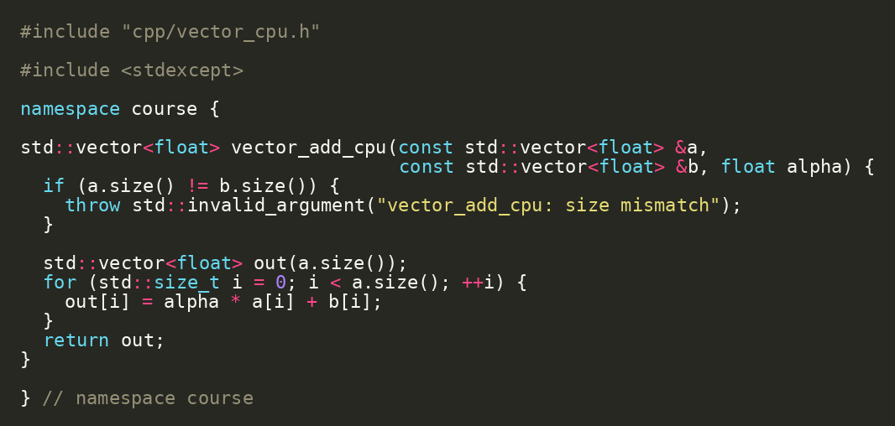
CPU Oracle Source
17/46
CUDA correctness starts with a boring CPU implementation
Validate input sizes before work.
Use a simple loop to express the contract.
This result becomes the comparison baseline.
projects/detailed/cpp/vector_cpu.cc | Source: CUDA C++ Best Practices Guide

Slide 18
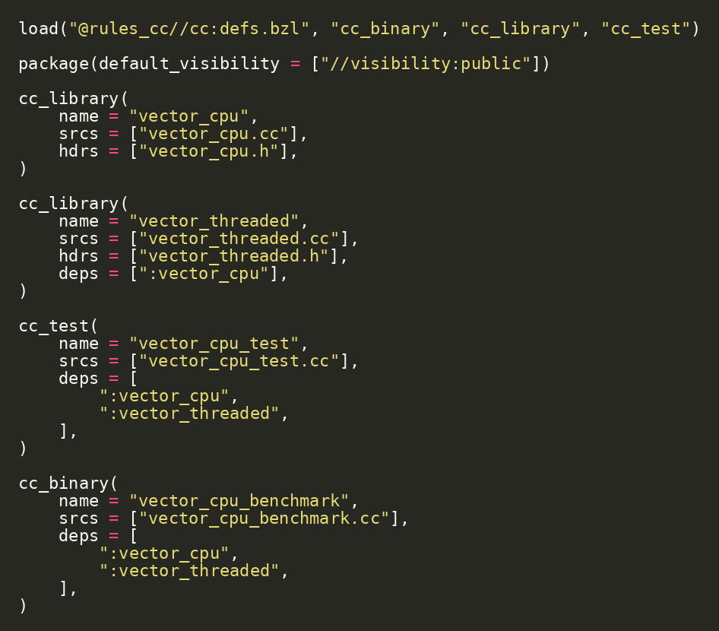
CPU Test Target
18/46
Tests capture the contract before acceleration
cc_test makes the CPU oracle executable in the build graph.
The test target depends on CPU libraries, not on CUDA.
This separates semantics from acceleration.
bazel test //cpp:vector_cpu_test

Slide 19
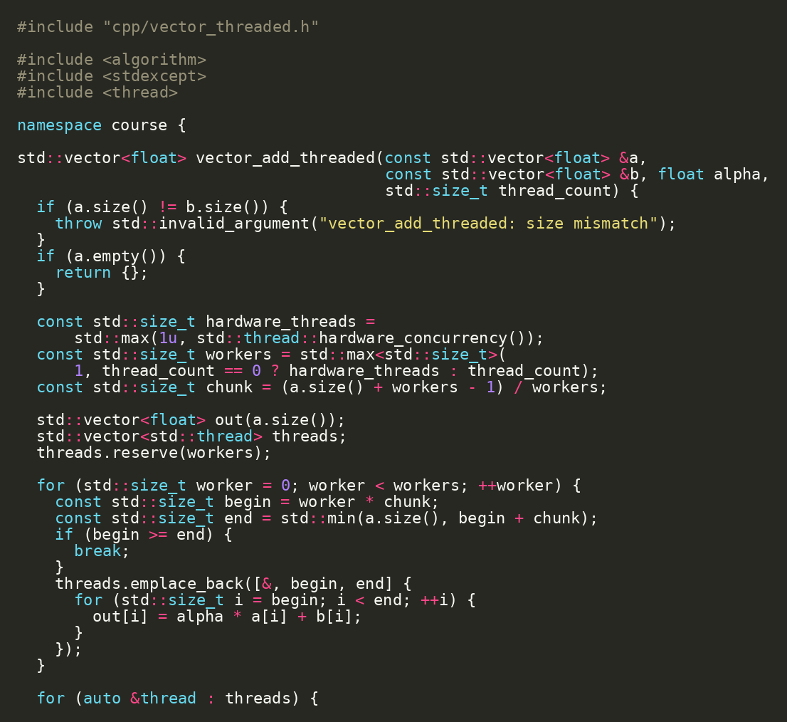
CPU Threaded Baseline
19/46
GPU comparison should include CPU parallelism, not only serial CPU
Split N elements into chunks.
Use host threads to show CPU parallel work.
This bridges C++ concurrency and GPU parallelism.
projects/detailed/cpp/vector_threaded.cc

Slide 20
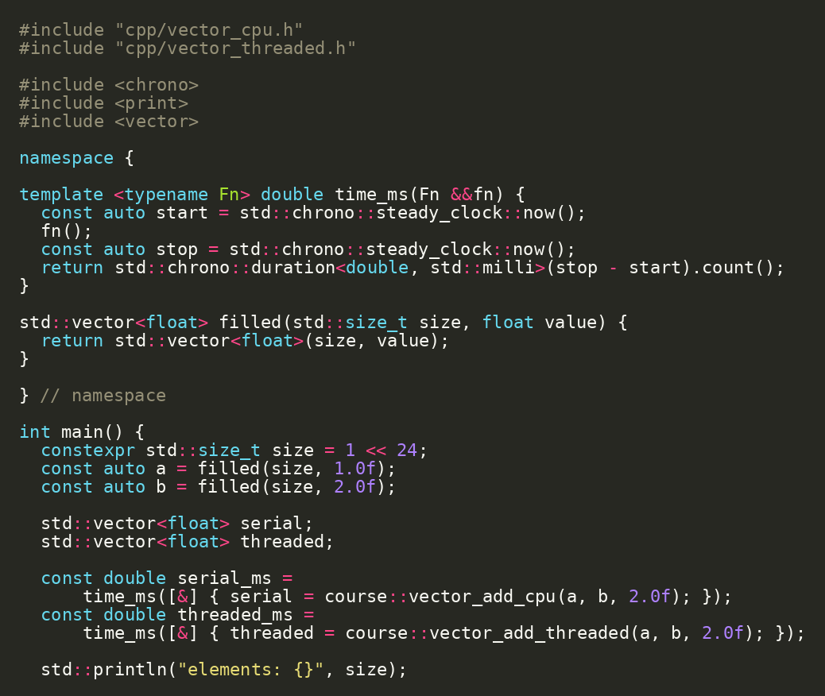
Benchmark Output Reading
20/46
A benchmark teaches only if we know what was measured
Record input size.
Separate serial and threaded paths.
Treat first-run and machine variance carefully.
bazel run //cpp:vector_cpu_benchmark
projects/detailed/cpp/vector_cpu_benchmark.cc | Source: CUDA C++ Best Practices Guide

Slide 21
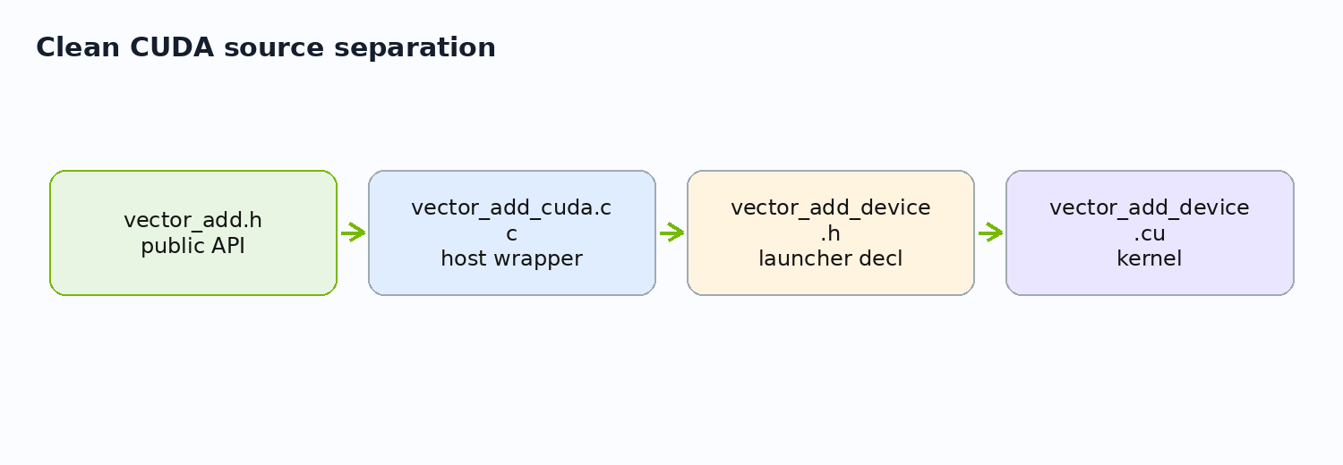
CUDA Source Separation
21/46
Keep host orchestration and device kernel code cleanly separated
Public API: gpu/vector_add.h.
Host wrapper: gpu/vector_add_cuda.cc.
Device launcher + kernel: gpu/vector_add_device.{h,cu}.
This prevents one tangled .cu file.
projects/detailed/gpu

Slide 22
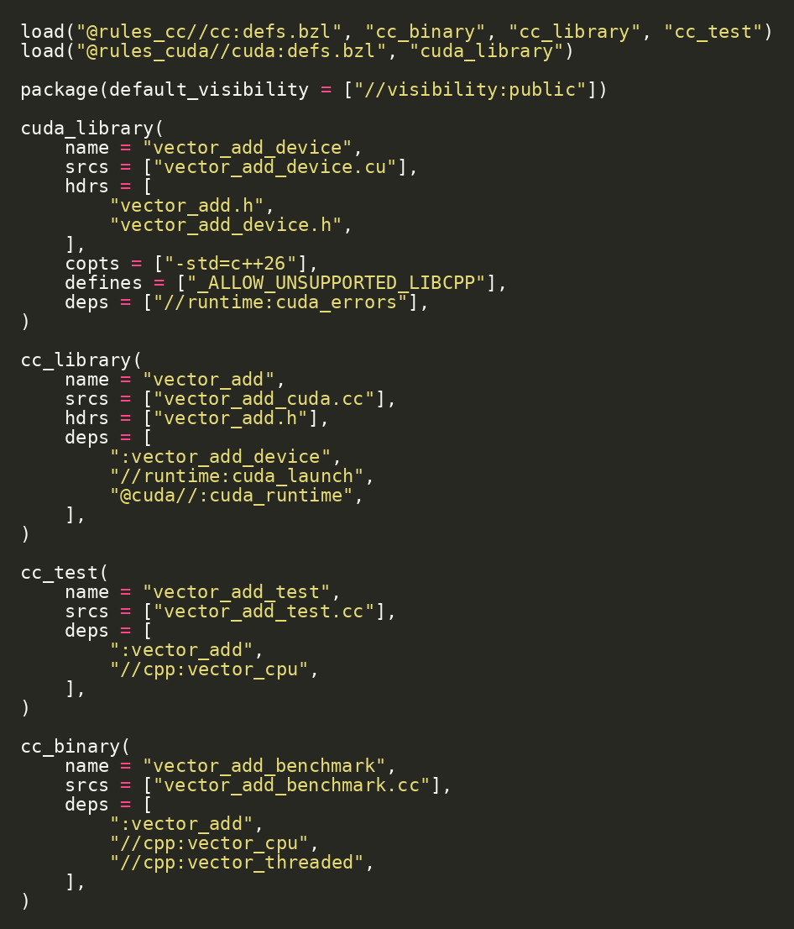
CUDA Target in Bazel
22/46
CUDA source becomes a Bazel target like everything else
cuda_library compiles device code.
cc_library wraps host-side logic.
Tests and benchmarks depend on the API target, not raw files.
projects/detailed/gpu/BUILD.bazel | Source: rules_cuda

Slide 23
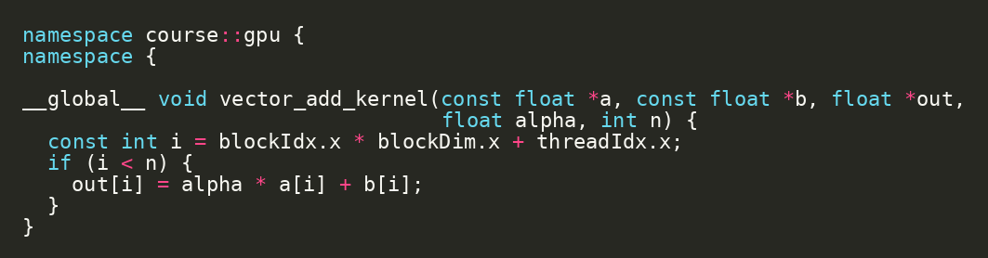
Kernel Code: One Thread, One Element
23/46
Global thread index maps CUDA threads to vector elements
blockIdx.x identifies the block.
blockDim.x is the block size.
threadIdx.x identifies the thread inside the block.
The bounds check protects the final partial block.
projects/detailed/gpu/vector_add_device.cu | Source: CUDA C++ Programming Guide

Slide 24
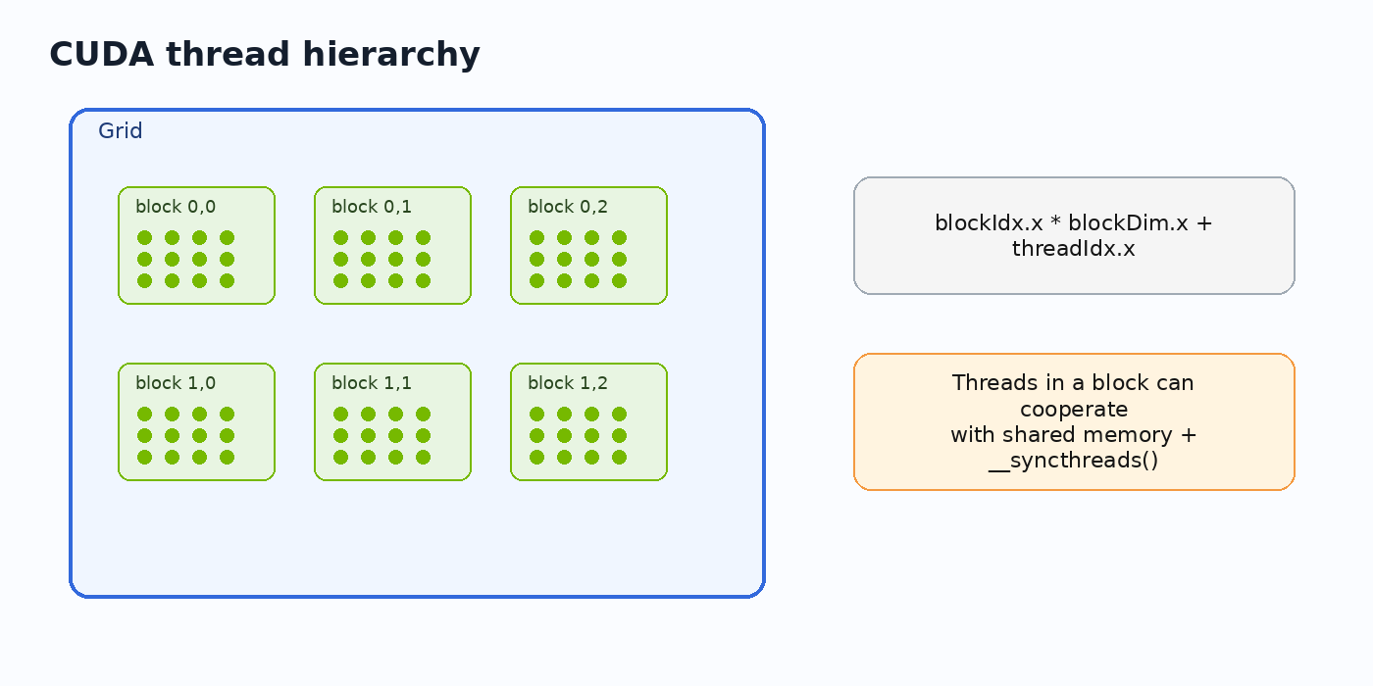
Thread Hierarchy
24/46
CUDA exposes grid -> block -> thread hierarchy
A kernel launch creates a grid.
A grid contains blocks.
Blocks contain threads.
Threads in a block can cooperate with shared memory.
blockIdx, blockDim, threadIdx | Source: CUDA C++ Programming Guide

Slide 25
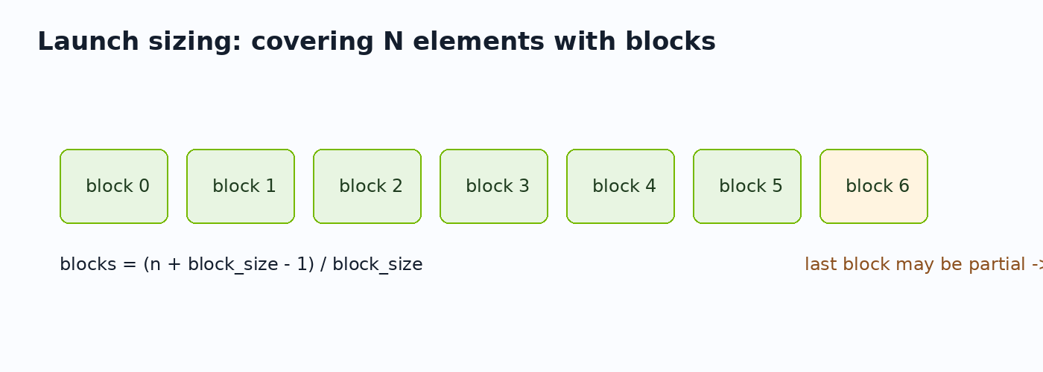
Choosing Block and Grid Size
25/46
Launch configuration controls how many threads run
Use a fixed block size for the first kernel.
Round grid size up to cover all N elements.
Keep if (i < n) inside the kernel.
constexpr int block_size = 256

Slide 26
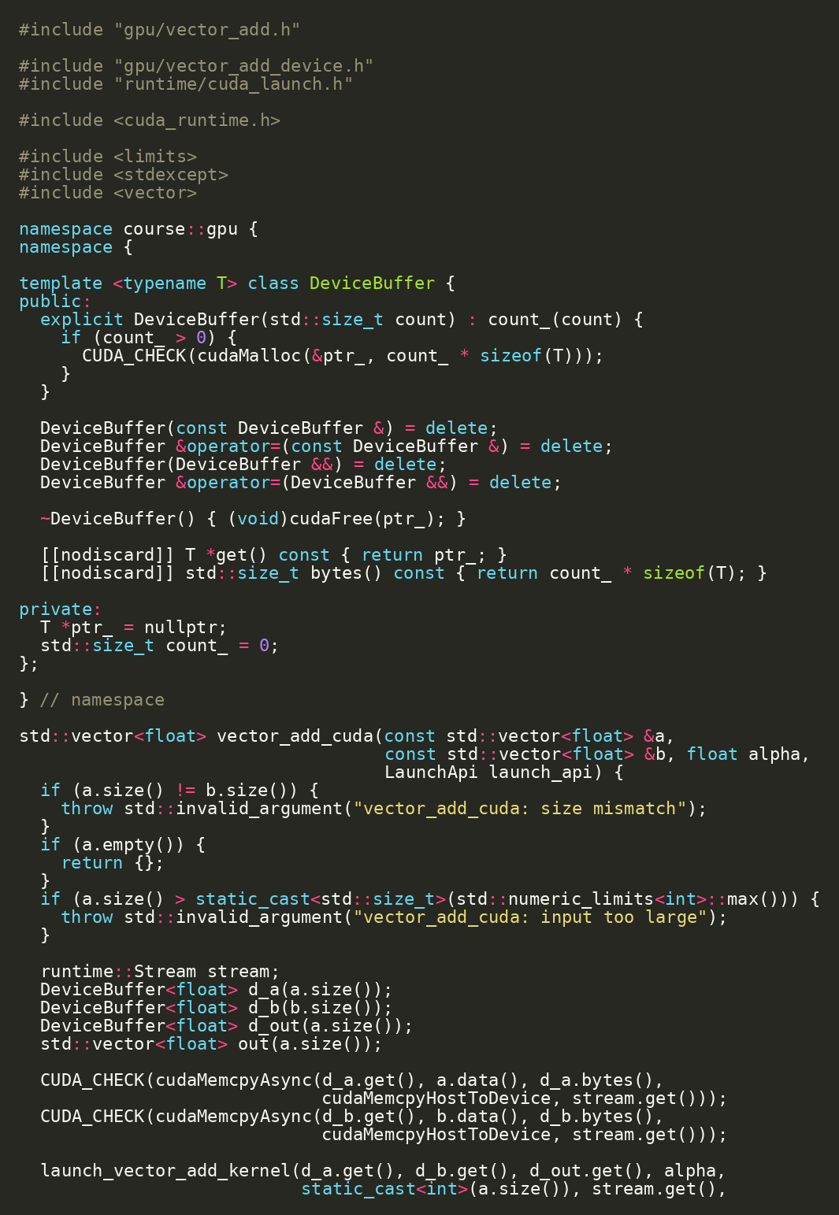
Host Wrapper: Memory and Launch Ownership
26/46
Host C++ owns allocation, copies, launch, sync, and result transfer
Validate inputs and compute byte counts.
Allocate device buffers.
Copy host-to-device, launch, synchronize, copy back.
Free device buffers.
projects/detailed/gpu/vector_add_cuda.cc | Source: CUDA Runtime API - Execution Control

Slide 27
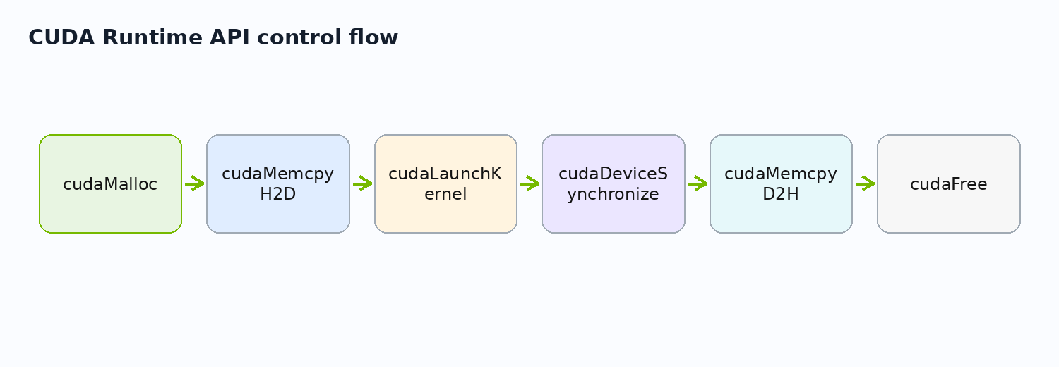
CUDA Runtime API Calls
27/46
CUDA Runtime API is the control surface for device work
cudaMalloc creates device buffers.
cudaMemcpy moves data.
cudaLaunchKernel launches work explicitly.
cudaDeviceSynchronize waits for completion.
cudaFree releases device memory.
gpu/vector_add_cuda.cc + gpu/vector_add_device.cu | Source: CUDA Runtime API - Execution Control

Slide 28
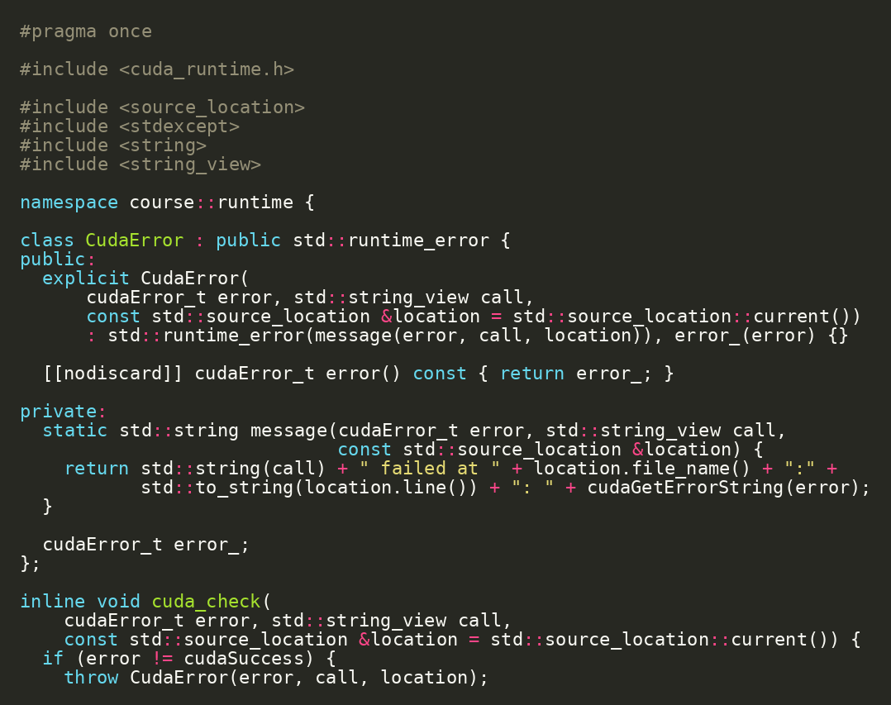
Error Handling Helper
28/46
Every CUDA call should be checked
Unchecked CUDA errors make debugging unreliable.
The helper captures file and line context.
Use it around allocation, copies, synchronization, and runtime launches.
projects/detailed/runtime/cuda_errors.h | Source: CUDA C++ Best Practices Guide

Slide 29
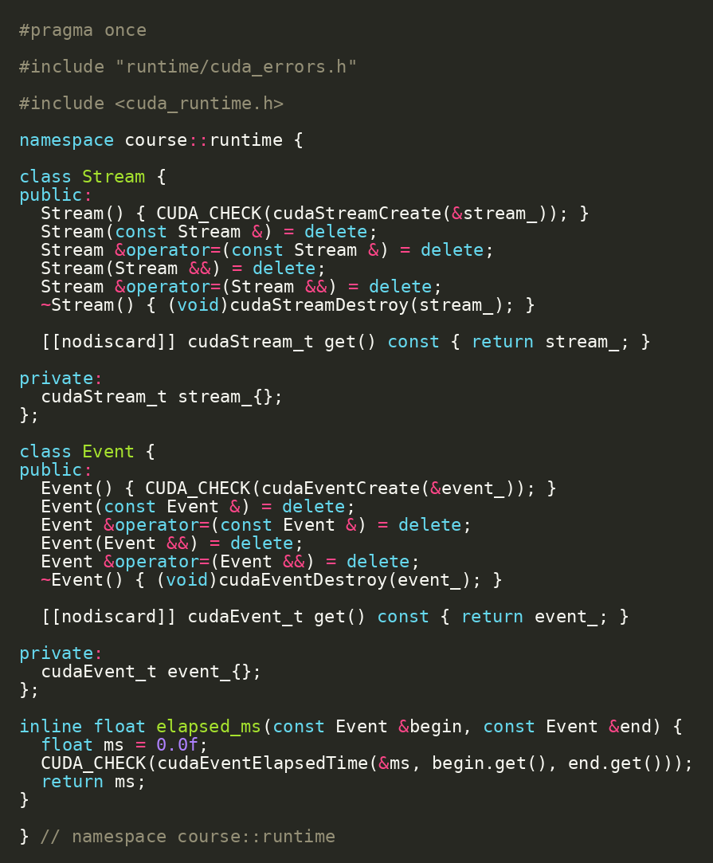
Stream and Event Helpers
29/46
Small RAII helpers make CUDA runtime objects safer
Stream wrapper owns cudaStreamCreate/cudaStreamDestroy.
Event wrapper owns cudaEventCreate/cudaEventDestroy.
elapsed_ms centralizes CUDA event timing.
projects/detailed/runtime/cuda_launch.h | Source: CUDA C++ Programming Guide

Slide 30
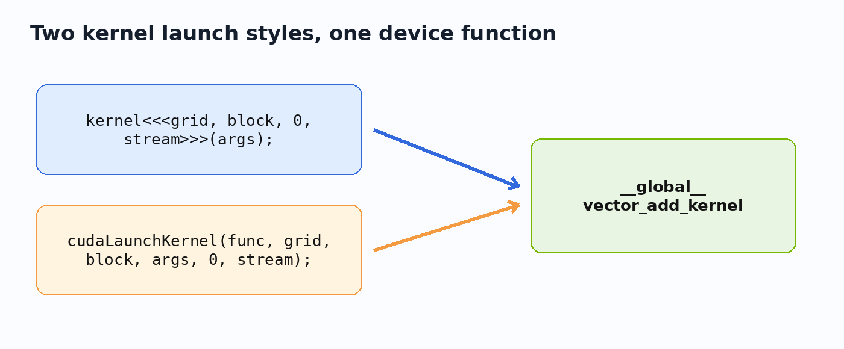
Two Launch Styles
30/46
Triple-chevron syntax and cudaLaunchKernel launch the same device function
Triple-chevron is the normal readable CUDA C++ syntax.
cudaLaunchKernel exposes the Runtime API mechanism explicitly.
The project lets both paths be benchmarked and tested.
LaunchApi enum + vector_add_device.cu | Source: CUDA Runtime API - Execution Control

Slide 31
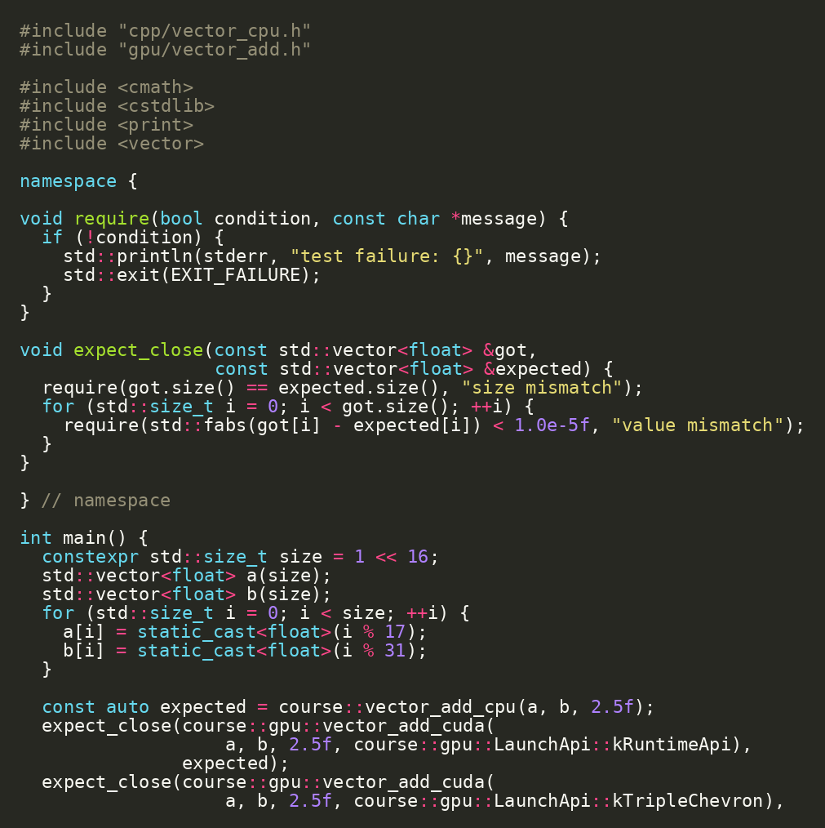
Correctness Test: CPU vs CUDA
31/46
The GPU result must match the CPU oracle
CPU and CUDA paths share the same inputs.
Outputs are compared element by element.
No performance discussion until this target passes.
bazel test //gpu:vector_add_test
projects/detailed/gpu/vector_add_test.cc

Slide 32
Live Demo: Run the CUDA Test
32/46
The first CUDA feature is now real
Checkpoint / exercise
cd projects/detailed bazel test //gpu:vector_add_test # optional: --nocache_test_results
Run the test target.
If cached, use --nocache_test_results for a live run.
Confirm both launch styles are covered by tests.
//gpu:vector_add_test

Slide 33
Aquery: Proving Hermetic Clang
33/46
Trust, then inspect the action graph
Checkpoint / exercise
bazel aquery 'mnemonic("CppCompile", //gpu:vector_add_test)'
aquery reveals the compile actions Bazel will run.
Look for external LLVM toolchain paths.
The goal is to prove the compiler is not an ambient /usr/bin guess.
Bazel action graph | Source: Bazel Hermeticity

Slide 34
Build Graph as a Teaching Tool
34/46
Build dependencies mirror architecture decisions
Benchmark target depends on CPU and CUDA implementations.
CUDA wrapper depends on device library.
Device library uses runtime helpers.
The target graph is a design diagram.
Bazel target graph mirrors project architecture
vector_cpu
benchmark
vector_add
device_lib
runtime
projects/detailed/gpu/BUILD.bazel

Slide 35
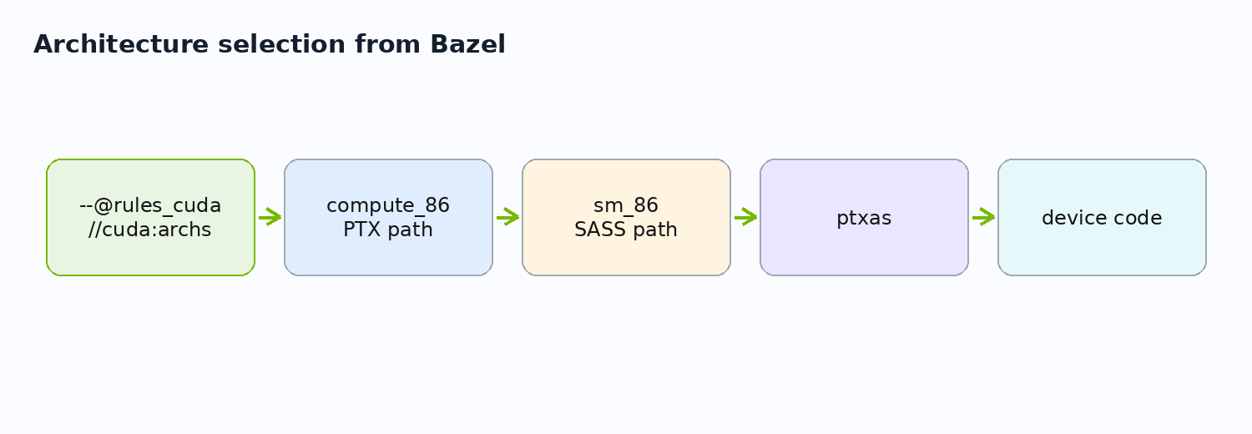
CUDA Architecture Flag
35/46
Device code is compiled for GPU architecture choices
Bazel config selects compute/PTX and sm/SASS targets.
PTX path gives compatibility; SASS path is architecture-specific.
Labs may change this for a different GPU fleet.
projects/detailed/.bazelrc | Source: rules_cuda

Slide 36
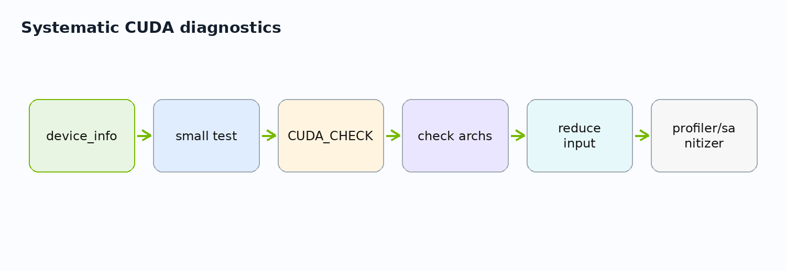
What Can Go Wrong
36/46
CUDA failures are usually environment, architecture, memory, or launch bugs
No driver or no GPU access.
Architecture flag mismatch.
Wrong copy size or direction.
Unchecked launch failure.
Use device_info and CUDA_CHECK to localize.
runtime/device_info + runtime/cuda_errors.h

Slide 37
Lab 2: Read and Explain the Kernel
37/46
Be able to narrate the CUDA kernel line by line
Checkpoint / exercise
code projects/detailed/gpu/vector_add_device.cu
Open gpu/vector_add_device.cu.
Identify the index calculation.
Identify the bounds check.
Identify where grid and block sizes are chosen.
gpu/vector_add_device.cu

Slide 38
Lab 3: Change Vector Size
38/46
Configuration changes should preserve correctness
Checkpoint / exercise
bazel test //gpu:vector_add_test bazel run //gpu:vector_add_benchmark
Change the benchmark vector size.
Re-run the CUDA test.
Run the benchmark.
Record serial CPU, threaded CPU, runtime API CUDA, and triple-chevron CUDA times.
gpu/vector_add_benchmark.cc

Slide 39
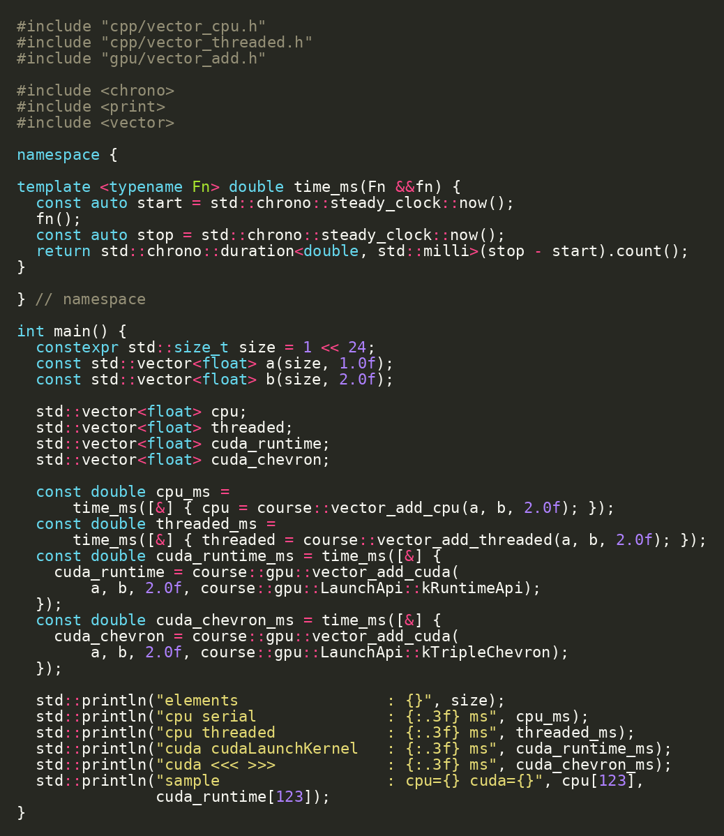
Benchmark Target Preview
39/46
Day 1 ends with the benchmark target ready for deeper analysis
The benchmark invokes CPU serial, CPU threaded, and CUDA variants.
Day 2 will explain timing, memory cost, and interpretation.
bazel run //gpu:vector_add_benchmark
projects/detailed/gpu/vector_add_benchmark.cc | Source: CUDA C++ Best Practices Guide

Slide 40
From Visual Studio Debugger to Repository Workflow
40/46
The old debugger-first flow becomes build/test/run first
Old course step | Repository-driven replacement
Install CUDA SDK manually | cuda.redist_json + rules_cuda toolchain
Create Visual Studio project | BUILD.bazel targets
Run a sample app | bazel run //runtime:device_info
Compare CPU/GPU manually | bazel test //gpu:vector_add_test
Package by copying files | rules_oci image target
Editor choice stays independent from build definition.
source.md -> reworked repository

Slide 41
Day 1 Architecture Recap
41/46
The foundation for a real CUDA project is now in place
Hermetic C++ compiler.
Hermetic CUDA toolkit.
CPU oracle and threaded baseline.
CUDA device kernel and host wrapper.
Error helper and runtime launch path.
Tests and benchmark target.
Bazel target graph mirrors project architecture
vector_cpu
benchmark
vector_add
device_lib
runtime
projects/detailed

Slide 42
Documentation Anchors for Day 1
42/46
Use official docs to support the repository decisions
Topic | Primary source | Repository anchor
CUDA programming model | CUDA C++ Programming Guide | gpu/vector_add_device.cu
Runtime launch API | CUDA Runtime API execution control | cudaLaunchKernel path
Clang CUDA | LLVM Clang CUDA docs | .bazelrc + rules_cuda
Hermetic build | Bazel hermeticity | MODULE.bazel + toolchains
CUDA Bazel rules | rules_cuda | gpu/BUILD.bazel
docs-to-code mapping | Source: CUDA / LLVM / Bazel official docs

Slide 43
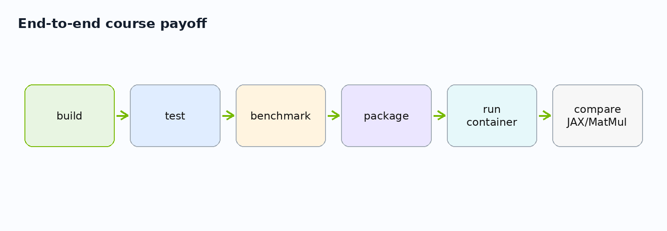
Day 1 Integration Demo
43/46
Run the end-to-end Day 1 path in four commands
Checkpoint / exercise
cd projects/detailed bazel run //runtime:device_info bazel test //cpp:vector_cpu_test bazel test //gpu:vector_add_test bazel run //gpu:vector_add_benchmark
Inspect the device.
Run the CPU test.
Run the CUDA test.
Run the vector-add benchmark preview.
projects/detailed

Slide 44
Prepare for Day 2
44/46
Day 2 asks what the GPU work costs and how we deploy it
How much time is launch vs transfer vs compute?
How do streams overlap work?
What belongs in a container?
How does JAX/XLA compare?
Why is MatMul different from vector add?
Day 2 targets: benchmark, deploy, JAX, MatMul

Slide 45
Day 1 Exercise Pack
45/46
Concrete practice tasks that extend the repository without changing architecture
Checkpoint / exercise
bazel run //runtime:device_info bazel test //gpu:vector_add_test bazel aquery 'mnemonic("CppCompile", //gpu:vector_add_test)'
Re-run //runtime:device_info and identify three hardware fields.
Add one new assertion to vector_add_test.
Change benchmark size and record timings.
Inspect the compiler path with aquery.
projects/detailed

Slide 46
Day 1 Closing
46/46
Foundation complete: code, build, test, and first GPU feature
The repository declares the build.
The CPU verifies CUDA.
Clang compiles host and CUDA code.
ptxas is part of device code generation.
Day 2 measures, overlaps, packages, and compares.
bazel test //...

