Slide 1
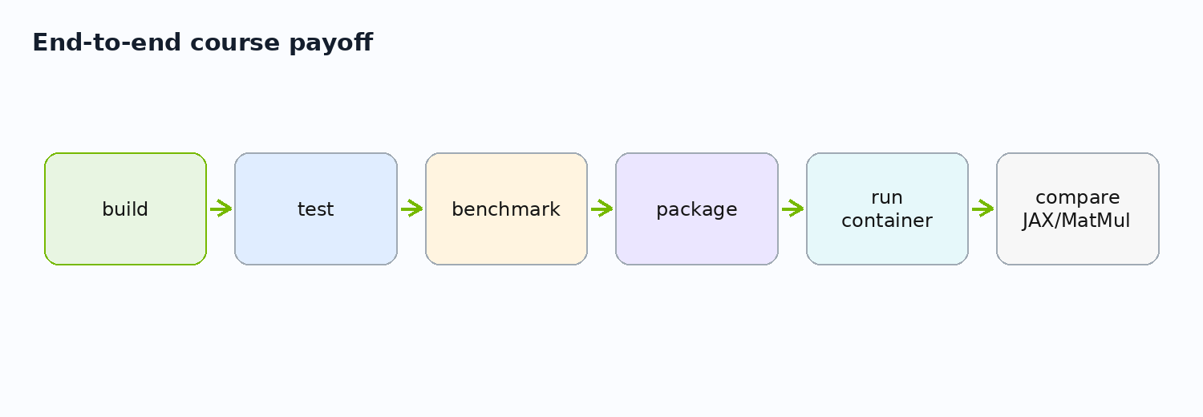
Day 2 - Measure, Package, Compare, and Scale the Mental Model
Runtime, performance, deployment, JAX/XLA, and MatMul
Today: measure -> overlap -> package -> compare -> extend to MatMul
Repository-driven CUDA/Bazel course

Slide 2
Day 1 Recap in One Graph
02/48
The repo now has CPU, threaded CPU, and CUDA implementations
vector_add_benchmark depends on CPU and CUDA implementations.
The CUDA path is split into host wrapper, device library, and runtime helpers.
This is the graph we now measure and package.
Bazel target graph mirrors project architecture
vector_cpu
benchmark
vector_add
device_lib
runtime
//gpu:vector_add_benchmark

Slide 3
Day 2 Outcomes
03/48
Reason about runtime cost and deployment
Read benchmark output responsibly.
Explain host/device memory movement.
Use timing and synchronization correctly.
Build/load a tiny GPU container.
Explain JAX/XLA compiler path.
Use MatMul as a separate performance ladder.
projects/detailed + projects/simple

Slide 4
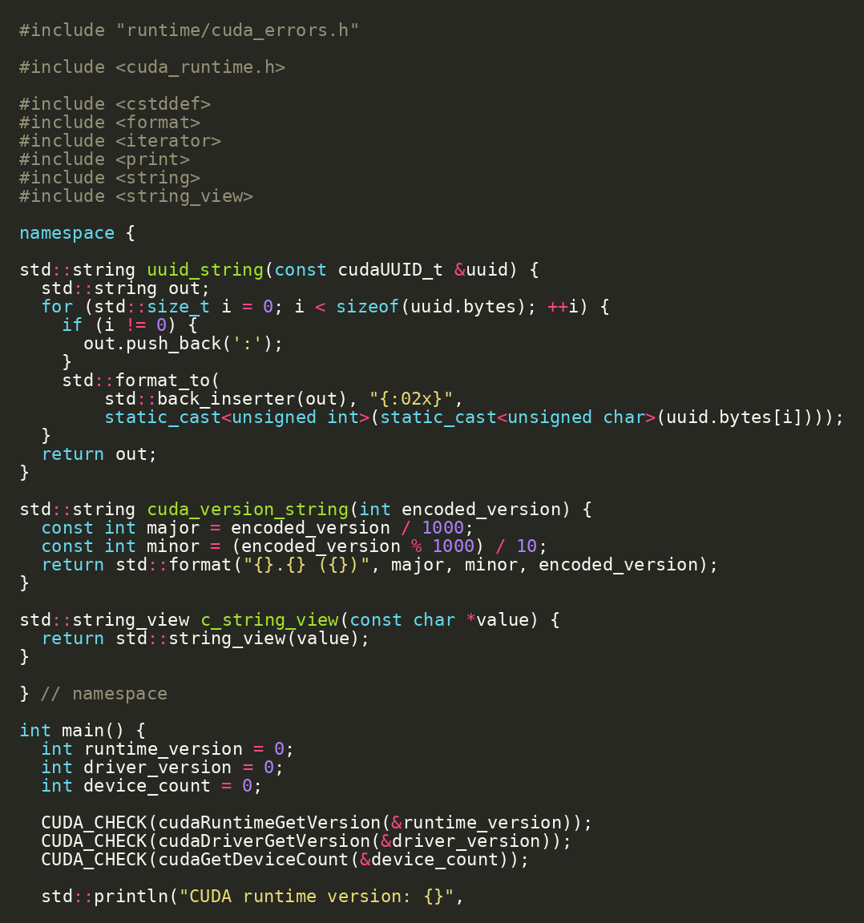
Start with Device Reality
04/48
Runtime facts decide what experiments mean
Run device_info before drawing conclusions.
Capture CUDA runtime, driver, device count, SM count, and warp size.
cd projects/detailed bazel run //runtime:device_info
projects/detailed/runtime/device_info.cc | Source: CUDA C++ Programming Guide

Slide 5
Hardware Fields That Matter Today
05/48
Not every device property matters equally for beginner kernels
Field | Why it matters today
multiProcessorCount | Parallel capacity for kernels
warpSize | Scheduling granularity and MatMul discussion
sharedMemPerBlock | Tiled MatMul and shared-memory limits
asyncEngineCount | Potential copy/compute overlap
maxThreadsPerBlock | Launch constraints
cudaDeviceProp | Source: CUDA C++ Programming Guide

Slide 6
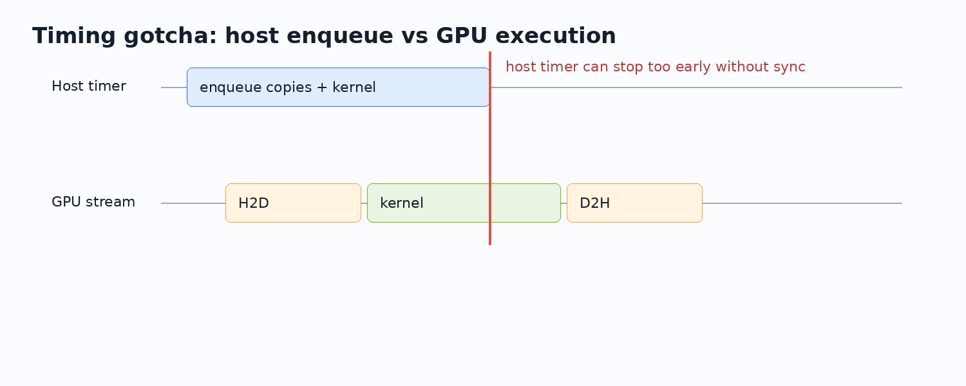
Measurement Before Optimization
06/48
You need a timing model before changing code
Warm up before measuring.
Know the sync point.
Know whether copies/allocation are included.
Avoid comparing first-run cache effects.
Keep sample correctness visible.
gpu/vector_add_benchmark.cc | Source: CUDA C++ Best Practices Guide

Slide 7
CUDA Timing Gotcha
07/48
GPU work is asynchronous from the host point of view
A host timer can stop before GPU work is complete.
Synchronize intentionally or use events.
Measure the same scope for every implementation.
runtime/cuda_launch.h | Source: CUDA C++ Programming Guide

Slide 8
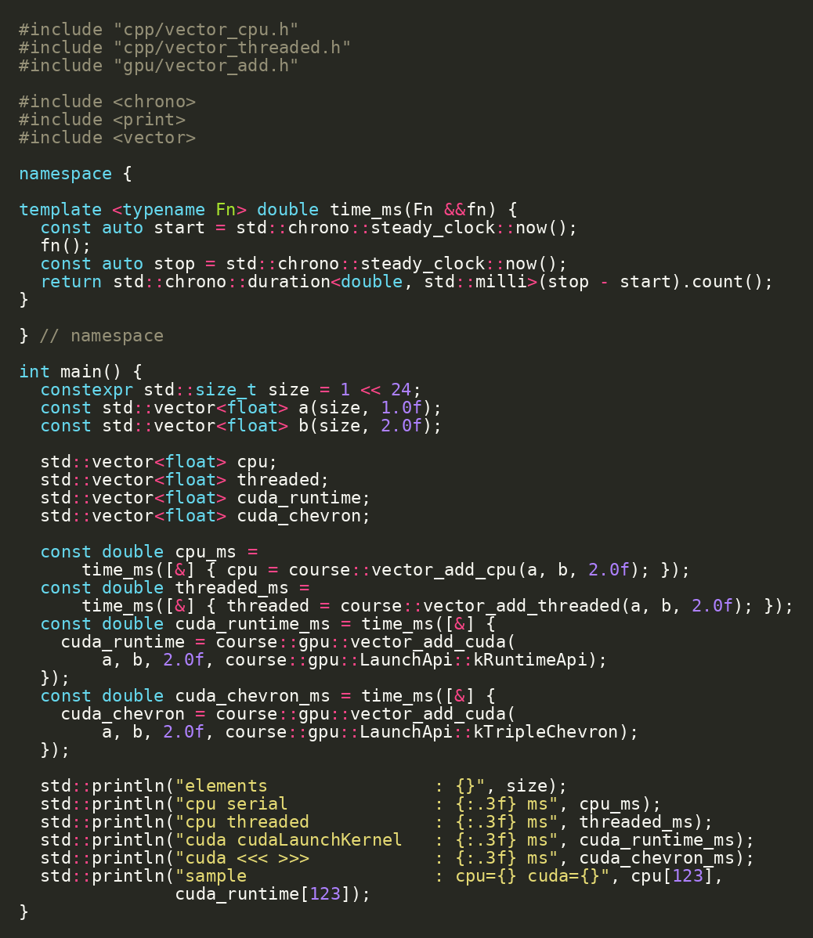
Vector Add Benchmark Target
08/48
The benchmark compares four paths in one executable
CPU serial.
CPU threaded.
CUDA Runtime API launch.
CUDA triple-chevron launch.
bazel run //gpu:vector_add_benchmark
projects/detailed/gpu/vector_add_benchmark.cc

Slide 9
Reading the Benchmark Output
09/48
Interpret vector add as memory-bound and transfer-sensitive
Path | What the time includes | Interpretation
CPU serial | single-loop host work | baseline semantics
CPU threaded | thread startup + chunk work | CPU parallelism
CUDA runtime API | allocation + copies + launch + sync | full GPU call cost
CUDA chevron | same work, different launch syntax | API comparison
benchmark_results.md | Source: CUDA C++ Best Practices Guide

Slide 10
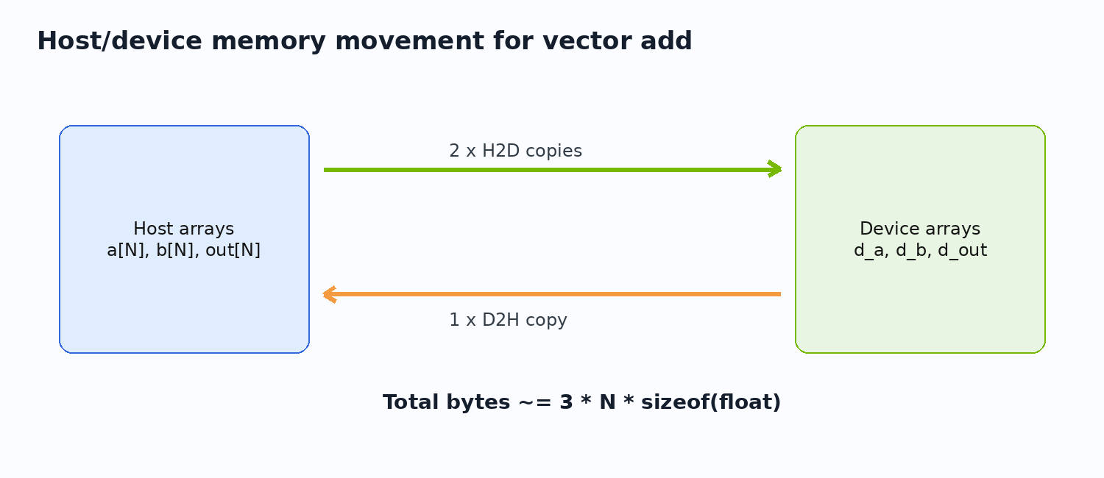
Host/Device Memory Flow
10/48
CUDA performance often begins with data movement
a and b move host-to-device.
The kernel writes d_out.
out moves device-to-host.
For vector add, bytes moved can dominate arithmetic.
gpu/vector_add_cuda.cc | Source: CUDA C++ Programming Guide

Slide 11
Lab 1: Estimate Bytes Moved
11/48
Performance reasoning starts on paper
Checkpoint / exercise
N = 1 << 24 bytes = 3 * N * sizeof(float)
For size = 1 << 24 and sizeof(float) = 4: estimate H2D for a and b.
Estimate D2H for out.
Compute total bytes moved.
Compare that with benchmark time.
docs/benchmark_results.md

Slide 12
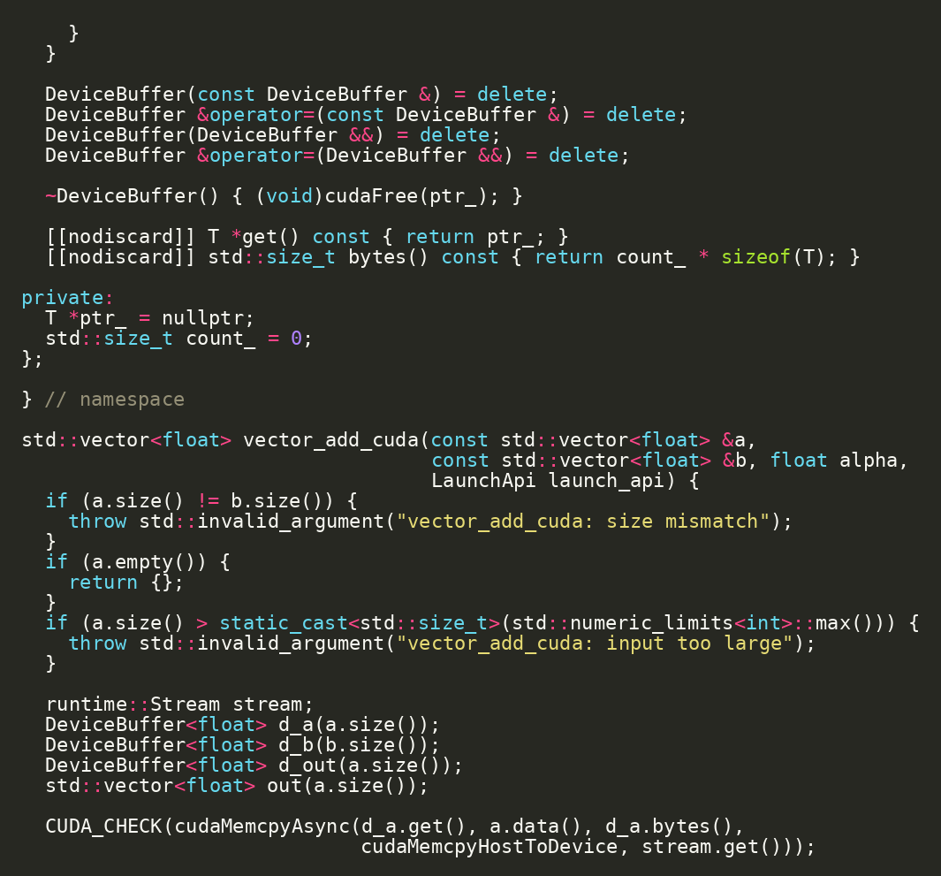
cudaMalloc and Allocation Cost
12/48
Allocation is not free and should not be hidden in a kernel-only story
Full-function timing includes allocation and free.
Real applications often reuse buffers.
Separate allocation cost when investigating performance.
gpu/vector_add_cuda.cc | Source: CUDA Runtime API - Execution Control

Slide 13
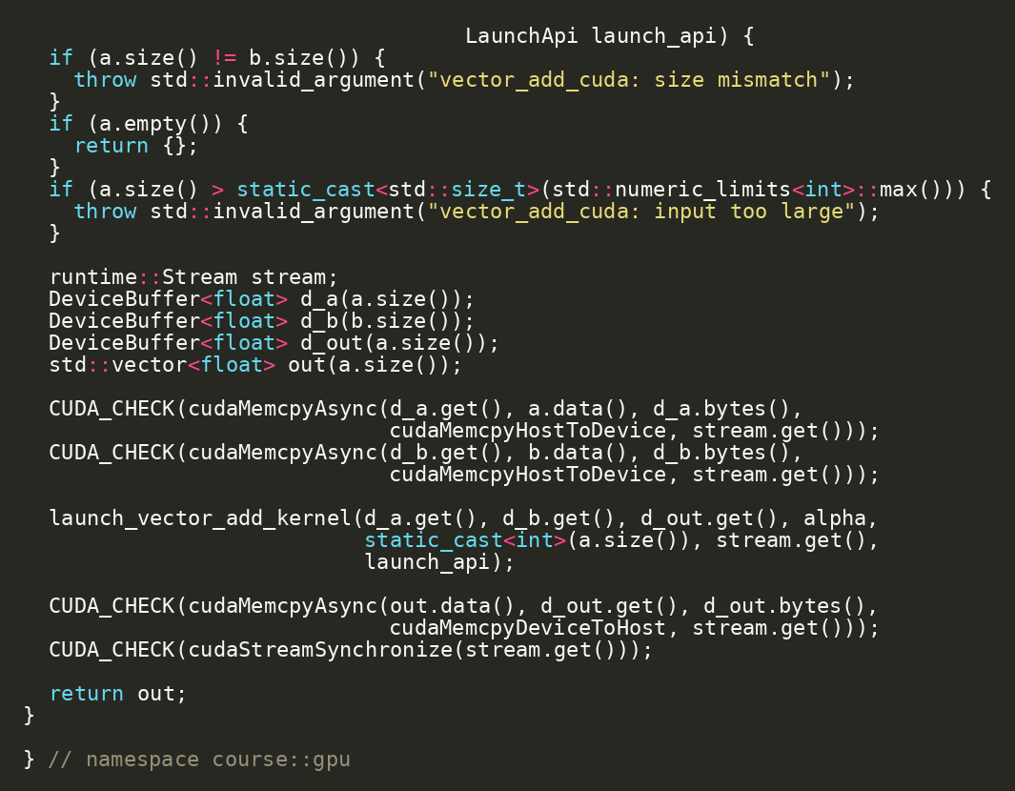
cudaMemcpy Direction and Intent
13/48
Direction flags make host/device ownership explicit
HostToDevice for input arrays.
DeviceToHost for output arrays.
Wrong direction can fail or silently invalidate results.
cudaMemcpy in vector_add_cuda.cc | Source: CUDA Runtime API - Execution Control

Slide 14
Kernel Launch Cost
14/48
Launch overhead means tiny work can lose to CPU
Host enqueues work.
GPU dispatches the kernel.
Synchronization brings errors and completion back to host.
Batching and larger work sizes amortize launch cost.
gpu/vector_add_benchmark.cc | Source: CUDA C++ Best Practices Guide

Slide 15
Default Stream Mental Model
15/48
The baseline code is intentionally serialized for correctness
Synchronous copies and simple launch form a clear baseline.
The default stream makes first correctness easier.
Overlap is a second step, not the first step.
gpu/vector_add_cuda.cc | Source: CUDA C++ Programming Guide

Slide 16
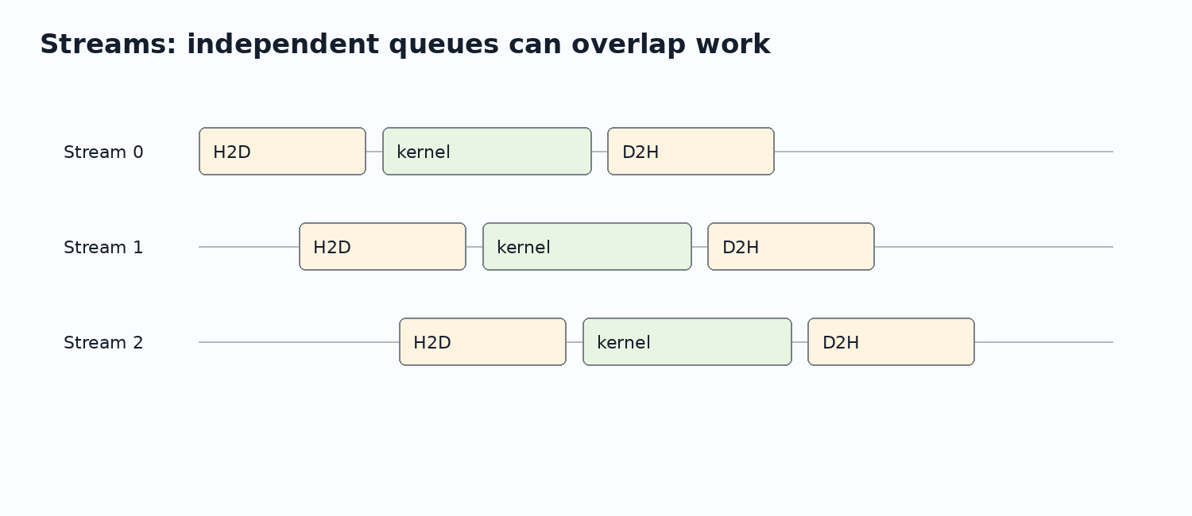
Streams: Why We Need Them
16/48
Streams allow independent queues of work
Split data into chunks.
Enqueue H2D, kernel, and D2H per stream.
Overlap requires hardware and memory prerequisites.
runtime/cuda_launch.h | Source: CUDA C++ Programming Guide

Slide 17
Async Copy Requirements
17/48
cudaMemcpyAsync is not magic by itself
Requirement | Reason
Pinned host memory | enables efficient async transfer
Non-default streams | allows independent queues
Independent chunks | prevents data dependency serialization
copy engines | hardware support for overlap
explicit synchronization | makes results reliable
device_info asyncEngineCount | Source: CUDA C++ Programming Guide

Slide 18
Lab 2 Design: Chunked Vector Add
18/48
Design stream overlap before implementing it
Checkpoint / exercise
for stream in streams: cudaMemcpyAsync(..., stream) kernel<<<grid, block, 0, stream>>>(...) cudaMemcpyAsync(..., stream)
Split the vector into chunks.
Allocate or reuse device buffers per stream.
Enqueue H2D -> kernel -> D2H per chunk.
Synchronize streams and compare with CPU oracle.
future extension of gpu/vector_add_cuda.cc

Slide 19
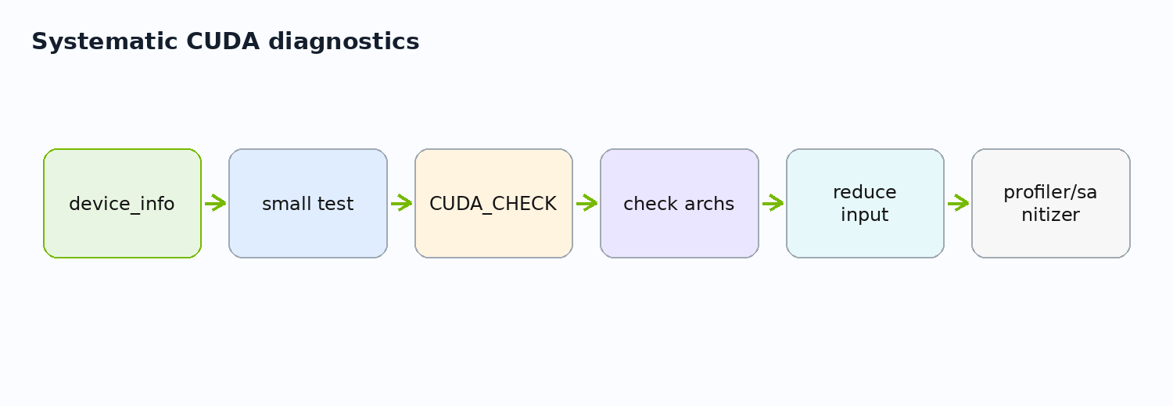
Error Handling Under Asynchrony
19/48
Launch-time and execution-time errors surface at different points
cudaGetLastError catches launch configuration issues.
Synchronization catches many execution errors.
A later CUDA call may report an earlier asynchronous failure.
runtime/cuda_errors.h | Source: CUDA Runtime API - Execution Control

Slide 20
Debugging Workflow
20/48
Use a repeatable diagnosis order
Run //runtime:device_info.
Run the smallest correctness test.
Check CUDA_CHECK failure location.
Reduce input size.
Inspect architecture flags.
Use compute-sanitizer or Nsight when available.
runtime + gpu tests | Source: Nsight / CUDA runtime docs

Slide 21
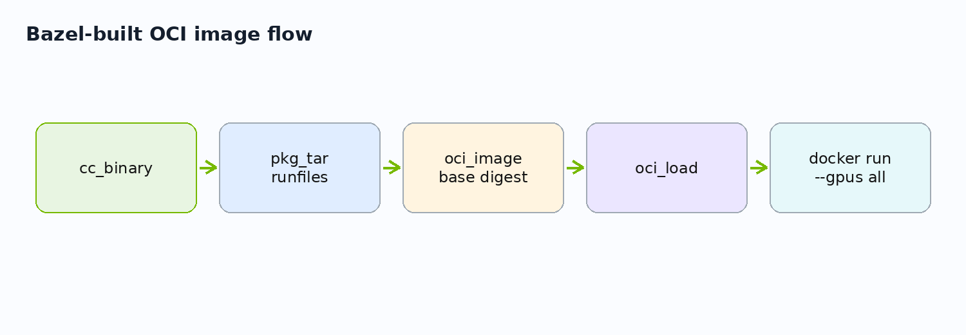
Packaging Motivation
21/48
Deployment should preserve the build contract
A working local binary is not a deployment artifact.
The runtime image should contain only what is needed to run.
Bazel can build the binary and assemble the image.
projects/simple/src/BUILD.bazel | Source: rules_oci

Slide 22
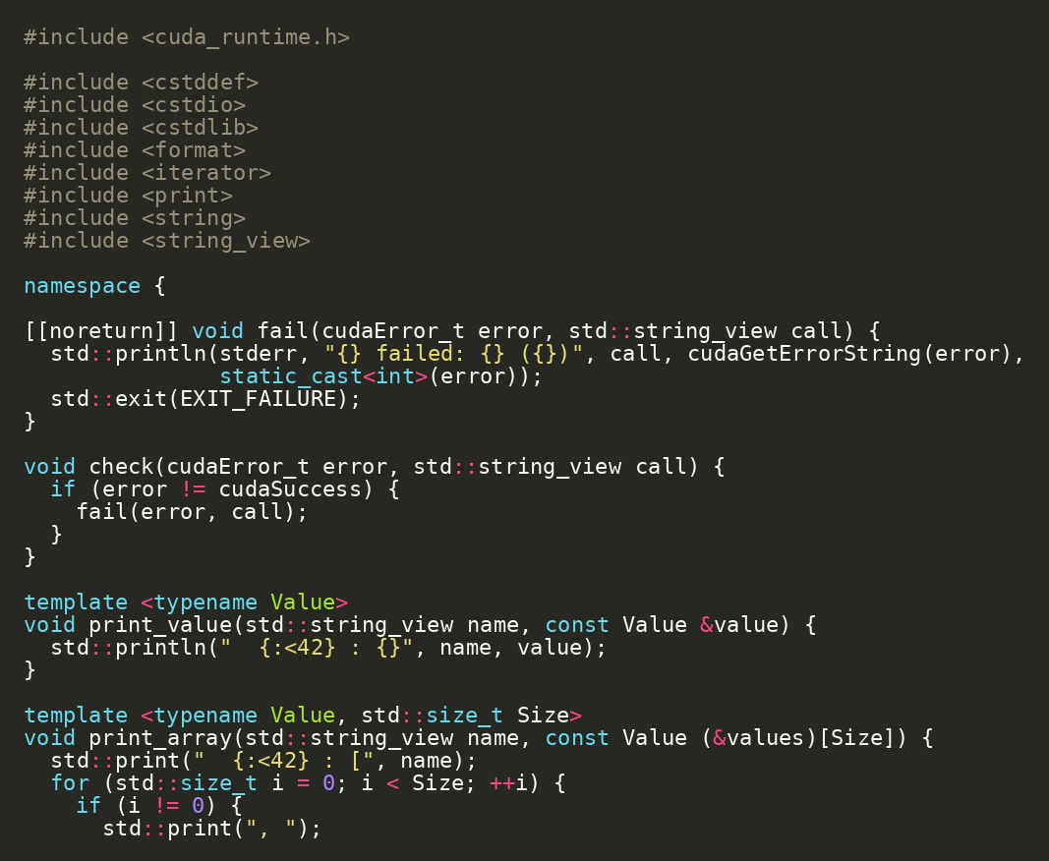
Simple Project as Deployment Specimen
22/48
projects/simple is the minimal hermetic CUDA image project
Small GPU info binary.
CUDA runtime dependency.
OCI target is easy to inspect.
cd projects/simple bazel run //src:gpu_info
projects/simple

Slide 23
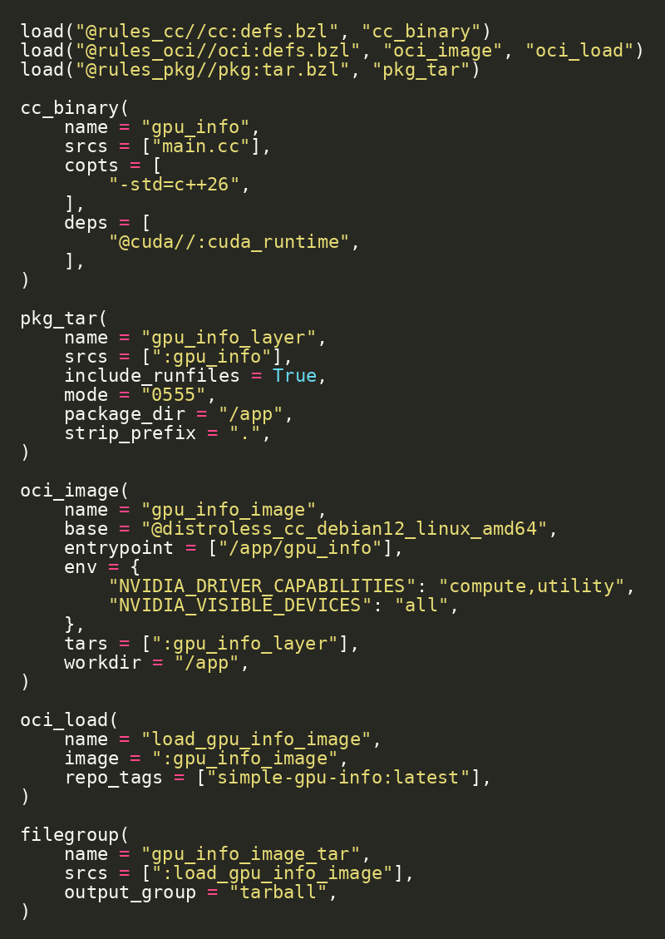
Container Target in Bazel
23/48
The image is a Bazel target, not a hand-written Dockerfile
cc_binary builds the app.
pkg_tar packages binary/runfiles.
oci_image creates the image.
oci_load loads it into Docker.
projects/simple/src/BUILD.bazel | Source: rules_oci

Slide 24
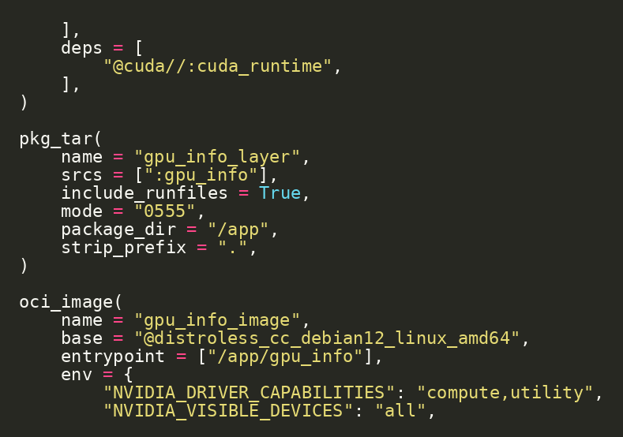
Packaging Runtime Files
24/48
Bazel runfiles make runtime shared libraries explicit
include_runfiles brings runtime dependencies into the layer.
The executable lands under /app.
The container entrypoint points to the packaged binary.
pkg_tar + oci_image

Slide 25
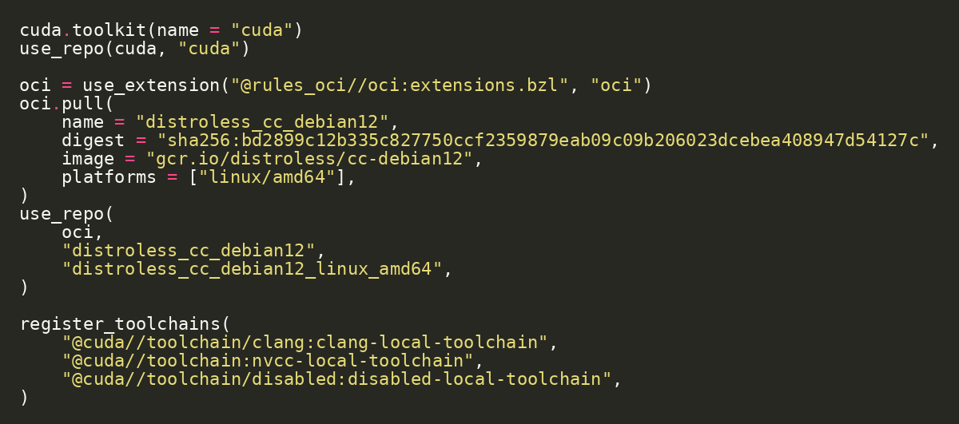
Digest-Pinned Base Image
25/48
Container reproducibility includes the base image
Pin the base image by digest, not only by tag.
This keeps the image input stable over time.
rules_oci pulls the OCI base as a declared repository input.
projects/simple/MODULE.bazel | Source: rules_oci

Slide 26
Live Demo: Load and Run the Tiny GPU Image
26/48
The GPU info tool runs inside a small container
Checkpoint / exercise
cd projects/simple bazel run //src:load_gpu_info_image docker run --rm --gpus all simple-gpu-info:latest
Build and load the OCI image.
Run the image with GPU access.
Confirm the host runtime provides the NVIDIA driver/GPU.
//src:load_gpu_info_image

Slide 27
Image Size and Artifact
27/48
The deployable image is a build artifact and a loaded Docker image
Checkpoint / exercise
bazel build //src:gpu_info_image_tar docker image ls simple-gpu-info:latest
Build the tarball output group.
Inspect the Docker image list.
Distinguish Bazel artifact from Docker daemon image.
bazel-bin/src/load_gpu_info_image/tarball.tar

Slide 28
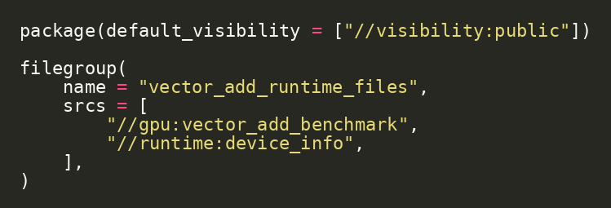
Detailed Deploy Target
28/48
Deployment starts by deciding which runtime files belong together
The detailed project collects benchmark and device-info runtime files.
This can evolve into a full detailed project image target.
Keep deployment explicit.
projects/detailed/deploy/BUILD.bazel

Slide 29
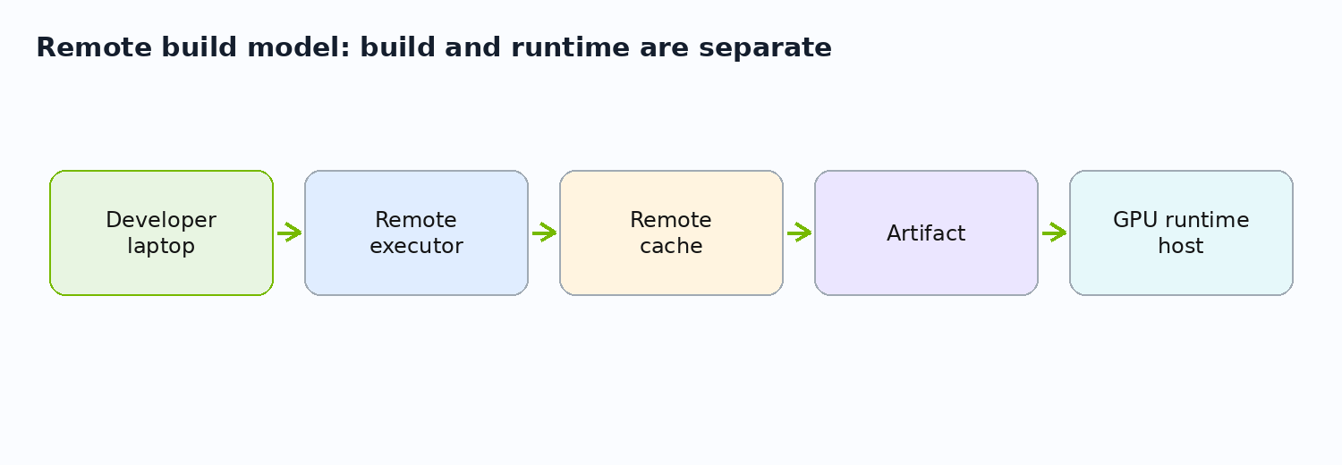
Remote Build Model
29/48
Hermetic targets are the prerequisite for remote build confidence
Local developer invokes Bazel.
Remote executor runs declared actions.
Remote cache stores reusable outputs.
GPU runtime host remains a separate concern.
remote execution concept | Source: Bazel Remote Execution

Slide 30
What Remote Build Does Not Solve
30/48
A remote build machine is not automatically a GPU runtime machine
Build-time CUDA headers/toolchains can be hermetic.
Runtime GPU driver and device access are environment-specific.
Validate GPU execution on compatible runtime hosts.
build machine vs runtime machine | Source: Bazel Remote Execution

Slide 31
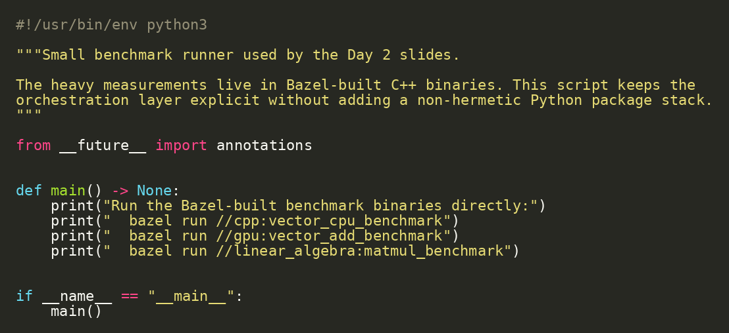
Python Hook: Benchmark Orchestration
31/48
Python can orchestrate without owning the heavy compute path
Python runs Bazel-built binaries.
The compute path stays in C++/CUDA.
This keeps measurement automation lightweight.
bazel run //python:benchmark
projects/detailed/python/benchmark.py

Slide 32
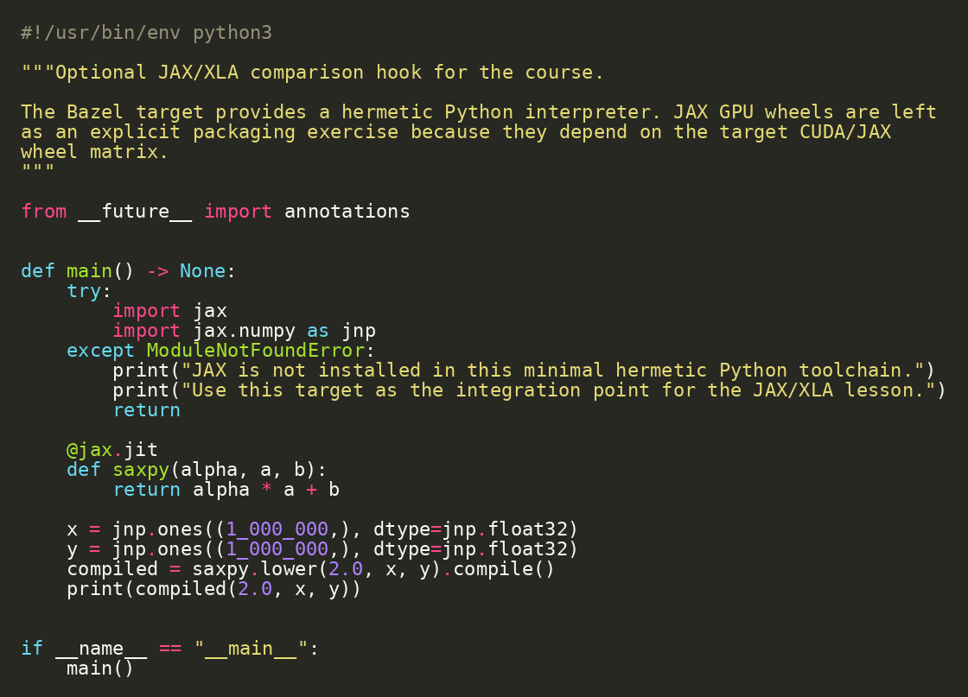
JAX/XLA Comparison Hook
32/48
JAX expresses computation and lets the compiler lower it
jax.jit traces a Python function.
lower() exposes the lowered form.
compile() produces an executable for a target backend.
bazel run //python:jax_xla_demo
projects/detailed/python/jax_xla_demo.py | Source: JAX AOT lowering and compilation

Slide 33
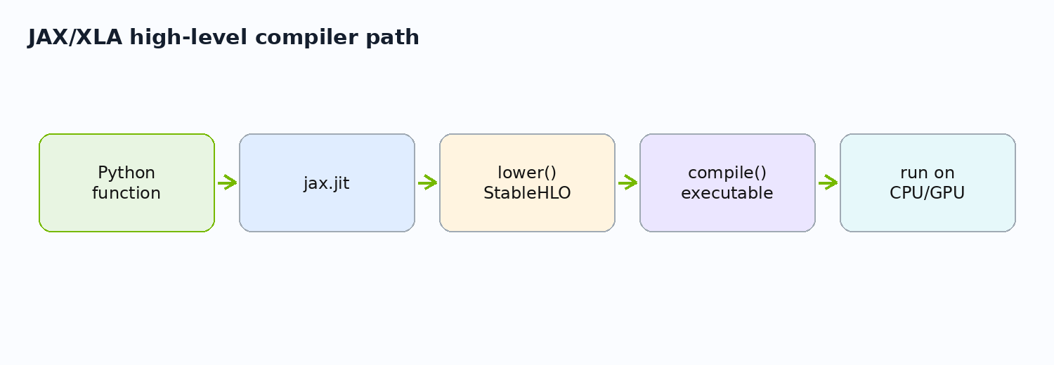
Manual CUDA vs JAX/XLA
33/48
Manual CUDA exposes control; JAX exposes compiler-managed array programs
Manual CUDA: explicit memory, launch geometry, and runtime calls.
JAX/XLA: array semantics, tracing, lowering, and compilation.
This is a layer comparison, not a winner-take-all decision.
gpu/vector_add_device.cu vs python/jax_xla_demo.py | Source: JAX AOT lowering and compilation

Slide 34
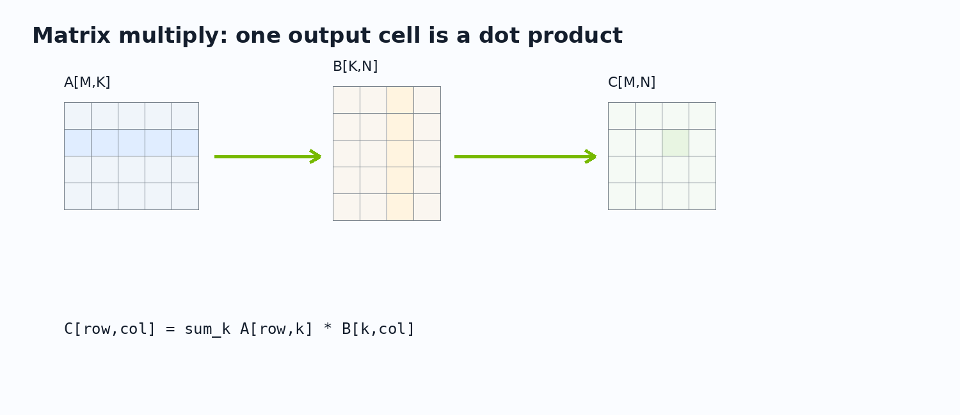
Transition to MatMul
34/48
Vector add teaches mechanics; MatMul teaches reuse and hierarchy
Vector add is memory-bound and simple.
MatMul reuses rows and columns.
The linear algebra module is separate by design.
projects/detailed/linear_algebra

Slide 35
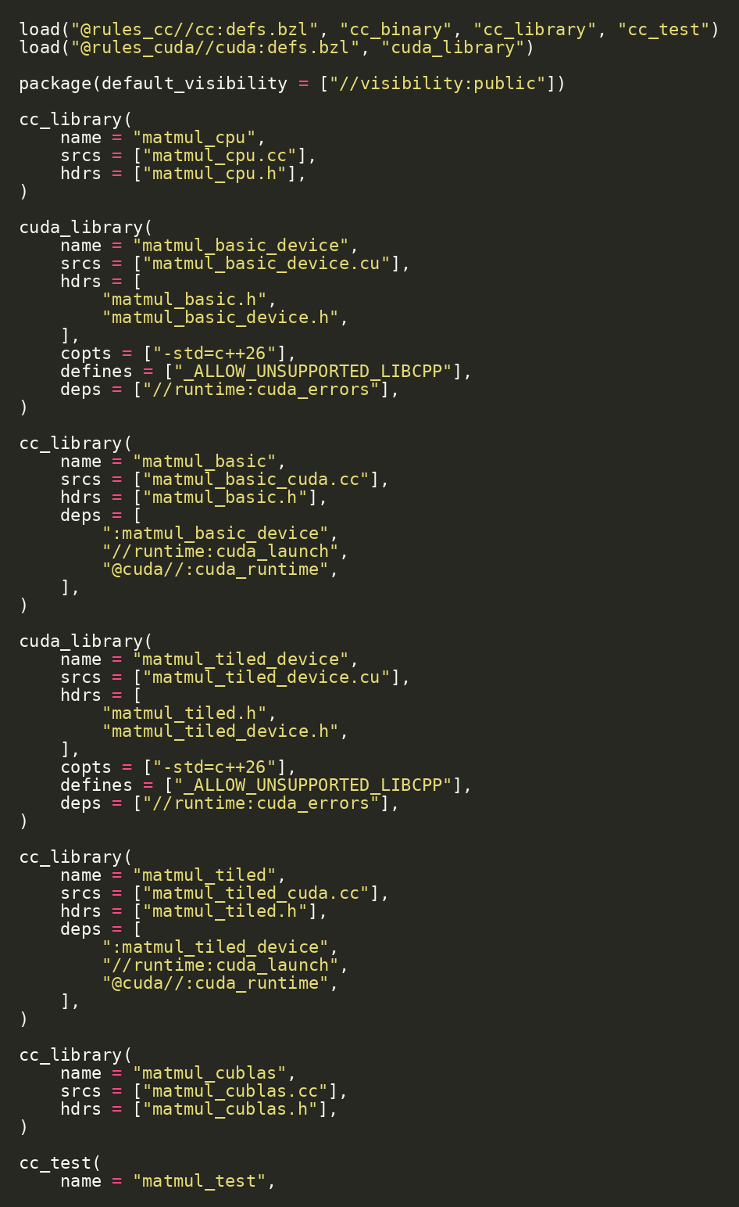
Linear Algebra Module Map
35/48
MatMul has a CPU oracle and two CUDA implementations
CPU MatMul oracle.
Basic CUDA one-thread-per-output kernel.
Tiled CUDA shared-memory kernel.
Test and benchmark targets.
projects/detailed/linear_algebra/BUILD.bazel

Slide 36
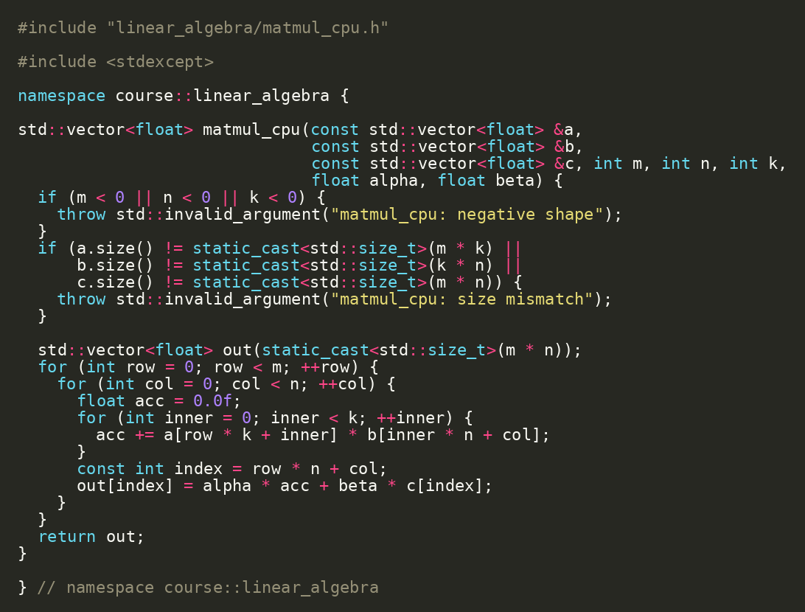
CPU MatMul Oracle
36/48
Even MatMul starts with CPU correctness
Nested loops over M, N, and K.
Defines exact semantics for small test sizes.
Used by matmul_test before benchmark interpretation.
bazel test //linear_algebra:matmul_test
linear_algebra/matmul_cpu.cc

Slide 37
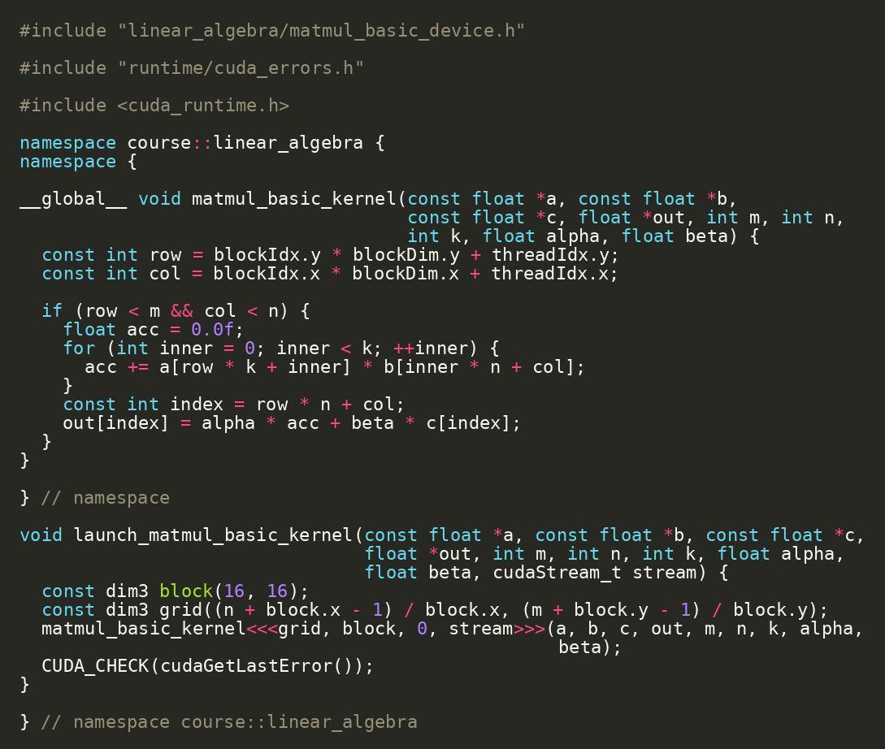
Basic CUDA MatMul
37/48
One thread computes one output element
Map 2D thread coordinates to row and column.
Each thread loops over K.
Correct and parallel, but global-memory reuse is poor.
linear_algebra/matmul_basic_device.cu | Source: CUDA C++ Programming Guide

Slide 38
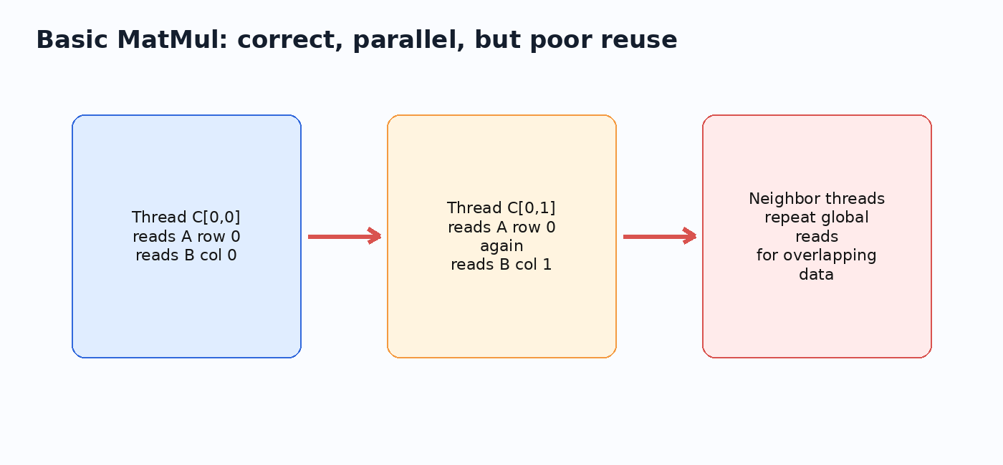
Why Basic MatMul Leaves Performance Behind
38/48
Re-reading global memory wastes bandwidth
Neighboring threads repeatedly read overlapping A/B data.
Memory bandwidth becomes the limit.
This motivates shared-memory tiling.
matmul_basic_device.cu | Source: CUDA C++ Best Practices Guide

Slide 39
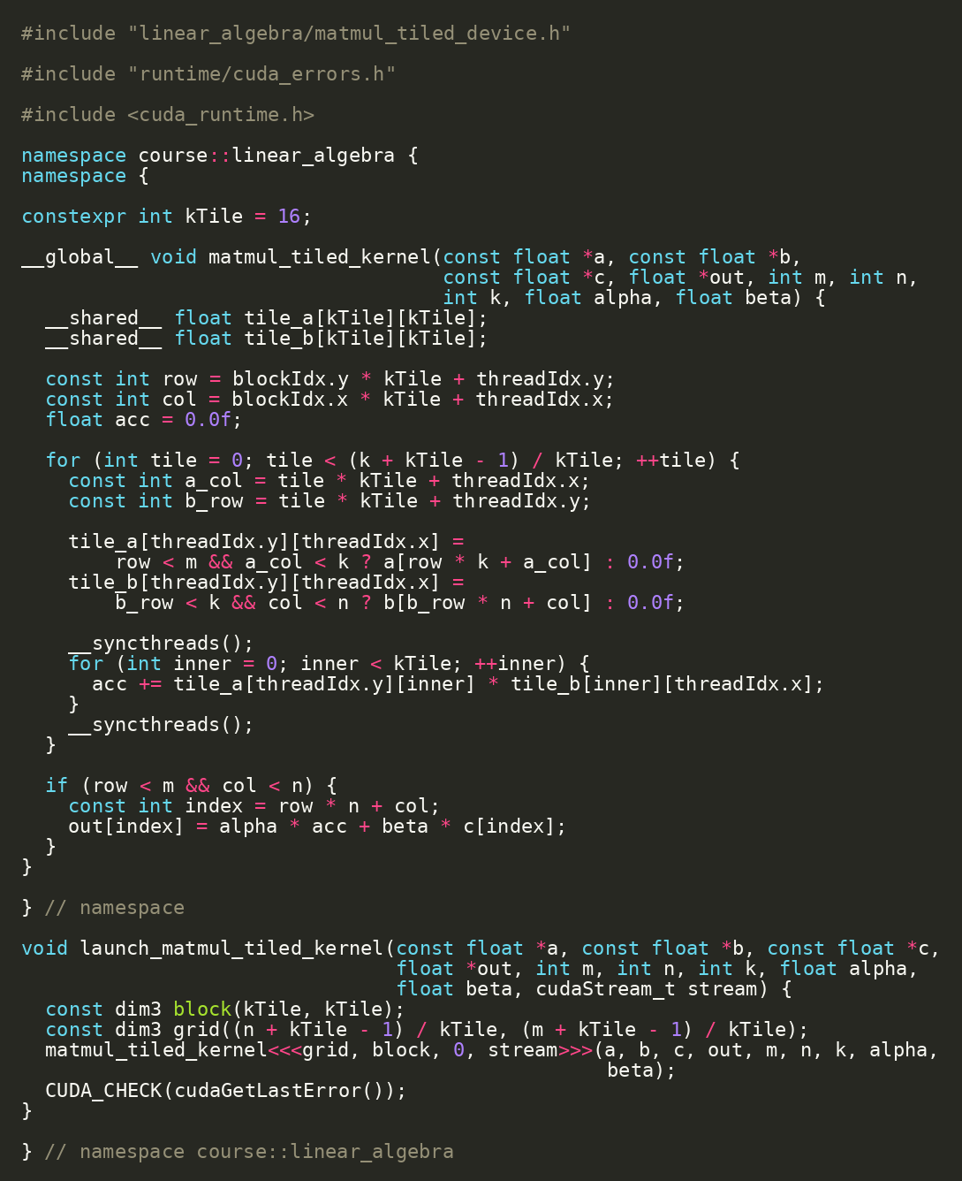
Tiled MatMul
39/48
Shared memory lets a block reuse tiles of A and B
Threads cooperatively load A and B tiles.
__syncthreads() creates a block barrier.
Each tile is reused across multiple multiply-adds.
linear_algebra/matmul_tiled_device.cu | Source: CUDA C++ Best Practices Guide

Slide 40
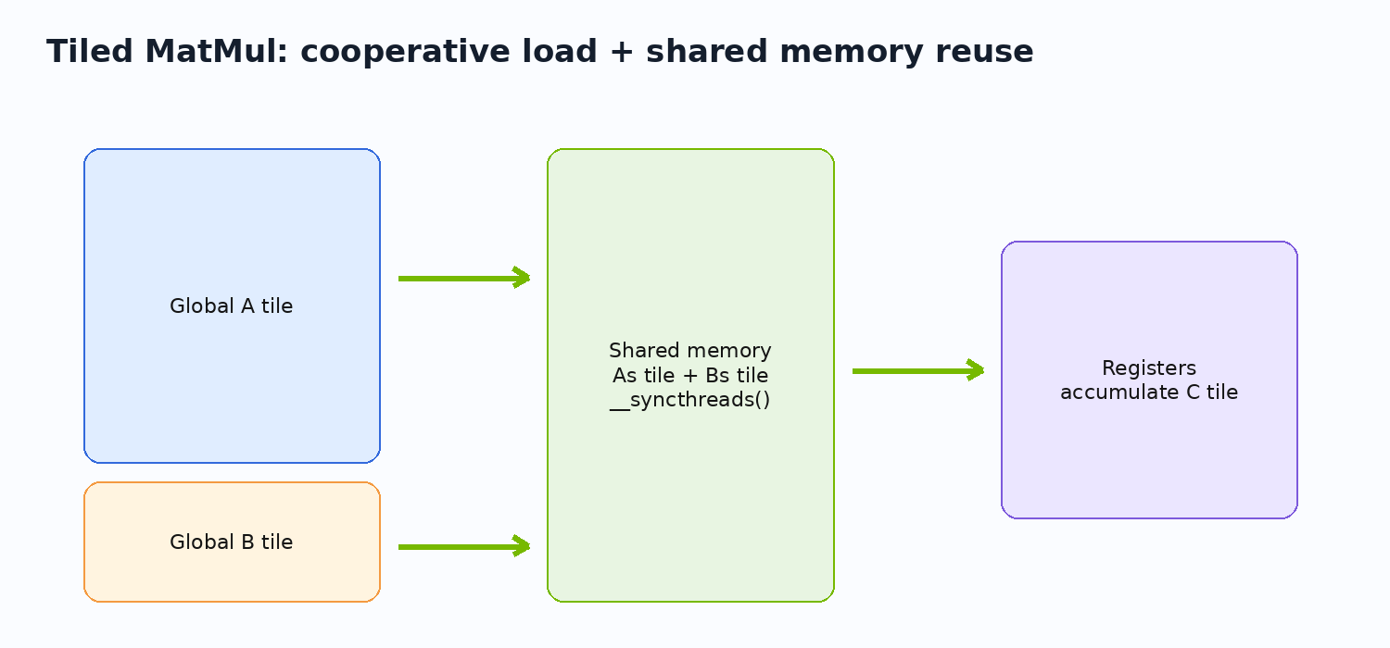
Shared Memory Mental Model
40/48
Shared memory is per-block scratchpad with explicit cooperation
Scope: one thread block.
Lifetime: one kernel block execution.
Use: cooperative data reuse.
Cost: limited capacity and synchronization constraints.
__shared__ + __syncthreads | Source: CUDA C++ Programming Guide

Slide 41
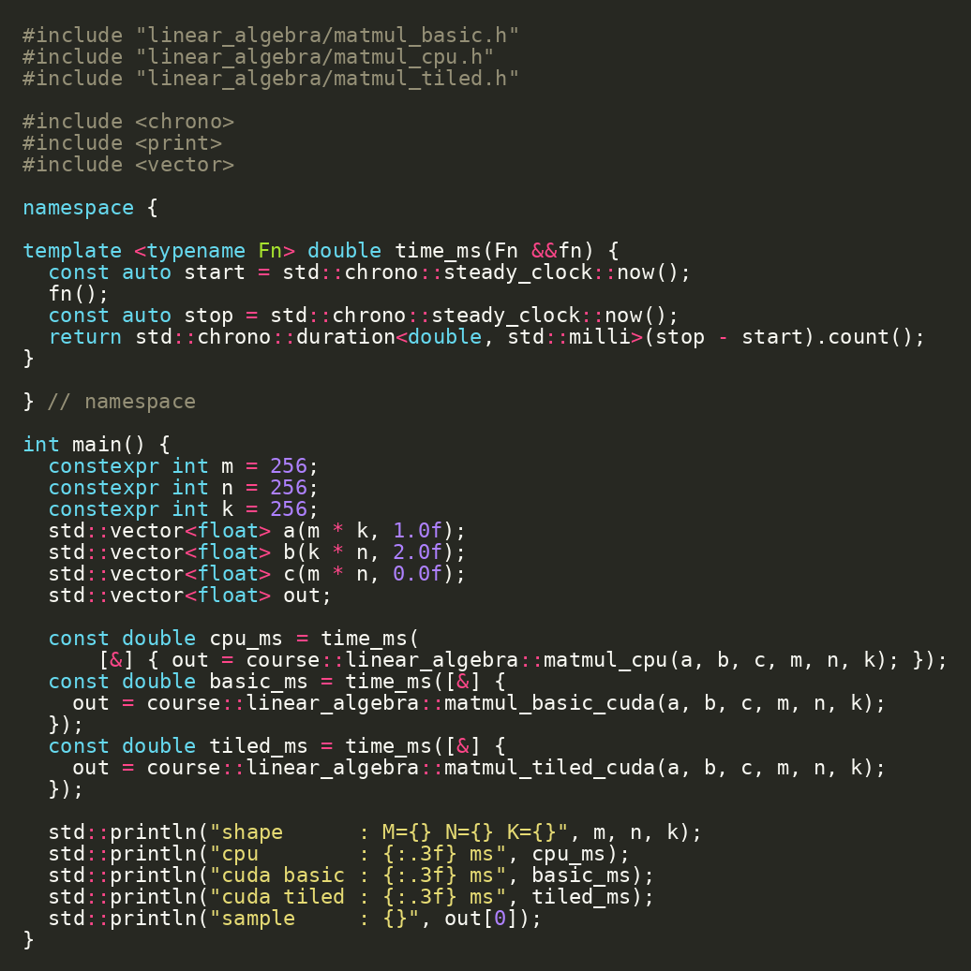
MatMul Benchmark
41/48
The benchmark shows the ladder: CPU, basic CUDA, tiled CUDA
Use small enough sizes for lab turnaround.
Record correctness and timing.
Interpret tiled performance through reuse, not just thread count.
bazel run //linear_algebra:matmul_benchmark
linear_algebra/matmul_benchmark.cc

Slide 42
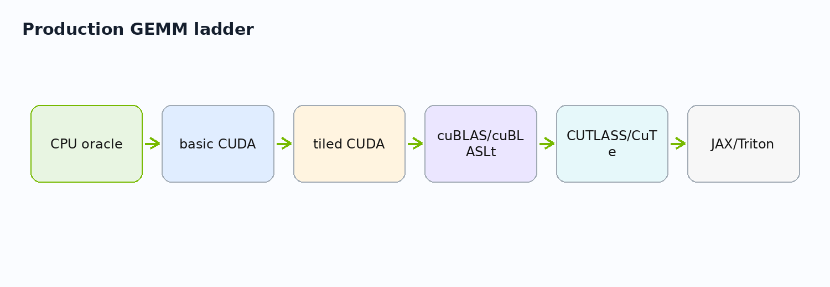
Lab 3: Fill the Benchmark Results Table
42/48
Runs become a small performance report
Checkpoint / exercise
bazel run //gpu:vector_add_benchmark bazel run //linear_algebra:matmul_benchmark
Open docs/benchmark_results.md.
Run vector-add benchmark.
Run MatMul benchmark.
Record CPU serial, CPU threaded, CUDA vector add, MatMul CPU, MatMul basic, MatMul tiled.
projects/detailed/docs/benchmark_results.md

Slide 43
Production GEMM: Why Libraries Exist
43/48
Real GEMM performance is a library engineering problem
Basic kernels teach the machine.
Tiled kernels teach data reuse.
cuBLAS/cuBLASLt define production baselines.
CUTLASS/CuTe show production-style customizable GEMM.
linear_algebra/matmul_cublas.cc hook | Source: cuBLAS/cuBLASLt + CUTLASS docs

Slide 44
Choosing the Right Level of CUDA
44/48
Use the lowest level only when the control is worth it
Custom CUDA C++ kernel: maximum control.
Thrust/CUB: reusable parallel primitives.
cuBLAS/cuDNN: production libraries.
JAX/XLA and frameworks: high-level compiler-managed math.
More control
More productivity
custom CUDA
explicit memory
kernel launch
debug lower level
Thrust/CUB
cuBLAS/cuDNN
JAX/XLA
PyTorch / TF / MLIR
alternatives and complements

Slide 45
Final End-to-End Demo
45/48
The complete project can build, test, benchmark, and package
Checkpoint / exercise
cd projects/detailed bazel test //... bazel run //gpu:vector_add_benchmark bazel run //linear_algebra:matmul_benchmark cd ../simple bazel run //src:load_gpu_info_image docker run --rm --gpus all simple-gpu-info:latest
Run all tests.
Run vector-add and MatMul benchmarks.
Load the simple GPU info image.
Run the image with GPU access.
projects/detailed + projects/simple

Slide 46
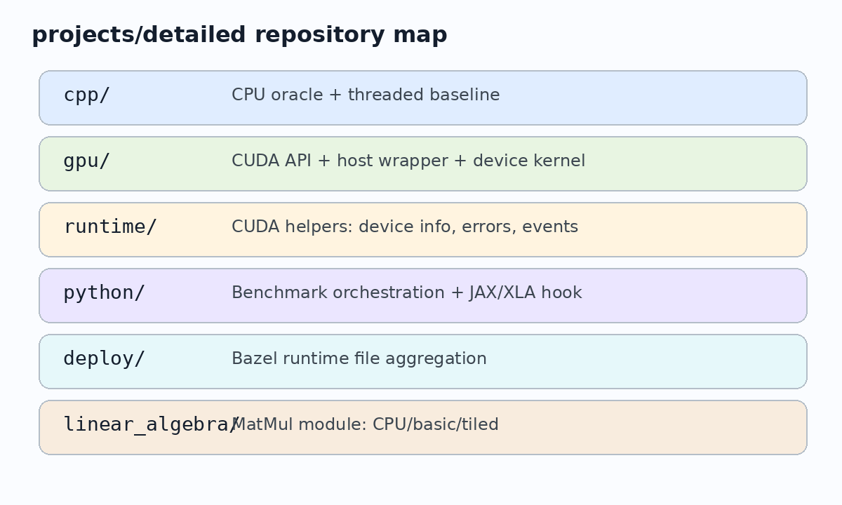
What to Reuse in Your Own Project
46/48
The reusable assets are patterns, not only files
Hermetic toolchain declaration.
CPU oracle + test.
CUDA host/device split.
Error checking helpers.
Benchmark target.
Container target.
Results worksheet.
copy patterns, not only source files

Slide 47
Capstone Exercise
47/48
Extend the repository without changing its architecture
Checkpoint / exercise
bazel test //... bazel run //gpu:vector_add_benchmark
Option 1: add a scalar multiply CUDA operation.
Option 2: add stream design notes to vector add.
Option 3: add an OCI image target for detailed benchmark files.
Option 4: add a benchmark row and explain it.
Bazel target graph
vector_cpu
benchmark
vector_add
device_lib
runtime
capstone extension

Slide 48
Closing: From Installed SDK to Reproducible GPU Project
48/48
The course goal is a reproducible GPU engineering workflow
Repository declares the build.
CPU verifies CUDA.
Benchmarks explain tradeoffs.
Containers package runtime.
JAX/XLA and libraries provide higher-level options.
//runtime:device_info, //gpu:vector_add_test, //gpu:vector_add_benchmark, //linear_algebra:matmul_benchmark, //src:load_gpu_info_image

