Slide 1
EDA Project:
House in king county
neuefisch
Xiaozhou Ye
15.05.2024

Slide 2
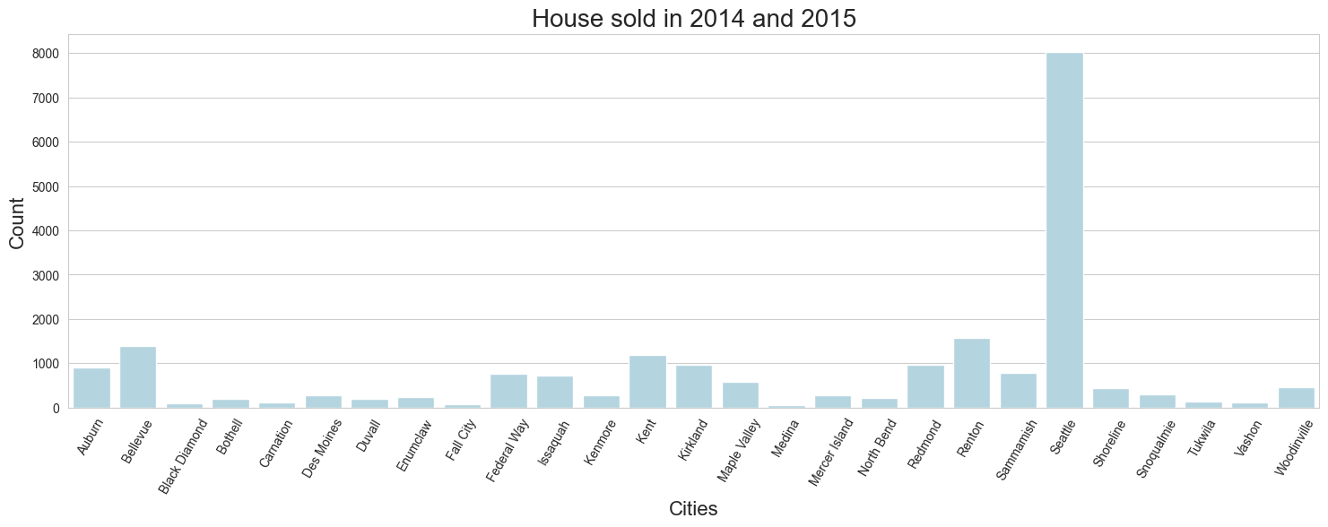
Overview of houses in 2014 and 2015 in the King County
21420 houses was sold from 2014.05-2015.05
in 27 cities , 70 areas(zipcode)
prices from $78000 to $7700000
2

Slide 3
Summary
 | price | bedrooms | bathrooms | sqft_living | sqft_lot | condition | grade | yr_built
count | 21420 | 21420 | 21420 | 21420 | 21420 | 21420 | 21420 | 21420
mean | 540739.304 | 3.374 | 2.118 | 2083.133 | 15128.038 | 3.411 | 7.663 | 1971
std | 367931.11 | 0.925 | 0.769 | 918.808 | 41530.797 | 0.65 | 1.172 | 29
min | 78000 | 1 | 0.5 | 370 | 520 | 1 | 3 | 1900
25% | 322500 | 3 | 1.75 | 1430 | 5040 | 3 | 7 | 1952
50% | 450000 | 3 | 2.25 | 1920 | 7614 | 3 | 7 | 1975

Slide 4
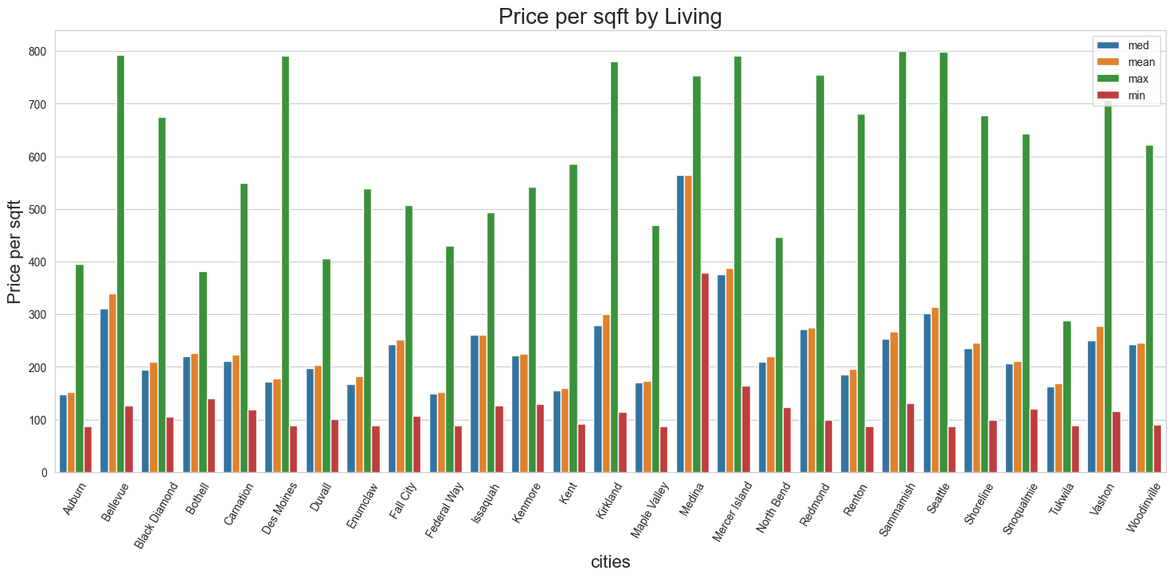
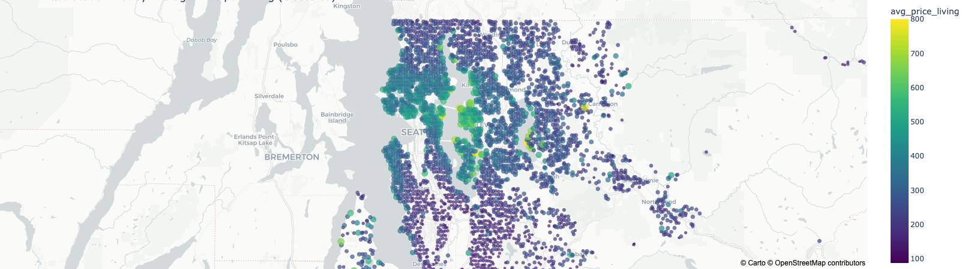
Top 5 cities with the highest medians
Medina
Mercer Island
Bellevue
Seattle
Kirkland

Slide 5
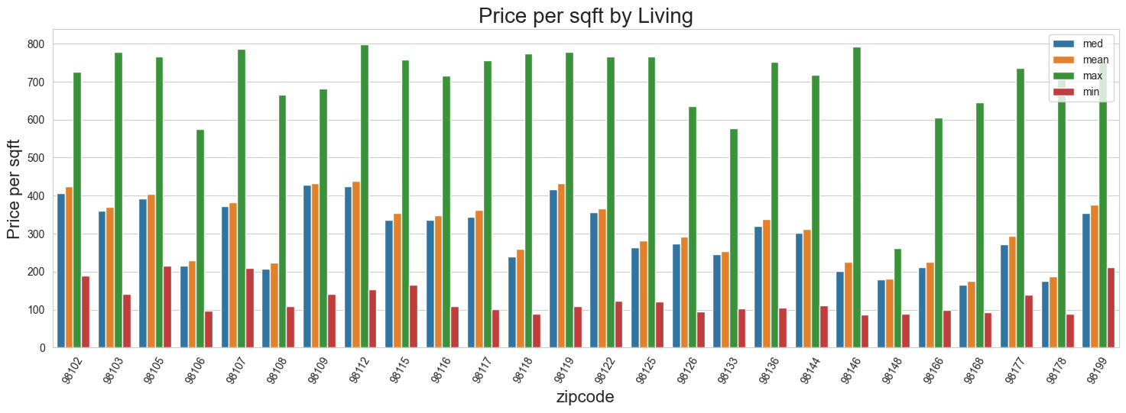
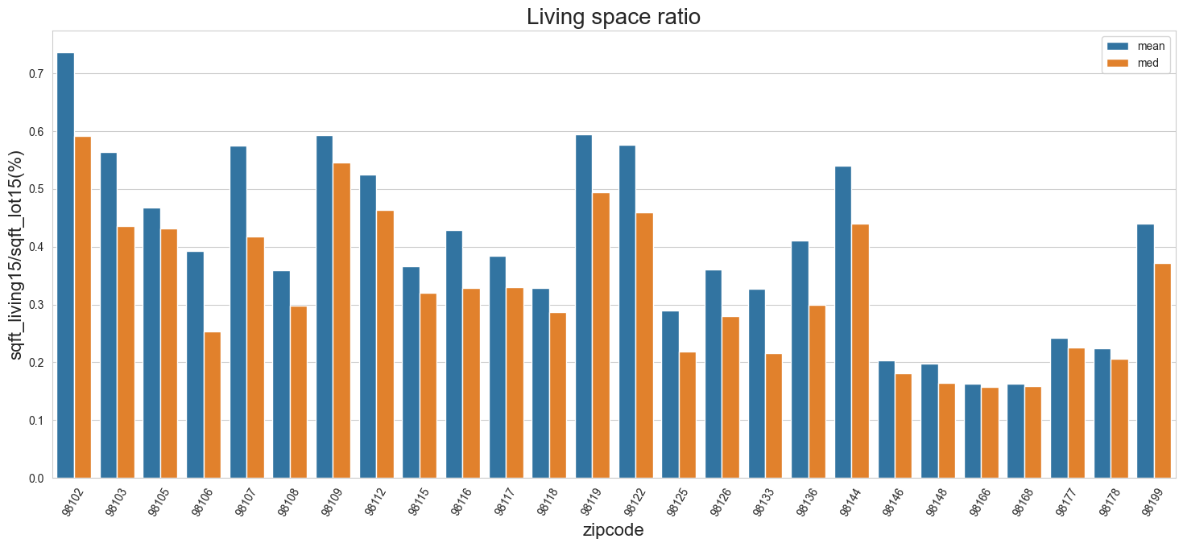
Overview of Seattle

Slide 6
Customer requirements
（ Nicole Johnson ，Buyer ， Lively, central neighborhood, middle price range, right timing ）
Lively—urban comfort
Seattle,with 27 zipcode,more houses were sold—big city
central neighborhood
On the basis of common sense, assumed:
in the city centre house price is more expensive
the ratio of living space to floor space is higher.
98102,98109,98112,98119,98107
middle price range (40%-60%?)
right timing (within a year)

Slide 7
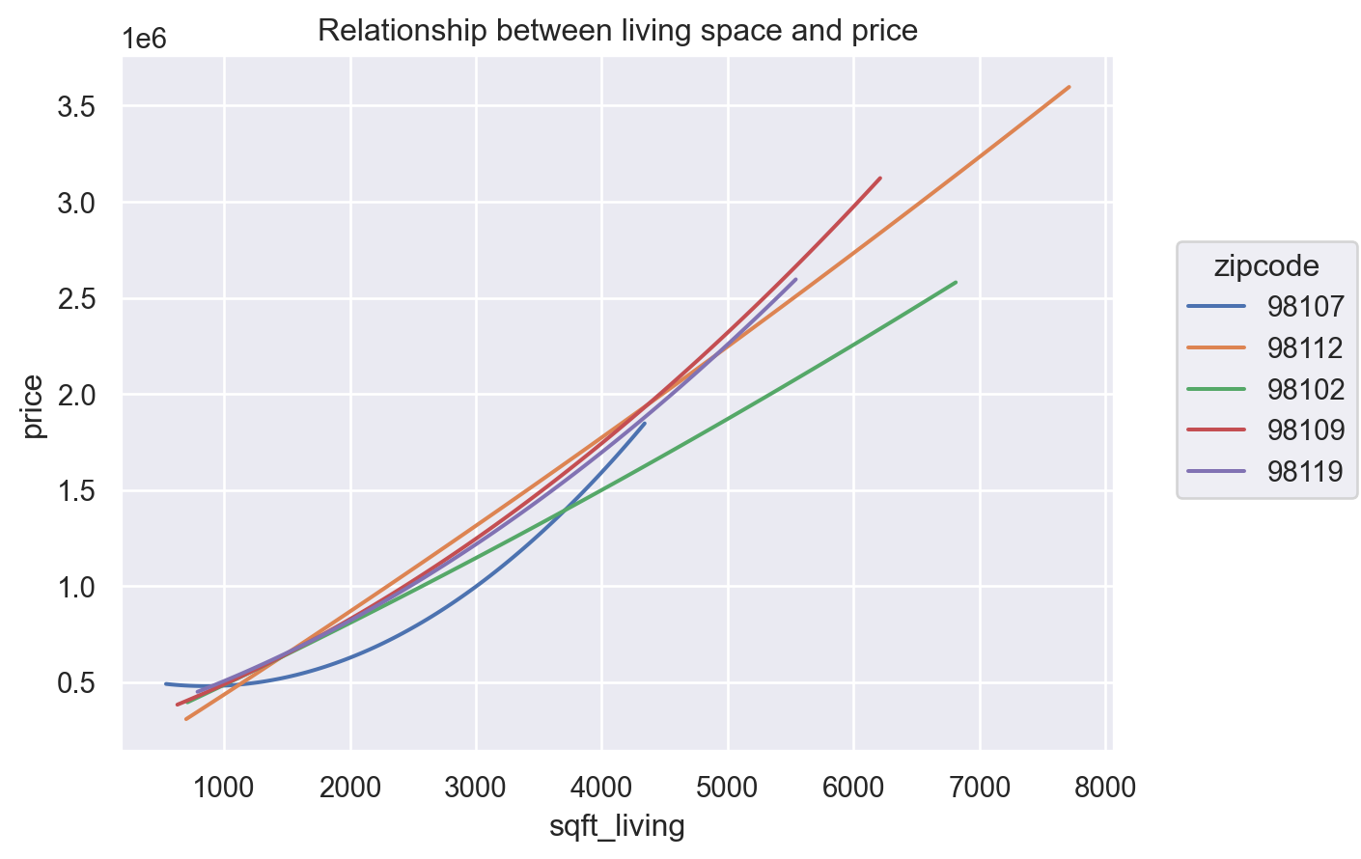
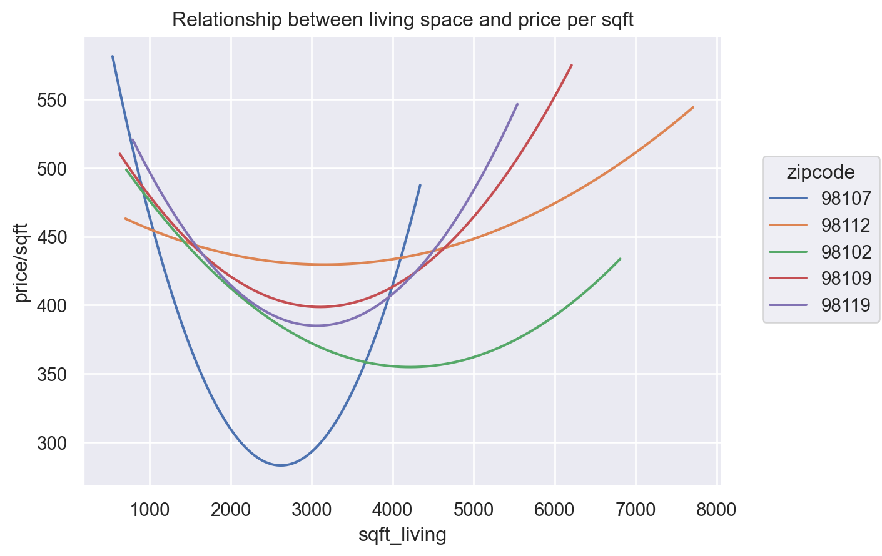
hypothesies：
1, price is related with living space
2,Price is related with the year of built

Slide 8
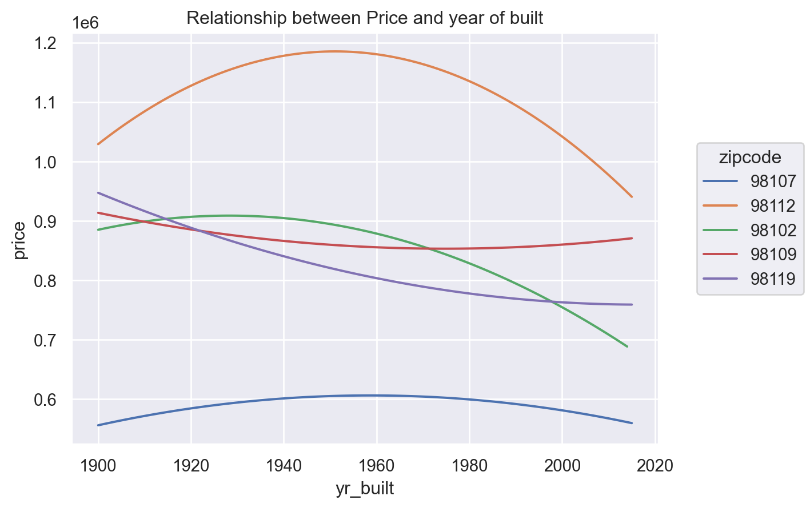
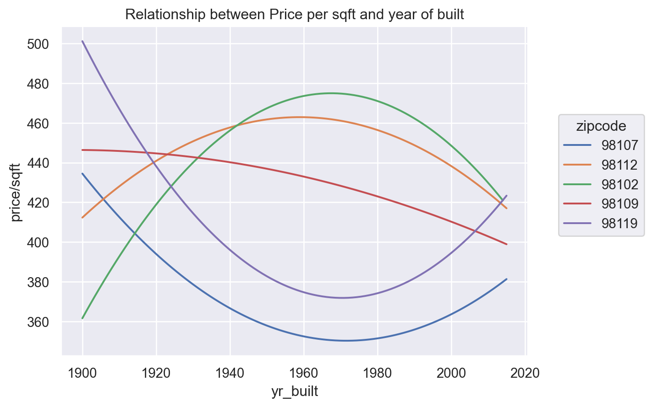

Slide 9
Conclusion about Price：
both total Price and Price-sqft are Strong correlation with zipcode and weak correlation with construction year
The bigger, the more expensive,but Price per sqft has a lowest points(not the smallest not the biggest)
most between $300-$500 per sqft
zipcode 98112,98102 and 98102 more expensiver
Total Price are Strong correlation with Condition and grade but Price/sqft is not
Higher value in Condition and Grade higher Price

Slide 10
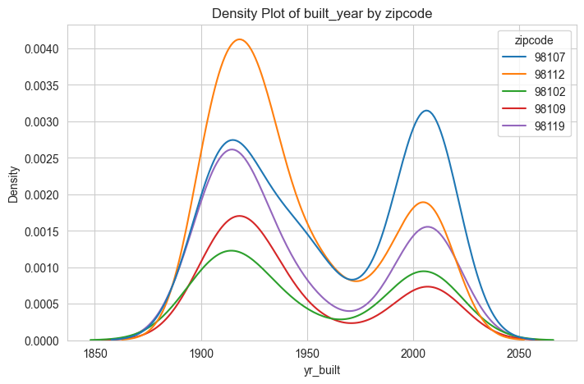
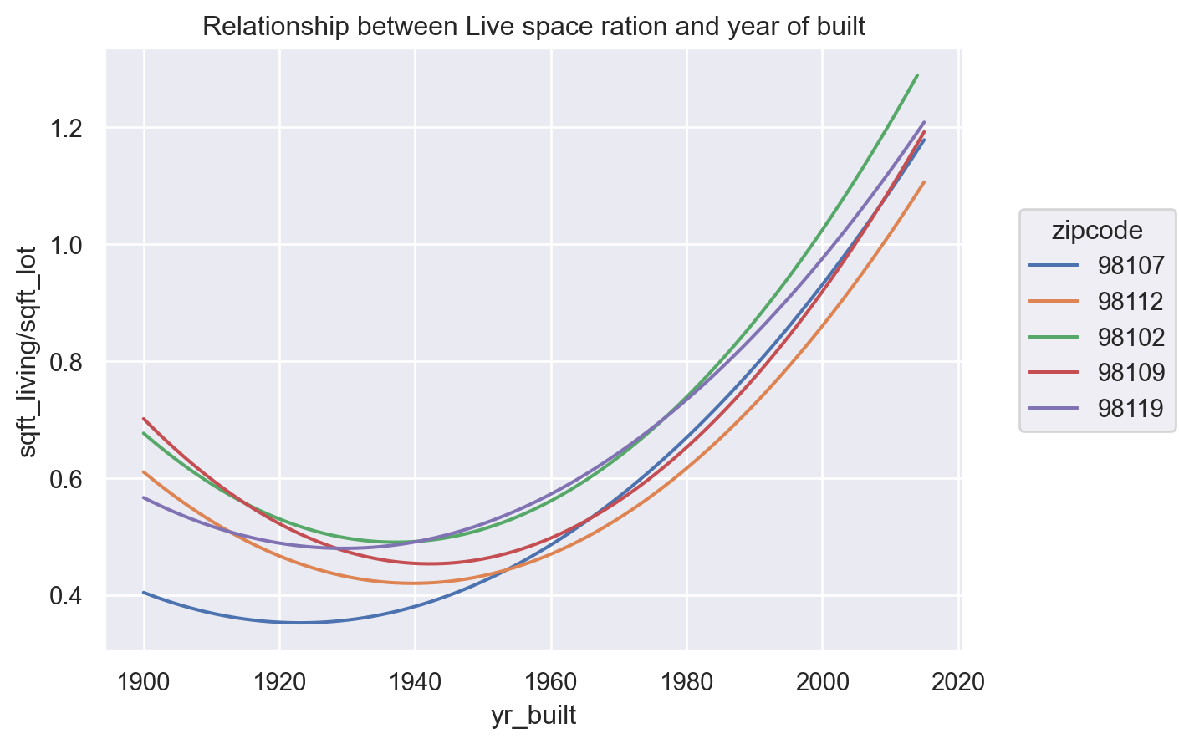
Conclusion about houses：
most of them are build around 1915 and 2010 some area is new some is older
for new houses,the living space ration(sqft_living/sqft_lot) is higher
most of houses are with 1-3.5 bathrooms and with 2-6 bedrooms
the bigger value of sqft-living the more bedrooms also bathrooms it has, and more expensive

Slide 11
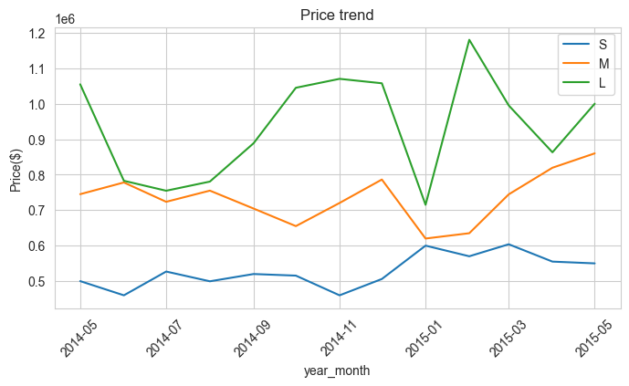
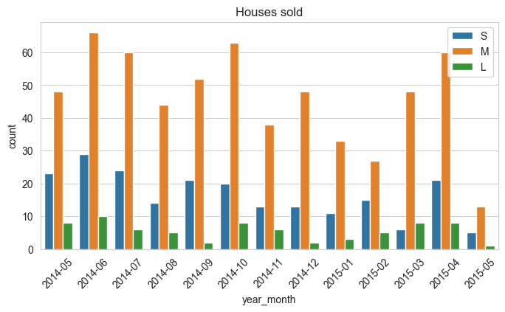
Price trend in 5 areas:
S: 1-2 bedrooms
M: 3-4 bedrooms
L: 5-6 bedrooms

