Slide 1
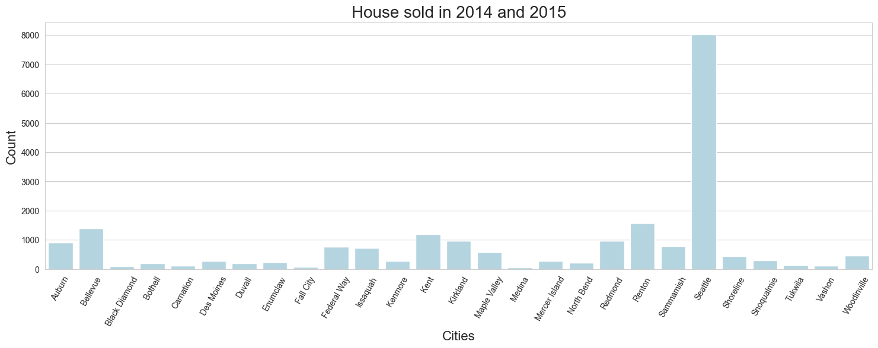
Overview of houses sold in 2014 and 2015 in the King County
21420 houses was sold from 2014.05-2015.05
in 27 cities , 70 areas(zipcode)
preis from $78000 to $7700000
2

Slide 2
Summary
 | price | bedrooms | bathrooms | sqft_living | sqft_lot | condition | grade | yr_built
count | 21420 | 21420 | 21420 | 21420 | 21420 | 21420 | 21420 | 21420
mean | 540739.304 | 3.374 | 2.118 | 2083.133 | 15128.038 | 3.411 | 7.663 | 1971
std | 367931.11 | 0.925 | 0.769 | 918.808 | 41530.797 | 0.65 | 1.172 | 29
min | 78000 | 1 | 0.5 | 370 | 520 | 1 | 3 | 1900
25% | 322500 | 3 | 1.75 | 1430 | 5040 | 3 | 7 | 1952
50% | 450000 | 3 | 2.25 | 1920 | 7614 | 3 | 7 | 1975

Slide 3
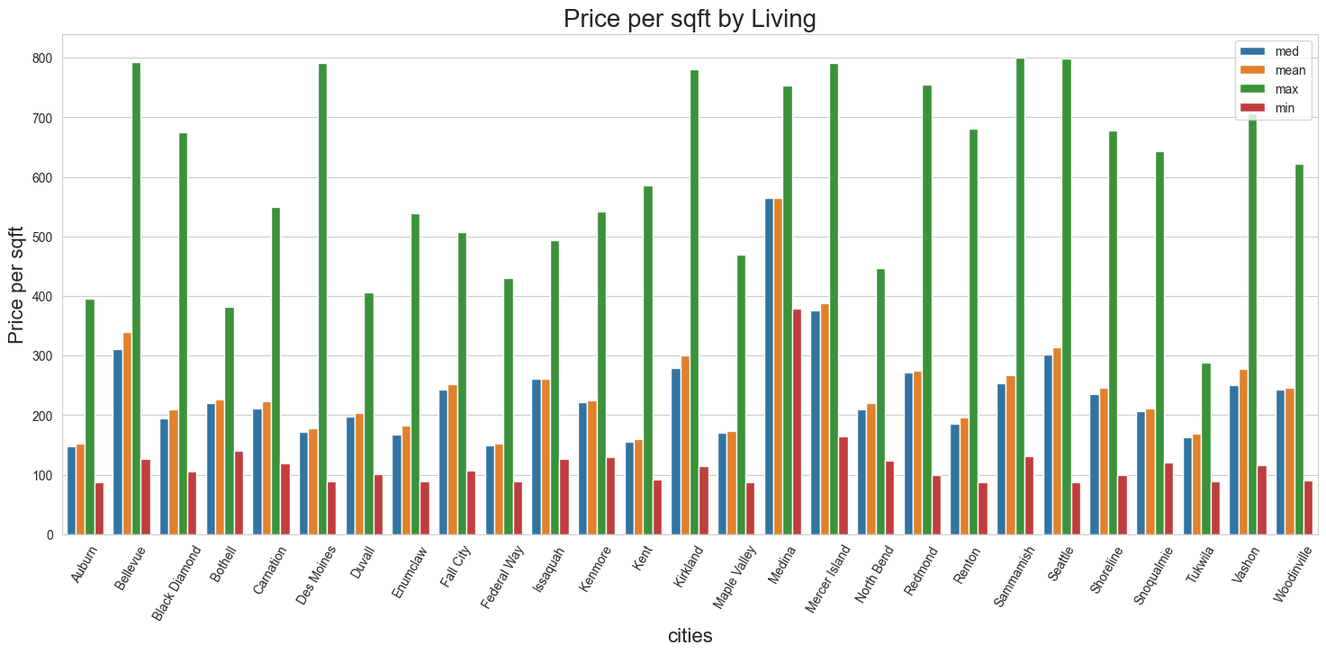
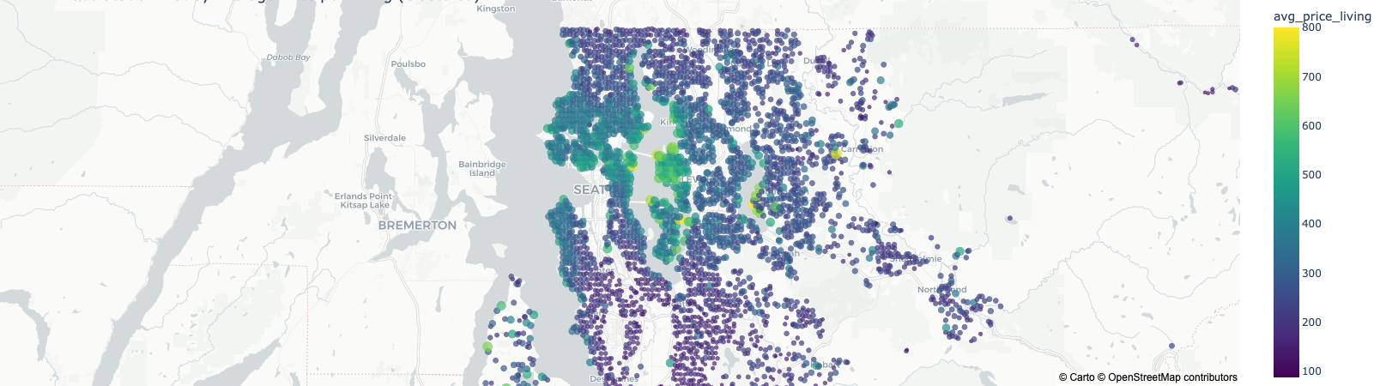
Top 5 cities with the highest medians
Medina
Mercer Island
Bellevue
Seattle
Kirkland

Slide 4
Customer requirements
（ Nicole Johnson ，Buyer ， Lively, central neighborhood, middle price range, right timing ）
Lively—urban comfort
Seattle,with 27 zipcode,more houses were sold—big city
central neighborhood
On the basis of common sense, assumed:
in the city centre house price is more expensive
the ratio of living space to floor space is higher.
98102,98109,98112,98119,98107
middle price range (40%-60%?)
right timing (within a year)

Slide 5
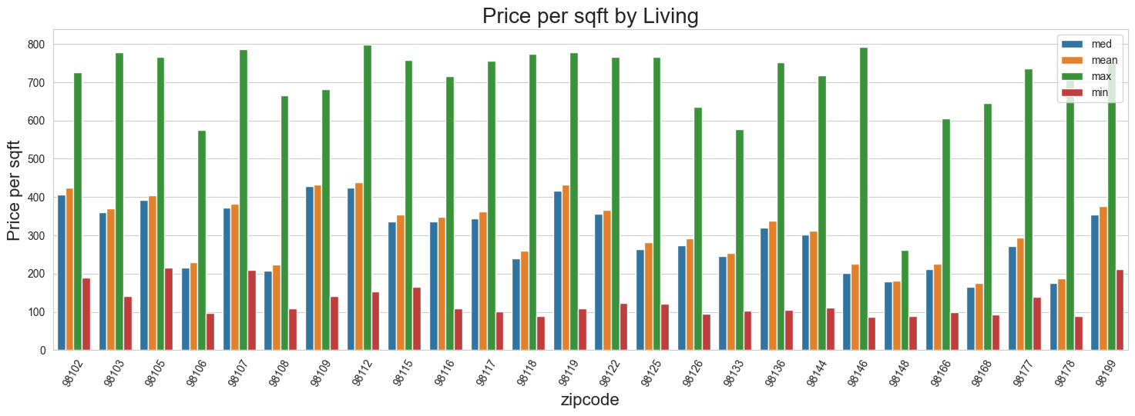
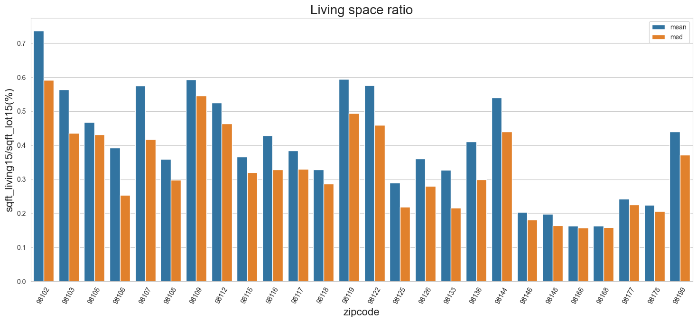

Slide 6
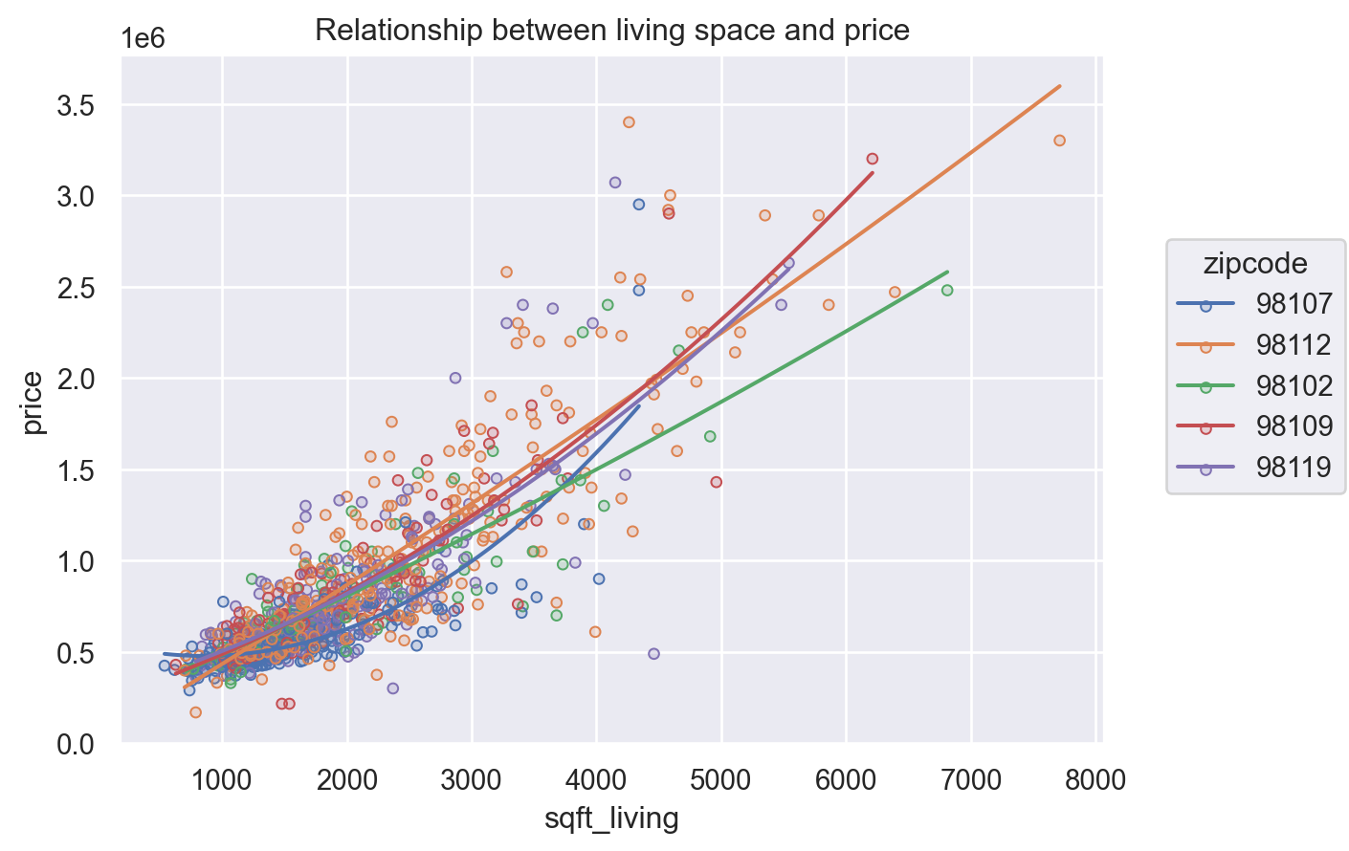
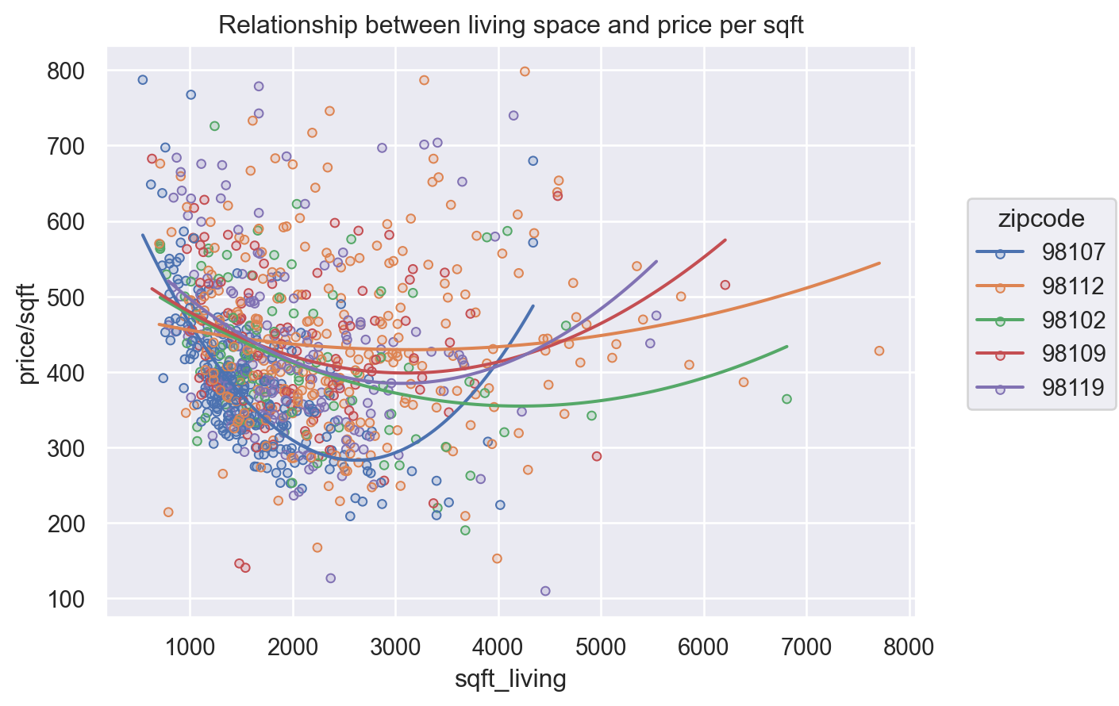
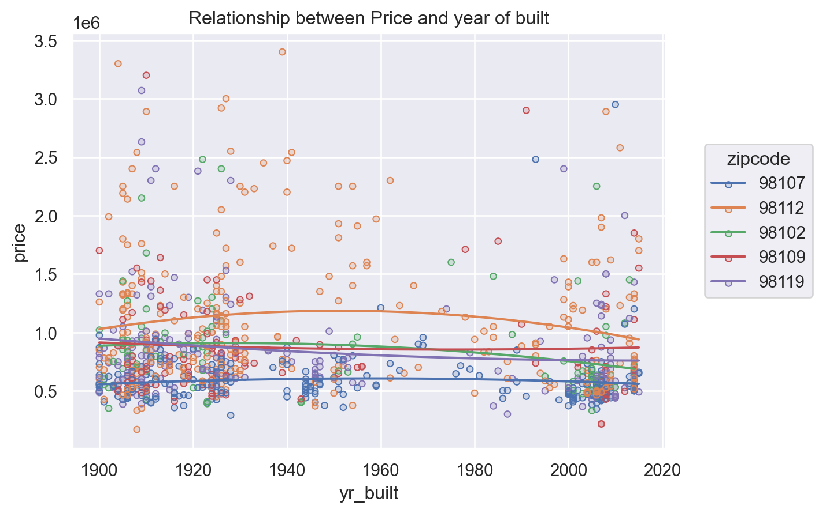
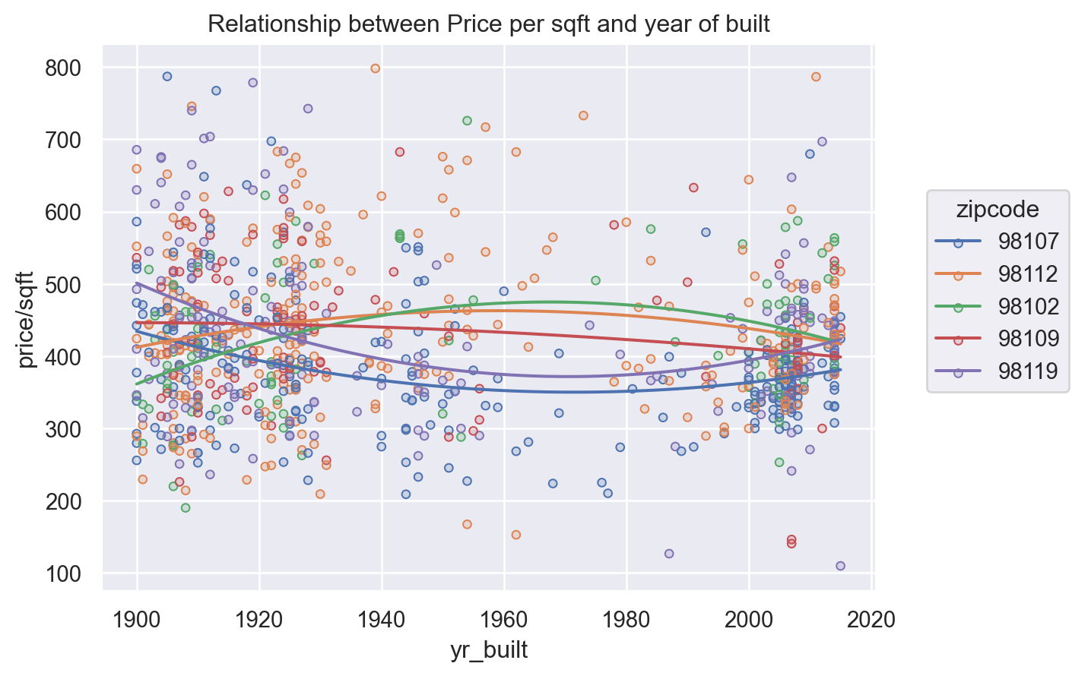

Slide 7
Conclusion about Price：
both total Price and Price-sqft are Strong correlation with zipcode and weak correlation with construction year
The bigger, the more expensive,but Price per sqft has a lowest points(not the smallest not the biggest)
most between $300-$500 per sqft
zipcode 98112,98102 and 98102 more expensiver
Total Price are Strong correlation with Condition and grade but Price/sqft is not
Higher value in Condition and Grade higher Price

Slide 8
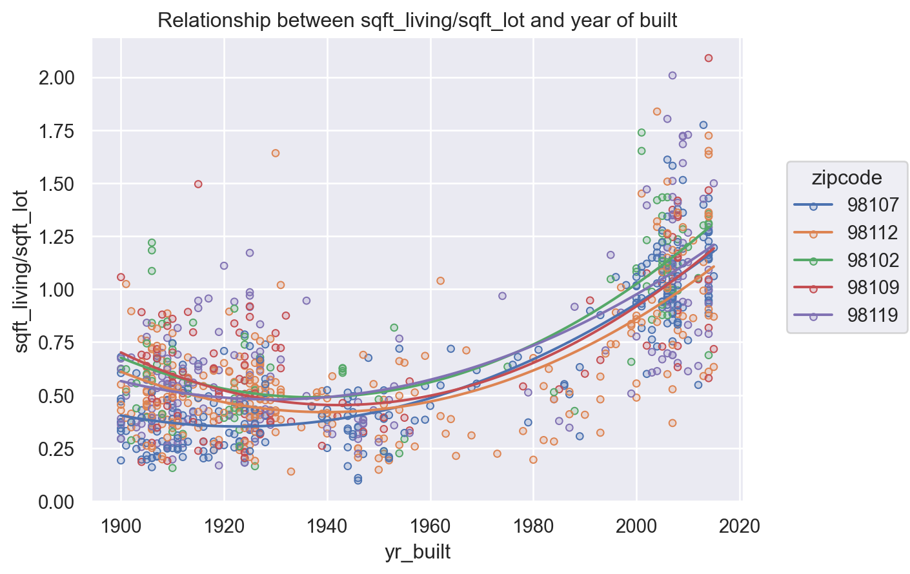
Conclusion about houses：
most of them are build around 1915 and 2010 some area is new some is older
for new houses,the living space ration(sqft_living/sqft_lot) is higher
most of houses are with 1-3.5 bathrooms and with 2-6 bedrooms
the bigger value of sqft-living the more bedrooms also bathrooms it has, and more expensive

Slide 9
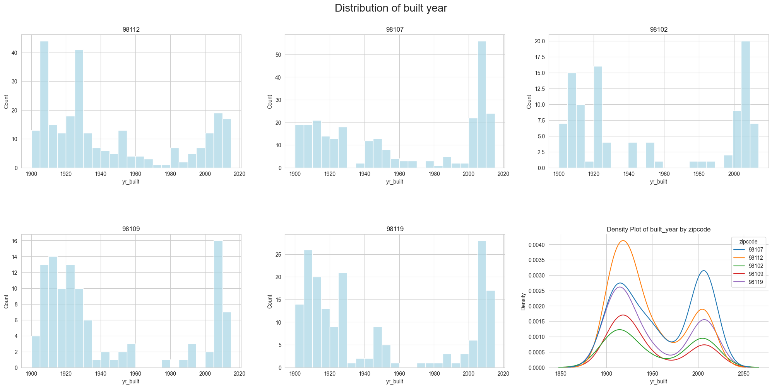

Slide 10
