Slide 1
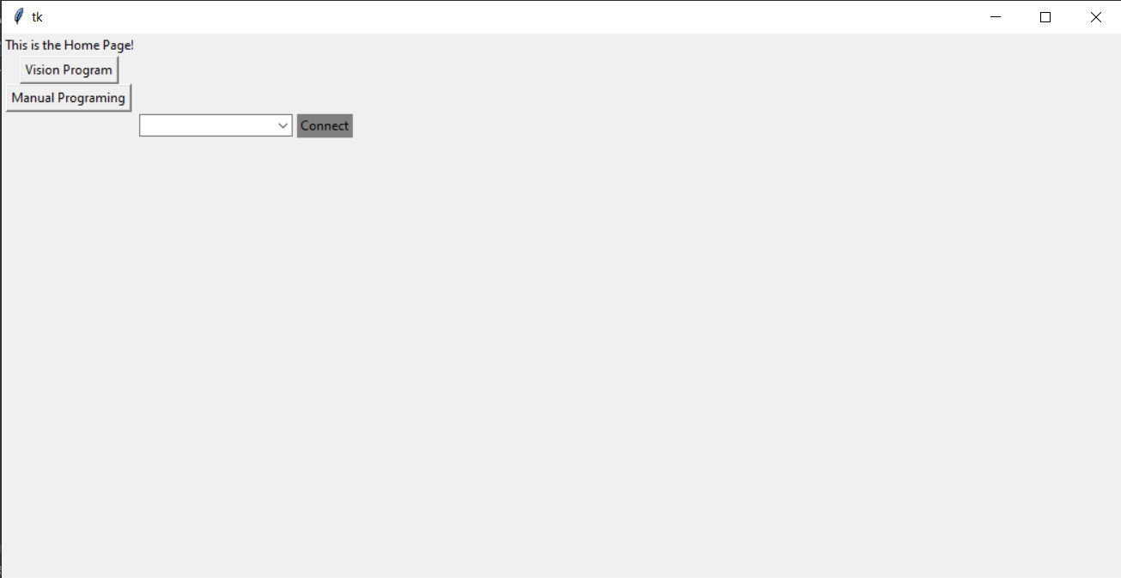
These buttons change to separate pages, I would like to use this as a home page to connect to the Arduino and then move to separate pages where I can perform functions that interact with the Arduino and pass data to the arduino

Slide 2
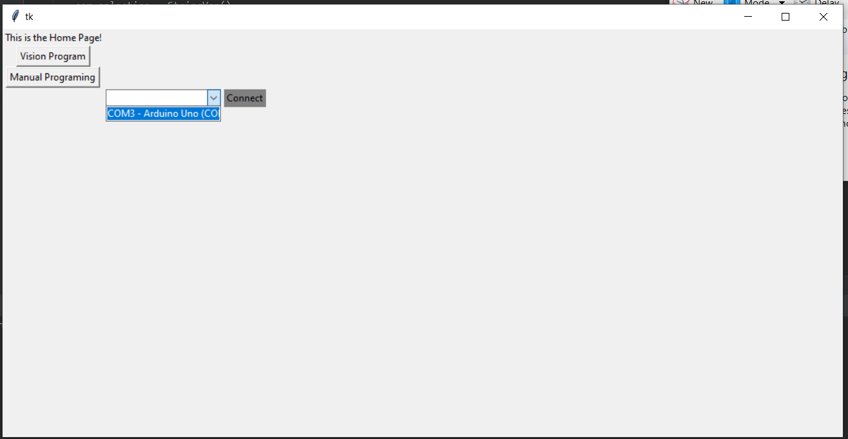
Drop down shows available USB connections
Looking for connection to Arduino
Connection options will always be “COM”+#

Slide 3
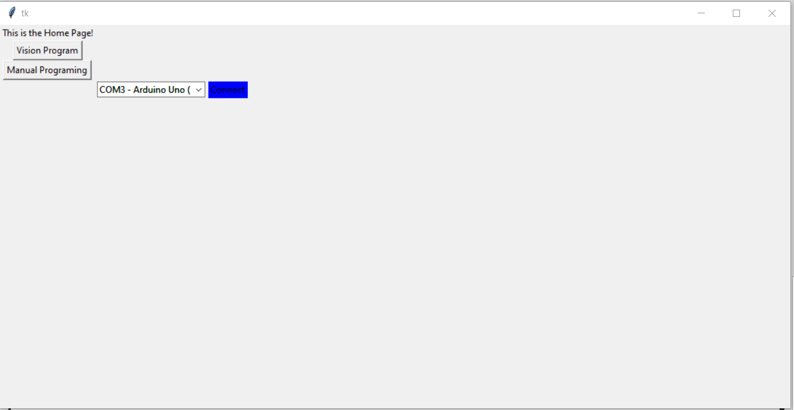
Making selection from drop down and clicking connect button will attempt to connect to Arduino
A “ping” and response from the Arduino confirms connection, if connection is successful the button turns blue.
Multiple variables can confirm connection:
Variable that changes from 0->1 when connected
Can check button color
Can check variable that defines COM number to see if available

Slide 4
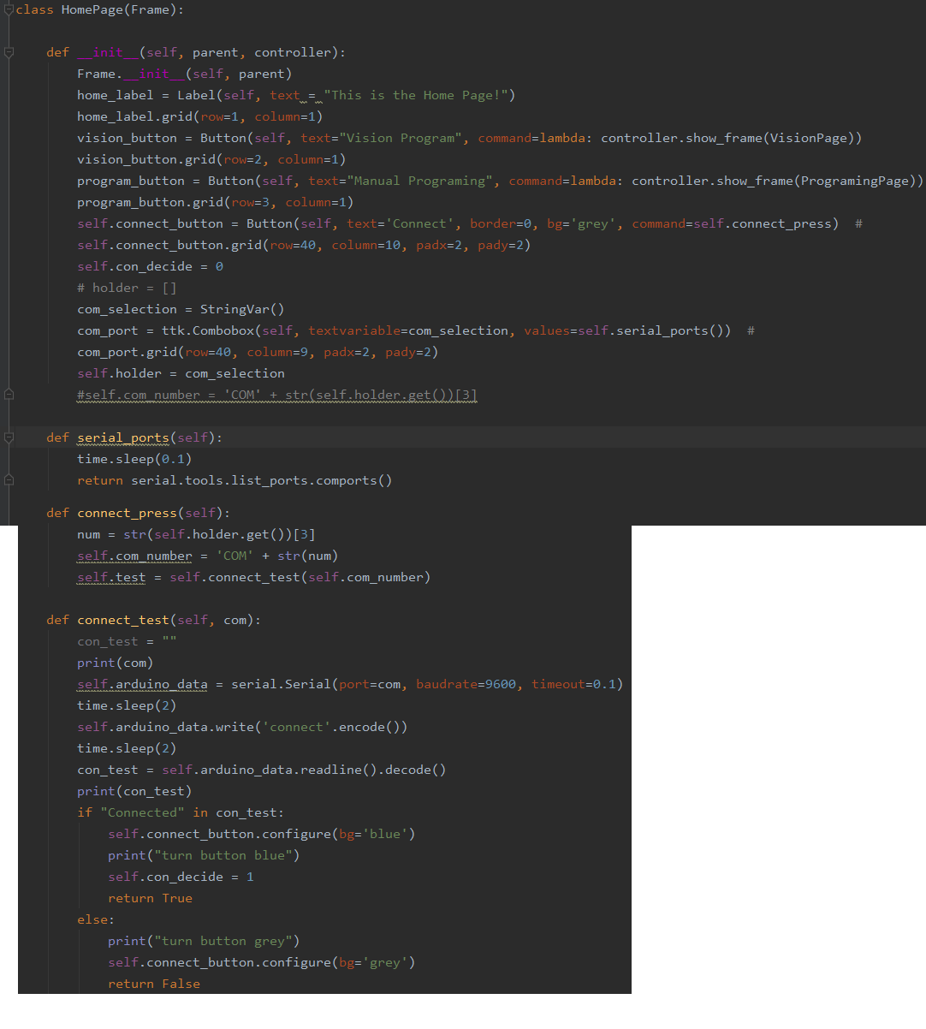
In HomPage class
Connection Button, when this is clicked I go into “connect_press” method and then the variable from the drop down menu is pulled
Here is where I define the COM #, I can’t get this COM# until the connect button is pressed, so I don’t know how I can get it inside __init__
Arduino_data is the variable that will allow me to communicate with the Arduino. This is the variable I would ideally be able to pass between classes, but again because I can’t define COM# without a button press I can’t define Arduino_data without a button press and therefore cannot define inside __init__
con_decide variable is originally defined in __init__
Changed to 1 when connection is successful
Variable and button color that are defined if connection is successful

Slide 5
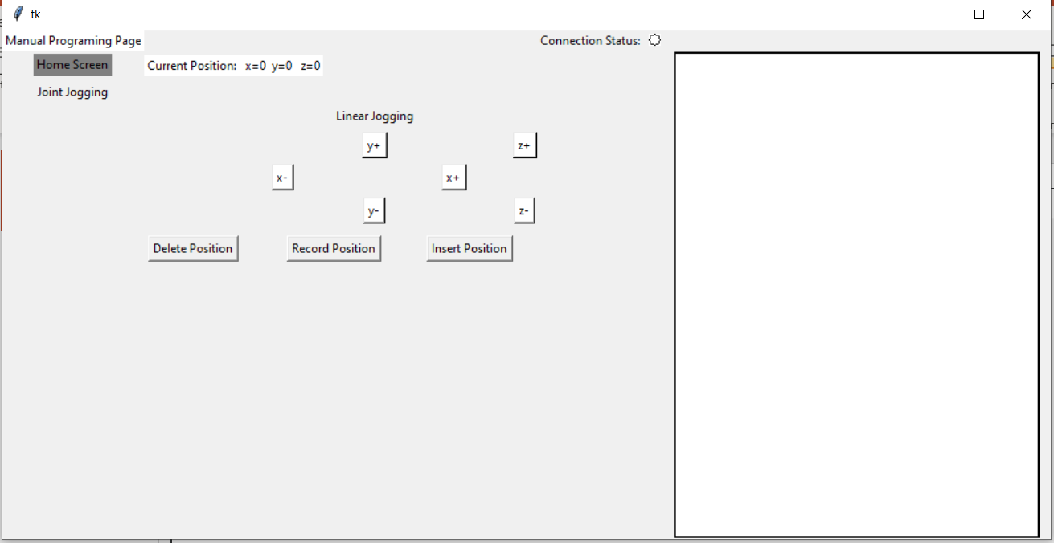

Slide 6
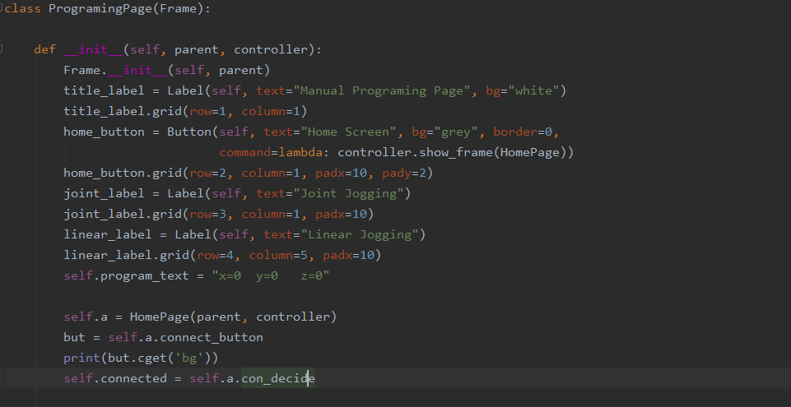
ProgrammingPage class
This allows me to access anything defined inside __init__ in HomePage class
con_decide is always zero when accessed here, even if I connect to Arduino using the button connection which uses a different method to switch con_decide to 1, when accessing here it remains 0
Is there a way to access a variable defined outside of __init__ from a separate class?
If I define a variable inside __init__ and then change it via the button click, if I later try to access that variable from a different class it always pulls the original value, not the new value the variable is changed to from the button click
In this case specifically I am looking for a way to access arduino_data

Slide 7
I can’t access Arduino_data variable when in ProgrammingPage class because it isn’t defined inside __init__ in HomePage
Is there a way to access arduino

