Slide 1
Correlation between Fertility and Birth rates
Kaustav Bose

Slide 2
Dataset(s)
For this project, the “World Development Indicators” dataset was used.

Slide 3
Motivation
Fertility rates have been dropping in developed countries as well as in developing countries over many decades. However, the population numbers of developing countries are on the rise whereas they are declining in developed nations.
Finding a correlation between fertility and birth rates will help public policy development understand the causes and help develop better healthcare systems and social programs.

Slide 4
Research Question(s)
What is your research question you aim to answer using the dataset? Be sure the research question is well defined (see project description for details).
I am exploring the relationship between fertility rate and birth rate, and if this is universal across all countries or different in developed and developing countries.

Slide 5
Findings
Among developing countries, there seems to be a very strong correlation between fertility and birth rates, whereas among developed countries, such a strong correlation doesn’t exist. Infact, in some developed countries, the correlation is negative.
Further, both fertility and birth rates have declined faster among developing countries than the developed countries over the time period examined 1990-2013

Slide 6
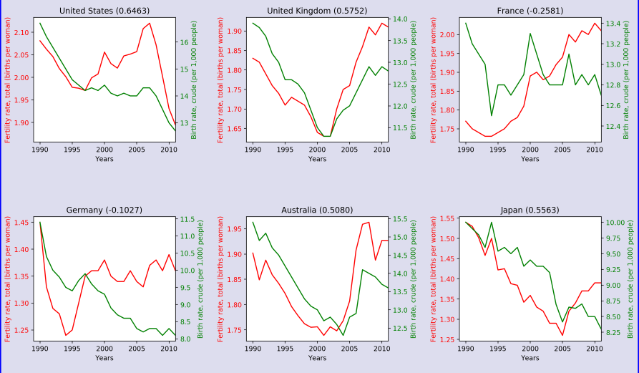
Correlation between fertility and birth rates – Developed countries (1990-2013)

Slide 7
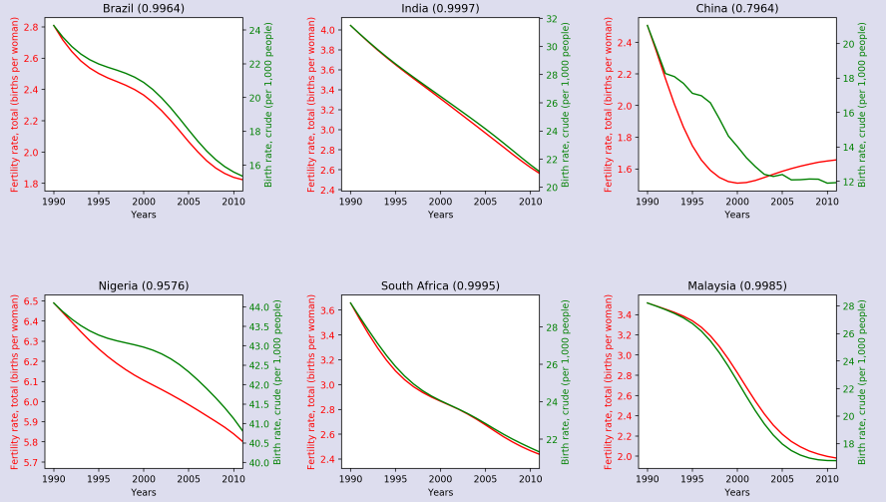
Correlation between fertility and birth rates – Developing countries (1990-2013)

Slide 8
Acknowledgements
I only used the data from the world economic indicators.

