Slide 1
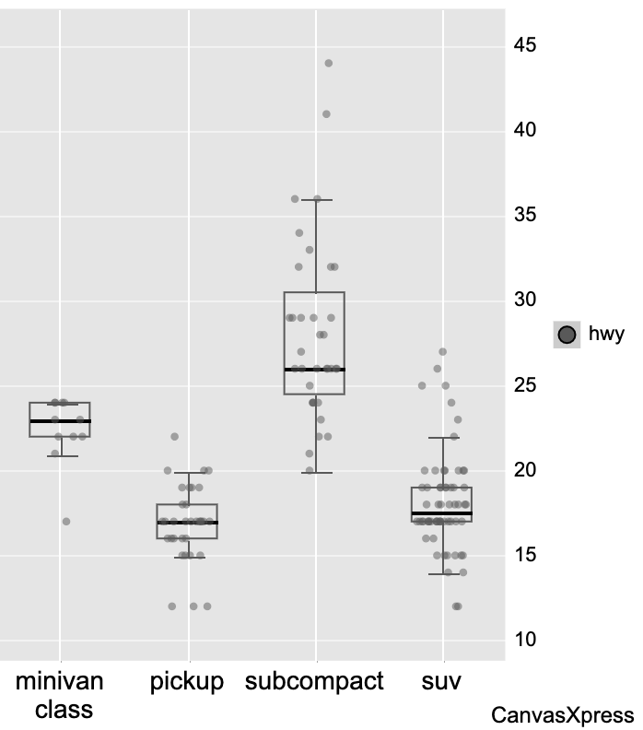
CanvasXpress - Image

