Slide 1
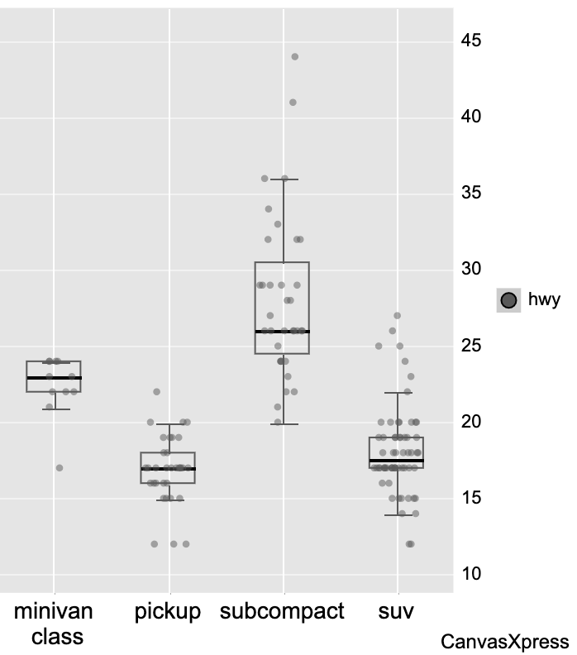
CanvasXpress Image

