Slide 1
Max 3SAT
Andrew G. Neumann

Slide 2
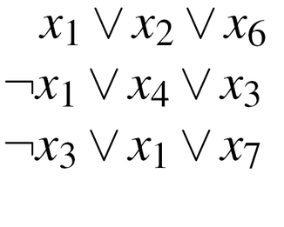

Background
Decision problem (3SAT): Given a 3-CNF formula, does there exist an assignment that satisfies every clause?
Optimization problem (Max 3SAT): Which assignment satisfies the most clauses?
Input: A 3-CNF formula.

Slide 3
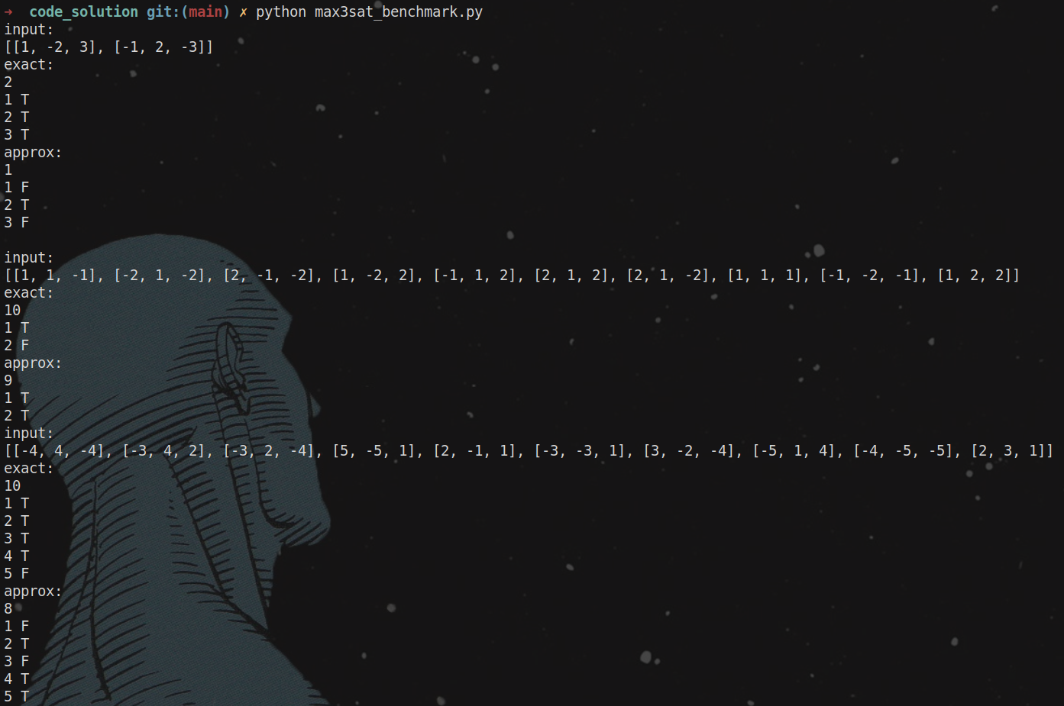
Max 3SAT Inputs/Outputs

Slide 4
SAT Importance
Encoding dependencies as CNF: (e.g. customer wants certain configuration of car. Can every option be satisfied? If not, which configuration satisfies the most?
Complex circuits: Determine which components are stuck at fault, meaning the output is 0 irrespective of input.

Slide 5
Polynomial Certification
For each clause, at most 3 literals need to be checked to determine satisfiability, so certifying a clause is constant time.
Each clause must be certified.
Therefore, the time complexity of 3SAT certification is O(n), where n ← number of clauses.
O(n) is for course polynomial.

Slide 6
Reduce SAT to 3SAT
Problem: Transform SAT (CNF) instance φ to to 3SAT (3CNF) instance φ’ in polynomial time, preserving satisfiability.
1 Literal Clause: L = (L∨Z1∨Z2)∧(L∨Z1∨Z2)∧
(L∨Z1∨Z2)∧ (L∨Z1∨Z2)
2 Literal Clause: L1∨L2 = (L1∨L2∨Z1)∧(L1∨L2∨Z1)
∧
∧

Slide 7
Reduce SAT to 3SAT
3 Literal Clause: No transformation needed
K > 3 Literal Clause: L1∨L2∨L3...∨Lk =
(L1∨L2∨Z1)∨(L3∨Z1∨Z2)∨(L4∨Z2∨Z3)∨...∨(Lk-2∨Zk-4∨Zk-3)∨
(Lk-1∨Lk∨Zk-3)
∧
∧

Slide 8
Reduce 3SAT to Max 3SAT
3SAT is NP-hard and also deals with a 3-CNF formula. The decision problem is the satisfiability of the entire formula.
The solution of Max 3SAT is the maximum satisfiable clauses.
Therefore, the solution of Max 3SAT is sufficient to solve 3SAT, because if the maximum equals the total, the entire formula is satisfiable.

Slide 9
Max 3SAT Exact Solution
P ← The set of all literal permutations.
For every permutation p, count the number of clauses p satisfies.
Return the maximum count.
Time complexity: O(2^n * c) where n ← number of distinct literals, c ← number of clauses

Slide 10
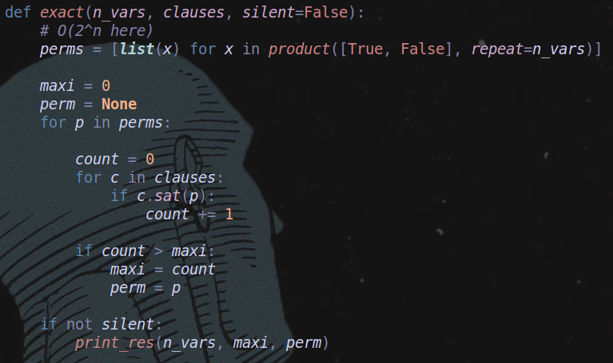
Max 3SAT Exact

Slide 11
Max 3SAT Approx.
Johnson’s Algorithm (Randomization, 2/3 for Max 3SAT, 7/8 for Max E3SAT)
P ← Permutation where each literal is randomly assigned True or False
Return the number of clauses P satisfies
Time complexity O(n * c) where n ← number of distinct literals, c ← number of clauses

Slide 12
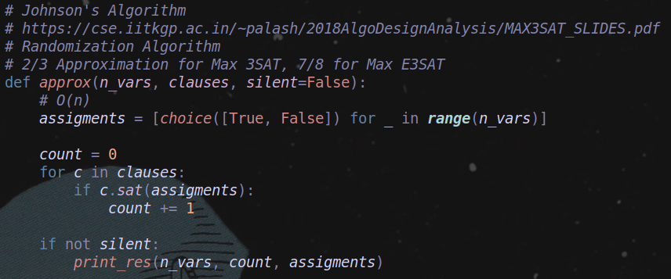
Max 3SAT Approx.

Slide 13
Max 3SAT Runtime

