Slide 1
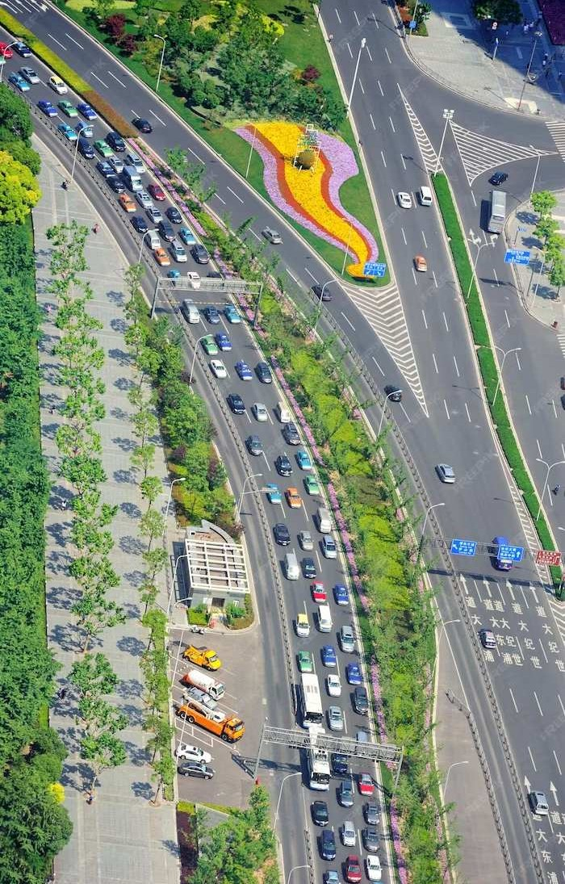
An Insight into Transportation Management Systems

Slide 2
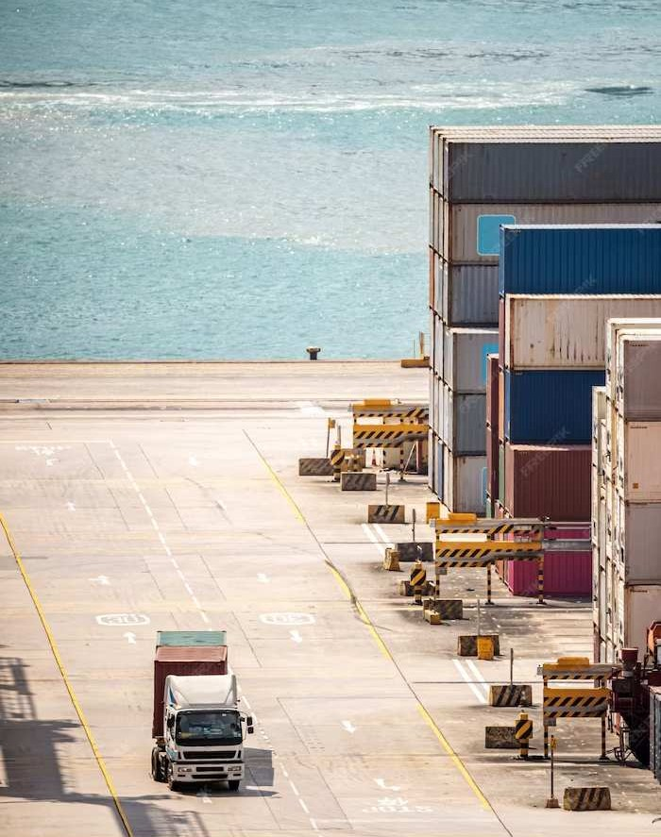
Introduction
A Transportation Management System (TMS) is a software solution designed to streamline and optimize the planning, execution, and monitoring of transportation operations.

Slide 3

Challenges in Logistics
Managing a complex supply chain involves coordinating multiple modes of transportation, dealing with varying regulations, and optimizing routes. Efﬁcient transportation is crucial for successful operations.

Slide 4

Role of TMS
A Transportation Management System (TMS) provides visibility, control, and optimization of transportation activities. It helps in route planning, carrier selection, and freight payment.

Slide 5
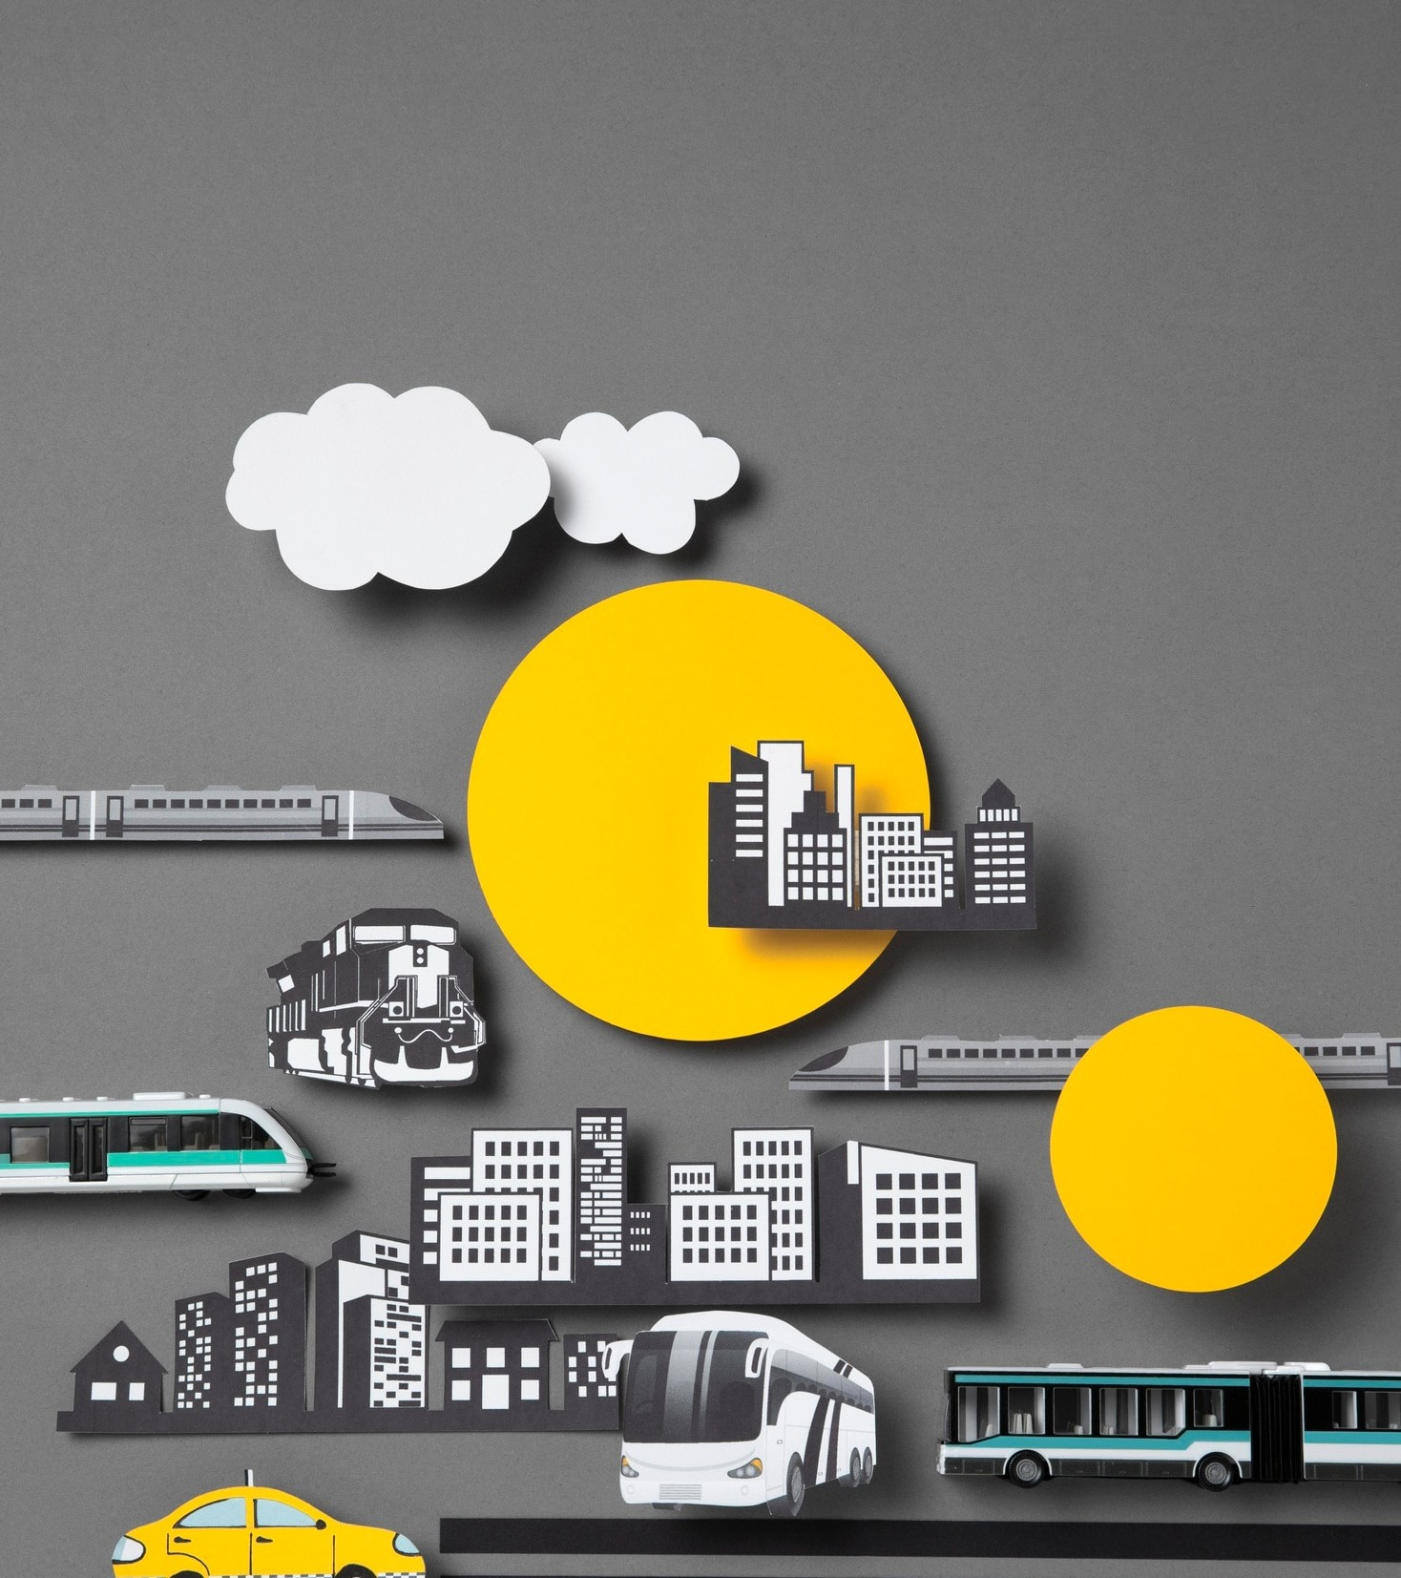
Beneﬁts of TMS
Implementing a TMS can lead to cost savings, improved customer service, and enhanced operational efﬁciency. It enables better inventory management and reduces transportation related waste.

Slide 6

Best Practices
To maximize the beneﬁts of a TMS, companies should focus on data integration, collaboration with carriers, and continuous performance analysis. Automation and real-time visibility are key.

Slide 7
Conclusion
In conclusion, leveraging a robust TMS is essential for efﬁcient logistics and supply chain management. It's a strategic investment that can drive signiﬁcant cost savings and operational improvements.

Slide 8
Thanks!
Presented by Shristi
Do you have any questions? srishtibh65@gmail.com www.shristibhandari.com.np Shristi Bhandari

