Slide 1
CHHUTTI
Hotel booking site

Slide 2
Project Members
Bipan Neupane
Birat Shrestha
Bibek Palanchoke
Dikesh Shrestha
Saharsha Ojha

Slide 3
Introduction
The project “Chhutti” is a web based program that accesses the internet to book rooms in hotels. The purpose of this study is to develop and implement an online hotel reservation system for hotels that will replace the manual method of booking for hotel rooms.
The aim of this project is to develop a system for hotel customers to make a successful reservation online and immediately get reservation confirmation about their booking.

Slide 4
Tools Used
1)Notepad++
2)Microsoft VS code
3)Xampp
4)Chrome

Slide 5
Objective
To enable online booking via the internet.
To enable automated data entry methods.
Avoid data entry errors by use of input masks.
Enforce security measures to avoid unauthorized access to guest records.

Slide 6
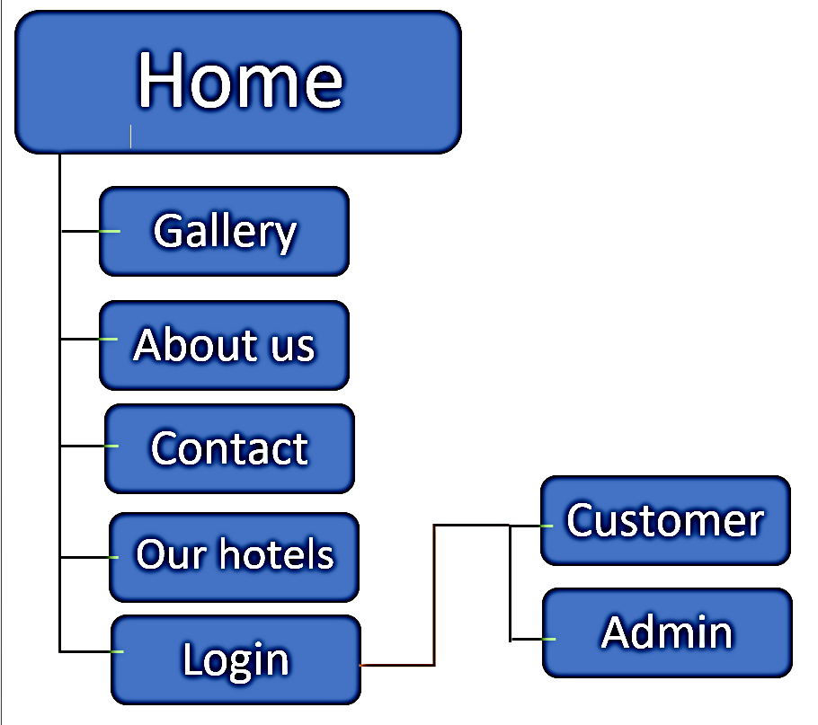
Design and implementation

Slide 7



Related works

Slide 8
Feature
User registration
Admin panel
Hotels description
Hotel booking

Slide 9
Future Enhancement
Simulation of room with VR.
Responsive to the user
Ensure efficient and reliable communication within the hotel.
Online Payment

Slide 10
Conclusion
Through out this project we learned about how the hotel booking websites work and how the hotels are linked and were able to create our first user friendly hotel booking website “Chhutti”.
Even though we had little knowledge of back-end and went through lots of problems while trying to connect the database we completed our project in due time.

Slide 11
Thank You…

