Slide 1
General Information services of National Informatics
Presented by: -
Rabin Neupane

Slide 2
Introduction
Natiional informatics is a term that refers to the use of information technology(IT) in the government of a country.
are the various IT services and systems that are deployed and managed by the government to support its various functions.
NITC acts as a data bank of information and assist in computerization of records at governmental offices and in developing and expanding the contents.

Slide 3
Some general informatics services of national informatics include:
E-government services
Electronic paymnet systems
Data management systems
Networking and communication systems
IT infrastructure management

Slide 4
Objective
Developing and implementing national it policies and strategies
Promoting the adoption of it in government operations
Developing and iplementing IT ssystem and services for citizens
Building IT capacity and skills
Facilitating international cooperation and collabaration

Slide 5
History Pre internet era
NITC established in 1988, before widespread adoption of the internet
Focused on developing and implementing IT systems and services like WAN and LAN
Major initiatives of NITC during this era was the development and implementation of the National Census Information System (NCIS), which was designed to automate the census data collection and processing process.

Slide 6
Internet era
Connectivity and infrastructure
E-Government Services
Data Management and Security
Digital Literacy and Skill Development
Cybersecurity and Incident Response
Collaboration and Patnership

Slide 7
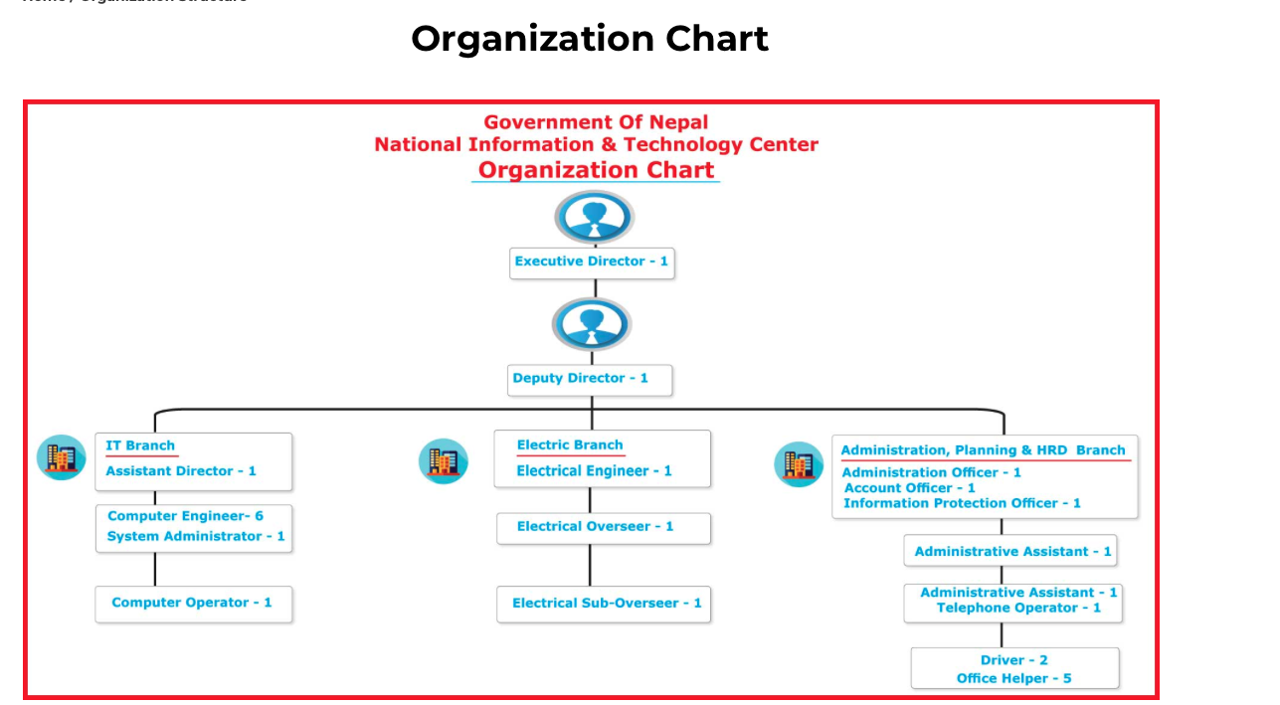

Slide 8
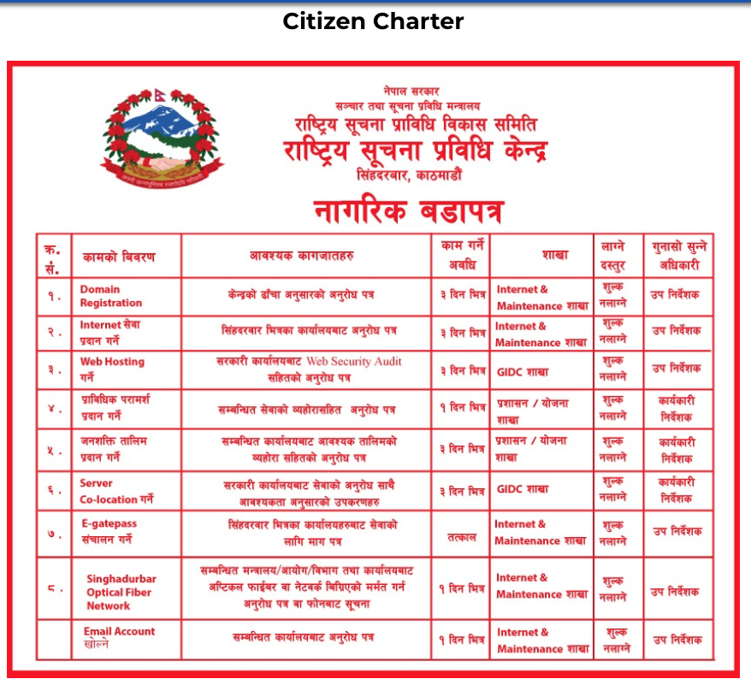

Slide 9
Thank You!

