Slide 1
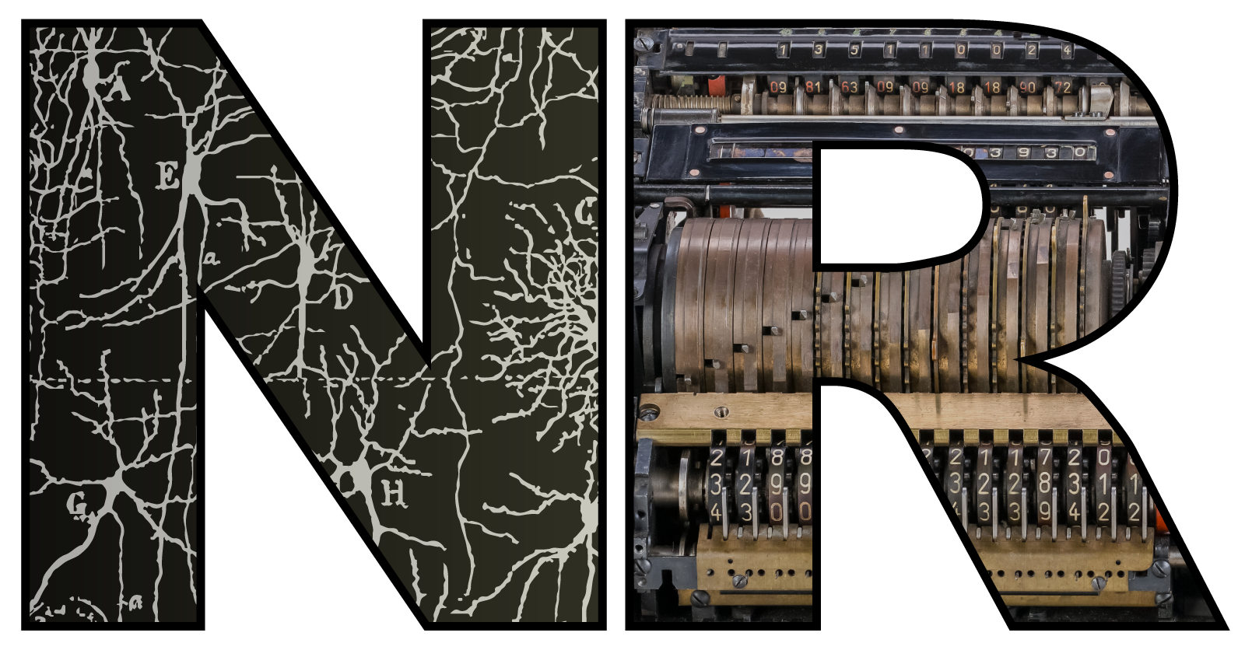

Intelligence as resource efficiency ⚠️ WIP – thinking out loud ⚠️
Dan Goodman
Imperial College London
Department of Electrical and Electronic Engineering
neural-reckoning.org

Slide 2
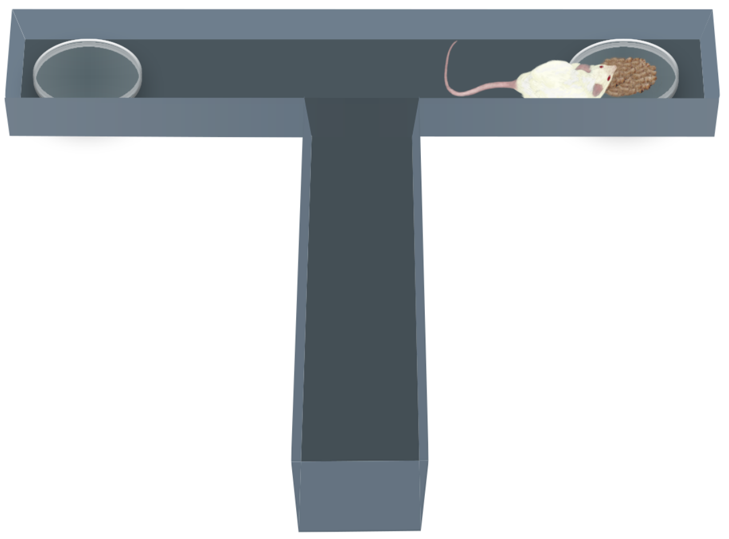
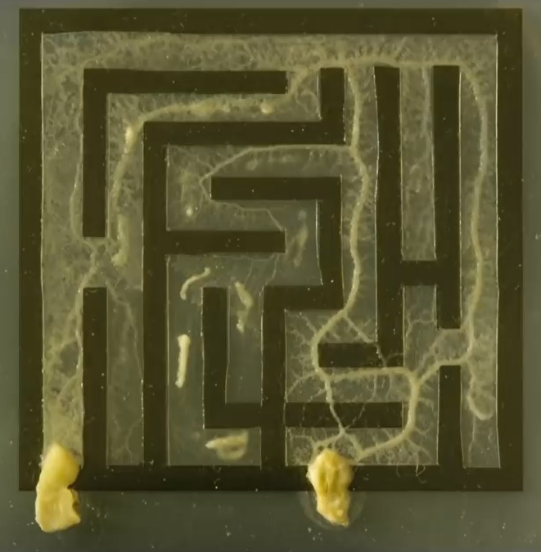
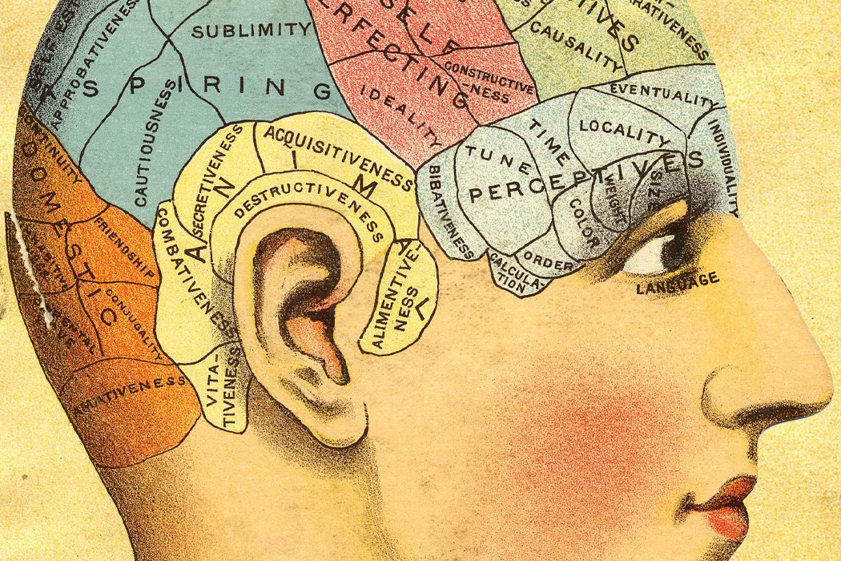
What does it mean to understand the brain?
Aim: understand the brain
Requirement: study things only the brain can do
Nontrivial – many ‘neuroscience’ studies don’t do this
Let’s call the unique thing the brain does “intelligence”
Dangerous, loaded term! Many definitions
I don’t propose to find the ‘right’ definition
I’m certainly not going to try to measure it!
Working definition of “intelligence”
Emerged as a result of our work
Turns out to have already been discussed in the literature
Useful for understanding my research
Suggests a research programme
Has mouse
⇒
Must be neuroscience
Slime mould ⇒ not neuroscience
Phrenology head (1905)

Slide 3

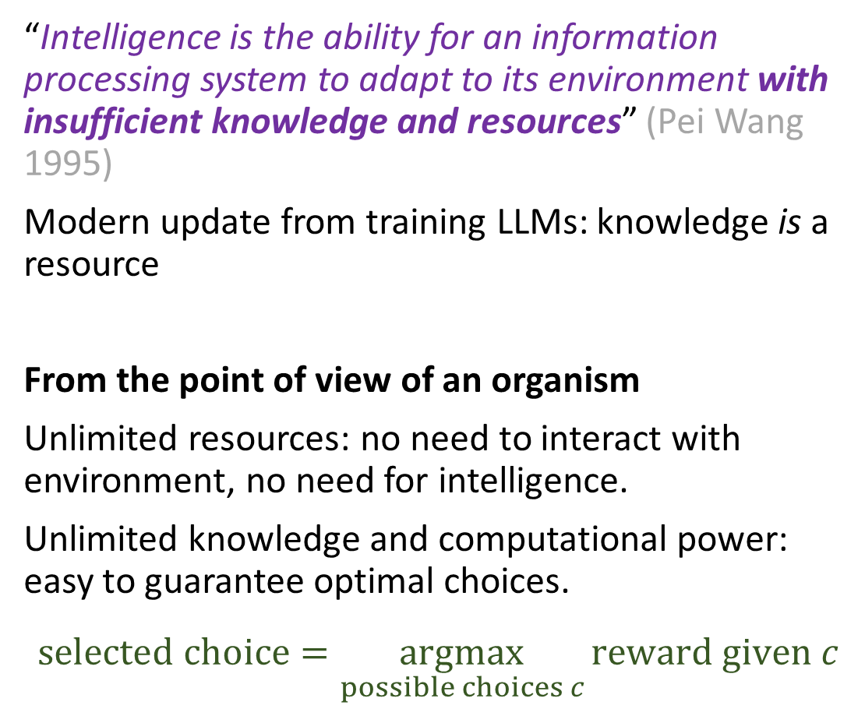
A “working definition” of intelligence
“Intelligence is the ability for an information processing system to adapt to its environment with insufficient knowledge and resources” (Pei Wang 1995)
Modern update from training LLMs: knowledge is a resource
From the point of view of an organism
Unlimited resources: no need to interact with environment, no need for intelligence.
Unlimited knowledge and computational power: easy to guarantee optimal choices.
$$selected choice=\underset{possible choices c}{argmax}{reward given c}$$
Things only get interesting when we impose limits.
Question becomes:
How can you approximate an ideal solution with a resource limited one?
My aim for today is to convince you:
Not just idle philosophy, but a practical research programme for both neuroscience and AI

Slide 4




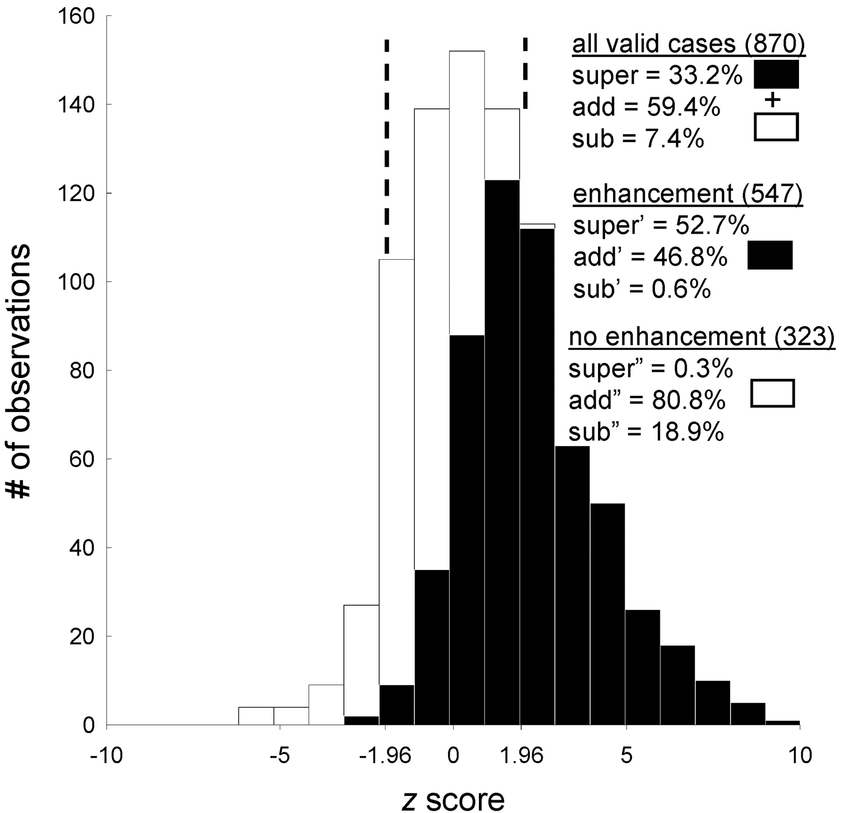
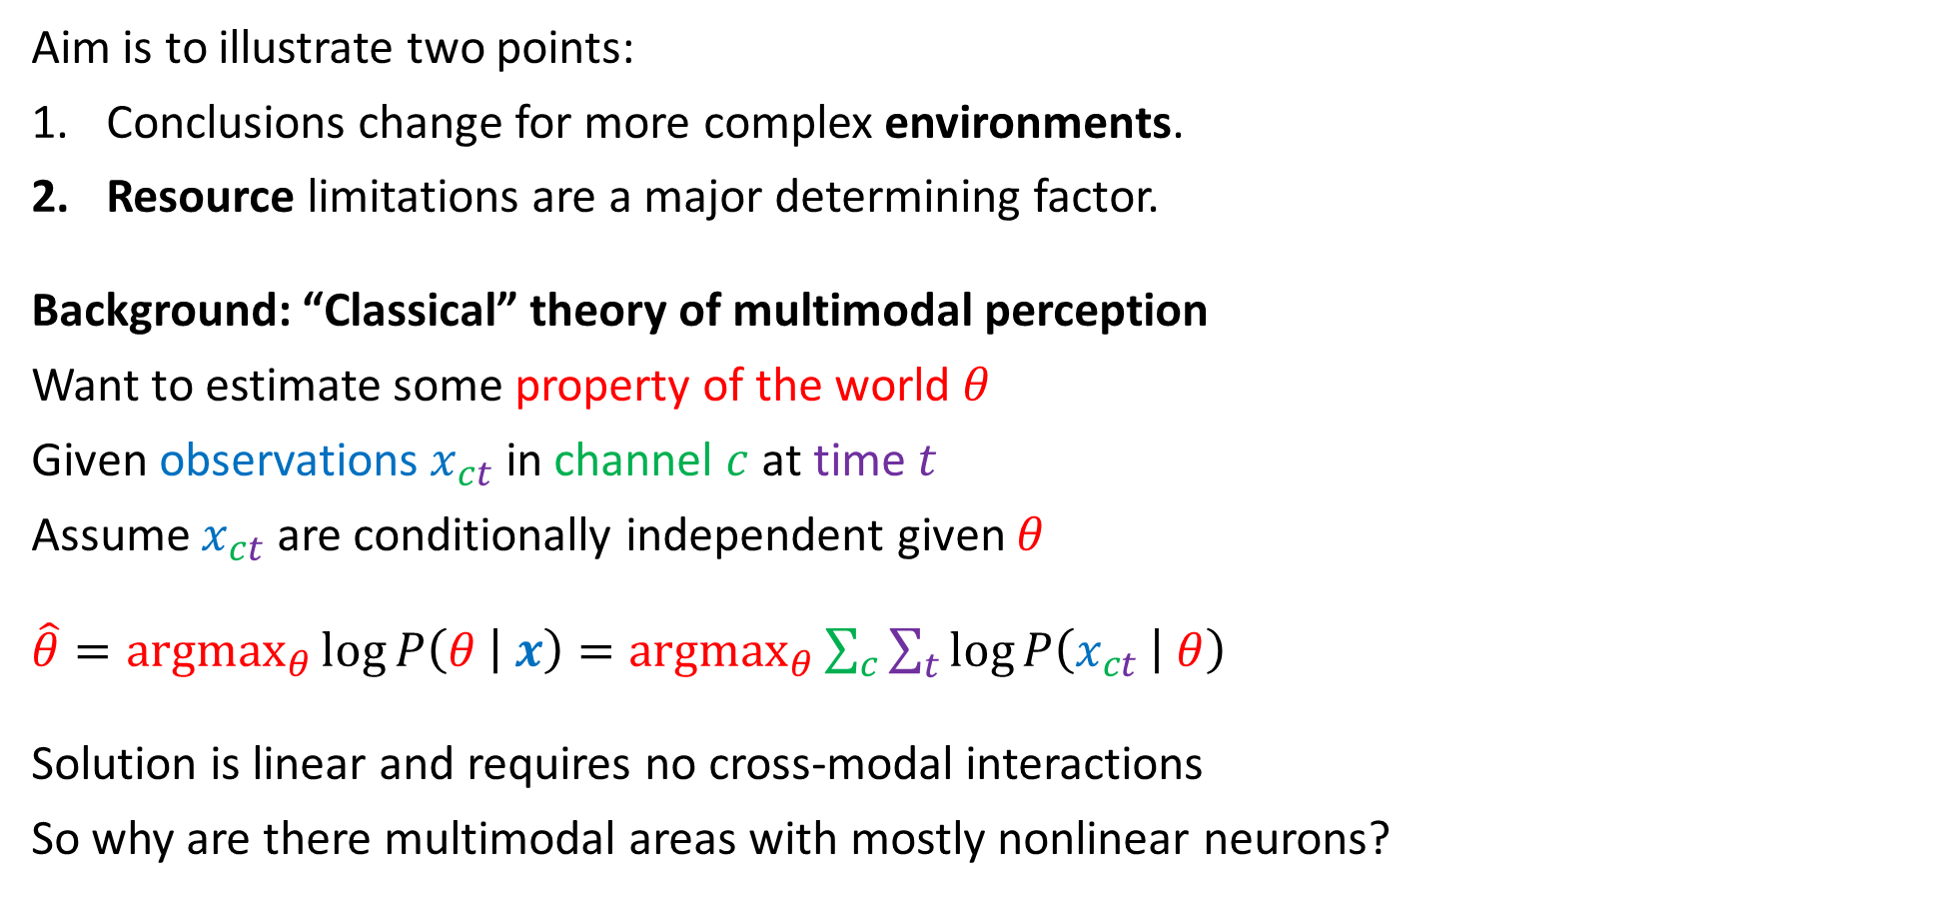





Case study 1: multimodal perception
time $t$
Aim is to illustrate two points:
Conclusions change for more complex environments.
Resource limitations are a major determining factor.
Background: “Classical” theory of multimodal perception
Want to estimate some property of the world $θ$
Given observations $x_{ct}$ in channel $c$ at time $t$
Assume $x_{ct}$ are conditionally independent given $θ$
$\hat{θ}={argmax}_{θ}{\log{P\left(θ | x\right)}={argmax}_{θ}{\sum_{c}{\sum_{t}{\log{P\left(x_{ct} | θ\right)}}}}}$
Solution is linear and requires no cross-modal interactions
So why are there multimodal areas with mostly nonlinear neurons?
$$θ$$
channel $c$
$$x_{ct}$$
$$\hat{θ}=$$
Stanford et al. 2005

Slide 5





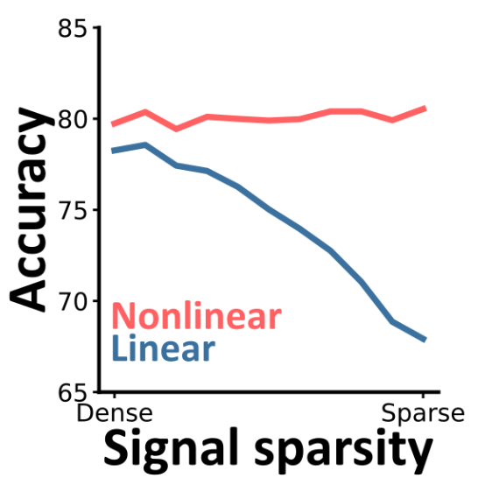
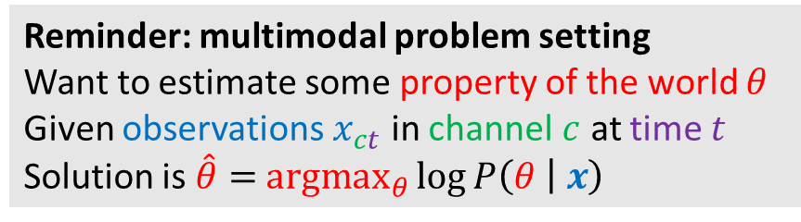
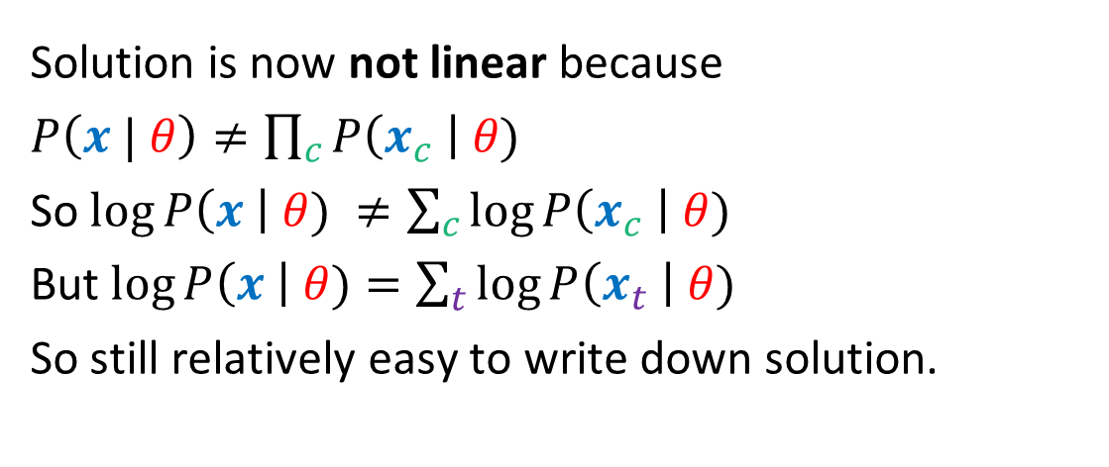
Step 1: introduce cross-modal dependency
Ghosh et al. (2024)
Classic multimodal task with one slight tweak:
Target emits signals at unknown times.
Creates a cross-channel conditional dependency
Reminder: multimodal problem setting
Want to estimate some property of the world $θ$
Given observations $x_{ct}$ in channel $c$ at time $t$
Solution is $\hat{θ}=$ ${argmax}_{θ}\log{P\left(θ | x\right)}$
Nonlinear multimodal area gives advantage.
Advantage larger for sparser signals.
Solution is now not linear because
$P\left(x | θ\right)≠\prod_{c}{P\left(x_{c} \right| θ)}$
So $\log{P\left(x \right| θ) ≠\sum_{c}{\log{P\left(x_{c} \right| θ)}}}$
But $\log{P\left(x \right| θ)=\sum_{t}{\log{P\left(x_{t} \right| θ)}}}$
So still relatively easy to write down solution.

Slide 6



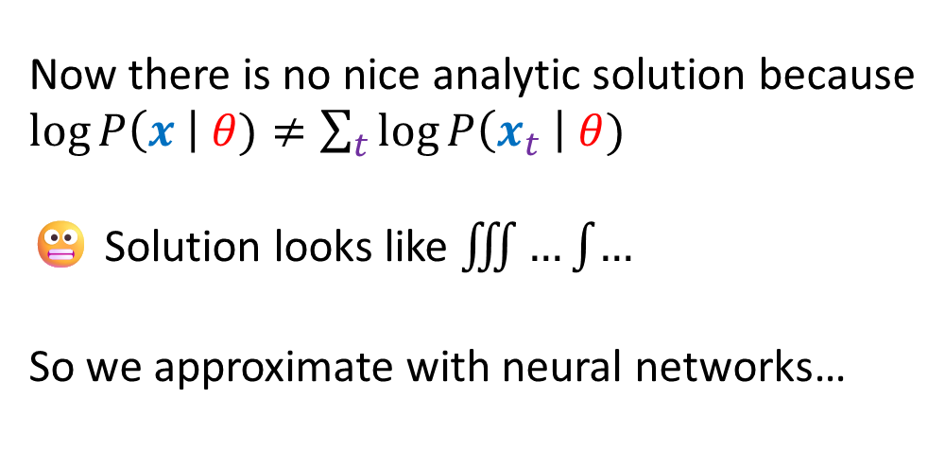
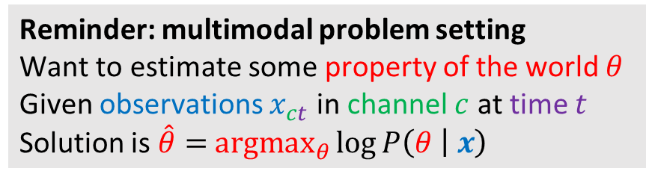
Step 2: introduce temporal dependency
Information is sparse but arrives in bursts and is correlated across modalities
Anil et al. (2024)
Background noise
Signal
Time
Now there is no nice analytic solution because
$\log{P\left(x \right| θ)≠\sum_{t}{\log{P\left(x_{t} \right| θ)}}}$
😬 Solution looks like $\iiint{…\int{…}}$
So we approximate with neural networks…
Reminder: multimodal problem setting
Want to estimate some property of the world $θ$
Given observations $x_{ct}$ in channel $c$ at time $t$
Solution is $\hat{θ}=$ ${argmax}_{θ}\log{P\left(θ | x\right)}$

Slide 7
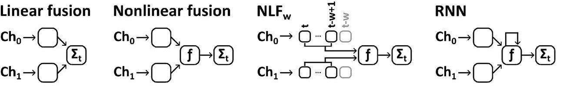
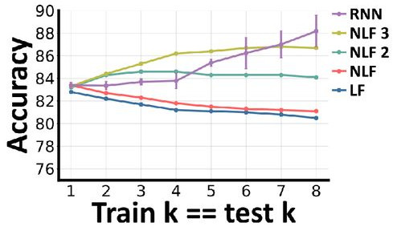
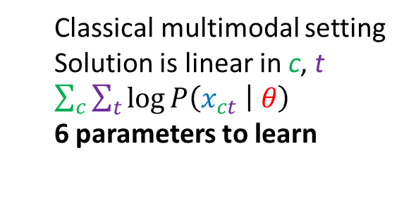
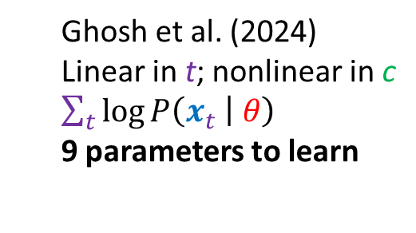
Neural network architecture = resources
Classical multimodal setting
Solution is linear in c, t
$\sum_{c}{\sum_{t}{\log{P\left(x_{ct} | θ\right)}}}$
6 parameters to learn
Ghosh et al. (2024)
Linear in t; nonlinear in c
$\sum_{t}{\log{P\left(x_{t} | θ\right)}}$
9 parameters to learn
Anil et al. (2024)
Option 1:
Generalise nonlinear fusion
Add memory window of length w
81 to 729 parameters (w=2,3)
k = length of signal bursts
Option 2:
Recurrent neural network
In principle, arbitrary long memory
10,903 parameters
RNN wins if unlimited resources
Params & Compute
Knowledge (test in-distribution)
NLF_{w} wins if resources limited

Slide 8

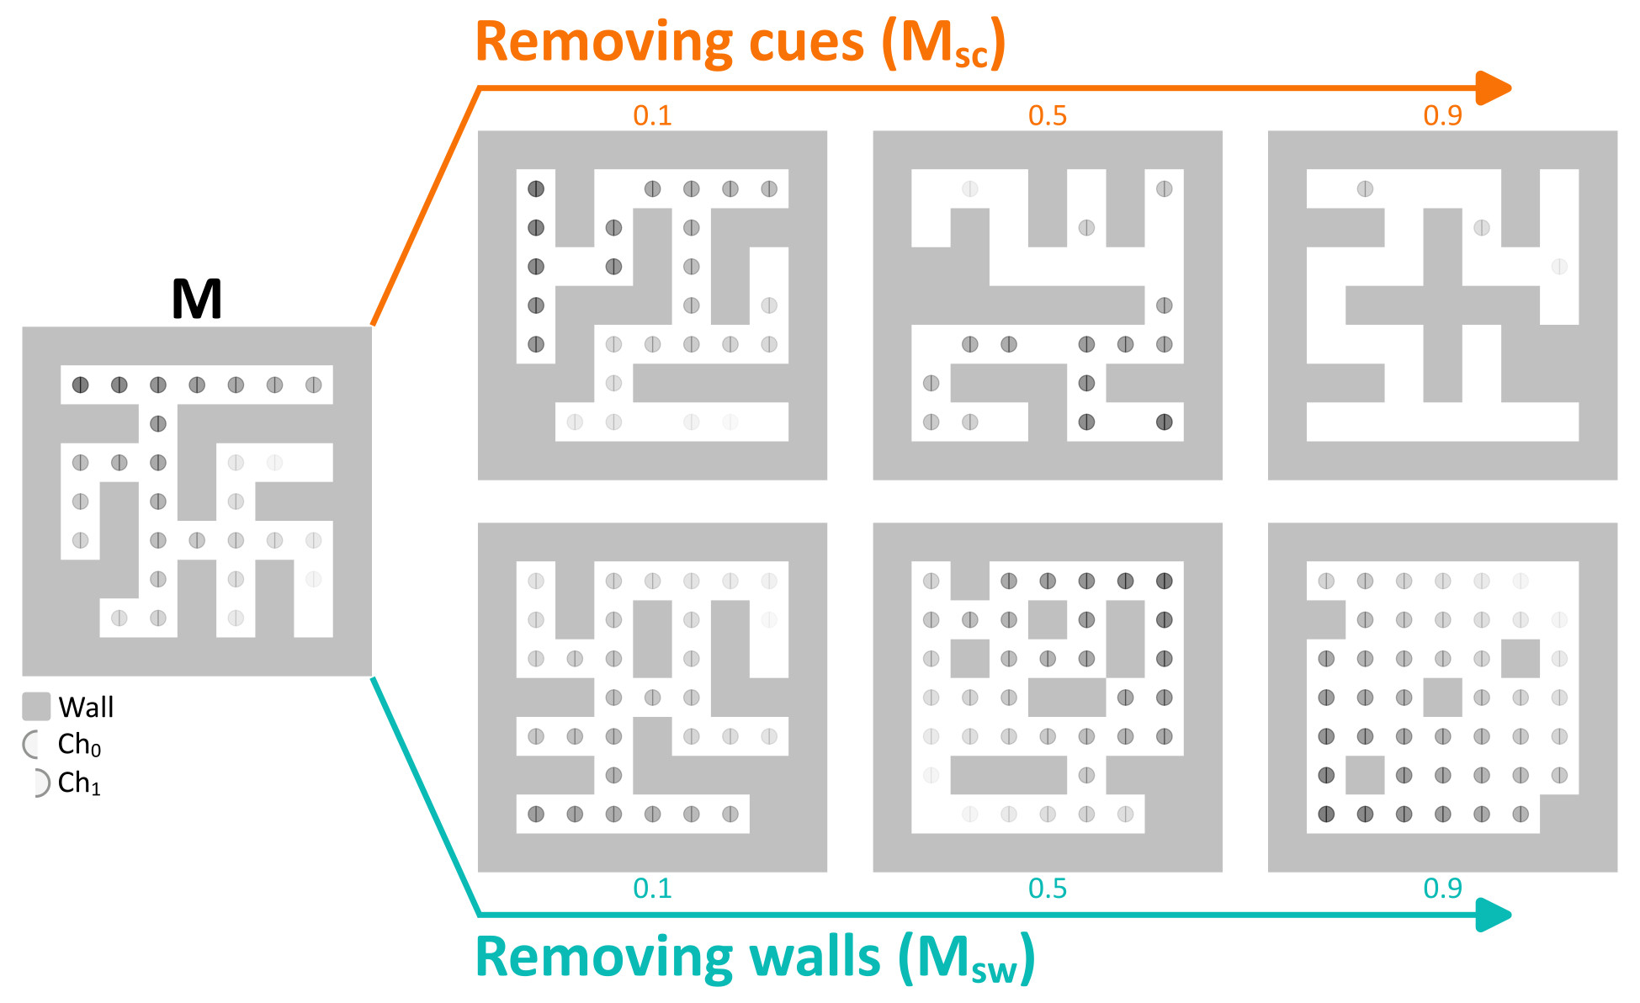

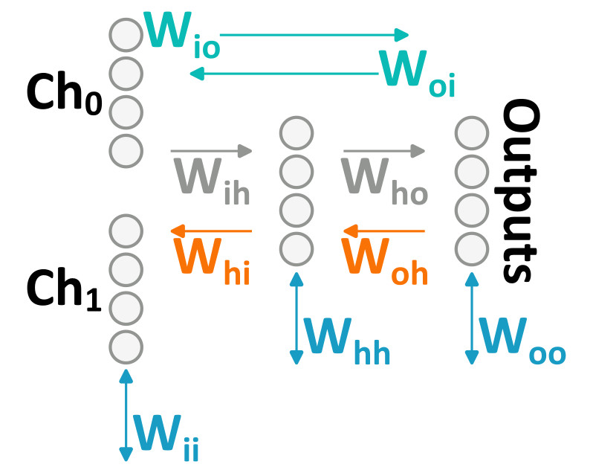
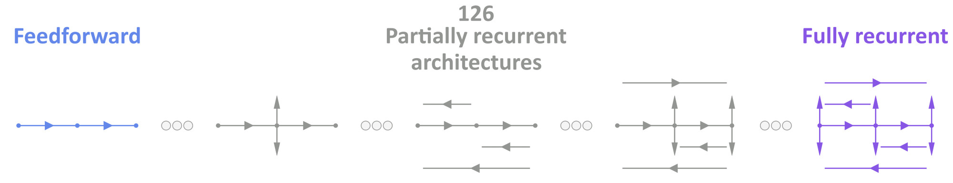
Step 3: introduce spatio-temporal dependency
Ghosh and Goodman (2026? 🙏)
“Partially recurrent neural networks”

Slide 9
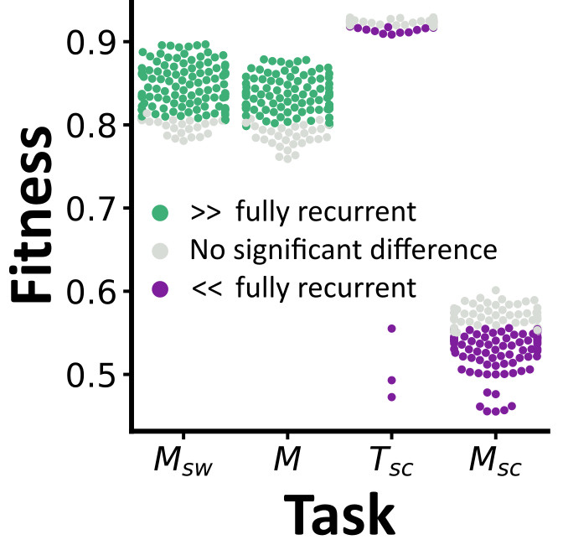
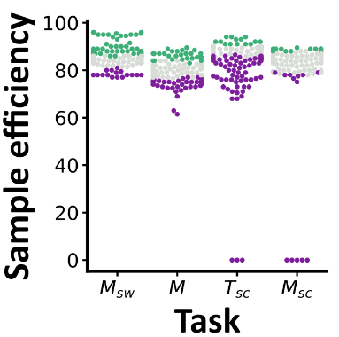
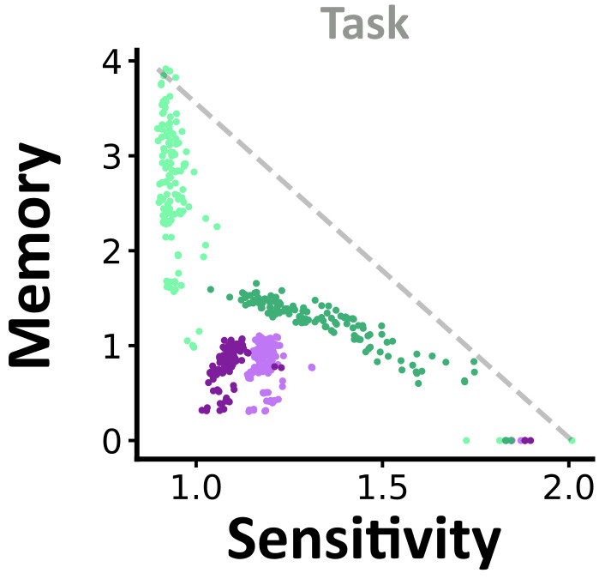
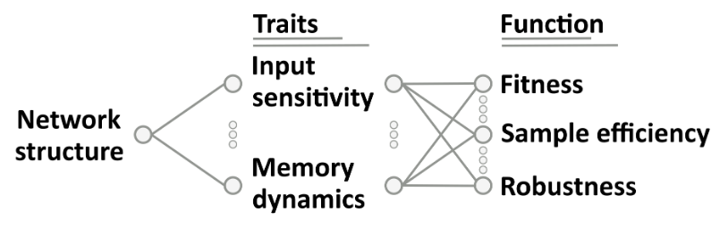
Step 3: introduce spatio-temporal dependency
Ghosh and Goodman (2026? 🙏)
Firmly in the zone of “resource limited”
Bigger is not necessarily better
Many networks perform as well as bigger ones
Sometimes better
And they can train faster
Brief mention of key finding of this paper:
Architecture itself does not seem to be the key property
“Computational traits” enabled by architectures
Sensitivity trades off again memory
Easy to measure these in NNs

Slide 10















Case study 2: Modularity
$$X,Y∈\{1,…,N\}$$
“Dumb”
“Smart”
Property $X$
Input
Class $C$
Input
Class $C=(X,Y)$
Property $Y$
Resource cost $cN^{2}$ per trial
Resource cost $cN$ per trial
Needs to see every example $(X,Y)$
Needs to see every $X$ and every $Y$ (generalisation)
Error cost 0
Error cost $ε$ per trial
If resource cost $c=0$
If resource cost $c>0$
Always be dumb
Industrial ML
Be smart
$$N$$
$$N$$
Brains:
Sometimes smart, sometimes dumb.
Be dumb
$$ε$$
$$ε$$
Notes:
Classic classification problem
What if we can factorise into two subproblems?
Resource costs are higher for left, so “dumb” compared to “smart”
But what if factorisation isn’t exact? Introduce error per trial
If resource cost is not an issue, then you should always be dumb
If resources are an issue, then if either error rate is small or number of resources required large, be smart instead

Slide 11

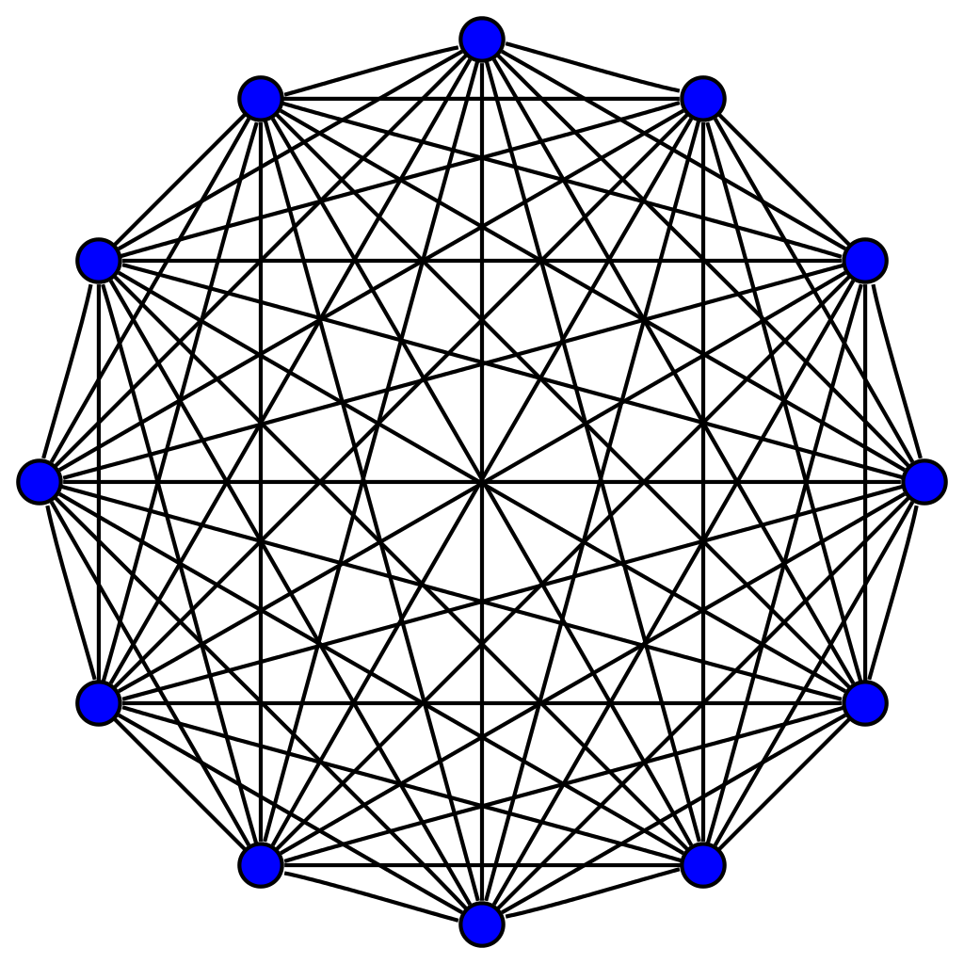

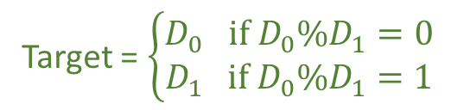

Trying to be “smart” with modules
Béna and Goodman (2025)
Within module:
Dense connections
Within module:
Dense connections
Evidence:
Brain is “structurally modular”
Knocking out brain regions seems to lead to functional deficits
So… functional specialisations a necessary consequence of structural modules?
We tested this by training ANNs in a task designed to encourage specialisation
Between modules:
Sparse connections
RNN₁
Digit₁
Sparsity $p$
Decision
Digit₂
RNN₂
Target = $\left\{\begin{aligned}D_{0} if D_{0}\%D_{1}=0 \\ D_{1} if D_{0}\%D_{1}=1\end{aligned}\right.$

Slide 12
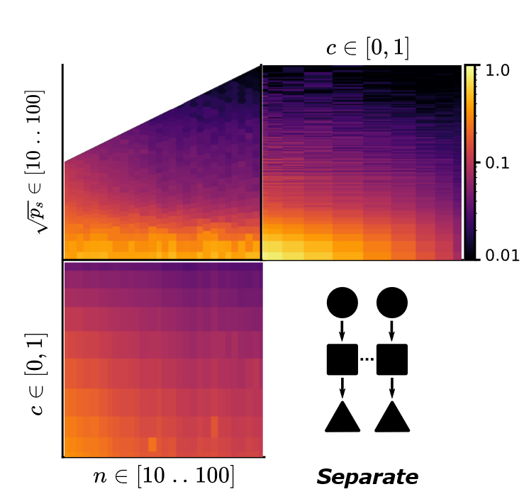
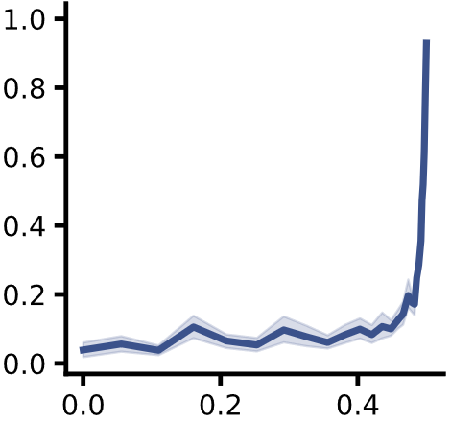
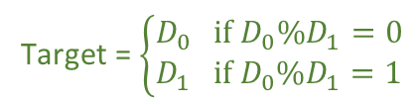

But modules want to be “dumb”
Béna and Goodman (2025)
RNN₁
Target = $\left\{\begin{aligned}D_{0} if D_{0}\%D_{1}=0 \\ D_{1} if D_{0}\%D_{1}=1\end{aligned}\right.$
Trained modular ANNs in a task designed to encourage specialisation. Does it work?
Negative answer: not necessarily.
It emerges with tight resource constraints.
WIP-1: generalisation (yes!)
WIP-2: mathematical explanation
Digit₁
Sparsity $p$
Decision
Digit₂
RNN₂
Abundant resources
Low specialisation
Num synapses
Specialisation
Maximum modularity
seen in brain
Specialisation
Few resources
High specialisation
Structural modularity
Num neurons

Slide 13


Programme for the future
Low hanging fruit: build resource constraints into models
“Blood and modularity”
Fix total blood / energy supply
Do we get more modularity? (Seems like yes!)
Do we get better generalisation? (WIP)
Is this useful for neuromorphic computing?
Biological features can improve accuracy and efficiency
Neural heterogeneity (Perez-Nieves et al. 2021)
Delays and quantisation (Sun et al. 2025ab)
Neuromodulation (AlKilany and Goodman 2025)
For AI/ML people:
The resource constraints will come eventually

Slide 14

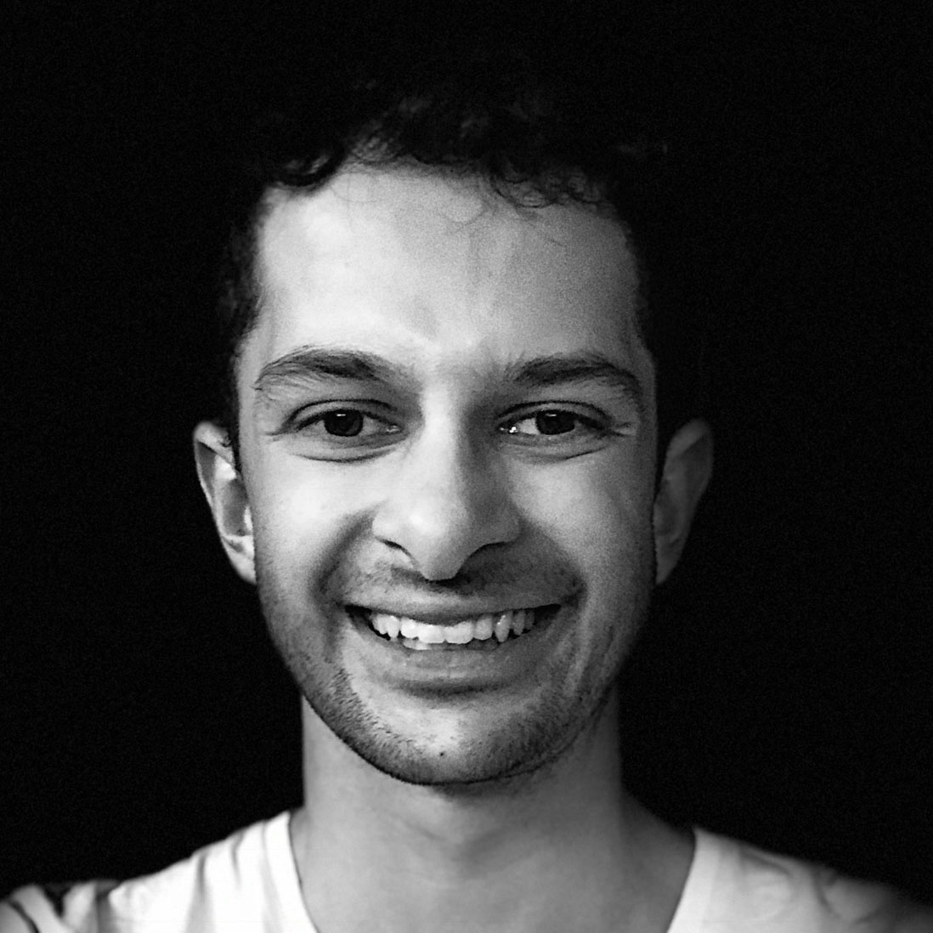
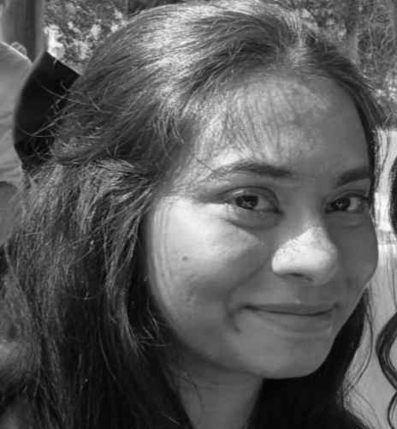
Thanks!
Recap
“Intelligence is the ability for an information processing system to adapt to its environment with insufficient knowledge and resources” (Pei Wang 1995)
Multimodal processing and neural architectures
Conclusions change for more complex environments.
Resource limitations are a major determining factor.
Modularity
“Smart” solution more resource efficient and generalises
But at the cost of higher error
Can we train for this directly by limiting resources?
Neuromorphic computing
Biological features can improve accuracy and efficiency
Gabriel Béna
PhD student 2021-
Marcus Ghosh
Postdoc fellow 2021-
Swathi Anil
Visiting PhD (2024)
And thank you for listening!

