Slide 1
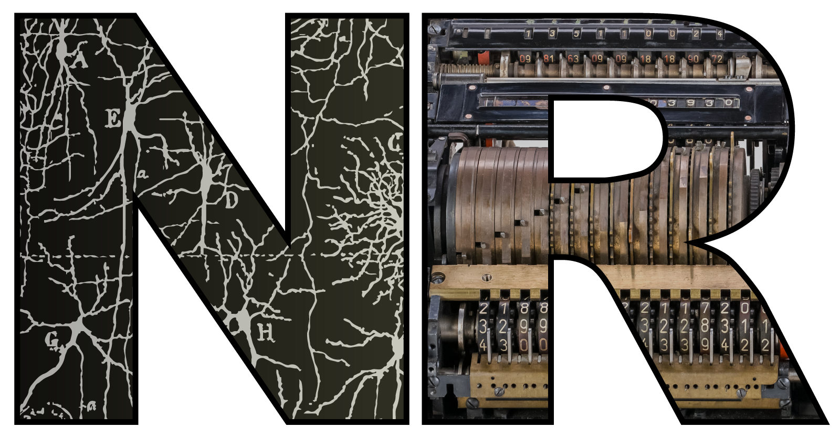

Neural architectures: what are they good for anyway?
Dan Goodman
Imperial College London
Department of Electrical and Electronic Engineering
neural-reckoning.org
Notes:
Abstract:
The brain has a highly complex structure in terms of cell types and wiring between different regions. What is it for, if anything? I'll start this talk by asking what might an answer to this question even look like given that we can't run an alternative universe where our brains are structured differently. (Preview: we can do this with models!) I'll then talk about some of our work in two areas: (1) does the modular structure of the brain contribute to specialisation of function? (2) how do different cell types and architectures contribute to multimodal sensory processing?

Slide 2
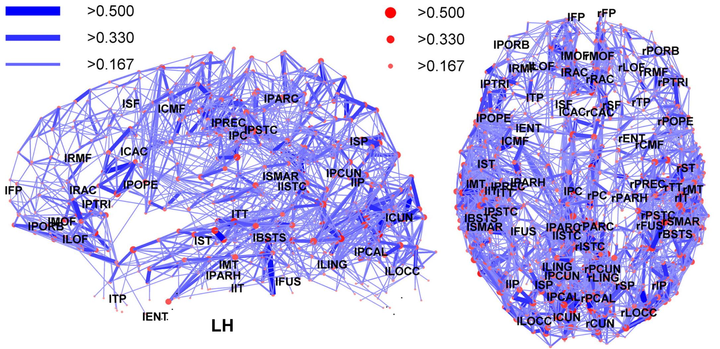
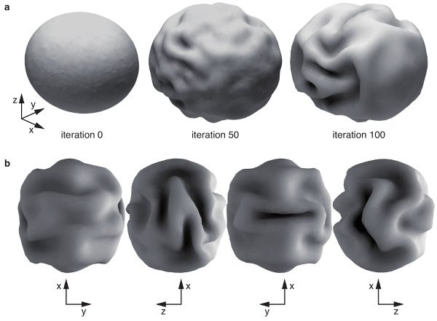
Why ask this question?
Brain clearly has complex structure.
We know that different brain regions have specific functions, e.g. language areas.
On the other hand, you can rewire visual inputs to auditory cortex in a ferret, and it will learn to ‘see’ (Melchner et al. 2000).
(Not very well though…)
And if you believe Roberto Toro, all that complex brain folding shape can just be explained by the mechanics of a growing brain (Foubet et al. 2019).
So maybe it doesn’t really mean anything?

Slide 3
How can we ask and answer this question?
What are some of the possible answers as to why the brain is structured the way it is?
One possibility is that there is some necessary link between structure and function. The brain couldn’t do the things it needs to do if it had a different structure. Or a weaker version, it would do them less well.
Maybe the system just happened to evolve that way (exaptation) but could equally well have been different.
Causal effects may be complicated (e.g. you need areas A or B to do task X; or you need areas A and B)
All of this is tricky to establish.

Slide 4



The parable of the missing chalk
Suppose we asked: what makes for a good lecture?
Imagine a mathematician at a blackboard.
Take away her chalk and give her a whiteboard pen. The students don’t follow her lecture.
⇒ So the chalk was key.
(Aside: many mathematicians believe this. I’m allowed to say this because I am one.)
This is a trivial example, but there are neuroscience papers today that do exactly this.

Slide 5
Theory comes to the rescue
Resolution of the chalk experiment:
If we also replace blackboard with whiteboard the students now understand.
Experimentally, we can’t always do this! However, with models we can.
Simple prototype (it can be more complicated – don’t say the words “causal inference”):
Compare best possible performance at task T with and without architectural feature F, allowing other parameters and features of the model to vary.
Theory is essential in neuroscience because there are questions we cannot answer with experiments.
We need to be careful to give equal attention to model with/without F. This is hard to do!
Computationally demanding: comparing best possible means big parameter sweeps
Modern machine learning methods help. We can finally do this properly.
(Or the old-fashioned way: sometimes we can analytically solve for optimal performance.)

Slide 6


Modularity: structure and function
Gabriel Béna
PhD student 2021-
Béna and Goodman (2025) Nature Comms

Slide 7
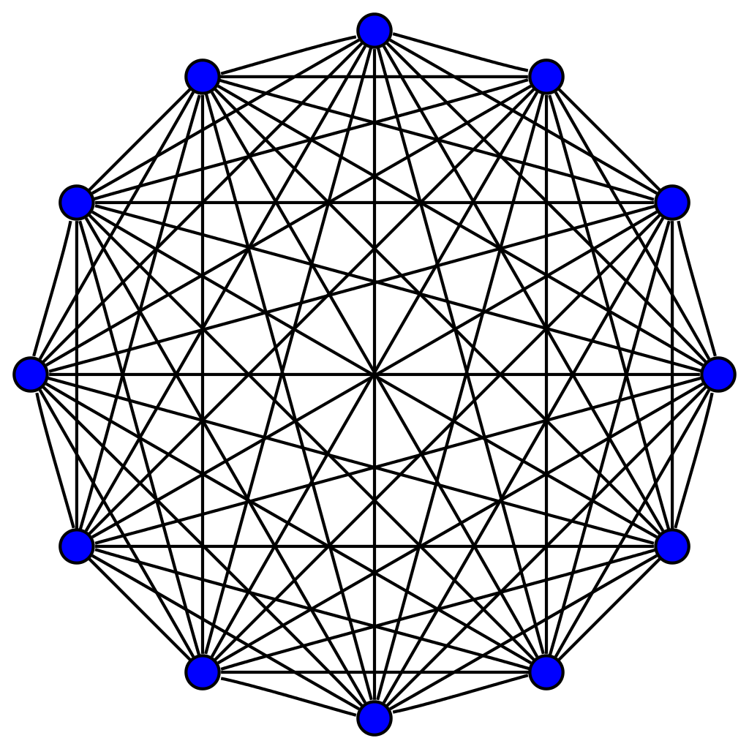
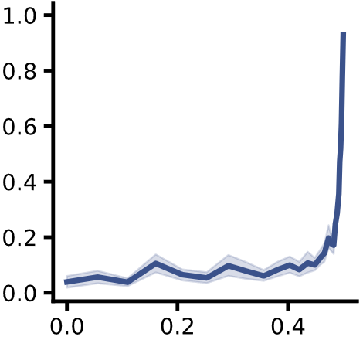
TL;DR version of this study
Within module:
Dense connections
Within module:
Dense connections
Evidence:
Brain is “structurally modular”
Knocking out brain regions seems to lead to functional deficits
So…?
Functional specialisations a necessary consequence of structural modules?
We tested this using ANNs
Answer is not necessarily.
At least, for levels of modularity in brain.
Also need tight resource constraints?
Interesting temporal dynamics.
Between modules:
Sparse connections
Maximum modularity
seen in brain
Specialisation
Structural modularity

Slide 8
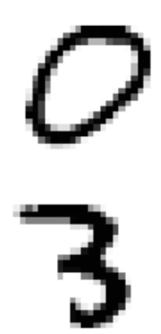
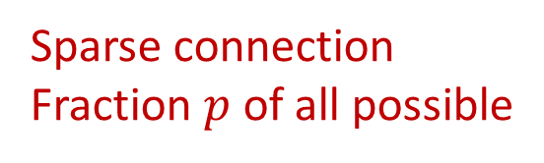
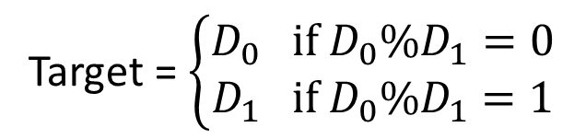


Task and model setup
Dense connections
Specialisation
Module 0
Decision 0
Structural modularity
$$D_{0}=$$
Joint
Decision
Sparse connection
Fraction $p$ of all possible
$$D_{1}=$$
Module 1
Decision 1
Target = $\left\{\begin{aligned}D_{0} if D_{0}\%D_{1}=0 \\ D_{1} if D_{0}\%D_{1}=1\end{aligned}\right.$
Note: structural modularity measured by $Q=\frac{1}{2}⋅\frac{1−p}{1+p}$
Notes:
Simplest case: digits, networks, sparse, decision, strongest decision
Task. Why? Maximise the chance the modules specialise on their digits.
They need to work together but only need to share 1 bit. Resource limited so nothing to waste. Decisions don’t interact.
Perfect specialised solution exists. So, surprising it’s not found.
Note structural modularity measured by Q based on expected number of intermodule synapses if it were random.
Here’s the precise setup of the task and model in the simplest case. We have two handwritten digits that are fed into separate densely recurrent networks. These networks can communicate via a sparse connection with a fraction p of all possible connections. Each network makes a decision and then the strongest of these two decisions becomes the joint decision.
The task is a bit strange. The network has to return digit 0 if the two digits have the same parity, otherwise it has to return digit 1. Why did we design it like this? The idea for the whole setup is to maximise the chance that the two modules will specialise on their digits, but that they do need to work together to solve the task. However, they only need to share one bit to solve the task, the parity of their own digit. This setup encourages specialisation because each module only receives sensory input directly from one digit, suggesting it should specialise in processing that. Further, each module has a non-trivial task to solve, and we set the number of neurons so that it has close to the minimum needed to perform the task, so it doesn’t have resources to waste. To further help minimise the amount of interaction required between the modules, each makes a separate decision, which is a vector of values we can think of as the probabilities of each possible answer. The decision vector with the highest single probability is used as the joint decision, i.e. whichever module is more sure of its answer.
So you can see a solution to this problem with perfect specialisation would be for each module to solve for its digit, pass the parity of that to the other module, and based on the two parities either give its answer, or give a flat distribution to stop itself from being the module whose answer is the joint decision.
So that’s why the results from the previous slide are surprising. It’s only when the structural modularity gets really extreme – beyond what you see in the brain – that the functional specialisation emerges.

Slide 9
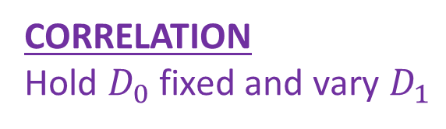
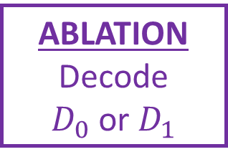
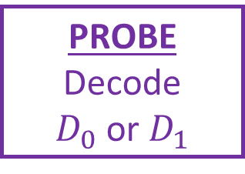
Measuring functional specialisation
PROBE
Decode
$D_{0}$ or $D_{1}$
Module 0
Decision 0
$$D_{0}=$$
CORRELATION
Hold $D_{0}$ fixed and vary $D_{1}$
Joint
Decision
$$D_{1}=$$
Module 1
Decision 1
ABLATION
Decode
$D_{0}$ or $D_{1}$
Notes:
Correlation = mean correlation of hidden state as you vary one digit only. Fodor separate modifiability.
Probe = sub function. Decode one digit well but not other.
Ablation. Fodor domain specificity.
In each case we get 4 values for each combination of digit and module, and normalised difference gives measure between 0 and 1.
Results qualitatively the same, so seems real.
It’s actually quite hard to measure how much a module has specialised on one function. To my knowledge, there’s no accepted definition. Our approach was to take three different definitions based on ideas that have been proposed in the literature, and show that they all give qualitatively similar results. If I have time, I’ll go through these three definitions now.
The first definition is based on correlation. If you correlate the hidden states of one module with itself when presented with different pairs of digits, holding one digit fixed and varying the other, it should be highly correlated if the module is specialised on the fixed digit, or weakly correlated if it is not specialised, because it is affected by both its own digit and the other digit. This is related to Fodor’s “separate modifiability” criterion of modularity.
The second definition is to directly test if the module is able to carry out the expected sub-function of the overall function. We freeze the trained network, and train a probe module to decode digit 0 or 1 from just one module’s hidden state. This should be possible with high accuracy for one digit but not the other if it is specialised on that digit.
The third definition is to do an ablation study. We train a single decoder that receives inputs from both modules, and then we ablate one or the other module. If the modules are specialised, then ablating the module that isn’t specialised on that digit should have little effect. This is related to Fodor’s criterion of “domain specificity”.
In each case, we get four different values from the measure on each choice of digit and module, and we use normalised differences of these to define a single specialisation metric that varies from 0 to 1.
And as I said, surprisingly they all give very similar results, so it seems as though in at least this case they are measuring something real and common.

Slide 10
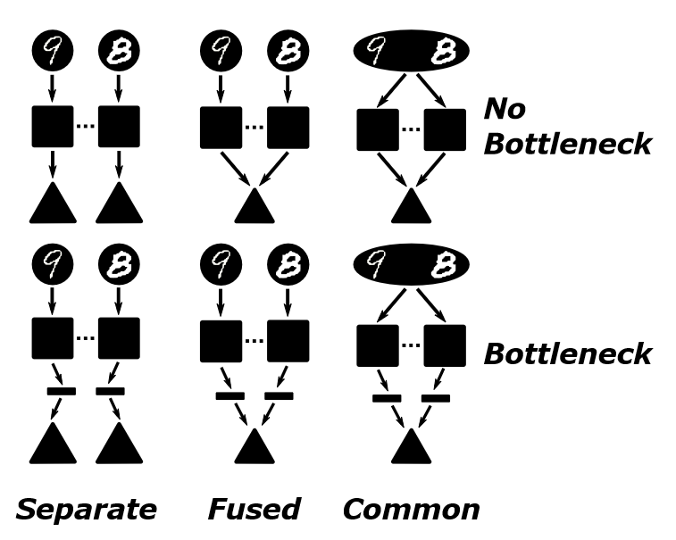
Model variants
6 variants on this model
Separate pathways
Fused output pathway
Common input and output
In each case, with and without bottleneck

Slide 11
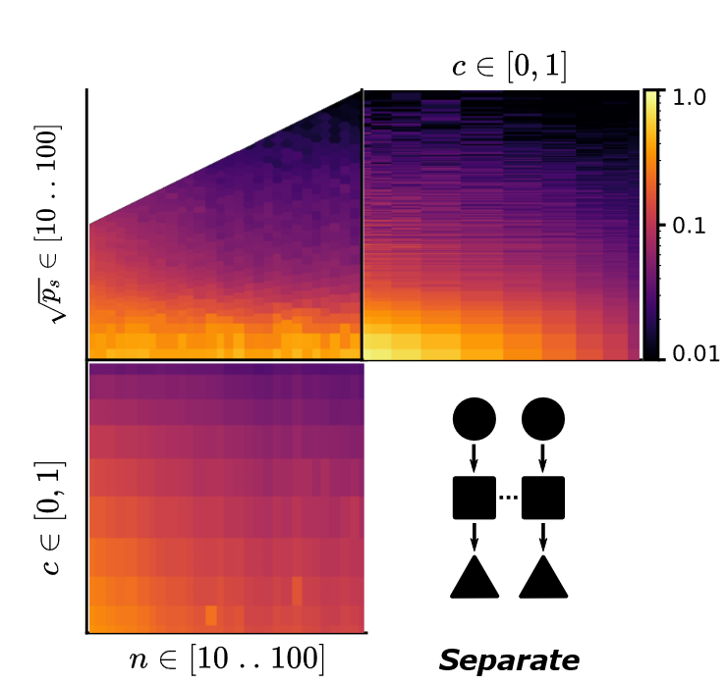
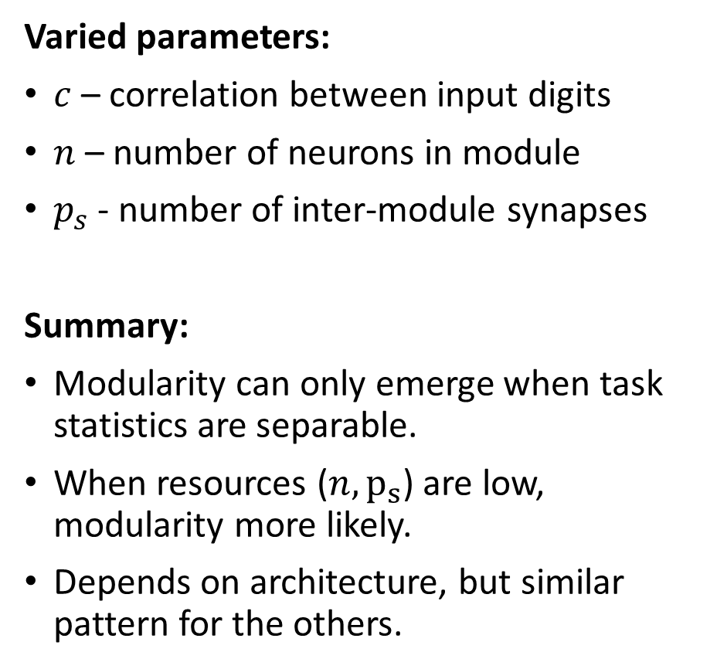
Detailed results
Varied parameters:
$c$ – correlation between input digits
$n$ – number of neurons in module
$p_{s}$ - number of inter-module synapses
Summary:
Modularity can only emerge when task statistics are separable.
When resources ($n, p_{s}$) are low, modularity more likely.
Depends on architecture, but similar pattern for the others.

Slide 12

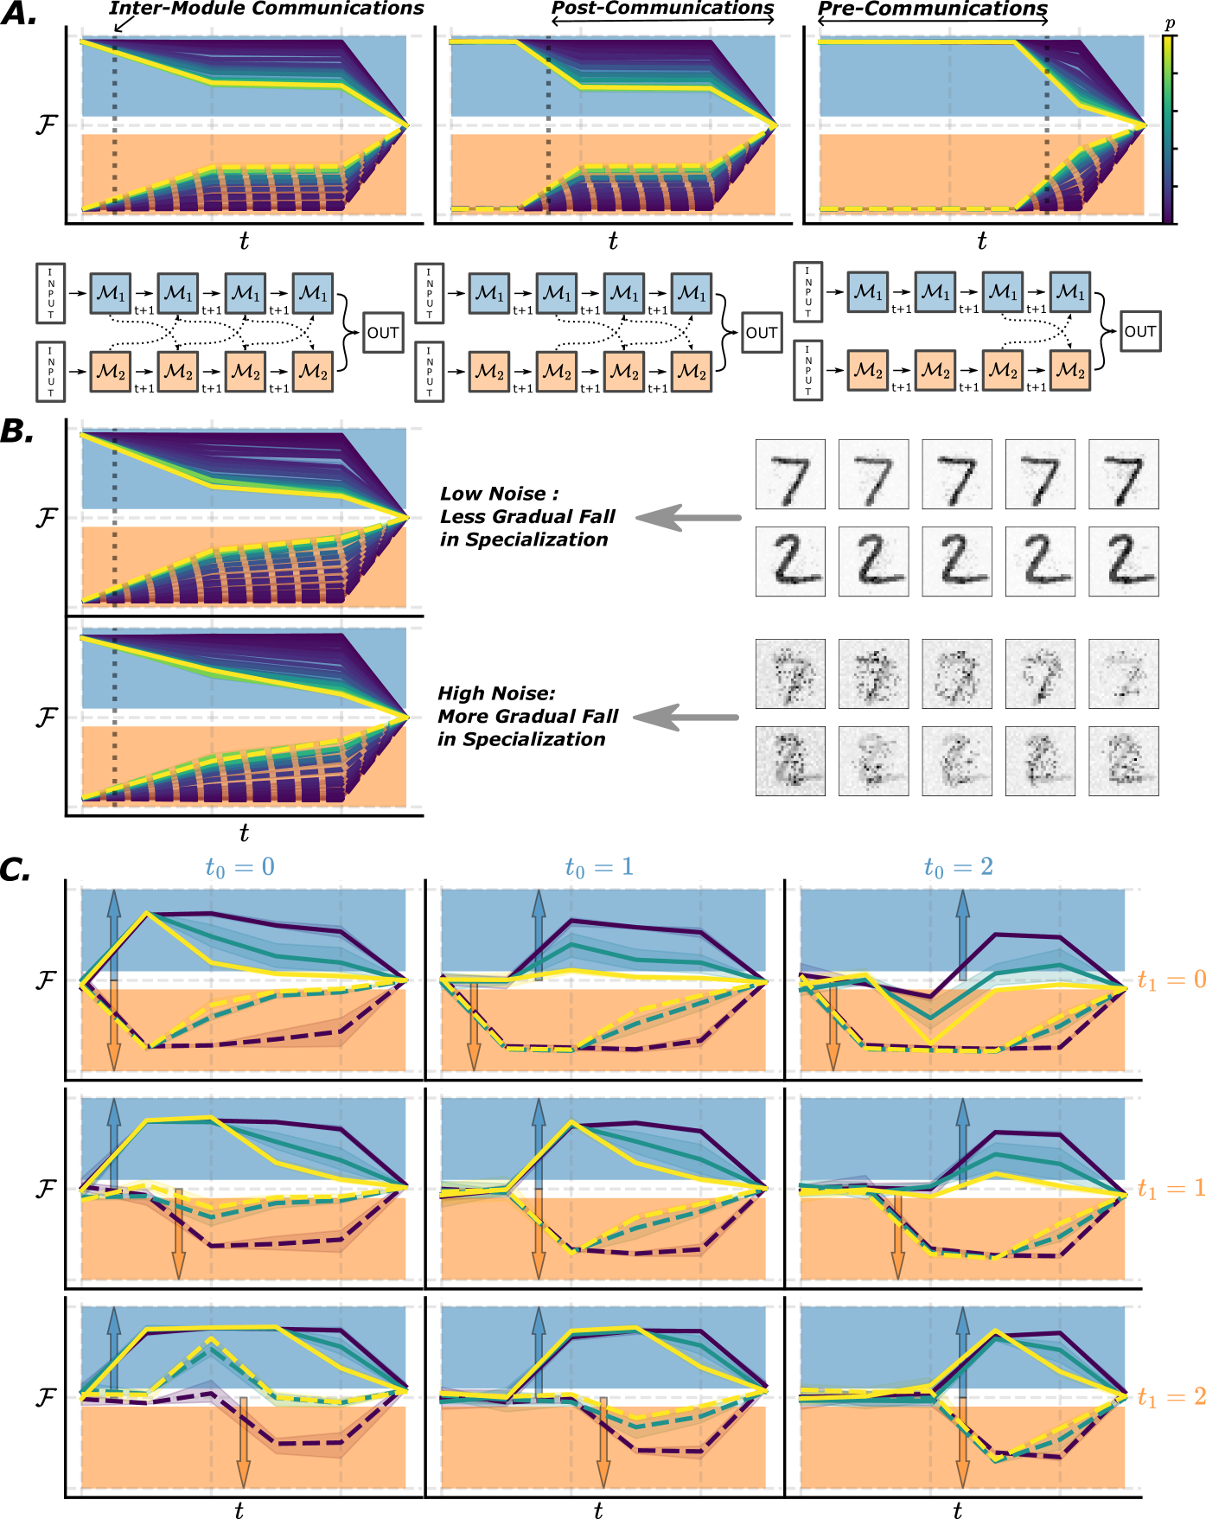
Specialisation is transient
Max specialisation
Low specialisation
Never have output specialisation
Specialisation decreases over time.
Decreases slower with sparse connectivity.
Decreases slower with noisy signals.
Suggests communication bandwidth is key.
Should we be looking for neural signatures of…?
Transient specialisation
Ongoing integration
Multiple timescales of integration

Slide 13
Conclusions
The role of the observed structural modularity in the brain is not to guarantee functional modularity.
However, that doesn’t mean they must be unrelated! We know they are.
But, we need more than just the structure to get that.
Resource constraints is one possibility.
But there may be others:
Learning rules. Environments (e.g. multi-task learning).
Training regimes. Architectures.
There seem to be interesting temporal dynamics to specialisation.
We need better analytical tools to think about this.
All of our measures of specialisation can be experimentally measured.
Notes:
Following up on architectures and environments at the moment, with a neuromorphic computing angle

Slide 14




Multimodal architectures
Marcus Ghosh
Postdoc fellow 2021-
Ghosh, Béna, Bormuth and Goodman (2024) PLOS CB
Swathi Anil
Visiting PhD (2024)
Anil, Ghosh and Goodman (2024) Preprint

Slide 15
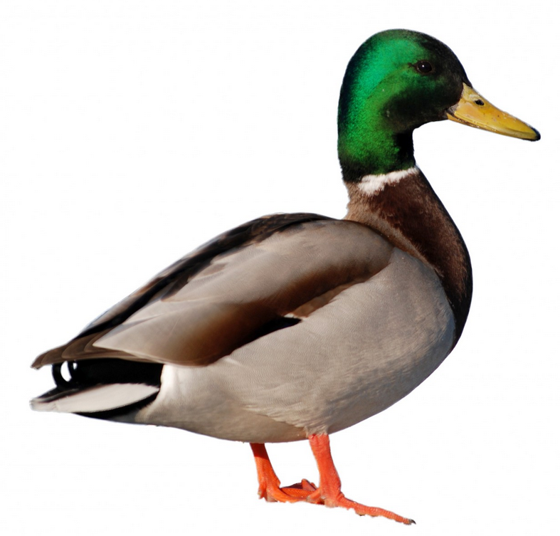




Q: optimal architectures for multimodal sensing…?
Cluttered audio-visual environment
Detect direction of object of interest
Use information from both audio and video
Task: target object moving left/right, background noise
Notes:
Started our project thinking about optimal architectures for multimodal sensing

Slide 16
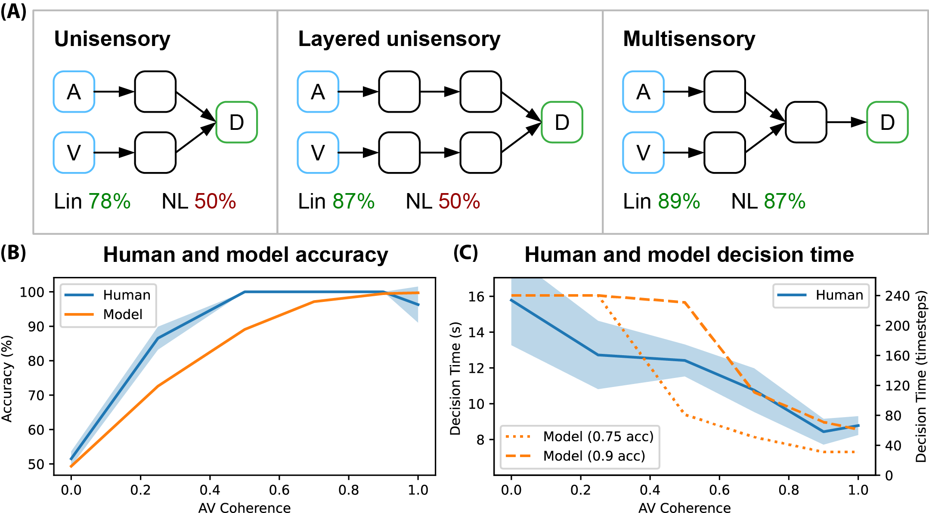
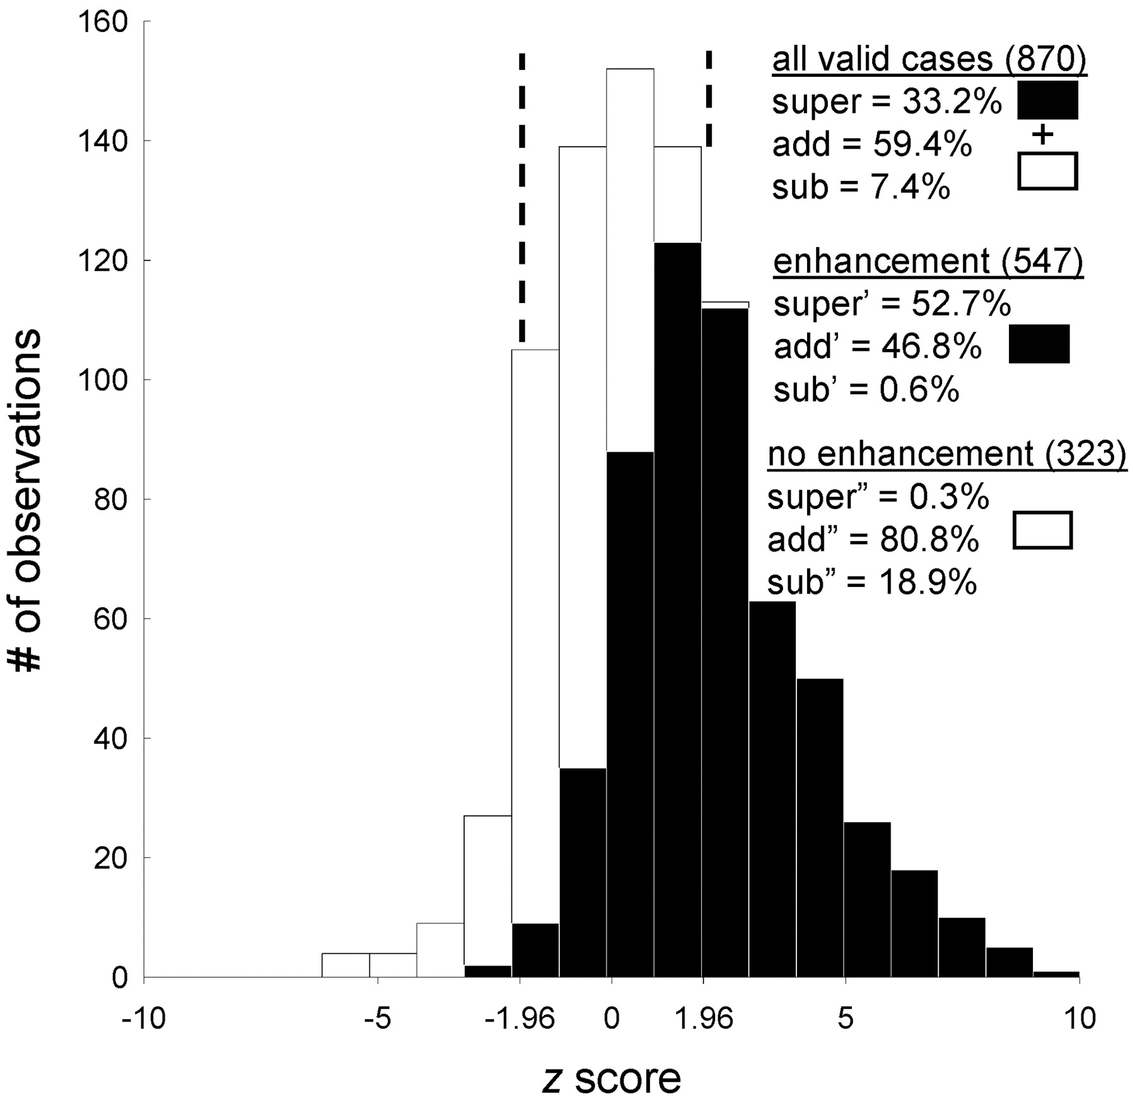
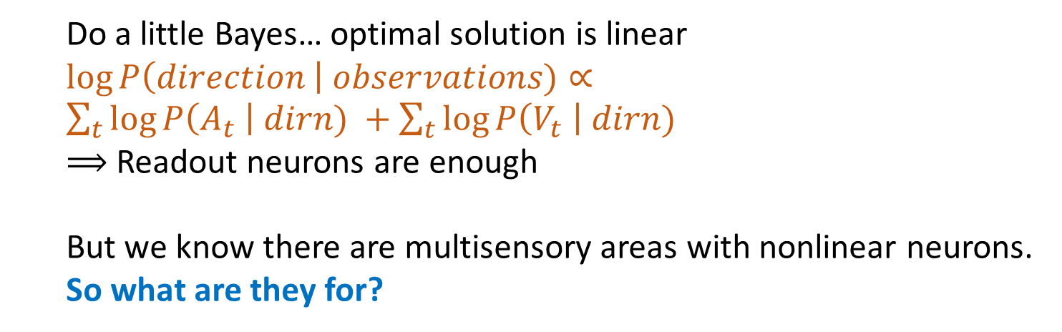
Dan in his happy place says “let’s try a spiking neural network”
It works!
Let’s just run a control…
Wait… we can do the task without a multisensory area?
93% correct
93% correct
Stanford et al. 2005
Do a little Bayes… optimal solution is linear
$\log{P\left(direction \right| observations)}∝\sum_{t}{\log{P\left(A_{t} \right| dirn) }+\sum_{t}{\log{P\left(V_{t} \right| dirn)}}}$
$⟹$ Readout neurons are enough
But we know there are multisensory areas with nonlinear neurons.
So what are they for?
Notes:
I like SNNs so we start with that
One of those observations that stops you in your tracks and you never get round to doing the project you had planned
What are they for? Well, in this case we know that optimal performance was linear and didn’t take time into account, so we decided to try to design a slightly more realistic task

Slide 17




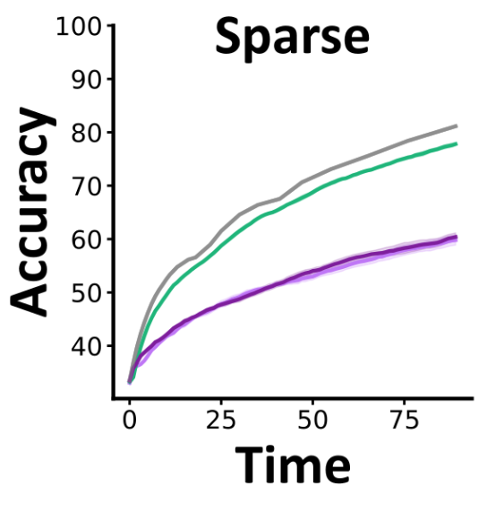
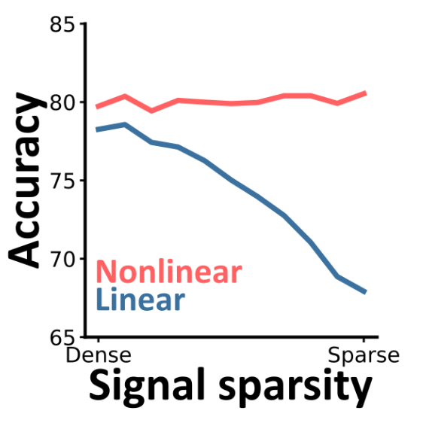
Prey detection task
Classic multimodal task with one slight tweak:
Target emits signals at unknown times.
Clear advantage to have a nonlinear multimodal area.
Advantage larger for sparser signals.
Ideal (Bayesian)
Multimodal SNN
Unimodal SNN
Notes:
Advantage sparsity: when signal is rare you need to weight evidence very strongly when you think it’s on. This is why nonlinearity is important.
Generalises to multiple classes, multiple modalities
Any nonlinearity works, including spiking

Slide 18
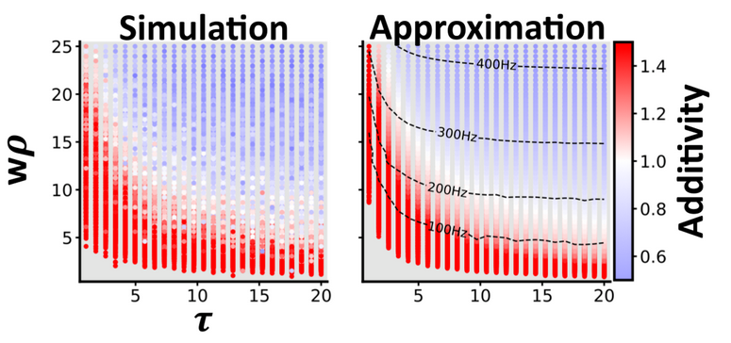
So does this explain the experimental data?
Can we explain this?
Yes, but it doesn’t depend on our model
Stanford et al. 2005

Slide 19
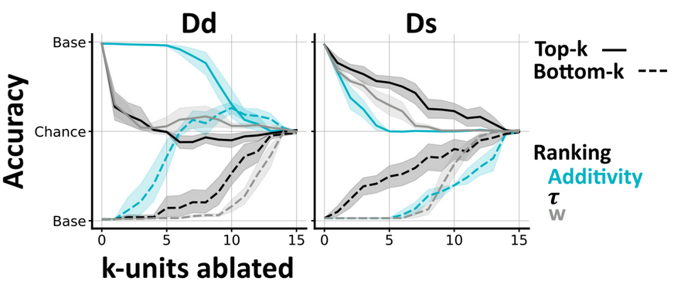
Could we test this experimentally?
Idea: ablations
Haven’t done the experiment yet, but our models suggest this should work
Removing superadditive units has little effect on task with dense signals (classical task)
But it has a big effect on the task when the signal is sparse (our new task)

Slide 20


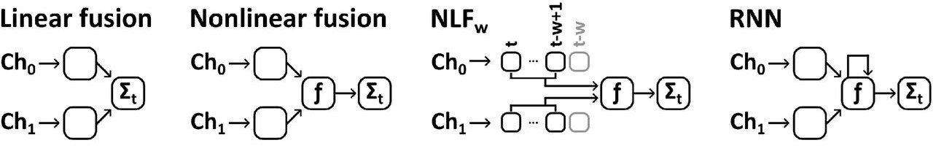
Follow-up: increasing time complexity
Information is sparse but arrives in bursts and is correlated across modalities
Swathi Anil
Marcus Ghosh
Background noise
Signal
Time
6 params
9 params
81 to 729 params
10,903 params

Slide 21
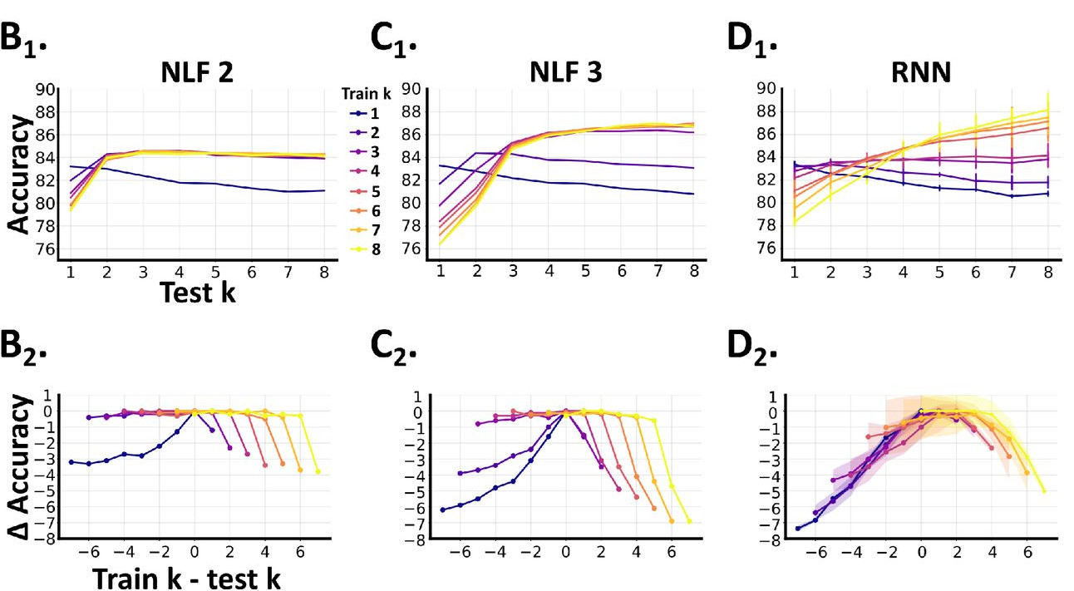
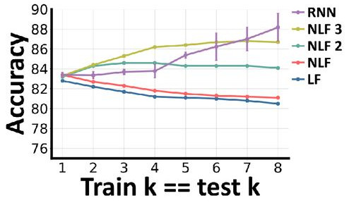
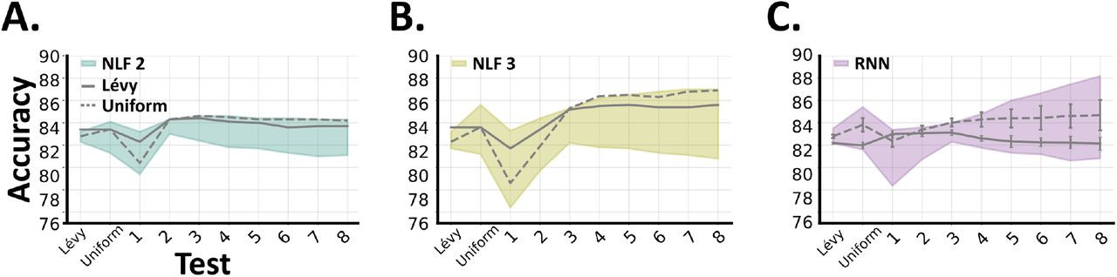
Result: simpler models seem to work better
k = length of signal bursts
Notes:
When the burst length is 1, this is equivalent to our previous task and you can see that adding nonlinearity is important, but there’s no advantage to the more complicated architectures with memory.
As the burst length increases, the fixed memory window models rapidly get better before topping out, whereas the full recurrent neural network is eventually better for sufficiently long bursts. Still, the simpler models use less than 10% of the parameters of the RNN.
We can also see how well they generalise. I won’t go into it in too much detail, but the short story is that the simpler fixed memory window models generalise well to longer bursts than they were trained on, and poorly to shorter bursts. The RNN meanwhile just gets worse the bigger the distance between training and testing.
Finally, we did some training with more realistic mixed distributions of burst lengths, and here we find that the simple models tend to do close to their best performance across the range of settings, whereas the RNN tends towards its worst performance.

Slide 22
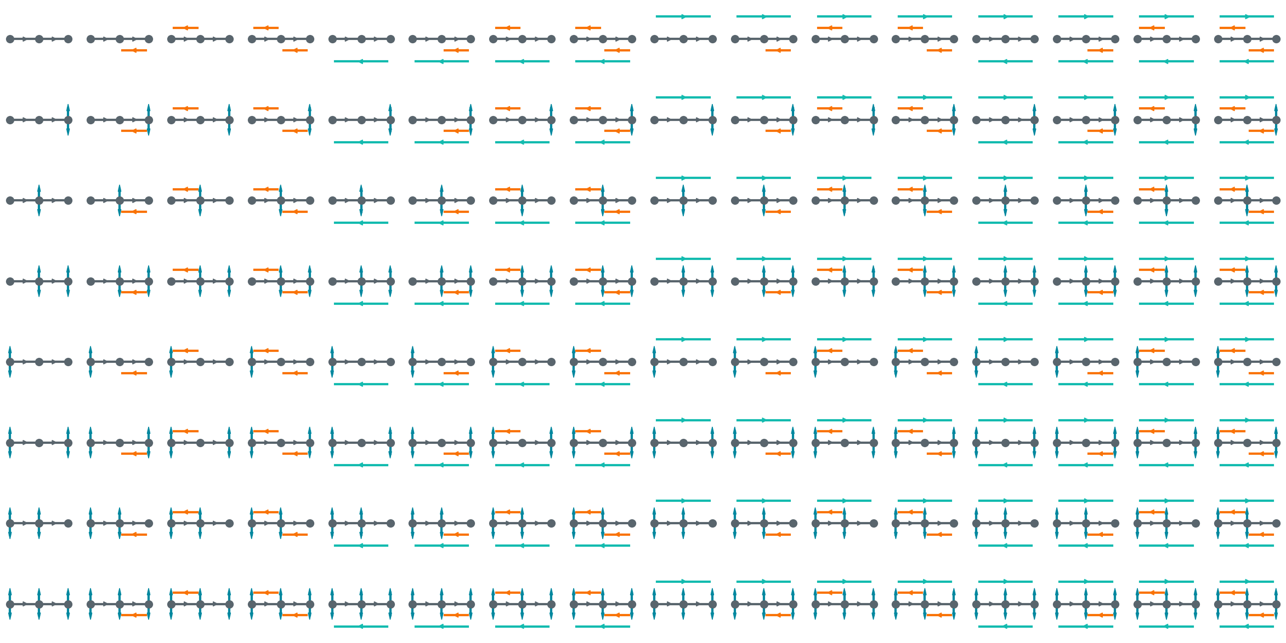
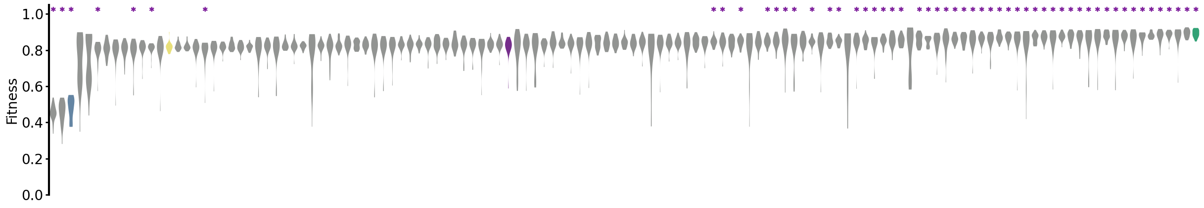
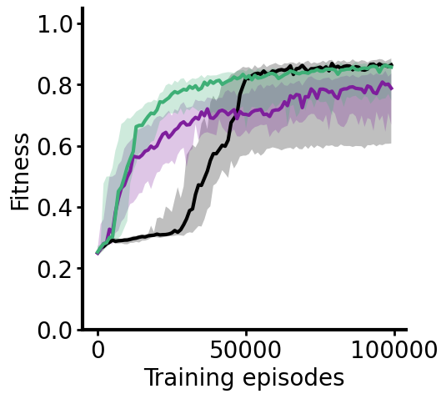
Preview: more complex set of tasks, more architectures
Notes:
As a last word on this multimodal story, I just wanted to say we are now getting back to the original idea of testing a wide range of possible multimodal architectures across a more complex set of tasks with both spatial and temporal multimodal components.
When we test every architecture on one of these tasks, we can rank them by how well they tend to perform, and interestingly we find that the recurrent architectures are not the best, even though in principle they are the most general.
We also see very marked differences in training dynamics, with some architectures consistently learning faster than others.
We’re still in the process of putting together an awful lot of data here, so this is just a little taster of what’s to come.

Slide 23
Conclusion / discussion
Did we answer the question of what neural architectures are good for?
No. Of course not. Sorry for suggesting that I would answer this in my social media posts.
But, we have some cool theory-based methods that can start to answer these.
We saw that:
Structural and functional modularity are not necessarily linked.
Although maybe they are when resources are tight.
In a multimodal setting, as task complexity increases, the importance of architecture and nonlinear neurons increases.
Just jumping straight to a full recurrent neural network may not be ideal, either for performance or understanding.
Big take home for me is this:
We need to study more complex tasks but in a controlled way. Challenging!

Slide 24
Thanks!
Gabriel Béna
PhD student 2021-
Béna and Goodman (2025) Nature Comms
Marcus Ghosh
Postdoc fellow 2021-
Ghosh, Béna, Bormuth and Goodman (2024) PLOS CB
Swathi Anil
Visiting PhD (2024)
Anil, Ghosh and Goodman (2024) Preprint
And thank you for listening!

